Slide 1
What Happens After the Project Ends?
Lessons learnt from tracing the impact of three eSTEeM Scholarship projects in Mathematics and Statistics
Professor Rachel Hilliam
School of Mathematics and Statistics
Wednesday 29th April 2026

Slide 2
The STEM Staff Tutors
The Mathematics and Statistics Study Site
Statistical Anxiety
https://university.open.ac.uk/scholarship-and-innovation/esteem/impact-sotl/impact-evaluation-framework-sotl

Slide 3
The STEM Staff Tutors

Slide 4
The STEM Staff Tutors, 2014-2016
https://university.open.ac.uk/scholarship-and-innovation/esteem/projects/themes/other/investigating-the-careers-staff-tutors-stem-athena-swan
Rachel Hilliam, Victoria Pearson, Shirley Northover, Elaine Thomas, Jean McCloughry, Katie Chicot, Martina Gibbons, Carol Calvert and Rosaria Gracia
Spring 2014 Athena SWAN bronze award for Mathematics and Statistics and Department of Physical Science
Department of Physical Sciences also obtained a Project Juno Practitioner award
All three sets of feedback identified the staff tutor role as an area for further investigation

Slide 5
The STEM Staff Tutors – Initial Questions
Is there a difference between the STEM departments in range and depth to which Staff Tutors engage with all areas of their academic roles?
Why does the staff tutor role seem to attract a greater proportion of females?
How do staff tutors feel their role is perceived within the different departments, faculties, the university and the wider HE sector?
Pilot Stage March – April 2015

Slide 6
The STEM Staff Tutors – Revised Questions
Gain more knowledge about the role of the staff tutor and what support this group of staff will need after the distribution of regional offices due to the locations analysis is clear
Identify key issues around career progression and aspirations and the support needed to achieve these goals
What attracted staff tutors to the role and how their role can be supported by the departments and the University
Nov-Dec 2015, 64% response rate and focus groups

Slide 7
The STEM Staff Tutors – Some findings!
Need to preserve a network, this can in part be provided by the department and the faculty.
Balance of face to face (2-3 times a year) and online meetings (per month) STEM staff tutor meetings to ensure that the STEM staff tutor network is preserved and strengthened
The University needs to urgently invest in IT equipment so that all staff can participate in online meetings which should be the norm and not an after thought. There needs to be more meetings rooms in MK which are equipped with 360 so that all participants are able to fully engage.

Slide 8
Recommendations and impact?
Clear definition and communication of the Staff Tutor role and the value the role plays in the organisation
Organisational commitment to ensuring good quality online access to all meetings as routine
Urgent review of the new promotion framework and analysis of feasibility for Staff Tutors to meet all the criteria.
Increased administrative support
C. Herman and R. Hilliam (2018) ‘The Triple Whammy: Gendered Careers of Geographically Marginalised Academic STEM Women’ International Journal of Gender, Science and Technology, Vol 10(1), 171-189.

Slide 9
Mathematics and Statistics Study Site

Slide 10
The Mathematics and Statistics Community of Learners, 2019-2020
https://university.open.ac.uk/scholarship-and-innovation/esteem/projects/themes/supporting-students/the-mathematics-and-statistics-community-learners
Rachel Hilliam, Gaynor Arrowsmith, Alexander Siddons, Derek Goldrei and Cath Brown
Evaluate how students, ALs and SRSC staff use the Mathematics and Statistics (M&S) Study Site.
Understand how students find the Study Site
Find new ways to encourage use of the Study Site.

Slide 11
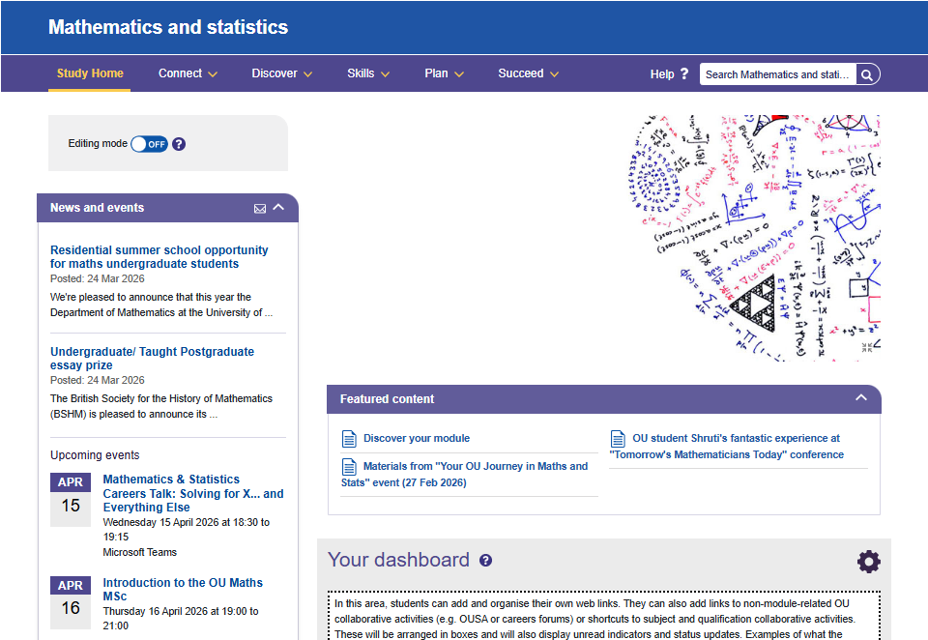
The Mathematics and Statistics study site

Slide 12
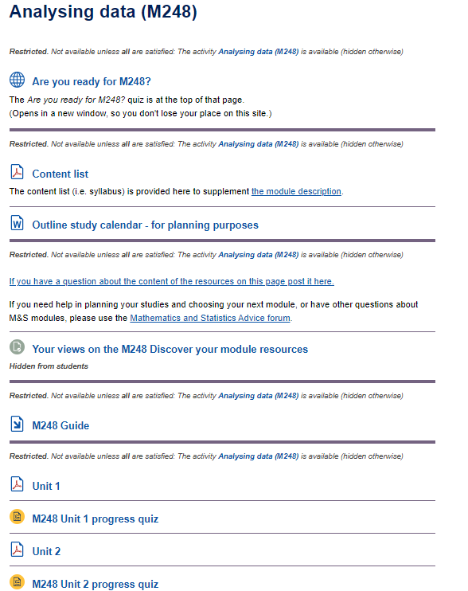
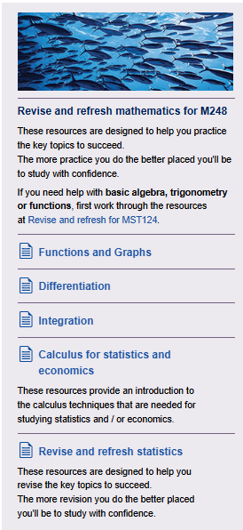
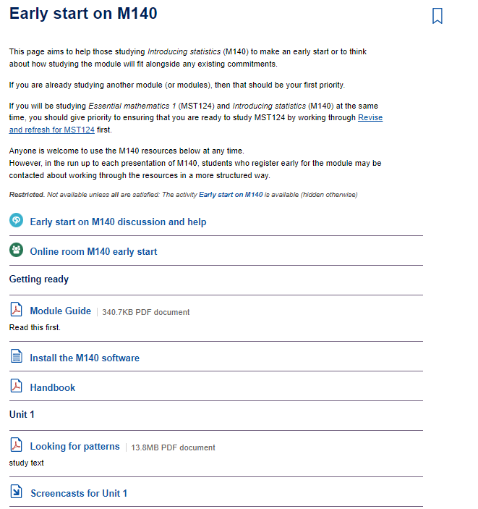
Discover Your Module

Slide 13
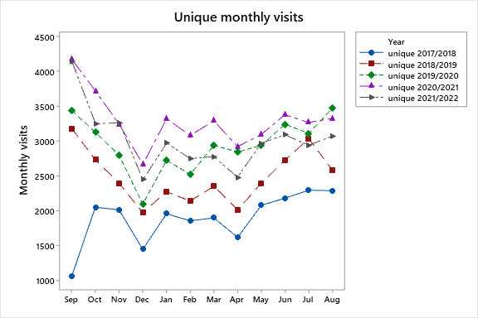
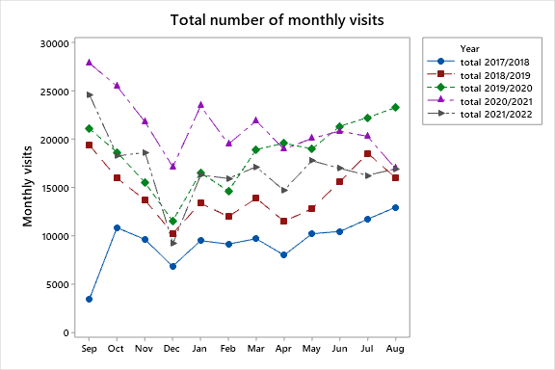
Evaluation
Study site usage

Slide 14
Evaluation
Student survey
June 2020 – 500 students
250 M&S UG
50 M&S postgrad
100 non-M&S qual
100 – no qual
Have you used M&S study site?
 | M&S | Non-M&S | Total
Yes | 32 (84%) | 18 (60%) | 50 (73%)
No | 6 (16%) | 12 (40%) | 18 (27%)
Total | 38 | 30 | 68

Slide 15
Evaluation
Staff survey
June 2020
300 ALs across all M&S modules
42 SST staff (12 Educational advisors, 30 Senior advisors)
60 SRF (October)
Have you used M&S study site?
 | AL | SST | SRF | Total
Yes | 36 (56%) | 29 (94%) | 13 (34%) | 78 (59%)
No | 28 (44%) | 2 (6%) | 25 (66%) | 55 (41%)
Total | 64 | 31 | 38 | 133

Slide 16
Recommendations and Impact
Improving the usability of the site by making the menu items meaningful; and improving the wayfinding through a sitemap or A-Z.
Following on from this SoTL inquiry, a new functionality of providing a short (online) page-tour was added to study websites

Slide 17
Recommendations and impact
Informing students about the study site: in 2019/2020 through a variety of student-communications in print/online including a student newsletter; via social media and in training events.
Consequently, there was a large increase in numbers of students using the study site in September 2020, with 4,176 unique monthly visits and 27,800 total monthly visits.

Slide 18
Recommendations and Impact
Informing tutors about the study site during induction and in staff development meetings;
M&S tutor receive an email each summer to encourage them to contact their students and highlight the resources on the study site to them.

Slide 19
Recommendations and Impact
Training SRF staff on the use of study sites for themselves and for students.
Following this SoTL project, a resource was established in the Knowledge Management System (KMS) in 2021 to increase the awareness of study sites amongst SRF staff.

Slide 20
Impact
Used as a case study for the STEM Impact Evaluation Framework https://university.open.ac.uk/scholarship-and-innovation/esteem/impact-sotl/impact-evaluation-initiative
https://oro.open.ac.uk/87488/1/Impact-of-SoTL-Compendiium-of-Case-Studies.pdf
And the Scholarship of Teaching and Learning in STEM BOC https://www.open.edu/openlearn/science-maths-technology/scholarship-teaching-and-learning-stem/content-section-overview?active-tab=description-tab

Slide 21
Impact
R. Hilliam, D. Goldrei, G. Arrowsmith, A. Siddons and C. Brown (2021) ‘Mathematics and statistics distance learning: more than just online learning’ Teaching Mathematics and Its Applications: An International Journal of the IMA, Vol 40(4), 374-391.
R. Hilliam and D. Goldrei (2019) ‘Creating an online mathematics and statistics community of learners’ New Directions in the Teaching of Physical Sciences, Vol 14(1). https://doi.org/10.29311/ndtps.v0i14.2824
R. Hilliam and G. Arrowsmith (2019) ‘Enhancing the student experience with the use of a dedicated subject website’ MSOR Connections, Vol 17(2), 39-45.
Advance HEA, 25/03/2020 https://www.advance-he.ac.uk/news-and-views/online-student-experience-more-learning-online

Slide 22
Statistical anxiety

Slide 23
Evaluating Statistics anxiety across different qualifications, 2022-2026
https://university.open.ac.uk/scholarship-and-innovation/esteem/projects/themes/access-participation-and-success/evaluating-statistics-anxiety-across-different
Rachel Hilliam, Carol Calvert, Emma Steele and Diane Haigney
Develop a statistics anxiety rating scale that can be used across the OU
Use the scale to identity type of anxiety and develop resources to alleviate the anxiety

Slide 24
Statistics anxiety
Statistics anxiety refers to the anxiety felt by learners when encountering statistics in any form, and at any level - such as gathering or using data or interpreting the results of statistical analyses from data
Cruise, Cash and Bolton (1985)

Slide 25
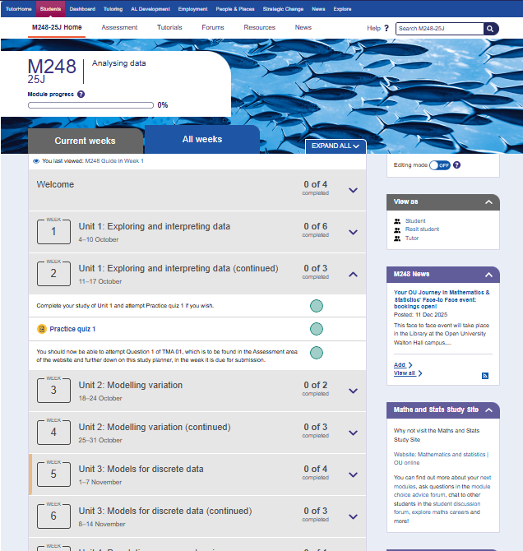
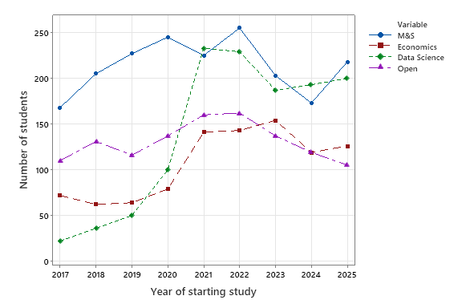

M248 Analysing Data
https://university.open.ac.uk/scholarship-and-innovation/esteem/projects/themes/supporting-students/how-one-module-can-serve-multiple-qualifications-through 2020-2021

Slide 26
Building confidence in learning statistics
A self-reflection tool for OU statistics students created in 2022 following review of 29 existing anxiety scales
Students have the opportunity to complete the questionnaire prior to module start.
The aim is to encourage reflection on the different areas of learning statistics.
In naming the tool we flipped the emphasis from anxiety to confidence, empowering students to take action.
Understanding and interpretation
Assessment
Support
Motivation and enjoyment
Studying
Engagement
How confident do you feel interpreting the meaning of a table or graph?
How confident do you feel doing the final examination in a statistics course?
How confident do you feel about emailing your statistics tutor a question?
Do you agree with the statement: I feel I will need statistics in my professional life
Do you agree with the statement: I’m more likely to give up when learning statistics, compared to other new topics.
How confident do you feel actively participating in activities during an online statistics tutorial

Slide 27
Impact
R. Hilliam, E. Steele and C. Calvert ‘Learning statistics: from anxiety to confidence’, RSS Annual conference (2024), Brighton.
R. Hilliam, E. Steele, C. Calvert and D. Haigney ‘Learning statistics: from anxiety to confidence’, UKCOTS (2024), University of Manchester.
R. Hilliam, E. Steele, D. Haigney and C. Calvert ‘Statistical Anxiety: A new measurement tool’, RSS Annual Conference (2023), Harrogate.
R. Hilliam, E. Steele, C. Calvert and D. Haigney ‘Statistical anxiety: a new measurement tool’ Horizons in STEM (2023), Swansea University.
R. Hilliam, E. Steele, C. Calvert and D. Haigney ‘Statistics anxiety: what is it and how do we measure it?’, eSTEeM Annual Conference (2023), The Open University
C. Calvert, D. Haigney, E. Steele and R. Hilliam ‘Student engagement and statistical anxiety’ CTEL-MSOR conference (2022), Dundee.
R. Hilliam, C. Calvert, E. Steele and D. Haigney, ‘Statistics anxiety: Does this differ by qualification?’ Horizon in STEM conference (2022), UCL.
E. Steele, R. Hilliam, C. Calvert and D. Haigney ‘Statistics anxiety: does this differ by qualification?’ Psychology of Mathematics Education Cluster Conference (2022), online
R. Hilliam, C. Calvert, E. Steele and D. Haigney, ‘Statistical anxiety: will qualification focussed student support help?’ eSTEeM Annual Conference (2022), The Open University.

Slide 28
Impact
Used in 23J and refined for 24J on M248
Used by multiple modules, 25J not just in M&S
External interest and future collaborations
Burwells webinar
Teaching Statistics Trust https://teachingstatisticstrust.org.uk/
Significance article https://significancemagazine.com/teaching-statistics-an-interview-with-rachel-hilliam/

Slide 29
Lessons learnt
Projects linked to ongoing work
Be prepared to flex due to circumstances!
Don’t expect anything to happen unless you create the opportunity
Don’t give up, keep pressing
Follow up on conversations (internally and externally)

Slide 30
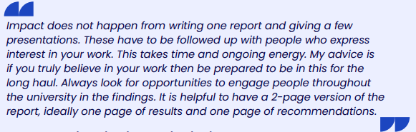
Lessons learnt

Slide 31
Thank you

