Slide 1
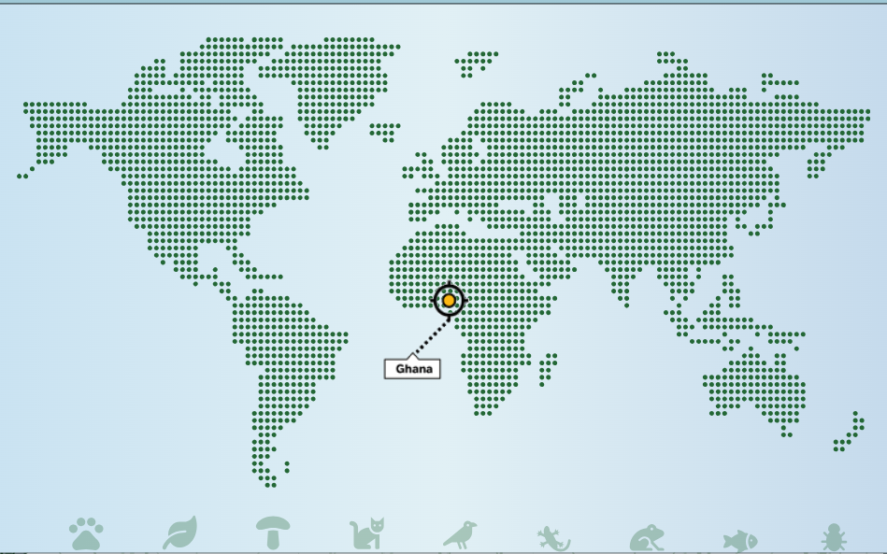

Co-investigating preparedness for virtual STEM practical education:
Testing & learning in Ghana
Sarah Davies, Jane Cullen, Maria Velasco
STEM and WELS
29th April 2026

Slide 2
Activity : explore the practicals
Links:
OpenSTEM Africa: University of Ghana
Chemical tests
Virtual field trip
Questions:
What relevance and resonance is there with activities in STEM?
What next steps and collaborations would you suggest / like to be involved with?

Slide 3





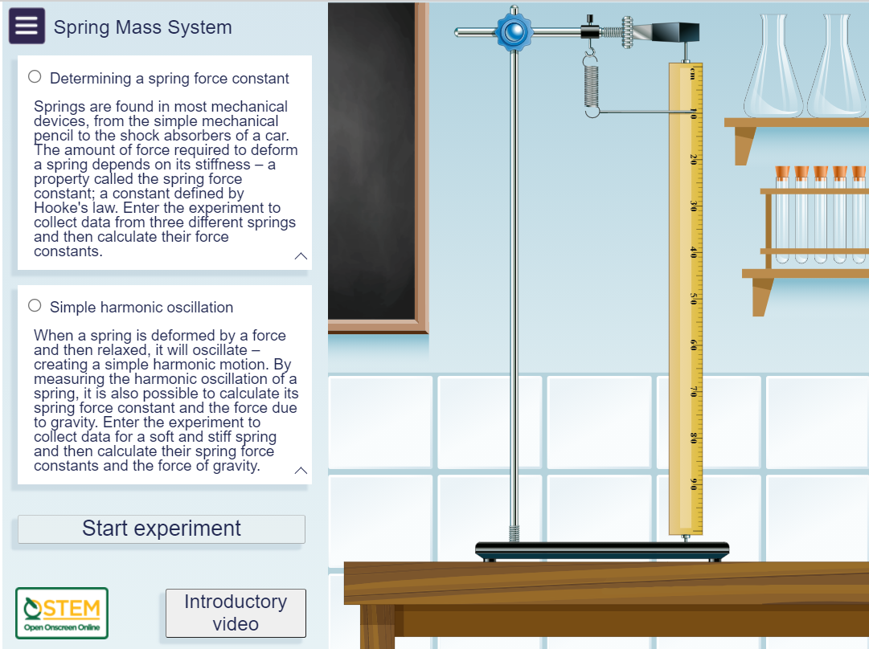
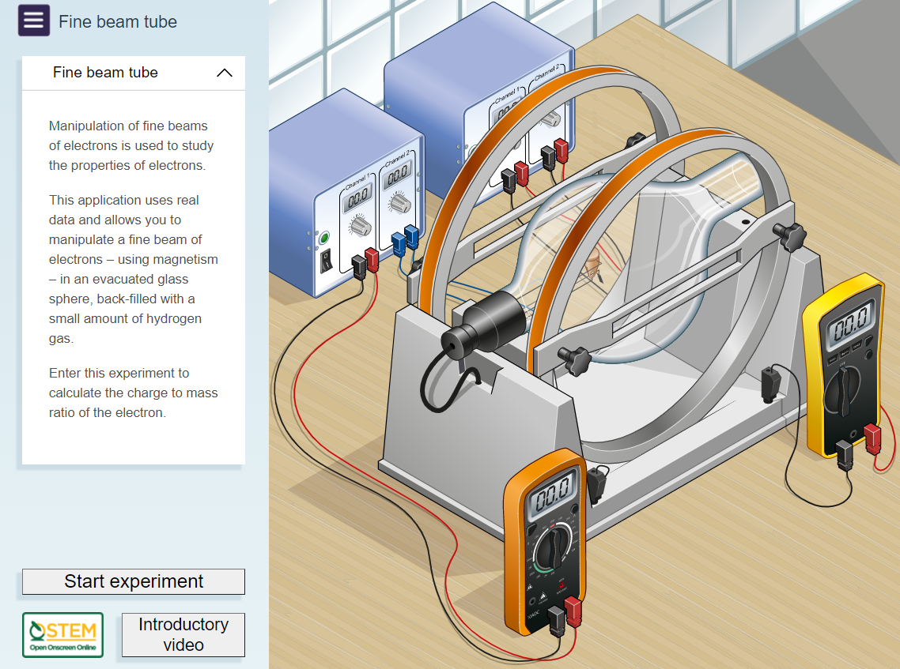
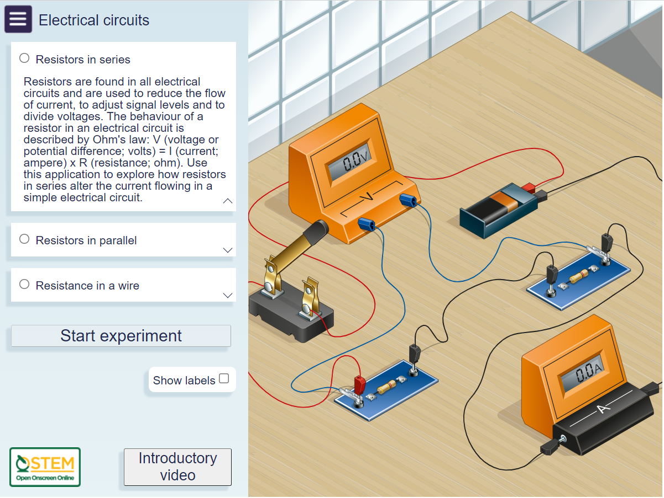
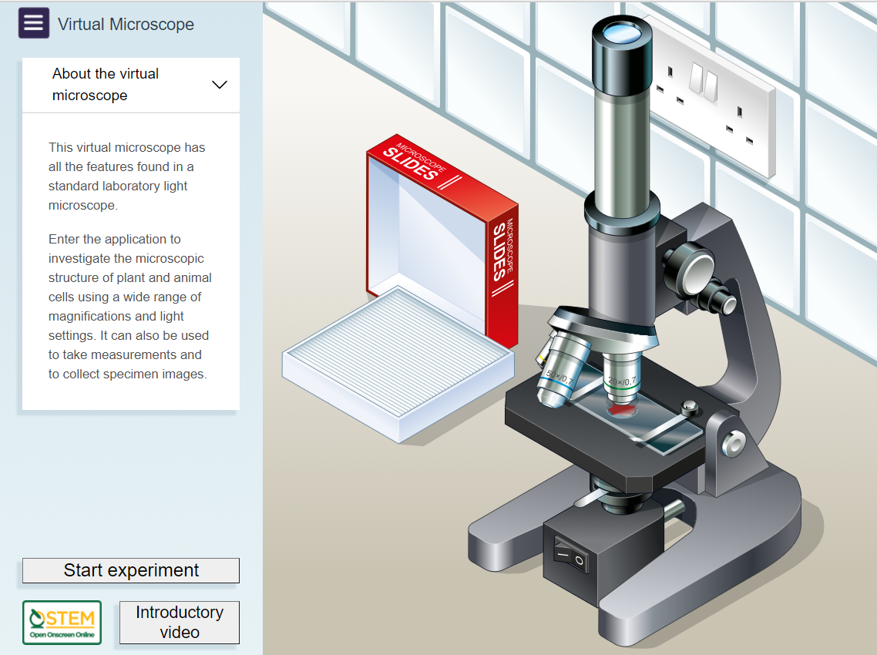
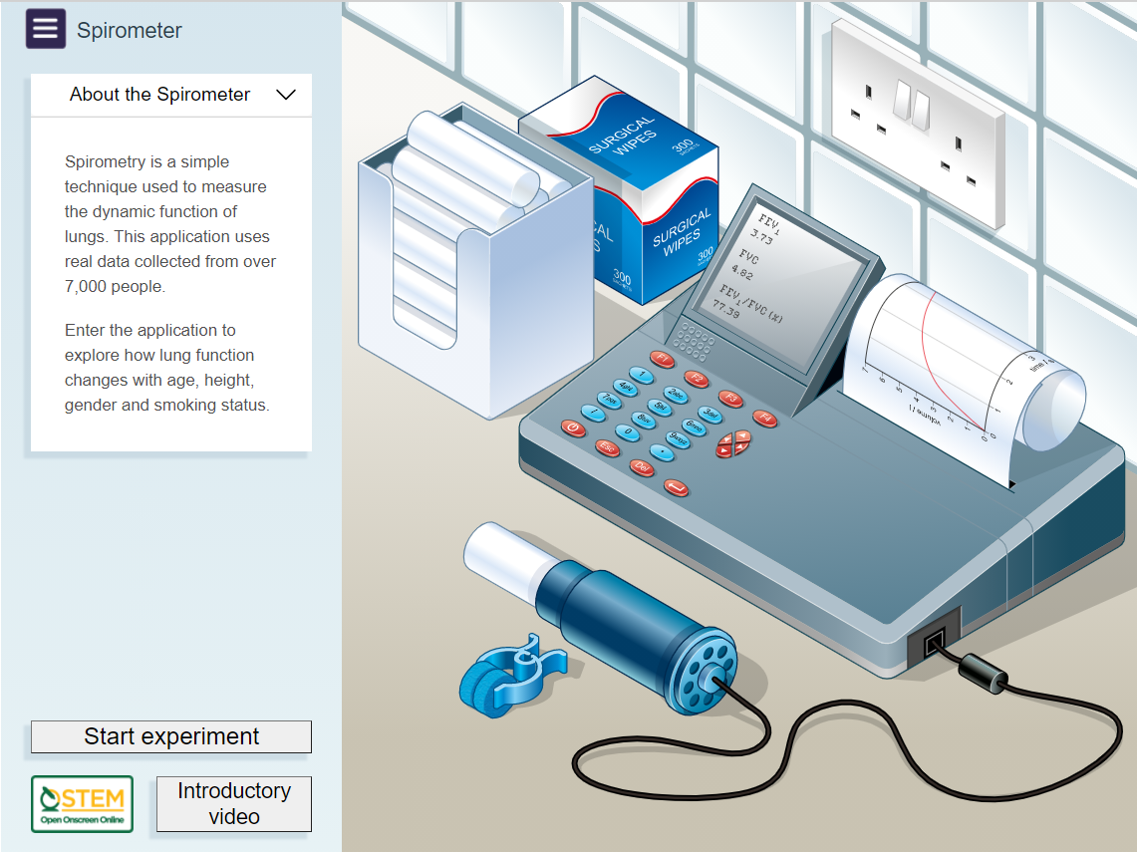
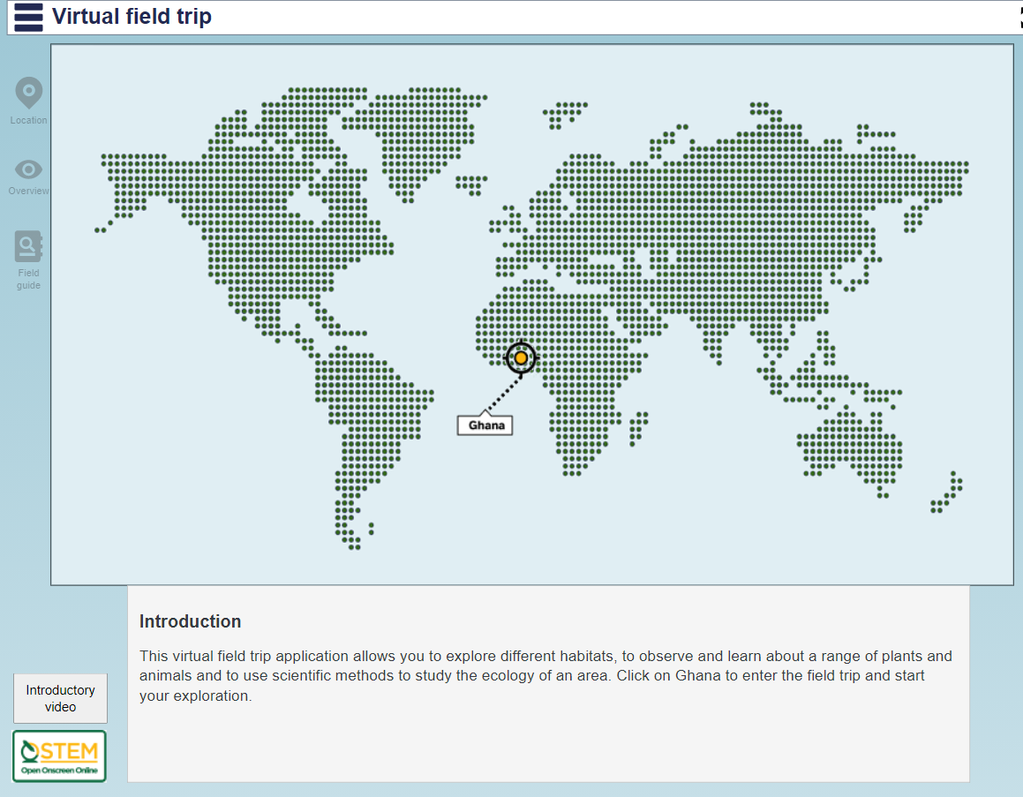
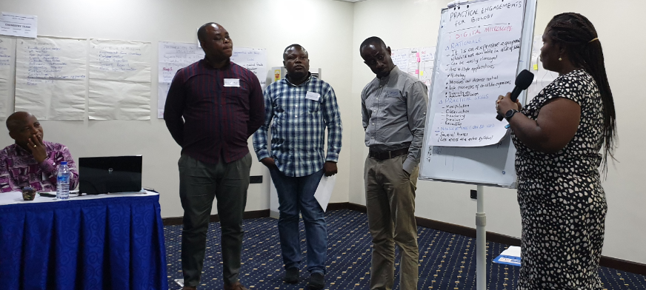
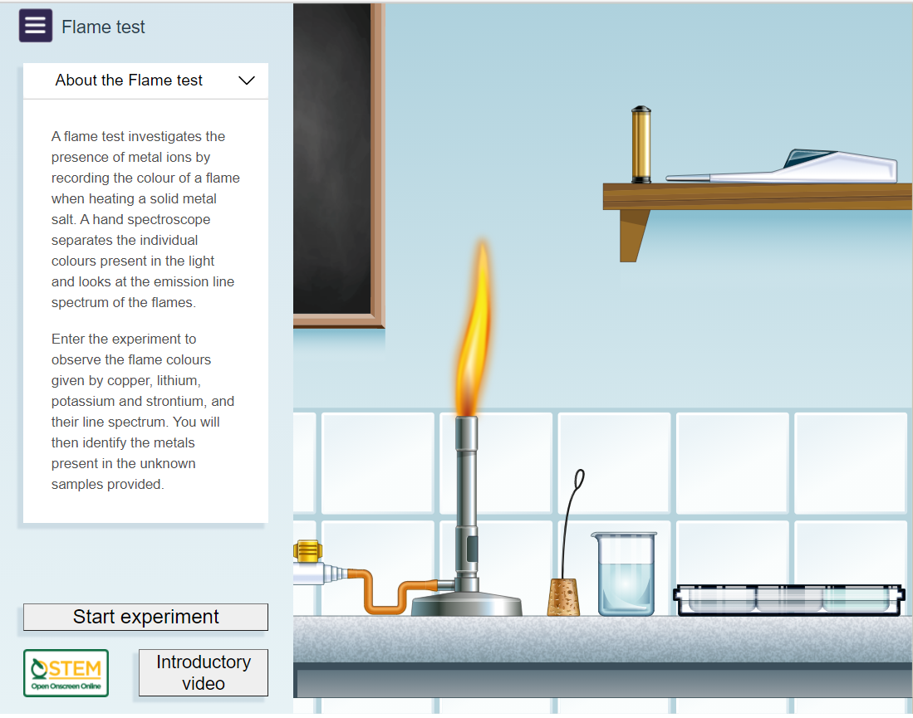
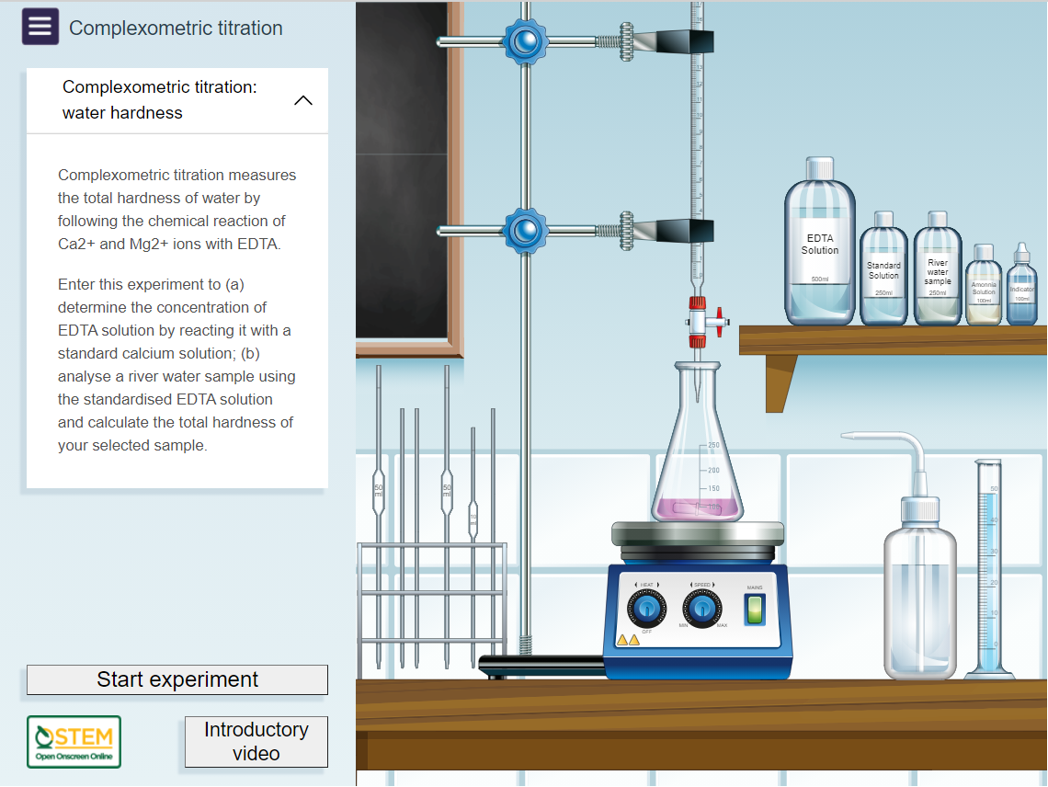
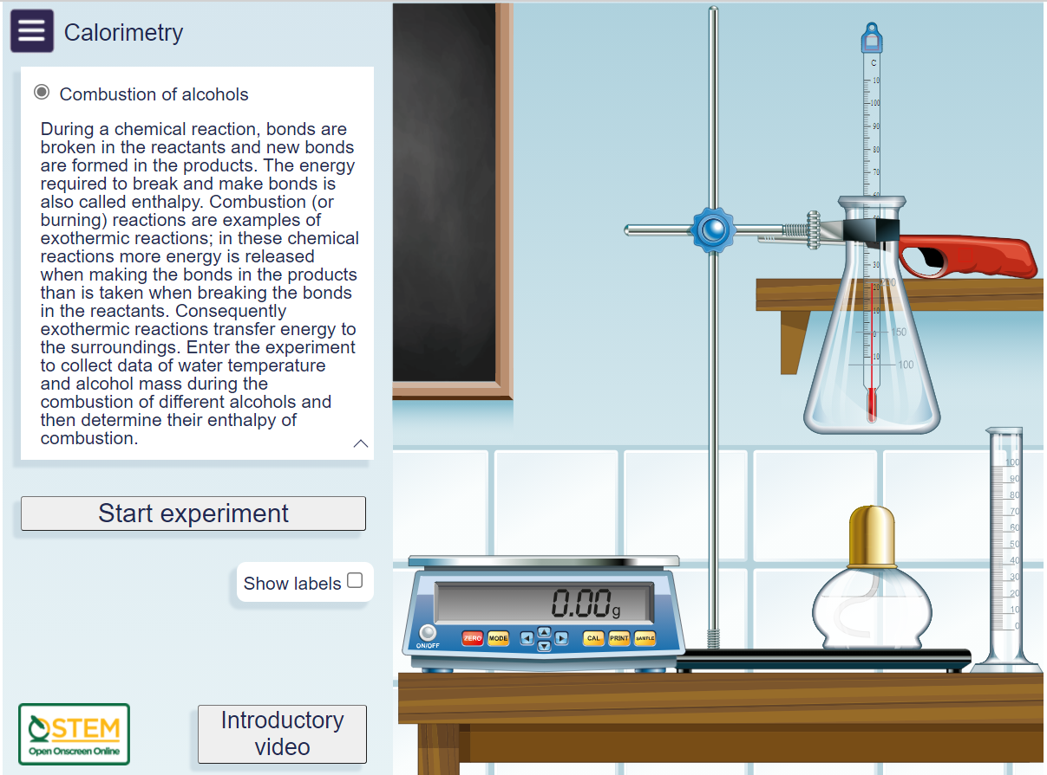
Collaboration
STEM education transformative, but access problems for practical work
Co-design workshops with science teachers, Ghana, 2019
Locally appropriate, inclusive learning
Exemplar lessons, professional development
Notes:
STEM education as transformative, but problems for access for students
Collaboration across Open University : WELS and STEM: and with:
Centre for National Distance Learning and Open Schooling (CENDLOS)
Ghana Education Service (GES) and Senior High Schools
University of Ghana and the University of Cape Coast, Ghana
SHS ed made free in 2017 in Ghana, Double track introduced in 2018
scarcity of laboratory space, equipment and resources at Senior High School (SHS) (upper secondary) and university undergraduate (tertiary) level
Pressure on teachers and on infrastructure to deliver practical science ed
technology to enhance science ed

Slide 4
OpenSTEM Africa ‘Test and Learn’: University of Cape Coast, Ghana
A collaboration
between OU and University of Cape Coast (UCC) education experts and science educators
UCC provides undergraduate and postgraduate programmes training future science teachers as well as scientists
Aims:
to investigate attitudes and pedagogical and technical preparedness for virtual/ computer-based STEM practical education at UCC
to explore gender aspects of development and progression in STEM learning
through co-designed research; qualitative and quantitative data gathering and analysis
Notes:
a strand of the larger OpenSTEM Africa project and run alongside the Open STEM Africa tertiary project funded by WELS Education Futures programme and OU Open Societal Challenges with the University of Ghana, the University of Nairobi and Kenyatta University
ICT can be a powerful tool for providing learning opportunities in STEM, however, for such approaches to be successful, they require an understanding of the technological and pedagogical context
Another challenge for the use of ICT in education is how to embed change and sustain new teaching and learning practices. Communities of practice in education (or professional learning communities, Botha 2012, Dogan et al 2016) are increasingly recognised as a better than the cascade model of training
This is an exploration of the potential for online and virtual STEM education at University of Cape Coast, Ghana (UCC).
Critically, this project is a collaboration between the Open University (OU) and UCC, involving UCC-based STEM education experts as well as UCC science educators and students
and thus represented an ideal population to test the efficacy and suitability of a transformational virtual STEM laboratory in both the training of teachers and future STEM practitioners.

Slide 5
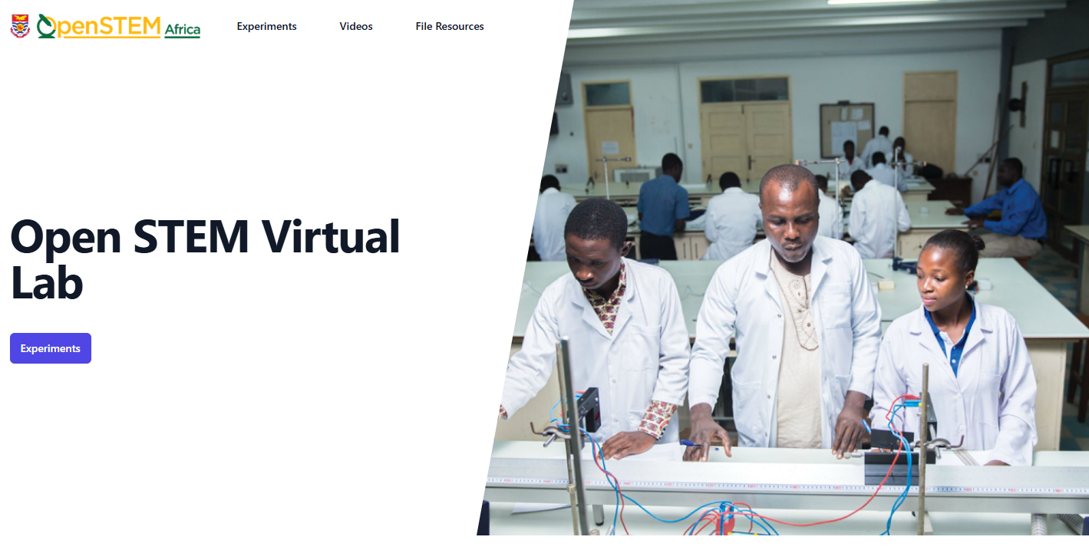
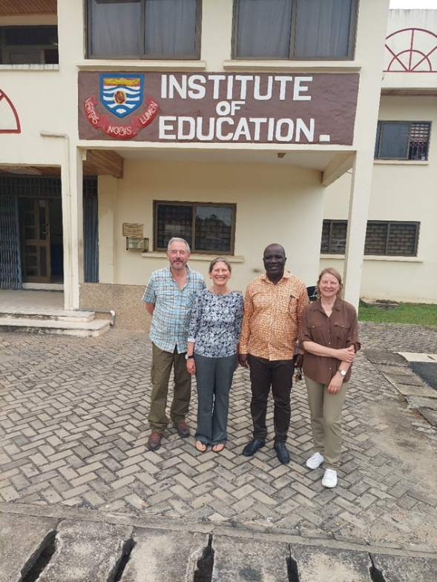
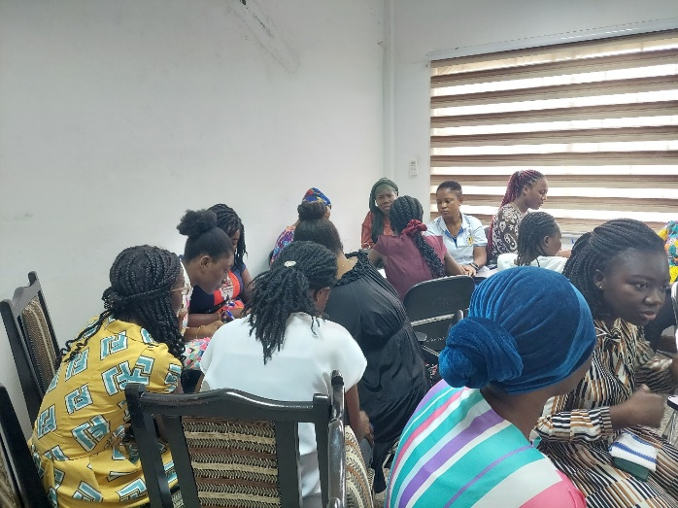
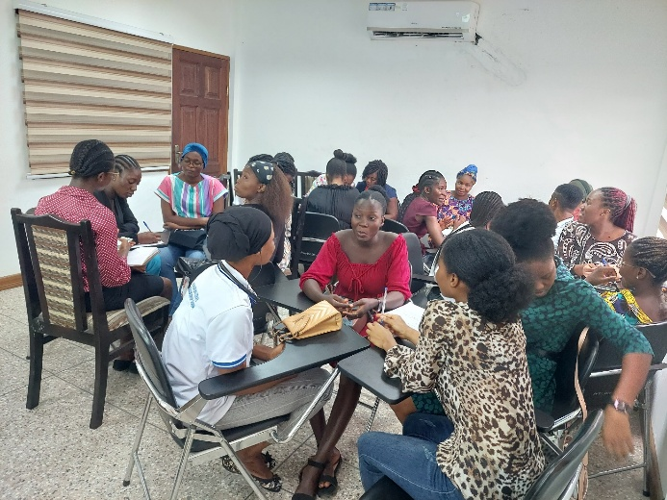
OU / UCC Activities
regular virtual meetings between OU and UCC colleagues to develop the project, data collection and analysis
a stakeholder workshop in Ghana,
interviews with academics and senior university staff​,
UCC instantiation of virtual lab
focus groups workshop with undergraduate science/science education students (Aug 2024),
a survey of undergraduate students 1638 responses
Kerry Murphy, Jane Cullen,
Chris Kwaah, Sarah Davies
Notes:
UCC created their own instantiation of Open STEM Africa virtual laboratory materials: UCC Open STEM Africa

Slide 6
Results – Student survey
Access to laboratories and practical work
Students express a strong desire for engaging in practical activities.
Current access to labs rated relatively high however concerns over levels of resources and support systems
Gender balance
Male students slightly outnumber females.
Men more represented in physics, chemistry, engineering
Females more prevalent in life sciences and applied sciences such as biology, environmental sciences.
“…almost everybody believes that there is a need for the field trip, but it doesn't come. And since we are familiar with attributing the challenge to there are no funds, there are no funds.” (UG student)
“there's an instance where the resources are available, but then it's hard as a student to access them. …Why? Because number one is lack of a skilled technician specific for the lab.” (KU student)
Notes:
quantitative and qualitative results from the study.

Slide 7
Results – Student survey
Access to ICT
Many students own digital devices; university-provided devices are rated modestly
Internet connectivity remains a significant barrier
ICT skills
Students report moderate to strong proficiency in the use of ICT tools.
Males consistently rate themselves more proficient.
Well developed skills in word processing, presentations and using email communication. Moderate ability in internet research and data analysis
Virtual laboratories and digital simulations are the least used tools
You see, at this time … I can go into my phone and find out what's a student in Leeds University as a civil engineering student is learning, which will open up my mind and will make me know that OK, so I can also do that as a student. I actually have …the capacity and the knowledge to know that I can also do this. (KU student)
Notes:
quantitative and qualitative results from the study.

Slide 8
Results – Qualitative analysis
ICT applications not yet widely adopted.
Recognition of the need for virtual / digital approaches to STEM learning.
Consensus on the need to move away from theory-based learning and teaching, and need for more practical hands-on.
A need for more individual development of knowledge and skills.
More connectivity between STEM learning at university and industry-specific skills.
STEM environments in universities enabling development and progression of female students and academics.
“…we need more hands-on projects. If we want to apply the things that we are learning now [in] class, we need to have problem-based projects that we can find certain solutions” (UG student)
the major limitation to practical teaching of science is the lack of spaces, adequate spaces. …If we can have a virtual lab, I think it will go a long way to enhancing the practical study of the STEM courses’. (Doctor, Plant Biology)
Notes:
quantitative and qualitative results from the study..

Slide 9
Activity : explore the practicals
Links:
OpenSTEM Africa: University of Ghana
Chemical tests
Virtual field trip
Questions:
What relevance and resonance is there with activities in STEM?
What next steps and collaborations would you suggest / like to be involved with?

Slide 10
Lessons and thoughts
A strong demand for practical learning
ICT seen as valuable for practical learning in STEM
The importance of leadership from within Africa and the benefits of collaboration
Co-created research design
UCC led on quantitative data
Who should have a voice in your community/research/teaching?
Notes:
Lessons
Collaborations. Importance of building and maintaining collaborations – multi-level and multi-stakeholder and intersecting partnerships - e.g. teacher and university collaborations in Ghana, within and across schools
Tensions in co-creation / Power (im)balances / responsibility, Trust , representation/engagement,,
who should have a voice in your community / research / teaching?

Slide 11
Thank you Open STEM Africa
With special thanks to:
Open University, UK
Dr Kerry Murphy, Oli Biaird & Dr Eric Addae-Kyeremeh
University of Cape Coast
Dr Kofi Owusu and Dr Chris Kwaah
University of Ghana
Prof Augustine Ocloo, Prof. Gbogbo, Dr. Owusu and Dr William N. Gblerkpor
CENDLOS and Ghana Education Service (GES), Ghana

