Slide 1

Front Cover Title 1
A Quizzical Approach to Employer-Facing Education: Engaging the eSTEeM Community Through Participatory Action Research.
Sarel Marais, Gareth Neighbour and Russ Lewis
29th April 2026

Slide 2
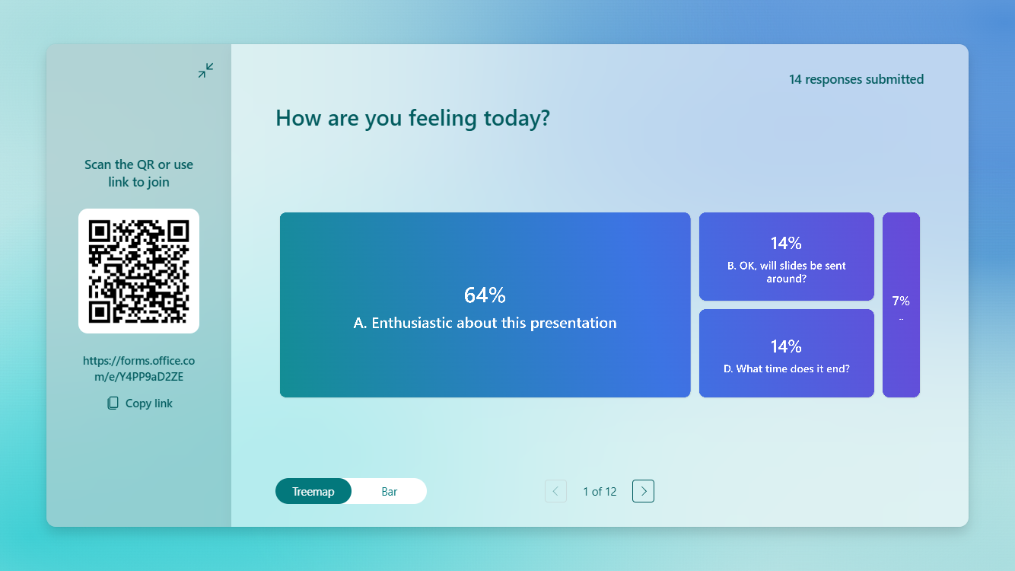

Slide 3
EFE definition
An agile provider delivering a flexible experience to enhance knowledge, up-skill and demonstrate competencies for learners embedded in an employment context relevant to the discipline and recognised as providing authentic learning to the employee and value to the employer.

Slide 4
Summary
Shifting HE landscape
Higher education has increasingly moved towards employability, work‑readiness and economic impact.
70%+ OU students already work while studying
Workplace is rapidly changing, and can HE institutions remain current
Is there a gap between practice and policy?
UK policy encourages employer involvement in curriculum design, but this influence is far less visible at the level of actual learner experience.
Existing frameworks (e.g., QAA) reference employers only lightly.
Practice and scholarship
Concepts such as work-based learning, employability and work readiness exist
Do we understand the needs of learners embedded in employment or the employers who support them?
Tension:
macro-level intentions (government, regulatory frameworks)
micro-level realities (learner needs, tutor practice, employer expectations)

Slide 5
Thank you for participating

