Slide 1
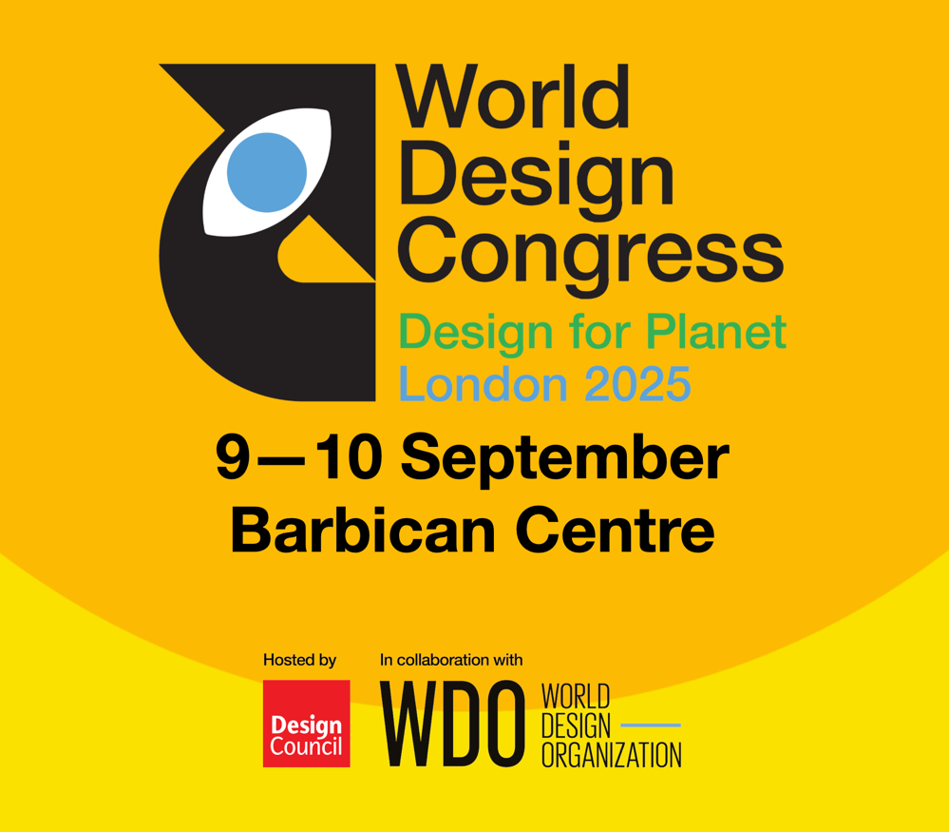
Intro Slide Title 2
Transformative Design Education
Cultivating Capabilities and Skills for the 21st Century
Emma Dewberry and Vera Hale
School of Engineering and innovation
29th April 2026

Slide 2

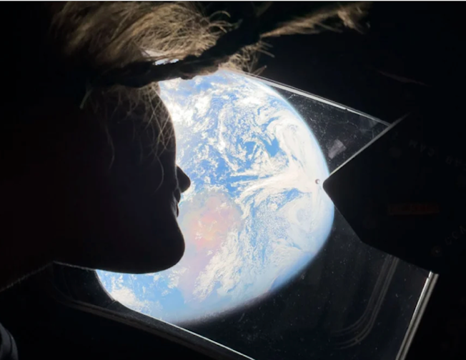

Intro Slide Title 3
Project context
Reframing Design > 360 credits of new design curriculum
BDes (Hons) Design for people, place and planet
Looking back at Earth from Orion, 2026
Apollo 11 1969 - Earthrise
Sustainability requires a step-change in people-planet relationships
57 years

Slide 3
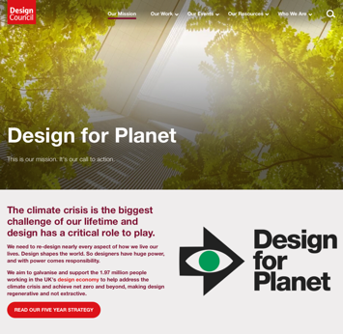
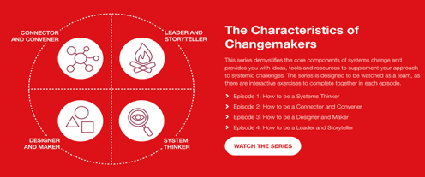

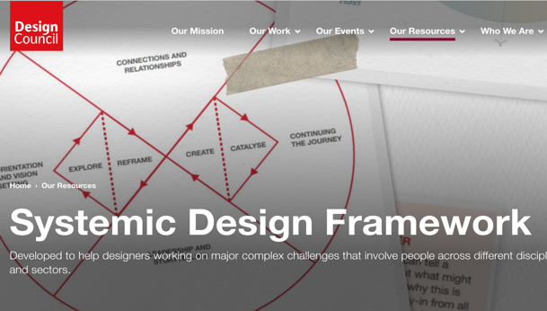

Intro Slide Title 3
Project context
Both the Design Council and RSA have the Planet in mind and have developed programs and frameworks to support professionals that work as change-makers and systemic designers

Slide 4
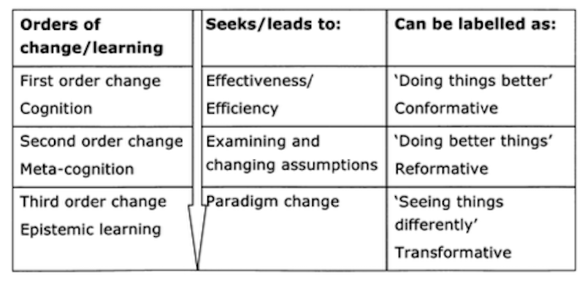
Intro Slide Title 3
Education for Sustainable Development
Remaking education {Sterling (2003), Orr (1994), Irwin (2017), Illich (1971)}
Looking differently at how we act in the world > how can landscapes of learning help shift perspectives from one paradigm to another?
Shifts to transformative learning (Sterling 2001):
constructive (not instructive); participative (not imposed)
progressive change to ‘strong’ sustainability
building on critically reflective adaptation
fostering creative re-visioning
Shifting from
Reducing Unsustainability to
Creating Sustainability
(John Ehrenfeld, )
Sterling, S. (2011) Transformative Learning and Sustainability: sketching the conceptual ground, Learning and Teaching in Higher Education, Issue 5, 2010-11
Notes:
Sterling talks about the vision of change and reimagining the purpose of education. He builds on Bohm’s systems of knowing and Bateson’s model of orders of learning.

Slide 5
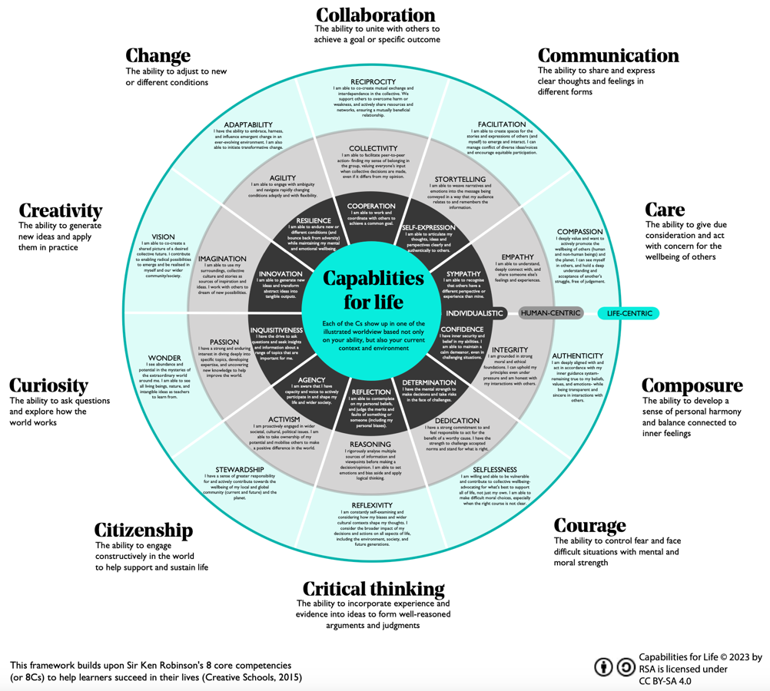
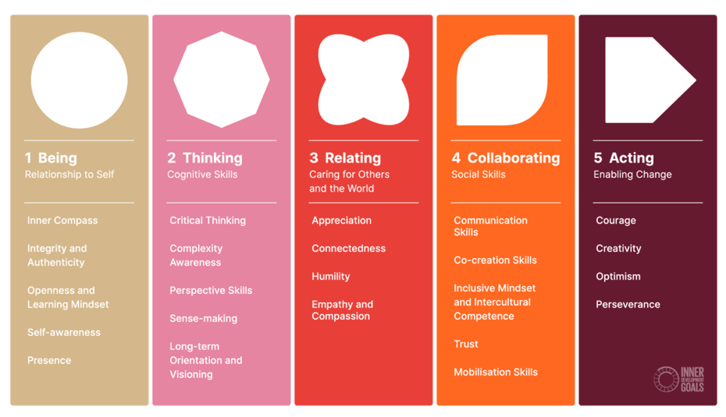
Intro Slide Title 3
Capabilities and Skills
RSA’s CAPABILITIES FOR LIFE FRAMEWORK
A framework to nurture life-centric capabilities
United Nations INNER DEVELOPMENT GOALS for Outer Change
https://innerdevelopmentgoals.org
https://www.thersa.org/design-for-life-our-mission/capabilities-for-life/capabilities-for-life-framework

Slide 6
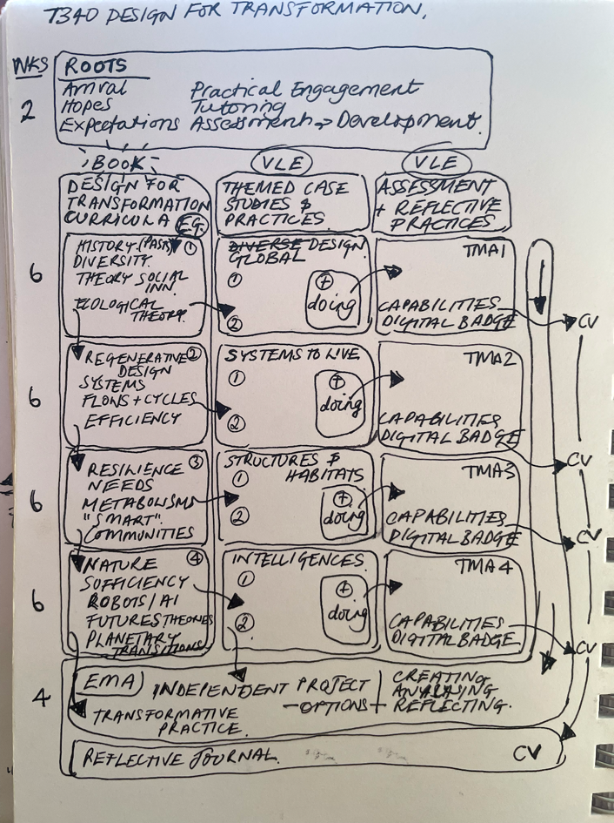
Intro Slide Title 3
Design focus
Proposed Stage 3 module T340 Design for Transformation
interdisciplinary
project-learning
reflective practitioner
alumni networks

Slide 7

Slide Title 8
Mapping exercise
Read the different worldview descriptions: individualistic; human-centric; life-centric
Select 3 different capabilities: - one where the description at the individualistic level aligns with you - one where the description at the human-centric level aligns with you - one where the description at the life-centric level aligns with you Place a dot on each of your selected capabilities
Discuss your selection as a group: - How easy was it to make a choice - Did it make you think differently - How useful is this for a UG audience
1 min
4 mins
5 mins

Slide 8
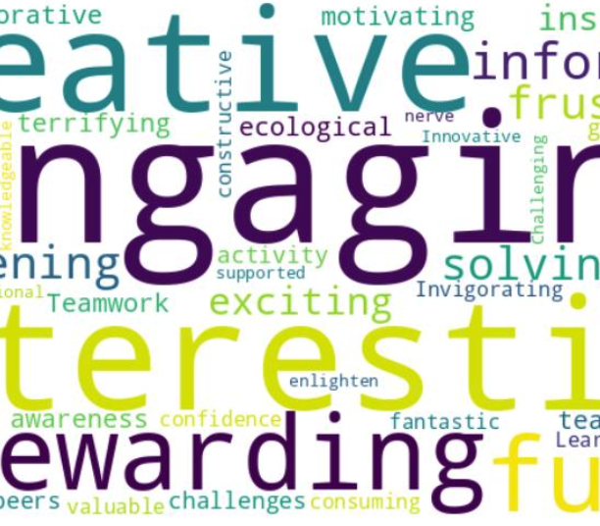
Sustainathon
Join us tomorrow at 09.45
Parallel Session H – CMR 1
Thank you
emma.dewberry@open.ac.uk
vera.hale@open.ac.uk

