Slide 1

Gamification to increase participation in maths practice quizzes in Level 1 Engineering modules
S. Varagnolo, Z. Golrokhi, C. McKenna, J. Openshaw, S. Hayes-Budgen, E. Mathews
eSTEeM conference 2026
29th April 2026

Slide 2

Slide Title 7
Who is working in modules with Practice quizzes?

Slide 3
Slide Title 7
How much are your students engaging with the Practice Quizzes?

Slide 4
Slide Title 7
Engagement in T192 - Engineering: origins, methods, context

Slide 5
Slide Title 7
Engagement in T192 - Engineering: origins, methods, context
Let’s do a scholarship project!

Slide 6
Slide Title 7
Engagement in T192 - Engineering: origins, methods, context

Slide 7
Slide Title 7
Effect on assignments

Slide 8
Slide Title 7
How did we do that?

Slide 9
Slide Title 7
Definition of gamification

Slide 10


Slide Title 7
Prizes

Slide 11
Slide Title 7
Any suggestion for improvement?

Slide 12
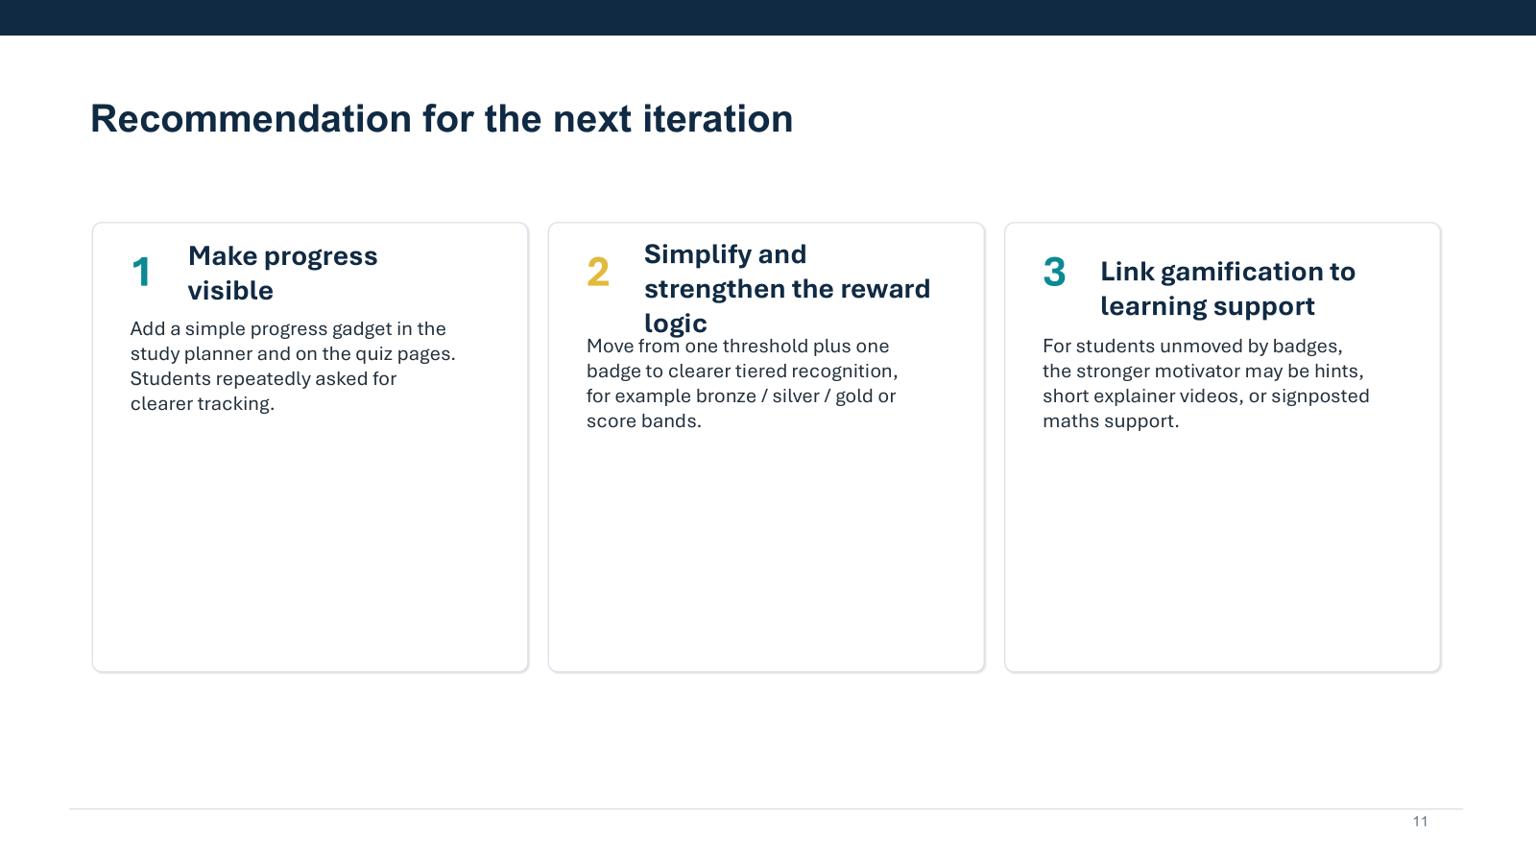
Slide Title 7
Feedback

Slide 13
Slide Title 7
How would you advertise the gamification?

Slide 14
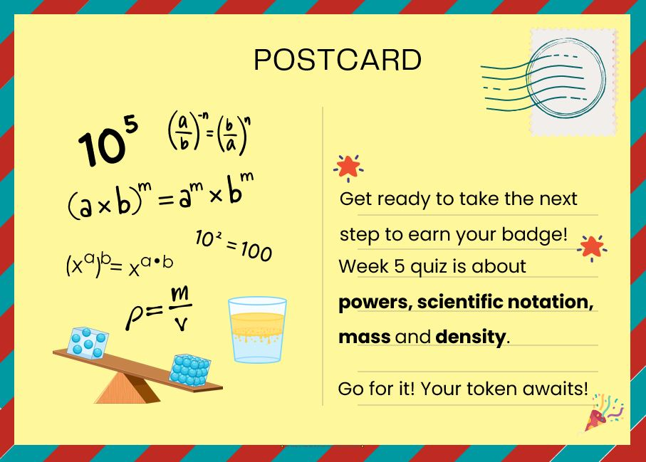
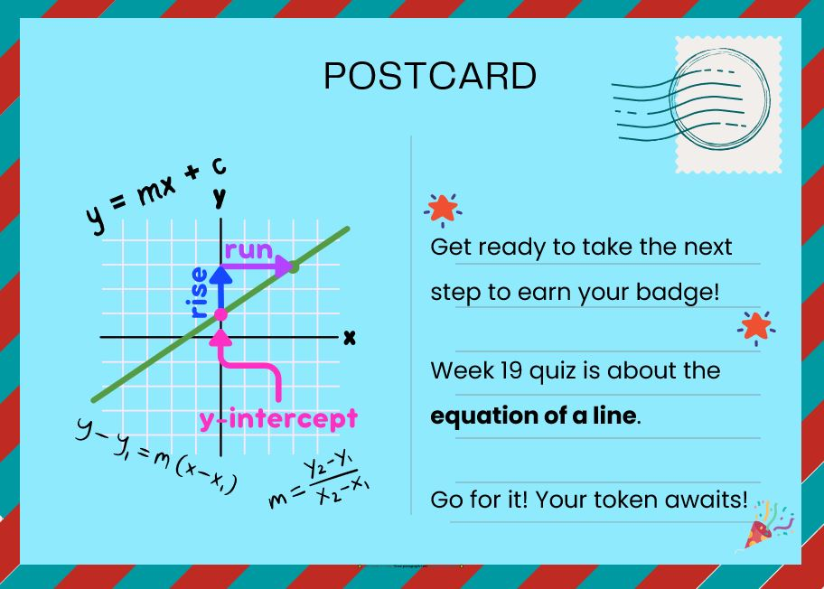
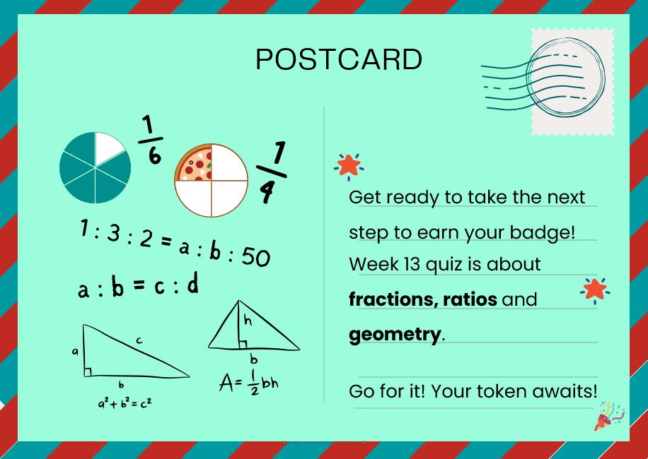
Slide Title 7
Promotion
Landing page of the quiz
Section about badges at the beginning of the module study planner
News items
Posts in module-wide forum
Posts in maths forum
Posts in café forums
Emails from tutors

Slide 15
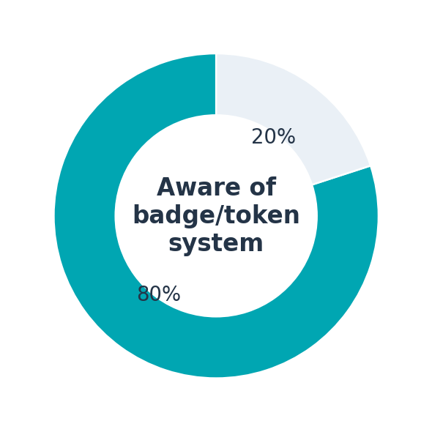
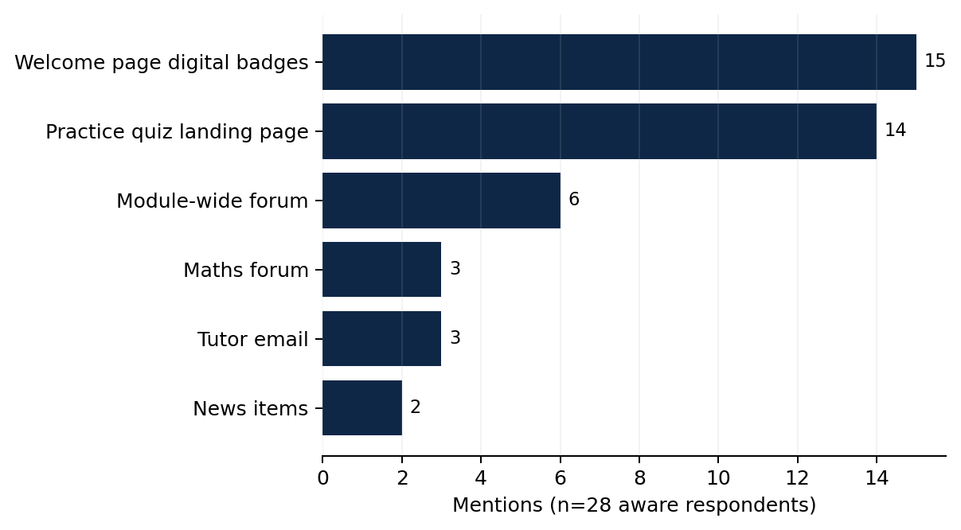
Visibility and reach
80%
were aware of the system
54%
noticed it via the welcome page
50%
noticed it on the quiz landing page
5
Notes:
[Sources] - User-uploaded file: Copy of gamification-t192-25D_08-10-2025.xlsx - User-uploaded file: gamification-t192-25d-summary.xlsx [/Sources]

Slide 16
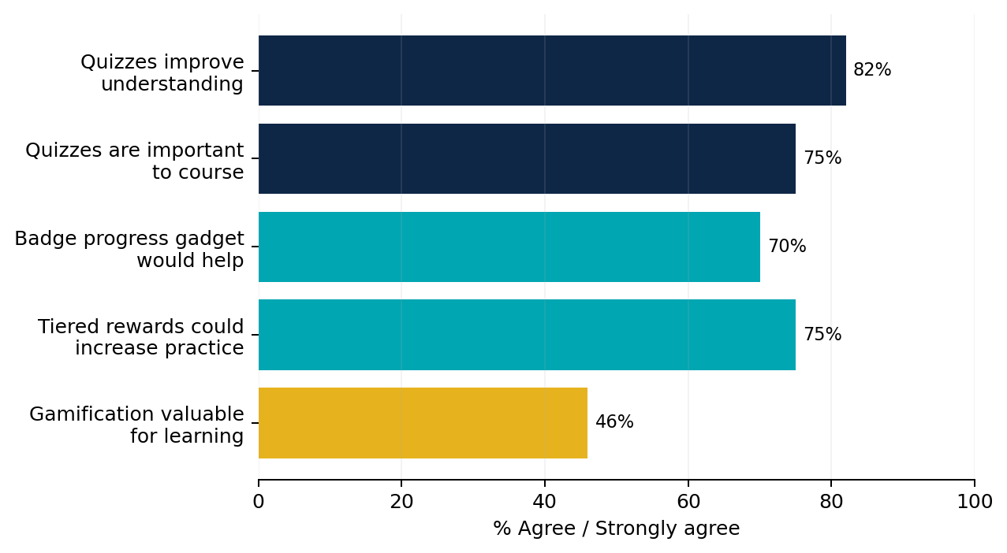
What students broadly thought
61%
70%
would like to see similar systems in other modules
said a visible progress gadget would help
75%
46%
said tiered rewards could increase maths practice
saw the existing system as valuable for learning
6
Notes:
[Sources] - User-uploaded file: Copy of gamification-t192-25D_08-10-2025.xlsx - User-uploaded file: gamification-t192-25d-summary.xlsx [/Sources]

Slide 17
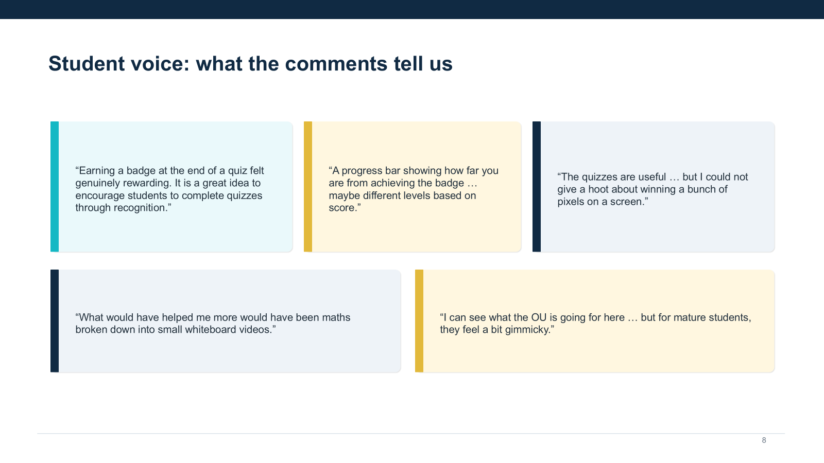
Acknowledgements
Colum McKenna
James Openshaw
Shawndra.Hayes-Budgen
Elizbeth Mathews
Colin Blundell (T192 Associate Lecturer)
eSTEeM
and you for your attention!
silvia.varagnolo@open.ac.uk
zahra.golrokhi@open.ac.uk

Slide 18
Slide Title 7
Summary
Higher engagements with the Practice quizzes (25D and 25J)
Improved students’ outcome (submission rate & marks in iCMAs in 25D and 25J)
Small intervention with minimal maintenance after the first time)
Next steps
To continue in T192
To extend to T193
To extend more widely – also your module if you are interested!

Slide 19
Acknowledgements
Colum McKenna (Product Development Manager)
James Openshaw (Learning Designer)
Shawndra.Hayes-Budgen (Learning Designer)
Elizbeth Mathews (Manager, Mathematics Support)
Colin Blundell (T192 Associate Lecturer)
Soraya Kouadri (Senior Lecturer in C&C)
eSTEeM
and you for your attention!
silvia.varagnolo@open.ac.uk
zahra.golrokhi@open.ac.uk

