Slide 1
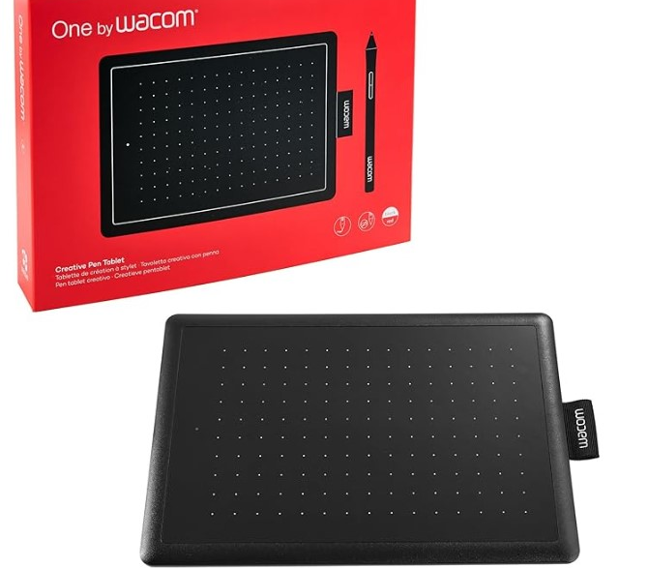
Esteem conference – graphics tablet project
Becca Whitehead and Gemma Warriner

Slide 2
Project aims
We aim to evaluate the effectiveness and student experience of using Wacom plug-in tablets as part of robust online assessment
Our online assessment is becoming increasingly vulnerable to the use of Generative AI to answer questions
This three phase project seeks to investigate the feasibility of using Wacom tablets to facilitate a mathematically and scientifically robust conversation between tutor and student
Phase 1 – testing the basic concept of Wacom tablets with six ALs - completed
Phase 2 – testing the useability and student experience of Wacom tablets with 20 students - (25J)
Phase 3 – testing how robust online assessment is with Wacom tablets with 80 students - (26J)

Slide 3
What kind of tablets are we using?
This is the One by Wacom small graphics tablet.
It is cheap (between £20-35 depending on where and when you source them
It is old technology – this is a good thing as it is well tested and reliable
They are simple – there is little to go wrong and they are difficult to break
They work with Windows machines, Mac and Chromebooks
You can use them without installing any drivers (important for students who may be working on locked down machines)

Slide 4
Why not just have a conversation with students?
It would be cheaper and easier…
We propose that you can have a more natural conversation that involves using equations, graphs and diagrams – all critical components of Physics, Astronomy and Planetary Science
We also propose that a tutor could hold a conversation that can have a framework including the components above that could be consistently graded
With the rapid improvements in AI it is now very difficult to be sure that a student in an online setting is answering any questions without making use of AI. With the improvement of video avatars would we be able to spot this? We propose our use of tablets would mitigate for this

Slide 5

The first slide you will encounter
All the questions will be based around Newton’s Laws
Information for students:
Before starting please confirm that you can annotate using the tablet and that your microphone and speakers are working. Have a calculator to hand
This discussion will be framed around 5 questions, for which you will need the tablet. Your tutor may ask you additional questions It will take about 30 minutes
Let your tutor know when you are ready to start
Practise Box
Notes:
Please ensure that students are ready to go before strating

Slide 6
Q1 - True or False questions
These should be good questions to settle in with
Q1
Next to the answers below ring if they are True (T) or False (F)
T / F
You will be given a series of statements
We would like you to ring T or F according to what you think
Your annotations don’t need to be super neat
As long as you can clearly indicate which option you have chosen it will be fine
T / F
T / F
T / F
Notes:
Ask student about one of the answers – that is to discuss their choice

Slide 7
Q2 – A sketch question
Q2
You will be given a physics question with a short description that requires you to draw a sketch.
Think about the sorts of diagrams that you see in your module materials.
These don’t need to be perfect artistic images – but do need to convey information
Notes:
Ask what quantities would be needed to quantify the forces

Slide 8
Q3 – working with an equation
Q3
You will be given a mathematical question that requires you to use an equation.
You might need to think of the correct equation to use but if you couldn’t remember it the tutor would give you a prompt to get started
You will write out the equation, rearrange it as necessary and complete the calculation
Notes:
Prompt student if needs be

Slide 9
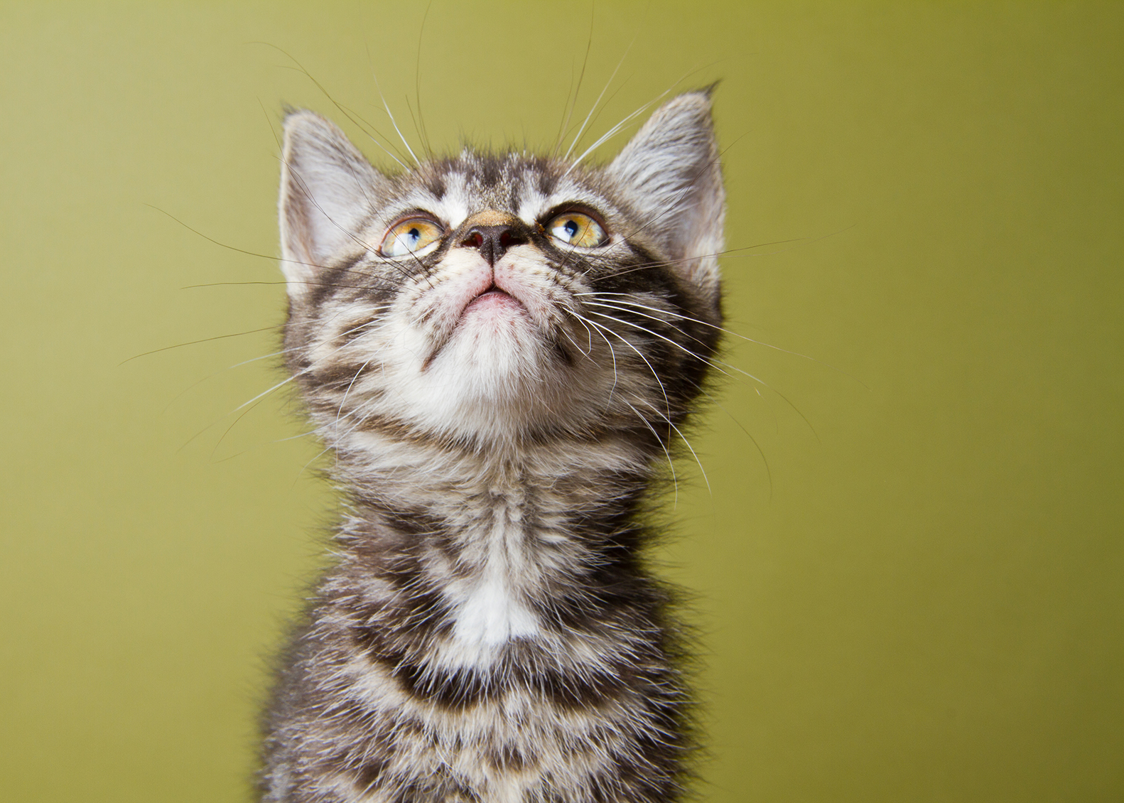
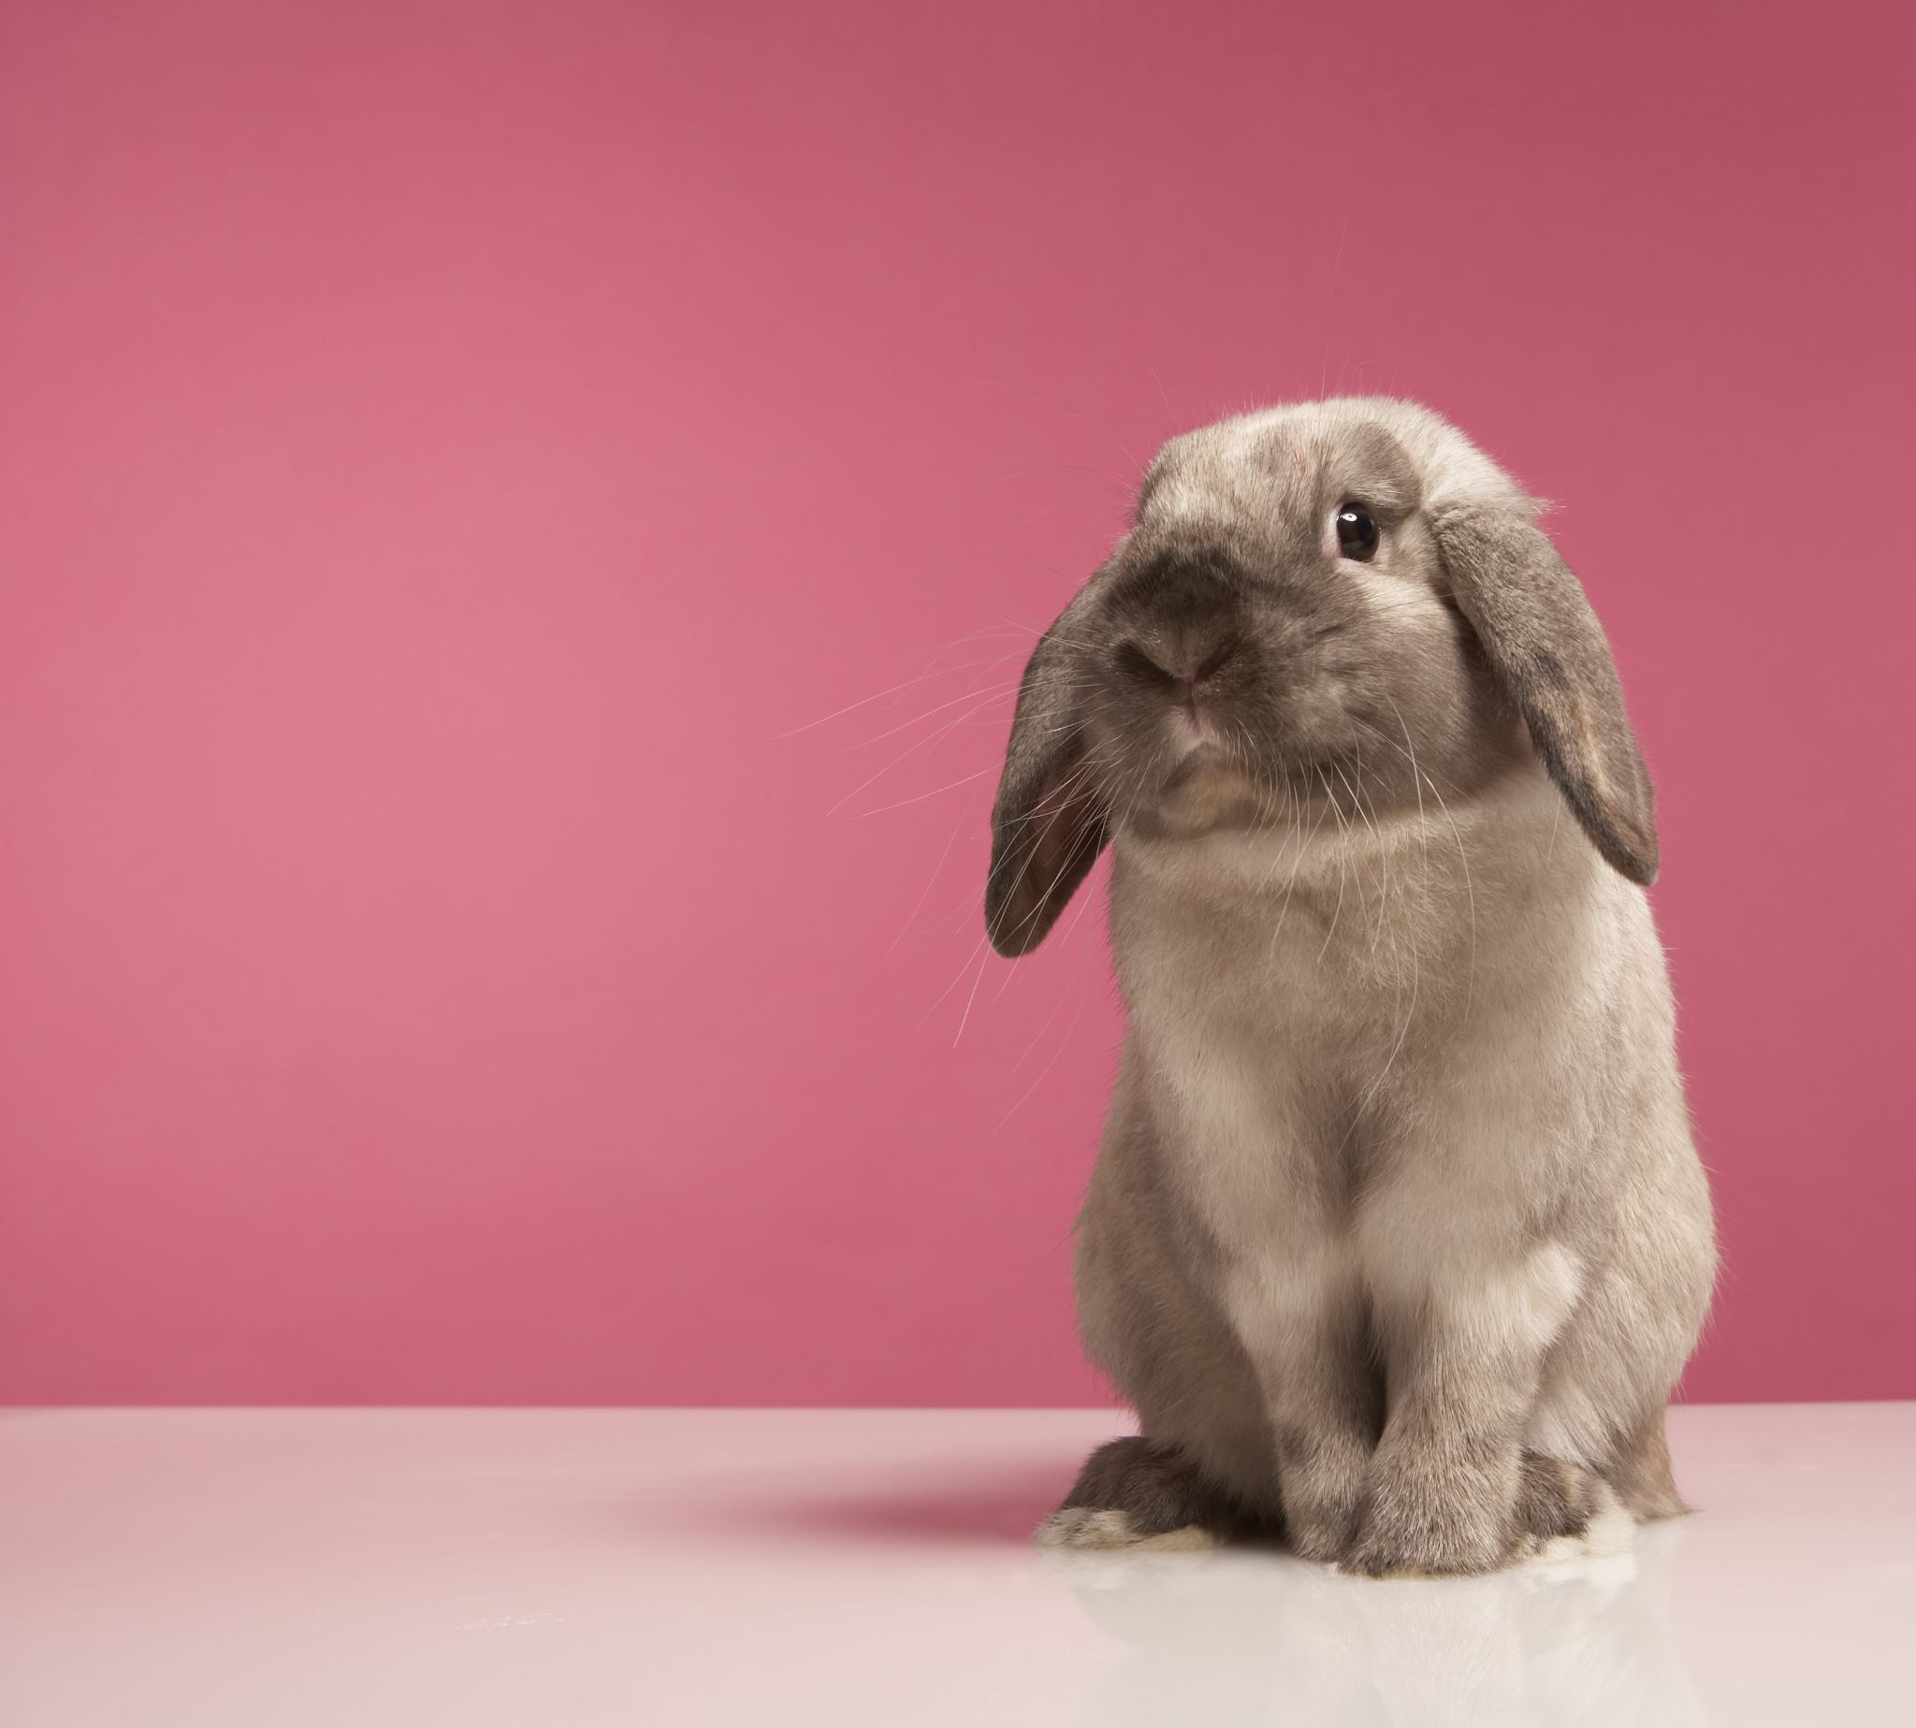
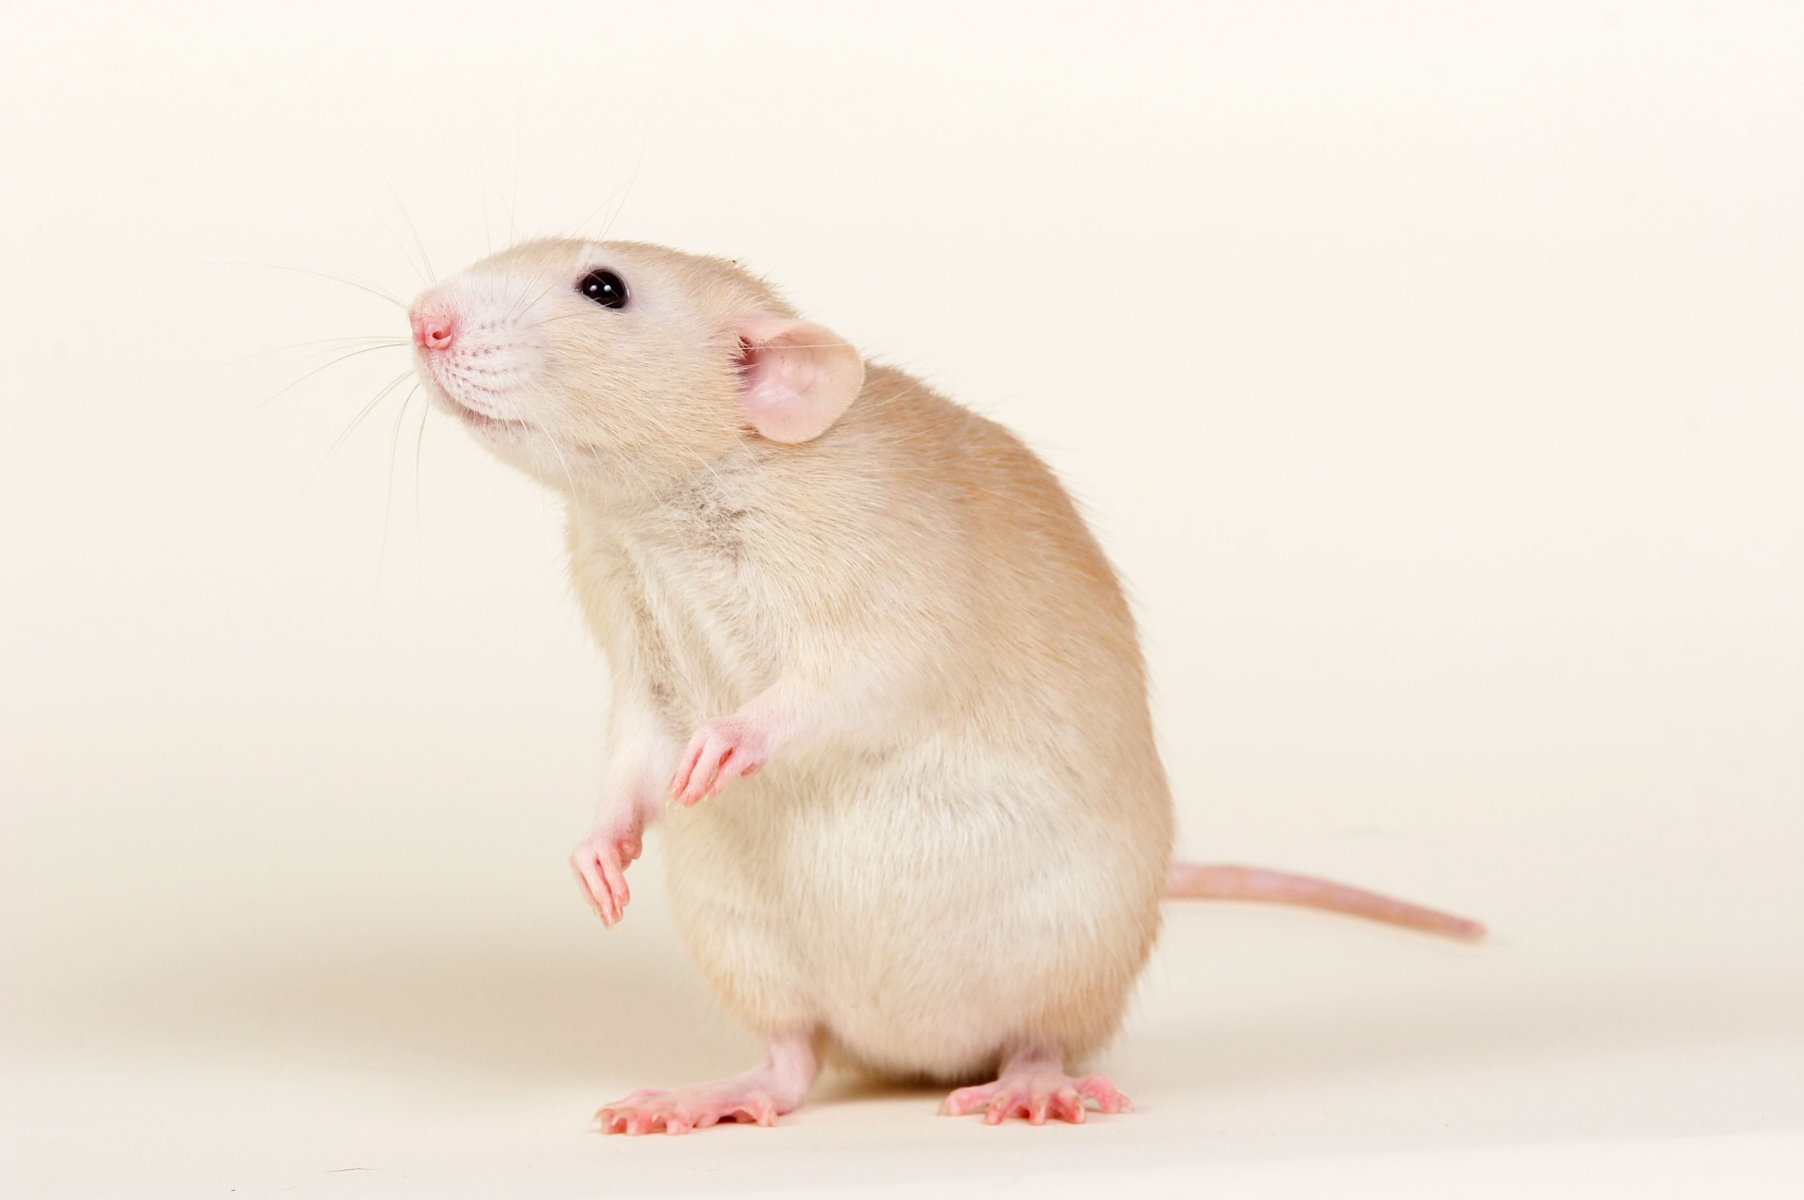
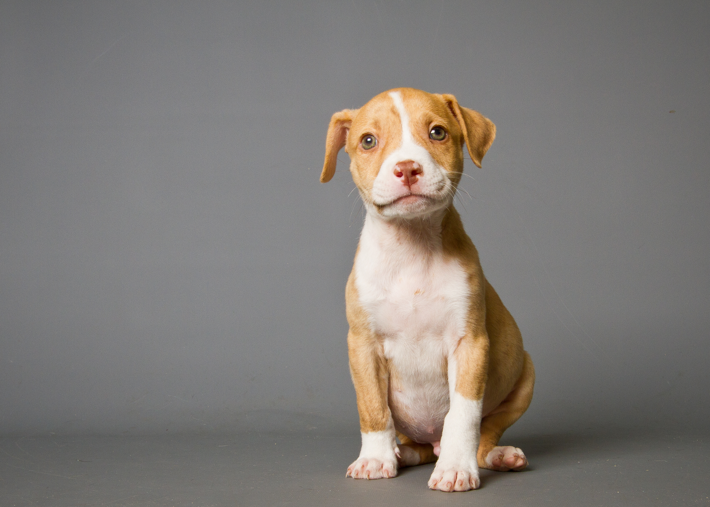
Q4 – circle the pictures
Q4
Have a look at the pictures – circle the ones that apply to a particular characteristic that will be described to you about Newton’s Laws.
Your circling doesn’t have to be neat – just needs to be clear
Notes:
Ask to explain think on each one

Slide 10
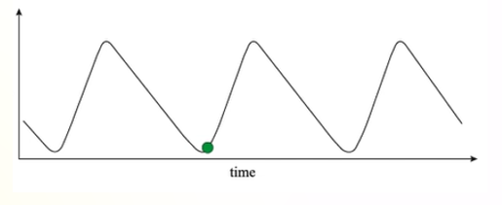
Q5 – annotate a graph
Q5
Have a look at the graph and answer the questions below:
We might ask you
- to label an axis
to indicate an area on the graph where a particular event is happening
to describe the event in more detail
Notes:
Ask: why is the graph this shape?

Slide 11
What will happen next
Just to recap - Phase 2 is focussing on the usability of the tablets and the student experience with a small number of students
Phase 3 (due to take place in 26J) will focus on the robustness of assessment using tablets against AI with a larger number of students. Approx 80 students
We will be led by outcomes from both Phase 1 and Phase 2 to decide exactly how we will proceed for Phase 3
Early testing in Phase 1 indicates that it is robust but we will test this on a larger scale

