Slide 1


Academic discussions: evaluating student experience and outcomes and tutor perceptions of this novel form of assessment
Fíona Moorman, Katja Rietdorf, Karen New and Kate Fox
S296 Cell and molecular Biology
15 minutes
10% of OES
Based on seen data
S317 Biological Sciences from genes to species
20 minutes
15% of OES
Based on seen research paper
(also assessed in summative TMA04)

Slide 2
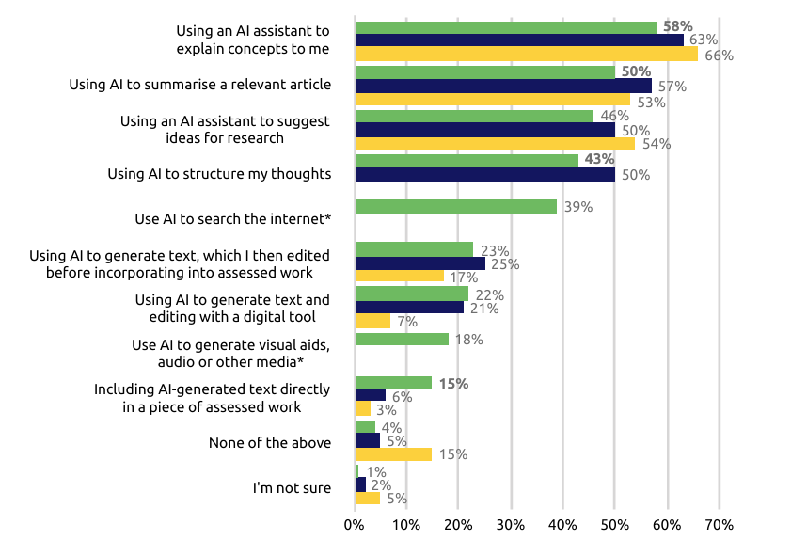
Why?
What?
Tutor support
Questions
Student support
Evaluation
Assessment
HEI context
Figure 5: ‘Which of the following would you typically consider an acceptable use of GenAI for assessed work?
GenAI use is almost universal (95% of students report using GenAI to “help with assessed work”)
Students increasingly use AI for core academic tasks
2026
2025
2024
HEPI 2026: HEPI-Report-199-Gen-AI-Survey-2026.pdf

Slide 3
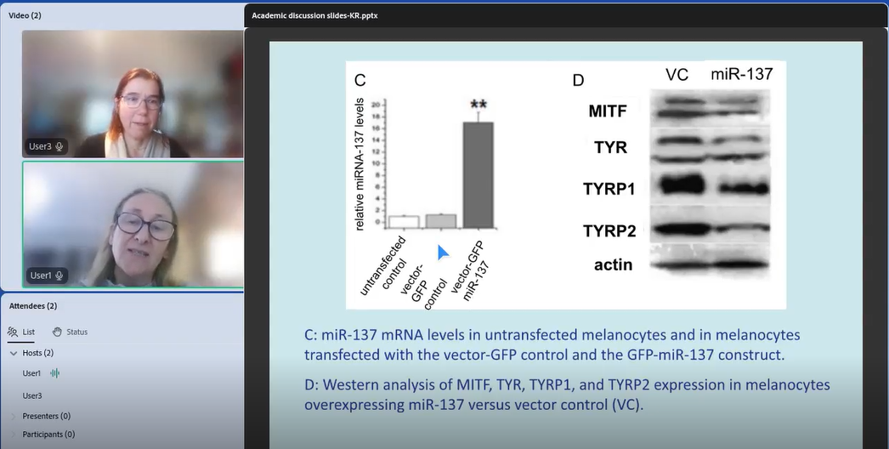
Why?
What?
Tutor support
Questions
Student support
Evaluation
Assessment
Oral assessment and academic integrity
Unsupervised written assessments are
vulnerable (even where policies clearly
define acceptable/unacceptable use)
Oral assessment provides evidence of
understanding, academic engagement,
student voice and authorship
A little more resistant to academic misconduct
Emphasise understanding, dialogue, and ethical authorship over detection and punishment
Address student anxiety over false accusation of misconduct
Notes:
Karen to present

Slide 4
Why?
What?
Tutor support
Questions
Student support
Evaluation
Assessment
What is an Academic discussion (AD)?
1:1 Adobe Connect discussion between student and their tutor (organised by Microsoft Bookings)
I.D. verification and welfare check step
Lasting up to 15-20 minutes
All ADs will be recorded (to allow for monitoring and appeals)
Microphone and camera on by default*
Questions on slide
Students will be offered a second opportunity if there are health or technical issues impacting their first AD opportunity
*Reasonable adjustments excluded

Slide 5
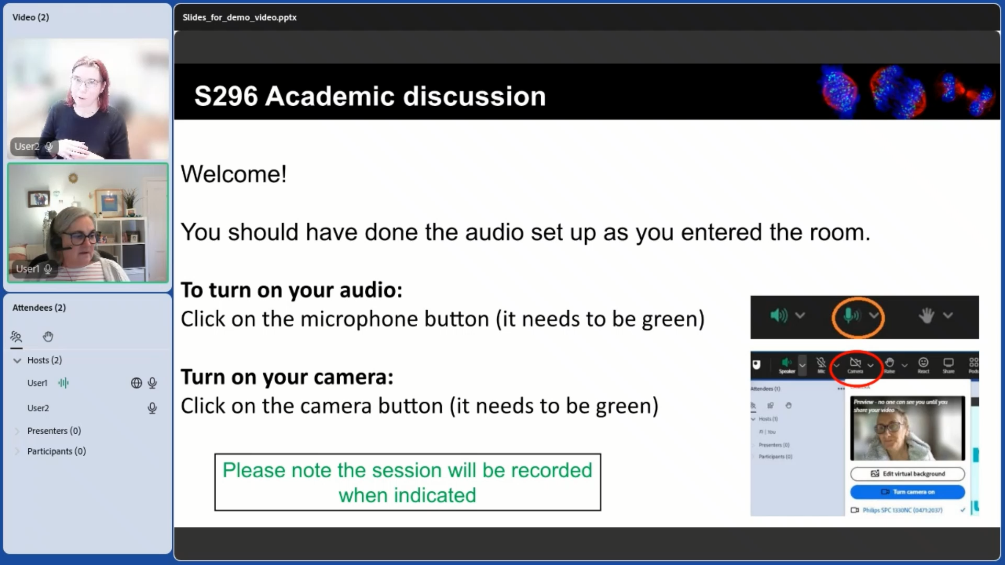
Why?
What?
Tutor support
Questions
Student support
Evaluation
Assessment
What is an Academic discussion (AD)?

Slide 6
Why?
What?
Tutor support
Questions
Student support
Evaluation
Assessment
Support for students
Detailed guidance on module website
Tutorials to provide information and opportunity for questions
Online Journal Clubs provide opportunity for students to practice talking online
Assessed materials (data or research paper) provided in advance
Example AD recording with questions and answers (which can be paused for students to practice answering questions)
Example marking grid
Opportunities for practice ADs with their tutor
Students will be offered a second opportunity if there are health or technical issues impacting their first AD opportunity
Reasonable adjustments

Slide 7
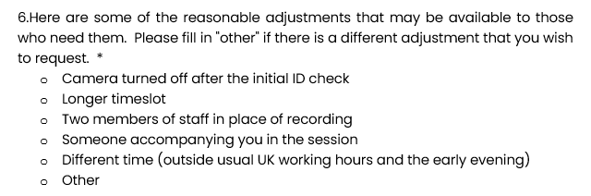
Why?
What?
Tutor support
Questions
Student support
Evaluation
Assessment
Reasonable adjustments (procedure)
Email to all students on both S296 and S317 with link to MS Form to request reasonable adjustments
Form monitored by MT who have access to disability profiles
Adjustments put into place (in communication with student)
Adjustments recorded in VOICE

Slide 8
Why?
What?
Tutor support
Questions
Student support
Evaluation
Assessment
Support for tutors
Tutor website: Detailed guidance, example AD recording, slides with questions and Marking grid
Assessed materials (data or research paper) provided in advance
AL Briefing (May 2026): provide information and answering questions
Staff Development day (Sept 2026): Practice ADs with MT / another tutor and marking coordination
MT support during process
(an oral presentation on S390)....."is often chosen as the single greatest achievement in their reflections."
"Would be nice to have 1-2-1 discussions with our students on so many levels, so yes I am in favour of it.“
Tutor feedback
"I have carried out ‘vivas’, a very long time ago, and appreciate that they require a different skill set compared with marking papers. Will training be available? "
"I fully understand why we need a new approach.“

Slide 9
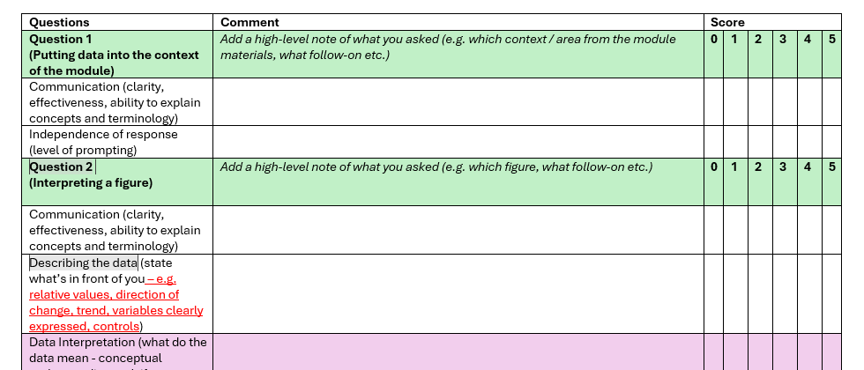
Why?
What?
Tutor support
Questions
Student support
Evaluation
Assessment
How will ADs be assessed?
Questions based on pre-seen data/article
Questions will be the same type but vary between students
ALs will be provided with slide deck and marking guidance and grid
Students must submit an AD checklist in advance (TMA)
TMA submission allows AL to submit marks in the eTMA system

Slide 10
Why?
What?
Tutor support
Questions
Student support
Evaluation
Assessment
Evaluation and research questions
Evaluate logistics of conducting ADs (bookings, timing, length)
Evaluate outcomes (AD uptake, AD scores, withdrawals / pass rates, numbers of spec circs, ACO referral case numbers, analysis demographic data)
Evaluate student perspectives (survey with Likert and free text questions)
  Pre-post AD anxiety
  Preparation for AD
  Perspectives of AD vs written assessment
Evaluate tutor experiences and perspectives (survey with Likert and free text questions and tutor focus group)

Slide 11

Why?
What?
Tutor support
Questions
Student support
Evaluation
Assessment

