Slide 1

Improving performance on remote exams in symbolically-rich disciplines:
Lessons from the past and lessons for the future
Sally Jordan, Jonny Nylk, Becca Whitehead and Cath Brown
Wednesday 29th April 2026

Slide 2
Project introduction
Aim: To investigate the effectiveness of various initiatives in encouraging student engagement with remote exams in physics
Builds on previous eSTEeM projects.
Focus on “Gateway” Stage 2 Physics module, S217 (15J-24J), with an exam that students submitted online from the 19J presentation.
“Formative thresholded” assessment strategy.
By 23J presentation, performance had improved from 20J low-point, but there were still academically able students who were let down by exam anxiety or poor exam technique.
In particular, a significant number of students were taking such care over the production of their mathematical responses and diagrams that they only had time to attempt a small subset of the paper.

Slide 3
Initiatives designed to improve exam confidence and performance (from 21J)
Shortening of the exam paper, and review in the light of time taken by AL checkers.
Provision of a Practice iCME (in the iCME system) in addition to the Specimen Exam Paper (SEP).
Generic School of Physical Sciences and S217-specific exam prep sessions.
Provision of hints and solutions to “500 short questions”
Reflection on revision and exam preparation in response to TMA questions
Requirement to evidence submission of Practice iCME in TMA06 (23J only)
Change in assessment strategy.
Provision of additional Practice iCME, with SEP designed for checking format and difficulty, iCME1 designed for practice in whatever way useful, iCME2 designed for timed practice.
Provision of 9 videos of MTC working through Practice iCME2 and one video of her discussing the marking of this.
23J
24J

Slide 4
Evaluation methods
Data analysis
Analysis of all scripts for 2022 (21J), 2023 (22J), 2024 (23J) and 2025 (24J) exams
Surveys
Surveys sent to students at the end of the 23J and 24J presentations, to ask about their experience of the exam and their use of the resources provided to help with exam preparation.
Focus groups
Four focus groups (two each for students from the 23J and 24J presentations) to further explore themes identified in the surveys.

Slide 5
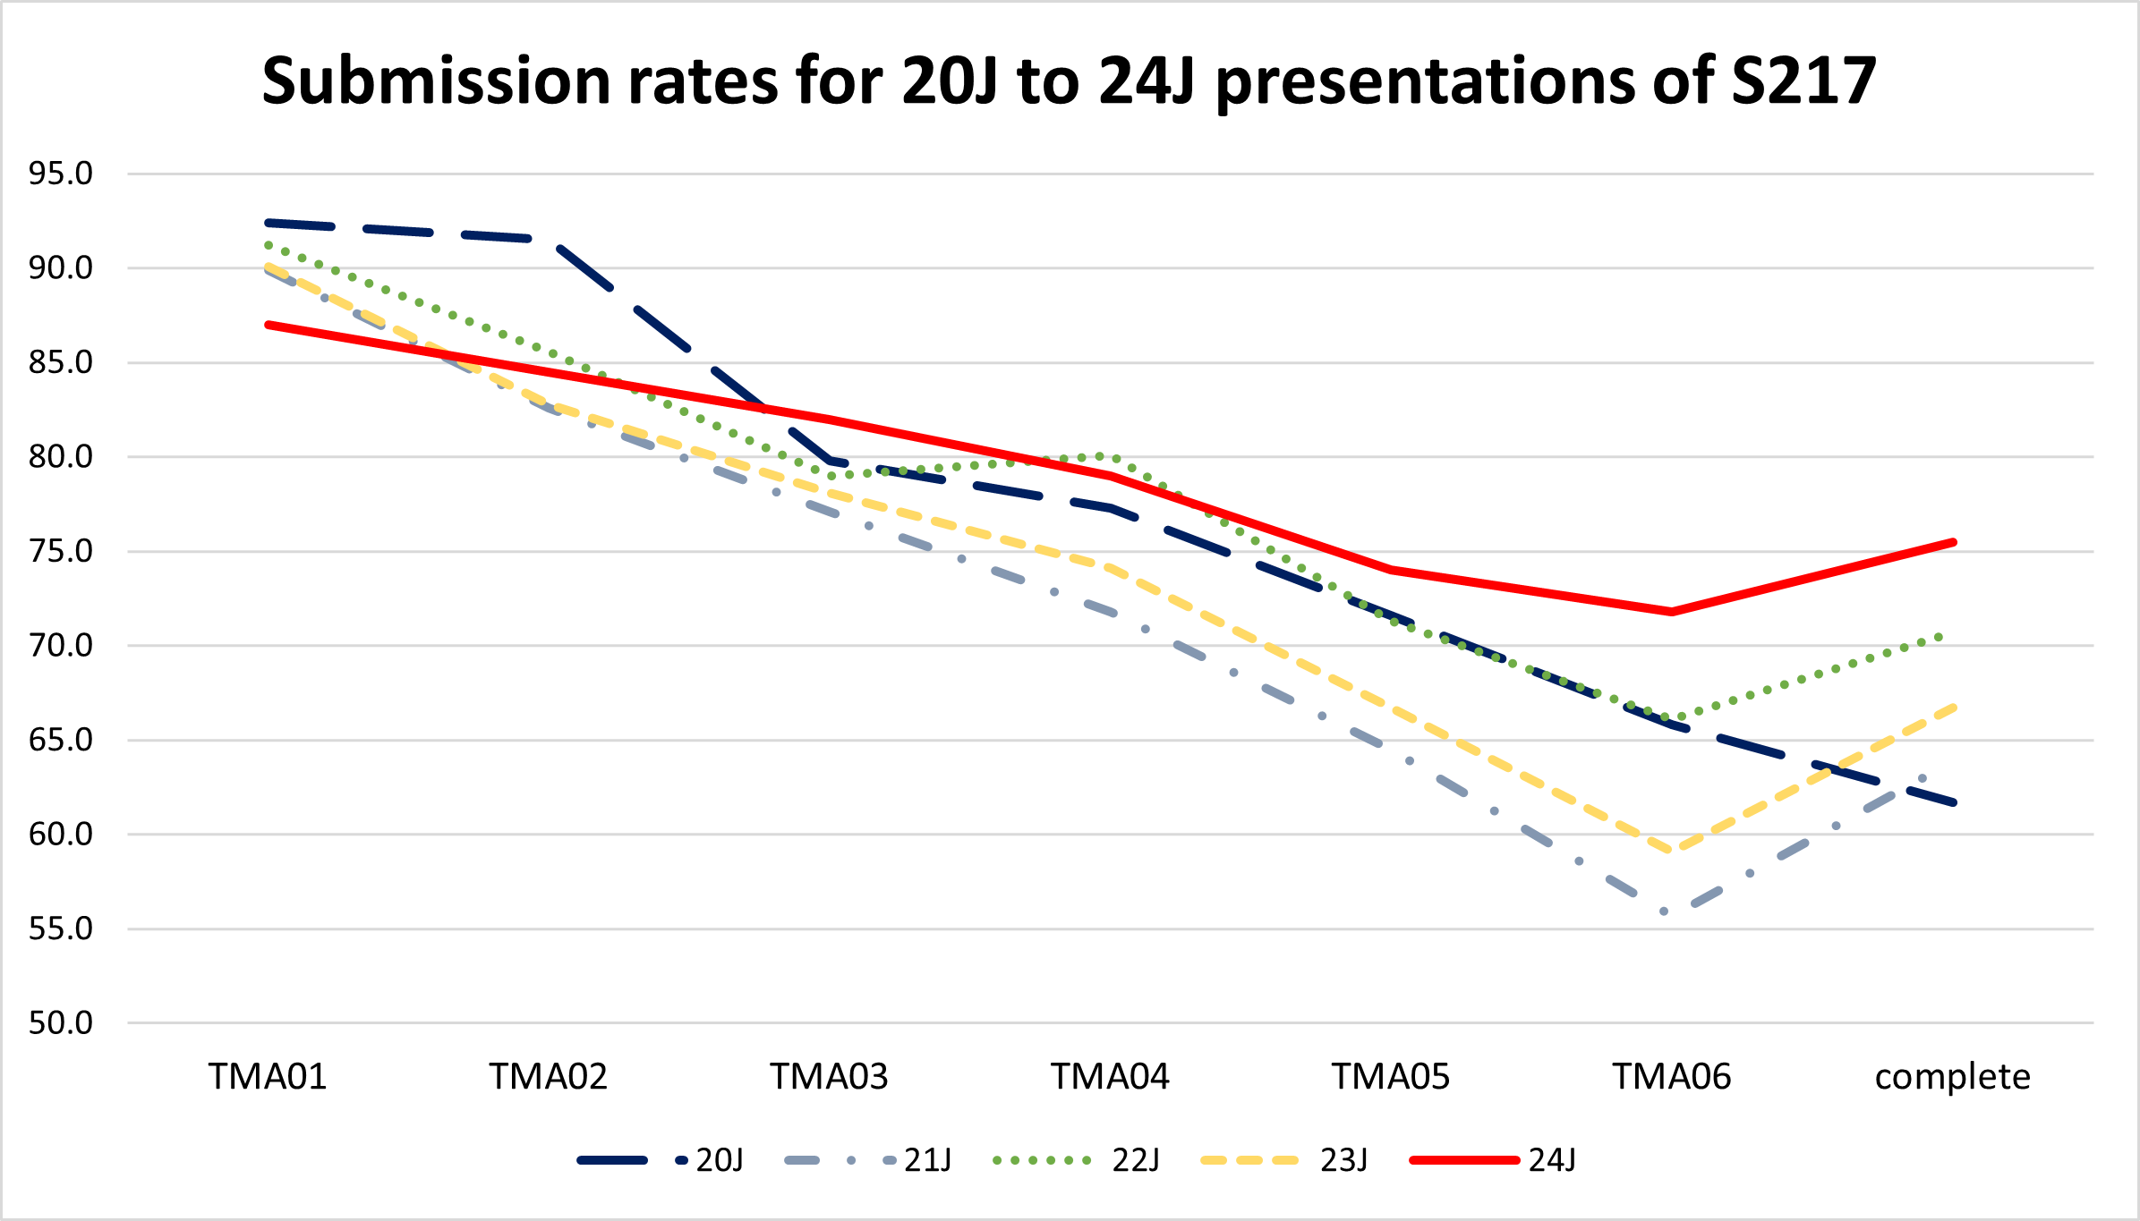

Slide 6
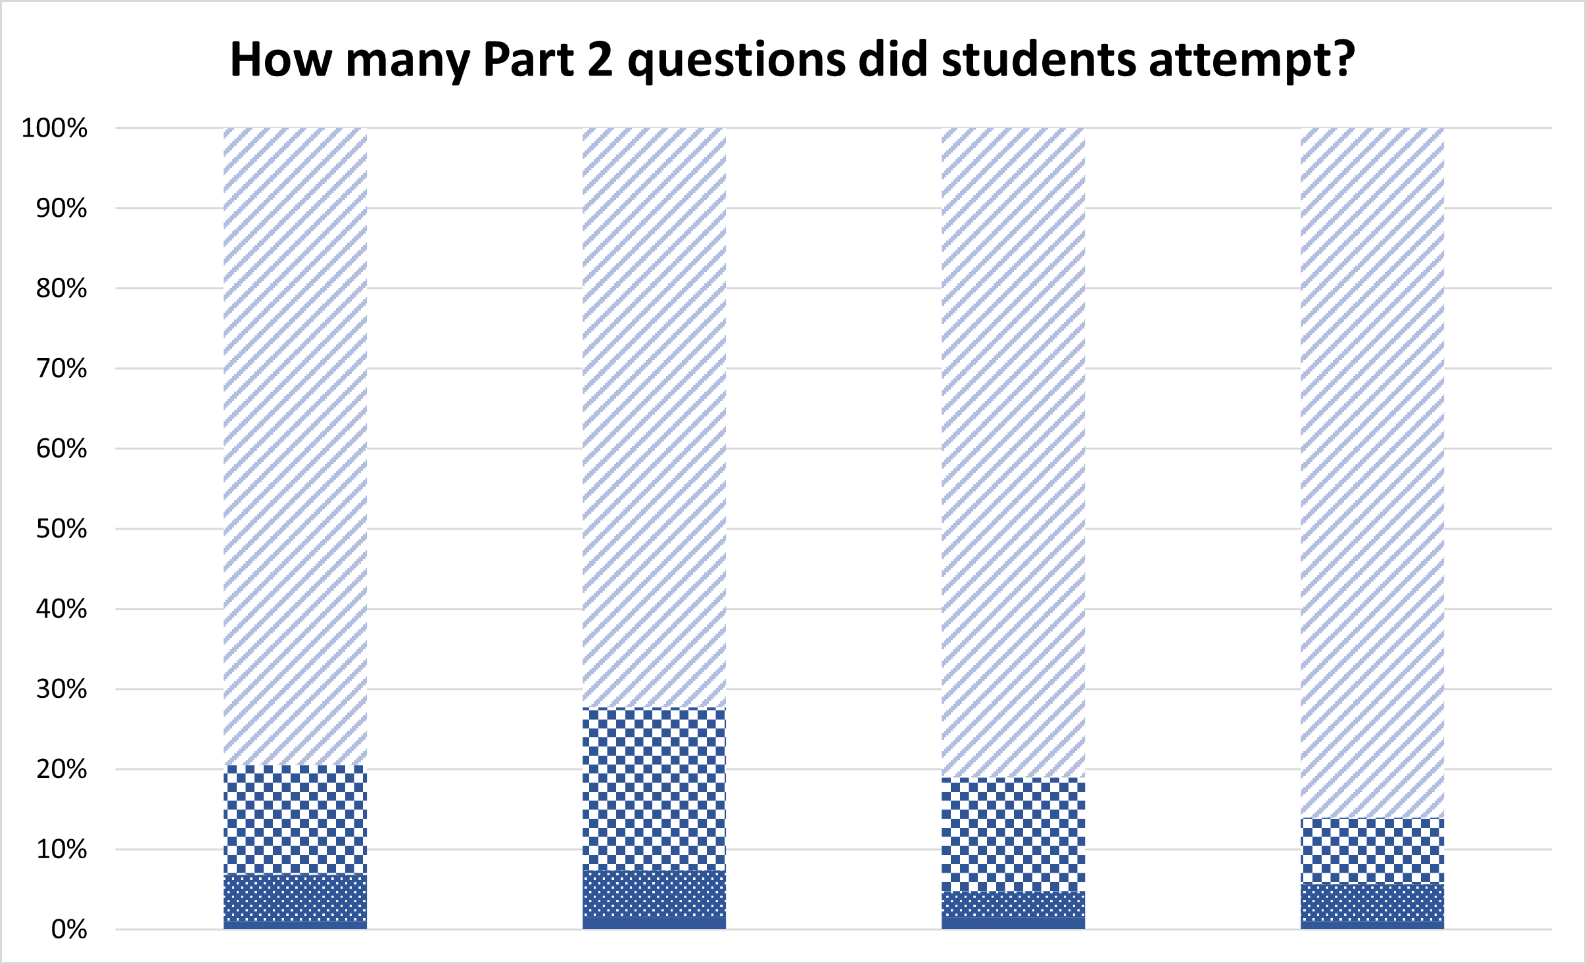

Slide 7
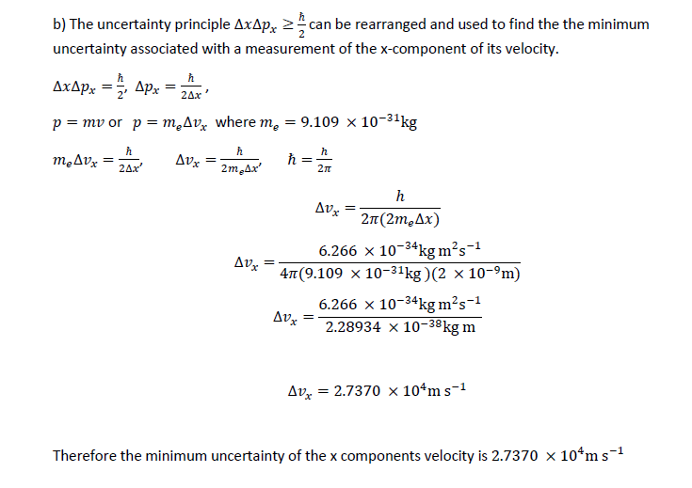
Format of scripts
2022
34 scripts (13.0%) were word-processed. 34.2% of these had attempted fewer than 3 Part 2 questions and the mean raw score was (52.2 ± 4.0)%.
c.f. 218 scripts (74.1%) were handwritten. 14.6% of these had attempted fewer than 3 Part 2 questions and the mean raw score was (67.2 ± 1.5)%.
2023 and 2024
For each of these exams, 8.4% of scripts were word-processed and about 75% were handwritten.
2025
What do you think happened? What percentage of scripts were word-processed?

Slide 8
Format of scripts
2022
34 scripts (13.0%) were word-processed. 34.2% of these had attempted fewer than 3 Part 2 questions and the mean raw score was (52.2 ± 4.0)%.
c.f. 218 scripts (74.1%) were handwritten. 14.6% of these had attempted fewer than 3 Part 2 questions and the mean raw score was (67.2 ± 1.5)%.
2025
14 scripts (4.6%) were word-processed. 42.9% of these had attempted fewer than 3 Part 2 questions and the mean raw score was (65.7 ± 6.6)%.
c.f. 280 (92.4%) were handwritten. 13.2% of these had attempted fewer than 3 Part 2 questions and the mean raw score was (76.3 ± 1.1)%.

Slide 9
Pause
Lessons for the past and lessons for the future
How do the results presented so far reflect your experience?
Have you noticed incomplete scripts when marking exam papers?
Have you submitted an incomplete exam? Have you spent too long on perfecting the appearance of a piece of work and so run out of time?
What might we do to improve the situation?
Continue to add examples from your own experience as we talk about a few of the findings from our surveys and focus groups.

Slide 10


Student feedback from surveys and focus groups
Exam anxiety
Anxiety was caused by the exam per se, whether online or in person, but for some students this was compounded by
worry about IT issues
time pressures
But most students still prefer to sit an exam online rather than in person.
I found it very traumatic. I didn't even have time to read all the questions. The length of the paper stressed me and I just froze. In retrospect it would have made sense to use the extra hour and lose 10% of the marks but I was worried in case anything went wrong with the submission.

Slide 11
Student feedback from surveys and focus groups
Exam preparation
I used iCME2 as a dry run for the actual exam two days before the exam. I attempted to replicate the exact environment and timings that would apply for the real exam. I found the videos on iCME2 invaluable, particularly the discussion of the marking schedule. I had not always answered the questions using the method specified in the solutions so it was reassuring to watch the video discussing the marking schedule and realise alternative correct methods of working would be accepted.
BUT not all students had used the Practice iCMEs and when they had used them it was not always under timed conditions. Not all students had accessed the videos.

Slide 12


Student feedback from surveys and focus groups
Barriers to exam preparation
I get too nervous in exam situations [so didn’t attempt the Practice iCME]
I went relatively slowly through the papers as rushing would probably have panicked me about my overall pace.
…we were only given 2 weeks for revision, which was nowhere near enough. I felt VERY underprepared, which was extremely stressful.
I didn't know about the videos.

Slide 13
Student feedback from surveys and focus groups
“Unintended consequences”
I couldn’t access the Practice iCME.

Slide 14
Student feedback from surveys and focus groups
“Unintended consequences”
Access to Practice iCMEs is restricted prior to the start of the real exam, to avoid confusion.
Access had been restricted a day too soon.
I couldn’t access the Practice iCME.
We wanted to ensure that students practised using the iCME submission interface, so in the 23J presentation, we required evidence of submission of the Practice iCMA in TMA06
What did students submit?:
I didn’t submit TMA06 – 2 responses
I submitted a different file or a blank piece of paper – 8 responses
I submitted a file with my answers to one or two of the Practice iCME questions – 4 responses
I submitted a serious attempt at the Practice iCMA – 1 response

Slide 15
Student feedback from surveys and focus groups
“One size doesn’t fit all”
For the record, I seriously question the value of i) time restrictions associated with exams; and ii) choosing from a selection of questions, which to answer since it is often difficult to know in advance what you will/will not master.
The exam itself is mainly a maths test against the clock and that is no doubt the right approach, but it did not suit me.
Seemed like a well-balanced exam. Enough easy questions to pass, some tricky ones to separate the rest.
I found it quite fun in all honesty.

Slide 16
How do the results reflect your experience? What might we do to improve the situation?
sally.jordan@open.ac.uk

