Slide 1
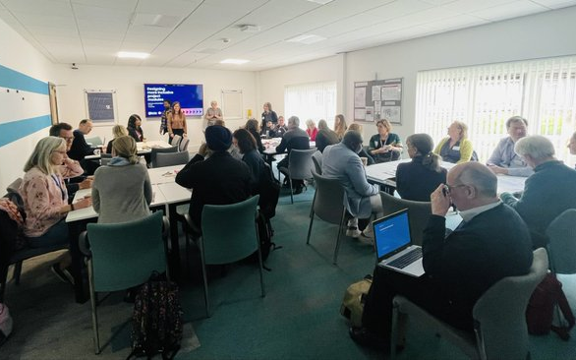
Intro Slide Title 1
Getting started with scholarship
Sue Pawley and Daphne Chang
Monday 25th November 2024, 14.30-16.00
esteem@open.ac.uk www.open.ac.uk/esteem
Please note: This session will be recorded
Activity: While we’re waiting to start, please introduce yourself on the padlet - https://padlet.com/esteem/gettingstartedwithscholarship

Slide 2
Session overview
Welcome and introductions
Definitions of Scholarship of Teaching and Learning (SoTL)
Designing a SoTL inquiry
Thinking about projects
Further info – SoTL in STEM BOC, websites and journals

Slide 3

Slide Title 9
eSTEeM people
School Scholarship Leads
Management Team
  Director: Sue Pawley
  Deputy Director: Daphne Chang
  Senior Manager: Diane Ford
  Support Assistant: Rachel Redford
  Project Officer: Jonathan Evans
C&C: Soraya Kouadri Mostéfaoui
EEES: Fiona Aiken
E&I: Anne-Marie Gallen
KMi: Trevor Collins
LHCS: Sarah Daniell
M&S: Cathy Smith
SPS: Jonathan Nylk

Slide 4

SoTL in STEM BOC
www.open.ac.uk/scholarship-of-teaching-and-learning-in-STEM

Slide 5
Slide Title 9
Activity 1: Aims of Scholarship of Teaching
and Learning (SoTL)
What does Scholarship of Teaching and Learning (SoTL) aim to achieve?

Slide 6
Slide Title 9
Characteristics of SoTL
Scholarship (of Teaching and Learning)
  is focused on improving and supporting learning through teaching practices
  includes reflection on our teaching and the learning of our students, … and the implementation of improvements
  requires knowledge of the discipline-specific area that is being taught, and about learning and teaching
  involves dissemination of teaching practices for public/peer scrutiny
Scholarship at the OU
  Scholarship is a term used to cover activities that lead to evidence-informed development of our learning and teaching
Other terms associated with scholarship
  Action Research
  Educational Inquiry
  Pedagogic Research

Slide 7
Slide Title 9
Defining SoTL
Useful definition of Scholarship of Teaching and Learning (SoTL)
  “systematic and ethically reasoned investigation of aspects of teaching and student learning by applying disciplinary knowledge, resulting in reflections and outcomes that are publicly shared for peer-review and for others to build upon” (SoTL BOC – Minocha and Butler, 2021)
SoTL is important in three ways
  For students: allowing us to evaluate our teaching to improve the quality of student learning
  For academic disciplines and institutions: ensuring we base future development on robust evidence enabling our teaching and learning to be recognised externally for its excellence and impact
  For practitioners: allowing staff to develop their professional practice in the field of teaching and learning

Slide 8
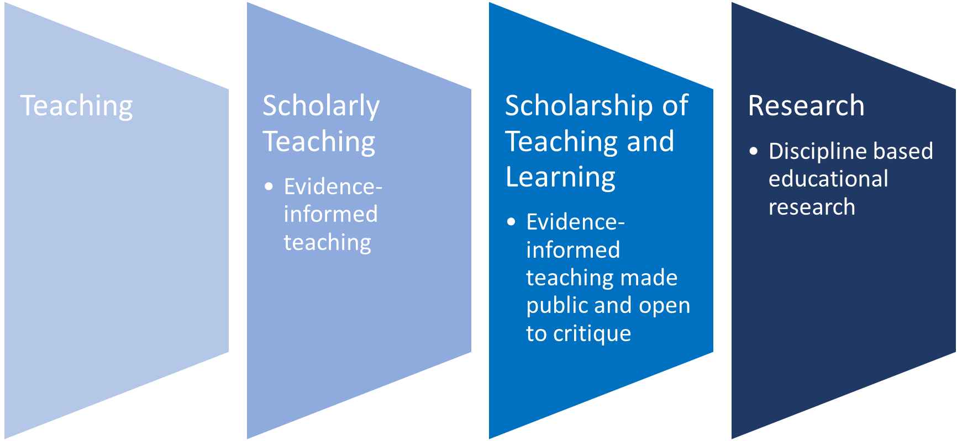
From scholarly teaching to SoTL

Slide 9
Slide Title 9
Activity 2: SoTL and you
Why are you interested in the Scholarship of Teaching and Learning?

Slide 10
What is SoTL for?
What SoTL can do
  Offers space to understand issues around teaching and learning
  Provide evidence to identify and address issues in module design and delivery
  Provide a basis for determining whether an intervention or change in practice is successful
What SoTL can’t do
  Provide a silver bullet to overcome issues of retention and attainment
  Provide absolute evidence of cause and effect

Slide 11
Slide Title 9
Initial considerations
What are the intended outcomes of the project?
  To inform module development
  For dissemination amongst colleagues
  For external publication
How many people will be involved?
How much time do you have?
Notes:
Sue to take over

Slide 12
Slide Title 9
Designing a SoTL inquiry
Seven-criteria framework to guide design and evaluation of a SoTL inquiry
Clear goals
Adequate preparation
Appropriate methods
Significant results
Effective communication
Reflective critique
Going public
Minocha & Butler (2021)
https://www.open.edu/openlearn/mod/oucontent/view.php?id=109157&section=4
See also
Charles Glassick, Mary Taylor and Gene Maeroff (1997) Scholarship Assessed: Evaluation of the Professoriate. San Francisco: Jossey-Bass.

Slide 13
Slide Title 9
Goals and preparation
When thinking about a potential project…
What are the goals of your project?
What initiated your interest in this project?
What is already known about the topic
  From existing evidence
  From shared practice
  From the research literature

Slide 14
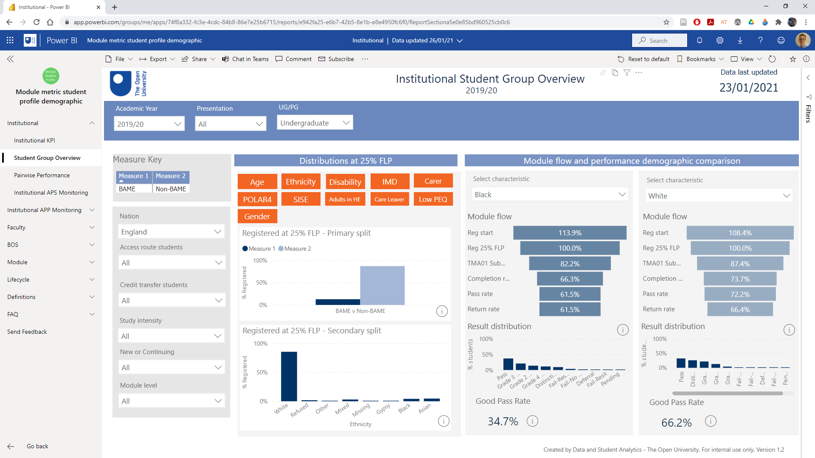
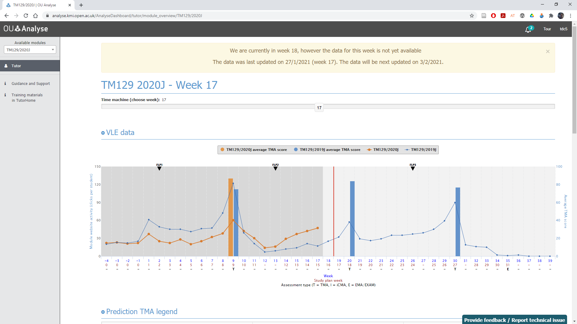
Slide Title 9
Finding Institutional Data
OU student data
  Data and Student Analytics (sharepoint.com)
Learning Analytics
  Analytics 4 Action
    A4A Home
  OU Analyse
    OU Analyse website
    OU Analyse Dashboard

Slide 15

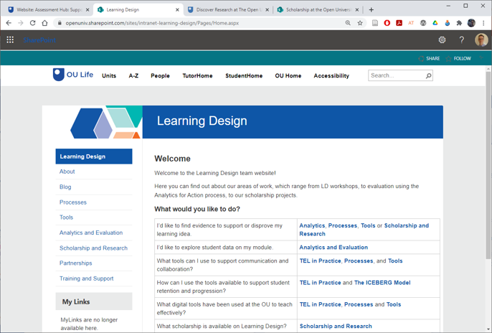
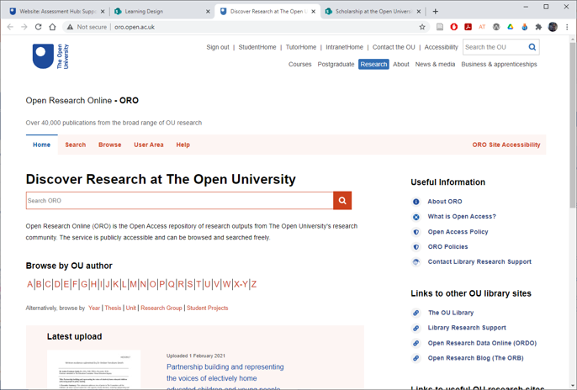
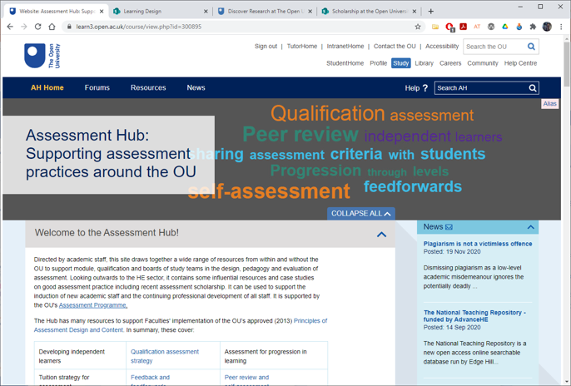
Slide Title 9
Finding OU Knowledge
OU Intranet – A to Z…
  Assessment Hub
  Learning Design
  Open Research Online
  Scholarship Exchange

Slide 16
Choosing appropriate methods
Questionnaires: Useful for getting snapshots in time, getting quantifiable data, identifying the situation before and after a change. Not so good for identifying feelings and attitudes.
Interviews/focus groups: Useful for gathering in-depth data, including feelings and attitudes. Can be used at any point in the research cycle. Generates a lot of data to analyse.
Observations (face to face and online): Useful for understanding what students actually do (rather than what they say they do in activities).

Slide 17
Choosing appropriate methods
Documentary evidence: Useful for identifying the current state of play and whether any changes have occurred after making changes (e.g., teaching and assessment materials, student assignments, policy documents).
Learning analytics: Provides data on student activity, can be used at any time in research cycle.
Research diaries by students: Useful for gathering data over time and gives some control to the student.
Research diaries by researcher: Useful for gathering data over time and provides a basis for analytical notes.

Slide 18
Examples of methodologies
Practical skills progression and employability in Life Sciences
(J Haresnape)
Innovation: practical skills development over two separate modules
Project aimed to investigate student perceptions
Methodology: survey
- conducted with students who had completed both modules
- survey included closed and open (free-text) responses
- closed questions – quantitative data
- free-text data – qualitative insights
Skills progression in practical science within the Life Sciences

Slide 19
Examples of methodologies
Exploring the extent of maths anxiety within the STEM Faculty at The Open University
(S Pawley and S Organ)
Investigation: The project sought to quantify and qualify Maths anxiety across the STEM Faculty
Project aimed to investigate the amount of anxiety felt by students on starting Level 1 STEM modules and the reasons behind the anxiety
Methodology: Mixed Methods
- Student survey across the introductory STEM curriculum to establish the extent of maths anxiety within the OU
- Survey contained only closed questions
- In-depth semi-structured interviews to further investigate specific issues and explore how these might be addressed and supported
Exploring the extent of maths anxiety within the STEM Faculty at The Open University

Slide 20
Significant results
Reality check on your design - is the work feasible, is it likely to achieve your aims?
Will it add to the field of inquiry?
Is it likely to open up further avenues of investigation?

Slide 21
Effective communication
In many STEM disciplines, dissemination of research focuses on the final output.
Dissemination of SoTL work can (and should) involve:
- More emphasis on discussion of “work in progress”
- Active identification of dissemination opportunities

Slide 22
Dissemination and reflective critique
OU events
  School or faculty seminars
  eSTEeM conference talks and workshops
External events
  Horizons in STEM Conference (June)
  Advance HE Conference (July)
Publications
Personal/professional development

Slide 23
Example Teaching and Learning Journals
Assessment and Evaluation in Higher Education
Distance Education
Higher Education Quarterly
Innovations in Education and Teaching International
International Journal for the Scholarship of Teaching and Learning
International Journal of Teaching and Learning in Higher Education
Journal of Further and Higher Education
Open Learning: The Journal of Open, Distance and e-Learning
Practice and Evidence of Scholarship of Teaching and Learning in Higher Education
Studies in Higher Education
Teaching in Higher Education
Also… Subject teaching and learning journals

Slide 24
Practical considerations and approvals
Ethics
  The OU’s Human Research Ethics Committee website has an ethics checklist and guidance (see HREC website)
Access to Students
  The Student Research Project Panel oversees the involvement of students in research (e.g. max 4 times per year) see SRPP website for application form and guidance
Data Protection
  Freedom of Information and GDPR compliance – Information Governance Liaison Officers (IGLOs) record OU datasets in the Information Asset Register (IAR)
Staff Survey Project Panel
  Approval required for surveys with more than 30 staff (see SSPP website for guidelines and application form)

Slide 25
Activity 3: Knowledge and skills gaps
Needs analysis
  What knowledge and skills do you already have in relation to
    Planning your scholarship project
    Identifying and reviewing the literature
    Selecting appropriate methods
  What skills do you need to acquire or develop?
  Can you work with others who have relevant knowledge and skills?

Slide 26

eSTEeM Community Support
Professional development sessions
Badged Open Course: SoTL in STEM
STEMinar Series
eSTEeM Annual Conference
SoTL speed dating
eSTEeM - Centre for Scholarship and Innovation in STEM

Slide 27
Further information – SoTL in STEM BOC
www.open.ac.uk/scholarship-of-teaching-and-learning-in-STEM

Slide 28
Session overview
Welcome and introductions
Definitions of Scholarship of Teaching and Learning (SoTL)
Designing a SoTL inquiry
Thinking about projects
Further info – SoTL in STEM BOC, websites and journals

Slide 29
External websites on SoTL
Getting Started in Pedagogic Research within the STEM Disciplines
  https://www.heacademy.ac.uk/system/
  files/pedagogic_research_guide_final_
  version_0.pdf
University of Edinburgh SoTL
  https://www.ed.ac.uk/institute-academic-development/learning-teaching/staff/sotl
Heriot Watt University Learning and Teaching Academy SoTL guides
  https://lta.hw.ac.uk/resources/scholarship-of-teaching-and-learning/
Plymouth University Pedagogic Research
  https://www.plymouth.ac.uk/research/
  pedagogic-research
University of York SoTL Network
  https://www.york.ac.uk/staff/teaching/
  develop/sotl-network
University of Central Florida SoTL and Discipline Based Educational Research
  https://fctl.ucf.edu/sotl-and-dber/
Vanderbilt University Guide to SoTL
  https://my.vanderbilt.edu/sotl/

Slide 30
Slide Title 30
Thank you for attending

Slide 31
Slide Title 31

