Slide 1
Intro Slide Title 1
Quantitative analysis for scholarship projects
Carol Calvert
eSTEeM Community Event
19th November 2024, 10.30-12.00
Please note: this session will be recorded

Slide 2

Slide Title 9
Quick poll
I have a specific scholarship project in hand/in planning
Yes
No
Maybe

Slide 3





Slide Title 9
Aims
Analysis plan
Collecting data
Hypotheses to test
Ideas of association
Key variables
Describing what is
Modelling what might be
Accessing existing
Collecting new
Presenting findings
Audience
Graphical/tabular
Style
Chatbox: what do you see in the right-hand picture?
Images: Stock Imagine Library and Copilot, 23rd Sept 2024

Slide 4

Slide Title 9
No different to qualitative analysis in many ways – just more data to summarise and extract the parts of the story it can tell you about.
The more existing preliminary / approx. data you can get the better
Decisions about the analysis you want at this stage will help you decide what to collect later including time/cost/ethics
Example
Aim: Improve TMA feedback to students.
Analysis Plan: Comparison of what students say in a survey - limited to some descriptive statistics and quotes from students in “free text elements”. Context is who does not pick up.
Data collection: student surveys needing SRPP/ethics approval AND analysis of existing data.
But concentration here is on
Presenting findings – you, yourself and broader audience.

Slide 5
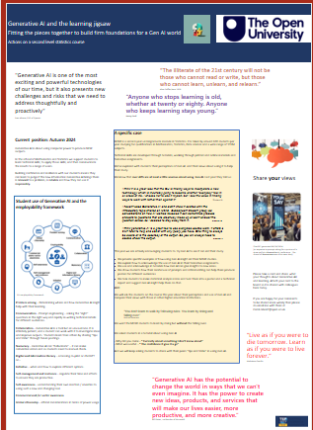
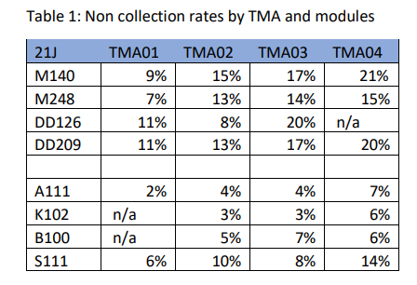
Slide Title 9
Step 1: For your purposes: Numerical or visual
Step 2: What you present
Numerical
Tables: Numbers or percentages
Averages: mean/median or mode
Spread of data: standard deviation or interquartile range
Over 40% of M248 students are at least a little anxious about using Gen AI
You are trying to
Be Fair
Be Concise/summarise
Appropriate for audience/some audiences have certain favoured styles

Slide 6
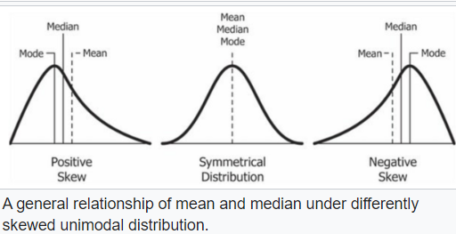
Slide Title 9
Average: Mean, Median, Modes
Pay of five workers is £10,000, £15,000, £15,000, £15,000 and £200,000
Median - middle when arranged in order = £15,000
Mode - Most often occurring = £15,000
Mean = £51,000
It is misleading to quote the mean AND it is telling you your data is skew
It matters to your analysis as many test assume you have “Normal” distribution. If it is skew, you may need to transform it before doing your analysis
You are trying to
Be Fair
Be Concise/summarise
Appropriate for audience/some audiences have certain favoured styles

Slide 7
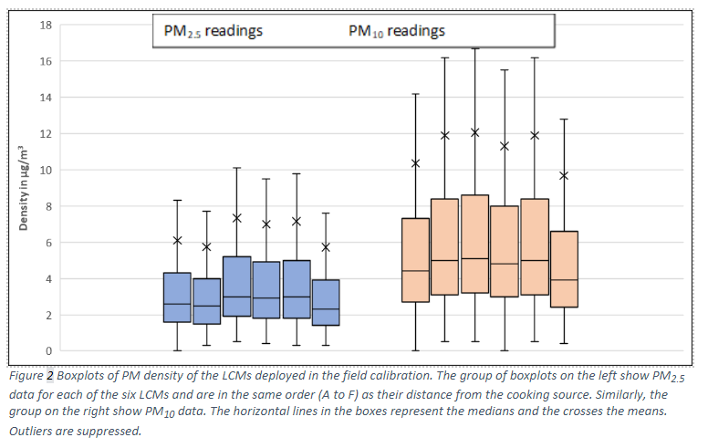
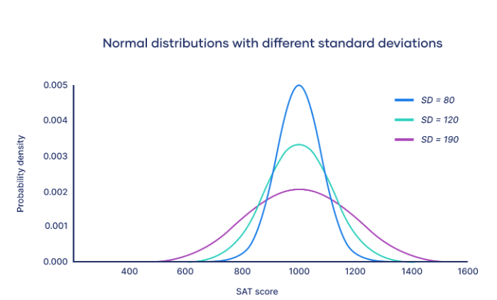
Slide Title 9
Spread of data
standard deviation Calculated using all your data
Interquartile range : the Middle 50%
Different areas traditionally use different statistics
e.g. Medical statistics – Odds ratios
So, need to consider any “standard” in your area

Slide 8
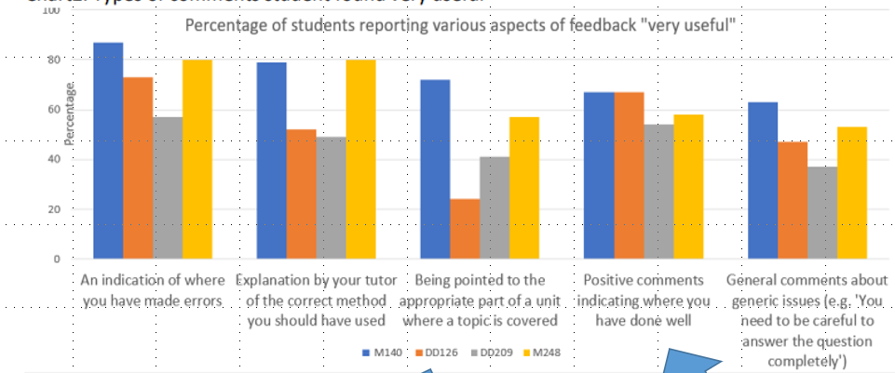
Slide Title 9
Visual
Bar charts / histograms
Box plots
Pie charts
Scatterplots
Line charts
Heatmaps
Other standard in other areas

Slide 9
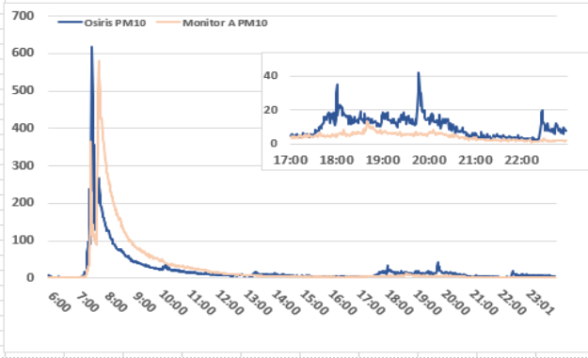
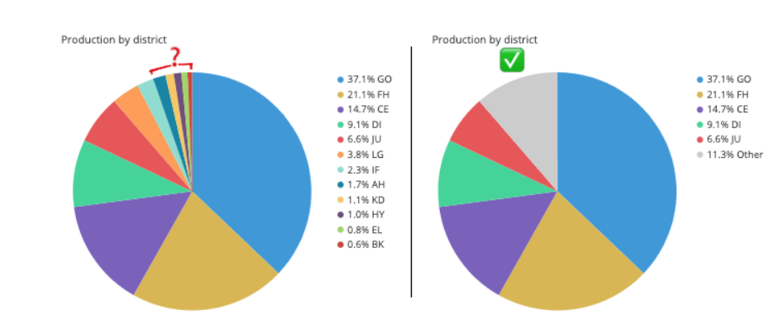
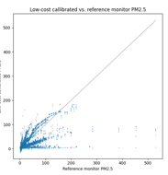
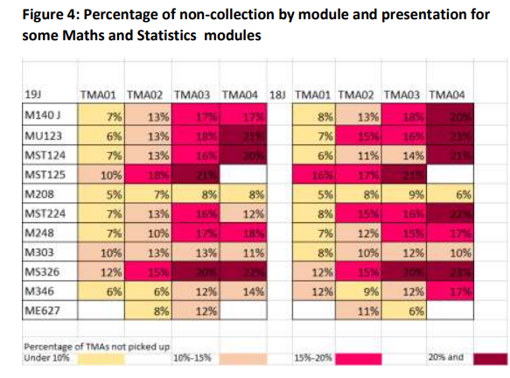
Slide Title 9
Regression and Modelling and association

Slide 10
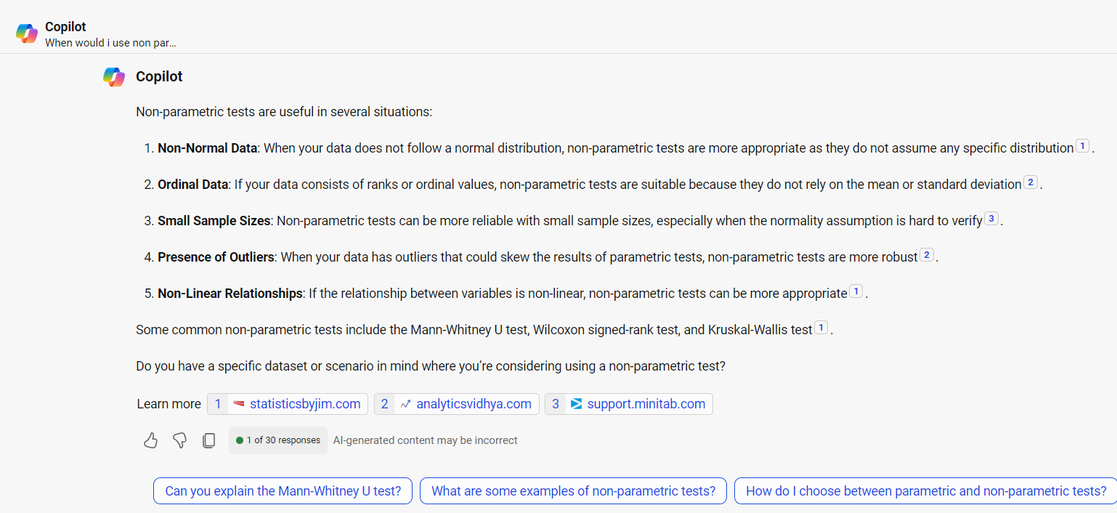
Slide Title 9
Parametric and non parametric tests
Copilot 15/10/2024 in response to “When would I use non parametric tests”

Slide 11
Slide Title 9
Quick poll
Have you heard of any of these three terms?
t test; z test; anova
Mann Witney; wilcoxen; chi squared
correlation

Slide 12
Slide Title 9
Regression and modelling?????

Slide 13
Slide Title 30
Thank you

Slide 14
Slide Title 31

