Slide 1

Intro Slide Title 1
Responsible scholarship and gaining approvals for your project
Sue Pawley with Information Rights, HREC, SRPP and SSPP
Thursday 11th July 2024, 11.30-13.00
esteem@open.ac.uk www.open.ac.uk/esteem
Please note: This session will be recorded

Slide 2
Session Plan
Today’s session will cover…
Welcome and introductions
OU’s commitment to standards
Project workflow
Data management
Approval processes
Questions and next steps

Slide 3
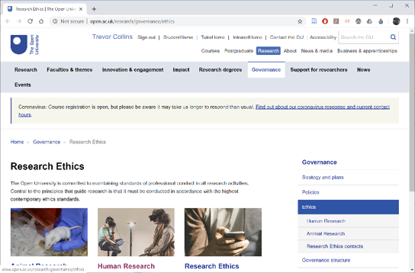
Slide Title 26
OU commitment
“The Open University is committed to maintaining standards of professional conduct in all research activities. Central to the principles that guide research is that it must be conducted in accordance with the highest contemporary ethics standards.”
ACTIVITY
Why is an ethical approach important?
What sort of research for scholarship could be unethical?
http://www.open.ac.uk/research/governance/ethics

Slide 4
Slide Title 26
OU commitment
“The Open University is committed to maintaining standards of professional conduct in all research activities. Central to the principles that guide research is that it must be conducted in accordance with the highest contemporary ethics standards.”
…and is a requirement from funders, publishers, and insurers
http://www.open.ac.uk/research/governance/ethics

Slide 5

Slide Title 26
Contemporary ethics standards
British Psychological Society (BPS)
BPS Code of Human Research Ethics | BPS - British Psychological Society
British Psychological Society gives four ethical principles:
  Respect for the autonomy, privacy and dignity of individuals, groups and communities
  Scientific integrity
  Social responsibility
  Maximising benefit and minimising harm
https://www.bps.org.uk/news-and-policy/
ethics-guidelines-internet-mediated-research

Slide 6

Slide Title 26
Further considerations (BPS)
Valid consent: “Researchers should ensure that every person from whom data are gathered for the purposes of research consents freely and voluntarily to participation, having been given sufficient information to enable then to make an informed choice. …” (BPS 2021, page 12)
Risk: “Risk can be defined as the potential physical or psychological harm, discomfort or stress to human participants that a research project may generate. …” (BPS 2021, page 10)
Confidentiality: “Subject to the requirements of legislation, including the Data Protection Act (2018), information obtained from and about a participant during an investigation is confidential unless otherwise agreed in advance.” (BPS 2021, page 21)
Research with individuals in a dependent or unequal relationship: “Researchers should be particularly diligent in establishing the valid consent of any person who is in a dependent or unequal relationship to them (e.g. student or client) because of the increased risk of consent being given under perceived coercion or obligation.” (BPS 2021, page 24)

Slide 7
Slide Title 26
Project workflow
Research design
Data management planning
Approvals
  Data Protection (GDPR)
  Human Research Ethics Committee (HREC)
  Student Research Project Panel (SRPP)
  Staff Survey Project Panel (SSPP)
Data collection
Data storage
Data deletion/anonymisation/archiving

Slide 8

Slide Title 26
Research design
Work out what you are going to do before seeking approval to do it
  What has been done before in your area that you can build on?
  What new data do you need to collect for your study?
  How will you go about collecting, analysing and presenting the data?
  How will you manage participants’ anonymity/identity?

Slide 9
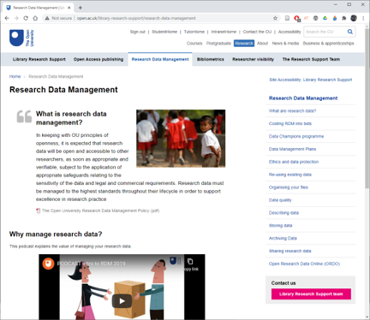
Slide Title 26
Data management planning
Think through what data you need to collect and how you will look after it
  What data do you need to collect?
  Do you have to store any personal data?
  How will you store the data securely?
  Would the data be of use to anyone else?
  When will the data no longer be needed?
More info
  OU Research Data Management Policy
  Library Research Data Management pages
  Data storage for OU research projects comparison table PDF | Word
Notes:
Library pages – recommend RDM Handbook

Slide 10
Slide Title 26
Approval processes
Approvals for…
  Data protection: General Data Protection Regulations (GDPR)
  Ethical research: Human Research Ethics Committee (HREC)
  Access to OU students: Student Research Project Panel (SRPP)
  Access to OU staff: Staff Survey Project Panel (SSPP)
Keep a record of your approvals and include in eSTEeM final report
  Data protection registration number
  HREC reference number
  SRPP application number
Recommendation
  Use the HREC templates (consent form, information sheet and invitation email)

Slide 11
Information Rights
Steven Bond, Information Rights Manager

Slide 12
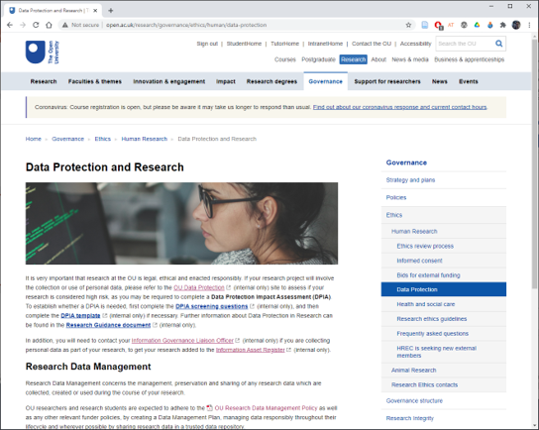
Slide Title 26
Data protection
Legal frameworks
  Freedom of Information Act 2000
  Data Protection Act 2018
  General Data Protection Regulations (GDPR)
http://www.open.ac.uk/research/governance/ethics/human/data-protection

Slide 13
Slide Title 26
Data protection
Data Protection by Design (sharepoint.com)
Complete a Data Protection Questionnaire​
  Do this as early as possible when considering your changes - you can answer "don't know yet" to questions, which will prompt that you need to clarify the answers before you start your new processing
  Send all questionnaires to data-protection@open.ac.uk, either when they are completed, or as soon as you have had an initial attempt at completing them. Please also request a discussion if you'd find that helpful.
  If your questionnaire indicates that it requires an impact and risk assessment by the information rights team, then don't start your processing until this has been completed
  The Questionnaire is an iterative process, and can be refined as you find out answers, and updated if your project or scope changes
  When you have made decisions about how your data is going to be processed, complete or update an Information Asset Register entry

Slide 14

Don’t
Do
Use Cloud storage eg OneDrive, Sharepoint & teams
Don’t confuse your role if you are a member of staff and also a student
Ask for the recipient to confirm their personal data, especially special category data (ethnicity/health
You might have access to data as a member of staff that you wouldn’t have as a student, and vice versa
Tell the participants what you will do with their data, including any extra data being used to match
Don’t make contact with students without approval
Don’t make contact with students using your internal or personal email
Use an approved delivery method – Jisc, Qualtrics*, MS Forms
Consider principle of necessity – only process what you actually need to achieve your outcome

Slide 15
Slide Title 2
Gaining support from the HREC
HREC = Human Research Ethics Committee

Slide 16
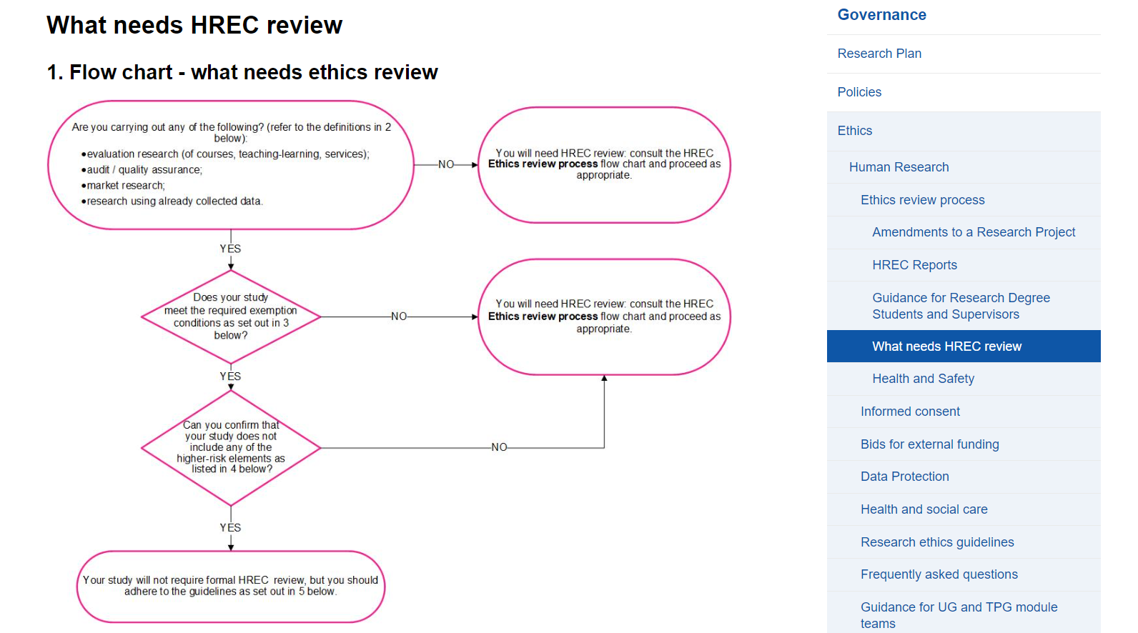
What needs HREC review? page
Human Research EthicsWhat needs HREC review | The Open University

Slide 17
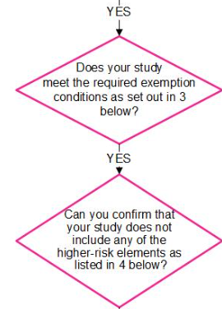
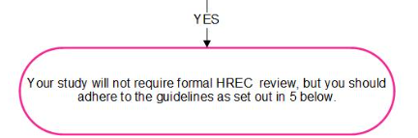
Slide Title 11
Projects which might not need HREC review
Evaluation research (including course evaluation, teaching-learning evaluation, service evaluation)
Evaluation research sets out to systematically assess the efficacy, effects or effectiveness of a particular service, procedure or policy. It is generally focused on generating knowledge about the specific service that can feed into improving that service. It often involves the analysis of existing data, or data gathered from user feedback surveys, interviews or focus groups.
Audit/quality assurance
Enquiry designed in order to assess the level of service being provided against a set standard (i.e. “does this service reach a predetermined standard?”).
Market research
Systematic enquiry designed to gather feedback from consumers in order to assess and guide decisions about services or products being offered.
Research using already collected data

Slide 18
Conditions for studies exempt from HREC review
  a) the study does not involve either vulnerable* or dependent groups
  b) no personally sensitive or confidential data are being collected
  c) topics covered are not likely to be upsetting or cause distress
  d) any personal data collected must be essential for the evaluation/review, and will be kept secure, confidential, and only processed/shared in anonymised form
  e) proper informed consent and data protection procedures must be employed that are GDPR compliant and conform to HREC guidelines (see SRPP student survey consent template, HREC Participant Information sheet and Consent form templates)
If conducting interviews or focus groups, all the above conditions a) - e) must apply, and in addition,
  f) any audio recordings of discussions must only occur after gaining explicit consent from all participants, and the recordings must be kept secure, confidential, and be transcribed/anonymised as soon as possible and the original recordings then destroyed
  g) the topics discussed must relate only to opinions and experiences relating to existing teaching-learning practices, or subjects deemed to be within participants' professional competence
  h) all participants involved in a focus group must agree to keep all information shared within the group confidential
If using existing data/data sets, the following conditions must be met,
  i) the data must only be processed and shared in accordance with the original permissions/informed consent agreements
  j) permission from the data controller for the required usage must have been obtained (and evidence of this must be able to be provided upon request)

Slide 19
Slide Title 11
Exempt projects that do NOT require HREC review still need to do the following:
Obtain Student Research Project Panel (internal link only) approval if using Open University students (unless the activity is exempt)
Obtain Staff Survey Project Panel (internal link only) approval if surveying more than 30 Open University staff
Register the activity with Data Protection (Internal link only) and comply with their guidelines for data processing
Use HREC-required compliant consent procedures (see HREC Participant Information sheet and Consent form templates

Slide 20
Slide Title 5
For HREC applications – where to apply?

Slide 21
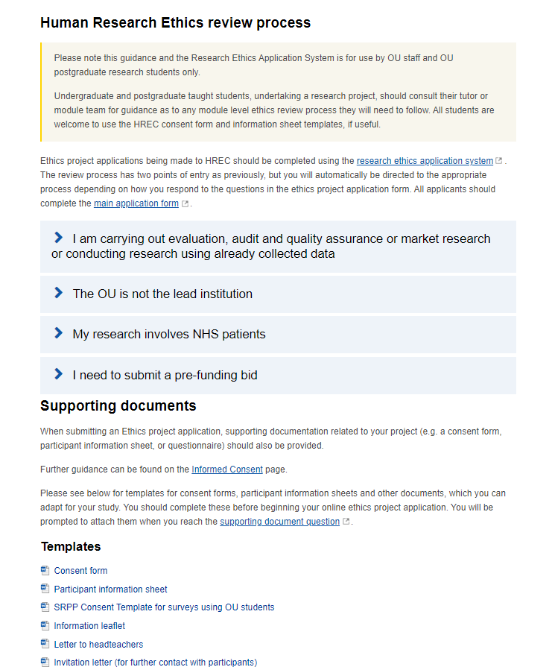
The Human Research Ethics Review process (now an online form)
Human Research Ethics Review Process | The Open University

Slide 22
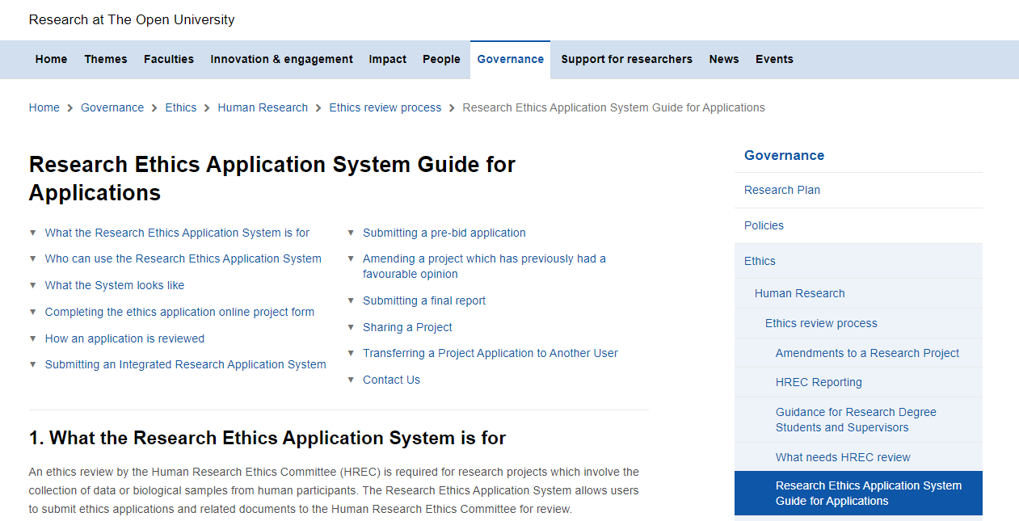
The HREC application form guidance
Research Ethics Application System Guide for Applications | The Open University

Slide 23
Slide Title 11
Anticipate growth of a project
For scholarship research…factors to consider
HREC is able to review broader research projects that have developed out of what was initially a local evaluation research project (see Definitions). For example, this may apply to Scholarship of Teaching and Learning (SoTL) projects.
HREC will look favourably upon the use of the initial evaluation data in a subsequent broader research project as long as appropriate consents have been gained from participants for this future usage.
Project teams are urged to plan carefully and gain appropriate consents where they anticipate such potential future developments emerging from an earlier evaluation research project.
HREC will require evidence of these consents and request that they be gained retrospectively where consent has not been gained already.
Research participants should normally be assured, when consenting, that any potential future use of their responses will be in an entirely anonymised form.
However, as part of the University’s movement to embracing students as partners, particularly in the case of collaborative or participatory research (where students are considered co-researchers) a case for acknowledging students by name might be made.
Planning ahead
Gaining consents at the outset
Anonymisation v Acknowledgement?

Slide 24
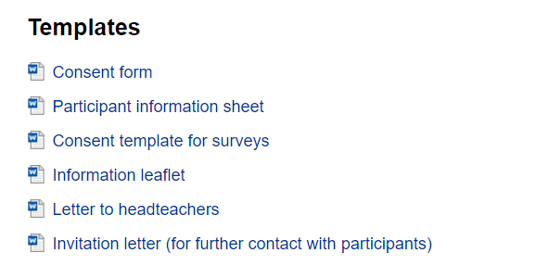
Templates for participant-facing documents are available Human Research Ethics Review Process | The Open University

Slide 25
Slide Title 2
Introducing SRPP
SRPP = Student Research Project Panel

Slide 26
Slide Title 11
SRPP - Who are we, and why are we here?
Our purpose, contribution and expertise
How we add value to research - The Student Research Project Panel (SRPP) was established to ensure that all research involving Students, Open University enquirers and alumni is of benefit to them and the institution and meets all relevant university guidelines.
Range of knowledge and expertise – our panel's Working Group is comprised of 45 cross university research experts representing each of the faculties as well as a range of other university offices (Academic Services, Marketing, the Library, etc.)
How have researchers benefitted from our feedback? Our panel's constructive feedback and recommendations routinely receive top marks in our applicant feedback questionnaire. These comments from our applicants are representative of their feedback to us:
  "Extremely helpful and supportive"
  "Positive experience"
  "Very useful"

Slide 27
Slide Title 11
SRPP Application
Deadline every two weeks, decisions returned within two weeks of the submission deadline
What you will need:
Completed Research Proposal Document (obtained via SRPP SharePoint site – find us in the A-Z)
A copy of your research instrument -draft survey or outline of your focus group / interview plans
Text of any planned student correspondence – invitations, reminders, participant information sheet, etc.
Consent language – usually incorporated into survey introductions or the participant information sheet
What you will receive upon approval:
Detailed feedback from our panel with recommended changes if appropriate
Access to a representative sample of students (if you have requested one) or an availability check of students if you have identified them

Slide 28
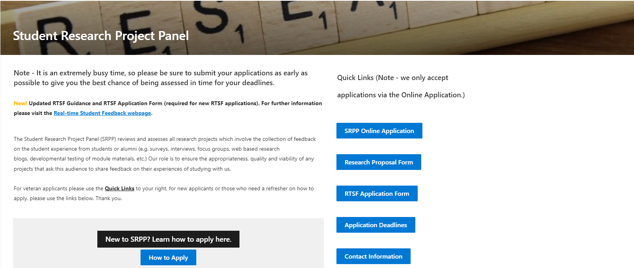
The Student Research Project Panel website
SRPP | The Open University

Slide 29
Think through from a participants’ perspective as to what their concerns and interests are likely to be and how you can minimise risks and maximise benefits
Top tips
Contact relevant teams with specific queries before submitting full applications
If you are collecting personal information, audio or video recordings remember to include it in your information asset register entry
Think through what data you will be collecting, including consent forms, and how you will store, when you will destroy, whether and how this can be withdrawn in a research data management plan
Start early - expect feedback from and dialogue with SRPP, SSPP or HREC and build this into the timeline for your project
If you are just getting started with your research design and planning, visit the Researcher's Journey Landing page for more help and guidance on the approval processes.

Slide 30
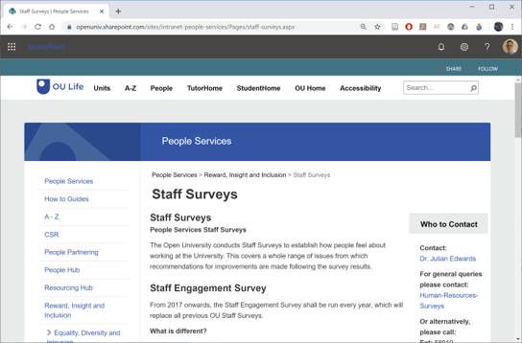
Slide Title 26
SSPP: Staff Survey Project Panel
https://openuniv.sharepoint.com/sites/intranet-people-services/Pages/staff-surveys.aspx
Email: Julian.Edwards@open.ac.uk
Who needs to apply?
  “Small-scale surveys that require less than 30 responses from staff do not need approval from the SSPP” (SSPP guidelines)
  For example: Surveying 30 or more associate lecturers
Notes:
https://openuniv.sharepoint.com/sites/intranet-people-services/Pages/staff-surveys.aspx

Slide 31
Slide Title 4
Other places for support?

Slide 32

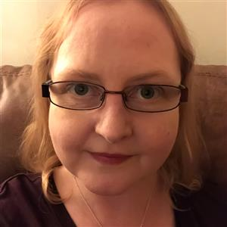




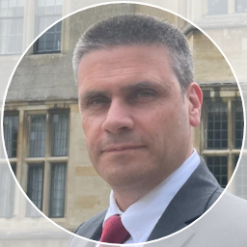





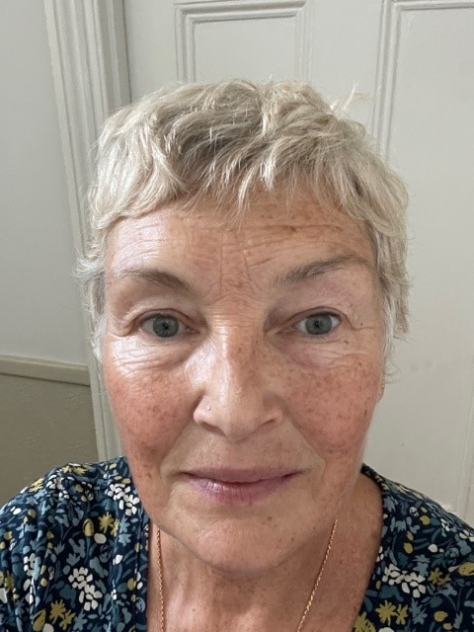
Research Approval Advice Drop-in
Meet the team members and colleagues here to assist you in gaining the needed approvals for your research. Our aim is to have representation from each team at every drop-in to support you, based upon our availability.
Student Research Project Panel (SRPP) srpp@open.ac.uk | Human Ethics (HREC) Research-REC-review@open.ac.uk | Information Rights Data-protection@open.ac.uk | Library Research Support Library-research-support@open.ac.uk | Learning Design / Real-time Student Feedback (RTSF)
Steph Lay, Senior Manager, Student Research | Alison Fox, Chair, Human Research Ethics Committee (HREC) | Steven Bond, Senior Information Rights Manager | Nicola Dowson, Senior Library Manager (Research Support), Library Services | Clare Hill, Learning Designer
Bart Gamber, Manager, Student Research | Claire Hewson, Deputy Chair, HREC | Matthew Robbins, Head of Information Rights | Isabel Chadwick, Research Support Librarian, Library Services | Rafael Hidalgo, Senior Learning Designer
Emma Street, Research and Evaluation Co-Ordinator | Kieron Sheehy, Deputy Chair, HREC | Sam Mansfield Senior Manager, Information Rights | Maxine Borton, Research Support Officer, Library Services
Kim White, Research and Evaluation Co-Ordinator | Alison Higgs, Deputy Chair, HREC
Researcher's Journey Landing Page | Nicola Payne, Manager, Research Governance (Ethics) | Information-Security@open.ac.uk for non-standard research tools.

Slide 33
Slide Title 30
Any questions?

Slide 34
Slide Title 30
Thank you for attending

Slide 35
Slide Title 31

