Slide 1
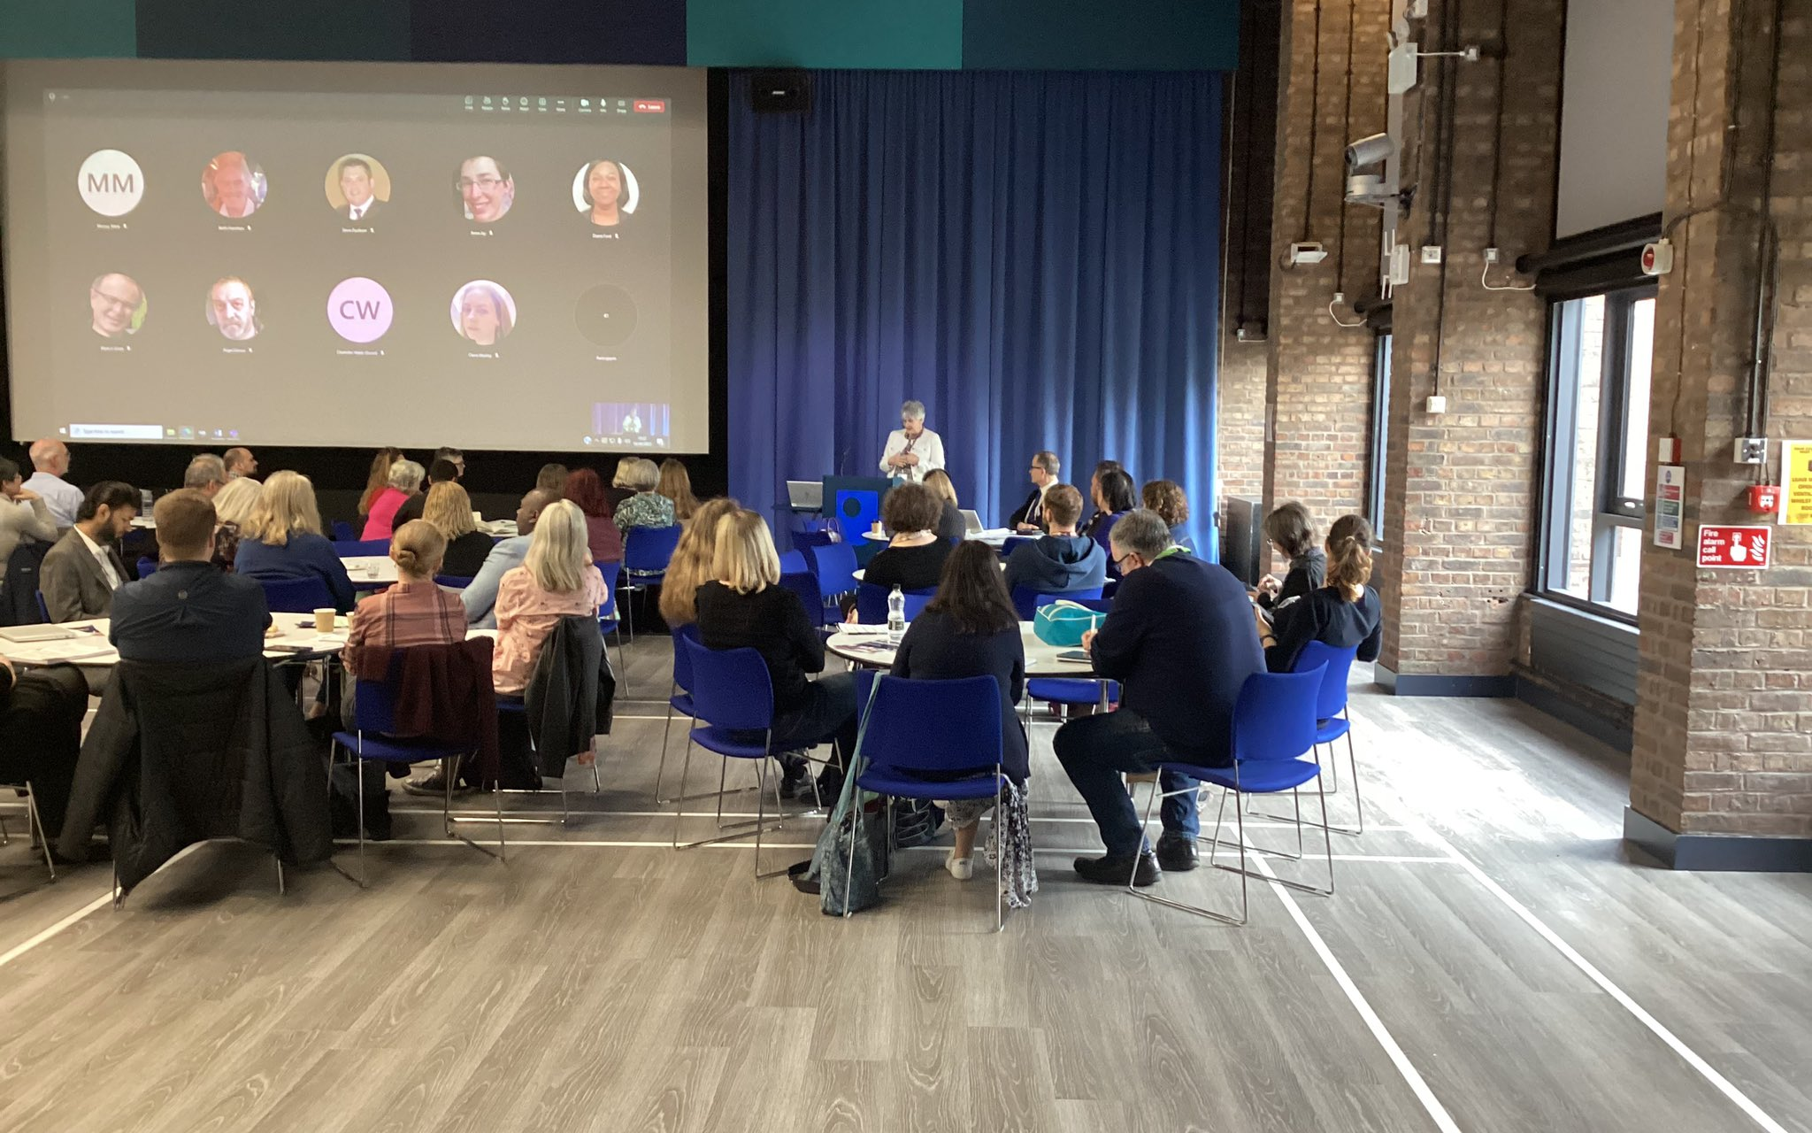

Intro Slide Title 1
eSTEeM Pre-bidding Workshop
Sue Pawley and Daphne Chang
eSTEeM Directors
Tuesday 6th February 2024, 14.00-15.30
esteem@open.ac.uk www.open.ac.uk/esteem
Call for projects January 2024
Please note: This session will be recorded
Notes:
Daphne 1-6 10 mins

Slide 2
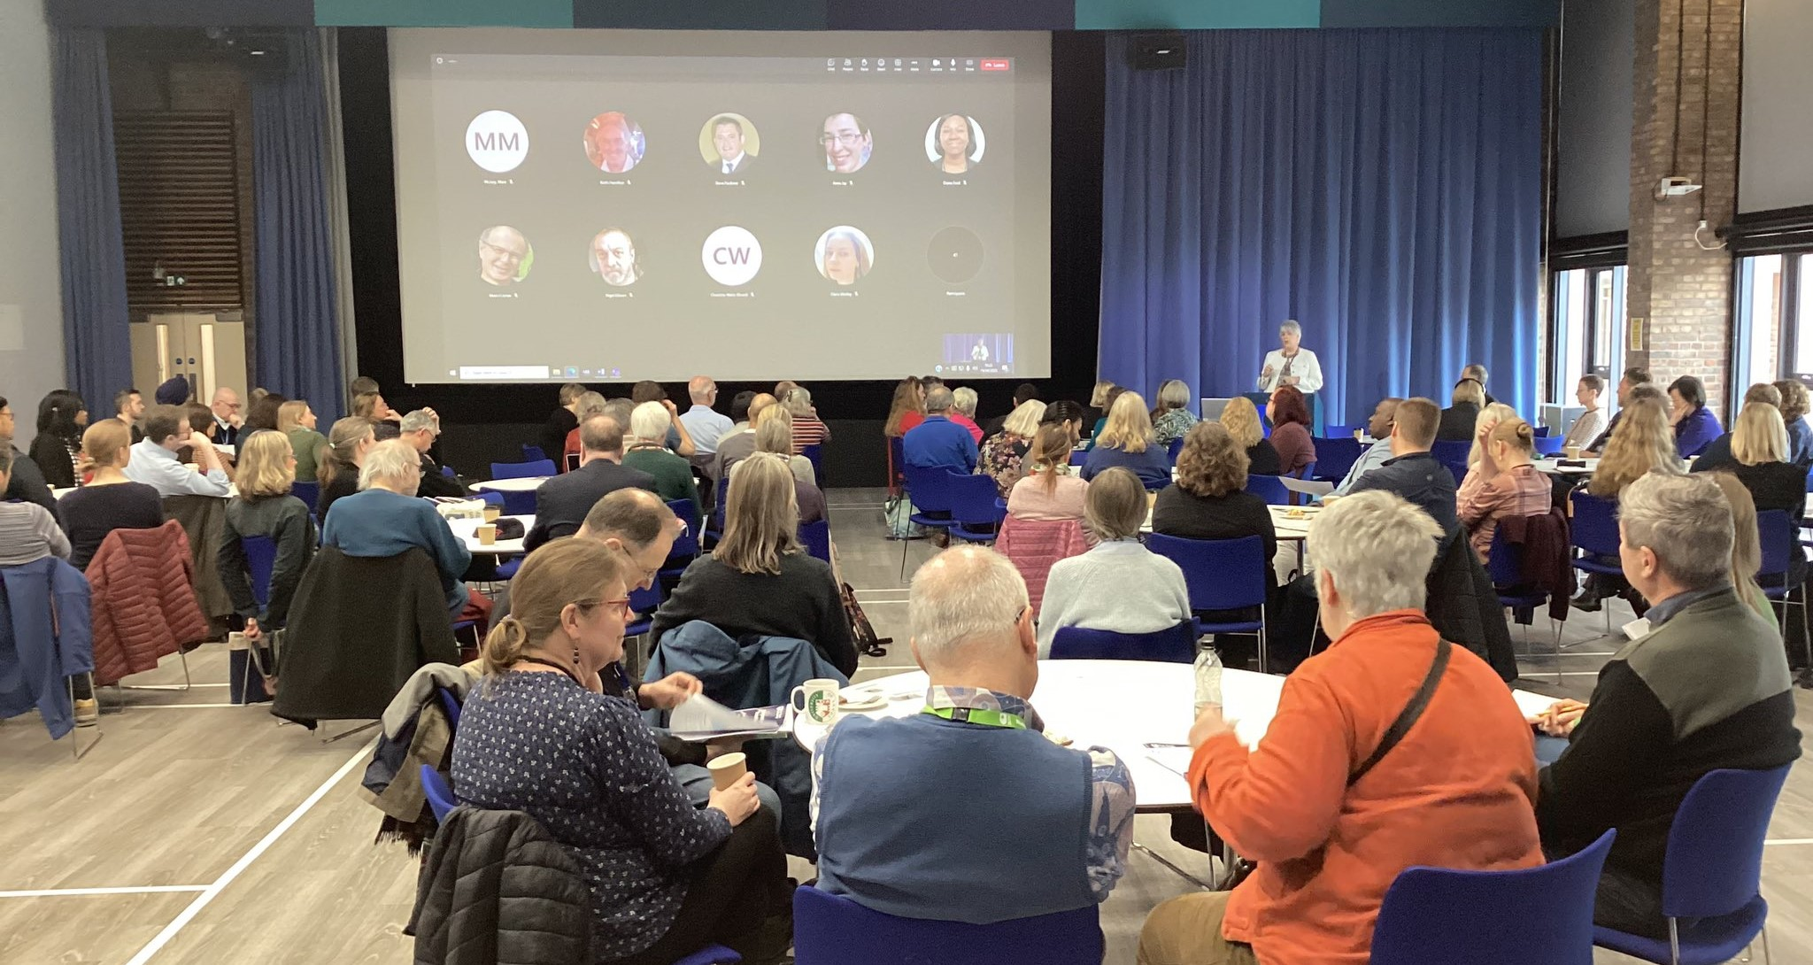
Slide Title 9
Overview
Defining scholarship
About eSTEeM
Proposal and project workflow
24th call for projects
Key information
Things to consider
Timeline and planning
Sources of support

Slide 3
Slide Title 9
Defining scholarship
Defining scholarship as the Scholarship of Teaching and Learning (SoTL)
  “systematic and ethically reasoned investigation of aspects of teaching and student learning by applying disciplinary knowledge, resulting in reflections and outcomes that are publicly shared for peer-review and for others to build upon” (SoTL in STEM BOC – Minocha and Butler, 2021)
SoTL is important in three ways
  For students allowing us to evaluate our teaching to improve the quality of student learning
  For academic disciplines and institutions ensuring we base future development on robust evidence enabling our teaching and learning to be recognised externally for its excellence and impact
  For practitioners allowing staff to develop their professional practice in the field of teaching and learning
Notes:
Daphne 1-6

Slide 4

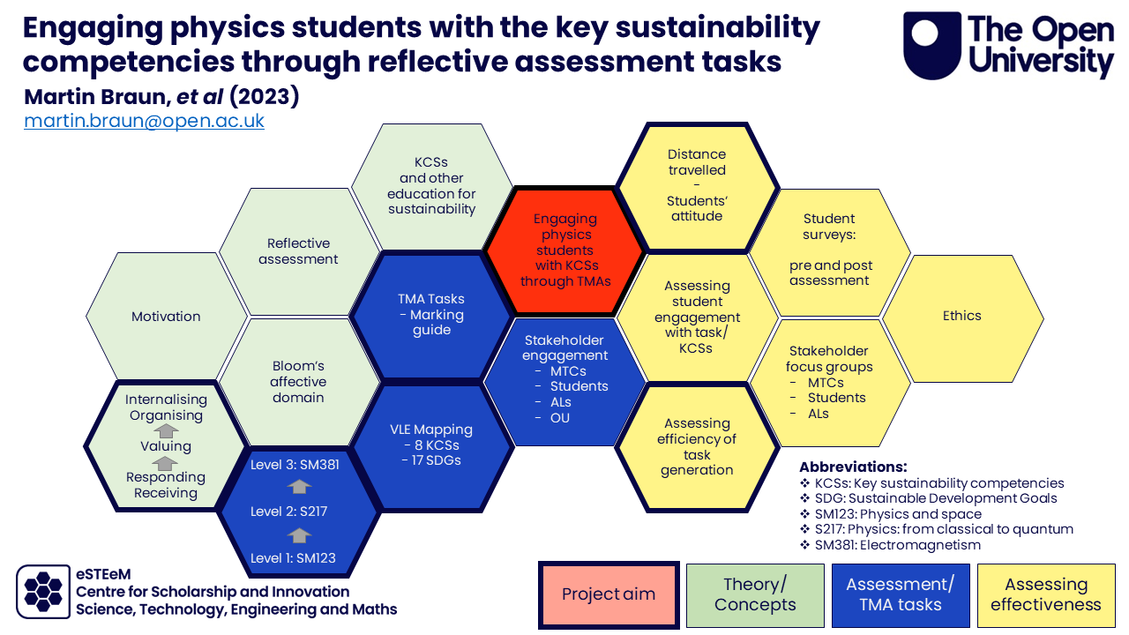
Slide Title 9
About eSTEeM
The STEM Centre for Scholarship and Innovation (Dec 2010)
Scholarship to enhance learning and teaching practice and strategy
Over 240 projects supported since 2011
Over 60 currently in progress
Individuals, groups and cross-disciplinary project teams
Professional development and support for project team – Applaud (Advance HE Fellowship)
External influence in HE STEM environment

Slide 5
Slide Title 9
From ideas to projects
Project idea – discuss with School Scholarship Lead/eSTEeM Directors
Project proposal form completed, endorsed by Scholarship Lead, approved by LLM and HOS to approve workload
Proposal submitted by advertised deadline
eSTEeM Coordination Group meeting to evaluate proposals – accept, revise or decline
Project proposers informed of decision
Where necessary, plans revised. Final sign-off by eSTEeM Directors

Slide 6
Slide Title 9
Progress and completion
Ethics review, SRPP/SSPP approval, Data Protection compliance
Induction workshop
- project begins
Mentoring, ongoing project management and support
Ongoing staff development events
Short reports once a year
Ongoing dissemination - eSTEeM Annual Conference, internal and external events
Final report, outputs and publications uploaded to eSTEeM website/ Scholarship Exchange/ ORO

Slide 7
Slide Title 9
24th call for projects
Continuation and completion: To meet the OU’s goal of enabling success for our students, we are actively seeking scholarship projects that investigate and implement strategies to enhance student continuation and completion, such as sense of community/belonging.
Access, Participation and Success: We continue to seek projects related to Access, Participation and Success which investigate issues around registration, tuition, completion and awarding gaps with respect to students from under-represented groups in STEM.
Curriculum design and assessment: We would be particularly interested in receiving proposals that plan to actively involve students as partners within project teams which explore student input into module and assessment design. eSTEeM can provide guidance on recruiting students.
Innovations in STEM teaching and learning: With the rise of generative AI and extended reality, we are keen to explore the challenges, opportunities and impact on STEM teaching and learning of these technologies.
Sustainability in the STEM curriculum: Universities play a key role in the global transition to Net Zero emissions, and we encourage projects that seek to enhance teaching of sustainability through the STEM curriculum.
Or other scholarship projects that fit within the eSTEeM portfolio.
Notes:
Sue 7 – break – 15 mins

Slide 8
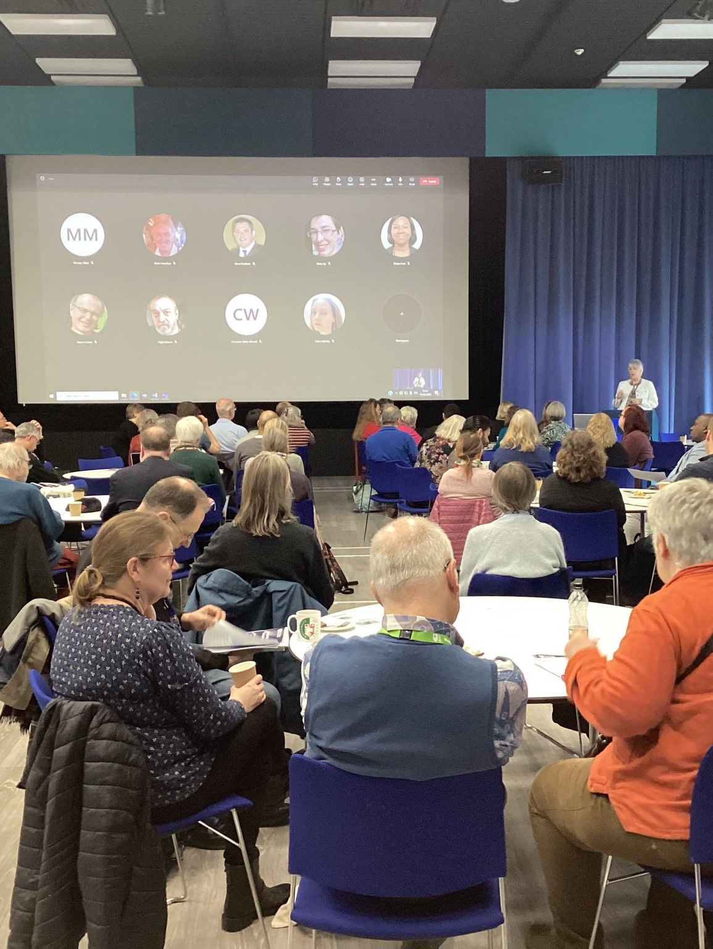
Slide Title 9
Key information
eSTEeM projects normally run to completion within 12-18 months with each team member expected to commit a minimum of 10 days.
Endorsement required from your School Scholarship Lead or eSTEeM Director if based outside a school. Please ensure you have contacted your relevant Scholarship Lead ideally by 16th February.
Central and regional staff require approval of time allocation from your HOS or line manager if based outside a school. ALs require approval of time from Lead Line Manager and approval of proposal from HOS.
ALs must be able to fulfil this role within the maximum working allowance of 1.3 FTE (may use spare FTE capacity or issue an additional duties contract).

Slide 9
Slide Title 9
Key information cont’d
All eSTEeM funded project teams are required to submit interim short reports and a final project report within two months of completion.
We particularly encourage projects that involve students as collaborators/co-investigators on the project (and not just as participants in a study) and draw upon the experience of colleagues in the Student Support Team.
eSTEeM may provide support for conference attendance and expenses to attend eSTEeM community events.
Scholarship skills development and project mentoring will be provided by eSTEeM.

Slide 10

Slide Title 9
Things to consider in your proposal
Is the project consistent with the aims of eSTEeM?
Which theme(s) does it address?
Have you considered the literature?
Are you aware of related projects? (check eSTEeM website)
Explain how your project builds on the prior work?

Slide 11
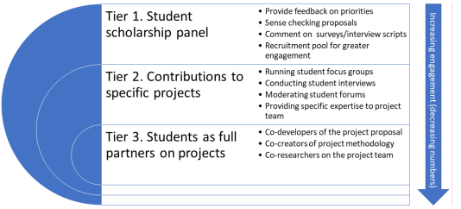

Slide Title 9
Things to consider in your proposal cont’d
Would your project benefit from student involvement at any stage (other than as participant in your research)?
Would your project benefit from SST staff involvement?
Do you have any specific development needs to enable you to undertake this project? How will you address this?
Will the project produce significant deliverables/outputs within a reasonable timeframe and what might these be?
Is there an evaluation and dissemination plan, including dissemination to students?

Slide 12
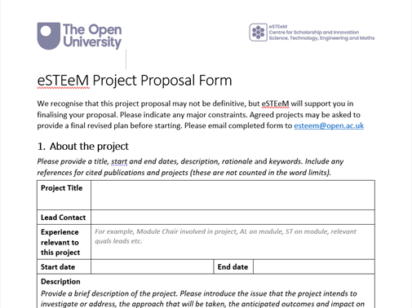
Slide Title 9
Checking your proposal
Is there a clear and realistic project plan with actions, responsibilities and timescales?
Will the project impact favourably on student experience and/or faculty effectiveness?
Is there a realistic workload allocation for staff?
eSTEeM project proposal form
eSTEeM project plan supplementary information

Slide 13
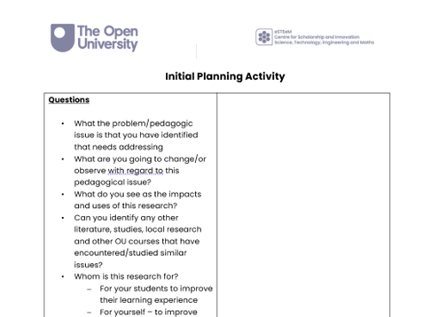
Slide Title 9
Timeline and planning
Timeline
  Deadline for project proposals
  17.00 Tuesday, 2nd April 2024
  Proposals scrutinised by the eSTEeM Coordination Group in late April
  Informed of their decision by early May
  Attend induction meeting in May/Jun
Planning activity
  Complete the Initial Planning Activity
  Sharing our plans/ideas so far
  Questions or further comments
Project planning activity
Notes:
Activity 45 mins in total Sue to introduce
Breakout room – 30 mins min
Daphne - What were Key thoughts from the process

Slide 14
Slide Title 9
eSTEeM people
School Scholarship Leads
  SPS: Jonathan Nylk
  M&S: Sue Pawley/Martina Gibbons
  C&C: Rehana Awan/Soraya Kouadri
  EEES: Fiona Aiken
  E&I: Anne-Marie Gallen
  KMi: Trevor Collins
  LHCS: Sarah Daniell
Management Team
  Director: Sue Pawley
  Deputy Director: Daphne Chang
  Senior Manager: Diane Ford
  Support Assistant: Rachel Redford
  Project Officer: Jonathan Evans

Slide 15
Intro Slide Title 1
eSTEeM Pre-bidding Workshop
Sue Pawley and Daphne Chang
eSTEeM Directors
Tuesday 6th February 2024, 14.00-15.30
esteem@open.ac.uk www.open.ac.uk/esteem
Call for projects January 2024

Slide 16
Slide Title 31

