Slide 1
Theory of Change: Developing pathways to impactful scholarship
Shailey Minocha
Faculty of STEM, The Open University
For eSTEeM, Centre for Scholarship and Innovation
Shailey Minocha (Profile), https://www.linkedin.com/in/shaileyminocha/
Blog: https://www.shaileyminocha.info/blog
All the links in this presentation were last accessed on 15th July 2024.

Slide 2
About me
Involved in scholarship over the last two decades
Scholarship Lead, School of Computing and Communications, 2017-24
Scholarship of Teaching and Learning (#SoTL) in STEM, Badged Open Course, OpenLearn, 2020-21
Impact evaluation initiative of eSTEeM-funded projects, 2021-23

Slide 3


Minocha, S. and Collins, T. (2023). Impact of Scholarship of Teaching and Learning: A compendium of case studies. The Open University, Milton Keynes, UK. DOI: https://doi.org/10.21954/ou.ro.000155c0
Minocha, S. and Collins, T. (2023). Impact of Scholarship of Teaching and Learning: A guide for educators. The Open University, Milton Keynes, UK. DOI: https://doi.org/10.21954/ou.ro.000155c1

Slide 4



Minocha, Shailey and Collins, Trevor (2023). Impact of Scholarship of Teaching and Learning: An Executive Summary. The Open University, Milton Keynes, UK.
DOI: https://doi.org/10.21954/ou.ro.000155bf
Available at: https://oro.open.ac.uk/87489/
Based around Theory of Change (ToC)
‘Impact of SoTL’, https://www5.open.ac.uk/scholarship-and-innovation/esteem/impact

Slide 5
Today’s plan
Scholarship of Teaching and Learning (#SoTL)
Impact of SoTL and why it matters?
Theory of Change (ToC)
Developing a ToC
------- break for 10 minutes --------
How a ToC helps to plan pathways for impact?
How a ToC guides impact evaluation and evidence gathering?

Slide 6
Definition of SoTL
‘SoTL’ is defined as a systematic and ethically reasoned investigation of aspects of teaching and student learning
by applying disciplinary knowledge,
resulting in reflections and outcomes that are publicly shared for peer-review and for others to build upon.
‘Scholarship of Teaching and Learning’, https://www.open.edu/openlearn/mod/oucontent/view.php?id=109160&section=1

Slide 7
Impact of SoTL
‘At its most simple, we can define impact as benefit. It is surprising how much clarity it brings, when you simply ask yourself “What was the benefit?”.’
…impact is the provable effects (benefits) of research in the ‘real world’.
The impact of a SoTL inquiry implies demonstrable (provable) benefits to learning and teaching that is contributed by the inquiry, or caused by and attributable to the SoTL inquiry.
‘What is impact?’, https://www.fasttrackimpact.com/what-is-impact-subpage; Bayley, J. (2023). Creating meaningful impact: the essential guide to developing an impact-literate mindset. Emerald. https://doi.org/10.1108/9781804551899; ‘The impact of SoTL’, https://www.open.edu/openlearn/mod/oucontent/view.php?id=109326&section=2

Slide 8
Why impact of SoTL matters?
implies research-informed learning and teaching
implies evidence-based changes in institutional processes and policies
provides evidence for funding bodies, assessment exercises such as TEF and REF
helps the institution to meet the internal and any prescribed external targets (for example, by Office for Students)
helps to develop a portfolio of publications and/or a research profile for promotions, fellowships and career advancement
‘Enabling factors for impactful Scholarship of Teaching and Learning (#SoTL)’, https://www.shaileyminocha.info/blog/2024/4/26/enabling-factors-for-impactful-scholarship-of-teaching-and-learning-sotl

Slide 9
What does the evidence of impact look like?
data analytics: [groupwork] student participation
[co-creating design exhibitions] students identified career path choices and adapted their study pathways
financial data: external research funds; costs of running a module reduced
data analytics: [early start to support the transition to Level 2] increased student engagement and reduction in student withdrawals
data analytics: [early interventions for at-risk students] student engagement and student retention
Minocha, S. and Collins, T. (2023). Impact of Scholarship of Teaching and Learning: A compendium of case studies. The Open University, Milton Keynes, UK. DOI: https://doi.org/10.21954/ou.ro.000155c0
Notes:
Based on the research questions and where you would like the change to happen because of your project.

Slide 10
Values for impactful SoTL
Inquisitive
Open-minded
Ethical
Strategic
Empathetic
Generous
‘Values for impactful Scholarship of Teaching and Learning’, https://www.shaileyminocha.info/blog/2023/4/8/values-for-impactful-scholarship-of-teaching-and-learning

Slide 11

Any questions so far before we move to the key topic of today’s event?

Slide 12
Theory of Change for pathways to impactful SoTL
Minocha, S. and Collins, T. (2023). Planning for SoTL evaluation workbook. The Open University, Milton Keynes, UK. Available from: https://oro.open.ac.uk/87489/

Slide 13
What is a Theory of Change (ToC)?
A ToC maps a process of change from beginning to end
…establishes a blueprint for the activities of an intervention or project…
…which will, in theory, lead to the intended outputs, outcomes and impact.
A ToC reveals what should be evaluated, when, and how.
It is a visual logical framework illustrating the flow from inputs through to impacts … and has a narrative that describes the pathways by which this flow occurs.
It makes explicit the assumptions underpinning the pathways plus any barriers or risks that may negatively influence the individual pathways.
‘Mapping change, Using a Theory of Change to Guide planning and Evaluation’, https://learningforfunders.candid.org/wp-content/uploads/sites/2/2018/12/theory_change.pdf

Slide 14
Theory of Change (ToC) Template
1 situation/problem
What situation/problem is the project trying to address or resolve?
2 context
What is the current context of the situation/problem?
3 Aim
What goal or objective is the programme/initiative trying to achieve? What is your proposed solution to the problem given the context?
4 stakeholders
Who are the stakeholders (including the beneficiaries) of the project?
7+ resources/
inputs
7 activities
7++ outputs
6 outcomes and indicators
5 impact
planning
intended results
What are the human, financial and organisational resources required to achieve the desired outcomes?
Activities that will mobilise the inputs to produce outputs.
Outline the interventions (supported by assumptions) that will bring about the desired change.
What are the results or deliverables of the activities relevant to the achievement of the outcomes?
What are the long-term goals which relate to the ‘problem’? What will result from the removal of the problem?
Short and medium-term outcomes and indicators which must be in place for the long-term goals to be achieved.
~ assumptions
The various conditions on which the project’s success will rely on.
~ risks
Risks to activities? Risks to impacts not being achieved, or leading to unintended consequences?
5-6 time
When will you conduct the various activities? When do you expect the impact to be achieved?
Minocha, S. and Collins, T. (2023). Planning for SoTL evaluation workbook. The Open University, Milton Keynes, UK. Available from: https://oro.open.ac.uk/87489/

Slide 15
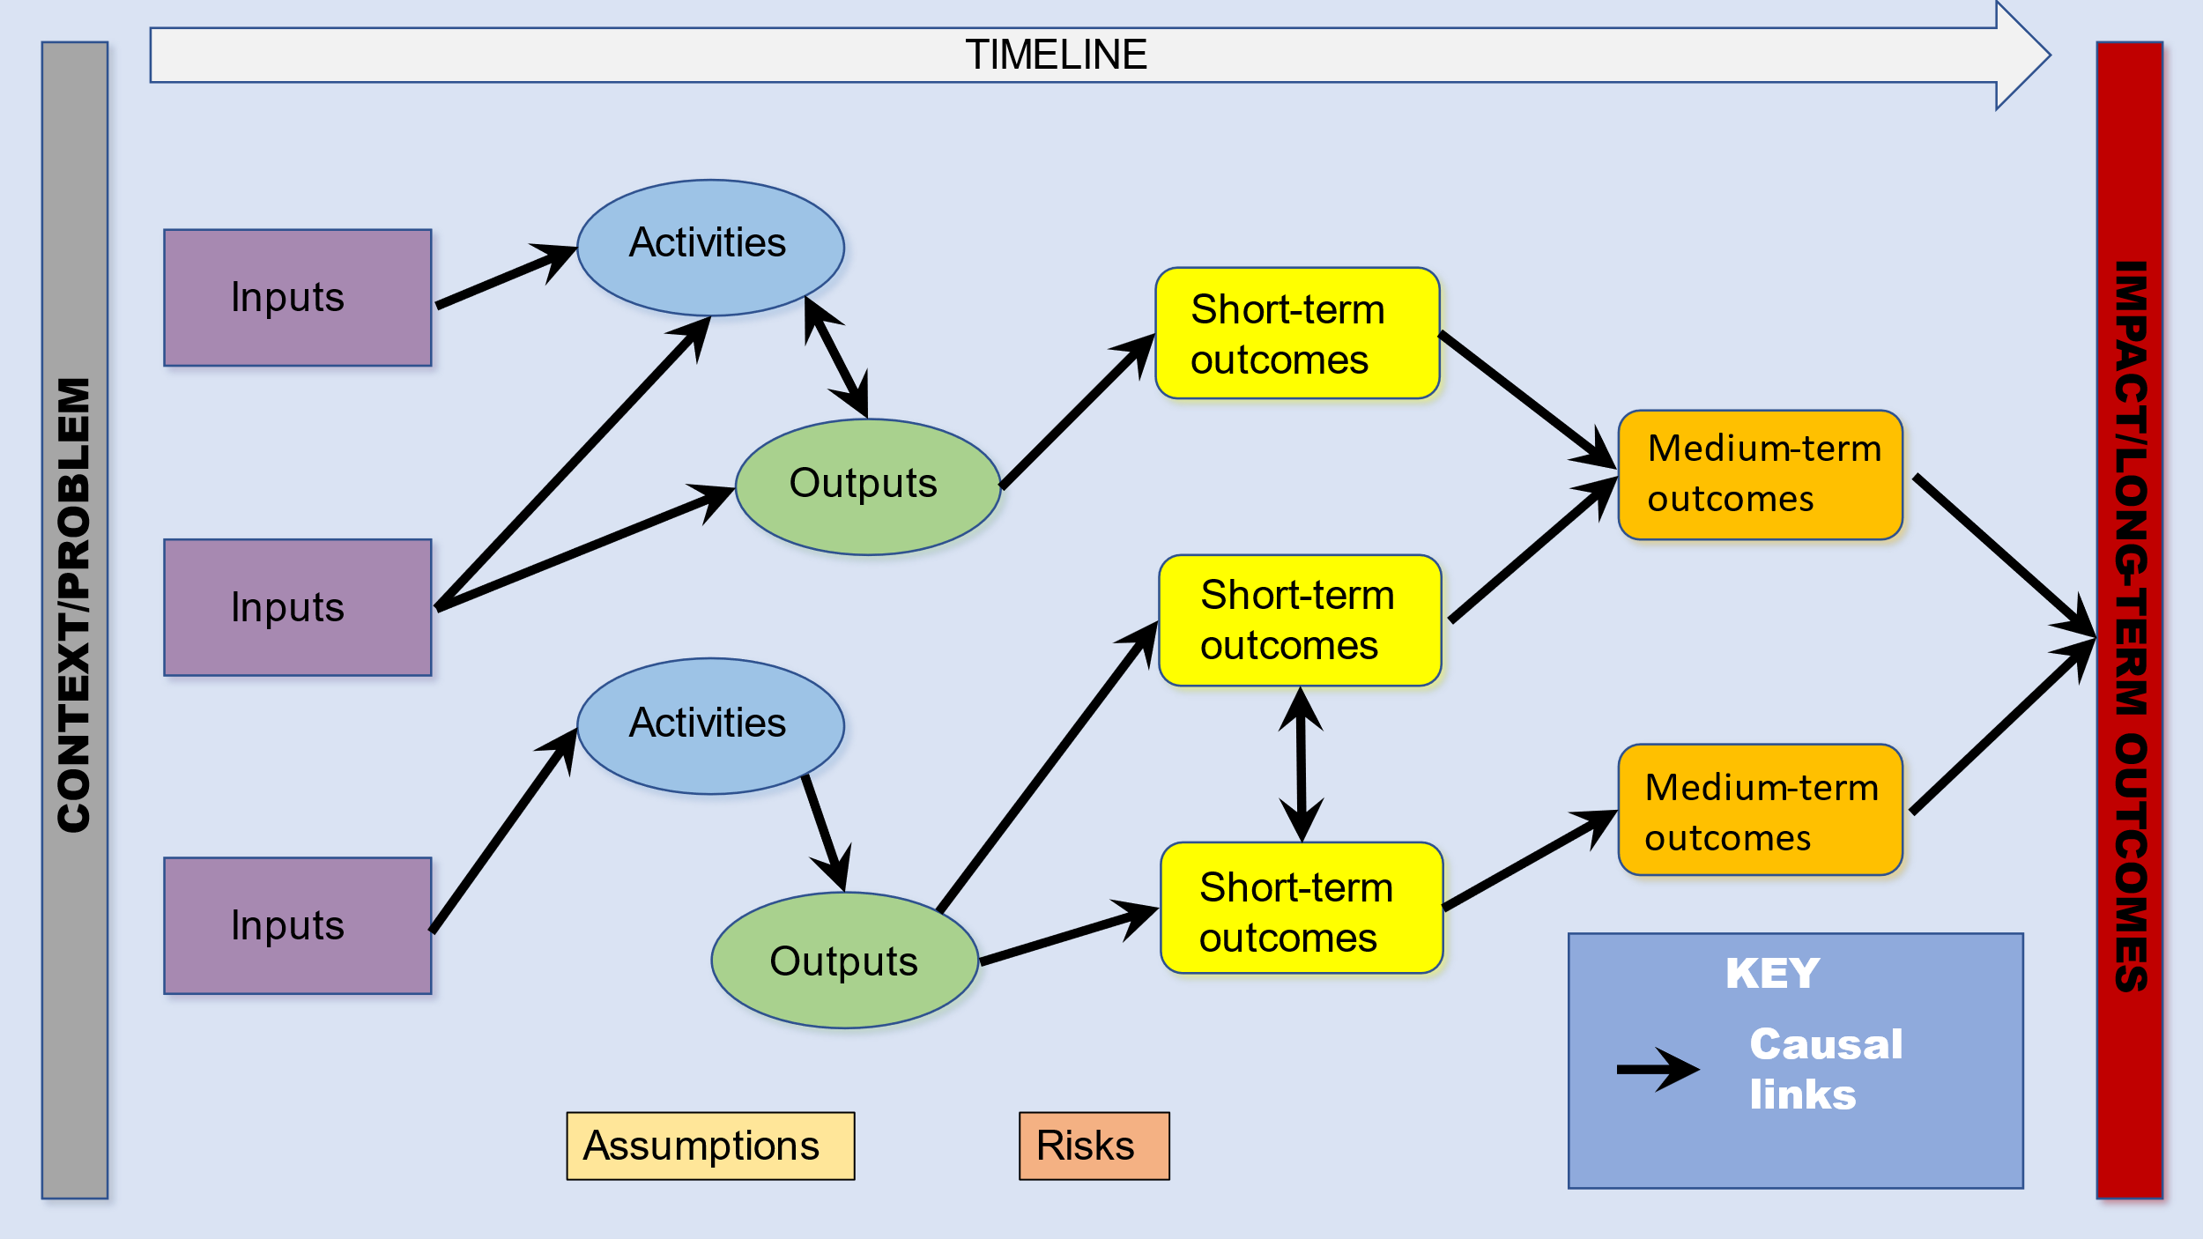
A Theory of Change (ToC)
The Theory of Change Process – Guidance for Outcome Delivery Plans, https://analysisfunction.civilservice.gov.uk/policy-store/the-analysis-function-theory-of-change-toolkit/#resources-to-help-quality-assure-your-toc

Slide 16
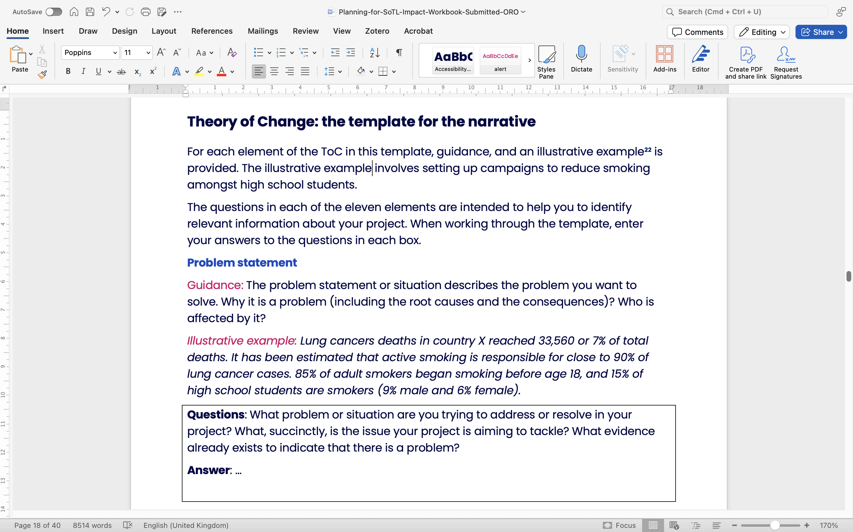
Minocha, S. and Collins, T. (2023). Planning for SoTL evaluation workbook. The Open University, Milton Keynes, UK. Available from: https://oro.open.ac.uk/87489/

Slide 17
Developing a Theory of Change (ToC)
Project plan
ToC visual
ToC template for the narrative
ToC visual and narrative
Minocha, S. and Collins, T. (2023). Planning for SoTL evaluation workbook. The Open University, Milton Keynes, UK. Available from: https://oro.open.ac.uk/87489/

Slide 18
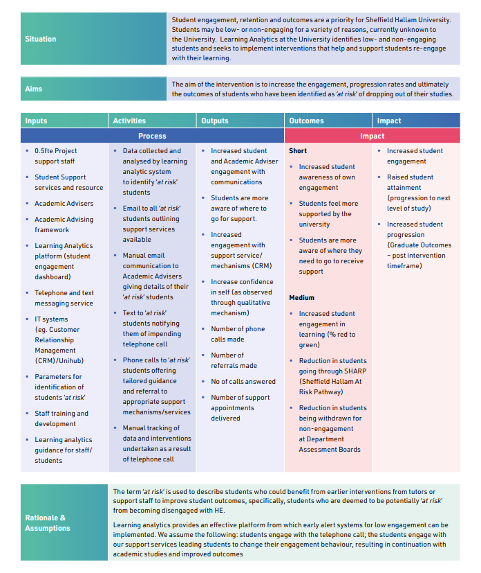
ToC: SHU (TASO)
Project report: Using learning analytics to prompt student support interventions Using learning analytics to prompt student support interventions (taso.org.uk)
TASO: Transforming Access and Student Outcomes in HE
Case study: SHU: Sheffield Hallam University
Theory of Change resources, https://taso.org.uk/evidence/evaluation-guidance-resources/toc/

Slide 19
Short-term outcome evaluation plan (SHU)
Short-term outcomes | indicators (3-5 weeks)
List each of the intermediate outcomes from your Theory of Change diagram | Describe the milestone or progress measure you will use to demonstrate your progress towards this outcome | Describe the methodology used to capture this progress measure.
Increased awareness of own engagement | number and nature of student involvement in social and academic activities improved online and face-to-face attendance | Personal tutor’s notes of salient points of conversations Data Analytics (attendance)
Students feel more supported by the university | students mention specific aspects when they have felt supported by the university through information and people. | Personal tutor’s notes of salient points of conversations Informal interviews with students
Students are more aware of where they need to go to receive support | number and nature of incidents where students have needed support | Self-reporting via the photovoice method focus groups (with a group of students)
Template attribution: The Royal Academy of Engineering, UK; this and the next slide are outcome evaluation plans for TASO’s SHU case study, the link for which is in the previous slide.

Slide 20
Medium-term outcome evaluation plan (SHU)
Medium-term outcomes | indicators (6-12 weeks)
List each of the intermediate outcomes from your Theory of Change diagram | Describe the milestone or progress measure you will use to demonstrate your progress towards this outcome | Describe the methodology used to capture this progress measure.
Increased student engagement in learning | increased student interaction with learning materials and assessment | VLE data Attendance data Library books issue Submission of assessment Performance data (data analytics)
Reduction in students at ‘risk’ | Reduction in the number of students placed on SHARP (Sheffield Hallam At Risk Pathway) | Data on the number of students placed on SHARP
Reduction in student withdrawals | Reduction in the number of students withdrawing from individual modules and the course | Data analytics Data from assessment boards

Slide 21
ToC-driven Impact Evaluation
Theory of Change (develop or revise)
Formulate Outcome Evaluation Plan
Conduct Evaluation (short- and medium-term outcomes)
Reflect on the Evidence of change or impact

Slide 22
Key principles for developing a ToC
It should be developed collaboratively to reflect the understanding of all relevant stakeholders.
It should be based on a deep understanding of the context.
It should be grounded in, tested with, and revised based on robust evidence at all stages.
It should support reflection, continuous learning and improvement from planning to the closure of a research programme.
Theory of change process – Guidance for outcome delivery plans, https://analysisfunction.civilservice.gov.uk/policy-store/the-analysis-function-theory-of-change-toolkit/

Slide 23
How does a ToC help in SoTL/ a research project?
in funding applications: whether the proposed impact aligns with the objectives of the call.
for shared understanding: of the project’s need, aim(s) and the long-term impact amongst the team and stakeholders
in planning for impact: to set a direction and specify explicit causal pathways of how the activities of a project can lead to impact.
to plan impact evaluation: provides a framework for collation of the evidence of impact.
to monitor a project’s progress: a project management tool to monitor the project and its performance.
for communication: outlines the process of change.

Slide 24
Role of ToC in a project lifecycle
Planning
engages stakeholders
Implementation
guides the activities of the project for the desired outputs
Evaluate
guides planning for impact
a tool for reflection
shows pathways for achieving target outcomes
feeds into project planning and vice versa
guides monitoring and evaluation of impact
the ToC is updated as the project progresses
Harries, E., L. Hodgson and J. Noble (2014). Creating Your Theory of Change: NPC’s Practical Guide. London: New Philanthropy Capital. Available at https://www.thinknpc.org/wp-content/uploads/2018/07/Creating-your-theory-of-change1.pdf

Slide 25
Example

Slide 26
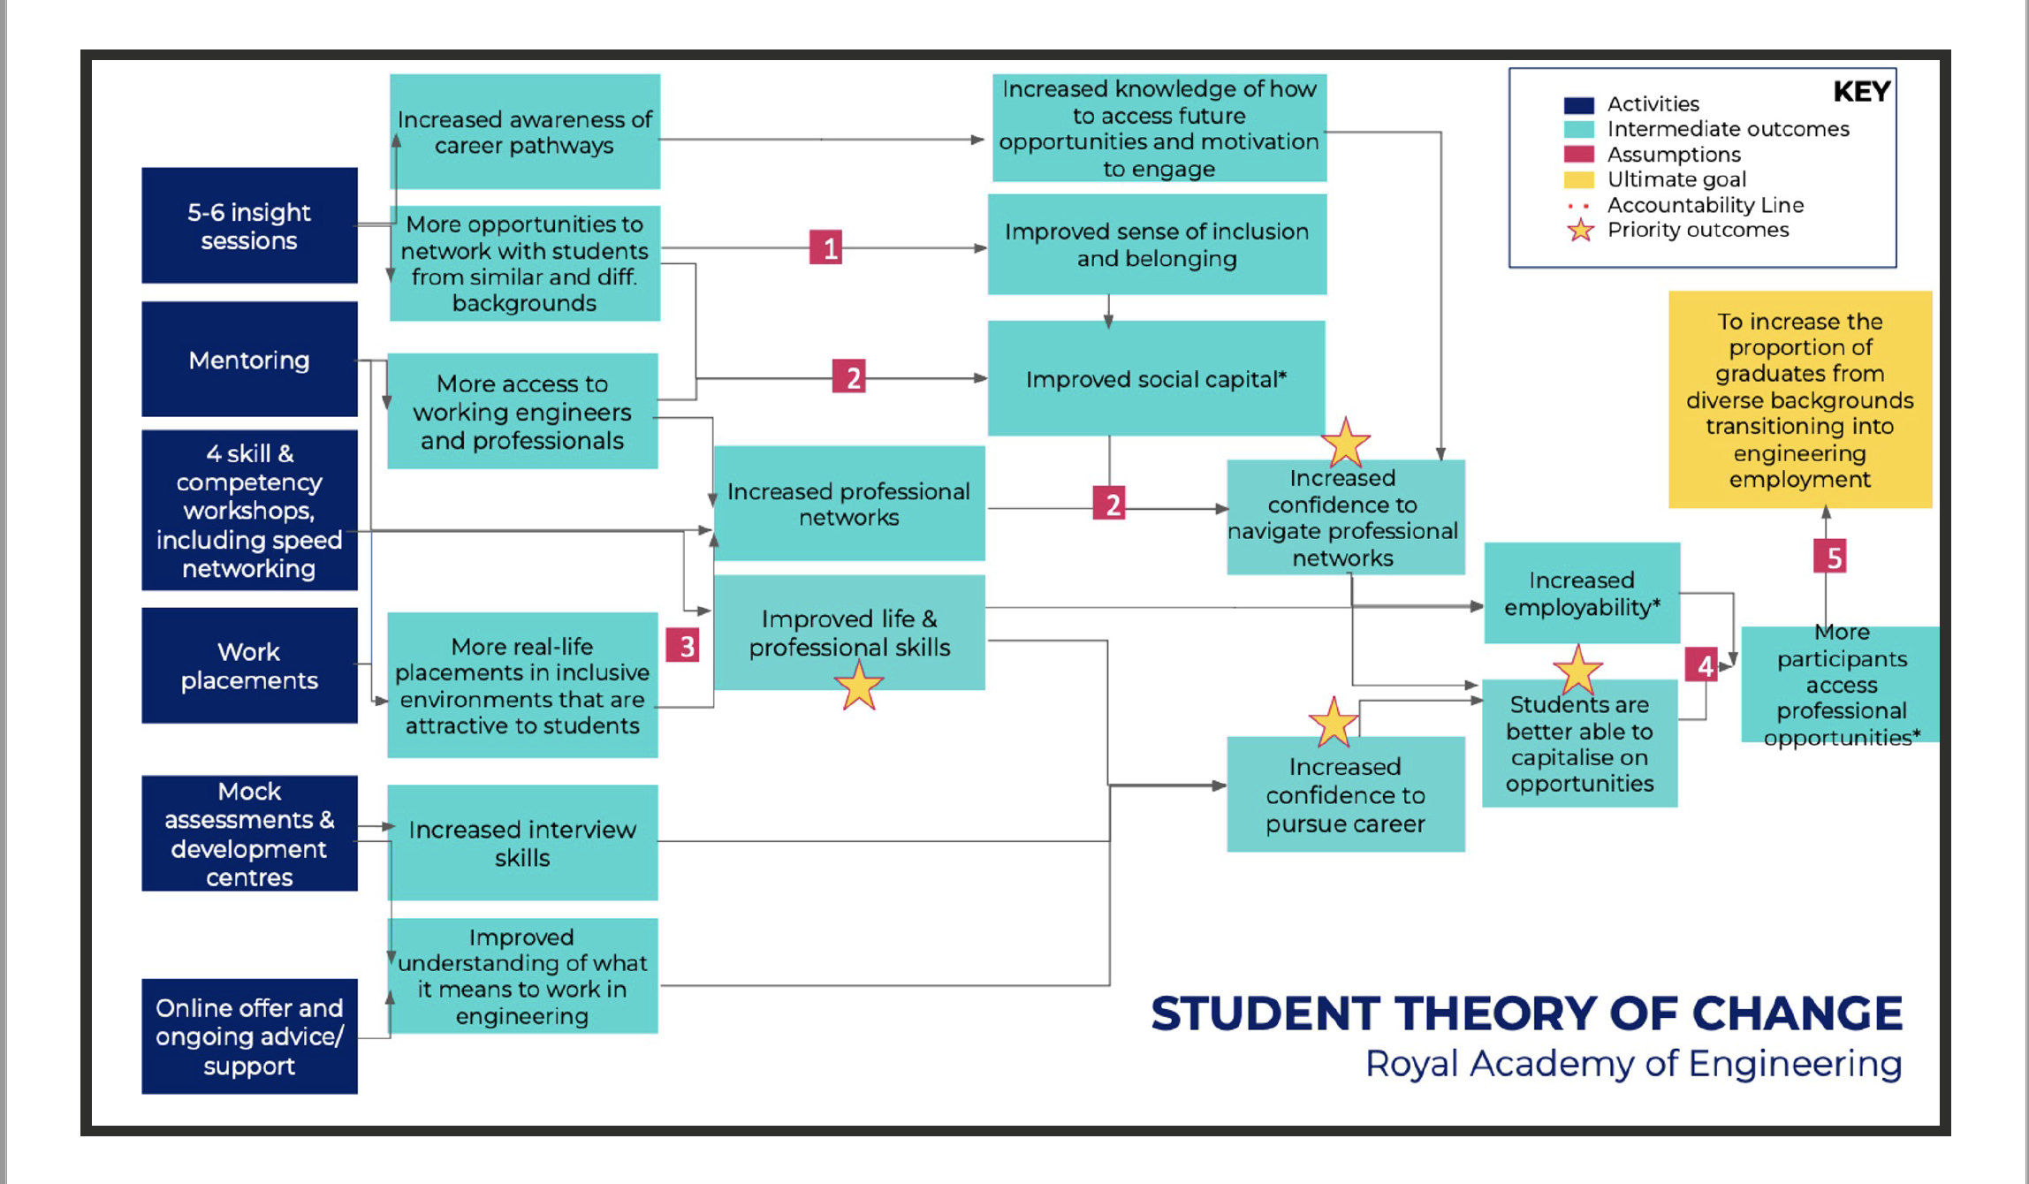
Invitation to Tender, The Royal Academy of Engineering is seeking Delivery Partners to scale its award-winning Graduate Engineering Engagement Programme. https://raeng.org.uk/media/xrkbjjtd/invitation-to-tender-royal-academy-of-engineering-geep-2023.pdf

Slide 27
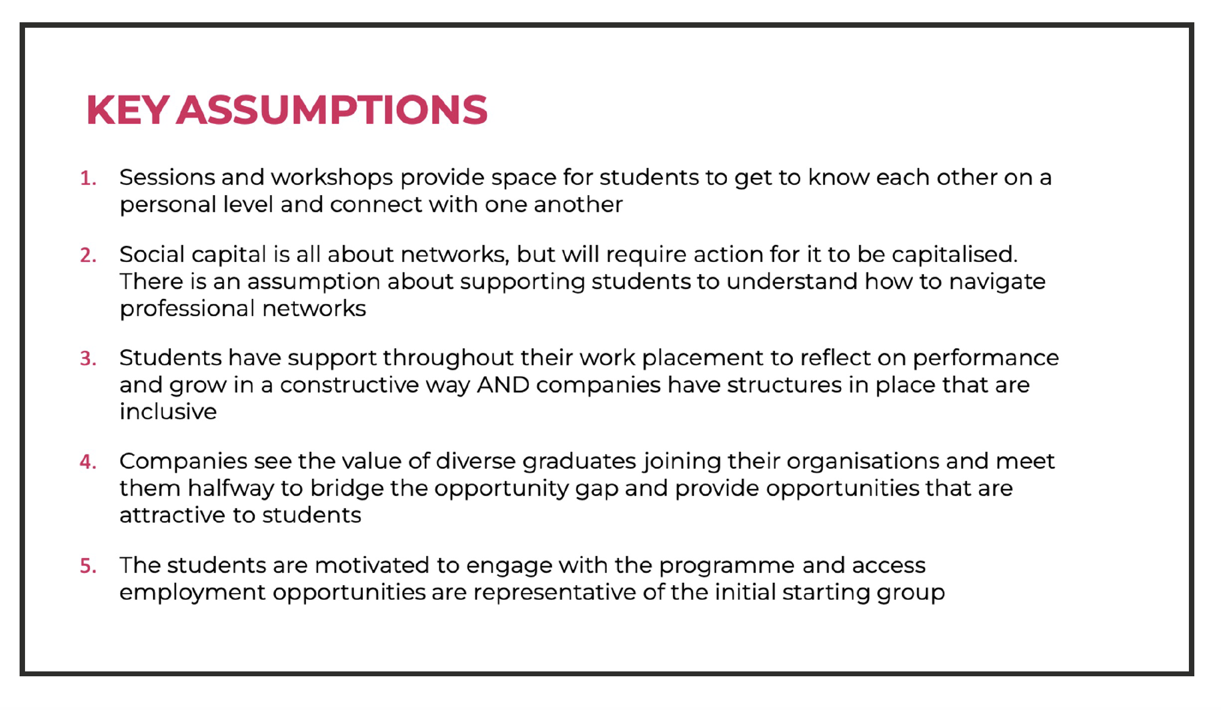
Invitation to Tender, The Royal Academy of Engineering is seeking Delivery Partners to scale its award-winning Graduate Engineering Engagement Programme. https://raeng.org.uk/media/xrkbjjtd/invitation-to-tender-royal-academy-of-engineering-geep-2023.pdf

Slide 28
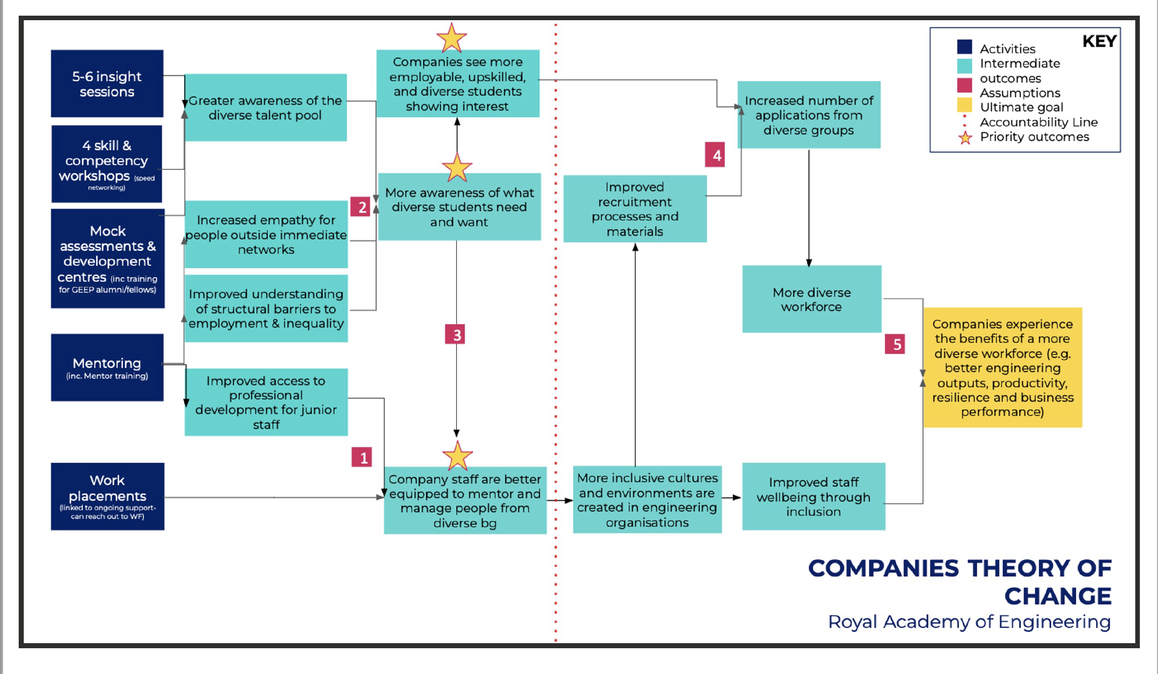
Invitation to Tender, The Royal Academy of Engineering is seeking Delivery Partners to scale its award-winning Graduate Engineering Engagement Programme. https://raeng.org.uk/media/xrkbjjtd/invitation-to-tender-royal-academy-of-engineering-geep-2023.pdf

Slide 29
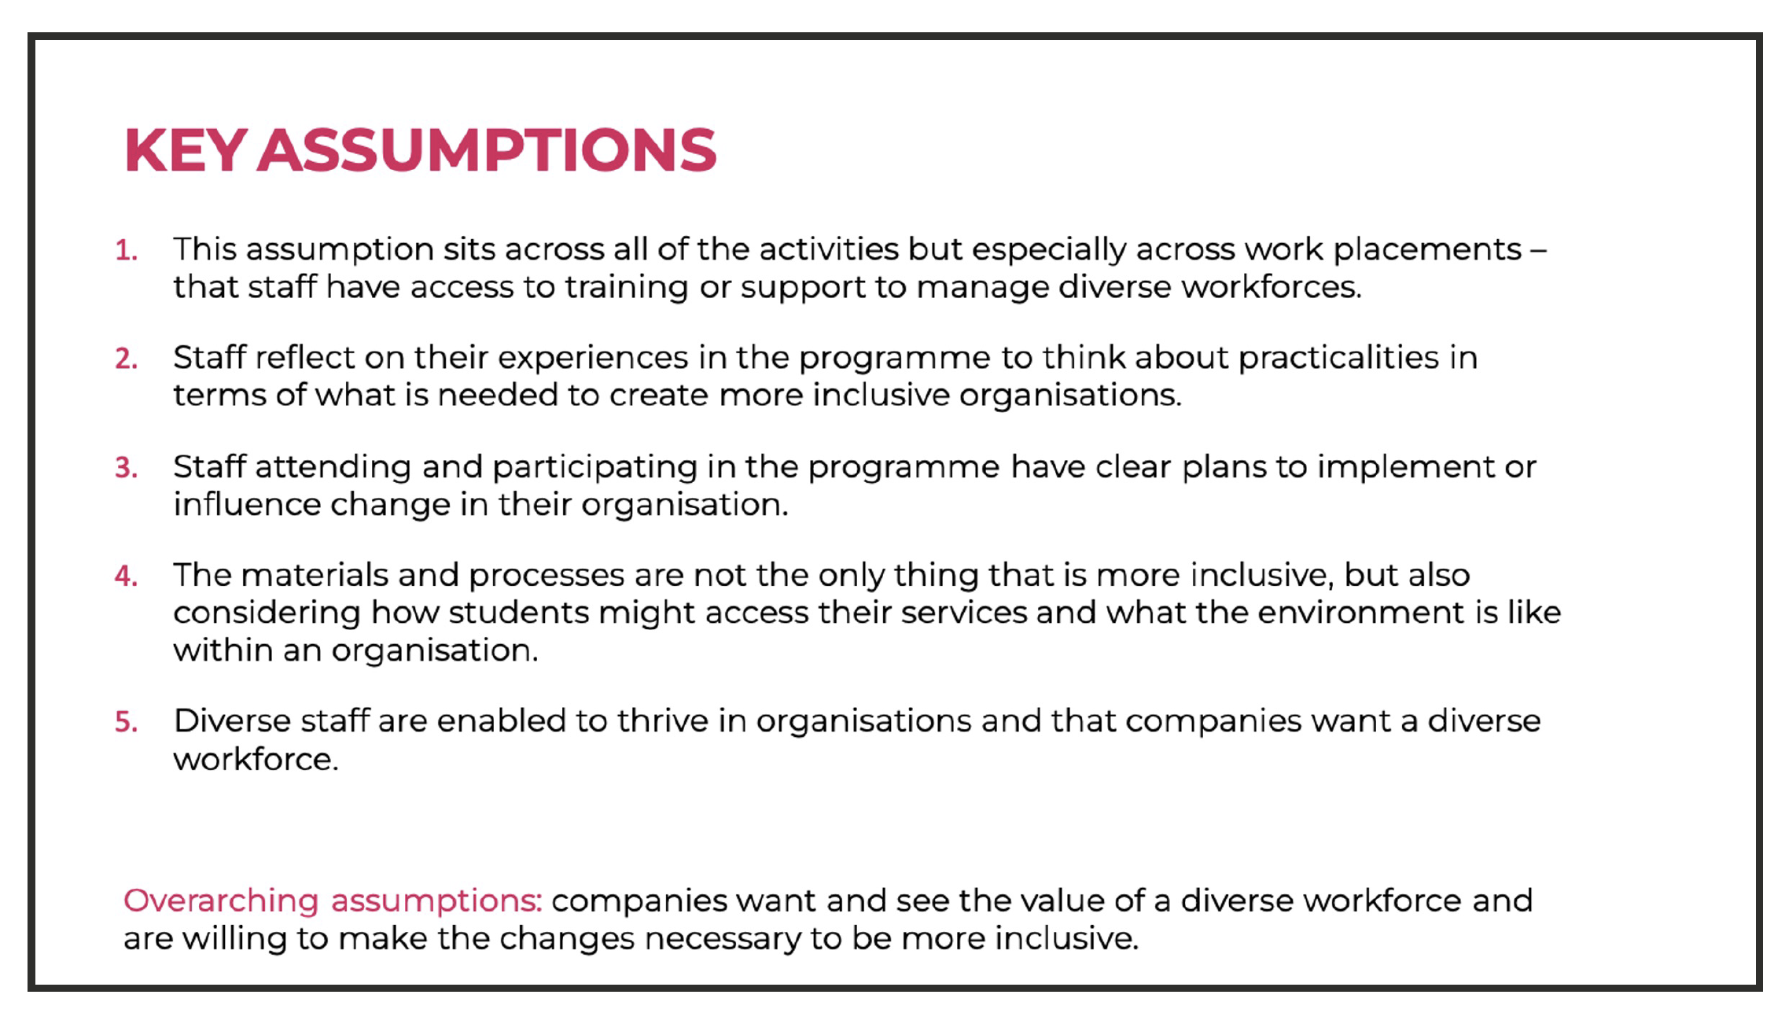
Invitation to Tender, The Royal Academy of Engineering is seeking Delivery Partners to scale its award-winning Graduate Engineering Engagement Programme. https://raeng.org.uk/media/xrkbjjtd/invitation-to-tender-royal-academy-of-engineering-geep-2023.pdf

Slide 30
Outcome evaluation plan
Outcome | Short term indicator (6-10 months) |  | Medium term indicator (12-18 months)
List each of the intermediate outcomes from your Theory of Change diagram | Describe the milestone or progress measure you will use to demonstrate your progress towards this outcome | Describe the methodology used to capture this progress measure. | Describe the milestone or progress measure you will use to demonstrate your progress towards this outcome | Describe the methodology used to capture this progress measure.
Improved life and professional skills | critical thinking skills Interview skills | Mock assessments | Networking skills Interview skills | Mock assessments
Increased confidence to navigate professional networks | number and nature of activities where students have interacted within the networks | Self-reporting in surveys workshops | Being able to search through events and calls for participation | Self-reporting in surveys Diary keeping workshops
Increased confidence to pursue career | Students identifying possible opportunities | Self-reporting | Students choosing career pathways | Self-reporting in surveys interviews
Students are better able to capitalise on opportunities | Number and nature of opportunities identified and the outcomes (what happened as a result) | Diary-keeping | Students choosing companies as possibilities for jobs and identifying role models | Diary-keeping Self-reporting in surveys Interviews
Template attribution: The Royal Academy of Engineering, UK

Slide 31
A good ToC implies
the context of the programme and existing evidence is clear
consistent definitions and terminology are used throughout the process
relevant stakeholders participate meaningfully throughout
leads to the development of an ‘impact’ evaluation plan
A good TOC is an iterative process that develops alongside changes in context and evidence
The Theory of Change Process – Guidance for Outcome Delivery Plans, https://analysisfunction.civilservice.gov.uk/policy-store/the-analysis-function-theory-of-change-toolkit/#resources-to-help-quality-assure-your-toc

Slide 32
Questions

Slide 33
Step-by-step guidance for developing a ToC Toolkit
The Theory of Change Process – Guidance for Outcome Delivery Plans, https://analysisfunction.civilservice.gov.uk/policy-store/the-analysis-function-theory-of-change-toolkit

Slide 34
1. Situation or problem
What problem or situation are you trying to address or resolve in your project?
What, succinctly, is the issue your project is aiming to tackle?
What are the causes of the problem?
What evidence already exists to indicate that there is a problem?
Note: The numbers in this and the other slides in this toolkit refer to the numbers of the components in Theory of Change in slide 14.

Slide 35
2. Context
What is the context of the situation in which the project is being conducted? (e.g. the details of the department or school and the institution, discipline, module of study, level of study, and demographics of students)
What are the characteristics of the environment in which the project is being conducted? (e.g. implies the influences related to the discipline, culture of an institution, power relations, the political and economic climate, and the quality and regulatory frameworks)
Is there evidence of effectiveness of similar projects or interventions that you or others may have run?

Slide 36
3. Aim
What goal or objective is the programme/initiative trying to achieve?
What is your proposed solution to the problem given the context?

Slide 37
4. Stakeholders
Who are the stakeholders, particularly the beneficiaries, of your project?
Carrying out a stakeholder analysis may help.

Slide 38
4. Stakeholder analysis (one possible set of categories)
participatory role
advisory role
advocates
communications role
amplifiers
beneficiaries
obstructors
Minocha, S. and Collins, T. (2023). Impact of Scholarship of Teaching and Learning: A guide for educators. The Open University, Milton Keynes, UK. DOI: https://doi.org/10.21954/ou.ro.000155c1

Slide 39
5: Conduct 3i’s framework of stakeholder – impact mapping
Interest: Who is interested in your research and what is the nature of their interest, or who would you like to be interested (based on their influence and/or impact) who is currently disinterested, and why are they not interested?
Influence: Who has the power to facilitate or block the generation of impacts from your research (indirectly)?
Impact: Who are the beneficiaries of the intervention? Who is likely to benefit from engaging with your research? Who is likely to benefit from the results of your intervention?
How to do a stakeholder analysis, https://www.fasttrackimpact.com/post/2019/03/11/how-to-do-stakeholder-analysis and 3 i’s advanced stakeholder analysis, https://www.fasttrackimpact.com/post/2019/11/19/3-i-s-stakeholder-analysis-advanced-analysis-reveals-more-than-ever-before-about-who-yo

Slide 40
5. Impact Evaluation Framework (IEF) for SoTL
to think about the possible impact
12 facets of IEF for SoTL are divided into four categories
Learning and Teaching
Transfer to others
Stakeholder benefits
Cultural and economic benefits
Minocha, S. and Collins, T. (2023). Impact of Scholarship of Teaching and Learning: An Executive Summary. The Open University, Milton Keynes, UK. DOI: https://doi.org/10.21954/ou.ro.000155bf

Slide 41
5. SoTL IEF: 4 categories and 12 facets
Learning and Teaching
  student experience
  student retention and progression
  excellence in teaching
Transfer to others
  discipline-based teaching, research and practice
  dissemination of the project’s outcomes
  adoption of the outcomes
Stakeholder benefits
  mutual stakeholder understanding
  Personal and professional development of project team and associated stakeholders
  Recognition of project team members and other stakeholders
Cultural and economic benefits
  fostering SoTL culture
  financial implications
  funding opportunities
Minocha, S. and Collins, T. (2023). SoTL Impact evaluation workbook. The Open University, Milton Keynes, UK. Available from: https://oro.open.ac.uk/87489/

Slide 42
6 & 7. Backward and forward mapping to develop pathways to impact
Inputs
Activities
Outputs
Outcomes
Impact
What are the human, financial and organisational resources required to achieve the desired outcomes?
Activities that will mobilise the inputs to produce outputs.
What are the results or deliverables of the activities relevant to the achievement of the outcomes?
Short and medium-term outcomes which must be in place for the long-term goals to be achieved.
What are the long-term goals which relate to the ‘problem’? What will result from the removal of the problem?
???
???
…
???
…
???
???
???
???
…
???
…
???
???
???
???
…
???
…
???
???
???
???
…
???
…
???

Slide 43
Finalising the first draft of ToC
Plot the outcomes (and indicators) and impact against a time-line (for example, 6-12 months, 12-18 months, in 2 years, in 5 years, and so on): see the next slide
Plan how the outcomes and impact will be monitored and evaluated.
Document assumptions, barriers and risks for the individual pathways

Slide 44
Outcome evaluation plan – a template
Outcome | Short term indicator (6-10 months) |  | Medium term indicator (12-18 months)
List each of the intermediate outcomes from your Theory of Change diagram | Describe the milestone or progress measure you will use to demonstrate your progress towards this outcome | Describe the methodology used to capture this progress measure. | Describe the milestone or progress measure you will use to demonstrate your progress towards this outcome | Describe the methodology used to capture this progress measure.
Template attribution: The Royal Academy of Engineering, UK

Slide 45
Assumptions
Assumptions imply the various conditions on which the project’s success will rely on.
Assumptions are the necessary conditions for change, or the “underlying conditions or resources that need to exist for planned change to occur”.
If the assumptions hold true, the expectation is that results will be achieved.

Slide 46
Risks
What factors can undermine the success of your project?
What are the risks to activities not working as planned?
What are the risks to impacts not being achieved, or leading to negative or unintended consequences?

Slide 47
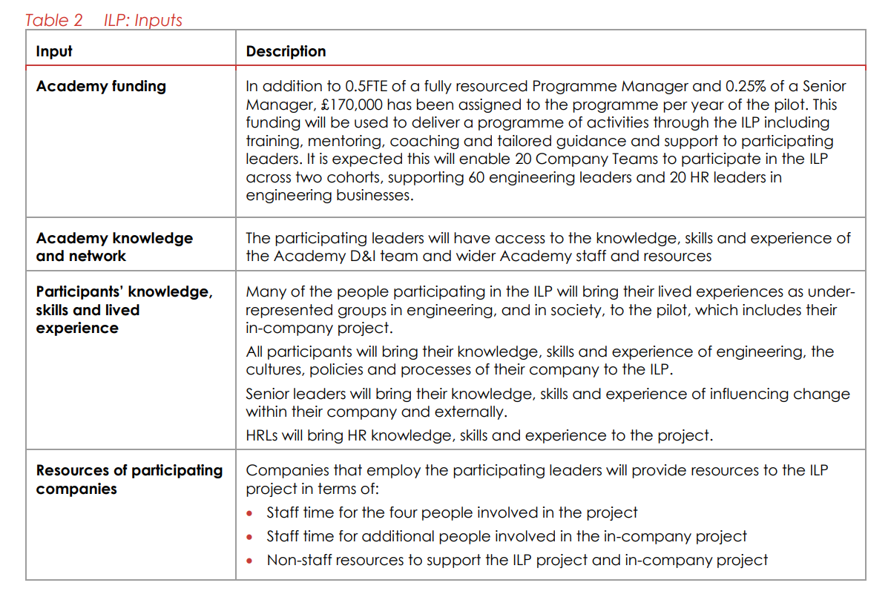
Tip for documentation
Each element of the ToC such as inputs, activities, outputs, etc. can be presented through a summary table and a narrative
Royal Academy of Engineering Pilot Inclusive Leadership Programme Theory of Change, https://raeng.org.uk/media/iqxdct0s/logic-model-and-theory-of-change-narrative.pdf

Slide 48
Over to you
What one thing from the session had caused you to think differently today?
What one action will you take as a result?
I have taken these prompts from a presentation by Dr Jon Rainford, WELS which he kindly shared with me: ‘Evaluating what we do: Creative forms of evidence generation’.

Slide 49
Bibliography
For a list of resources on ‘Theory of Change’, please refer to the notes at the bottom of some of the slides of this presentation and:
‘Bibliography sections’ in ‘Impact of Scholarship of Teaching and Learning: A guide for educators’, https://oro.open.ac.uk/87489/ and in the workbook ‘Planning for SoTL evaluation workbook’ available as supplementary material at the same ORO (Open Research Repository) link as the ‘guide’ - https://oro.open.ac.uk/87489/

Slide 50
E-books in OU’s Library
Simeone, L. (Ed.). (2023). Strategic Thinking, Design and the Theory of Change : A Framework for Designing Impactful and Transformational Social Interventions. Edward Elgar Publishing.
Morton, S. and Cook, A. (2022). How Do You Know If You Are Making a Difference?: A Practical Handbook for Public Service Organisations (1st ed.). Policy Press.
This book chapter, Research, Impact, and Institutional Actors: Where are the Leaders? And others in the book: O’Regan, N. (2024). From Purpose to Impact : The University and Business Partnership. (1st ed.). Taylor & Francis Group.

