Slide 1
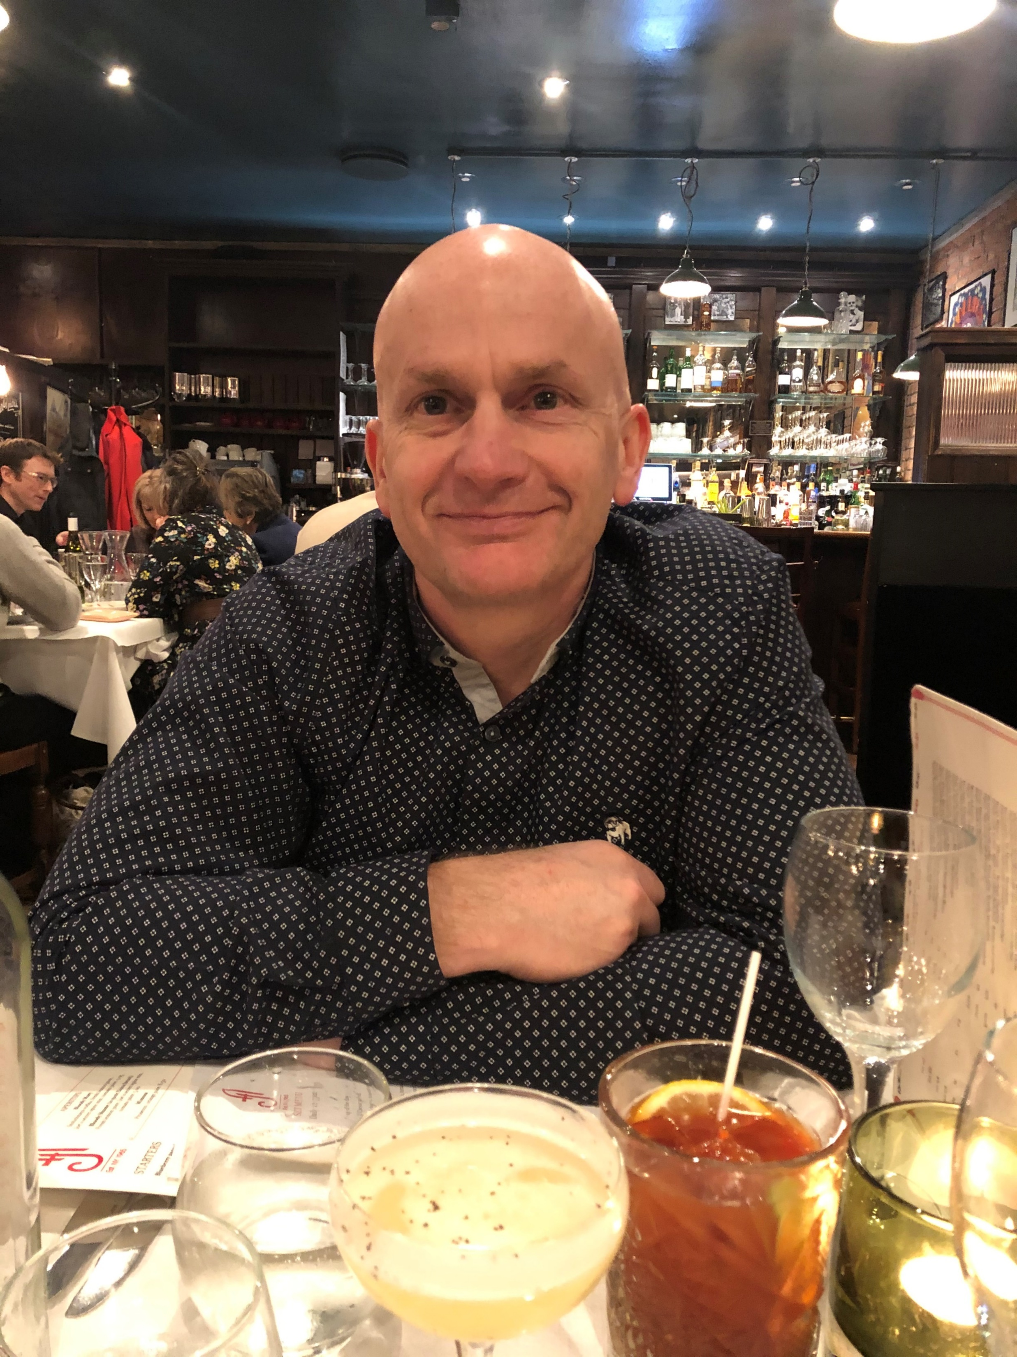
An investigation into running taster tutorials within prisons for non-OU students…
…and an evaluation of how we can improve support for Students in Secure Environments (SiSE)
colin.blundell@open.ac.uk

Slide 2

Going to Cover
Research project part 1
Research project detour
Things to improve
Outcomes-successes-suggestions
Positives

Slide 3
Project part 1: The plan
Running multiple tutorials in numerous NW prisons pre 2020
Busy short staffed education departments
Non-OU prisoners would ‘come and look’ at what we were doing
Barriers to taking up OU study
Taster sessions (Maths) with SiSE support team member
Focus on prisons with few or no OU student and woman’s prisons

Slide 4

Some facts and figures
Over 47% of prisoners in the UK don’t have any formal education
57% of adult prisoners had literacy levels below that expected of an 11-year-old
30% have Special Educational Needs and/or Disabilities (SEND)
43% decrease in reoffending rate for prison learners
13% higher chance of employment for prison learners
200 prisons, secure units, private prisons in UK
UK prison population approx 95,000
Woman make up 4% of total prison population
Prison education poor state-long term decline-Prison Reform Trust
OU SiSE students approx 2000

Slide 5
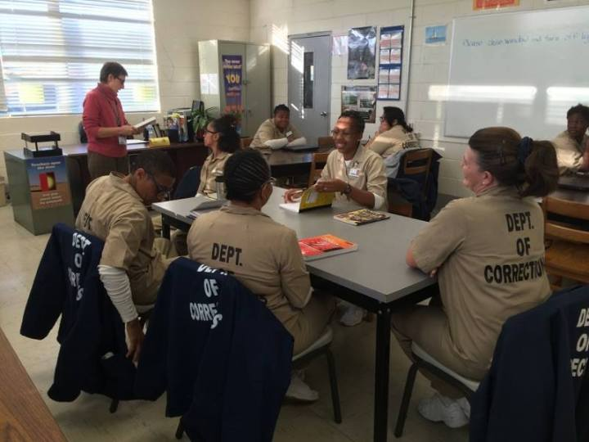
HMP STYAL WHAT I DID
High profile visit & 20 attendees
Their education experiences good and bad
Some basic Maths problems
Group work informal
SiSE session support
More interactive Maths/Engineering
Q&A and questionnaires
This Photo by Unknown Author is licensed under CC BY-NC

Slide 6
HMP STYAL EVALUATION
Getting a large cross section-HMP Preston example
Ministry of Justice (MoJ) and Offenders’ Learning And Skills Service (OLASS) buy in with OU
Prisoners think they can’t, not worthy, too difficult
“I always thought I would sink, so I never swam”
From Malibu by Miley Cyrus

Slide 7
“This project supports the ‘access to education for all’ agenda”
“The buzz in the room was palpable”
“I enjoyed the visit, some of the Maths was hard but appreciated the guys coming in to talk to us like we matter”
“I liked it that the 2 of them spent time talking to us and asking our opinions”
“I never thought I would be able to understand degree level Maths…but I did!”
“I don’t really like Maths but was very interested to hear about other modules”

Slide 8

Part 2 the detour
Poor timing-COVID
Prisons difficult to pin down
Felt like a sales pitch
Decided to change tack
In research “you find what you weren’t looking for”
SiSE only groups MU123 & MST124

Slide 9
SiSE only groups
Dedicated 121 support throughout via telephone tutorials
Student group of 12 not 20 due to extra work
AL doesn’t give cluster/module wide tutorials
No extra pay/FTE for SiSE only (if AL has SiSE student in regular group it does come with extra pay/FTE)
Dealing with numerous SiSE support groups across nations/regions
Includes released prisoners and those on probation

Slide 10

Evaluation
Evaluation & discussions with students, education departments, module teams, SiSE support, other ALs, curriculum managers
Build great education department relationships
AL becomes very knowledgeable about SiSE support
Huge amount of work in module early stages for AL
AL becomes aware of inner workings and can make a difference

Slide 11

Things to improve
Silo working
More consistent AL support for SiSE
Tutorial provision
Delays

Slide 12

Outcomes-Suggestions-Successes
MU123 iCMAs results and feedback
Alternative materials better clarity for AL & education department
AL SiSE training module
F2F tutorials, more efficient telephone, look at Adobe Connect and TEAMS
AL central in helping with delays-be proactive
MST124 Personal Tutor trial extended to released SiSE
Direct feedback from prisons very good

Slide 13

Positives
Always rewarding
Some fantastic students
Resets your own preconceptions

Slide 14

QUESTIONS?

