Slide 1
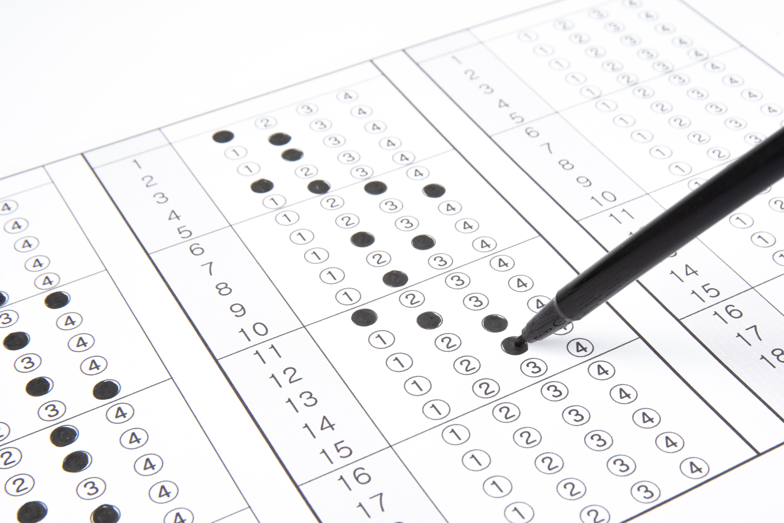

Intro Slide Title 1
How should formative assessments be assessed?
A study of S217 online quizzes
Jonathan Nylk and Andy Diament

Slide 2
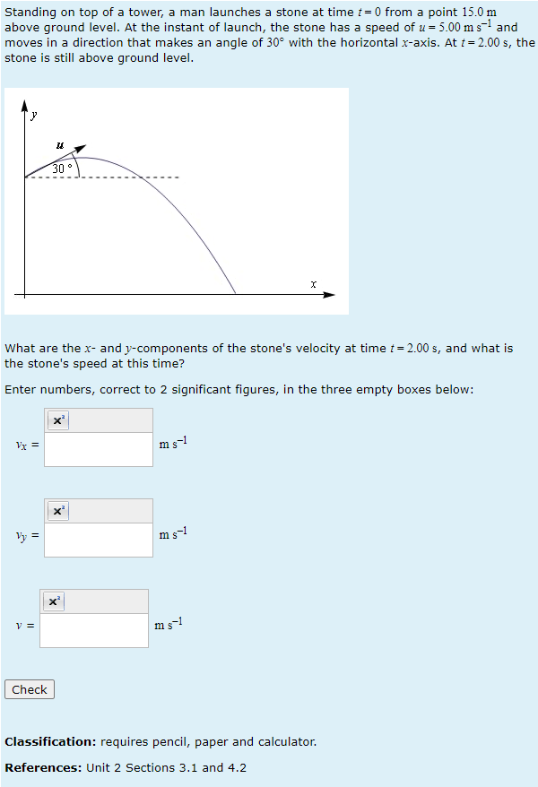
Formative activities are crucial for distance learning
Students engaging with formative activities are more likely to achieve success in summative assessments (Rust, O’Donovan, Price, 2005; Jordan & Butcher, 2010)
Tutor time is valuable but limited
Interactive online quizzes can act as a “tutor at the elbow”, providing immediate feedback (Ross, Jordan, Butcher, 2006)
Variation and randomisation allow reusability for more practice
However, engagement with optional activities can be low
How should formative activities be incentivised?

Slide 3
S217 assessment strategy
Physics: from classical to quantum
6 TMAs (5 formative, 1 summative (25%))
1 Exam (summative, 75%)
Additional requirements:
  30% threshold in exam
  40% threshold in 5 formative TMAs
8 online quizzes (all formative)
1 quiz per TMA, plus a maths revision quiz and another quiz on final topics with no TMA
Quiz engagement is prompted by reflective question in each TMA
S217 gives a unique opportunity to investigate the effect of indirect, reflective incentivisation
The effect of formative and summative incentivisation can also be studied

Slide 4
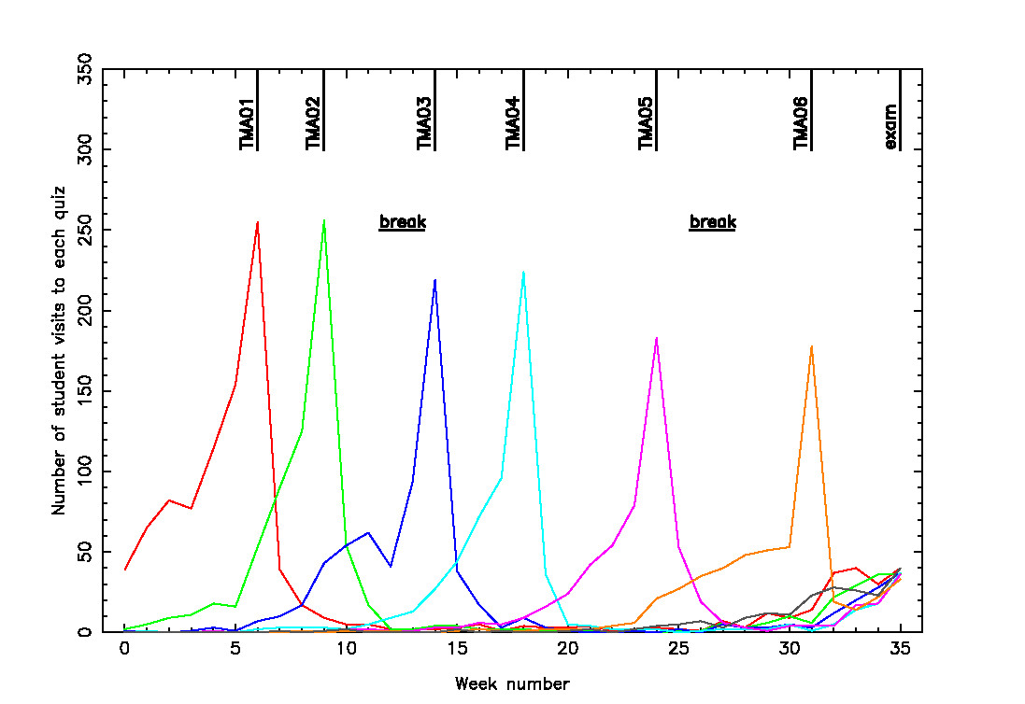
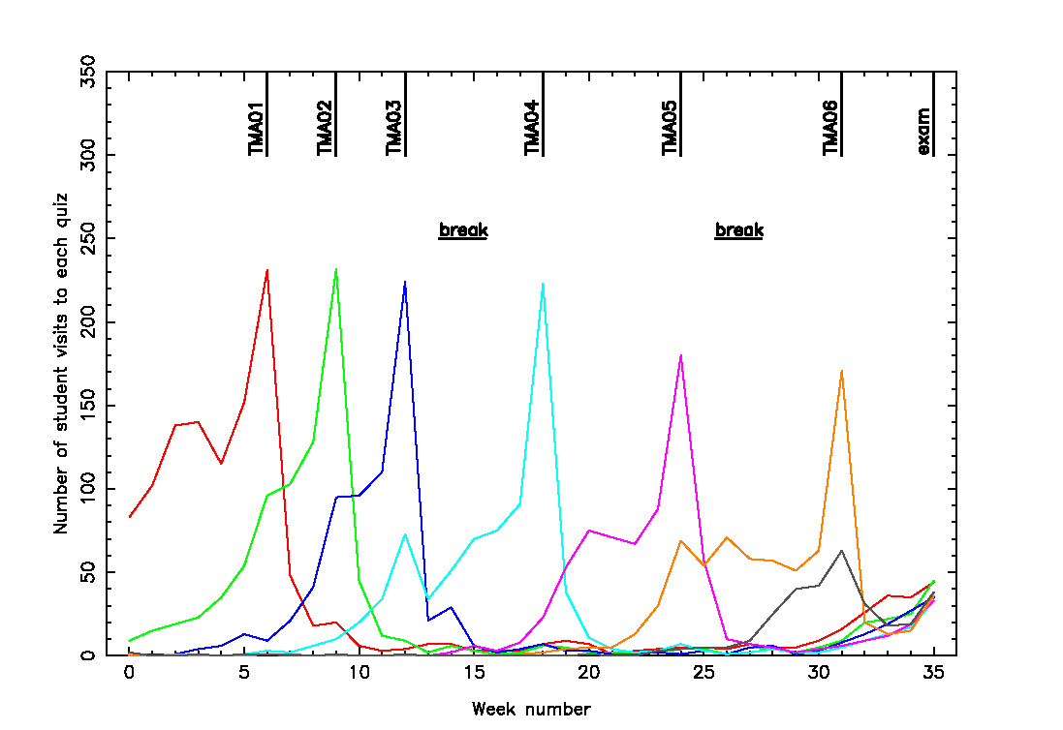
Prior work on S217 quizzes - Norton, 2016
Assessment analytics of student engagement with, and performance on, S217 online quizzes
15J
16J
Increasing visibility/signposting of quizzes in module materials and TMAs improved early engagement

Slide 5
Methodology
Quantitative
Qualitative
Learning analytics
Student survey
~1500 student records, 20J – 22J
Quiz engagement analytics
  Quiz scores
  No. of attempts
  Access times
Module outcomes
  TMA scores
  Exam score
13% response rate of 225 invited (30 responses, 22J)
April 2023 (between TMA05 and 06)
Coverage
  Quizzes
  Reflection on quizzes (in TMA)
  Reflection on TMA feedback (In TMAs)
What quiz use behaviours are markers for module success?
What motivates students to engage with the quizzes?

Slide 6
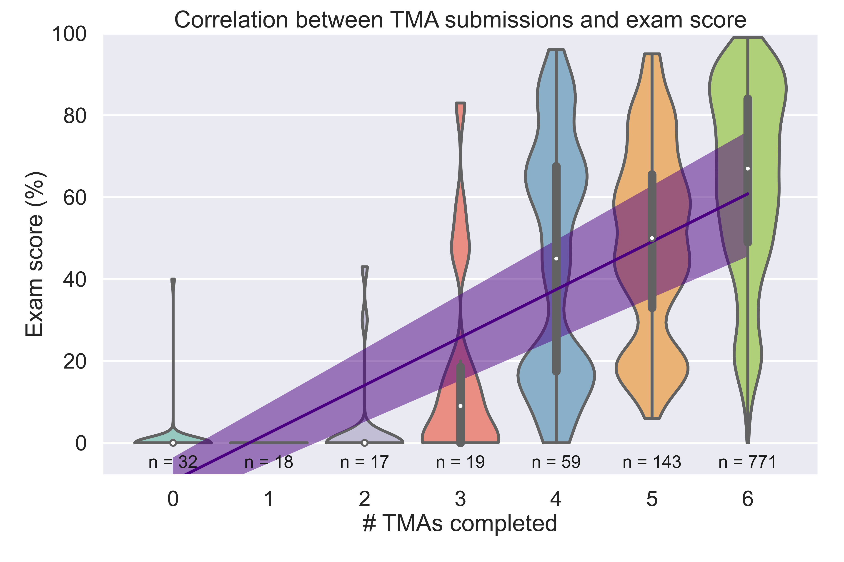
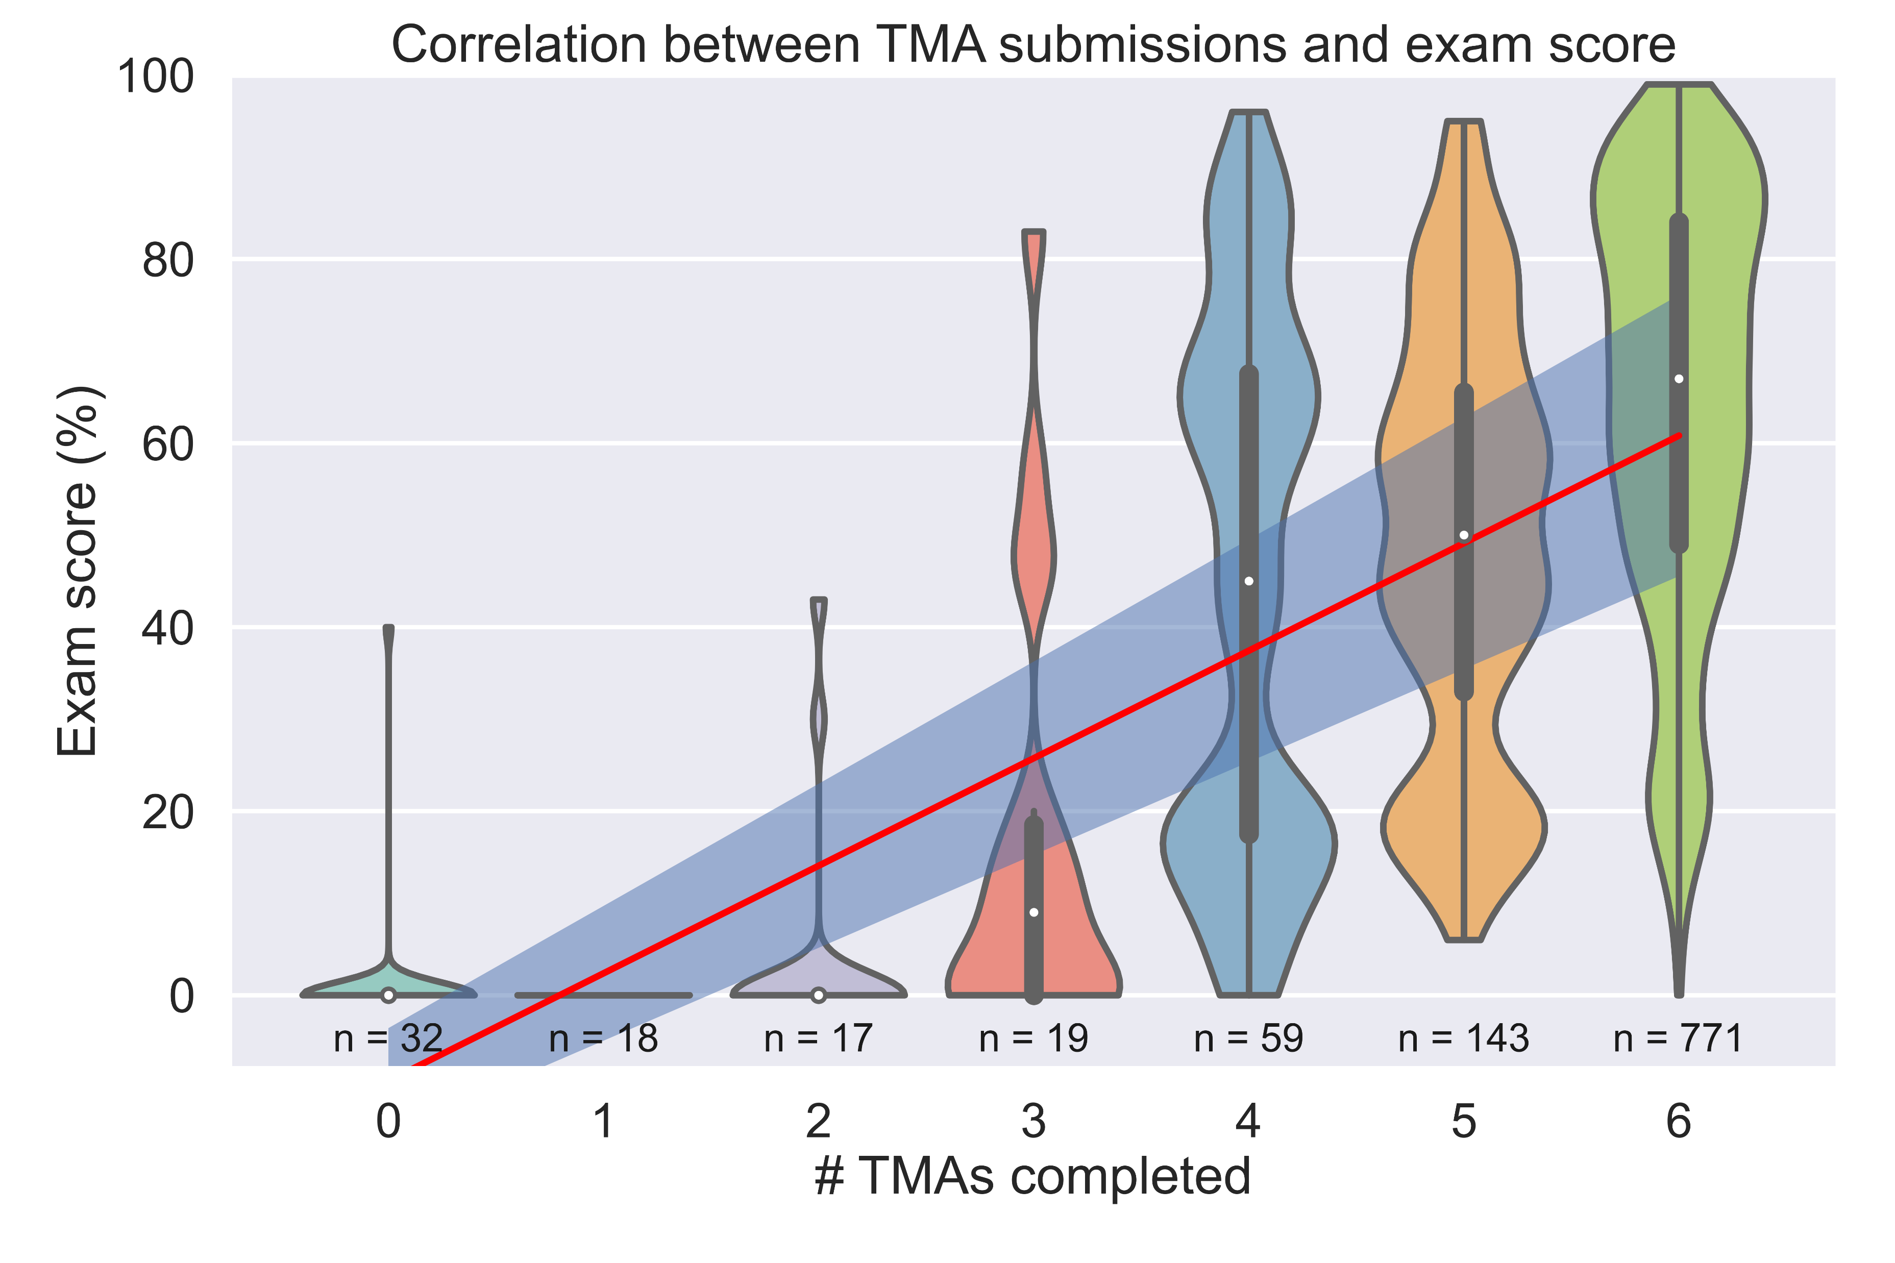
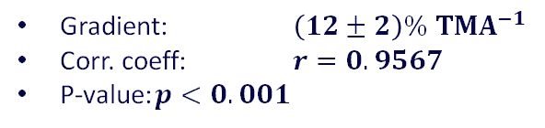
TMA submission is strongly linked with module success
Gradient: $\left(12±2\right)\% TMA^{−1}$
Corr. coeff: $r=0.9567$
P-value: $p<0.001$
Exam score has a strong dependency on number of TMA submissions
Possibly an artefact of TMA threshold requirement?
Some tutors suggested ‘strategically’ dropping the final TMA if a student was struggling

Slide 7
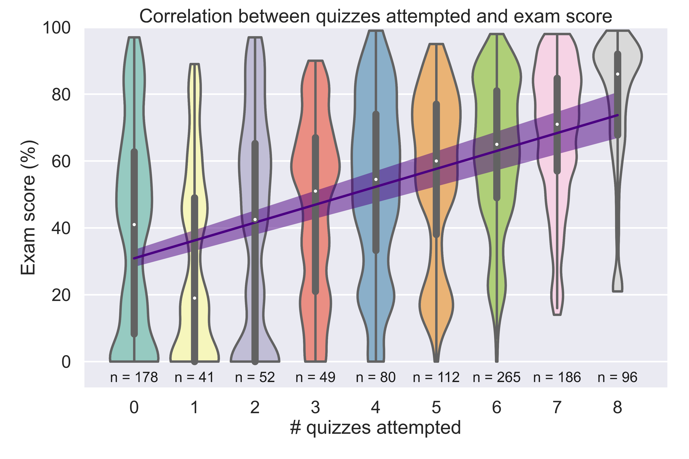
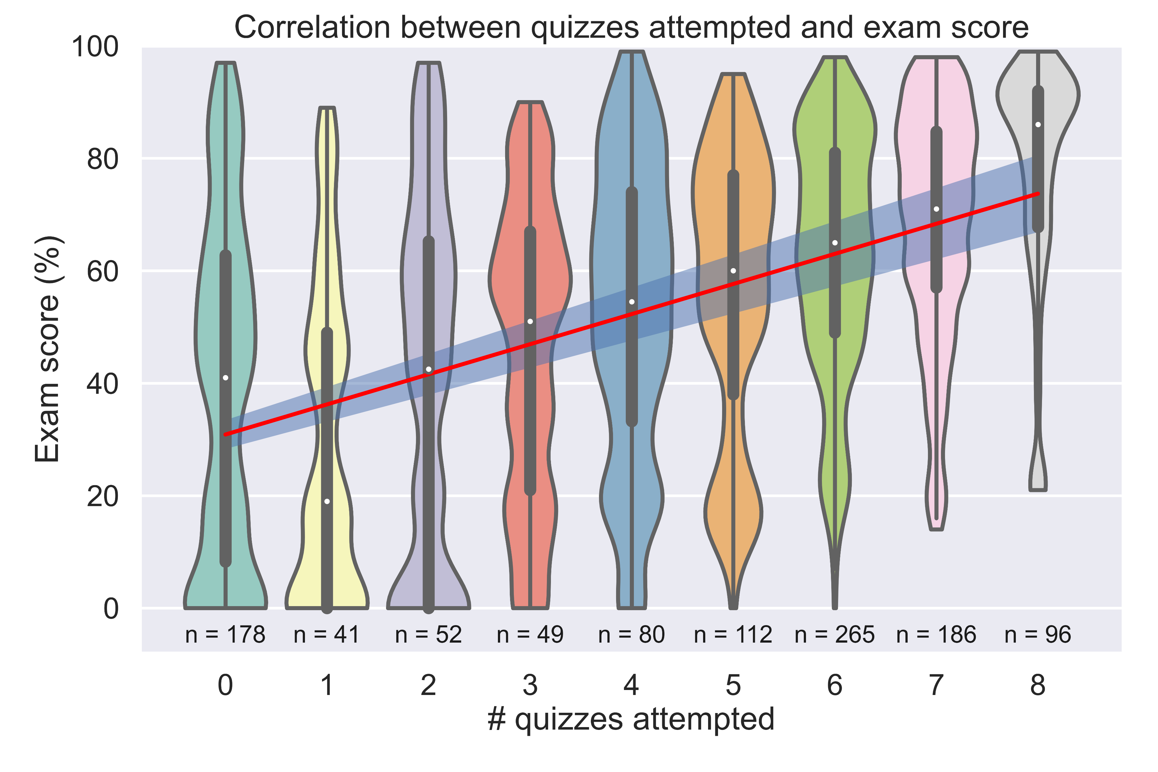
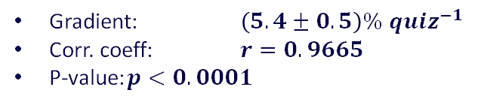
Quiz use is strongly linked with module success
Gradient: $\left(5.4±0.5\right)\% {quiz}^{−1}$
Corr. coeff: $r=0.9665$
P-value: $p<0.0001$
Most students engage with 6 quizzes (linked with TMAs)
No quiz engagement is also a large group
The difference between fully engaging with the quizzes and not, is the difference between achieving a distinction and barely scraping a pass in the exam

Slide 8
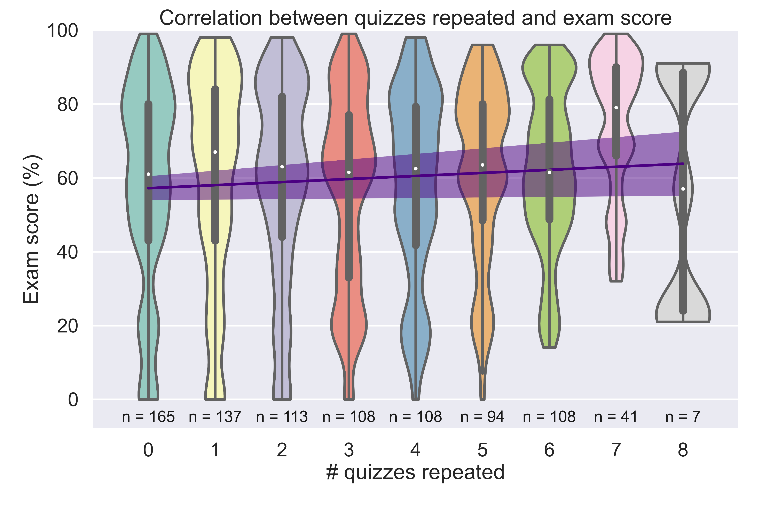
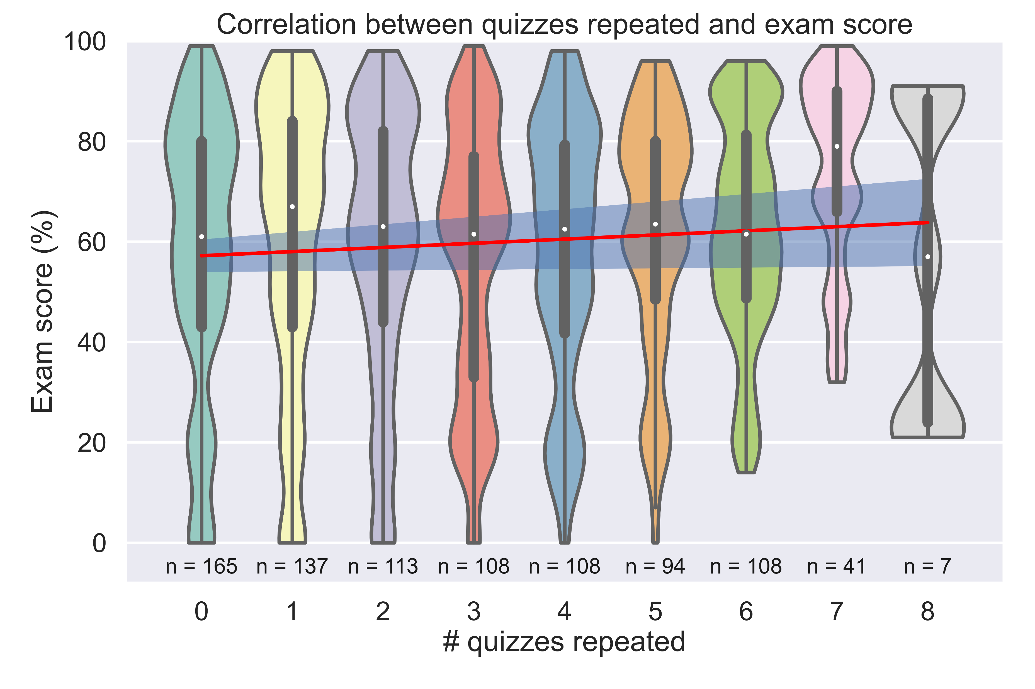
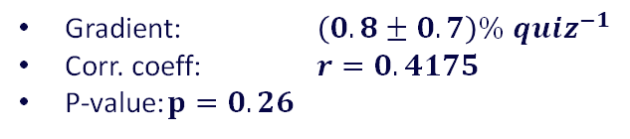
Quiz reuse is not linked with module success
Gradient: $\left(0.8±0.7\right)\% {quiz}^{−1}$
Corr. coeff: $r=0.4175$
P-value: $p=0.26$
Students are fairly evenly distributed between repeating 0 – 6 quizzes
Quiz reuse shows no apparent trend
  Or does it?

Slide 9
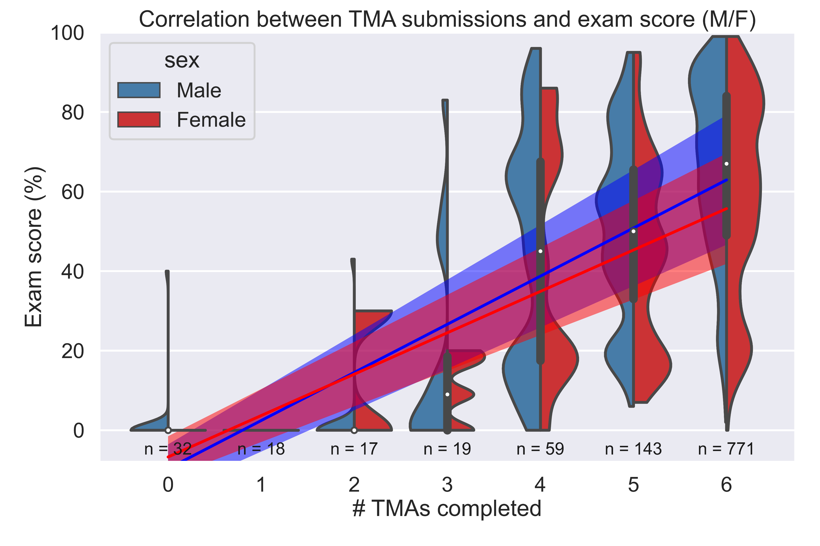
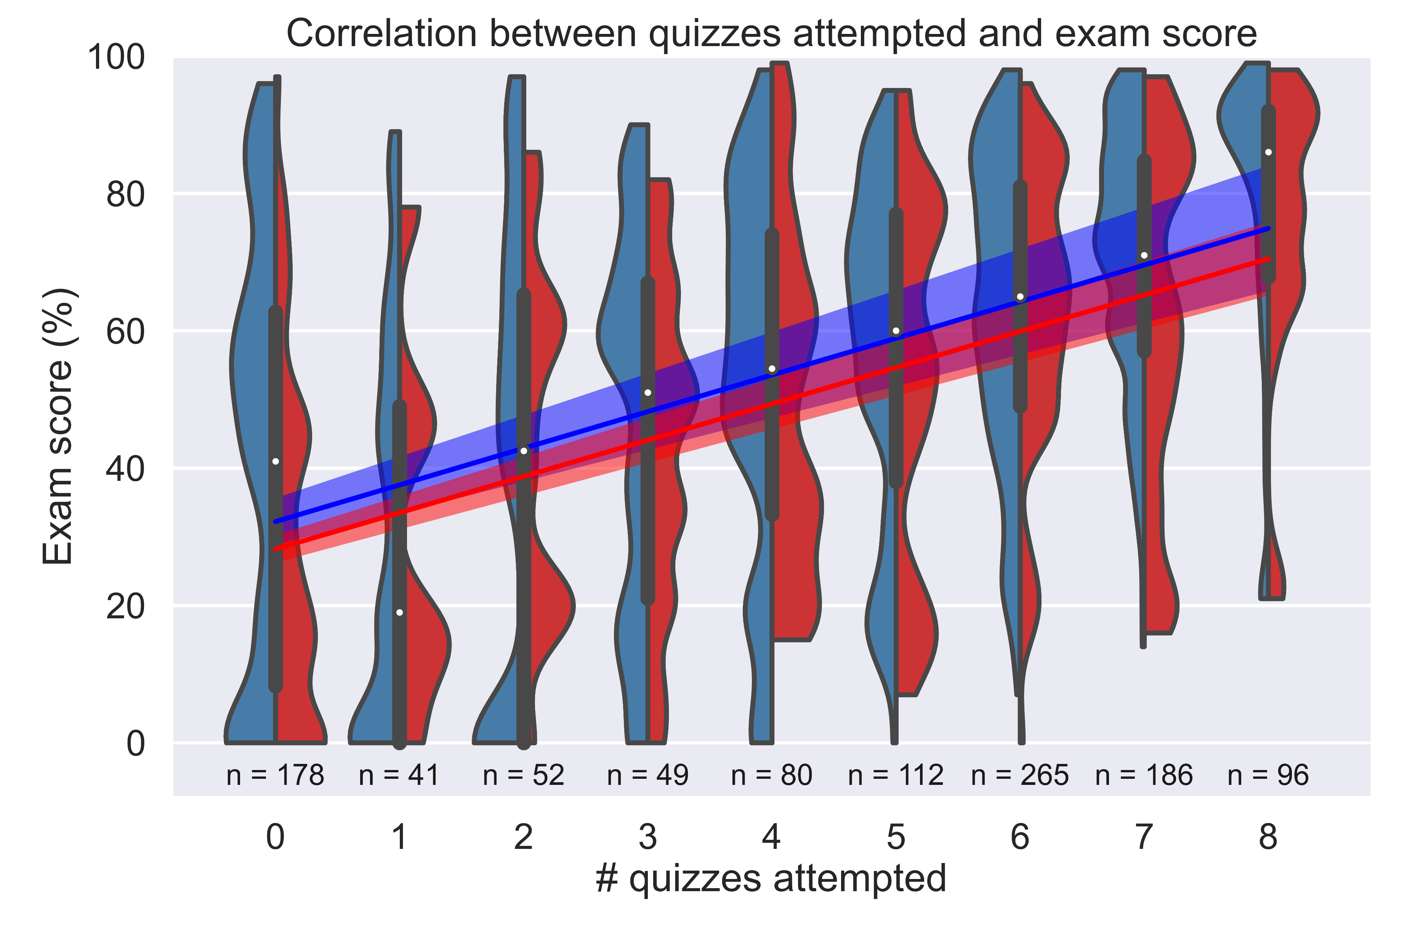
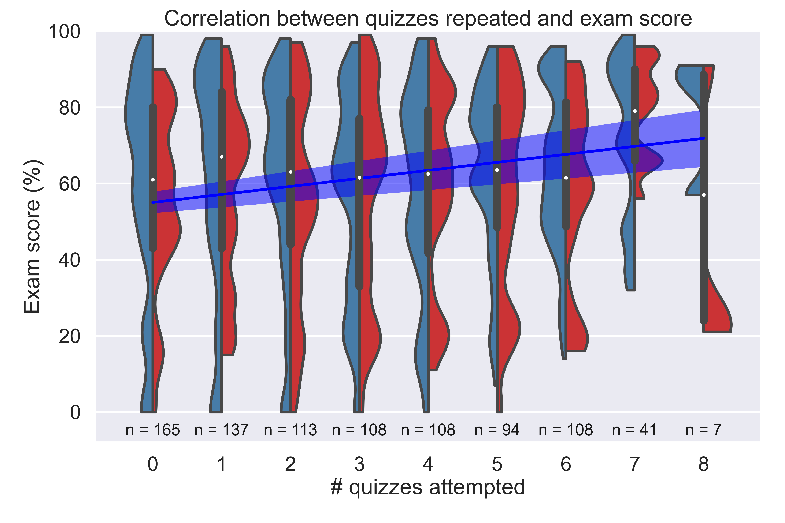
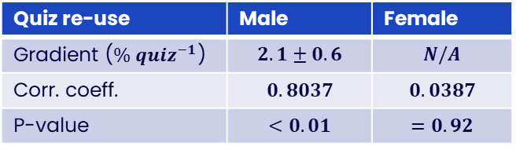
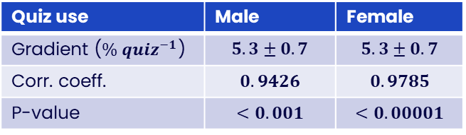
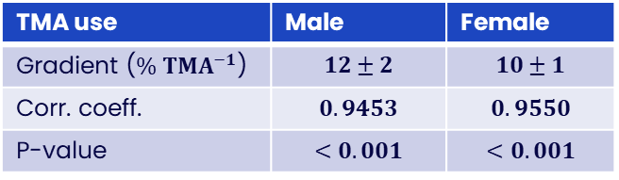
Quiz reuse shows a strong gender dependence
TMA use | Male | Female
Gradient ($\% TMA^{−1}$) | $$12±2$$ | $$10±1$$
Corr. coeff. | $$0.9453$$ | $$0.9550$$
P-value | $$<0.001$$ | $$<0.001$$
Quiz use | Male | Female
Gradient ($\% {quiz}^{−1}$) | $$5.3±0.7$$ | $$5.3±0.7$$
Corr. coeff. | $$0.9426$$ | $$0.9785$$
P-value | $$<0.001$$ | $$<0.00001$$
Quiz re-use | Male | Female
Gradient ($\% {quiz}^{−1}$) | $$2.1±0.6$$ | $$N/A$$
Corr. coeff. | $$0.8037$$ | $$0.0387$$
P-value | $$<0.01$$ | $$=0.92$$
Reuse of online interactive quizzes appears to be a more effective learning strategy for men than for women

Slide 10
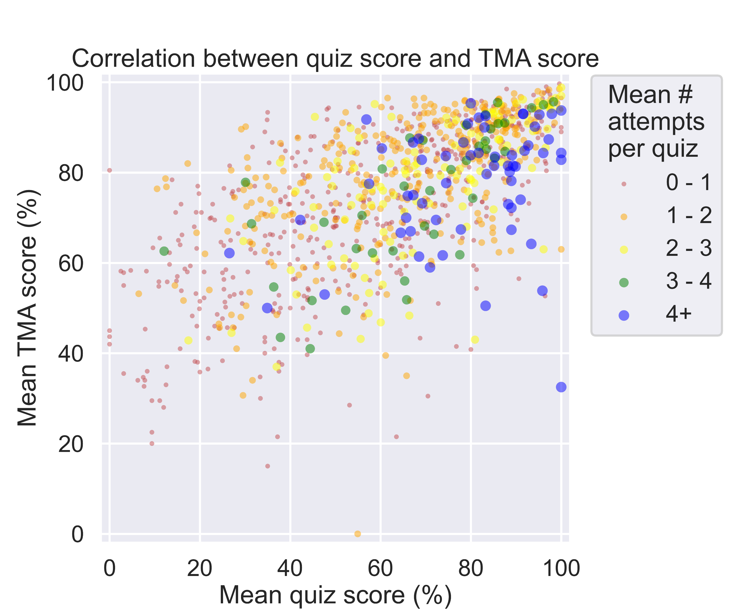
Is reflection incentivisation influenced by marks?
Quiz/TMA number | Corr. coeff. | # students attempted quiz | # times quiz accessed
1 | 0.6253 | 2355 | 8816
2 | 0.4796 | 2512 | 6934
3 | 0.4846 | 1861 | 6272
4 | 0.4632 | 2104 | 7316
5 | 0.4990 | 1717 | 6883
6 | 0.4703 | 1536 | 6133
TMA04 is summative
More students engage with quiz 4
No other effects observed
Incentivisation by reflection is not strongly influenced by summative marks

Slide 11
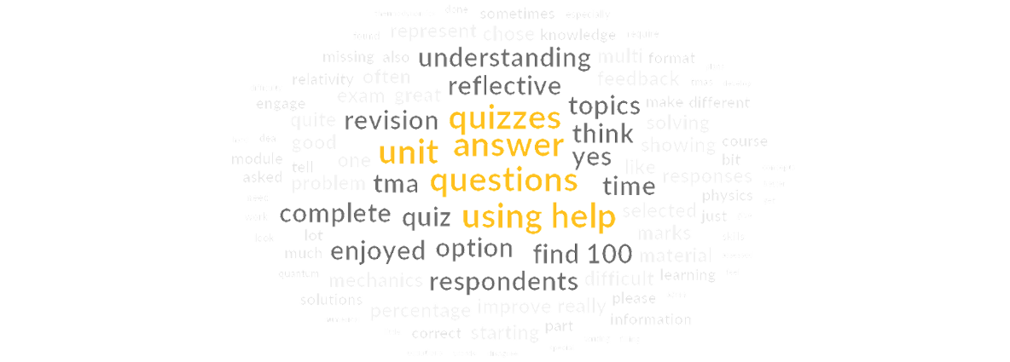
Chapter Title 1
Survey results

Slide 12
Page Title 2
Survey Details
Open between 6th April 2023 and 27th April in 22 J presentation
Between TMA05 and TMA06
Multiple choices, Likert scales, free responses
30 replies – 13% of cohort invited to participate (225) and 9% of registered students (350)
  Warmup – general enjoyment
  Quiz completion and revisiting
  Useful quiz questions
  Reflecting on quizzes in TMAs
  Reflecting on feedback in TMAs
 | Mean TMA Score | Standard deviation | Mean Exam Score | Standard Deviation
All students | 75.3 | 21.3 | 60.1 | 27.4
Surveyed Students | 80.4 | 19.3 | 66.7 | 23.1
Notes:
Warm ups indicated students enjoy the module a great deal and favourite topic is quantum physics, least fave is gases/thermodynamic
Though surveyed students appear to score better, difference is not significant, z= 0.24 for both measures, p(survey mean > population mean) = 0.41

Slide 13
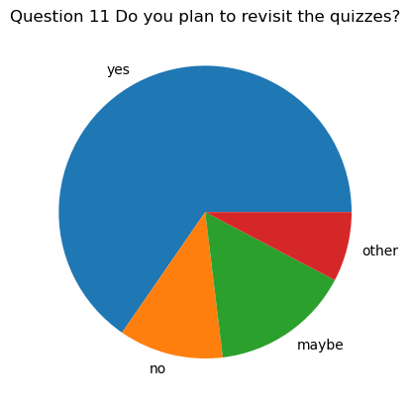
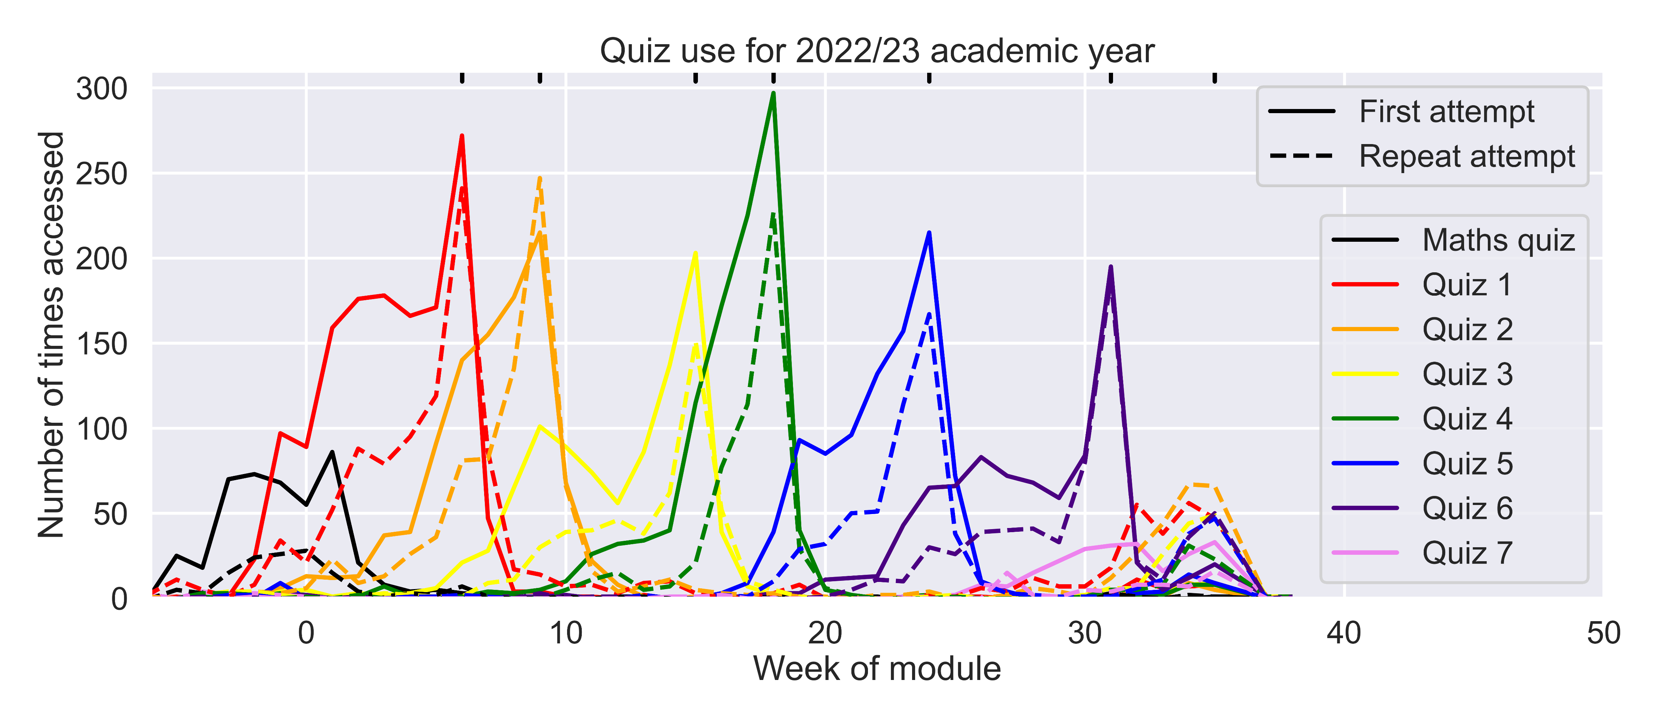
Revisiting Quizzes
Most students intended to revisit the quizzes
A lot of revisiting occurred within the module: students returned to individual questions over multi-week span of quiz
Revision was given as the main reason for revision
In reality, significant use in revision period

Slide 14
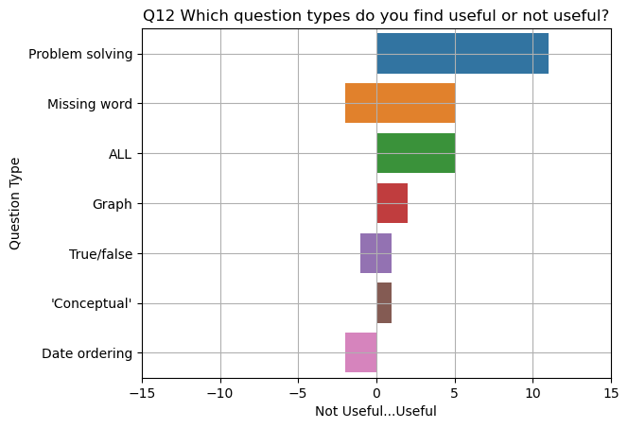
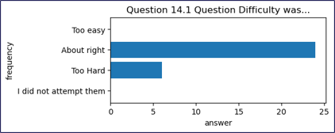
Pie Chart 5
Questions – types and difficulty
Question types
Date Ordering is putting discoveries in time order
Anecdotally, students more likely to mention True/False as useful in TMA feedback
Difficulty
About right or on the hard side
Not considered easy or trivial

Slide 15
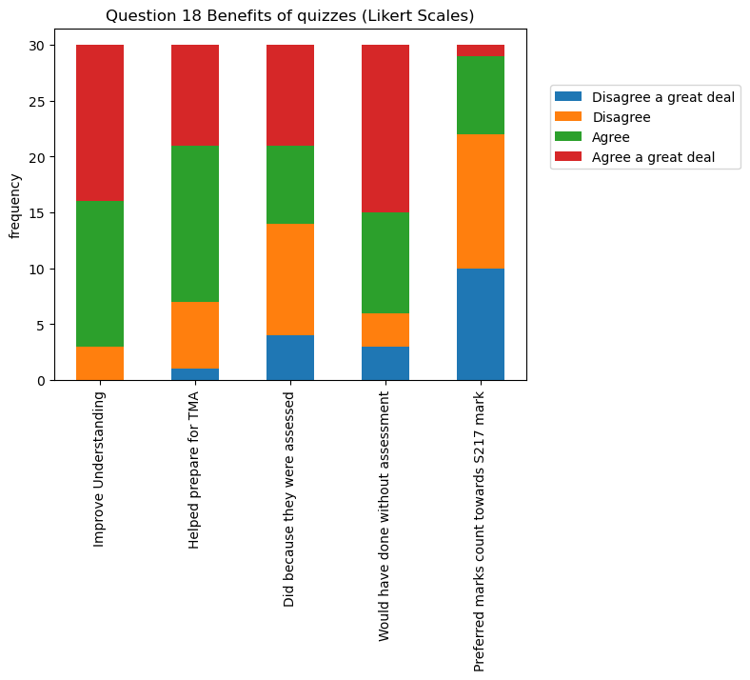
Benefits of quizzes
Agreement ranked
Strongest agreement
Quizzes improve understanding
Would have done quizzes even if no marks given in TMAs
Quizzes help TMA preparation
Did quizzes just because they were assessed (50% agree, 50% disagree)
Should be part of TMA final mark
Weakest agreement

Slide 16
Reflective TMA Questions
First question in each TMA for prominence
2 marks for evidence of doing the relevant quiz
4 marks for reflection on the quiz
4 marks for reflection of TMA feedback (after TMA02)
Counts towards OES in TMA04 – ‘straightforward’ marks
Some found them useful ​
They help me reassure myself and reflect on skills I gain.​
I suspect their value will come later when I have to list what I know and or skills i've developed doing tis (sic) module.​
helped me to understand`d how the quizzes improved my skills.​
Some found them less useful.​
I find reflective questions totally useless and a complete waste of time.​
For me it doesn't help my skills/knowledge​
Personally, they did very little to improve my skills. I only answered them to get the grade.

Slide 17
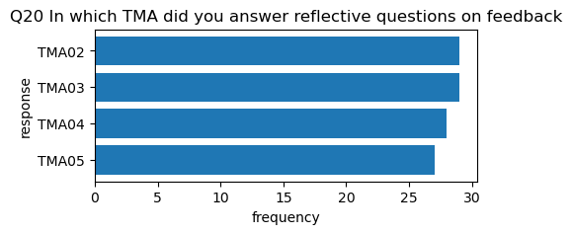
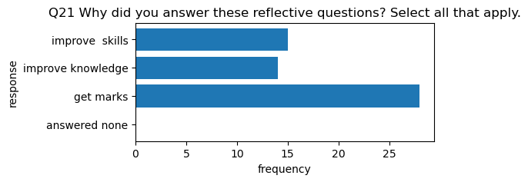
Reflecting on TMA feedback
Mixed answers
“Mainly improving my mathematics, layouts of answers and other small details. I don't think it improved my knowledge of physics as a subject though”
“I picked up marks the next time round thanks to the reflection”
“My answer to Q1c was often a lie to get the marks”
“forced me to properly engage with the feedback on my TMAs and also reminded me to apply it in the TMA I was actually working on”

Slide 18
Survey takeaways
Quizzes are widely used by students
Quizzes are useful for improving understanding and TMA preparation
Quizzes can be time consuming and difficult to interpret what is required
Students do not want (these) quizzes to contribute to overall mark
Many students see value in reflecting on tutor feedback – directs them to apply feedback in TMA they are working on
BUT
Some students see no value in reflection and give reflect 'flippantly' to get marks

Slide 19
Conclusions
Strong relationships between quiz use, TMA submissions and exam performance
  TMAs are an indicator of passing the module
  Quiz use is an indicator of how good a pass
Quizzes are useful for improving understanding and TMA preparation
Students do not want (these) quizzes to contribute to overall mark
Many students see value in reflecting on tutor feedback – directs them to apply feedback in TMA they are working on

Slide 20
References
Agnew, S., Kerr, J. & Watt, R. (2021), ‘The effect on student behaviour and achievement of removing incentives to complete online formative assessments’, Australasian Journal of Educational Technology, 37(4), pp. 173–185.
Jordan, S. & Butcher, P.G. (2010), ‘Using e-assessment to support distance learners of science’, in The GIREP-EPEC & PHEC 2009 International Conference, 17-21 Aug 2009, Leicester, UK.
Kibble, J. (2007), ‘Use of unsupervised online quizzes as formative assessment in a medical physiology course: effects of incentives on student participation and performance’, Advances in Physiology Education 31(3), pp. 253–260.
Ross, S., Jordan, S. & Butcher, P. (2006), ‘Online instantaneous and targeted feedback for remote learners’, Innovative assessment in Higher Education, pp. 123–131.
Rust, C., O’Donovan, B. & Price, M. (2005), ‘A social constructivist assessment process model: how the research literature shows us this could be best practice’, Assessment & Evaluation in Higher Education, 30(3), pp. 231–240.

Slide 21
Slide Title 30
Thank you

