Slide 1
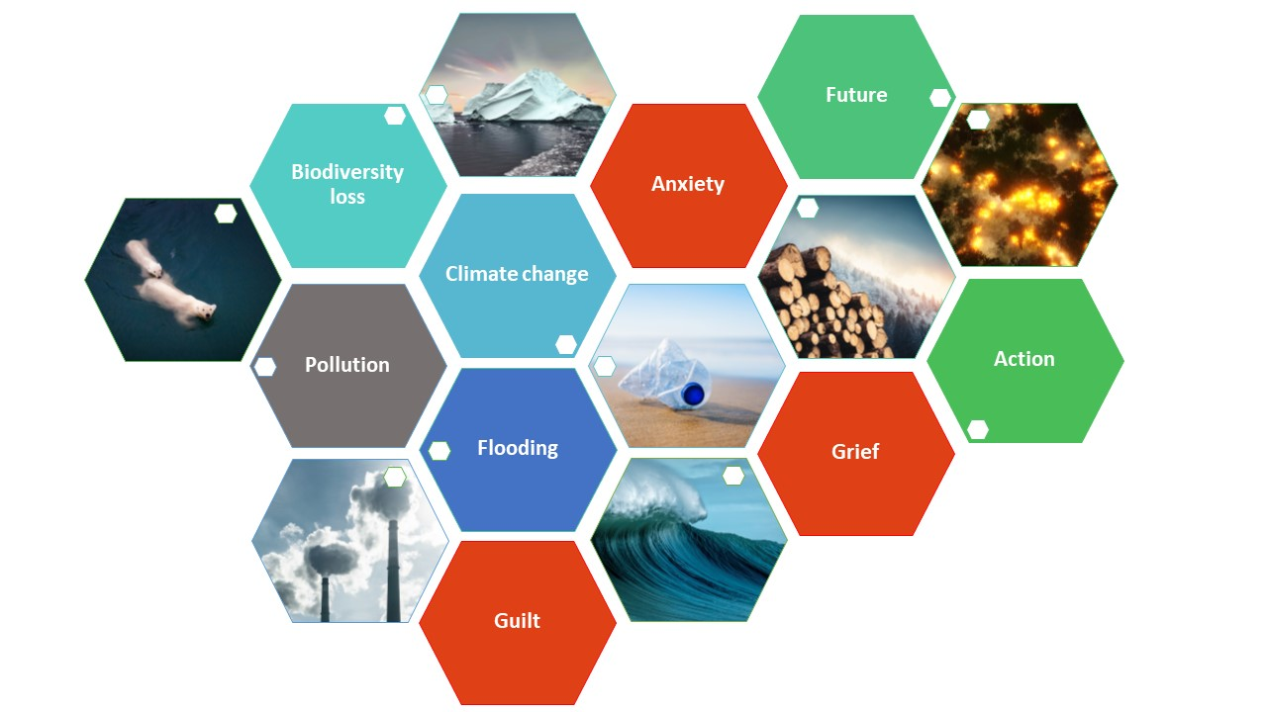

Ecoanxiety and environmental
education:
Stories, conversations, actions
Sarah Davies, Fiona Aiken, Elaine McPherson, Volker Patent, Maria Townsend, Debra Croft, Harriet Marshall, Joanna Shelton & Kate Lister
11th April 2023

Slide 2
Project background
Ecoanxiety
The distress related to the climate and ecological crises
Connected to negative emotions of grief, guilt and hopelessness
But also to positive, adaptive or ‘practical’ responses
Our students
Anxiety expressed to tutors
Threads on forums:
- concern over a range of issues
- get and share your good news here
Pilot question: 56% of survey respondents said studying their module made them anxious about the environment and climate change. Expressed feelings of fear, worry and being overwhelmed, but also empowerment and determination to help
OU students’ anxiety around environmental issues, impacts on their learning and managing ecoanxiety
Notes:
Ecoanxiety is the distress related to the climate and ecological crises. Whilst it is, perhaps, a rational reaction to climate change, biodiversity loss and other environmental issues, ecoanxiety is often connected to negative emotions of grief, guilt and hopelessness. But it can also be linked, more positively, to adaptive or ‘practical’ responses. The impacts of ecoanxiety on wellbeing may be unequal, depending on individual circumstances and capacities
We know the effects of climate change are unequal but we still know less about ecoanxiety
Results so far are mirrored in wider population of OU students – this level of worry is not limited to environment students

Slide 3

Ecoanxiety and environmental education
Aims
To provide support for students dealing with ecoanxiety
To use student experiences to inform curriculum and pedagogy to take account of ecoanxiety linked with their environment education and to help equip students to have an impact in the world
Approach
Literature review of ecoanxiety and environmental education
Review core environmental science modules for issues and approaches
Explore student experiences of ecoanxiety
Explore tutors' experiences of supporting students with ecoanxiety
Provide support : webpage and digital stories

Slide 4
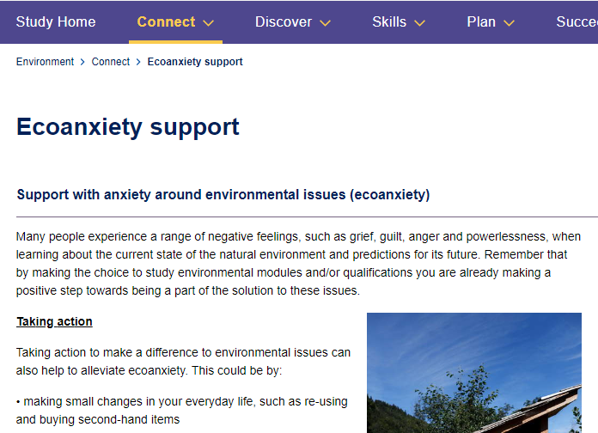
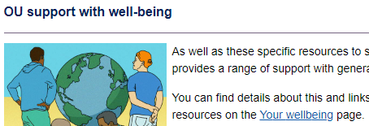

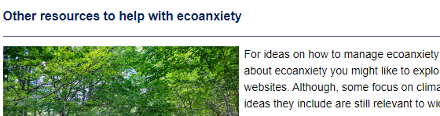
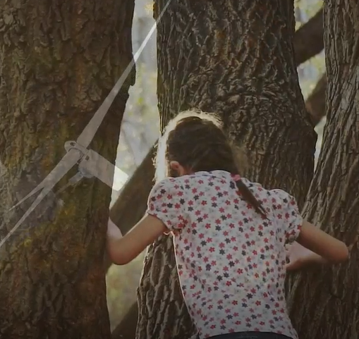

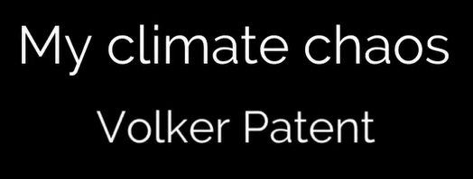
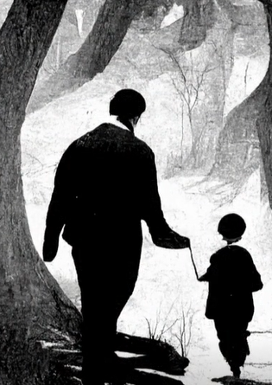
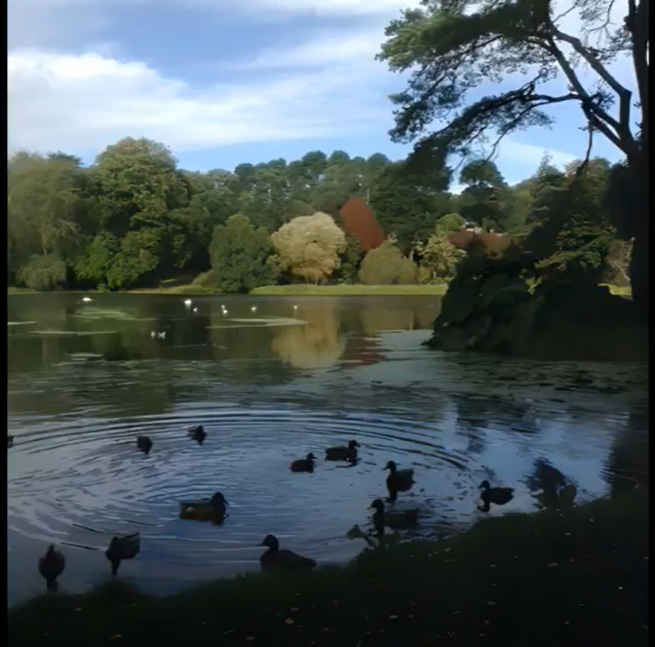
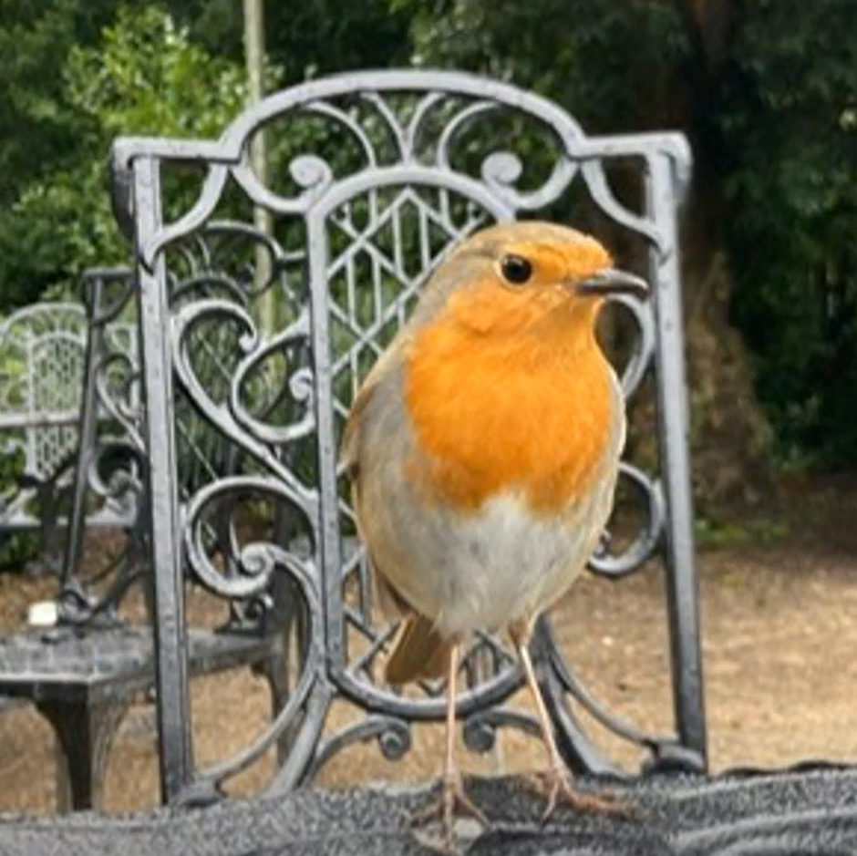
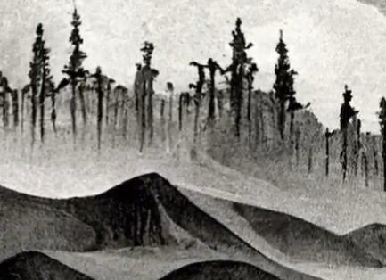
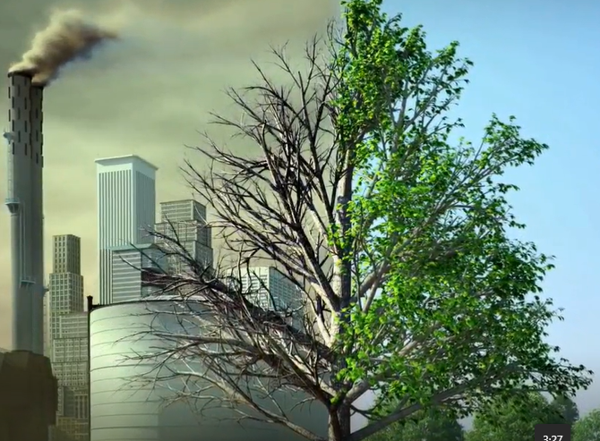
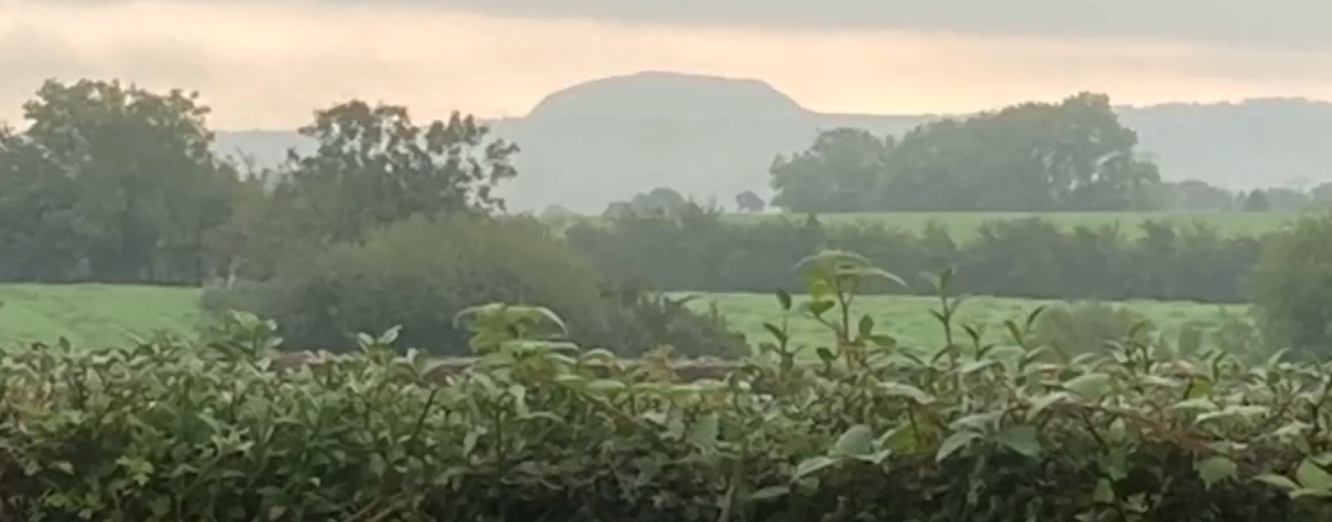
Support resources
1. Ecoanxiety webpage
Environment subject website, under the Connect tab
Website: Environment | OU online (open.ac.uk)
2. Digital storytelling
Environmental stories / journeys from a variety of people
Notes:
Approach to collecting stories… workshop … skills development

Slide 5
Results
Module review
Good practice examples
U116: Calculating your carbon footprint: examples of what actions individuals can take as active citizens
S112: Warns students that they will learn about negative impacts of env change
S206: makes it clear we can address concerns with science
DD210: Acknowledges that knowing about environmental problems can cause anxiety
DST206: How different actors mobilise and cooperate around addressing environmental issues
SDT306: Covers biodiversity loss … then covers reversing this loss
Issues
Cover a wide range of negative environmental impacts
Sometimes no acknowledgement of how students may feel about troubling topics, what they can do or where they can access support

Slide 6
Results
Student ecoanxiety survey : validated scale developed by Ágoston et al. (2022) with additions around OU module content
agree and strongly agree
Strong feelings
I worry about the next generation because they will be drastically affected by climate change = 93%
It makes me angry that many people fail to do even the most basic things to protect the environment = 89%
I am terrified by how things have changed in just a few years because of climate change = 77%
Negative consequences
I worry that every decision I make will result in something harmful to the environment = 44%
I am so anxious about climate change that I cry = 26%
I am so anxious about climate change that it affects my performance at university = 11%
OU study
I do not look forward to studying OU material relevant to human-made environmental impacts = 13%
I feel that learning about climate change at a distance increases my anxiety = 15%
My feelings about the content of what I study get in the way of studying at the OU = 6%
Ágoston, C., Urbán, R., Nagy, B., Csaba, B., Kőváry, Z., Kovács, K., Varga, A., Dúll, A., Mónus, F., & Shaw, C. A. (2022). The psychological consequences of the ecological crisis: three new questionnaires to assess eco-anxiety, eco-guilt, and ecological grief. Climate Risk Management, 37, 100441.
Notes:
Student survey (260 responses, 10% response rate)
The survey utilises standardised eco-anxiety scale strategies using a validated scale developed by Ágoston et al. (2022). This scale was selected because it makes fewer assumptions than other scales and shows good reliability and validity. Covers habitual ecological worry + negative consequences of eco-anxiety
A few questions were also included to ask students about their reactions to OU module content relating to environmental issues, such as climate change and biodiversity loss.
11 student interviews

Slide 7
Results
About OU teaching
agree and strongly agree
Content and Emotion:
My module has provided me with content that helps me to cope with any environmental anxiety = 51%
I felt that my module supported me emotionally = 41%
Empowered and Determined:
Studying my module has made me feel more empowered = 78%
Studying my module has made me feel more determined to help mitigate
human-made environmental impacts = 93%
Support
I felt supported by my peers in discussing environmental issues that may cause me anxiety = 54%
I felt supported by my tutor in managing any anxiety around environmental issues = 61%
Where would you be likely to go for support for ecoanxiety?
Most likely: friends and family, internet search
Less likely: module forum, social media, student support team, counselling, GP
Ágoston, C., Urbán, R., Nagy, B., Csaba, B., Kőváry, Z., Kovács, K., Varga, A., Dúll, A., Mónus, F., & Shaw, C. A. (2022). The psychological consequences of the ecological crisis: three new questionnaires to assess eco-anxiety, eco-guilt, and ecological grief. Climate Risk Management, 37, 100441.

Slide 8
Results
How do you manage your ecoanxiety?
I remember that me knowing more doesn't make the problem bigger, I’m just more aware/alert to reality
I distract myself until I’m ready to start studying again
I remain optimistic in the knowledge the course brings
I had to approach it a little at a time, also researching the problem further and looking at the current mitigation
I don’t encounter anxiety

Slide 9
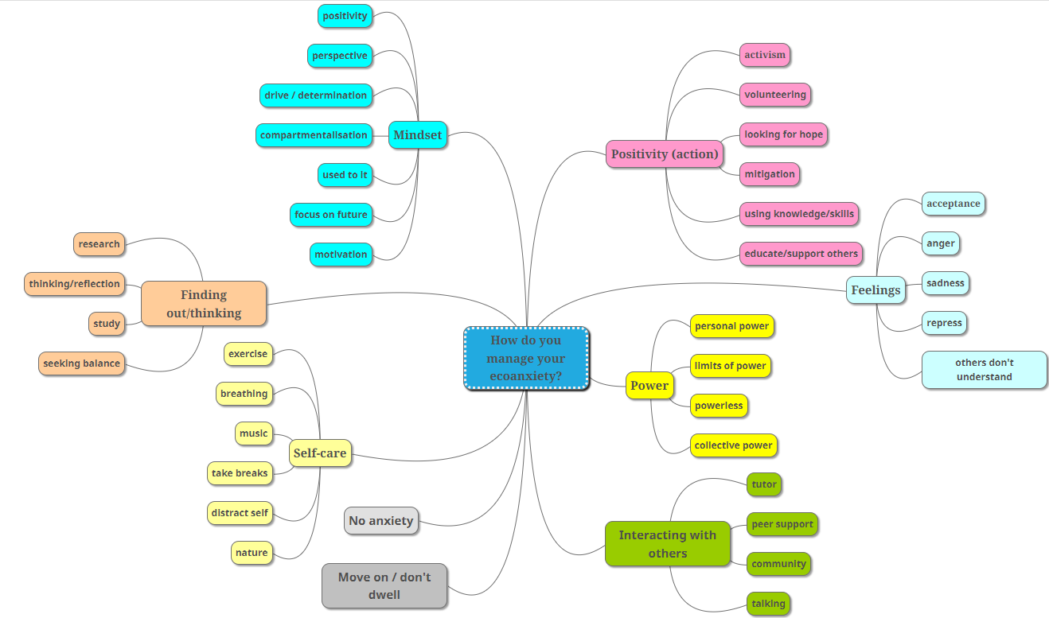
Thematic
analysis

Slide 10
Results
Student interviews: How could the OU improve support for ecoanxiety?
  Online café or conversation space
  Workshops on how to set up a local group or network
  In hard hitting modules /sections - discussion forum about thoughts and feelings
  Local and face to face meet ups
Opportunities for peer support, peer learning
Signposting
Trigger warnings
Social media etc.
To outside material, groups
Suggestions for action,
turn learning into action
In module materials
  More and varied social media (less formal than forums)
  WhatsApp or similar that a tutor could engage with - for those that feel anxious and want to discuss the issues
  More discussions, somehow

Slide 11
Summary and next steps
Findings
There are high levels of ecoanxiety and strong feelings amongst our environment students
A high proportion feel their study is empowering and makes them more determined to help the environment
Fewer students feel it has a negative impact on their study
Students are not always feeling they can turn to us for support
Next steps
Ongoing data analysis…
Exploration of AL experiences of students expressing ecoanxiety and how to support students
Recommendations for module teams and tutors
Open Societal Challenge : Ecoanxiety and environmental education project accepted at the initiate phase
A new Pan-OU scholarship project: extending this work to other areas of OU teaching: embedding sustainability across the curriculum: survey is live now!!
Notes:
Benefits gained and lessons learned

Slide 12
Slide Title 30
Thank you

