Slide 1

Intro Slide Title 3
Developing reflective assessment tasks to engage physics students with the key sustainability competencies
The 13th eSTEeM Annual Conference
Open University, Milton Keynes, 10-11 April 2024
Martin Braun, Anita Dawes, Sally Jordan, Carlton Wood, Olga Andrianova, Maria Nita, Georgina Gough, Kathleen Calder, Paul Astles, Rosie Meade, Teresa Cox and Anna Elliott
Email: martin.braun@open.ac.uk
11 April 2024, 1 pm - Parallel Session J

Slide 2

Show of hands
Have you heard of the:
17 Sustainability development goals?
8 Key sustainability competencies?
OU employability framework?

Slide 3
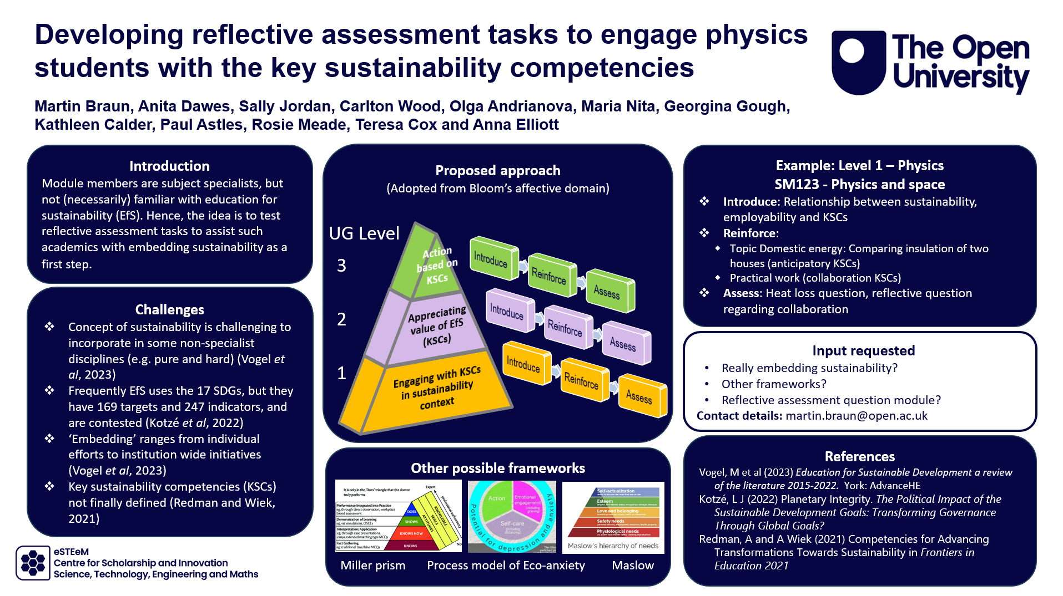
Purpose of presentation
Engage in academic debate on embedding sustainability
Ask provide feedback and critique
Valid approach to embed sustainability?
Email:
martin.braun@open.ac.uk

Slide 4
Presentation overview
Problems with embedding sustainability in physics
Approach selected
Example

Slide 5

Slide Title 2
Problem space

Slide 6
What are the challenges to ‘embedding sustainability’?
Problem space
17 SDGs
169 targets & 247 indicators
Are contested
Non-specialist discipline
Key sustainability competencies
Not finally defined
Embedding?
… and others

Slide 7
Problem & project aim
Problem statement
Module team members are subject specialists and not (necessarily) familiar with education for sustainability. Hence, they may feel reluctant to embed sustainability.
Project aim
Produce and test reflective TMA tasks which can be easily adapted to a wide variety of modules as a starting point.

Slide 8

Slide Title 2
Approach

Slide 9
Adapted from the Affective Domain (Bloom)
UG Level
KSCs really embedding sustainability?
Action based on KSCs
Appreciating value of EfS (KSCs)
Engaging with KSCs (in sustainability) context
Introduce
Reinforce
Assess
3
Introduce
Reinforce
Assess
2
Introduce
Reinforce
Assess
1

Slide 10
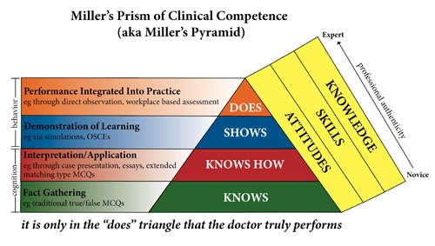
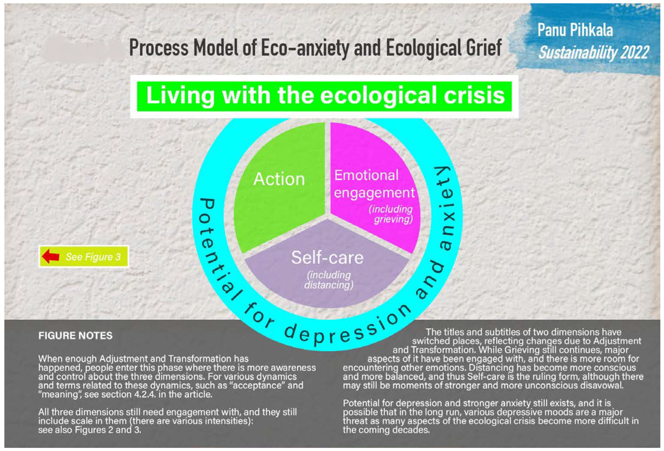
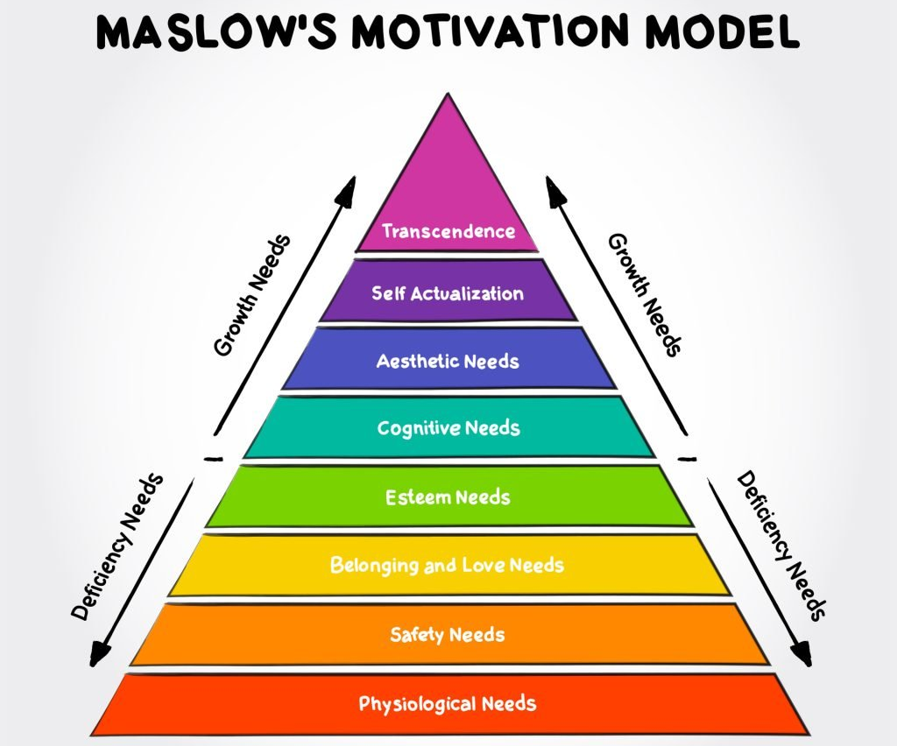
Other possible frameworks
Any of them better?

Slide 11

Slide Title 2
Example

Slide 12
Assess
Reinforce
Introduce
Level 1 Physics: SM123 - Physics and space
Heat loss question
Reflective question regarding collaboration
  Topic Domestic energy: Comparing insulation of two houses (anticipatory KSCs)
  Practical work (collaboration KSCs)
Relationship between sustainability, employability and KSCs

Slide 13
Input requested
KSCs and affective domain
Really embedding sustainability?
Affective domain pyramid
Other framework better?
Q&A
Reflective assessment question model?
Email:
martin.braun@open.ac.uk

Slide 14
Slide Title 30
Thank you

Slide 15
Slide Title 31

