Slide 1


To Evaluate the Effectiveness of Focused Staff Training
in Recruitment on Specialised Modules
Project team:
Phil Hackett: (phil.hackett@open.ac.uk)
Anthony Johnston: (anthony.johnston@open.ac.uk)
David McDade (Project lead)
(david.mcdade@open.ac.uk)
04 April 2024

Slide 2
Introduction
This presentation outlines the work of an eSTEeM project that has been ongoing over the past 18 months or so (now in final stages)
The project has been examining the impact of offering focused training to support the delivery of specialist (new) curriculum areas within Computing & Communications
The R60 Cyber Security qualification contains two brand new modules that requires tutors with specialist skills

Slide 3
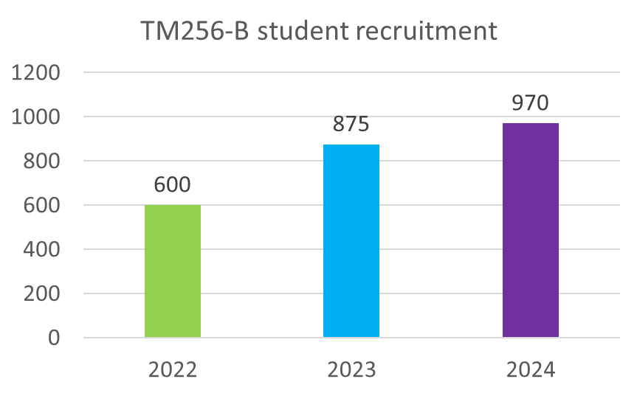
Background to the project
Over recent years, the ‘skills gap’ within the UK and global cyber security workforce has remained an area of concern
As of 2023, DSIT reports that around 50% of business still have a skills gap. Only 2% of cyber graduates go on to become HE teaching professionals
Updates to curriculum within C&C highlighted issues around skills gaps within the school and potential impact on tutor (and student) recruitment
The popularity of TM256

Slide 4
Questions:
To what extent is focused staff training effective in the recruitment of tutors for specialised modules at levels 2 and 3?
What approaches are required to upskill tutors to successfully tutor in specialist curriculum areas?
What resources are required to upskill tutors to successfully tutor in specialist curriculum areas?

Slide 5
Developing the workforce
Curriculum mapping activity and development of module specifications for R60 identified risks associated with the lack of cyber specialisms in the AL community
A good handful of ALs within the school have existing skillset as cyber elements are being delivered on other C&C modules - not enough to meet demand
Two computing vendor awards were offered to ALs interested in teaching on:
  TM256: Cyber Security (Cisco Cybersecurity Essentials)
  TM359: Systems Penetration Testing (Certified Ethical Hacker)

Slide 6
Existing literature
The OU offers staff fee waiver as well as recognition of the importance of staff development (through the Staff Development Policy):
  there does not seem to be any scheme in existence that provides a focused approach to address specific gaps in skills (within STEM/C&C)
Recent studies across Europe and the US identify that focused training to address cyber skills gaps for academics is now critical in HE in the face of global increase in cyber-attacks (more so across Europe)
Recommendations from recent literature mirror approaches taken in this study:
  Self-education and enhanced proficiency through participation in targeted programmes of study

Slide 7
Method
Using Jisc Online Surveys, we gathered quantitative and qualitative data related to the CPD offered
Targeted survey – 110 tutors
Very good participation – 40% responded
Different groups were identified
We used Likert scale questions to ascertain:
How helpful certain aspects of the CPD were? (e.g. Setting a deadline for completion)
How influential certain aspects of the CPD were? (e.g. Sponsorship payment)
Impact on tutor confidence in tutoring certain module topics
We also used free text responses to gather additional detail regarding responses
Notes:
We approached tutors who had participated in either Cyber Essentials CPD or Certified Ethical Hacker CPD.
We also included current TM256 & TM359 tutors who may not have participated in either CPD offer.
Participation was high possibly because the way the survey invitation was framed – it was a chance to have input on the potential future offers of CPD
Groups - We had responses from tutors who had participated in sponsored CPD and non-sponsored CPD. We also had responses from tutors who did not participate in the CPD, but they were current TM256 or TM359 tutors.
The question types gave us a rich set of data – we were able to gain tutor perceptions and confidence in the different blocks within each module (TM256 & TM359).

Slide 8
Results
These results are from the following groups:
Cybersecurity Essentials (TM256) sponsored tutors – 1 day ADC
Cybersecurity Essentials (TM256) non-sponsored tutors
Certified Ethical Hacker (TM359) sponsored tutors – 2 days ADC
Tutors participated in TM256 or TM359 sponsorship rounds or non-sponsored (TM256)
The following key points were identified from 35 responses:
Main influence for completing the CPD
Willing to do CPD in own time (without payment)
Would you have applied to tutor (TM256/TM359) without completing the CPD?
Notes:
Some tutors may have participated in both TM256 & TM359 sponsorship.

Slide 9
Results
Main influence for completing the CPD
Notes:
The single biggest influence is that the CPD provided was module specific and beneficial to tutoring on the respective modules.
The next biggest influence was the vendor – the fact that these are industry recognised CPD from well know vendors.
The fact that sponsorship of 1- or 2-days Additional Duties Contract (ADC) was provided was also influential…although, on the next slide…

Slide 10
Results
Willing to do CPD in own time (without payment)
Notes:
…we also asked tutors if they would be willing to participate in this type of CPD in their own time.
From the 35 respondents, just over half of them received sponsorship. The quality of the materials and potential of official certification, were some of the reasons indicated for completing the CPD.

Slide 11
Results
Would you have applied to tutor (TM256/TM359) without completing the CPD?
Notes:
One of the most important data that we identified is shown here.
We may have struggled to recruit enough tutors without the CPD offering.
We did note that some of the tutors indicating yes, already had some teaching and/or industry experience in the Cyber Security discipline.

Slide 12
Discussion
Why is it difficult to recruit for specialist modules?
  Specialist knowledge required
  External pool of potential candidate can earn more elsewhere
Is it possible to equip existing tutors to teach on specialist modules?
Is there a financial cost in training existing tutors?
Should tutors be paid for training that will help them gain more work?

Slide 13
Conclusion
It is difficult to recruit for specialist modules
Focused Staff Training can be effective in helping tutors:
  Developing in confidence to apply for specialist modules
  Feel equipped to teach on specialist modules
Training linked to industry-recognised qualifications
Tutors may be willing to undertake such training in their own time

Slide 14
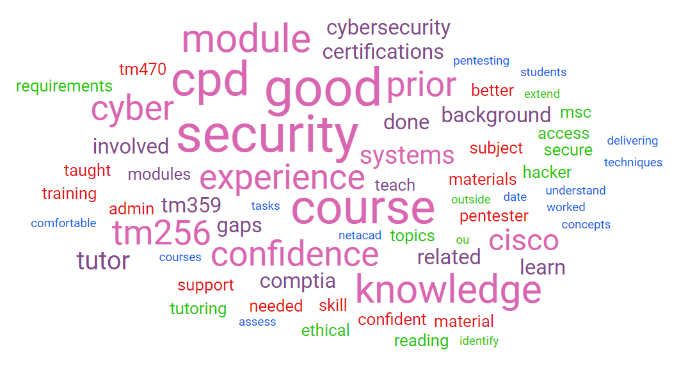
Survey comments
Survey comments word cloud

Slide 15

Questions
Thank you for listening

