Slide 1
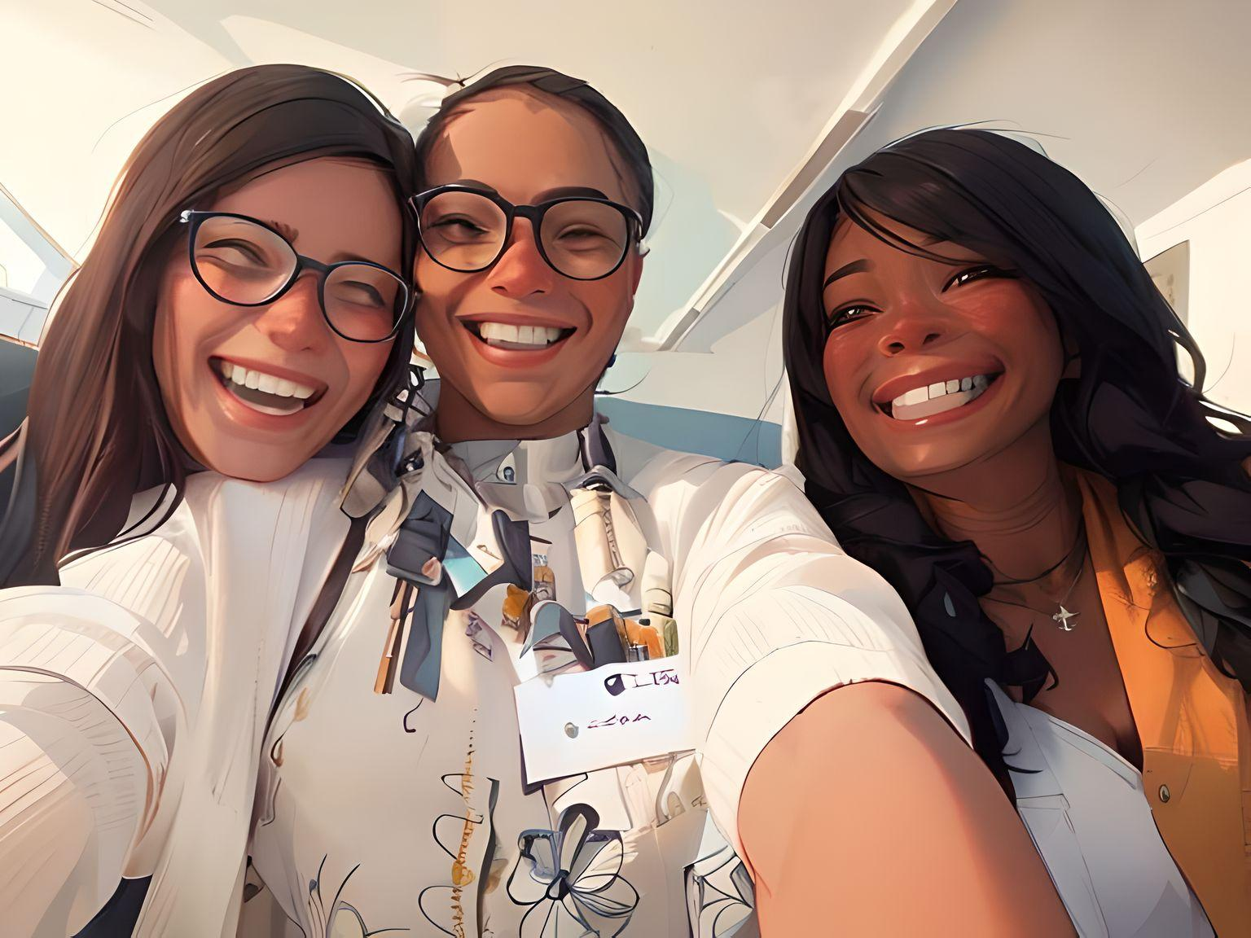
Front Cover Title 2
BDes Virtual Interns
Co-designing and decolonising curriculum in distance design education
Nicole Lotz, Vera Hale, Cindy Darbandi & Ida Rodrigues
Design Group, School of Engineering and Innovation

Slide 2
Page Title 2
About the interns
Sought interns with protected characteristics
Contribute with their lived and study experience to new curriculum design
New curriculum: Bachelor in Design Qualification BDes
Interviewed and appointed 2 interns in 2022, 2023 and 2024
Students had followed the Q61 Design qualification
Students attended Design Qual Engagement events (rapport building)
Eager to attend a face to face curriculum workshop
Benefit of simultaneous interns (peer-to-peer support)

Slide 3
Page Title 6
Managing interns
Expectations
Full member of the production team
Sync/Async working
Chatty open and transparent team culture
Actively call interns into discussions
Objectives
Miro objective setting (from interview and initial chat)
Manageable tasks aligned to objectives
Feedback
Initial more frequent meetings to give deeper explanations
Tailor-made feedback on tasks

Slide 4
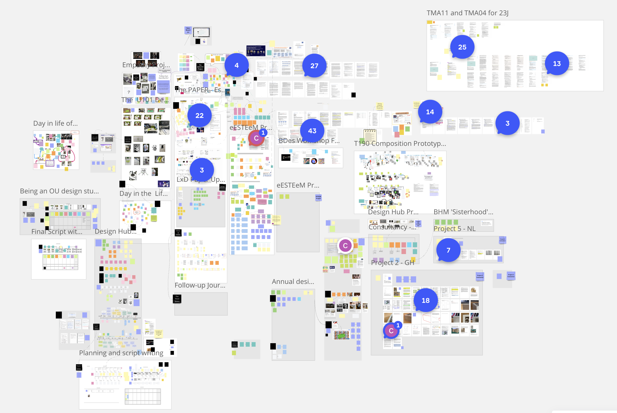
Page Title 1
Intern’s
individual
Miro
board

Slide 5
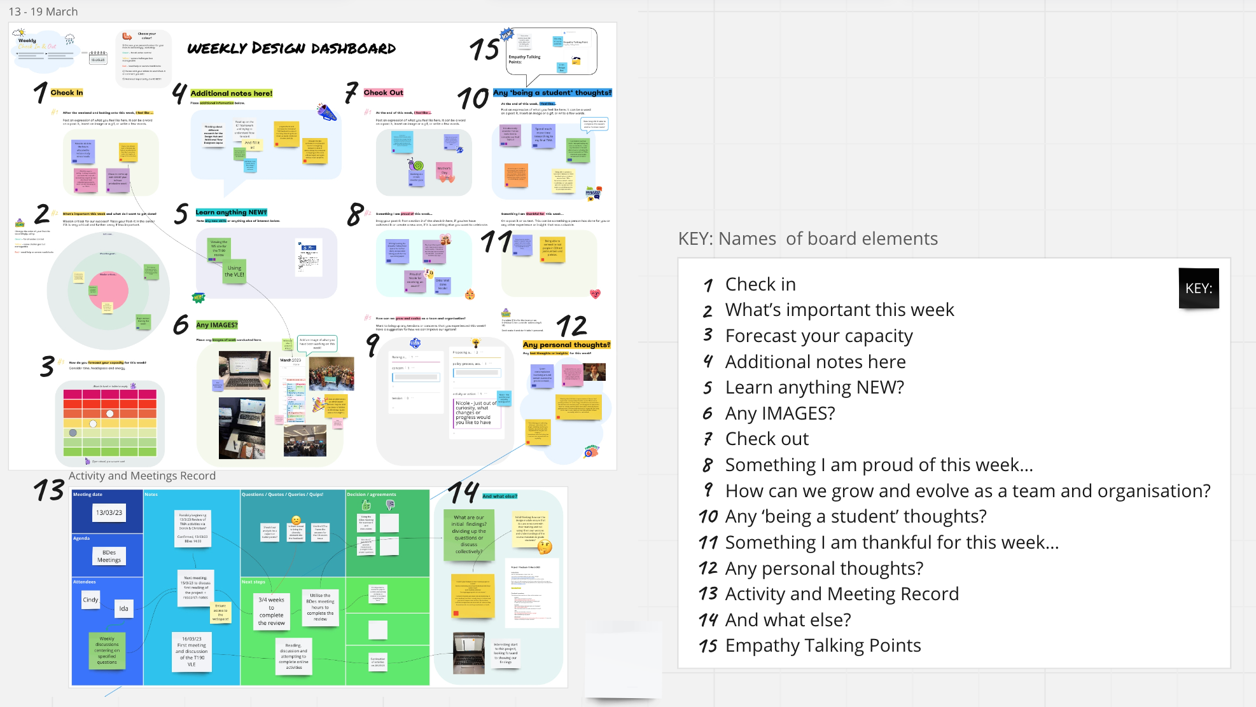
Empathy Board

Slide 6
Co-design and collaboration: being honest, feeling safe and whole
“My internship began with a separate MIRO workspace. I questioned whether working alone created better ideas for novel curriculum? It was important that the collective space be very multi-sensual, offering encounters for further conversation, sparking idea generation for collaborative working.“
Transparency: coping with studying and working pressures
Awareness: availability to actively collaborate during certain times, e.g., assignments
Serendipity: chance encounters, corridor conversations at the distance
Persistence: co-create a shared history of activity
Trust: making the implicit explicit
Whole: enjoyed revealing our respective physical and virtual workspaces and feelings
The board has become a catalyst for decolonizing curriculum, including how to create a shared language (glossary) and how to challenge misinterpreted curriculum content from the Global South.

Slide 7
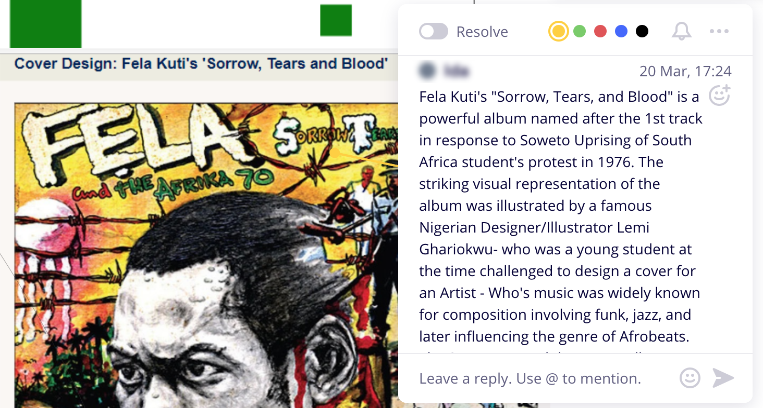

Difficult conversations around decolonisation
An African cover design of music by Fela Kuti was misrepresented in the Draft curriculum content
“At first glance, I was surprised and immediately happy to see African representation in the new curriculum, which is rare. There was a sense of familiarity and relatability because I knew who this artist was, and I had heard of his stories, and the impact he has had within Nigerian culture. However, when I compared the text describing this cover to other covers from western artists some key differences became apparent. Words of affirmation which repeatedly mention ‘iconic’ and ‘brilliant visuals’ used elsewhere were missing in the description of Fela Kuti’s album design.“
Intern worked closely with curriculum author to integrate appropriate cover examples and descriptions in the curriculum

Slide 8
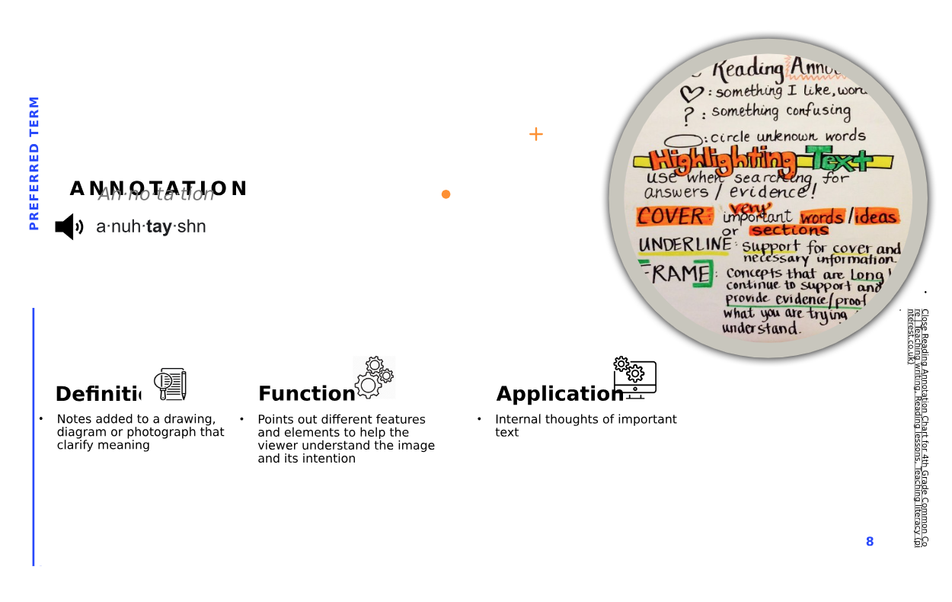
Language and decolonisation
lived experience of how a language barrier impacted written design assignments and progression through the qualification
“It was unfortunate for me to have come to find out about glossaries at a late stage in my study. English is not my first language. I found it challenging to build confidence to communicate my ideas and express my thoughts to my tutor. I became apprehensive with thoughts of experiencing the same situation in next year’s module. I thought: ‘was design really for me?’”
Work on the curriculum glossary eliminated the initial imposter syndrome and gave space to create a shared language on Empathy Board

Slide 9
Decolonising curriculum: a process of reflexivity and dialogue
“Apparently, there’s a procedure one must follow when bringing up these issues with instructions and further questions to attend to that feel more like tokenism than resolution.”
Open interactions revealed assumptions, bias, prejudices, and racism in our design curriculum and in the process of designing our curriculum
Critiquing Inclusive Curriculum Tool: token gestures by people with cultural capital
Reflect on our mistakes that were perceived as tokenisms and test ideas to undo oppressions
Decolonisation is radical and substantive redesigning of the dominant cultures
'undoing' privileges of certain bodies while humanising others

Slide 10
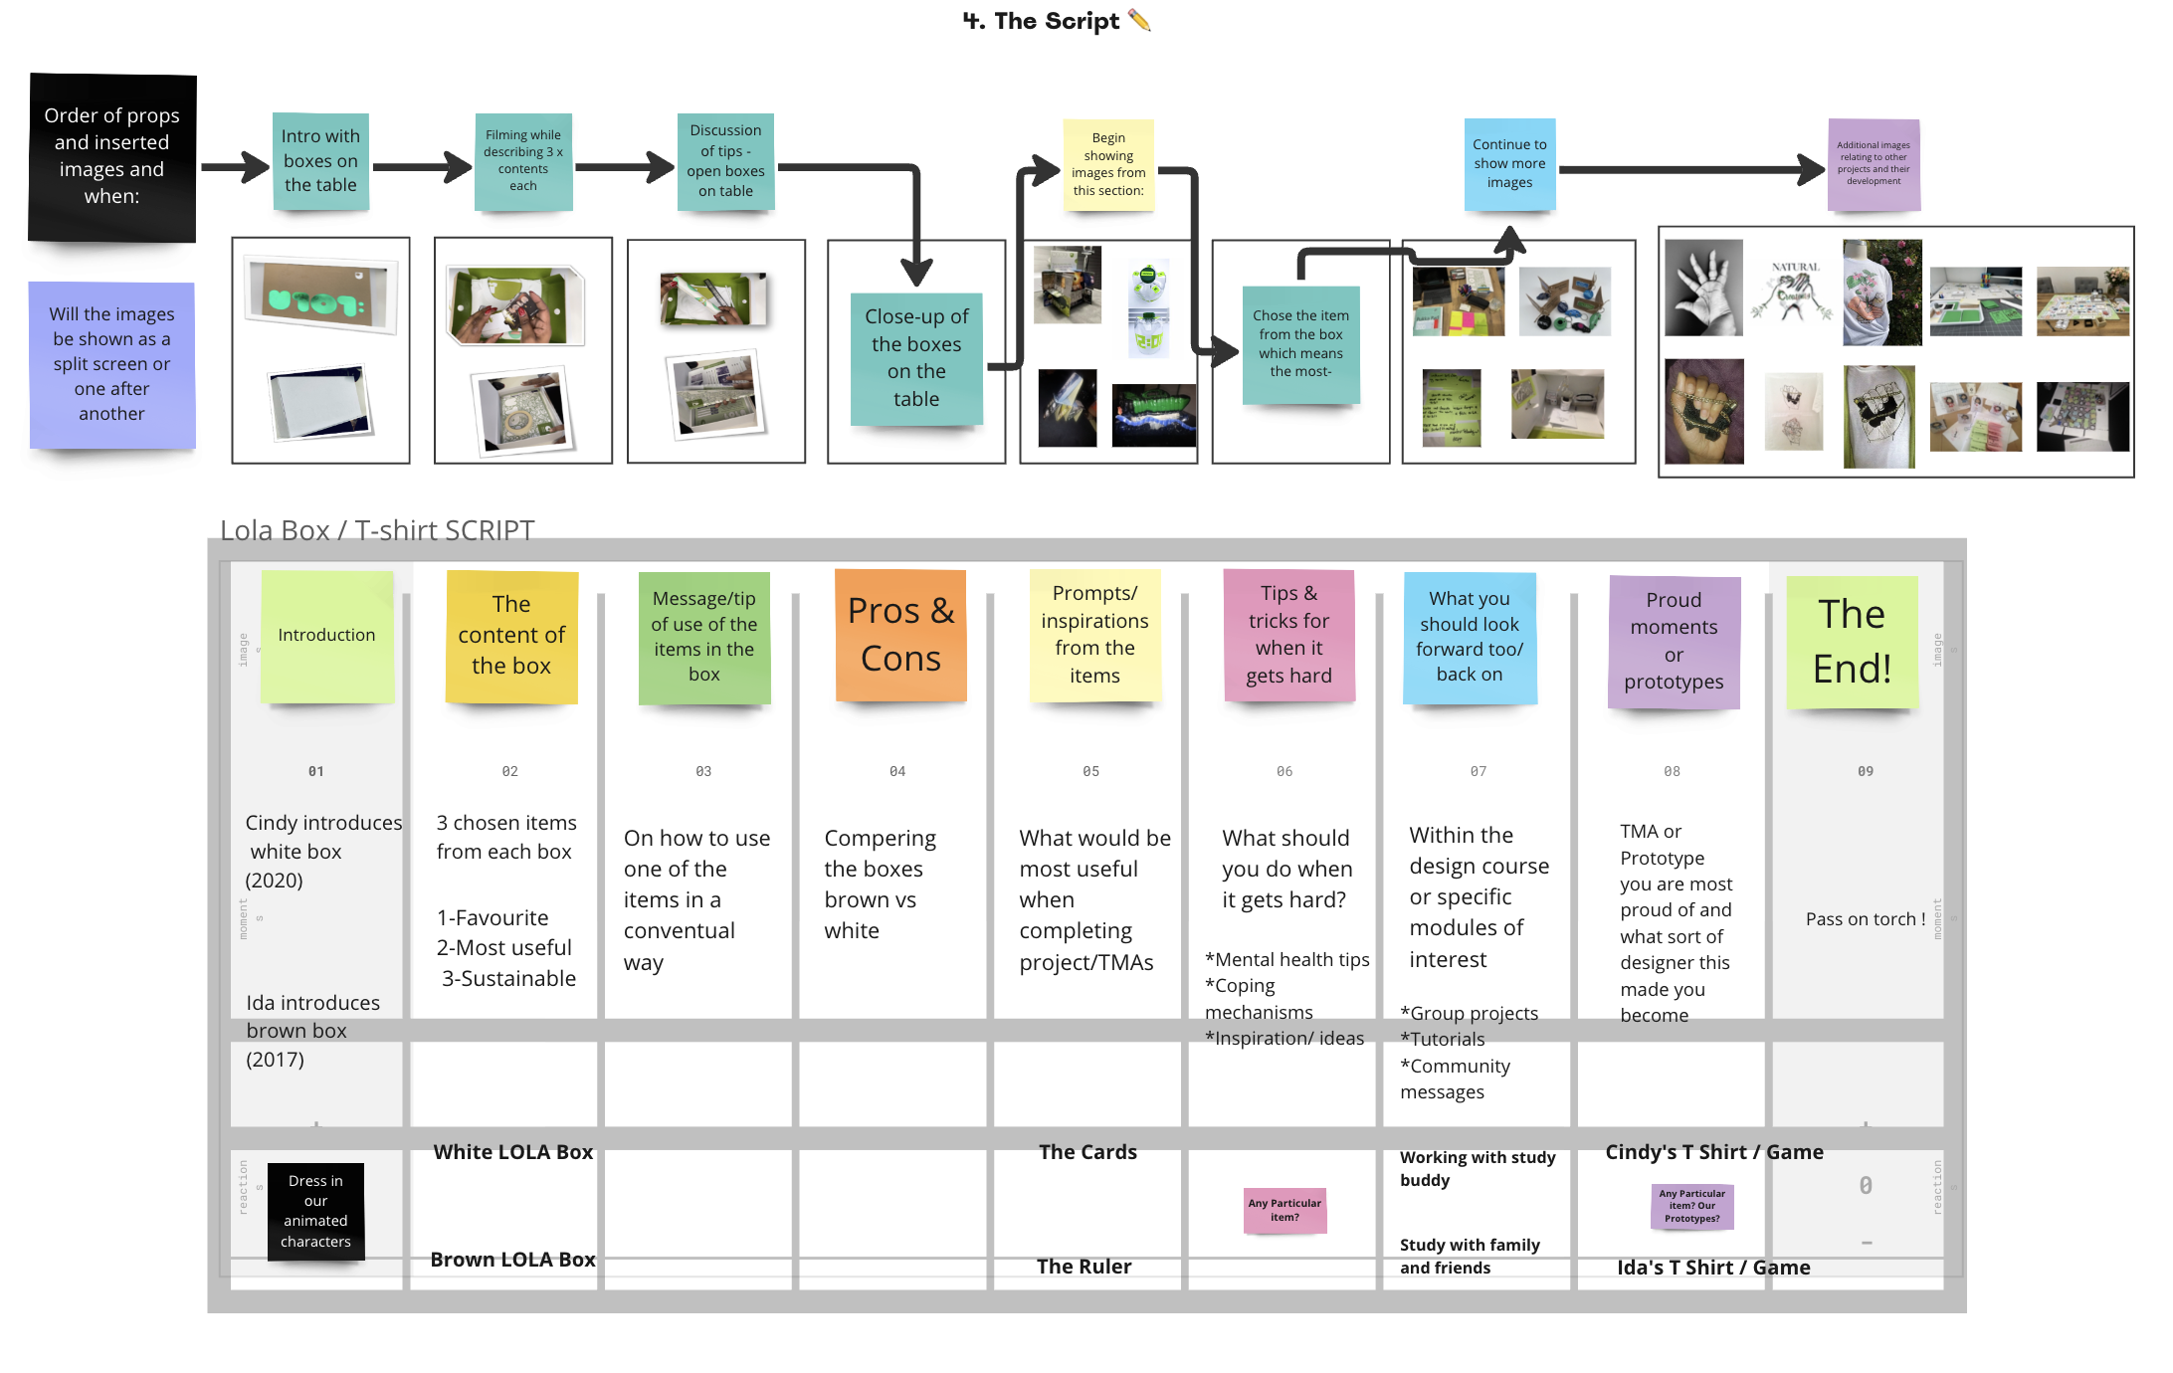
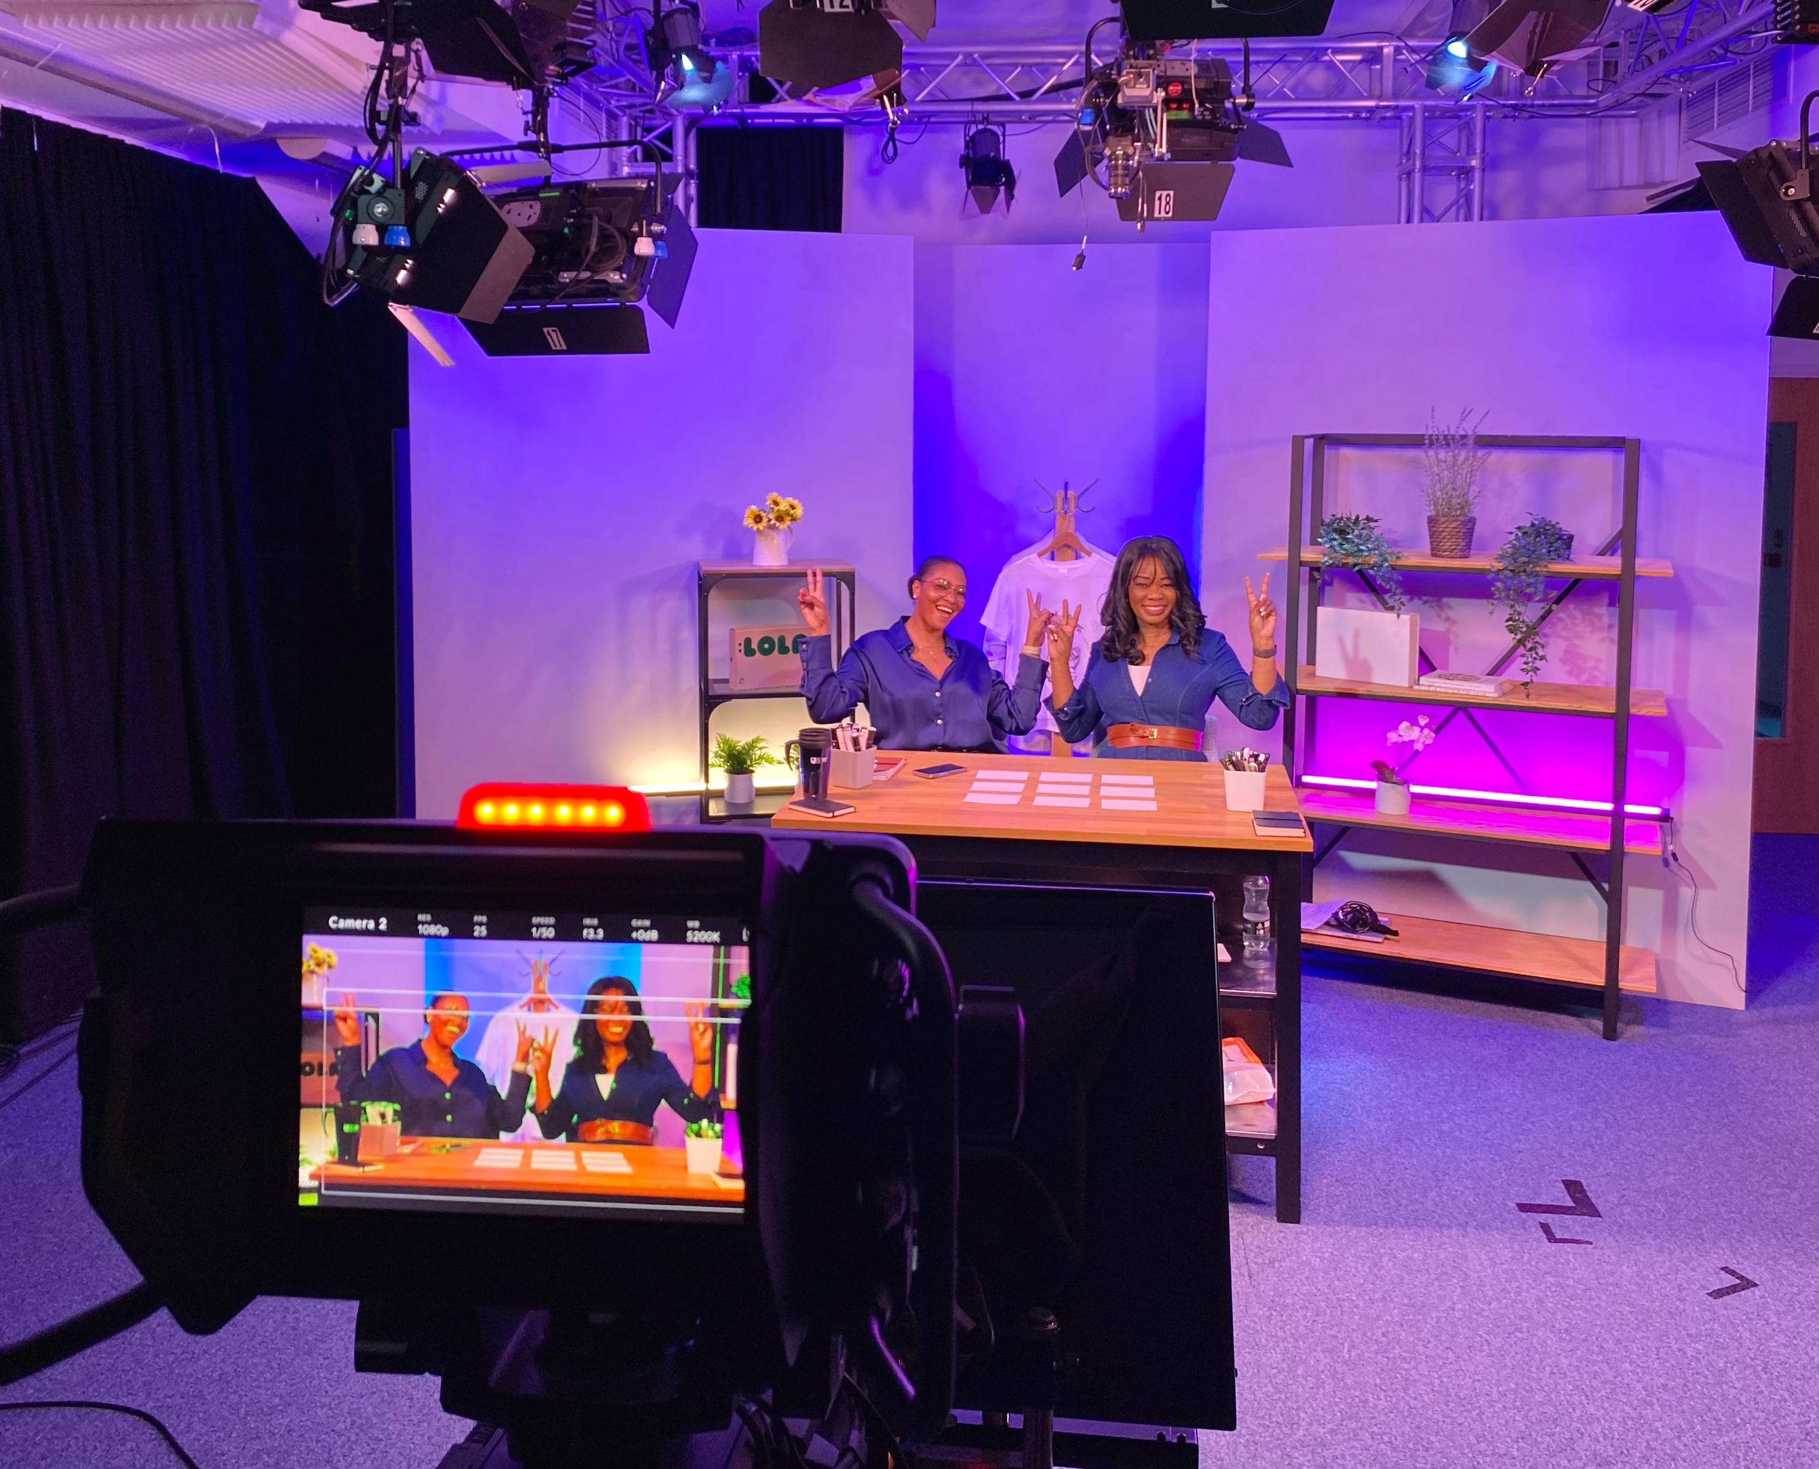
Bringing lived experiences to the curriculum
Beyond critical reading, Interns created V&A content for the new Design Qualification

Slide 11
Intersecting identities: feeling represented, emancipated and empowered
“conversation is the central location of pedagogy for the democratic educator” (Hooks 2003, p. 44).
“whole human beings, striving not just for knowledge in books, but knowledge about how to live in the world” (Hooks 1994, pp. 14-15).
“cultural hegemony breeds complicity, as our peers are taught not to honour their intersectional differences, their multidimensionality but to prioritise fitting in” (Rittner 2022 p. 41).
Honest conversations include intersectional differences
Showing complexity and vulnerability opened the space to encourage participants to be their authentic selves of wholeness
“radical openness” that can be uncomfortable
OU has tendency to produce polished and perfect content which may limit openness for dialogue and authentic student voices

Slide 12
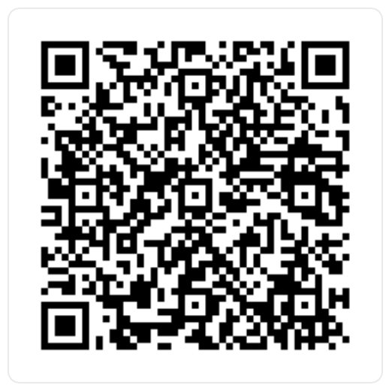
Dowload our paper
https://dl.designresearchsociety.org/learnxdesign/learnxdesign2023/casestudy/28/
https://doi.org/10.21606/drslxd.2024.098
Thank you for listening

