Slide 1
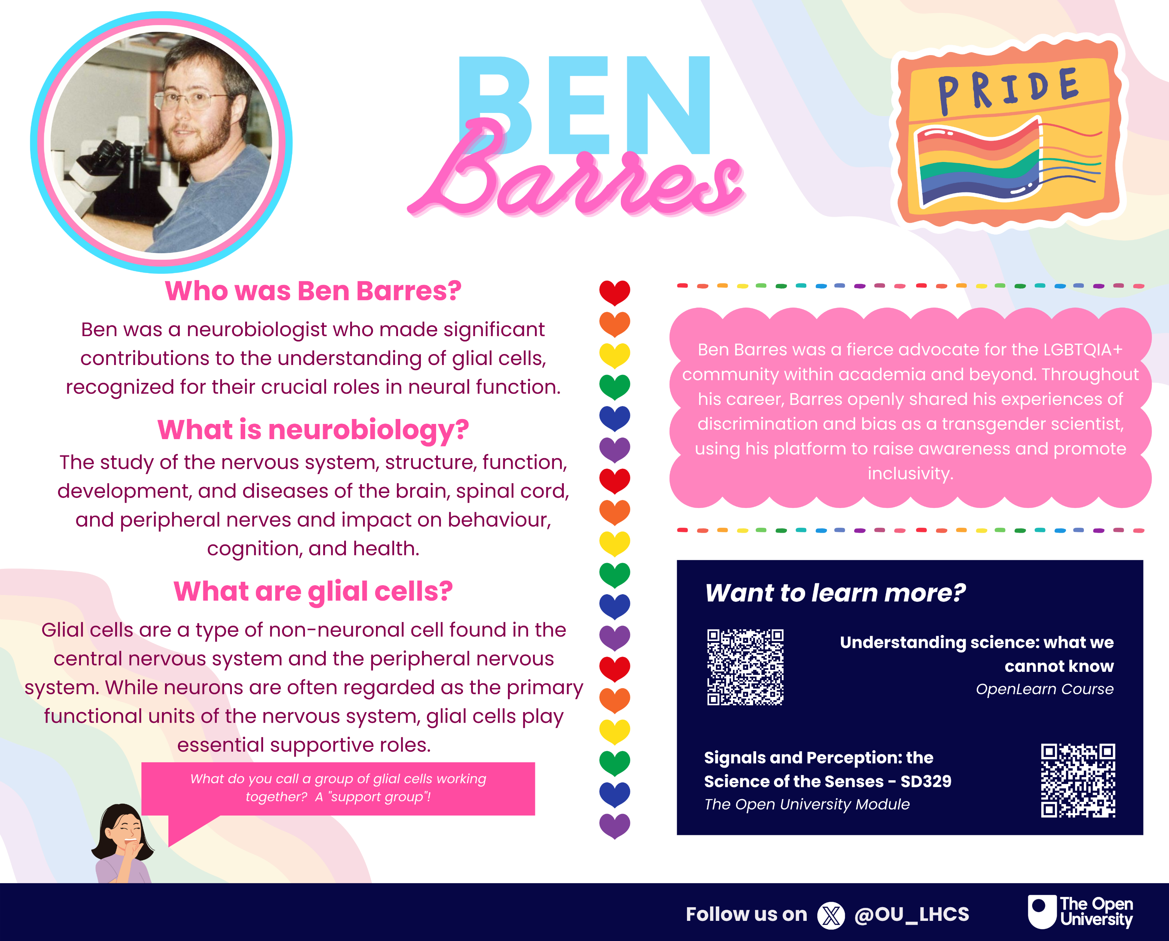
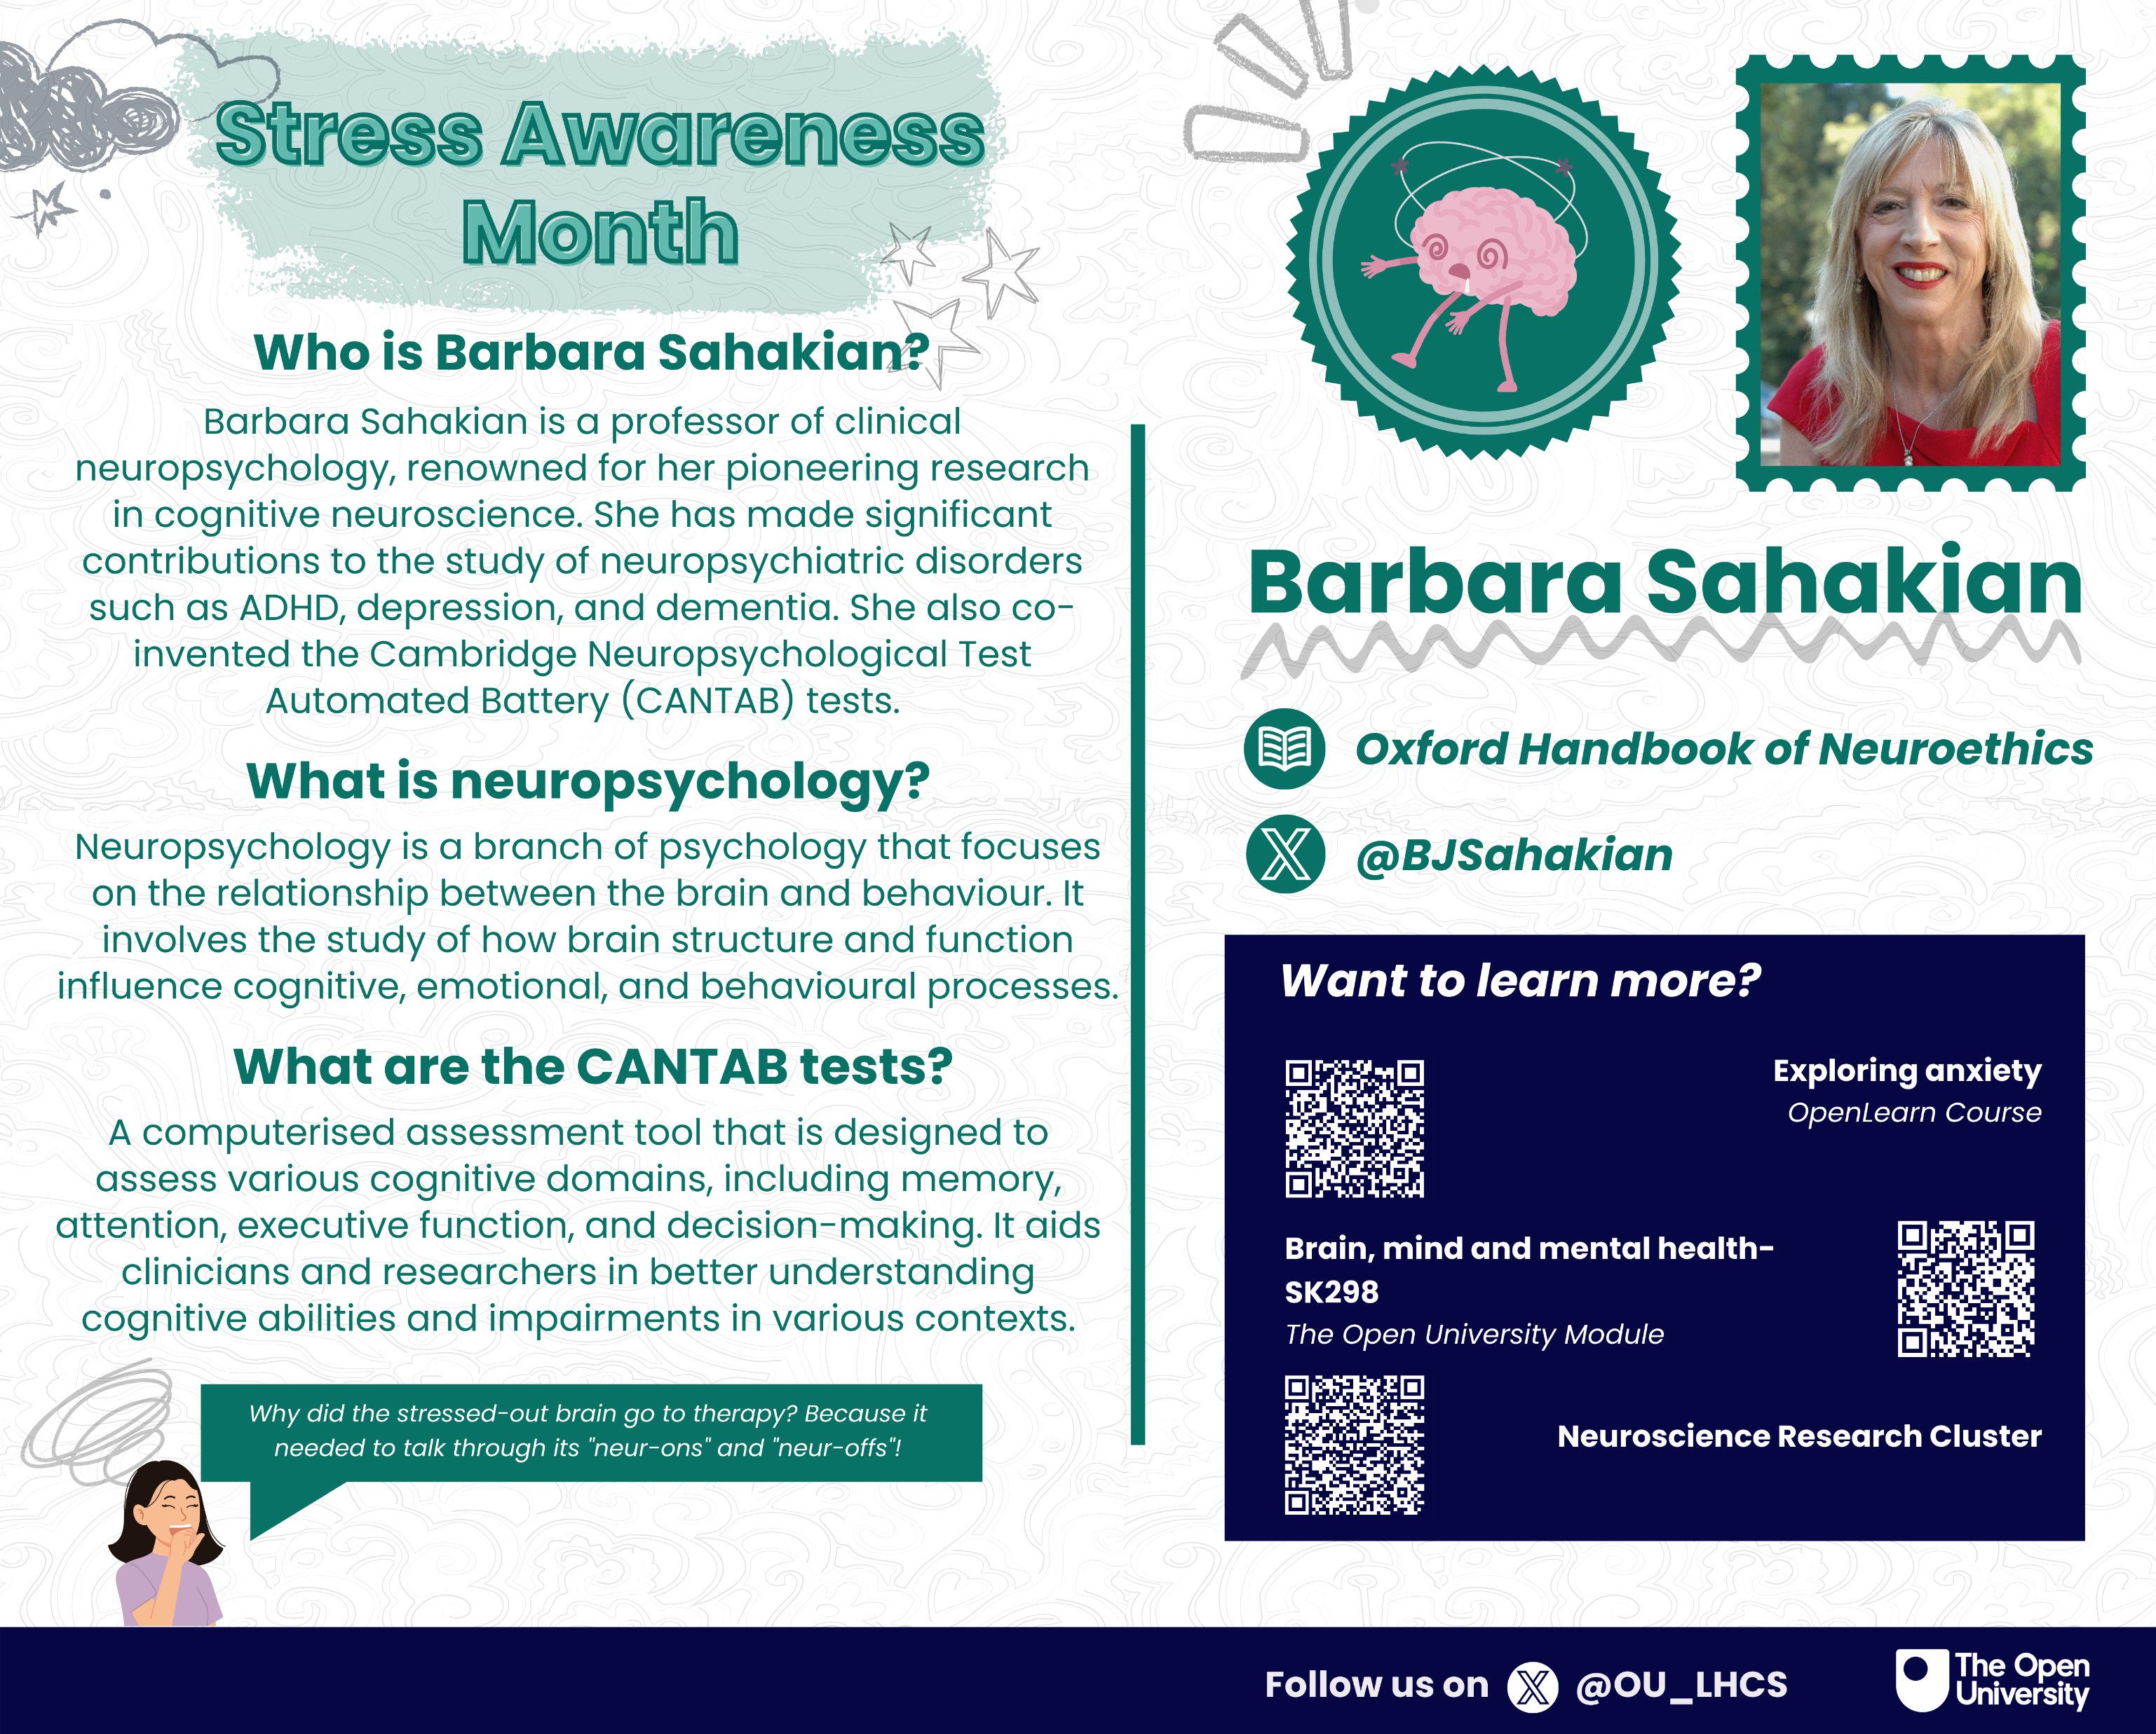
Slide Title 3
Experiences, engagement and evaluation of intern involvement in creating digital assets to support a sense of belonging for LHCS students.
Janette Wallace, Zoë Chapman, Aasiyah Nana
eSTEeM Conference 11th April 2024

Slide 2
Slide Title 9
Background
Increase in HEI’s offering online distance learning programmes (Lockee.B.B 2021) therefore supporting student retention and attainment has become key to the OU to remain competitive.
STEM-LHCS APS team have several initiatives to increase retention and attainment, some of which are focussed upon building a sense of belonging which has been linked to STEM student success in previous studies (Rainey, K et al., 2018).
Initiative plans include:
  Creation of digital assets (such as inspiring scientist postcards, student newsletter etc.)
  Building an informal online space (e.g., café forum on the science site, Discord)
  Creating more informal events (e.g., virtual quizzes) to run alongside academic offerings.
Focus of this project:
  Creation of digital assets (such as inspiring scientist postcards, student newsletter etc.)

Slide 3
Slide Title 10
Approach
Delivering any initiatives takes time and resources which are in short supply.
LHCS hired a student intern to provide student perspective on, as well as co-creation of, digital assets.
The role of the intern was to participate in discussions around initial ideas for the creation of digital assets and evolve these into a bank of digital assets.
This scholarship project aims to document the process of, and evaluate outputs of, the co-creation of digital assets and the potential impact of these digital assets on students’ sense of belonging within LHCS.

Slide 4
Assets
Series of 12 postcards to be disseminated via email on the 1st of every month starting 1st Oct 2024 (24J presentation).
  Each postcard celebrates a particular month or day, and showcases a scientist linked to LHCS in terms of their topic/research interest.
Series of 4 student magazines to be disseminated via email on the 1st of the month, also starting 1st October 2024 but with quarterly editions starting Autumn then Winter (January), Spring (April) and Summer (July).
  Each magazine has similar features but with differing thematic content.
Both the postcards and the magazines will be available online and hosted accordingly with access via the Science Study Site.

Slide 5

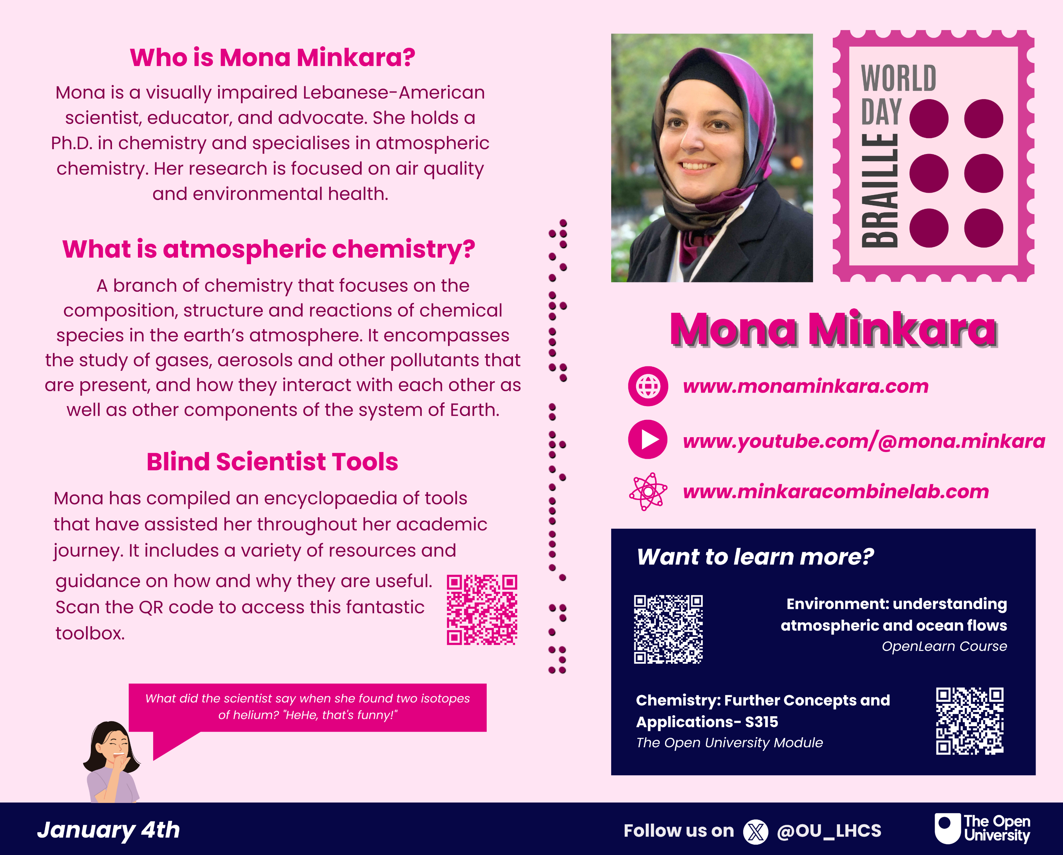
Key features:
- Awareness day/month
- Person from traditionally under-represented demographic
- Facts about their work
- Links to external resources including websites, social media handles etc.
- QR code link to related LHCS module
- QR code link to related OpenLearn course
- QR code link to relevant research cluster area
- Lighthearted, appropriate joke to add informal element
- Themed design elements
- OU Brand Hub compliant

Slide 6
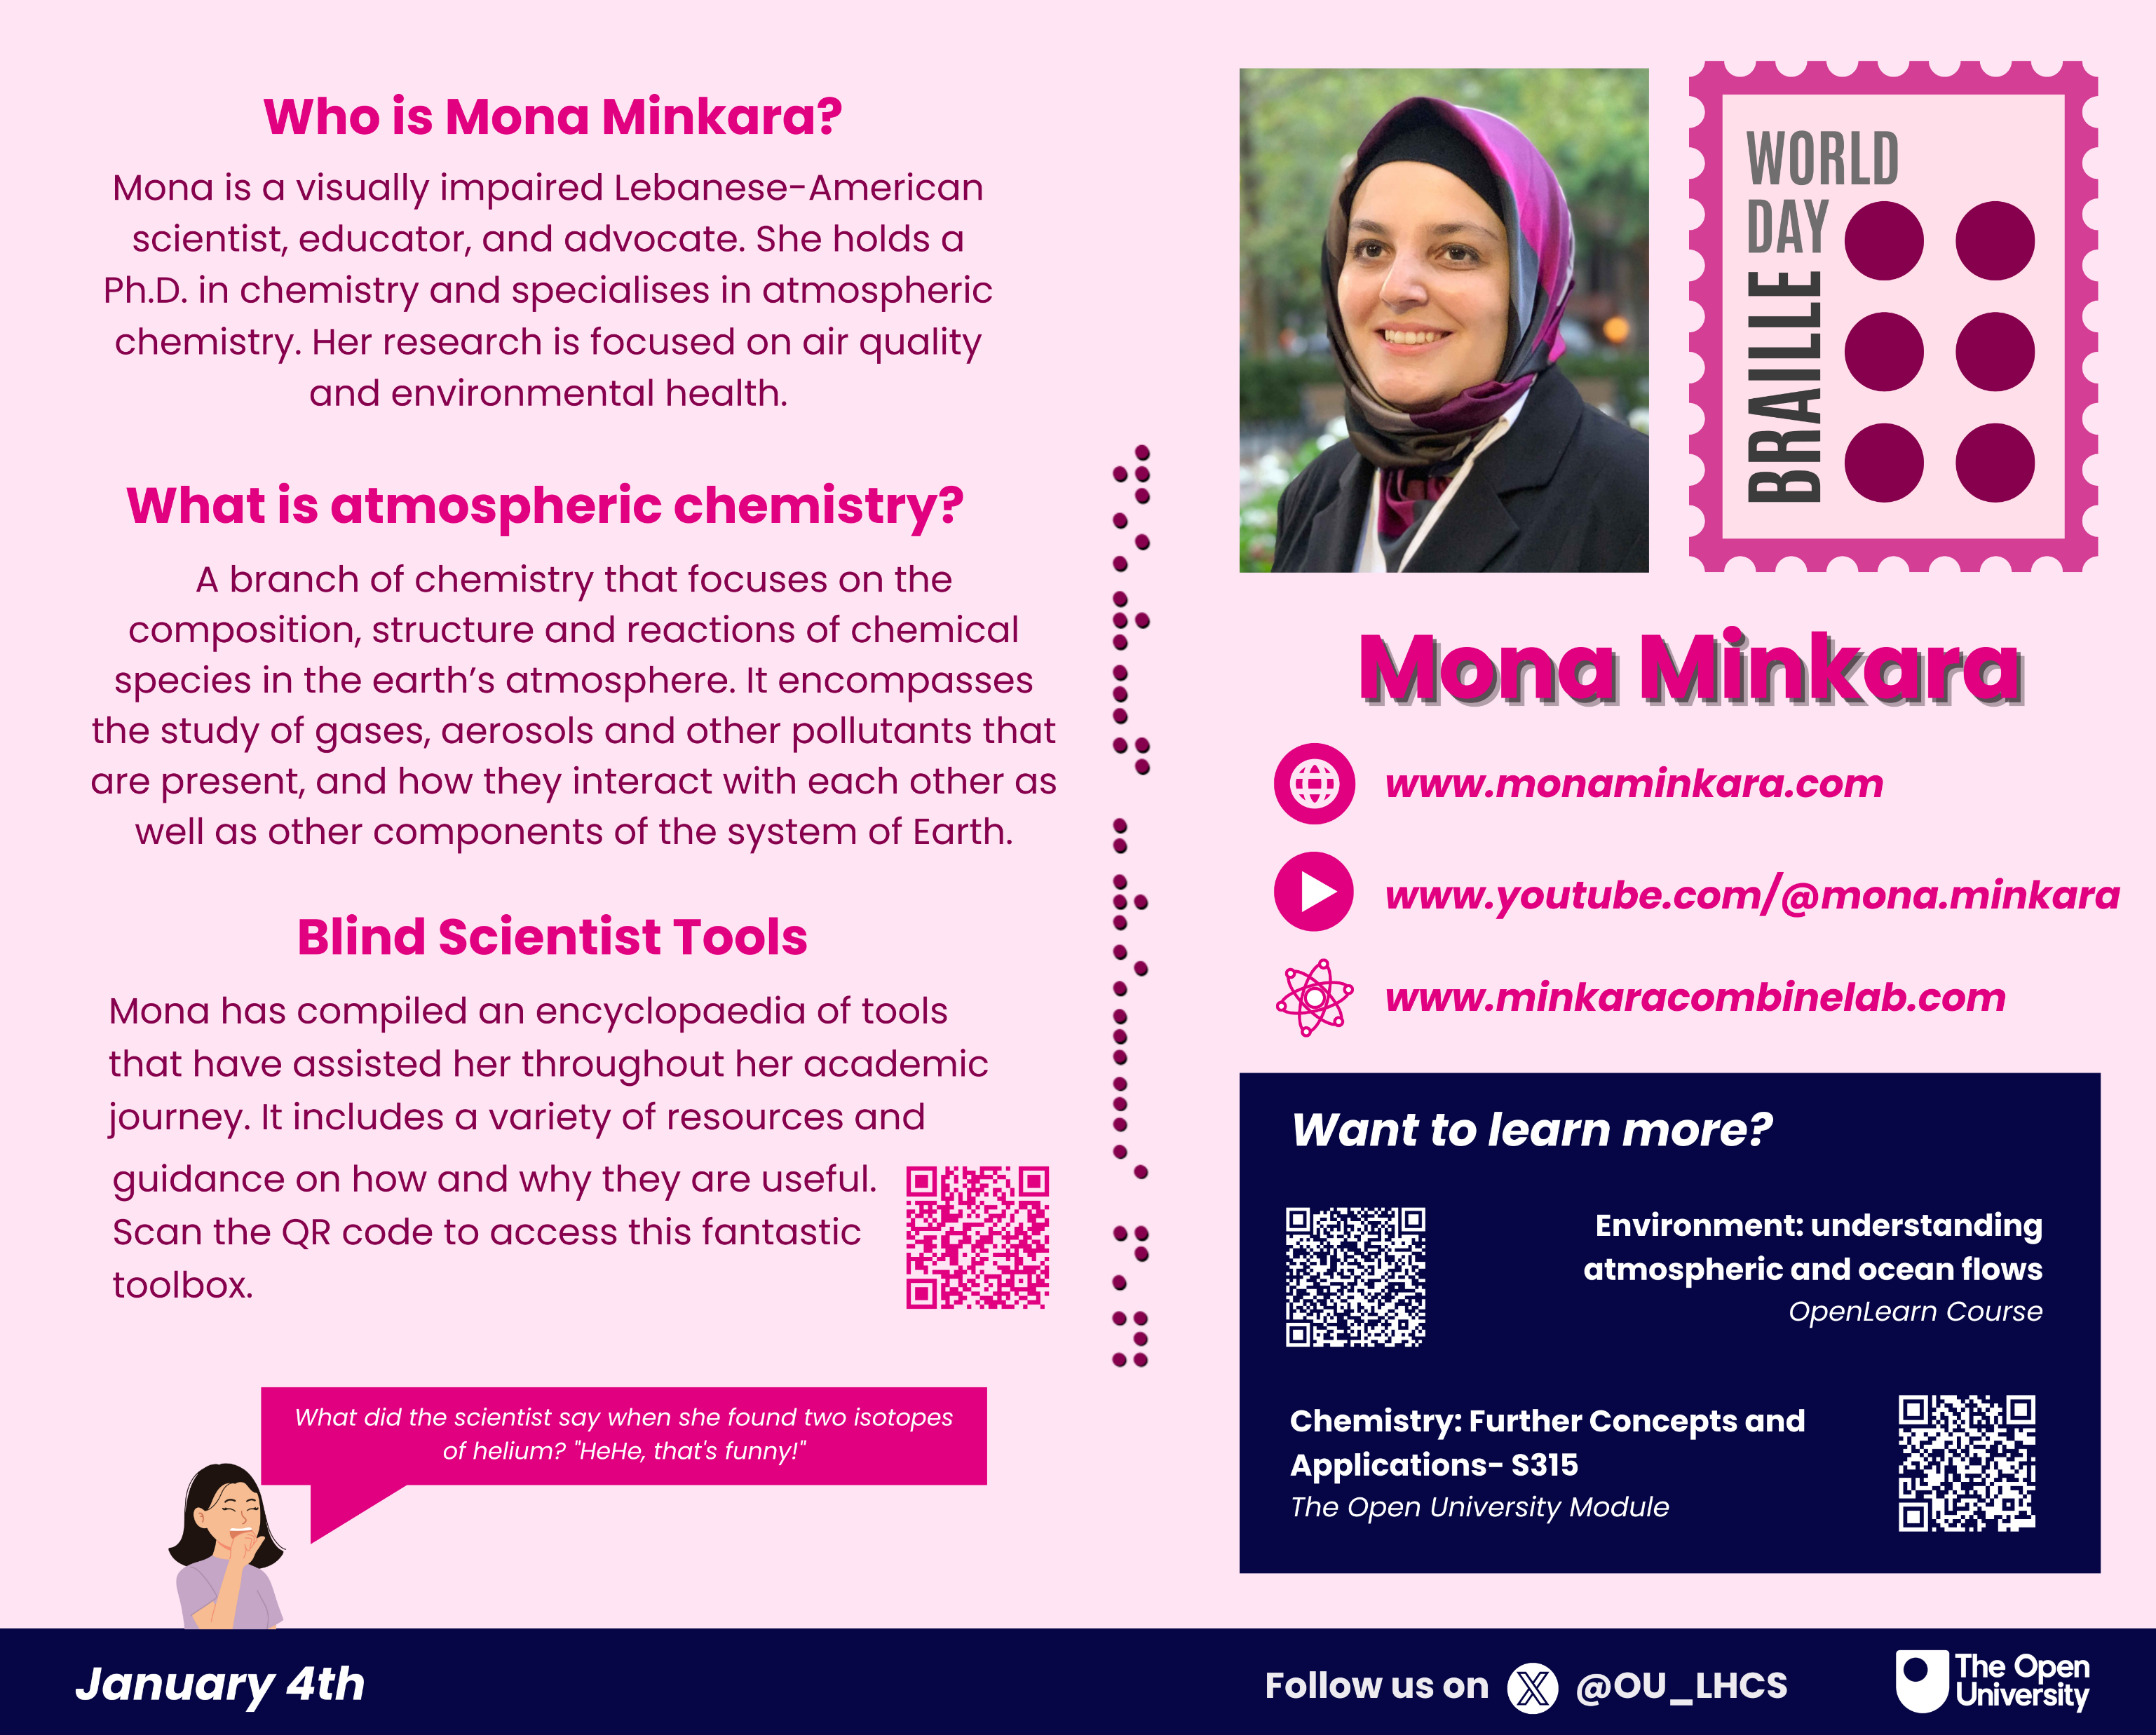

Slide 7

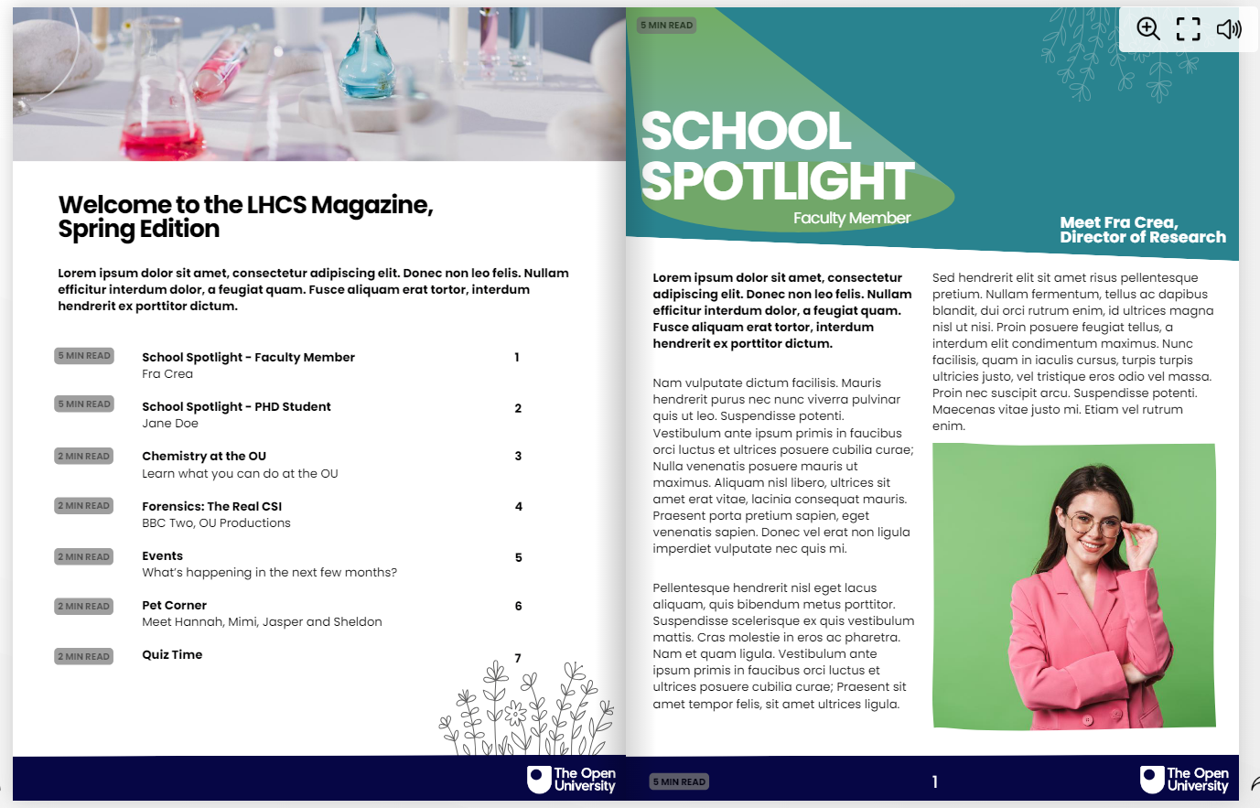

Slide 8
Evaluation
Evaluation to begin almost immediately by utilising Real Time Student Feedback (RTSF)
Other evaluation methods will be considered e.g:
  student survey to ask for thoughts on digital postcards
  focus groups (exploring the theme of a general sense of belonging)
  quantitative data collection based on traffic to a host site and/or interactions with the assets

Slide 9
Dissemination
Of assets
To all students in LHCS via email (method TBC e.g., CAMEL etc.)
Hosted on Science Study Site
Of scholarship
Initial experiences of LHCS internship project and provisional assets shared at eSTEeM conference April 2024.
Hoping to share provisional findings from evaluation at eSTEeM conference April 2025 and at Horizon in STEM June 2025.
Hoping to share results and project outcomes in full at eSTEeM conference April 2026 and at Horizon in STEM June 2026.
Other dissemination includes at STEM teaching conference, scholarship day, school meetings, APP conference if/when appropriate.

Slide 10
Future Opportunities
If evaluation shows the assets are received positively, LHCS will look to continue producing the assets on a regular basis in future presentations.
Also scope to broaden out to wider STEM Faculty therefore increasing options for relevant content, and audience.

Slide 11
References
Crawford, J. et al. (2023) ‘Sense of belonging in higher education students: an Australian longitudinal study from 2013 to 2019’, Studies in higher education (Dorchester-on-Thames), ahead-of-print(ahead-of-print), pp. 1–15. Available at: https://doi.org/10.1080/03075079.2023.2238006.
Lockee, B.B (2021) Online education in the post-COVID era. Nature Electronics | VOL 4 | January 2021 | 5–6 | www.nature.com/natureelectronics https://doi.org/10.1038/s41928-020-00534-0
Peacock, S. and Cowan, J. (2019) ‘Promoting a Sense of Belonging in Online Learning Communities of Inquiry’, Online learning (Newburyport, Mass.), 23(2). Available at: https://doi.org/10.24059/olj.v23i2.1488.
Rainey, K. et al. (2018) ‘Race and gender differences in how sense of belonging influences decisions to major in STEM’, International journal of STEM education, 5(1), pp. 10–14. Available at: https://doi.org/10.1186/s40594-018-0115-6.
Thomas, L. (2021) ‘Ibelong: Towards a sense of belonging in an inclusive learning environment’, Widening participation and lifelong learning, 23(3), pp. 68–79. Available at: https://doi.org/10.5456/WPLL.23.3.68.
Thomas, L., Herbert, J. and Teras, M. (2014) ‘A sense of belonging to enhance participation, success and retention in online programs’, The international journal of the first year in higher education, 5(2), pp. 69–80. Available at: https://doi.org/10.5204/intjfyhe.v5i2.233.
Zumbrunn et al. (2014) Support, belonging, motivation, and engagement in the college classroom: a mixed method study. Instr Sci 42:661–684 DOI 10.1007/s11251-014-931.

Slide 12

Slide Title 30
Thank you
Any questions?

Slide 13
Slide Title 31

Slide 14
Slide Title 11
Proposed Timeline
Sep ‘23 – Advertisement for intern recruitment to go out.
Oct ‘23 – Interviews by ZC/JW for intern recruitment.
Nov ‘23 – Offers made by ZC/JW and start dates agreed.
Dec ‘23 – Initial literature review (ZC/JW).
Jan ‘24 – Student intern post to start.
Mar ‘24 – Student intern post to finish.
Apr ‘24 – Apr ‘25 - Digital asset series dissemination.
Apr ‘25 – Begin evaluating.
Apr ‘25 – Sep ‘25 – Data analysis/write up.

Slide 15
Slide Title 12
Revised Timeline
Sep ‘23 – Advertisement for intern recruitment to go out.
Oct ‘23 – Interviews by ZC/JW for intern recruitment.
Nov ‘23 – Offers made by ZC/JW and start dates agreed.
Dec ‘23 – Initial literature review (ZC/JW).
Jan ‘24 – Student intern post to start.
Apr ‘24 – Student intern post to finish.
Oct ‘24 – Oct ‘25 - Digital asset series dissemination.
Oct ‘24 – Begin evaluating (RTSF)
Nov ‘25 – Start data analysis/write up

