Slide 1
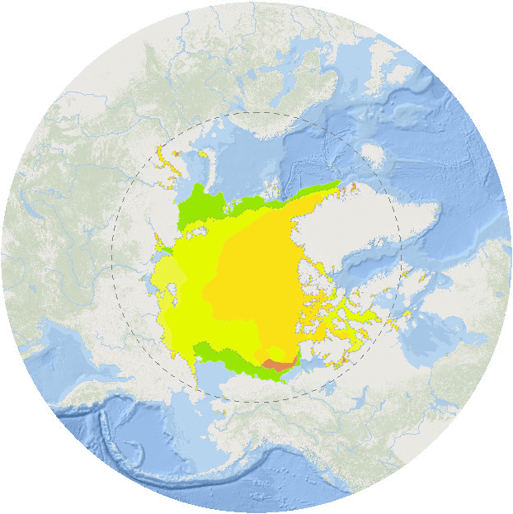
Intro Slide Title 3
Teaching GIS supercharged
by ArcGIS Online
Tom Argles, Phil Wheeler
Environment, Earth & Ecosystem Sciences
10th April 2024

Slide 2
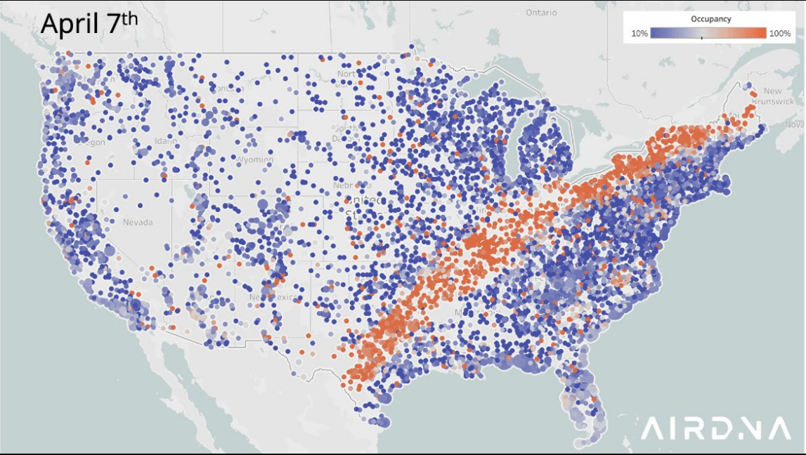
Slide Title 27
Why teach Geographic Information Systems?
Increasingly ubiquitous in modern life
Key employability skill in multiple careers
Ideal vehicle for interdisciplinary learning
AirBnB occupancy in US, April 2024, by @Jamie_Lane

Slide 3
Slide Title 27
GIS at a distance: the challenges…
Brick university | Distance education
Face-to-face classes | Remote learning
Dedicated computer labs | Individual, bespoke IT setups
Consistent hardware/software | Huge software download required; frequent conflicts
Numerous demonstrators | Sparse specialist technical support
On-demand, hands-on troubleshooting | Delayed help; reliance on forums

Slide 4
Slide Title 27
GIS at a distance: the challenge
Brick university | Distance education
Face-to-face classes | Remote learning
Dedicated computer labs | Individual, bespoke IT setups
Consistent hardware/software | Huge software download required; frequent conflicts
Numerous demonstrators | Sparse specialist technical support
On-demand, hands-on troubleshooting | Delayed help; reliance on forums
ALMOST
IMPOSSIBLE
POSSIBLE

Slide 5
Slide Title 27
A solution – web GIS via ArcGIS Online
FEATURES | COMMENTS
Browser-based | No software download Consistent student experience Minimal conflicts
ESRI-backed | Copious support online – lessons, tutorials, videos, forums… Wide range of data available Global reach
Market-leading | Employability tick!
Single sign-on | Simple access for students

Slide 6
Slide Title 27
Some highlights

Slide 7
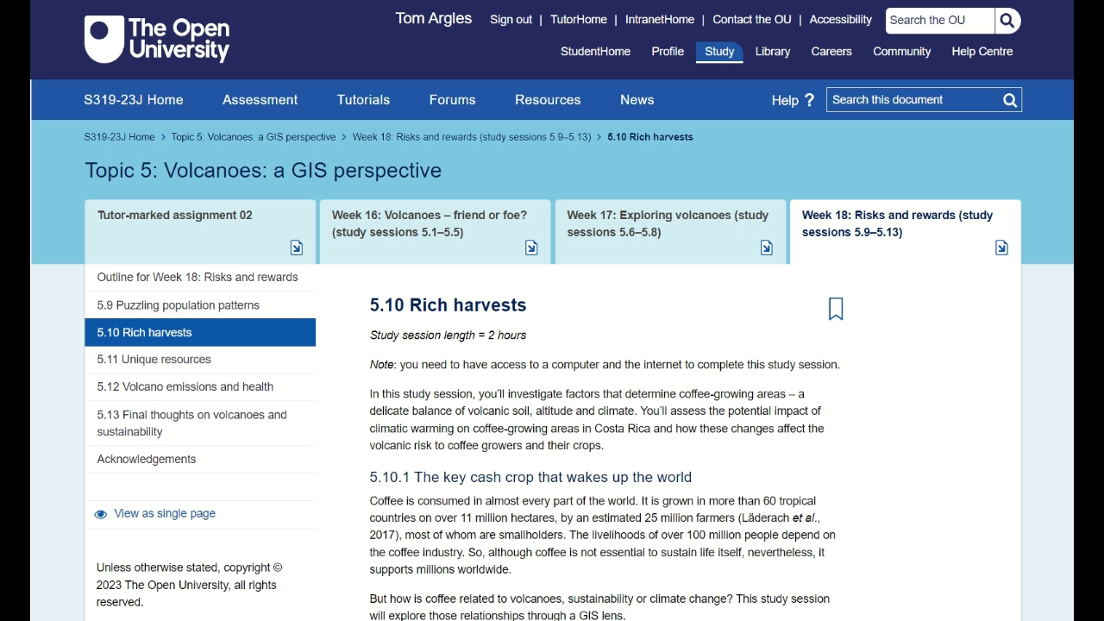
Slide Title 27
S319 – Geology and sustainability
Some highlights
Interactive webmaps
The world according to coffee
Environmental range
Exporters, importers
Elevation control
Volcanic soils
< Embedded in VLE or accessed via ArcGIS Online >

Slide 8

Slide Title 27
S831 – Environmental Science Challenges
Some highlights
< Embedded in VLE or as standalone webpages >
Bespoke storymaps
Assessing bias in citizen science data of Superb Parrot sightings, NSW
Retrieving data
Symbolizing map
Buffers on roads
Intersect road buffers with sightings data

Slide 9
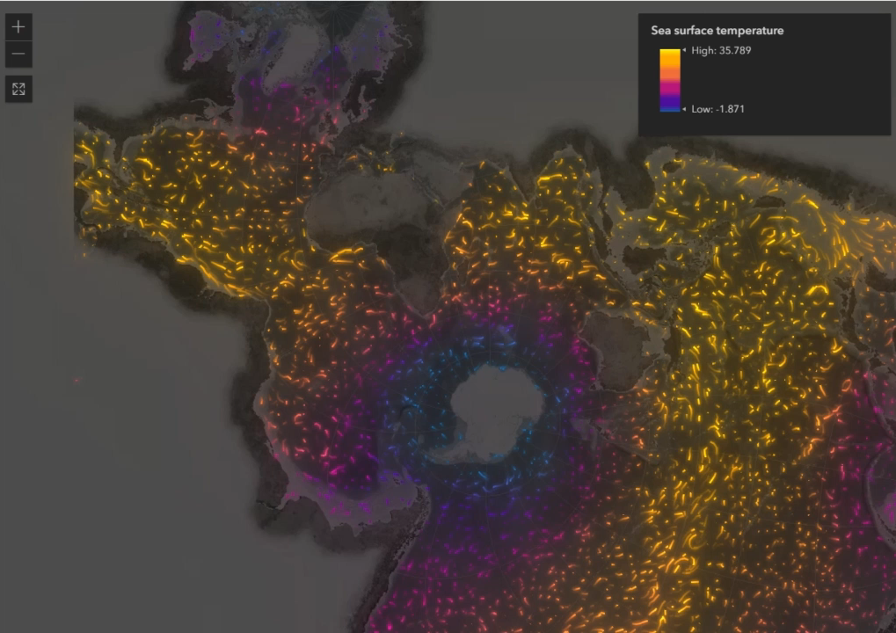
Slide Title 27
S226 – Environmental science
Some highlights
Embedded animations
Animations of data on maps for S226 Environmental science
Visualise real world data
Spatial context of important concepts
Explore key Earth processes

Slide 10
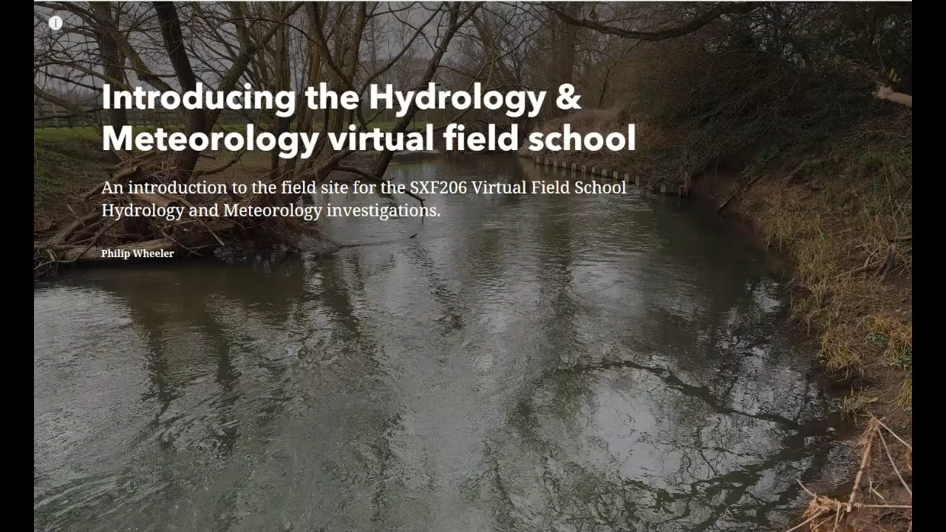
Slide Title 27
S206 – Environmental science
Some highlights
Virtual field trips
Online field school for S206 Environmental science
Developed as ALE prior to Covid
Expanded and extended for pandemic
Accessible; widening participation

Slide 11
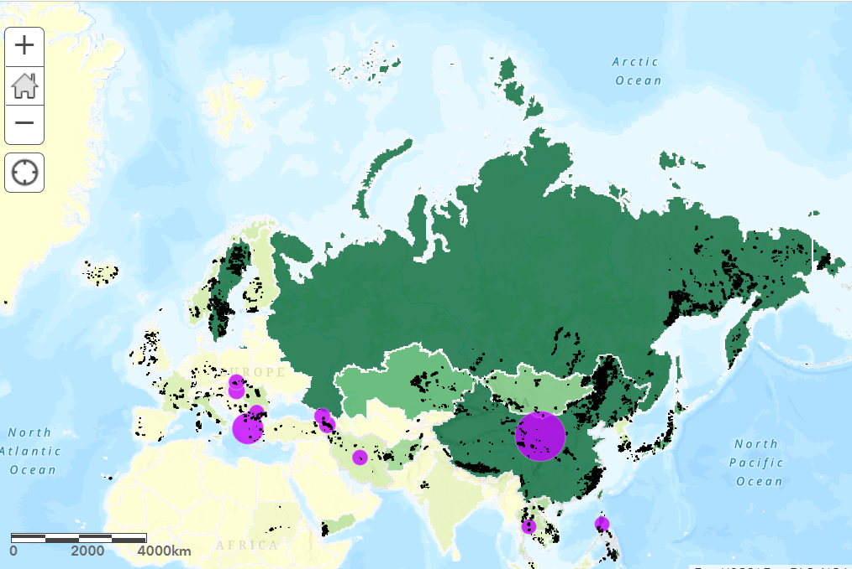
Slide Title 30
THANK
YOU

Slide 12
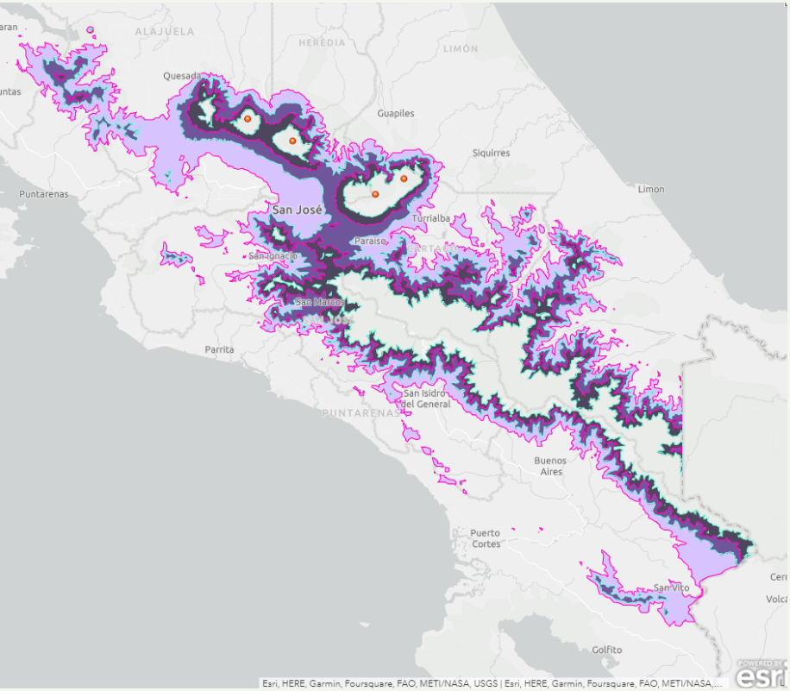
Slide Title 27
S226 – Environmental science (from 25J)
S229 – Earth science (from 26J)
Future development
ArcGIS Management Group
Coordinate how ArcGIS accounts are administered and managed at the OU
Provide advice on integrating GIS teaching into modules
Digimap
Potential to integrate data from Digimap service into GIS teaching
Virtual field trips
Potential to create more virtual experiences

