Slide 1

Quantum computing as a teaching resource for level 3 quantum Physics
  SM380 Quantum Physics
  Fundamentals and applications
Silvia Bergamini & Calum MacCormick

Slide 2

Quantum Physics
Importance
Challenges for teaching
Explains the world, starting from the fundamental particles that make up matter
New Quantum technologies: Quantum computing, Quantum sensing, quantum cryptography
Highly reliant on advanced mathematics
Many counterintuitive concepts: wave-particle duality, tunnelling, indeterminacy, superposition, entanglement, measurement.
Unlike classical physics, students cannot develop an intuition, as they cannot observe quantum phenomena=> misconceptions
Quantum phenomena can be observed at the microscopic scale or under extremely well controlled laboratory environment

Slide 3

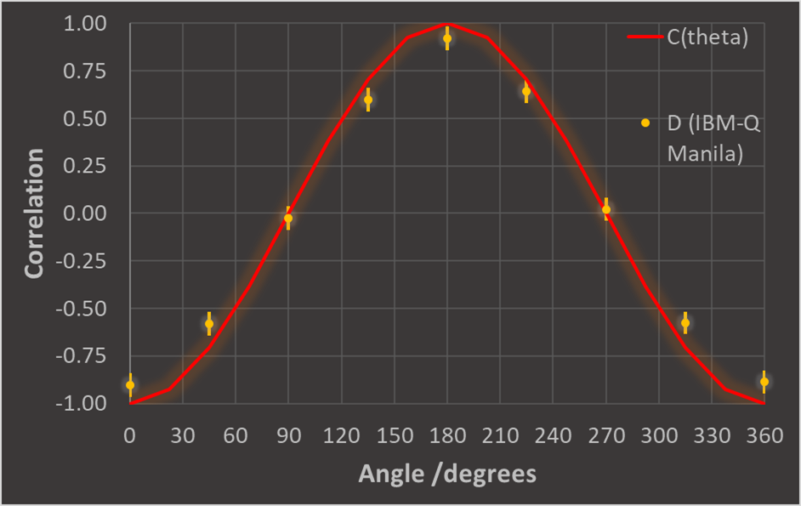
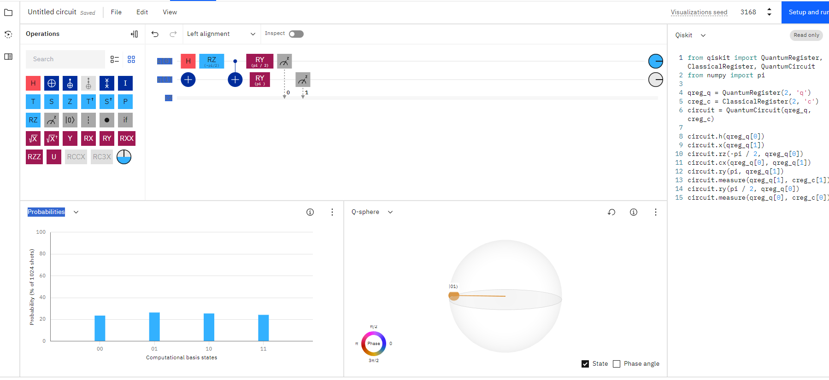
Quantum computer (IBM-q)
Able to tackle problems beyond the reach of classical computers (optimization and simulation tasks exponentially faster)
What/how
How does it look
Learn how QC harnesses the quantum behaviour (superposition and entanglement) to process information and how a quantum algorithm works
IBM Cutting edge technology with easy interface
2-level system, simple matrix maths.
Considered an advanced topic for research. Successfully introduced it at level 3 UG for the first time in SM380 (22J)
TMA03=> 24%

Slide 4

Outcomes
What students learn:
  Understand how to manipulate the state of quantum objects to create superposition and entangled states (circuit design)
  Students need a deep understanding to plan how to unveil quantum behaviour and why classical explanations fall short.
  Emphasis in discovering the non-classicality of quantum behaviour (discussion and results)
Students enjoyed the relevance to new industries and the opportunity to explore quantum behaviours often deemed too strange to understand
Some students take it further by engaging with the IBM quantum computing material.
22J : Increased pass rate and higher grades (though we need to monitor several presentations)
Level 4 Quantum computing

Slide 5
Some quotes from students
“The use of teh IBM quantum computer was a very good inclusion in the course”
“I was quite anxious about this assignment but, at the same time, excited to actually be doing some quantum mechanics! It has piqued my interest in quantum computers and I am minded to do IBM's courses on it”
“quantum computing task (excellent - spectacular result proved with modest resources - don't know how you'll top that next year)”
“I appreciated the module teams efforts to give us a glimpse into the real world applications and cutting edge research work in this fascinating field.”
“The material was very interesting and I enjoyed using the IBM quantum computer.”

