Slide 1
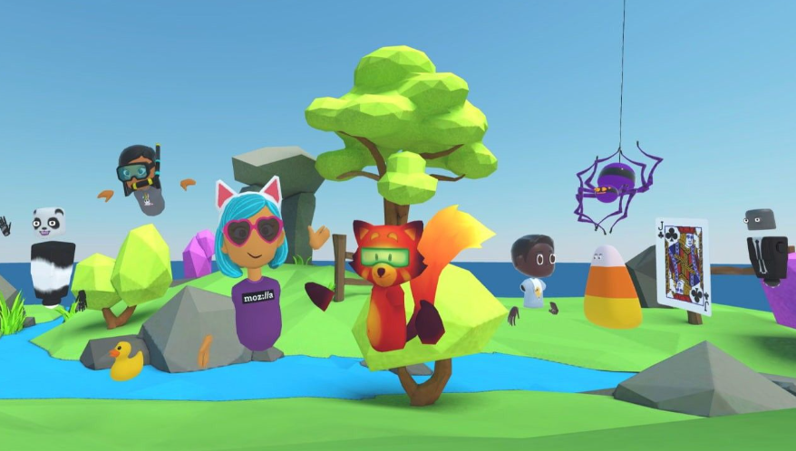

Intro Slide Title 1
Exploring the impact of VR tutorials on S296, Cell and molecular biology
Sarah Daniell, Lorraine Waters, Katja Rietdorf, Heather Fraser, Patrizia Paci & Seth Racey.
LHCS
10th April 2024

Slide 2
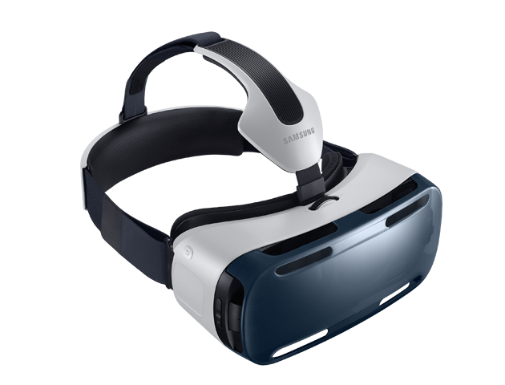

Slide Title 9
Would introducing VR tutorials alongside Adobe Connect benefit our science students?
Student attendance at Adobe Connect tutorials is low.
We’re doing a great job of providing excellent tutorials and recordings, but they don’t give a sense of community and neither do our forums.
For some students that may influence their sense of belonging, motivation, engagement, learning outcomes, retention and continuation within a qualification.
Research shows VR very popular with students – they interact!
Popular with students who struggle in conventional environment.
Visually interesting – helps with engagement.

Slide 3
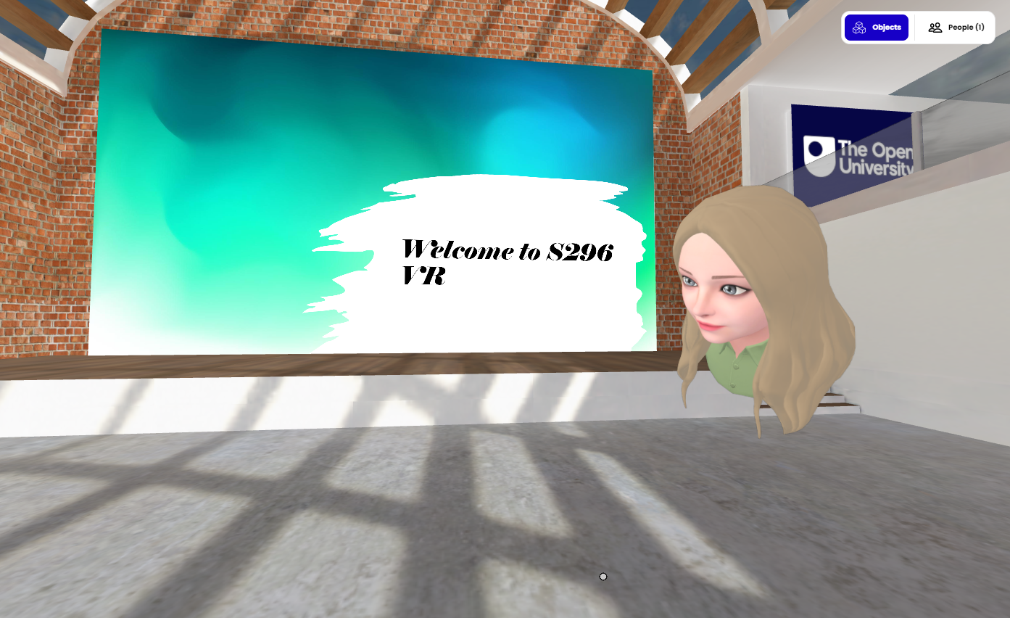
What did we do?

Slide 4
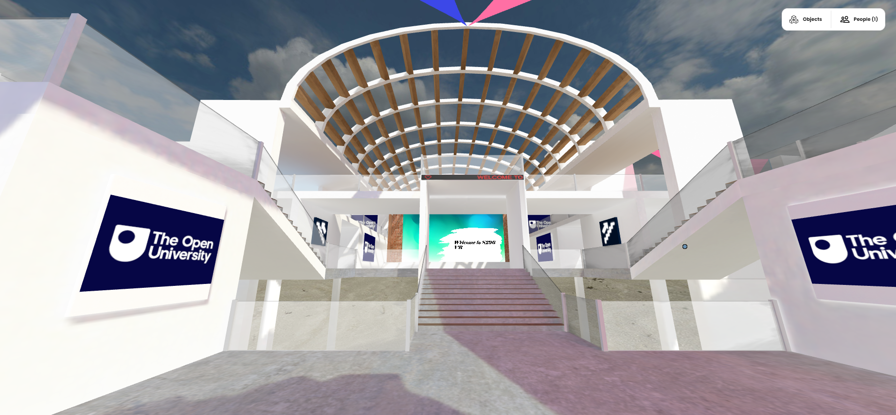
Our tutorials:
Fun orientation sessions before Christmas
Tutorial 1: Exploring the structure of amino acids
Tutorial 2: A close look at protein structures
Tutorial 3: Thinking about membranes
Tutorial 4: Understanding ion channels
We also ran equivalent sessions in Adobe Connect
c

Slide 5
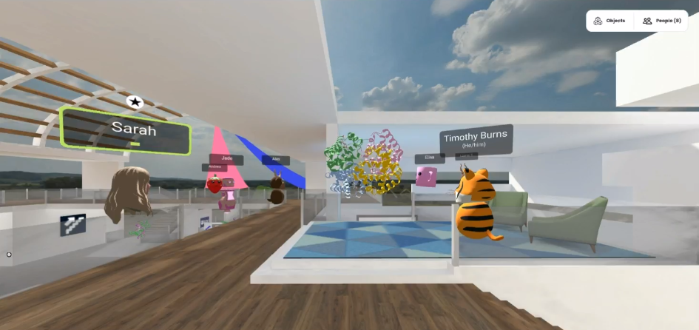
What happened?
c

Slide 6
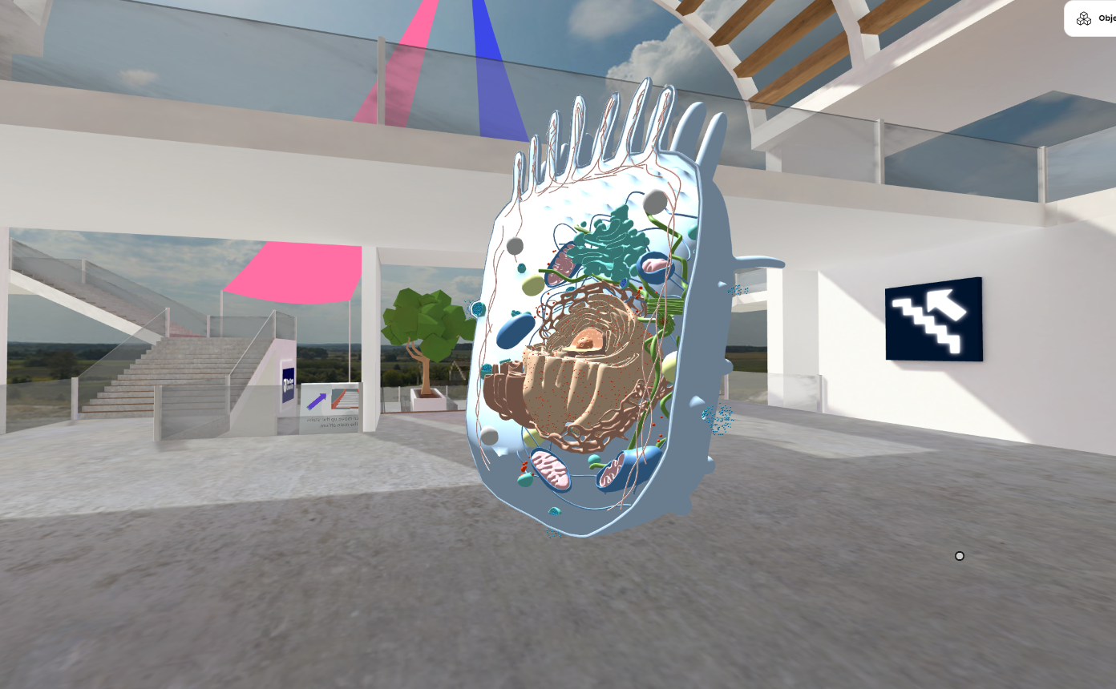
We explored cells….

Slide 7

Slide Title 9
What did the students think?
I really enjoyed all of the vr sessions, I think they worked best when they were guided I.e. Sarah guided us through the specific tasks and to all the 3D models and what they showed. But I loved them all and I can really see it being a useful and fun part of the module materials and tutorials in the future.
I loved going into the cells and being able to manipulate the protein structures.

Slide 8
Slide Title 9
Talking more in VR
It felt more comfortable to speak in the VR tutorials than it does in a tutorial presented on Adobe Connect, perhaps as the VR sessions feel slightly less formal and closer to an 'in-person' or 'face-to-face' experience despite still being virtual.
It was amazing to speak to my colleagues

Slide 9
What’s next?
Would you like to see VR introduced more widely in your education experience, in addition to Adobe Connect tutorials?
83% Yes
c

Slide 10
Slide Title 30
With many thanks to eSTEeM for all their support!

Slide 11
Slide Title 31

