Slide 1
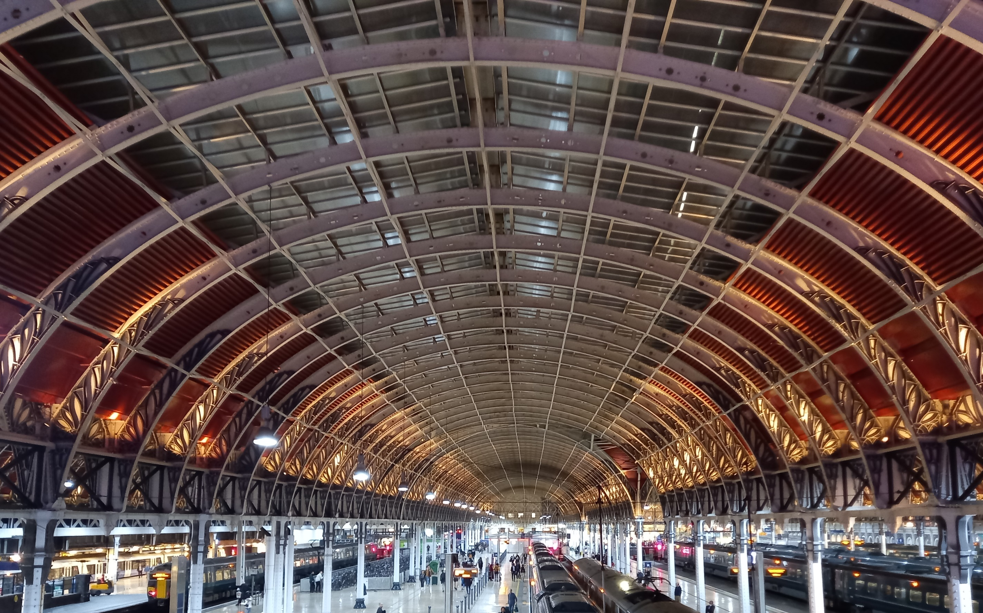
Intro Slide Title 1
Making space for women in Engineering
Building networks for female engineering students
Fiona Gleed and Claudia Eckert
Engineering and Innovation
13th eSTEeM Annual Conference - April 2024

Slide 2
Need
For women in Engineering
UK Engineering profession
Open University
Future skills
Strength in numbers
More engineers
Climate action
Career progression
Specialists and generalists
With different knowledge, skills and behaviour
Sustainability
Systems thinking
Creativity
Increasing diversity addresses both aspects
Big in Engineering
Most taught students in UK
30% of all UK PT UG Engineering students
Gender diverse
E&I Athena Swan Silver Award
64% female Undergraduates
But below UK average for female Engineering UG
Notes:
Help centre includes Computing help

Slide 3
Inputs
What can we do – previous eSTEeM projects
Promoting engineering to women
Supporting women in engineering
OPEN STEM -
Degrees of diversity
Elaine McPherson and Mary Keys (2020-2022) Investigating the motivations of female students choosing an open versus named qualification
Women on Engineering entry module (T192 19J)
16.4% of all students
33% of Combined STEM degree students
Carol Morris and Sally Organ (2017-2019) Engineering qualifications at the OU – what motivates women to study?
Women on Engineering qualifications are
less likely to be working in engineering
more likely to have a degree already
aware they are minoritised
Notes:
Assessments and exams | Help Centre | The Open University

Slide 4

Activities
Women in Engineering conferences
Events
Face-to-face by default or design?
Timed for close to INWED (23 June) uno
Ready to return from online?
Year | Topic | Location
2016 | Making connections | Milton Keynes
2017 | Creating supportive environments | Milton Keynes
2018 | Levelling the playing field | Milton Keynes
2019 | Transforming the future | Birmingham
2020 | cancelled
2021 | Engineering heroes | Online
2022 | Webinar series (November) | Online
2023 | Boundless engineering | Milton Keynes
2024 | Enhanced by Engineering | Online
2025 | ? | ?

Slide 5




Outcomes
Evaluating what matters - now
Cohort
Conference
Comparison to previous and all students
Engagement and experiences
Demographics and motivations
Enrolments by qualification and module
Intersections – age, entry qualifications
Study – qualification, path, pace,
Employment – relevance, sponsorship, time
Social – support, commitments, role models
Profile – minoritised?
Technologies, target audience and topics
Events attended – OU and external
Logistics – timing, travel, costs
People - meeting, connecting, listening
Programme – focus and format
resources
inspiration
direction
guidance

Slide 6

Next steps
Getting permissions in place to engage with students at and after …
Women in Computing and Women in Design and Engineering (Virtual) | learn1 (open.ac.uk)

