Slide 1
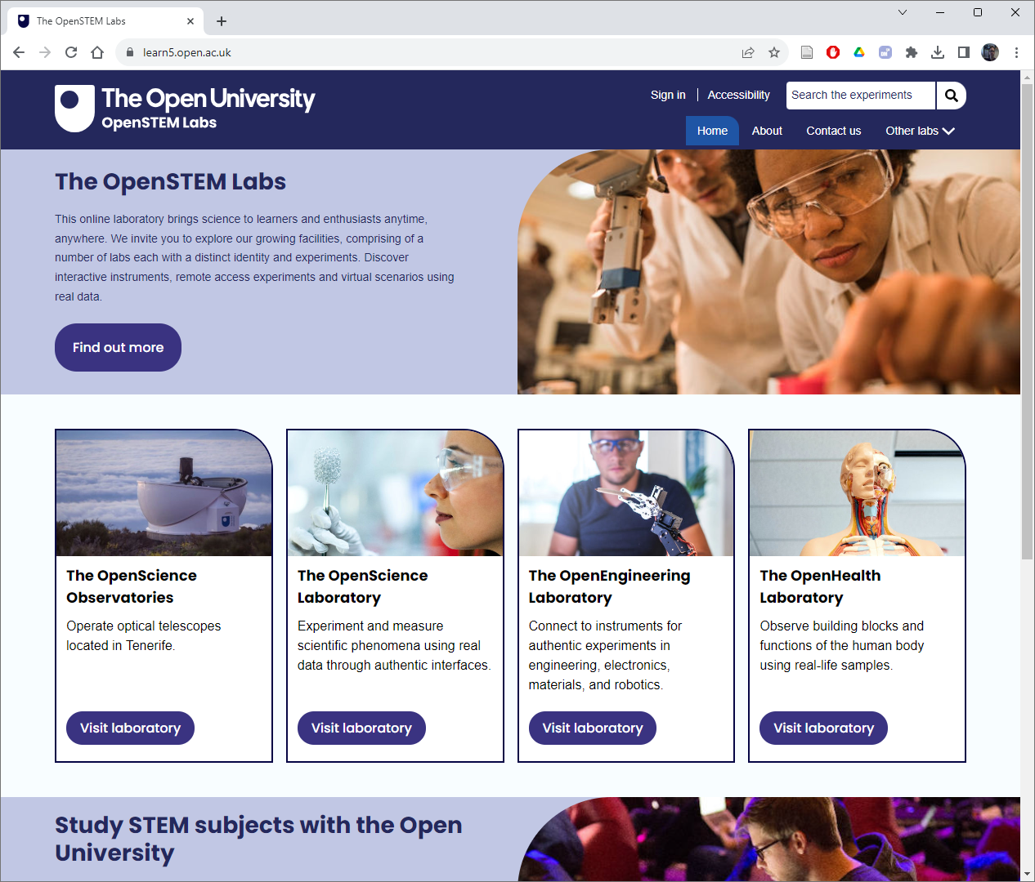

A strategic approach to innovation in the curriculum
Trevor Collins, James Smith, Victoria Nicholas and Alexis Peters
eSTEeM Conference
Wednesday 10th April 2024

Slide 2
Overview
OU Charter
OU Charter and Strategy
Teaching and Learning Plan
STEM Vision and Plan
Innovation in the Curriculum
Examples from The OpenSTEM Labs
Reflections and direction
“3. The objects of the University shall be the advancement and dissemination of learning and knowledge by teaching and research by a diversity of means such as broadcasting and technological devices appropriate to higher education …” (OU Charter and Statutes, 1969)

Slide 3
OU Strategy 2022-27: Learn and Live
Mission: open to people, places, methods and ideas
Vision: life-changing learning that enriches society
Values: inclusive, innovative, responsive
Goals: greater reach, success for our students, societal impact, equity and sustainability
Enablers
Living our values
Supporting each other
Continuously improving
Employing secure and effective technologies
Using data and evidence
Building on our uniqueness
Stewarding our finances

Slide 4
Teaching and Learning Plan 2022-27
1. A high-quality, supported distance learning experience is enabled through innovative teaching and assessment.
2. Students are supported to begin and progress through their OU journey at the appropriate level and intensity for their needs.
3. Learning is designed and delivered as anti-racist, anti-discriminatory, accessible and inclusive.
4. Students and their voice are integrated into the planning of our teaching to enhance the quality of our provision.
5. Teaching and learning are designed and delivered as an academically rigorous, research-informed process

Slide 5
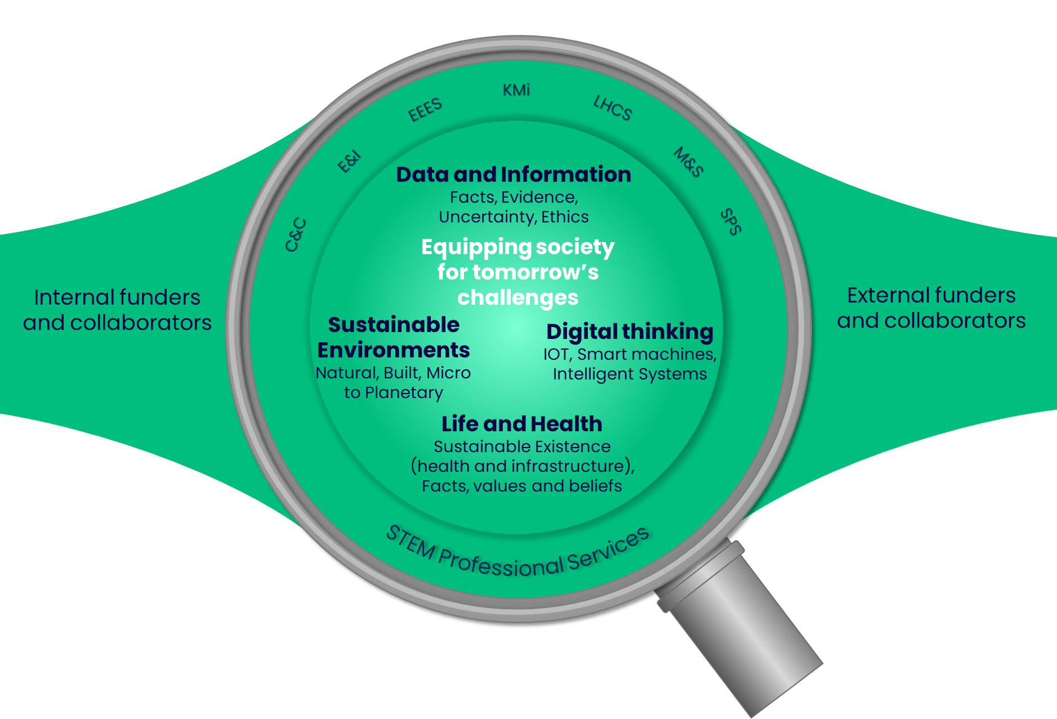
STEM Vision: Bringing the vision to life
Inclusive, innovative and high impact STEM teaching and research, equipping society for tomorrow’s challenges
To prepare our future knowledge sharers, we will move from a subject focus to themes that embrace complexity and provide boundaryless, multidisciplinary education. Our themes are:
Digital thinking
Sustainable Environments
Data and Information
Life and Health
These are considered within the context of the needs of external collaborators and funders, the changing external environment and in partnership across the University
We recognise the marketing challenge for students’ recognition of single versus multidisciplinary subjects and will work with Marcomms for a solution.
Notes:
The STEM OU vision focuses on Delivery of inclusive, innovative and high impact STEM teaching and research, equipping society for tomorrow’s challenges

Slide 6
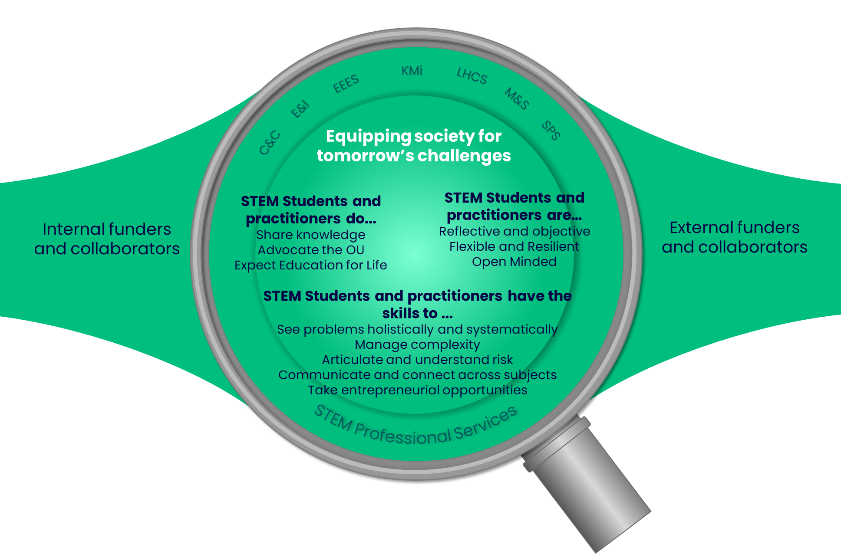
STEM knowledge sharers of the future…
Deliver inclusive, innovative and high impact STEM teaching and research, equipping society for tomorrow’s challenges
To meet tomorrow’s societal challenges, our students and researchers must have the skills to share and communicate.
They will develop cross discipline solutions that embrace complexity and manage risk.
Their knowledge should provide impactful solutions that benefit wider society
Notes:
Core to this is our students being knowledge sharers of the future

Slide 7

AD Student Experience: AD Faculty and Strategy,
PVC-S, Academic Services, Academic Strategy
1: Deliver a Positive, Consistent and Inclusive Student Experience
Provide a positive, consistent and more inclusive student experience driven by the Teaching and Learning Plan, particularly integrating students and their voice into our plans to enhance the quality of provision. It’s recognised that some of our aims are driven from specific STEM requirements and others are more collaborative activity driven by and/or including colleagues across the OU.
Continue to enhance innovative STEM pedagogy
We will use our unique competitive position delivering authentic online practical work (OpenSTEM Labs, OpenLivingLab, OpenComputing Lab) and immersive environments for skills development (OpenXR), harnessing the power of artificial intelligence, for an outstanding student experience.
Focus on Continuation, Completion and Progression
The following projects will be prioritised in line with the teaching and learning plan principles.
Address awarding gaps for students prioritising those for Black students, those in the Index of Multiple Deprivation quintile 1 and students with mental health issues in line with OU APP priorities.
Disseminate good practice in high quality and timely feedback to students
Ensuring students with low PEQs are encouraged to take fast track Access prior to stage 1 study.
Use our academic experience and capabilities to influence OU wide projects related to student progression
Improve processes for managing academic conduct and complaints that inhibit progression
Support and influence the OU in addressing environmental and system issues impacting assessment and tuition
Ensure opportunities for students to develop their research and enquiry skills as per the Teaching and Learning plan.
We will also continue to improve student outcomes through ongoing student engagement, quality monitoring, scholarship through eSTEeM and schools’ progression plans.
Revise and simplify assessment
Provide a better STEM student experience by implementing the simplified Assessment Framework and consistent word limit guidance.
Notes:
Key to delivering a Positive, Consistent and Inclusive Student Experience is a focus on Innovative STEM pedagogy
Extract from the ‘STEM Five-Year Vision’ (due for internal publication now)

Slide 8
Innovation in the Curriculum
How can the ‘innovation’ referred to be expressed and delivered
Where does it happen?
Module Team Ideas
Faculty Vision, Plans and Frameworks
University Plans, Frameworks and Innovation Projects
The OpenSTEM Labs
The OpenXR Studios

Slide 9
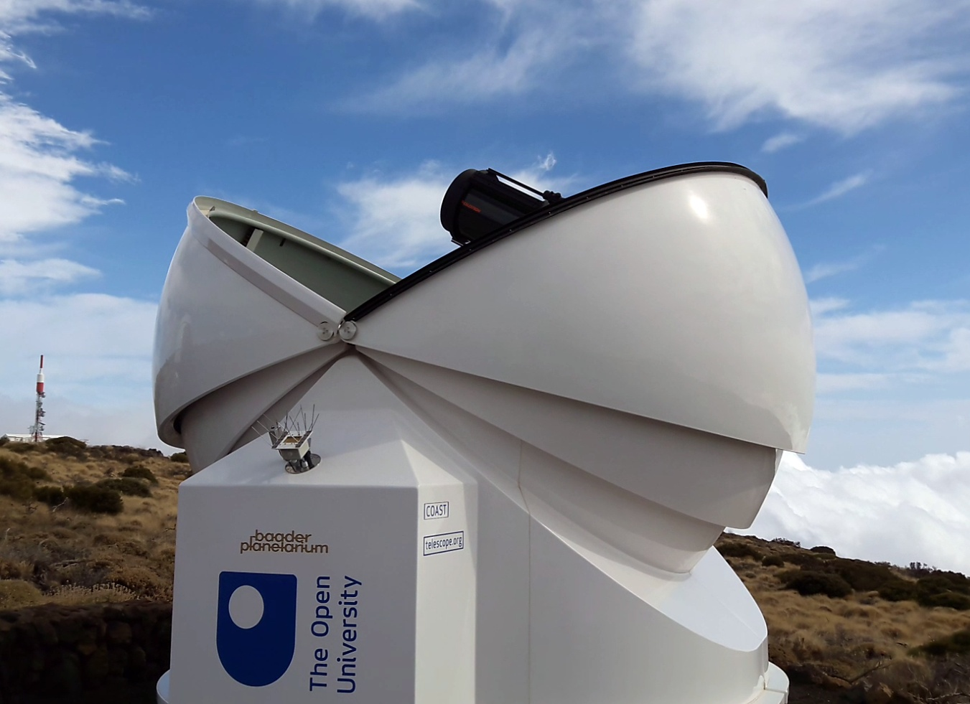
Examples from The OpenSTEM Labs
OpenScience Observatories
Teaching
Research
Outreach
Enterprise
A flagship example of OpenSTEM Labs activity
Evolved over 15 years (pre-dates The OpenScience Lab and The OpenSTEM Labs)

Slide 10
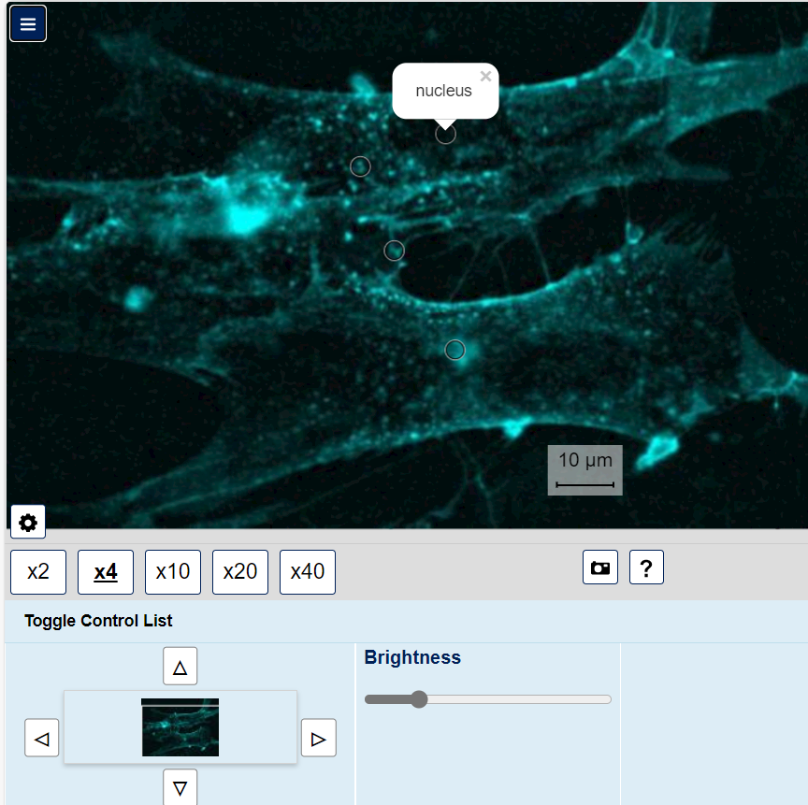
Examples from The OpenSTEM Labs
Virtual / Digital Microscopes
KMi
EEEs
LDS
IET
Ubiquitous practical activity across the OU ecosystem
Evolves over time (pre-dates The OpenScience Lab and The OpenSTEM Labs)

Slide 11
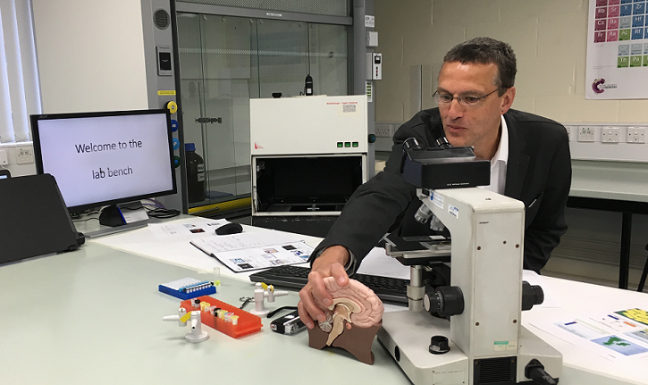
Examples from The OpenSTEM Labs
Labcasts and Fieldcasts
Stadium
Stadium Live
Live broadcast with Question-and-Answer widgets for student responses
XR Labcasts will be a focus for The OpenXR Studios

Slide 12
Reflections and Direction – The OpenSTEM Labs
Is the OpenSTEM Labs a flagship example of innovation in the curriculum?
Is the OpenSTEM Labs itself innovative or is it the discrete experiments?
How important is its scale and scope (more than the sum of its parts)?
Could the OpenSTEM Labs have happened as a result of a central OU initiative?
Are practical- and practice-based activities different to other module materials?

Slide 13
Reflections and Direction – STEM Vision and Strategy
We are required to be ‘innovative’ but who decides what that is?
What structures need to be in place (Faculty, University)?
What is tangible and actionable from the visions and strategies?
How can we close the gap between module production processes and University ‘innovation’ schemes?
What would activity in this gap look like?
Timespan
Resources
Purpose

Slide 14
A strategic approach to innovation in the curriculum
Trevor Collins, James Smith, Victoria Nicholas and Alexis Peters
eSTEeM Conference
Wednesday 10th April 2024

