Slide 1

Intro Slide Title 1
Assessment and feedback on the introduction of group work on M140
Preliminary findings
Ruth Neal, Kaustubh Adhikari and Kellee Patterson
Maths and Stats
3rd April 2024

Slide 2
Slide Title 6
Assessment and feedback on the introduction of group work on M140
Our project aims to find a method of introducing group work on a level 1 statistics module, M140 and to take this forward to level 2 and 3 statistics modules.
We have sent an initial survey to all M140 students to ascertain their views on group work.
The survey was sent to 683 M140 students and 119 students responded.
Why are we doing this?
We want to find a method of successfully introducing group work on a level 1 statistics module and take this forward to level 2 and 3 statistics modules.

Slide 3
Slide Title 6
Assessment and feedback on the introduction of group work on M140
What is the group work?
TMA04 of M140 has a seed growing experiment. Students are asked to grow some mustard or cress seeds in light and dark conditions. The students measure the length of the roots and analyse these results using a statistical test. The students are also asked to upload their results to a shared database.
We would like the volunteer students to discuss their experiment and results. How the experiment went for them and what issues they found.
We would then like them to download the data from all students and analyse this. They can plot this data, calculate data summaries and suggest tests to run on the data.

Slide 4
Slide Title 21
Group work on M140
Have you participated in group work before?
34% had participated in group work before
66% had not taken part in group work before
Most students had not taken part in group work before

Slide 5
Slide Title 21
Group work on M140
What was the purpose of this group work?
Study comprises of 55%
Work comprises of 38%
Other is 8%
Most students had experienced group work as part of their studies

Slide 6
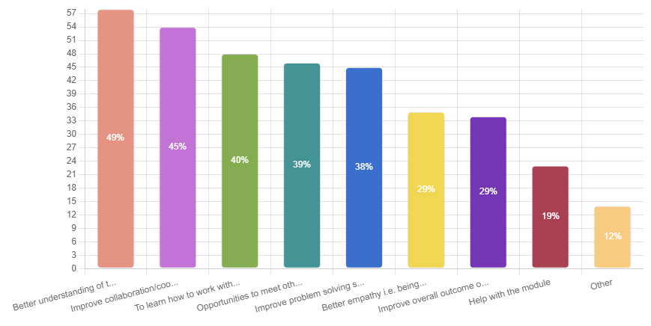
Slide Title 21
Group work on M140
Expectations from the group work
Most students wanted better understanding of the module materials.
Also important were collaboration skills and working together
Of least importance was better empathy, improve their module outcome and help with the module

Slide 7
Slide Title 21
Group work on M140
What were the student expectations of this group work?
All categories were identified as important
The most important areas were communications between team members and meeting the project deadlines
Also important were working successfully as a group and collaboration

Slide 8
Slide Title 21
Group work on M140
Previous education background of the students responding
The largest category of student responding is A levels or equivalent
Perhaps surprising is the large numbers of responses from students who already have higher education and post graduate qualifications

Slide 9
Slide Title 21
Group work on M140
Ethnicity of the students responding
The largest category of students answering the survey is white.
The smallest categories are black, Asian, or mixed.

Slide 10
Slide Title 21
Group work on M140
How do students feel about group work?
Words that stand out are nervous, apprehensive and unsure
But it is good to see that excited, curious and happy are also prominent

Slide 11
Slide Title 6
Assessment and feedback on the introduction of group work on M140
The group work will take place at the end of April and the beginning of May
We sent invitations the M140 students asking them to take part in the group work discussions. These are to take place in closed forums, 10 to 15 students per forum and a tutor to supervise and direct where necessary.
We have a group of volunteer M140 students, so far, we have 64 volunteers, invites were sent to 683 students.
After the group work, we will survey the students again to assess how the activity has gone.

Slide 12
Slide Title 30
Thank you
Any questions?

Slide 13
Slide Title 31

