Slide 1
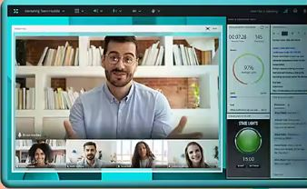

Synchronous Online tutorials: analysis to identify groupings or types of student
eSTEeM Conference
Team members
STEM: Karen Kear, Helen Donelan, Jon Rosewell
FASS: Paige Cuffe, Tracey Elder
FBL: Allan Mooney, Kevin Amor, Carol Edwards
WELS: Kieron Sheehy, Ale Okada
Anthony Johnston
April 2024

Slide 2
Background
Online synchronous tutorials, using Adobe Connect, are an important part of our teaching.
However, there is often a lack of active participation by students.
Our project addressed the following research questions:
What are the factors affecting active student participation in online tutorials?
To what extent do the challenges of active student participation vary across faculties?
How can these challenges be addressed?
Notes:
Put in more background – use slide from another

Slide 3
Research Methods to Date
Two large-scale surveys - of students and of tutors
Included 18 modules covering all four faculties
Similar questions in both surveys
620 students responded (8% response rate)
197 tutors responded (22% response rate)
Quantitative and qualitative data
Focus groups - with students and with tutors
Notes:
Put in more background – use slide from another

Slide 4
The Student Survey
Questions were about ACTIVE participation in online tutorials
Included 18 modules covering all four faculties
620 students responded (8% response rate)
Notes:
Put in more background – use slide from another

Slide 5
Research Questions
Can the students be grouped into student typologies?
If so, does the composition of each typology suggest a tutorial technique or approach that would benefit each type of student?

Slide 6
Methodology
Codification of the Results
Export to SPSS (Statistical Package for the Social Sciences)
Cluster Analysis
Export back to Excel
Use of Pivot Tables to investigate each group
Notes:
Remember stats for audience

Slide 7
Limitations
A preliminary investigation
Exploratory Tool
Students who had not attended a tutorial (n=100) were removed from the data set

Slide 8
Clusters

Slide 9
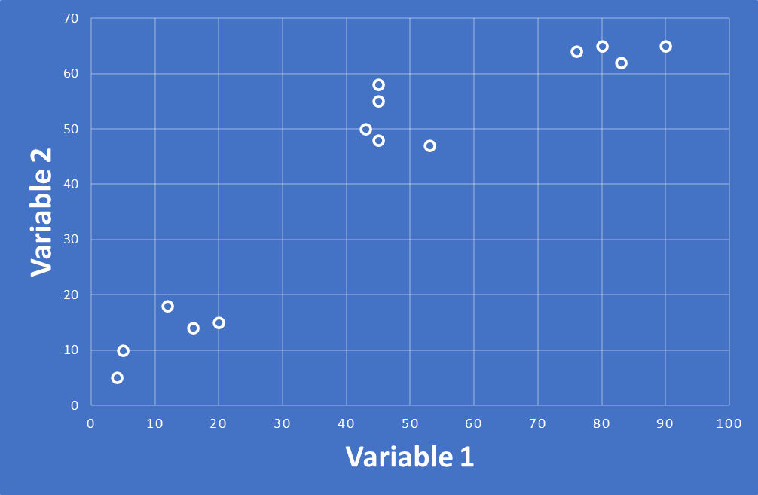
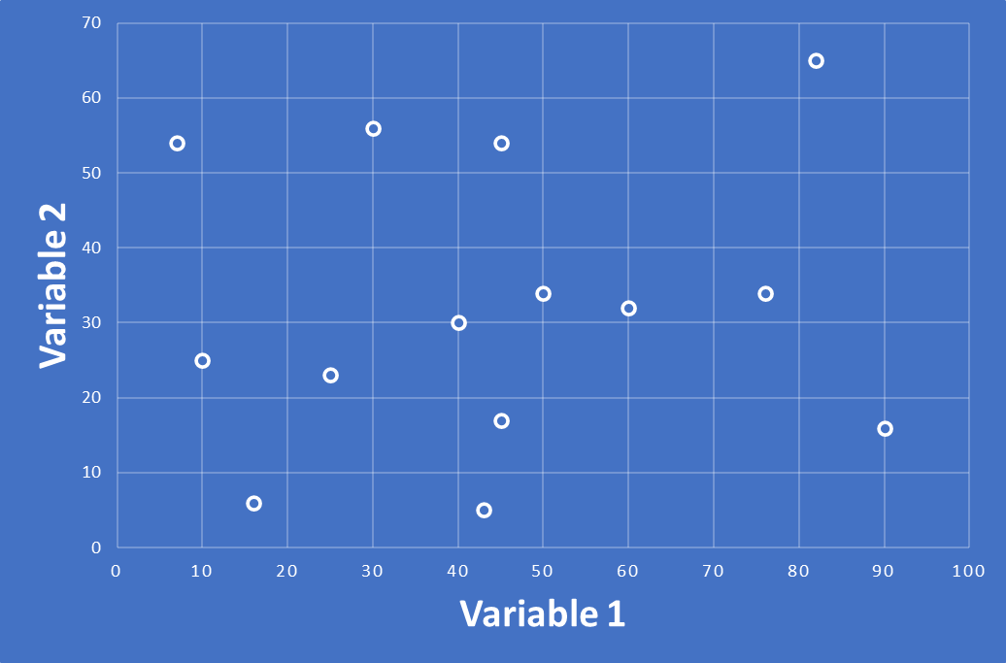
Cluster Analysis
Aim
Use results of questionnaire to find “clusters” of student
Silhouette Value = +1
Terminology (Metric used)
Ideal Clusters – no overlap between clusters
Silhouette Value = +1
No true clusters – elements scattered through variable space
Silhouette Value = -1
Silhouette Value = -1

Slide 10
Cluster Analysis
SPSS allows for different techniques
Hierarchical Cluster Analysis
Groups data from top down
K-Means
Initial cluster centres determined
Assigns cases to nearest centre
Iteratively moves cluster centres based on mean value of the cases
Two-Step
Forms pre-clusters from “dense” regions in the attribute-space
Merges pre-clusters that are close to each other

Slide 11
Cluster Analysis
Both Hierarchical and K-Means work best with continuous data
We have categorical data
Likert scale – strongly agree, agree, neutral, disagree, strongly disagree
yes/no data (binomial)
Two-Step Cluster Analysis
Works with both Continuous and Categorical variables ✓

Slide 12
Two-Step Cluster Analysis
It is an exploratory tool
It provides automatic cluster selection – and in this case the software determined the number of clusters to be 3 ✓
A black box – hard to determine reasoning
Assumptions: categorical variables should be multinomially distributed, the data order may make a difference and should be random
We are familiar with normal distribution for continuous data, put simply multinomial distribution looks similar but is for discrete data where there is a limited number of outcomes.

Slide 13
Investigations

Slide 14
Investigation
Some examples
Choosing the Questions
Boolean Type
“I wanted to meet my tutor” – option on why attended tutorial
Likert Scale (Please indicate how you feel about the following statements)
“Students learn best through collaborative activities”
Strongly Disagree > > > Strongly Agree

Slide 15
Investigation
Trial & Error and Intuition
Tried various combinations of Questions
Software determines number of clusters
Hierarchical and K-Means pointed towards three clusters
Two-step gives the Silhouette Value
Aimed for a Silhouette Value greater than 0.1

Slide 16

Investigation
Questions Chosen
I enjoy online tutorials where I can actively take part
Helping students to talk to one another productively is a good way of teaching
Students learn best through collaborative activities
I think there is a benefit to me if I actively take part in online tutorials
I feel stressed in online tutorials when I am expected to actively take part

Slide 17
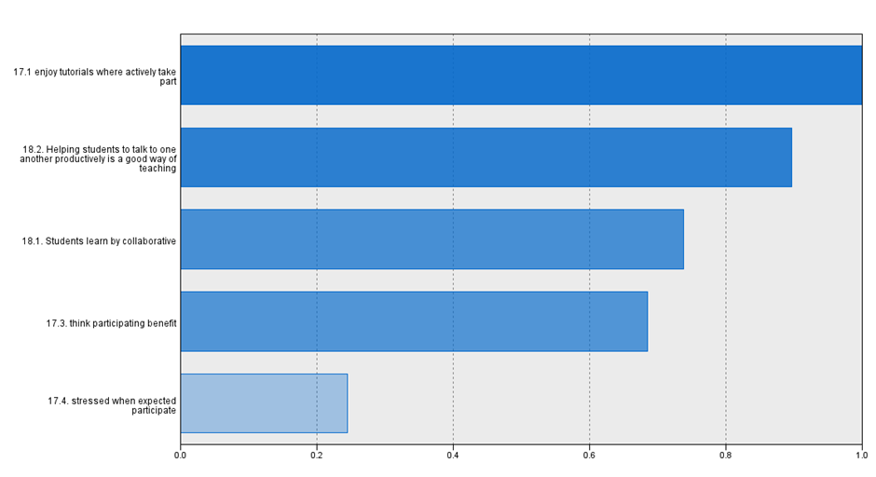
Relative influence of questions on the clusters
I enjoy online tutorials where I can actively take part
Helping students to talk to one another productively is a good way of teaching
Students learn best through collaborative activities
I think there is a benefit to me if I actively take part in online tutorials
I feel stressed in online tutorials when I am expected to actively take part

Slide 18
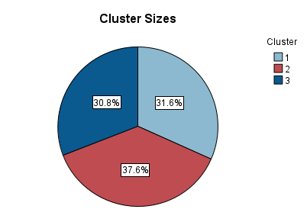
Cluster Sizes
Cluster sizes:
1: 163
2: 194
3: 159

Slide 19
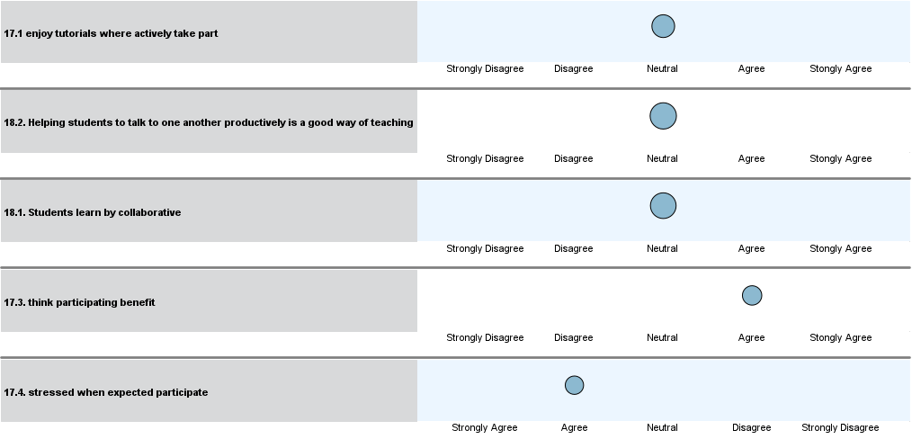
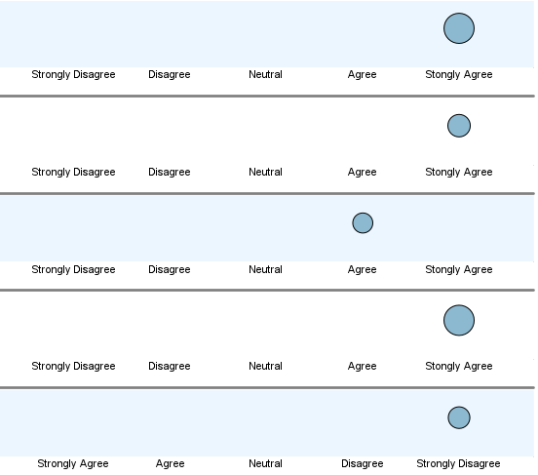
Group 3: tend to be more active
I enjoy Active online tutorials
Talk productively is good
Learn through collaboration
Benefit if active in online tutorials
Stressed when have to take part

Slide 20
Group 1: tend to be more passive
I enjoy Active online tutorials
Talk productively is good
Learn through collaboration
Benefit if active in online tutorials
Stressed when have to take part

Slide 21
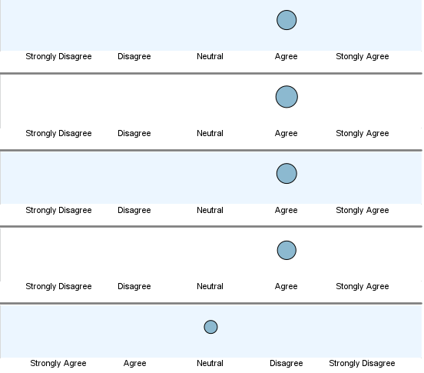
Group 2: Middle Group
I enjoy Active online tutorials
Talk productively is good
Learn through collaboration
Benefit if active in online tutorials
Stressed when have to take part

Slide 22
Use of Pivot Tables to Compare Groups
Notes:
Active Participation: Did you take part in activities? (Yes, quite a lot; Yes, a little, No, not really, No, not at all)

Slide 23
Group 3: Most active
30.5% of students
Want to interact and can see the value of interaction
Tend to be those who would:
Be prepared to use microphone and camera,
Ask questions
Agree that collaboration is important
Feel confident speaking in online tutorials

Slide 24
Group 1: More passive students
32% of students
Don’t agree that students learn through collaboration
Tend to be those who would:
Be somewhat anxious
Feel main role of tutors is to teach facts

Slide 25
Group 2: Middle Group
37.5% of students
Agree that students learn through collaboration
Their own participation levels are not high
Tend to be those who would:
Lack confidence in speaking in online tutorials
An Interesting Group!
Approach-Avoid Conflict

Slide 26
Group 2: Middle Group
Perceive a benefit in active participation but they also perceive barriers
Barriers could include:
lack of confidence,
worry about what other students or tutor would think of their contribution
finding the pace too fast
being conscious of being behind in their studies
37.5% of students
Agree that students learn through collaboration
Their own participation levels is not high
Tend to be those who would:
Lack confidence in speaking in online tutorials
An Interesting Group!
Approach-Avoid Conflict
Notes:
one of the three main types of conflict as described by the German–US psychologist Kurt Lewin in 1931
finding the pace too fast - 14 in group 2, 11 in group 1 and 1 in group 3

Slide 27
Cluster Composition by Faculty - percentage
Notes:
Explain percentages – why is FBL different? Law and others

Slide 28

Further Investigations
Limitations
For Further Research
Human nature is complex
Overlap between clusters
Consolidation cluster analysis
How much influence is technology?
Does one group influence another?
Difference between Faculties

Slide 29
Suggestions

Slide 30
Suggestions for Tuition Models
Different Events
Standard Tutorial Slot
Lecture-event
Workshop tutorial
Safe-Tutorials
Confidence-building tutorial
start with a short lecture
proceed to a structured participatory section
finish with an optional cameras-on workshop.
Notes:
Quiet tutorials

Slide 31
Suggestions in detail
Possible suggestions
1) Rather that a one-size fits all tutorial system we could develop a set of events for different student typologies.
Lecture-event: a tutor or module team member delivers a topic to do with the syllabus. This could be impartation of part of the syllabus or a talk about a new development in the field. This type of event would suit students from group 1 who want to absorb essentials of the unit syllabus.
Workshop tutorial: a highly participatory event in which students interact with one or probably two tutors. Camera use would be considered normal, and students would work together to explore particular topics
Safe-Tutorials: one or two tutors deliver a workshop-tutorial where students are invited to participate. The tutorial is themed around the module content and contains activities with various degrees of participation required.
Confidence-building tutorial: a workshop exploring how students can build their confidence in an online environment.
2) If Module chooses to continue with current tuition model then adjustments could be made. For example, a tutorial might start with a short lecture, proceed to a structured participatory section, and finish with an optional cameras-on workshop.

Slide 32
Slide Title 31

