Slide 1

Designathon
Creative online career and employability development
Vera Hale
Engineering and Innovation, STEM
eSTEaM 2024 - 10th April 2024

Slide 2

Designathon
Creative online career and employability development
OU CES and OU Design Group (E&I) Collaboration
The Designathon is a day-long online workshop, where the OU Design group (initially with support from OU Career and Employability Services) collaborated with an organisation to set a design challenge for self-selected students from different levels on the Q61 Design Qualification.
The main aim is a chance for our students to develop employability skills and experience working on real-world problems.

Slide 3
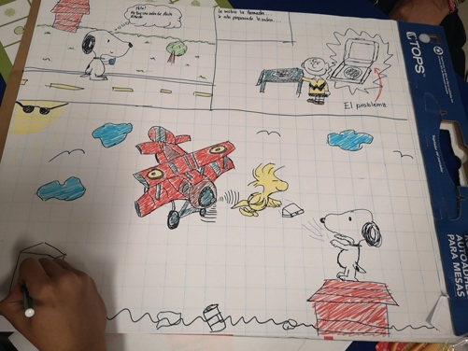
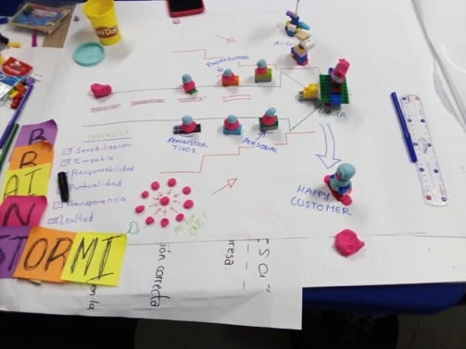
Designathon
Creative online career and employability development
OU CES and OU Design Group (E&I) Collaboration
OU CES – Georgina Hawkins and Arabelle Nock
OU Design Group – Georgina Holden, Derek Jones, Nicole Lotz, Vera Hale
Based on a day-long face-to-face hackathon model trailed in Mexico developed by Georgina Holden, Derek Jones and Nicole Lotz.
Example
presentations Mexico
workshop
Notes:
Using a template, the company or organization shares a summary of a problem or challenge they face, for example in day-to-day business or in business development. Previous workshops addressed following problems:
Catering: how to make take-away food more sustainable
Construction: how to improve resource management
Car parts and repair: how to address decreasing sales and high staff turnover
Retail: how to diversify the retail of organic tea products and increase sales

Slide 4

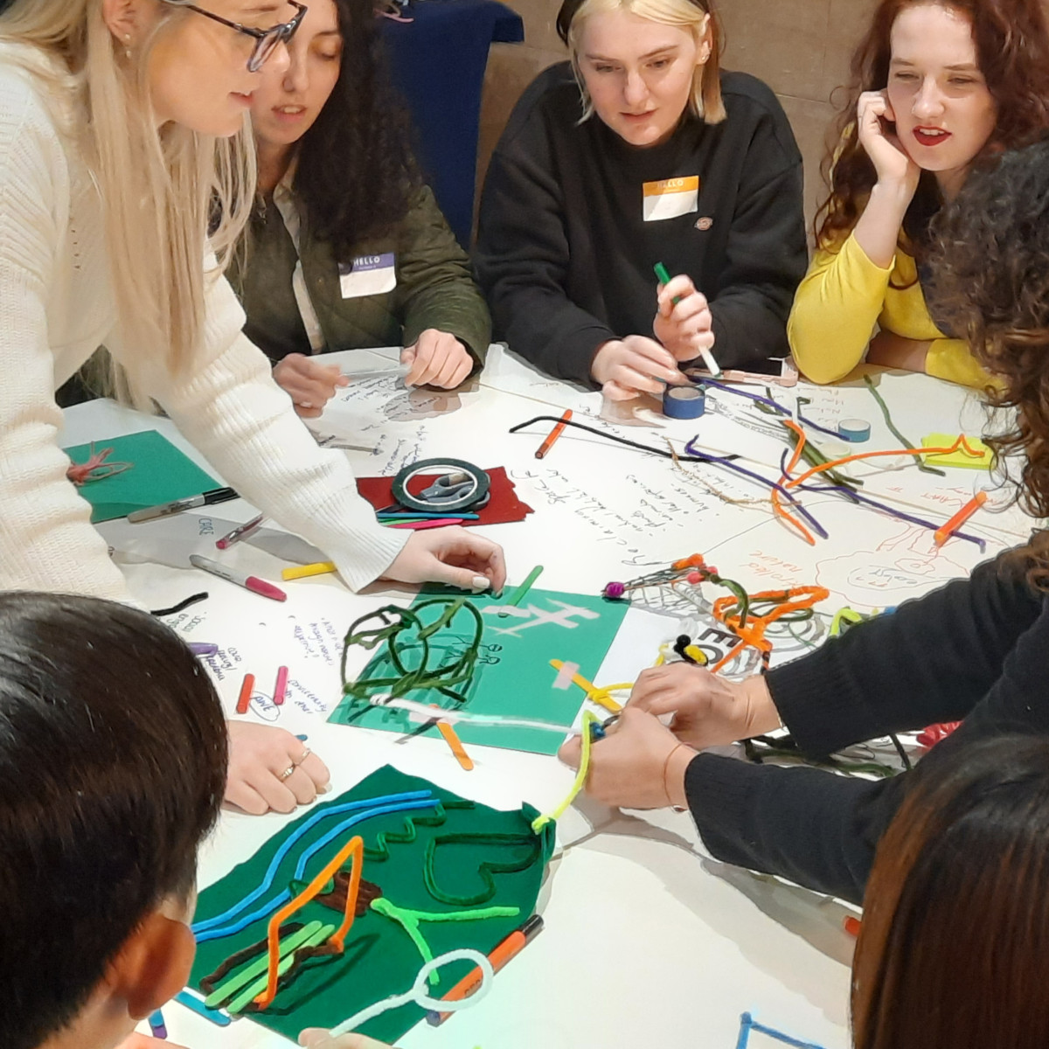
Designathon
Creative online career and employability development
Community/ Organisational Partner
The Glass-House Community Led Design (TGH)
National charity that supports communities, organisations, and networks to work collaboratively on the design of buildings, open spaces, homes, and neighbourhoods.
Designathon offers the participating community partner a fresh perspective, new ideas and possible markets for a particular challenge that they face.
Design challenges around their WEDesign program.
WEDesign event
Images courtesy TGH
Notes:
For two decades, The Glass-House has enabled people and organisations to work collaboratively to improve the design of their buildings, open spaces, homes, and neighbourhoods.
They see design not only as a tool for creating great places, but also as a way to connect people and empower them with enhanced confidence, skills and a greater sense of agency.
The Glass-House provides hands-on support and training, shares knowledge and learning, and inspires new thinking and debate through action research, events and resources.
WEDesign is a student-supported engagement event that invites the wider public to engage in a discussion or workshop around a particular theme.

Slide 5


Designathon
Creative online career and employability development
Inspirational Dynamic Day (10 am- 4.30 pm)
Design Problem Framing
Design Brainstorming
Design Refining
Design Solution/ Presentation
Notes:
10.00 Welcome and introduction
10.15 Team Ice-Breaker
11.00 BREAK
11.15 Glass-House introduction
11.45 Design Problem Framing
12.15 Q&A
12.45 Design Problem Summary
13.00 LUNCH
13.45 Design Brainstorming
14.15 Design Refining
14.45 BREAK
15.00 Presentation
16.15 Feedback & next steps
16.30 END

Slide 6
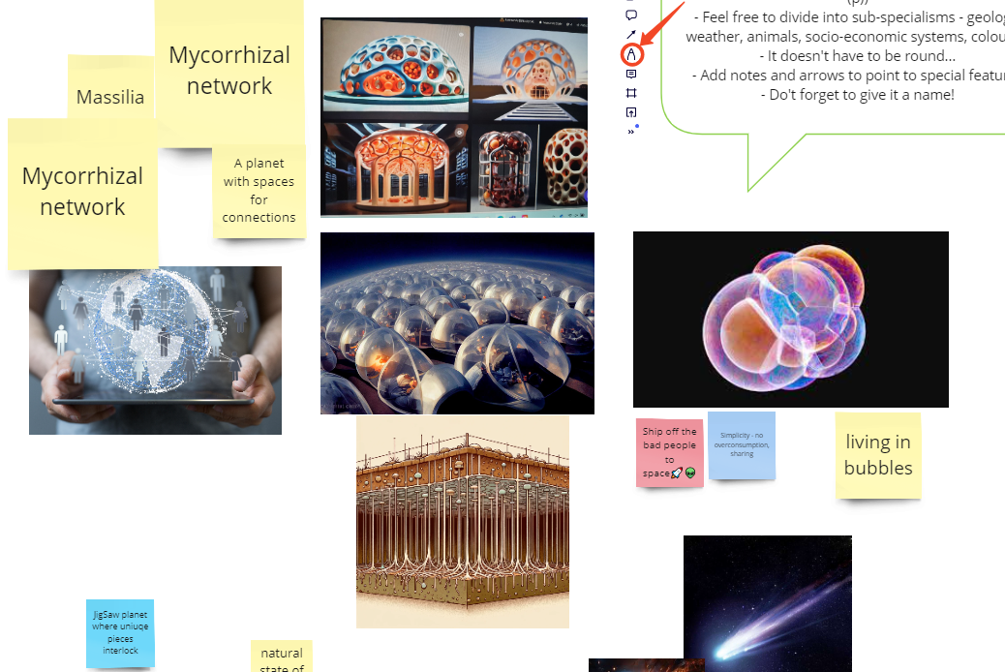
Designathon
Creative online career and employability development
Ice Breaker (10.15 am- 11.00 am)
Design a Planet
CE Skills
Team building
Creative thinking
Navigating Miro
Notes:
10.00 Welcome and introduction
10.15 Team Ice-Breaker
11.00 BREAK
11.15 Glass-House introduction
11.45 Design Problem Framing
12.15 Q&A
12.45 Design Problem Summary
13.00 LUNCH
13.45 Design Brainstorming
14.15 Design Refining
14.45 BREAK
15.00 Presentation
16.15 Feedback & next steps
16.30 END

Slide 7
Designathon
Creative online career and employability development
Design Brief (11.15 am- 11.45 am)
“How might The Glass-House grow and sustain a network of co-designers and community of interest who participated in the WEdesign programme?
Use your own experience to explore the possibilities of how The Glass-House can deal with this design challenge. You can look at this design brief from different angles, from branding to affiliations, systems to economies, from projects to ecologies.”
Notes:
10.00 Welcome and introduction
10.15 Team Ice-Breaker
11.00 BREAK
11.15 Glass-House introduction
11.45 Design Problem Framing
12.15 Q&A
12.45 Design Problem Summary
13.00 LUNCH
13.45 Design Brainstorming
14.15 Design Refining
14.45 BREAK
15.00 Presentation
16.15 Feedback & next steps
16.30 END

Slide 8
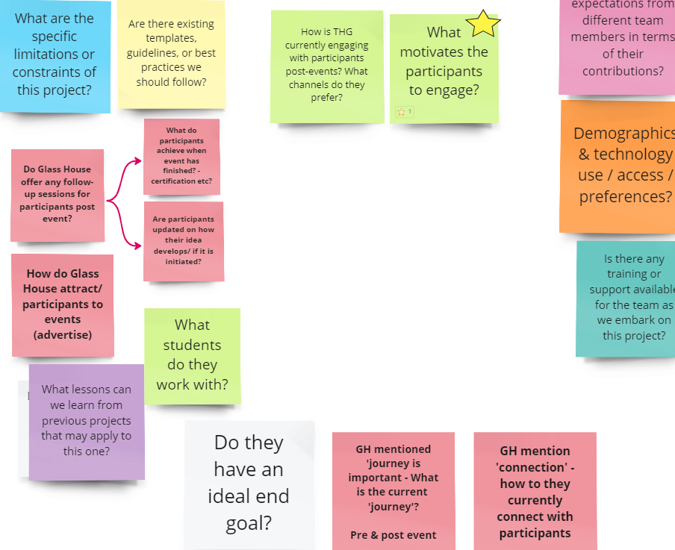
Designathon
Creative online career and employability development
Design Framing and Summary (11.45 am – 1pm)
CE Skills
Design thinking
Communication (Q&A)
Notes:
10.00 Welcome and introduction
10.15 Team Ice-Breaker
11.00 BREAK
11.15 Glass-House introduction
11.45 Design Problem Framing
12.15 Q&A
12.45 Design Problem Summary
13.00 LUNCH
13.45 Design Brainstorming
14.15 Design Refining
14.45 BREAK
15.00 Presentation
16.15 Feedback & next steps
16.30 END

Slide 9
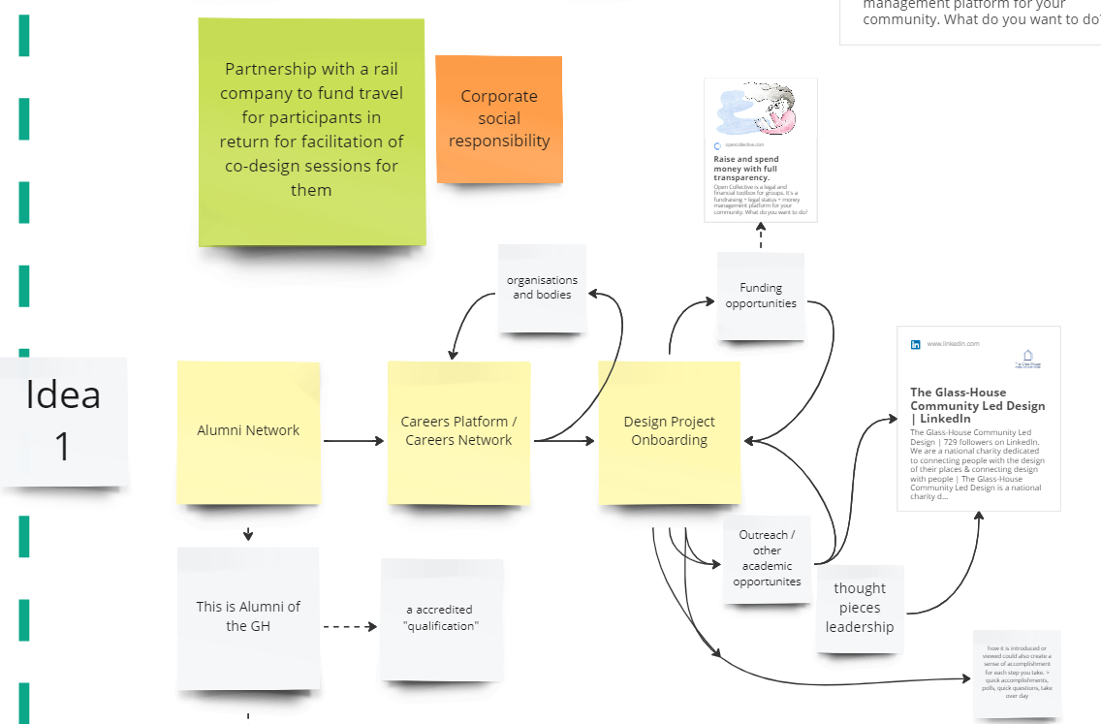
Designathon
Creative online career and employability development
Design Brainstorming (1.45 – 2.15 pm)
CE Skills
Design thinking
Prototyping
Blue Sky Thinking
Notes:
10.00 Welcome and introduction
10.15 Team Ice-Breaker
11.00 BREAK
11.15 Glass-House introduction
11.45 Design Problem Framing
12.15 Q&A
12.45 Design Problem Summary
13.00 LUNCH
13.45 Design Brainstorming
14.15 Design Refining
14.45 BREAK
15.00 Presentation
16.15 Feedback & next steps
16.30 END

Slide 10
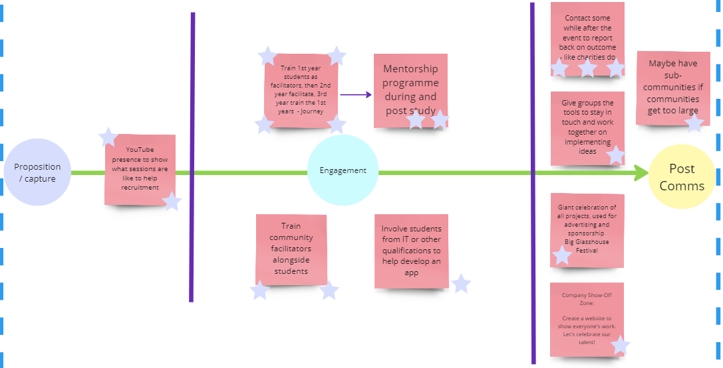
Designathon
Creative online career and employability development
Design Refining (2.15 – 2.45 pm)
CE Skills
Design thinking
Analysing
Prioritising
Communication
Notes:
10.00 Welcome and introduction
10.15 Team Ice-Breaker
11.00 BREAK
11.15 Glass-House introduction
11.45 Design Problem Framing
12.15 Q&A
12.45 Design Problem Summary
13.00 LUNCH
13.45 Design Brainstorming
14.15 Design Refining
14.45 BREAK
15.00 Presentation
16.15 Feedback & next steps
16.30 END

Slide 11
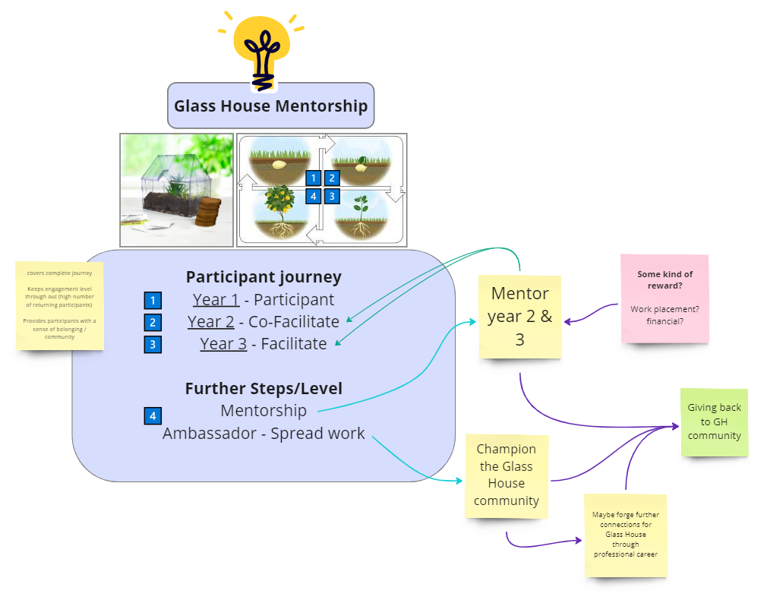
Designathon
Creative online career and employability development
Design Solution & Presentation (3 – 4pm)
CE Skills
Presentation skills
Communication
Receive feedback
Give feedback
Notes:
10.00 Welcome and introduction
10.15 Team Ice-Breaker
11.00 BREAK
11.15 Glass-House introduction
11.45 Design Problem Framing
12.15 Q&A
12.45 Design Problem Summary
13.00 LUNCH
13.45 Design Brainstorming
14.15 Design Refining
14.45 BREAK
15.00 Presentation
16.15 Feedback & next steps
16.30 END

Slide 12
Slide Title 13
Designathon
Creative online career and employability development
Co-design
The students are learning Participatory design practices in an online setting which will be a beneficial skill in a more digital meeting world.
Play
Creative and design thinking to help develop solutions. The Miro board facilitated a creative means to develop their ideas and communicate between the team members
Story Telling
The groups want to share their solutions but also their journey and most groups develop a great narrative process to support their presentations.

Slide 13
Slide Title 13
Designathon
Creative online career and employability development
Collaboration Impact
Students indicated that they would like to know what happens/ happened to their recommendations. It is important to have a legacy moment for them to see where things ended up.
Personal Impact
The workshop hasn’t captured post-participation feedback to understand the personal development of the students. Something to develop for the future with CES

Slide 14

Slide Title 15
Designathon
Creative online career and employability development
The Designathon helped us rethink and process how to continue the conversation with WEDesign attendees.
It was a convener for open conversations about the different solutions and opportunities, and a great catalyst to help us continue our challenge.
The Glass-House

Slide 15

Sustainathon 2025
Future creative online career and employability development
Sustainathon 2025
Wider pan-university opportunity work on sustainable challenges
Design students trained as facilitators.
Design PhD students as mentors/ support teams.
Wider OU co-design teams
Multiple sustainable organisational challenges (maybe supplied by the OSC challenge request)
Face-to-face and online opportunities
Possible eSTEeAM project (scholarly research on career skills development)
Sustainable Development Goals: Global Cooperation and Hope
(Creative Commons)
Notes:
Image:
https://easy-peasy.ai/ai-image-generator/images/global-cooperation-sustainable-development-goals

Slide 16
Slide Title 30
Thank you
Vera Hale
Vera.Hale@open.ac.uk

Slide 17
Slide Title 31

