Slide 1

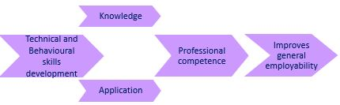
Evaluating and enhancing student recognition of employability skills development
Examples from postgraduate project management
Kay Bromley, Joan Jackson, Jill Shaw, Mark Slaymaker
Computing and Communication
10 April 2024

Slide 2
eSTEeM project: Evaluating and enhancing student recognition of employability skills development
Context: M815 Project management (30-credit postgraduate module)
Optional module in STEM MSc qualifications including Computing; Technology management, Engineering, Environmental management, Space science
Motivation for the research
Tutors’ anecdotal observations that there is a positive impact for some students’ professional development after study
Personal reflection embedded in the EMA seems to show:
  Examples of positive impacts on professional development
  Examples of impacts in the students’ workplace
The module highlights general employability skills development
However, only some students appear to benefit?
This research aims to identify ways to strengthen student recognition of transferable employability skills development.
We believe the approaches used could be applied to other modules.

Slide 3
Methods
This talk is based on research conducted so far and the implementation of interim recommendations for the 24E presentation of module M815: Project management
Identification of professional competences and transferable employability skills relevant to the module based on:
  Professional competence frameworks,
  OU employability framework,
  Qualitative characteristics for postgraduate skills
  Literature review.
Student questionnaire delivered to 3 cohorts of students assessing student perception of competence knowledge before and after study and ability to apply competences before and after study.
Quantitative analysis of reflective material from the EMA for 1 cohort, identifying competence development and ability to apply after study. Thematic analysis of quotes to support future recommendations for module development (not fully complete).

Slide 4
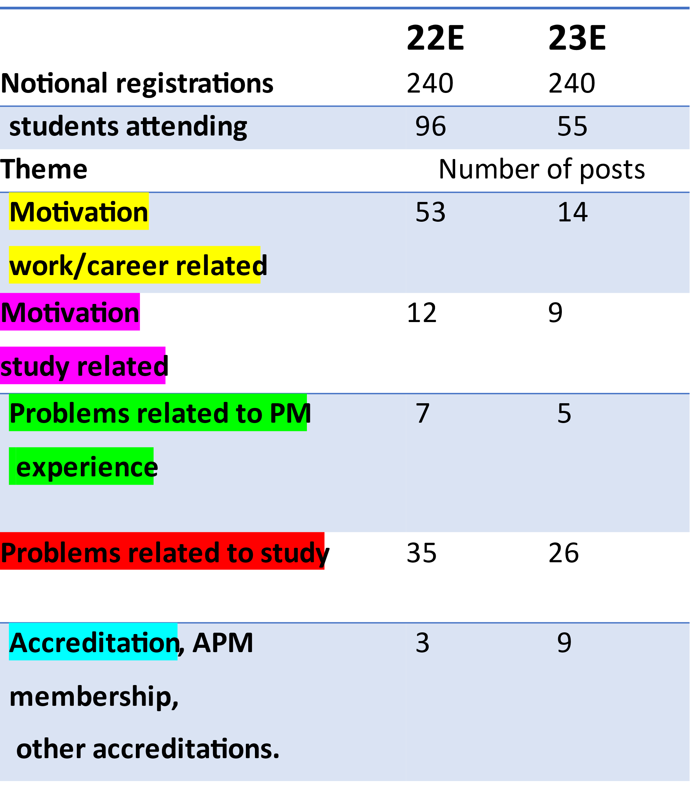
Student motivation to study the module – based on responses to polls/chat in Introductory tutorials
Based on analysis of tutorial chat
This analysis can only be informal:
Not all students attend, only some attendees participate in polls /chat
23E poll
  33% formalise existing PM knowledge
  21% move into PM role
  15% team member wishing to understand Project Manager role
  17% need 30 credits for MSc
  15% other (in chat)

Slide 5
What is meant by professional competence?
Competence is a combination of knowledge and ability to apply that knowledge
Knowledge is acquired through study, past training and experience
Ability to apply is improved by applying the knowledge in assessment or in practice in the workplace.
Professional competence can be a combination of:
  Technical competences – practices or skills needed to succeed in the discipline,
  Behavioural competences – personal and interpersonal needed to succeed, and
  Contextual competences – relating to specific organisational factors to be aware of (not considered relevant to this research).
Behavioural competences are usually related to transferable employability skills.

Slide 6
Why identify specific competences for a discipline?
Encouraging student reflection on identified technical and behavioural competences improves student recognition of improved professional competence and general employability.

Slide 7
Identifying technical and behavioural competences relating to M815 Project management
Derived from a comparison of competence frameworks, OU Employability framework, findings from the literature, postgraduate assessment criteria
18 Technical competences – practices or skills to succeed in projects
  Life cycles, Financial management, Transition management, Benefits realisation, Stakeholder engagement and communication, Time-based planning, Resource management, Risk and issue management, Change control, Team management, Governance, Quality management, Ethics, compliance and professionalism, Requirements management, Solutions development, Integrated planning, Conflict resolution, Leadership.
4 Behavioural competences – personal and interpersonal skills to succeed in projects
  Problem solving, Communication, Critical thinking, Reflection.

Slide 8
Quantitative analysis of development of competences
Instances of development recorded based on personal reflection section in the EMA (138 EMAs analysed – 85% students recognised development
Development assessed in terms of knowledge acquired and improved ability to apply in the workplace as a result of study of M815 (competence coding explained in appendix)

Slide 9
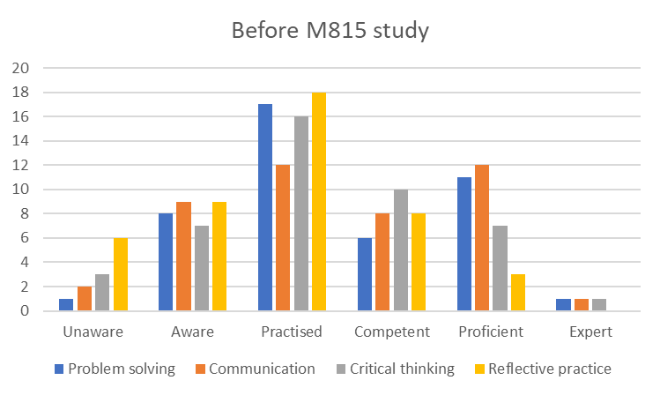
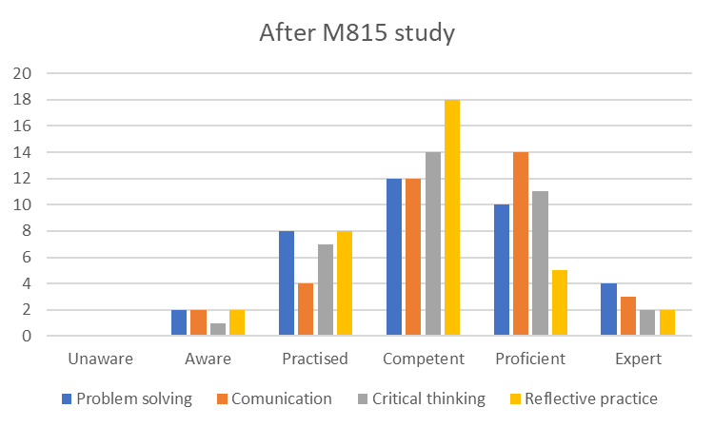
Competence development identified from questionnaire
Example based on student assessment of development of ability to apply 4 behavioural competences using a 6-point scale (49 out of 374 13% response rate)
Ratings before M815 study
Ratings after M815 study demonstrating improvement

Slide 10
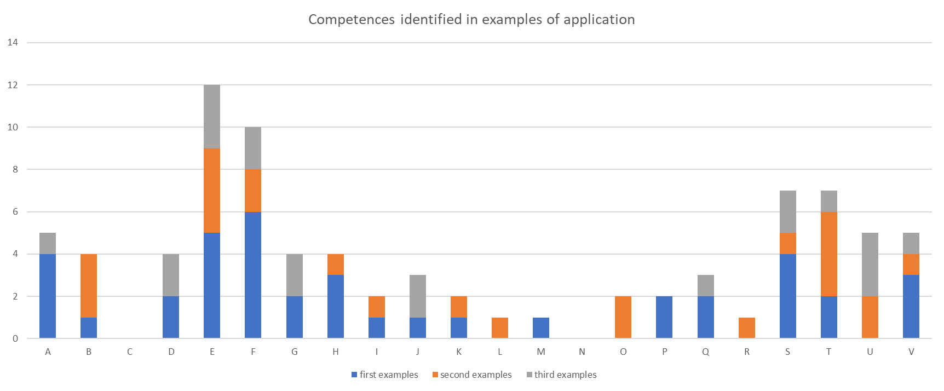
Quantitative analysis of examples of ability to apply competences in the workplace from student questionnaire
Students could provide up to 3 examples across all competences (28 students responded)

Slide 11
Thematic analysis of ability impact in the workplace based on researcher EMA analysis
Key words derived from literature and EMA analysis

Slide 12
Drawing on the findings of this research in M815 24E
New reflection tutorial to be delivered by module chair after TMA01,
  Explicit identification of technical and behavioural competences.
  Link reflective practice theory to consideration of development and ability to apply competences.
  Identification that outcomes from reflection can relate to impacts in the workplace, future studies and general employability.
Update of introductory tutorials to identify technical and behavioural competences related to module material,
  Explicit link between study and impact on development of professional competence and employability.
Personal reflection section in the EMA updated to demonstrate reflection on competences developed and future impacts.
Improved communication with APM re free student membership and improved process for applications.

Slide 13
Further work!
Finish writing literature review and completion of more detailed thematic analysis of EMA reflection to uncover additional outcomes.
  For example, emergence of keywords ‘confidence’, ‘impact on further study’ and ‘time management’ not currently analysed.
Write final report.
Dissemination – abstract submitted to STEM Horizons conference.
Review impact of the 24E changes
  Jill Shaw, Module chair
  Possible questionnaire to 24E cohort.
  Further research and changes for 25E.
Internally dissemination of findings regarding student recognition of competence development and impact on employability.
  E&I through Scholarship Lead Daphne Chang
  Employability in C&C through Jill Shaw, and then employability group .
Thank you for listening. Any questions after this session please contact Kay.Bromley@open.ac.uk or Joan.Jackson@open.ac.uk

Slide 14
References
Association for Project Management (APM) (2024) APM Competence Framework - Overview. Available at: https://www.apm.org.uk/resources/find-a-resource/competence-framework/overview/ (Accessed: 2 April 2024).
BCS, The Chartered Institute for IT (2024) SFIAplus - IT skills framework. Available at: https://www.bcs.org/it-careers/sfiaplus-it-skills-framework/ (Accessed: 2 April 2024).
BS6079 The British Standards Institution (BSI) (2019) BS 6079:2019+C1:2019 Project management – Principles and guidance for the management of projects. Available at: https://bsol-bsigroup-com.libezproxy.open.ac.uk/Home (Accessed: 2 April 2024).
Engineering Council (2020) The UK Standard for Professional Engineering Competence and Commitment (UK-SPEC). Fourth edition. Available at: https://www.engc.org.uk/standards-guidance/standards/uk-spec/fourth-edition-implemented-from-31-december-2021/ (Accessed: 2 April 2024).
IPMA International Project Management Association (IPMA) (2015) Individual Competence Baseline for Project Management. Version 4. Available at: https://www.ipma.world/individuals/standard/ (Accessed: 2 April 2024).
The Open University (2024) Reflect on the development of your employability from OU Study – Computing (Postgraduate). Available at: https://learn2.open.ac.uk/mod/oucontent/view.php?id=1696832 (Accessed: 2 April 2024).
Rezende, L. B. D. and Blackwell, P. (2019). Project management competency framework. Iberoamerican Journal of Project Management, 10(1), 34-59. Available at: http://www.ijopm.org/index.php/IJOPM/article/view/439 file:///C:/Users/Owner/OneDrive/Documents/M815Esteem/Published_Project_management_competency_framework.pdf (Accessed: 2 April 2024).
Udo, N. and Koppensteiner, S. (2004). What are the core competencies of a successful project manager? Paper presented at PMI® Global Congress 2004—EMEA, Prague, Czech Republic. Newtown Square, PA: Project Management Institute. Available at: https://www.pmi.org/learning/library/core-competencies-successful-skill-manager-8426 (Accessed: 2 April 2024).
Title slide image: ©iStock/Rawpixel

Slide 15
Appendix – explanation of competence codes
code | Technical competence | code | Behavioural competence
A | Life cycles | S | Problem solving
B | Financial management | T | Communication
C | Transition management | U | Critical analysis
D | Benefits realisation | V | Reflective practice
E | Stakeholder engagement and communication
F | Time-based planning
G | Resource management
H | Risk and issue management
I | Change control
J | Team management
K | Governance
L | Quality management
M | Ethics, requirements and professionalism
N | Requirements management
O | Solutions development
P | Integrated planning
Q | Conflict resolution
R | Leadership

