Slide 1


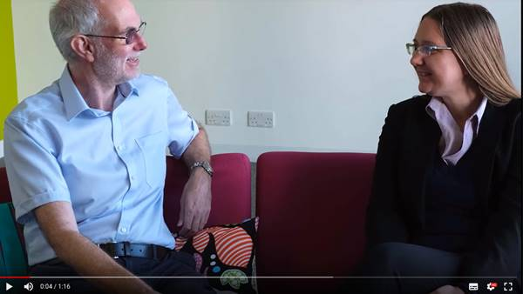
Learning Logs: Employability
skills for remote experiments
2024 Update
Alan Cayless Former Module chair SXPS288
Arabella Nock Careers and employability, STEM
Stella Bradbury, Mark McJury AL consultants – data analysis
Notes:
All images are ATC own artwork or from SXPS288 module materials (OU-produced)
Review map widget

Slide 2
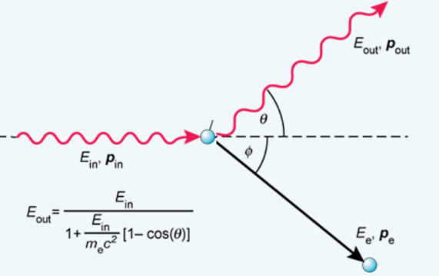
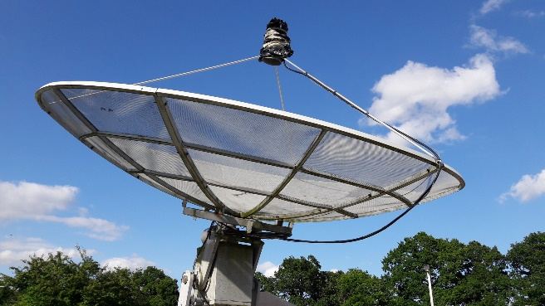
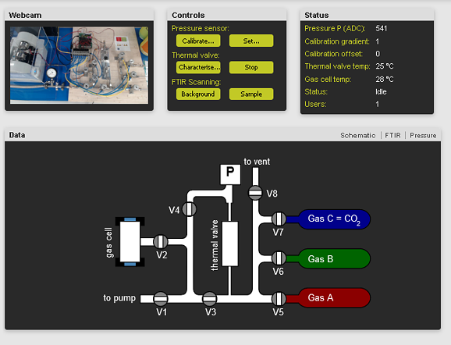

SXPS288 projects
Physics (Compton)
ARROW
PIRATE
Planetary
Science
(Gas Cell)
Courtesy NASA/JPL-Caltech
Notes:
ARROW and PIRATE images, Compton graphic and Gas Cell interface from SXPS288 materials. Internally produced and © OU.

Slide 3
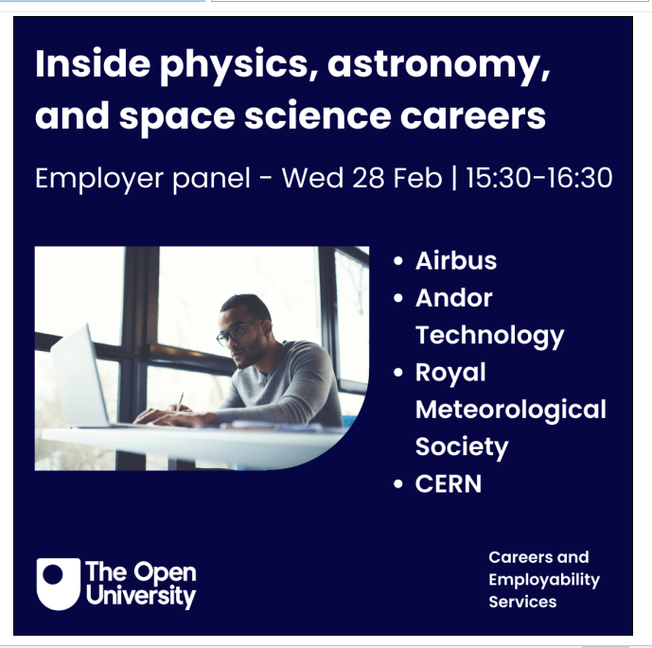
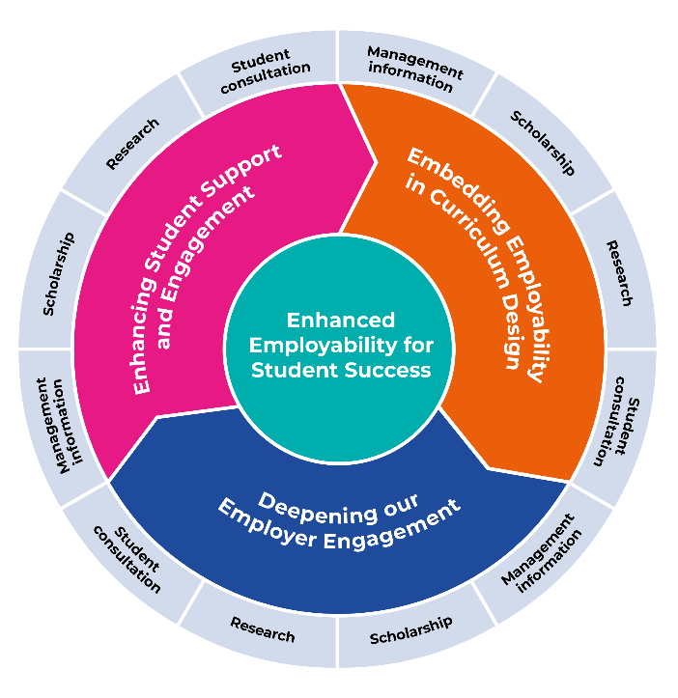
The Open University Student Employability Strategy (2019-2025)
Aims of theme 2
• To embed core employability skills and attributes more explicitly in all curriculum
• To enable our students to review articulate and evidence core skills and attributes gained through OU study
.
Three themes:
Enhancing Student Support and Engagement
Embedding Employability in Curriculum Design
Deepening our Employer Engagement
Notes:
OU Employability Strategy consists of 3 parts. It is running from 2019 to 2025, when it will be reviewed and replaced with an updated version.
We have several services, under these 3 areas – this includes our 121 Student Consultations, Regular workshops on problem areas such as CV’s interviews or confidence, also the Employer Engagement Team are super, they organise all the extra curricular employer guest events such as online careers fairs, webinars, panels and most recently a STEM themed spectacular Inclusive Futures’ –’Exploring STEM Careers, over 20 events across 2 days with a panel event for each school. Hugely popular and lots of great feedback coming in. Finally the orange slice of the pie there is where this project, and the work of Learning and Teaching Careers consultants sits. We are systematically mapping and cataloguing the whole curriculum by 2025 and using this as a starting point for increasing emphasis on employability in all levels of study. Working with Alan on SXPS288, was one such module development, aimed at helping students review and evaluate their learning with the Learning logs. Graphics internally produced and © OU.
‘’

Slide 4
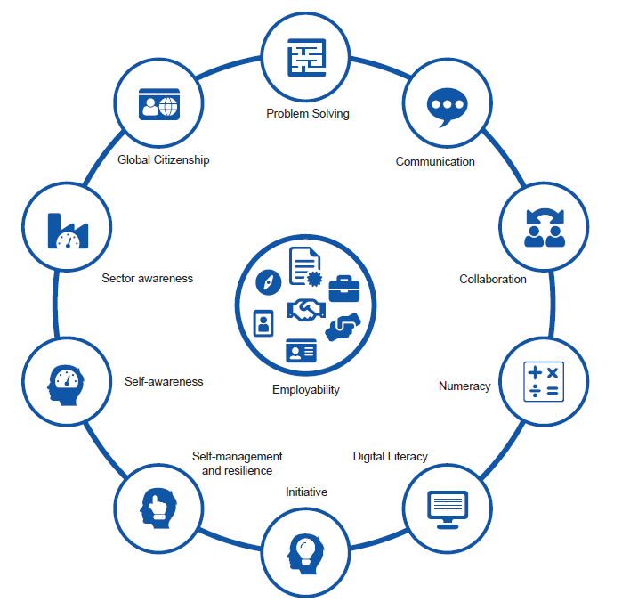

Mapping the curriculum – The Employability Framework
The Employability Framework encapsulates the core competencies, skills, behaviours and underlying values OU students need to help them in their personal and career development.
Notes:
Graphics internally produced and © OU.

Slide 5
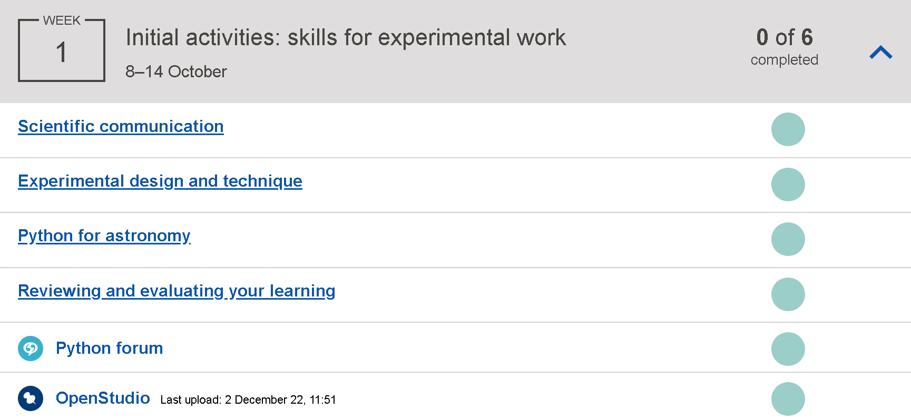

Slide 6
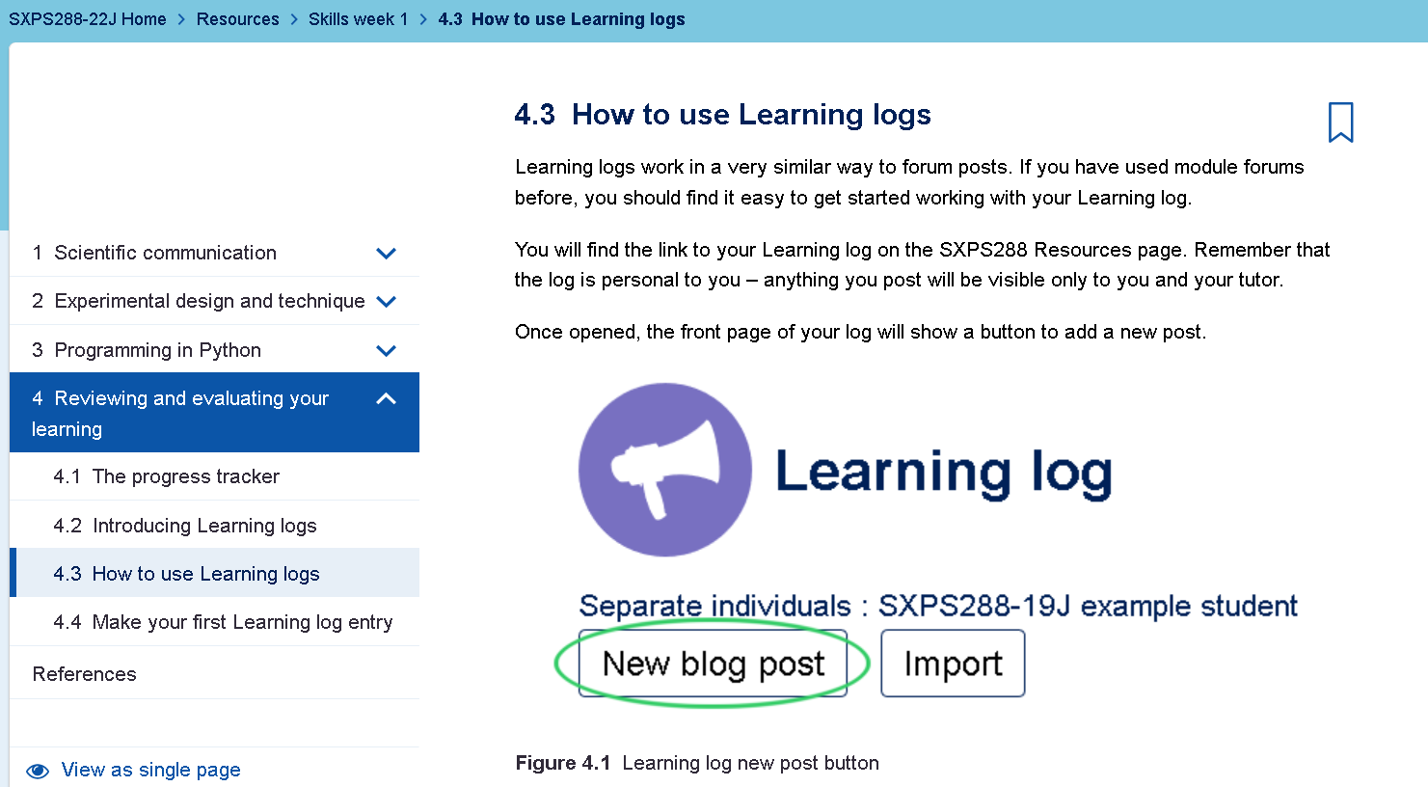
Notes:
https://learn2.open.ac.uk/mod/oucontent/view.php?id=1926098&section=4.3

Slide 7
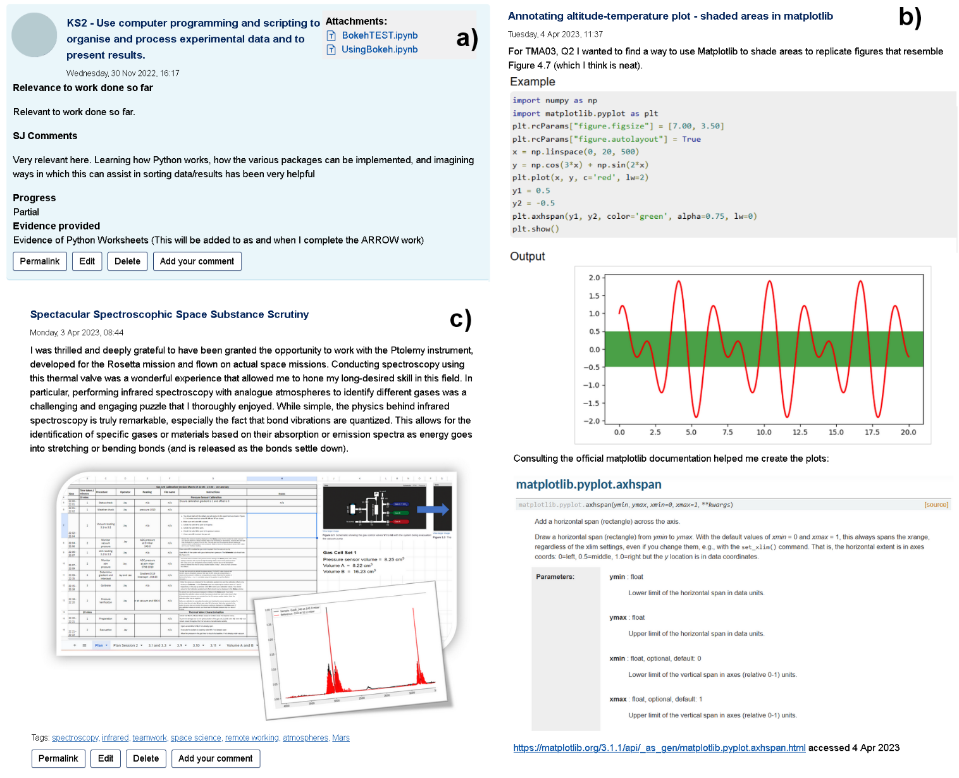
Examples of typical Learning Log posts:
a) Text-based post detailing progress towards a named module learning outcome (KS2).
b) Post detailing use of the Matplotlib Python library
c) Post detailing participation in the Spectroscopy project with extract from analysis spreadsheet and graphical output.

Slide 8

Data collection and analysis
Quantitative
1 Website logs: participation, numbers of posts
2 Power BI analytics: timings, links to assessment
3 Content analysis: analysis of tags – distribution of posts by content
Qualitative
1 Student feedback (SEAM): unstructured feedback
2 JISC online survey: structured questionnaire

Slide 9
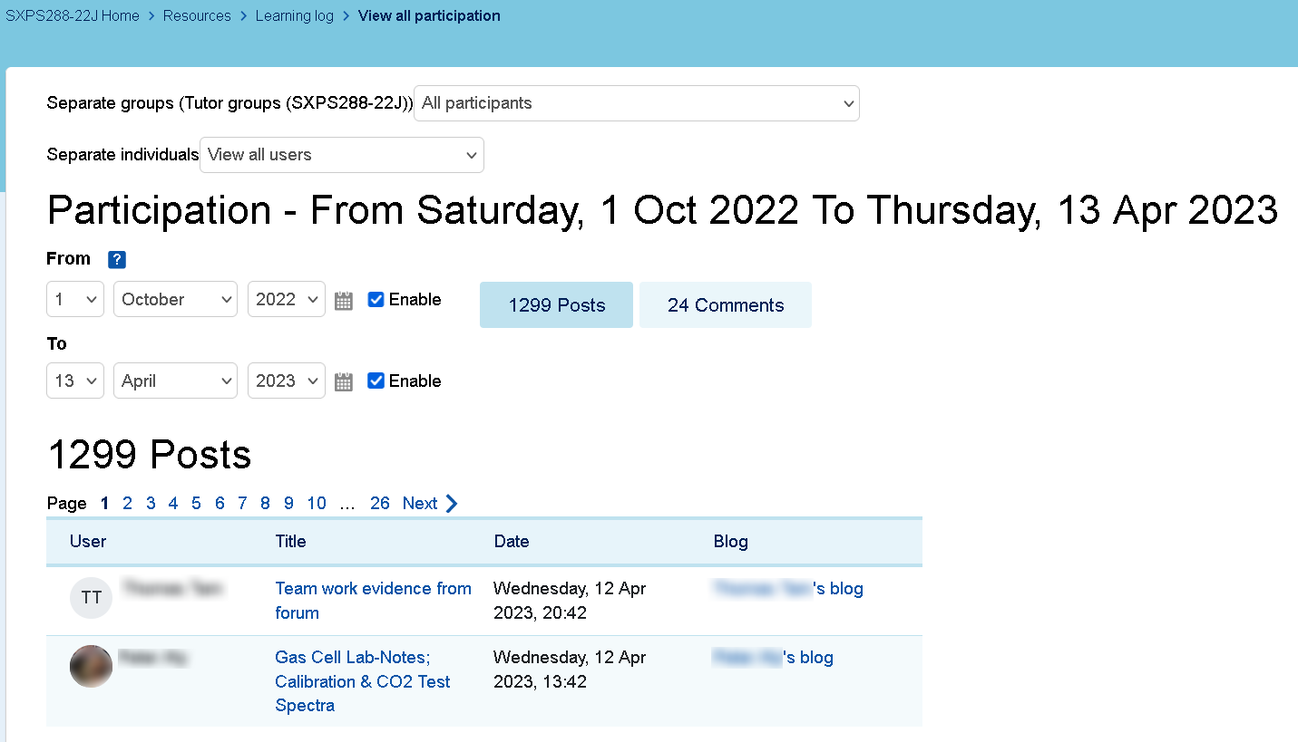
SXPS288 2022J

Slide 10
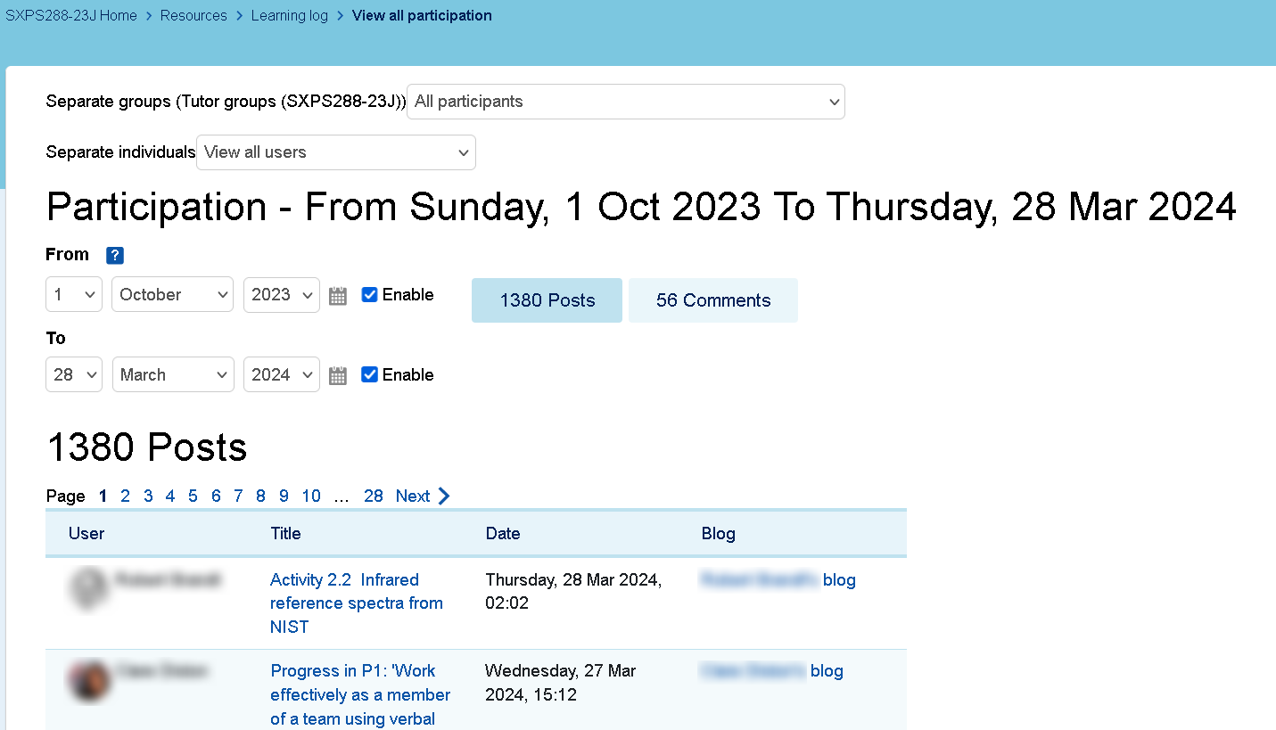
SXPS288 2023J

Slide 11
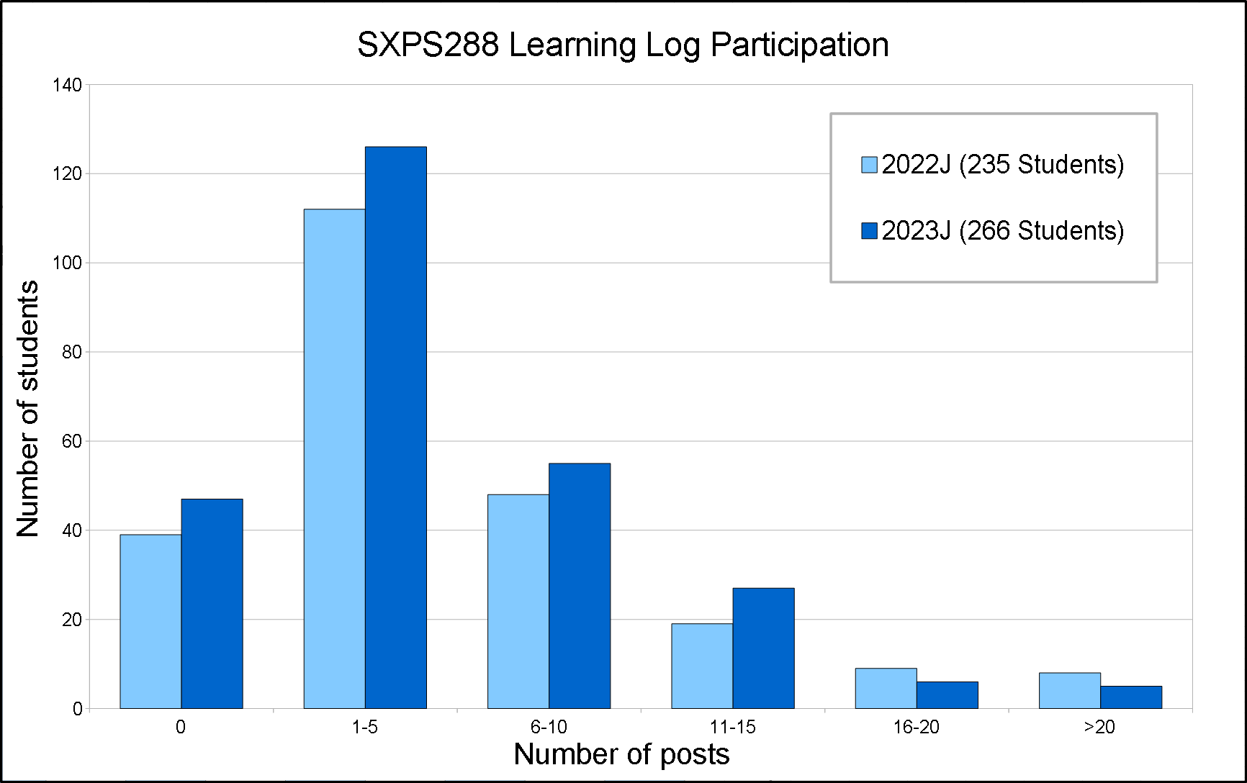
Quantitative results 1: Learning Log Participation

Slide 12
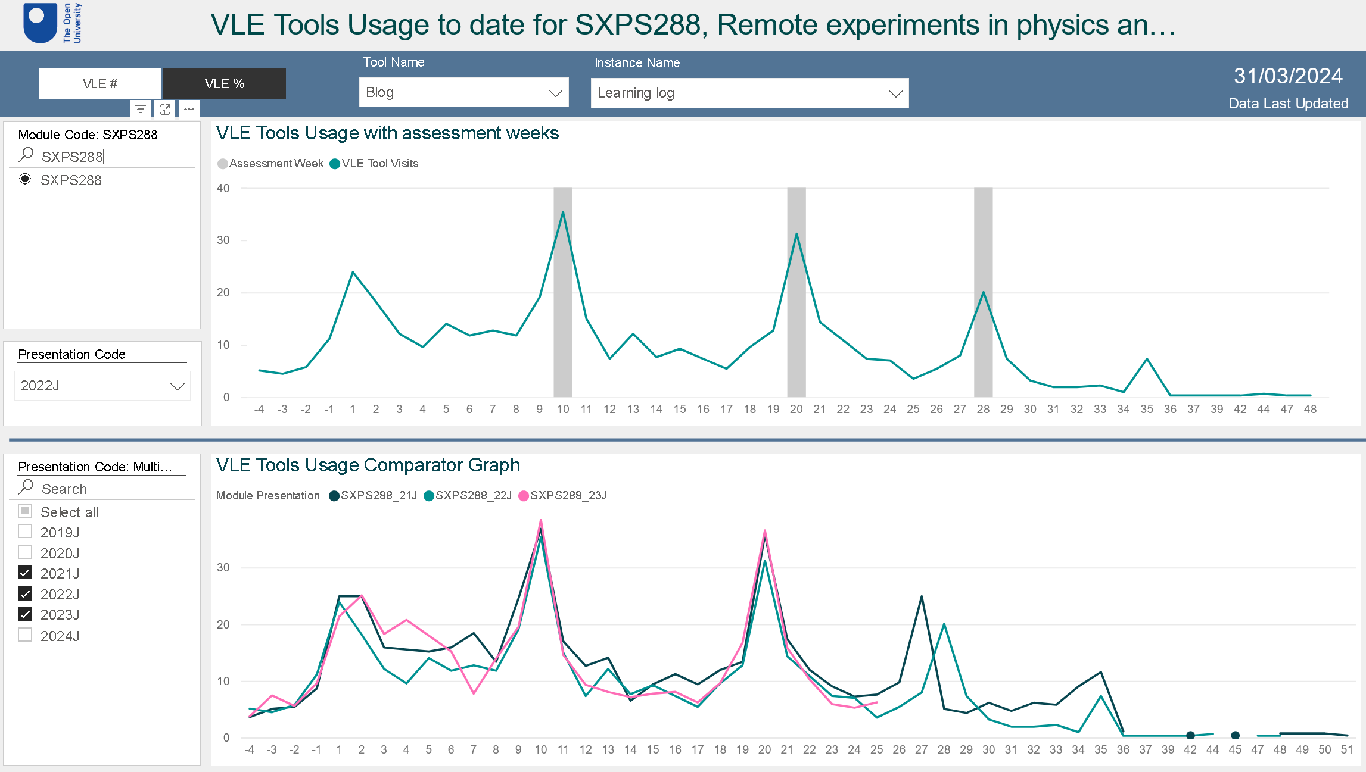
Quantitative results 2: Timing of posts

Slide 13
Quantitative results 3: Distribution of posts by content
Category | Description | Number of tags | Tags as percentage of posts
Module code | Posts labelled with the module code SXPS288 | 1971 | 66%
Learning Outcomes | Tags relating to named Learning Outcomes (KU1 etc.) | 1834 | 61%
Experiments | Posts relating to specific aspects of the experiments | 1438 | 48%
Skills Development | Skills development or skills weeks | 1150 | 38%
Python programming | Python programming and packages | 819 | 27%
Evidence / Reference | Reference information (e.g. evidence for jobs) | 223 | 7%
Assessment | Posts relating to the assignments (TMAs) and EMA | 120 | 4%
Other | Other tags | 176 | 6%

Slide 14
Qualitative results 1: Survey feedback – good, bad and ugly !
I was concerned about the module at a start due to poor communication skills in general but I genuinely feel as though I have learned a lot and also have developed my communication skills more than I could have hoped.
The module […] gave a clear picture of the skills I was developing and gave information about how to apply for placements. This is the most useful module for experimental science work and employability, I absolutely loved it!
I liked the videos that focused on what PhD students and OU staff were studying/researching
the amount of time wasted on introspective posts to a journal that I felt no benefit for using.
I enjoyed the task of keeping a personal development plan and I also was very happy with learning about employment prospects and the need to supply evidence. Very useful. Thank you.
this module seemed […] to cover excessively non-topic areas/life-skills that I didnt feel particularly relevant to me as someone who is retired and with no intention of re-joining the workforce.
incredibly tedious questions regarding development which I would come to dread every time an assignment rolled around.

Slide 15
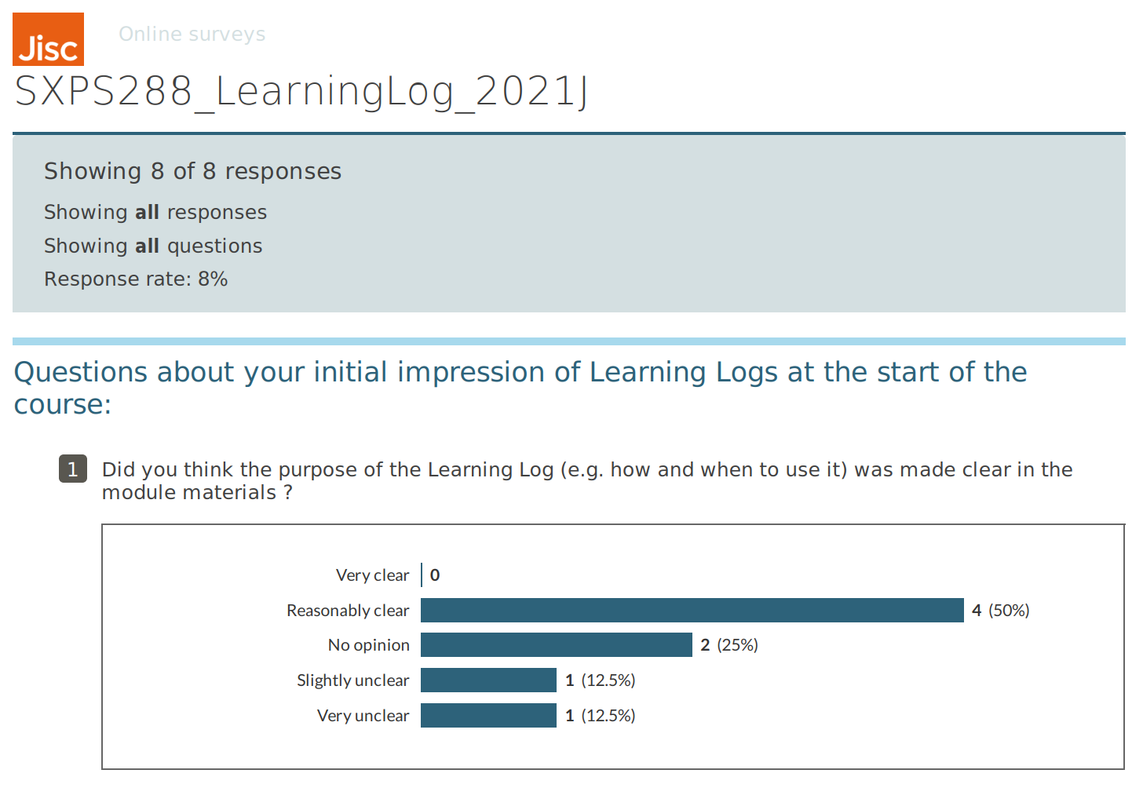
Qualitative results 2: Online survey

Slide 16
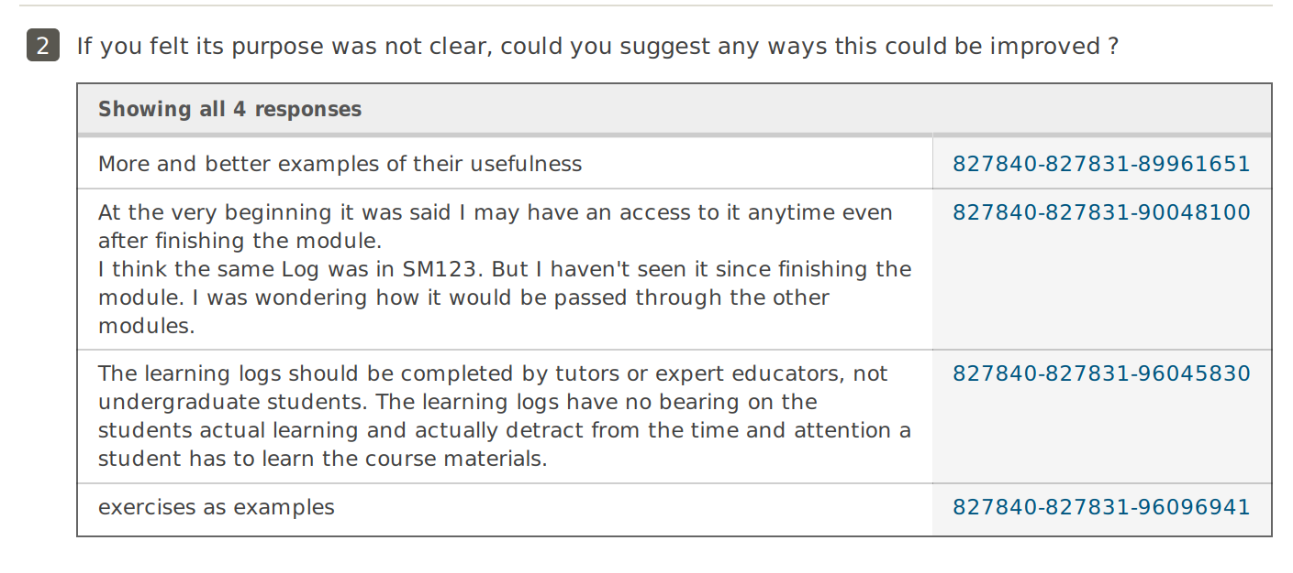

Slide 17
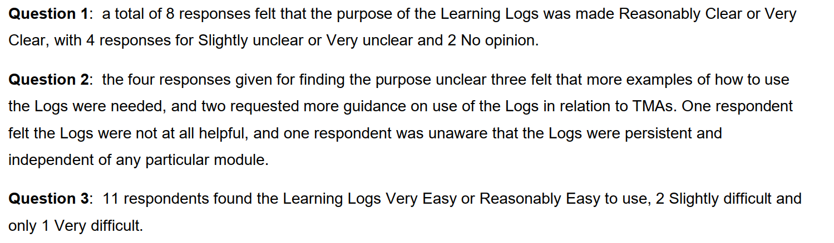
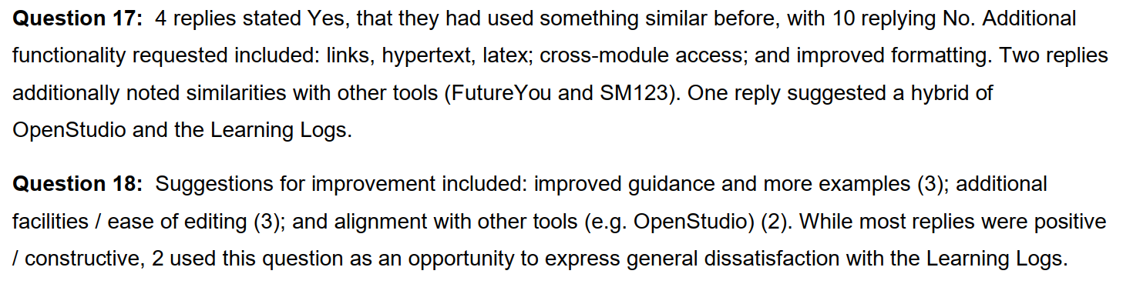

Slide 18
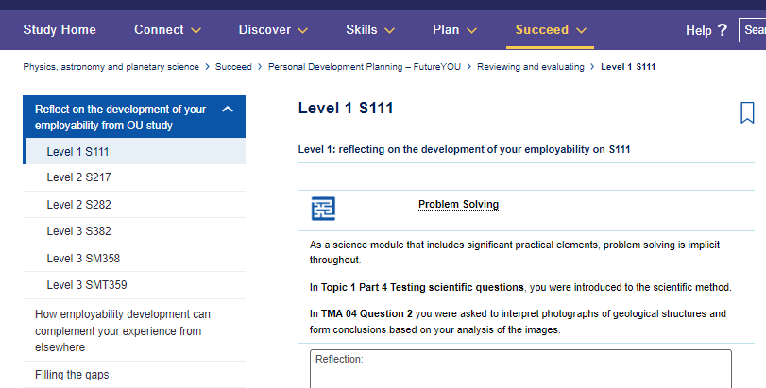
Physics and Astronomy Study Home Site - FutureYOU
Notes:
Website screenshot from S111 © OU.

Slide 19
Future integrations of SXPS288 – Learning Log Improvements
To improve engagement - consider enhanced explanation of benefits with evidence from academic papers – activity? Better explanation of how it can be used, address confusion in some open text comments
Consider how to link learning evaluation across modules, qualification view. FutureYOU is one example, would need to be adapted into module content.
Consider other tools, such as Open Studio (student suggestion) to enhance functionality?
Future Research - Examine interactions with Learning logs in engineering curriculum for comparison. Could compare externally with other forms of learning evaluation.

Slide 20
Conclusions and module team plans
2023J following same trends as previous presentations
Some students unaware of capabilities (e.g. formatting, linking across modules)
- improved visibility and placement of "how to use learning logs"
Engagement >80 % – Links to achievement / assessment
- update TMA02 and TM03: tutor feedback linked to log posts
Link with forum (non-) engagement ?
Reinforce instructions with more examples and improve signposting in skills weeks
Clarify benefit to students not on career path

