Slide 1

Understanding and amplifying student perspectives on decolonising the computing curriculum
Image: LSE blogs
Magnus Ramage, Zoe Tompkins and Clem Herman
School of Computing & Communications

Slide 2
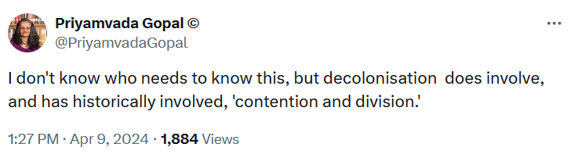
Decolonising the Computing & IT curriculum
Decolonisation = initially a political phenomenon, soon extended in meaning to include all elements incurred in the colonial experience, ‘whether political, economic, cultural or psychological’ (Raymond Betts, 2011; quoting David Gardinier, 1967)
Lots of universities (including the OU) exploring what it means to decolonise the curriculum, especially following the Rhodes Must Fall movement in South Africa and the Black Lives Matter movement
How might Computing & IT be colonial?
  Historic: Technologies in general and digital technologies in particular were directly implicated in colonialism
  Contemporary: current computing practices and artefacts continue to bear colonial imprints
Decolonising Computing & IT: “attempting to think through what it might mean to design and build computing systems with and for those situated at the peripheries of the world system” (Mustafa Ali)

Slide 3
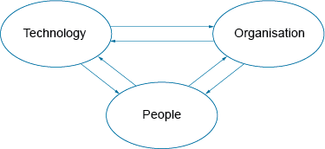

‘Decolonising Computing: Resources for Educators’
eSTEeM project, ran June 2021 to February 2023
Project team: Mustafa Ali, Ray Corrigan, Clem Herman, Andy Hollyhead, Magnus Ramage, Zoe Tompkins, Steve Walker
Initial goals
  Increase awareness of legacy systemic effects of colonialism
  Develop guidance for computing educators
  Methods: development of scoping document on key readings; workshops with ALs and students; student survey; some development of educator resources
  Addressing both content and pedagogy, framed around a critical sociotechnical approach, with focus on positionality (both collective and individual)
  Follow-on projects:
  Workshop in Leicester, May 2023 with participants from several other UK university Computing & IT depts
  Ongoing eSTEeM project ‘A case study analysis of STEM decolonising activity within UK Higher Education Institutions’ (Tompkins et al) – workshop this morning

Slide 4

Student survey – overview
Image: Blue Diamond Gallery
Survey conducted in June 2022
Invitation sent to 3695 undergraduate students in Computing & IT
(following opt-in by module chairs & and student survey panel)
Responses received from 399 students, with 394 consenting to data use (10% response rate)
Students on 17 different modules
Demographics given to us by the student survey panel (but only seen by two members of the project team); compared to our largest undergraduate qualification, Q62
  Gender: Female 21.3%, Male 78.7%​ - similar to C&C student population
  Ethnicity: Arab: 0.3%; Asian: 4.3%; Black: 3.6%; Mixed: 1.3%; Other: 0.8%; PNTS: 3.6%; White: 86.3%
  (again similar to C&C student population, which is 84% white)
  Rather fewer students with declared disability : 13.2%​ (cf. 20% population)
  Skewed a bit older than our typical student population
  Religion would have been very interesting to analyse, but 35% didn’t declare, and 41% said None

Slide 5
Student survey – questions asked
Likert-Scale Questions (Choice of Five Options, from ‘Strongly Agree’ to ‘Strongly Disagree’)
  1. The curriculum raises critical questions about power and/or privilege that are usually taken for granted
  2. The curriculum encourages students to challenge existing power structures in society
  3. The curriculum encourages students to critique unearned privilege
  4. The curriculum encourages students to connect learning to social, political or environmental concerns
  5. The curriculum encourages students to take actions that fight inequity or promote equity
  6. The curriculum features people from diverse backgrounds
  7. People of diverse ethnicities are represented as researchers or professionals not just as participants in research
  8. The curriculum respects that different cultures may have different understandings, skills and/or philosophies
  9. The curriculum addresses problems that are of concern to marginalized people/communities
  10. Do you see yourself reflected in the module materials?
  11. How well do the materials value/appreciate difference?
  12. Does the module allow your lived experience to be drawn upon?
Free-text questions
  13. What does decolonising mean to you?
  14. What do you think it means to decolonise the computing curriculum?
  15. How do you think we can start to decolonise computing at the OU?
  16. It is important to engage students as partners in decolonising activities—how best could this be done?
  17. What challenges do you foresee?

Slide 6

Student survey – overview of quant results
Two methods of analysis
  For each question, tallying of questions with highest % of agree / strongly agree
  Converted Likert scale to 1-5 and carried out statistical analysis (t-tests) in SPSS –
  compared gender (female/male) and ethnicity (non-white/white); tried religion but less helpful
  Problematic to use binary scales for both gender and ethnicity (and the term non-white), but best available
Statistically significant differences seen for six of the questions
For three questions, non-white respondents agreed with statements more white respondents
  The curriculum raises critical questions about power and/or privilege that are usually taken for granted
  The curriculum encourages students to critique unearned privilege
  The curriculum encourages students to take actions that fight inequity or promote equity
  Three cases where male respondents agreed with statements more than female respondents
  The curriculum features people from diverse backgrounds
  People of diverse ethnicities are represented as researchers or professionals, not just as participants in research
  How well do the materials value/appreciate difference?
  For details, see our published papers (links at end of presentation, or via ORO)

Slide 7
Student survey – overview of qual results
Questions 13–15 covered how respondents saw the nature of decolonisation and its relationship to Computing; Questions 16 and 17 covered issues around student engagement in decolonising the curriculum.
Analysed using inductive coding
  ZT and MR took the qualitative question with the most responses (n = 270), coded all responses individually and then combined our codes
  Tested this with the team for intercoder reliability
  This produced a set of 13 broad codes, showing views of decolonising computing from the very positive to the very negative, which were in turn applied to two further qualitative questions
Positive | Accurate history | Global perspective | Inclusive perspectives | Independence | New ways of thinking | Removing privilege/bias | Undoing colonisation
Neutral | IDK (I don’t know) | No response
Negative | Irrelevant to Computing | Not needed | Rewriting history | Woke Marxism

Slide 8
Student survey – examples of qualitative responses
Positive responses:
  “to rethink and revise the curriculum so that it takes a broader view rather than just the European or Euro-centric”.
  “Not focusing on white people white men as the only way”.
Neutral responses:
  “I have no idea, too many fancy words going on.”
  “Honestly, before now, I had never heard of the word.”
Negative responses:
  “Nothing, this is a computing course not critical race theory”.
  “’Decolonisation’ is part of the insane woke ideology, which [has] no place in academia, least of all in a STEM subject such as computing or IT.”
Positive | Accurate history | Global perspective | Inclusive perspectives | Independence | New ways of thinking | Removing privilege/bias | Undoing colonisation
Neutral | IDK (I don’t know) | No response
Negative | Irrelevant to Computing | Not needed | Rewriting history | Woke Marxism

Slide 9
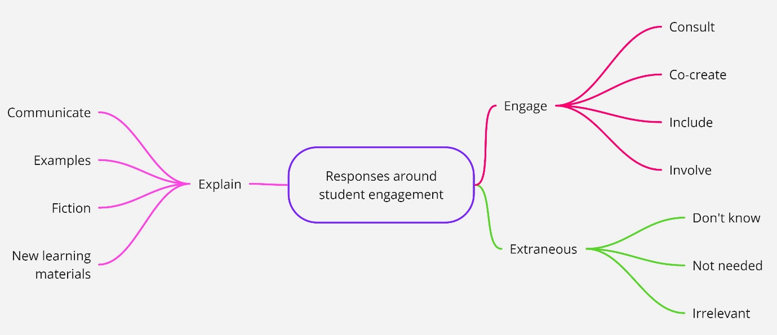
Student Engagement in Decolonising the Curriculum
Responses to Q16 (n=225) on student engagement – three main types of responses
  Explain: communicate, examples, fiction readings, new curriculum examples, new learning materials.
  Engage: consult, co-create, include, inclusive perspective, involve. Possible methods suggested for this include: focus groups, surveys, workshops, newsletters, debate, forums, emails, included in development, co-creation, online discussions, previous and currents students, industry, social media, student panels, questionnaire, webinar, working groups.
  Extraneous: these responses expressed either do not know, not needed or irrelevant

Slide 10
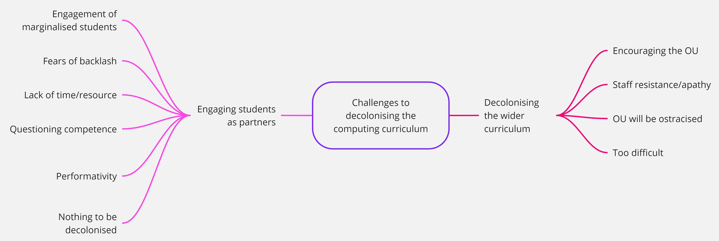
Challenges to Student Engagement
Responses to Q17 (n=208) on challenges to engagement
  Engagement of marginalised students: How it was possible to engage marginalised students, due to smaller numbers of such students, pressures on their time, and whether it was ethically appropriate
  Fears of a backlash: Concerns about how others may respond in terms of its effects on the university, and whether participating students may receive more hostility
  Lack of time/resource: Concerns about availability of time/resources for decolonising, both students and staff
  Questioning competence: Doubted ability of students to engage and educators to respond appropriately – sometimes a judgement on competence, others seen as arising from a lack of knowledge and/or awareness
  Performativity: These respondents felt that, while there might be plenty of rhetoric in favour of decolonising the curriculum, in practice this manifested as empty gestures and there was little chance of actual change.
  Nothing to be decolonised: Reiterating negative positions already identified in other questions
  Encouraging the OU: Feeling among a number of respondents that OU might struggle to rise to the challenge of decolonising, but that the institution needed to be encouraged to do so
  Staff resistance or apathy: Some respondents perceived that the challenge of de-colonising the university and/or its computing curriculum arose from issues around staff unwillingness to change more generally
  OU will be ostracised: Extended earlier concerns around a backlash: could there be a significant impact upon the university as a whole, in terms of its standing with the current government
  It is too difficult: Whether it would prove too difficult in conceptual and academic terms

Slide 11
Amplifying the Voices of Black & Minoritised Female Students
During Black History Month in October 2023 (theme ‘Saluting our Sisters’), one of us (ZT) wrote an online article discussing the survey results coming from Black, Asian and Mixed heritage women
Only seven women identifying as such, so results are not statistically significant, but we felt it was important to amplify the voices of this highly marginalised group
  Shift in knowledge production via a decolonial turn through the acceptance of different and diverse forms of knowledge, to ‘rethink the curriculum with new ways of delivery’
  To begin decolonising requires ‘unpicking the ideologies that are creating colonisation in the first place’.
  These female voices wanted to bring in their lived experience so that the curriculum did not just celebrate difference but normalised it, ‘freedom to be able to apply personal learning … into the workplace’.
  A decolonised curriculum would represent everyone – not just to celebrate difference, but also to normalise diversity: ‘Don’t just focus on culture, consider lived experience too’
  These Black and Brown women believe in allyship and seek opportunities for enhanced student collaboration through “offering students the ability to engage with each other more”;
  Strong international dialogue: “Keep in touch with students; not just in the UK, but worldwide”.
  Key starting point for decolonising the computing curriculum is not just what is being done, but also the way it is done: “Who is doing this work... do they reflect and support decolonisation of this subject?”

Slide 12
Conclusions
Decolonising the curriculum in the OU is vital, both in terms of social justice and pragmatic engagement with the world as it is (not as it used to be when Britannia ruled the waves)
This applies as much to ‘technical’ subjects as the humanities: but they need to be understood in their full sociotechnical nature
Interesting tensions between decolonial and EDI approaches: the Inclusive Curriculum Tool is brilliant, but only goes so far
Student awareness needs to be improved: moving perceptions from the negative to the neutral, and from the neutral to the positive
Student engagement is crucial, at all stages of the process
Need to amplify marginalised voices
A decolonised curriculum in Computing & IT will look a lot different than the existing curriculum, in content and pedagogy, and the people doing it might look different – but it could look a lot more like society & its needs

Slide 13
Further reading
Tompkins, Zoe; Herman, Clem and Ramage, Magnus (2024), Perspectives of Distance Learning Students on How to Transform Their Computing Curriculum: “Is There Anything to Be Decolonised?". Education Sciences, 14(2), article no. 149, https://doi.org/10.3390/educsci14020149
Tompkins, Zoe and Ramage, Magnus (2023). What does it mean to decolonise Computing and IT - Another dumb buzzword or re-envisaging all cultures and knowledge systems for how the world is framed? In: INTED2023: Proceedings of the 11th International Technology, Education and Development Conference, IATED pp. 4250–4261, https://oro.open.ac.uk/89444/
Project website: https://www5.open.ac.uk/research-groups/critical-information-studies/activities/decolonising-computing-esteem
Ali, S. M. (2016) ‘A Brief Introduction to Decolonial Computing’, XRDS 22, pp. 16–21. https://doi.org/10.1145/2930886

