Slide 1
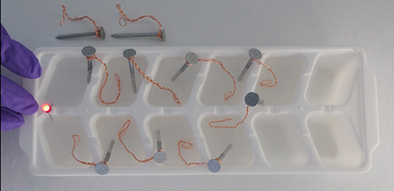
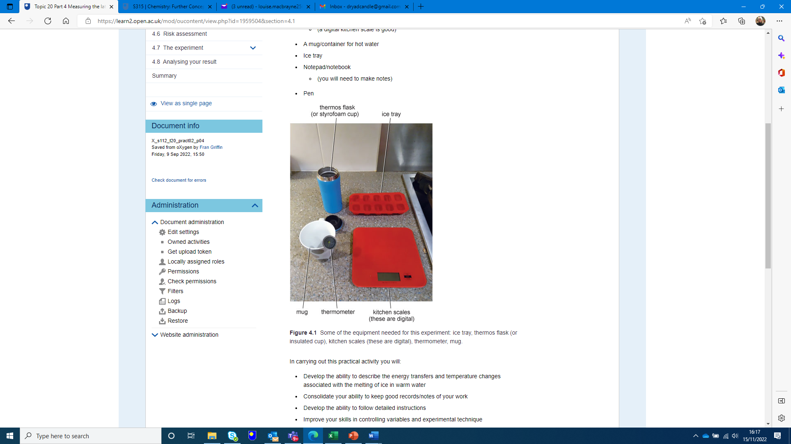
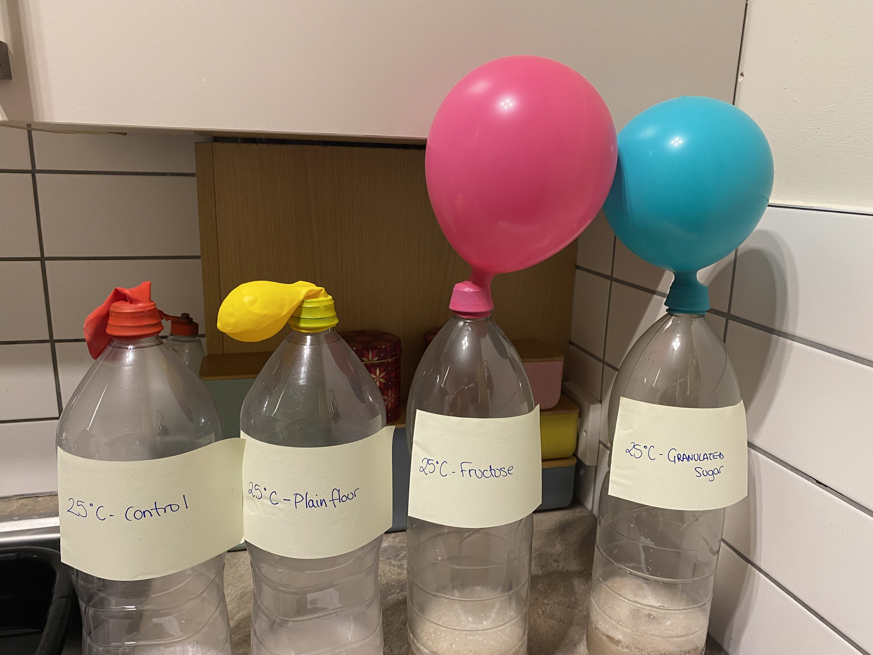

Is the cost of home experiments a potential barrier to learning?
Experiences from two level one science modules
Louise MacBrayne, Zoë Chapman
School of Life, Health & Chemical Sciences
April 2024

Slide 2
Project Background
Preliminary data collected from a focus group for a previous S112 eSTEeM project suggested that the cost associated with home experiments could be a potential barrier to learning but also student success as many of these experiments contribute to assessment
“the experiment it assumed that you had certain things in your house…it assumed that you had everything in your house and they don’t support you”
“Having to give an alternative option for the experiment was like us asking for too much”.
“Times are hard, and you are trying to salvage whatever”
“so when you’ve got to go out and get this [equipment]…it’s annoying but you want to pass it so you end up sacrificing”

Slide 3
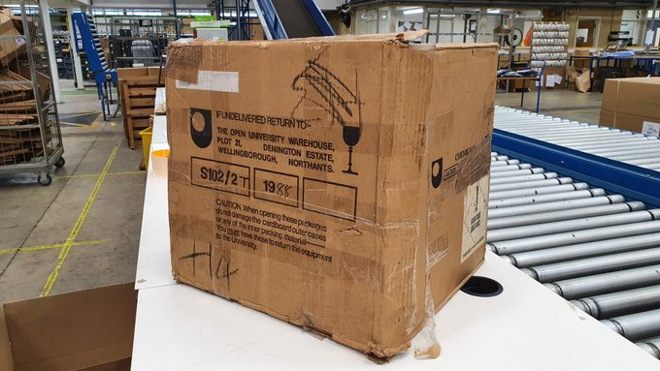
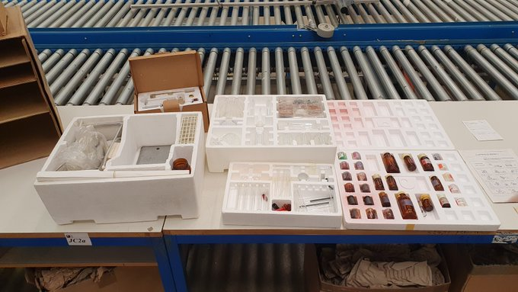
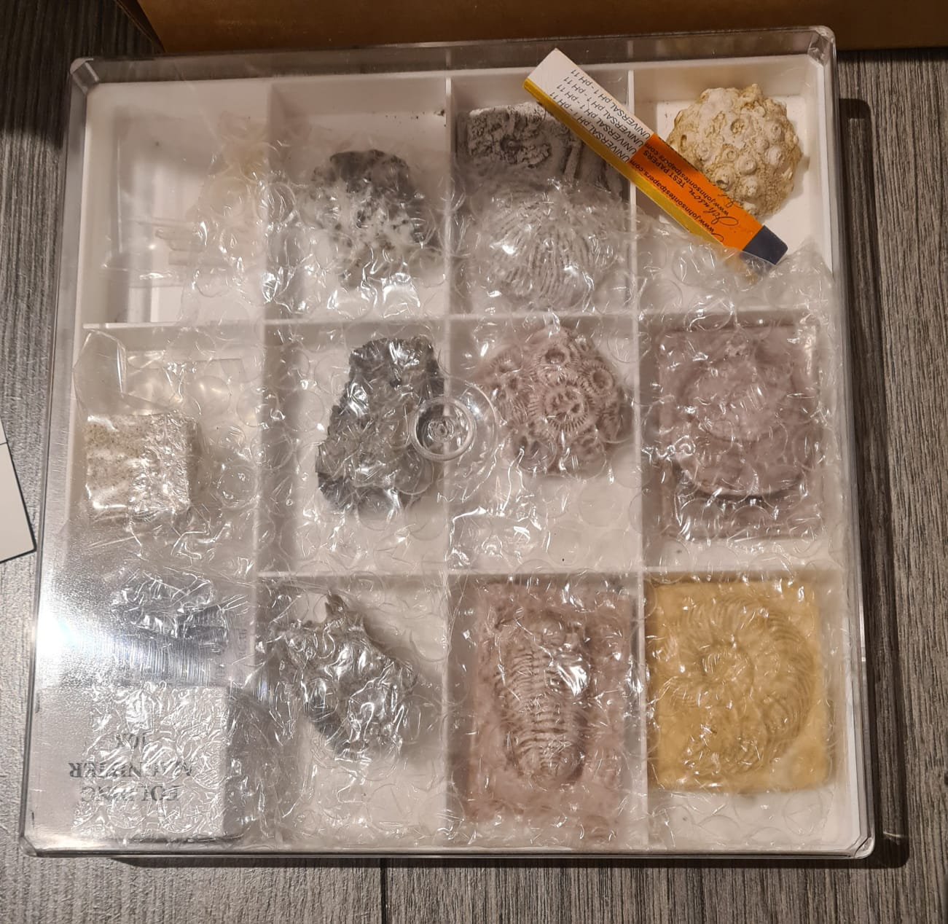
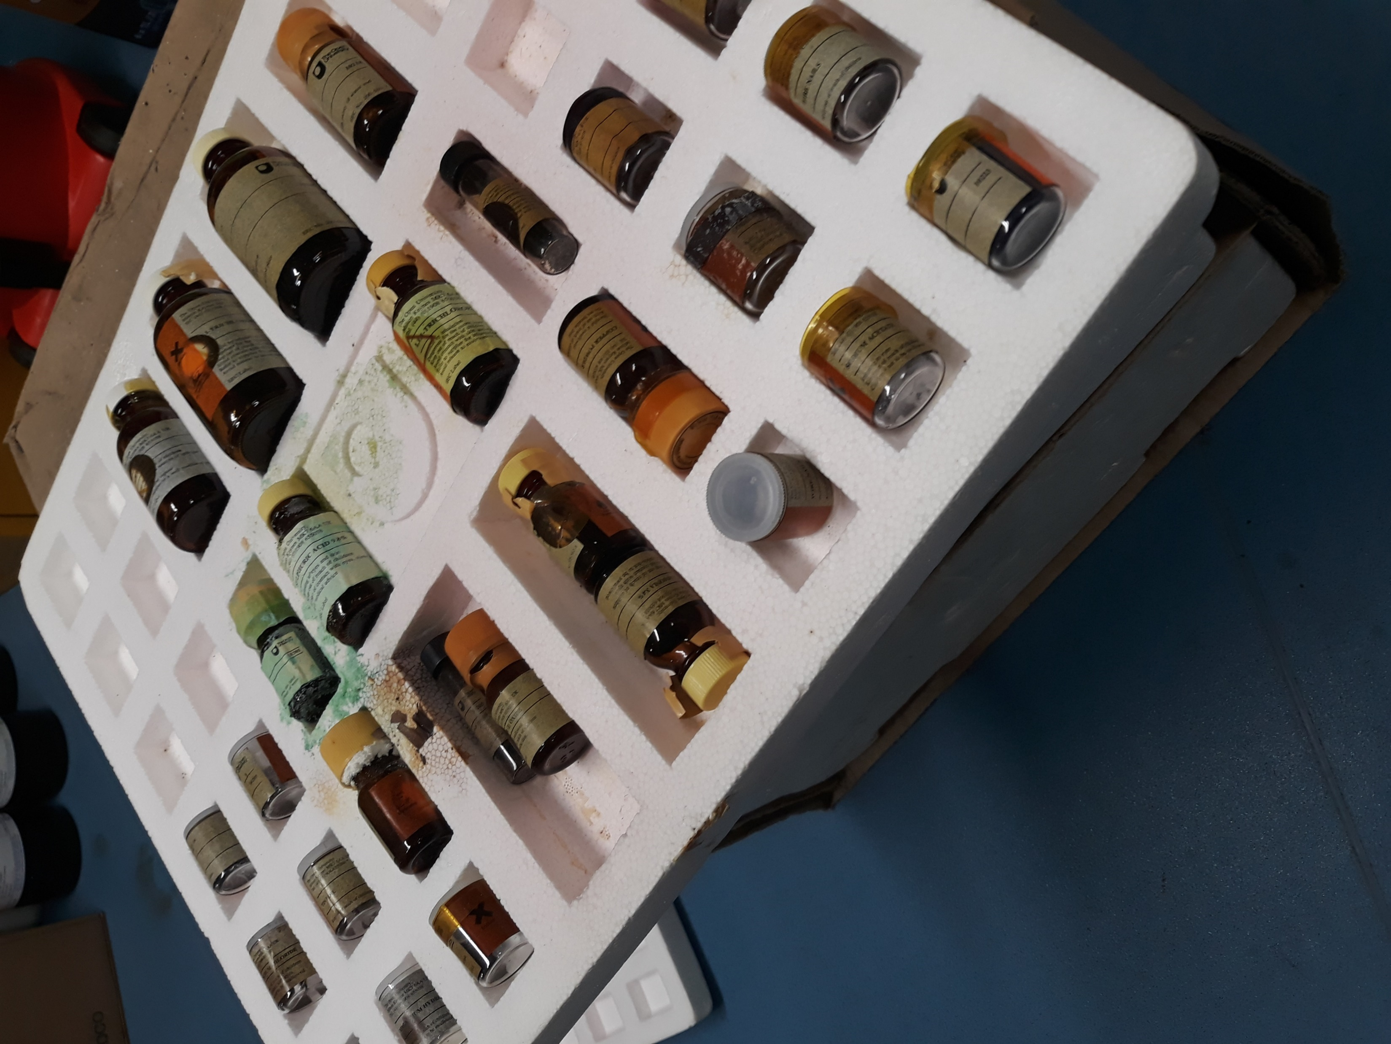
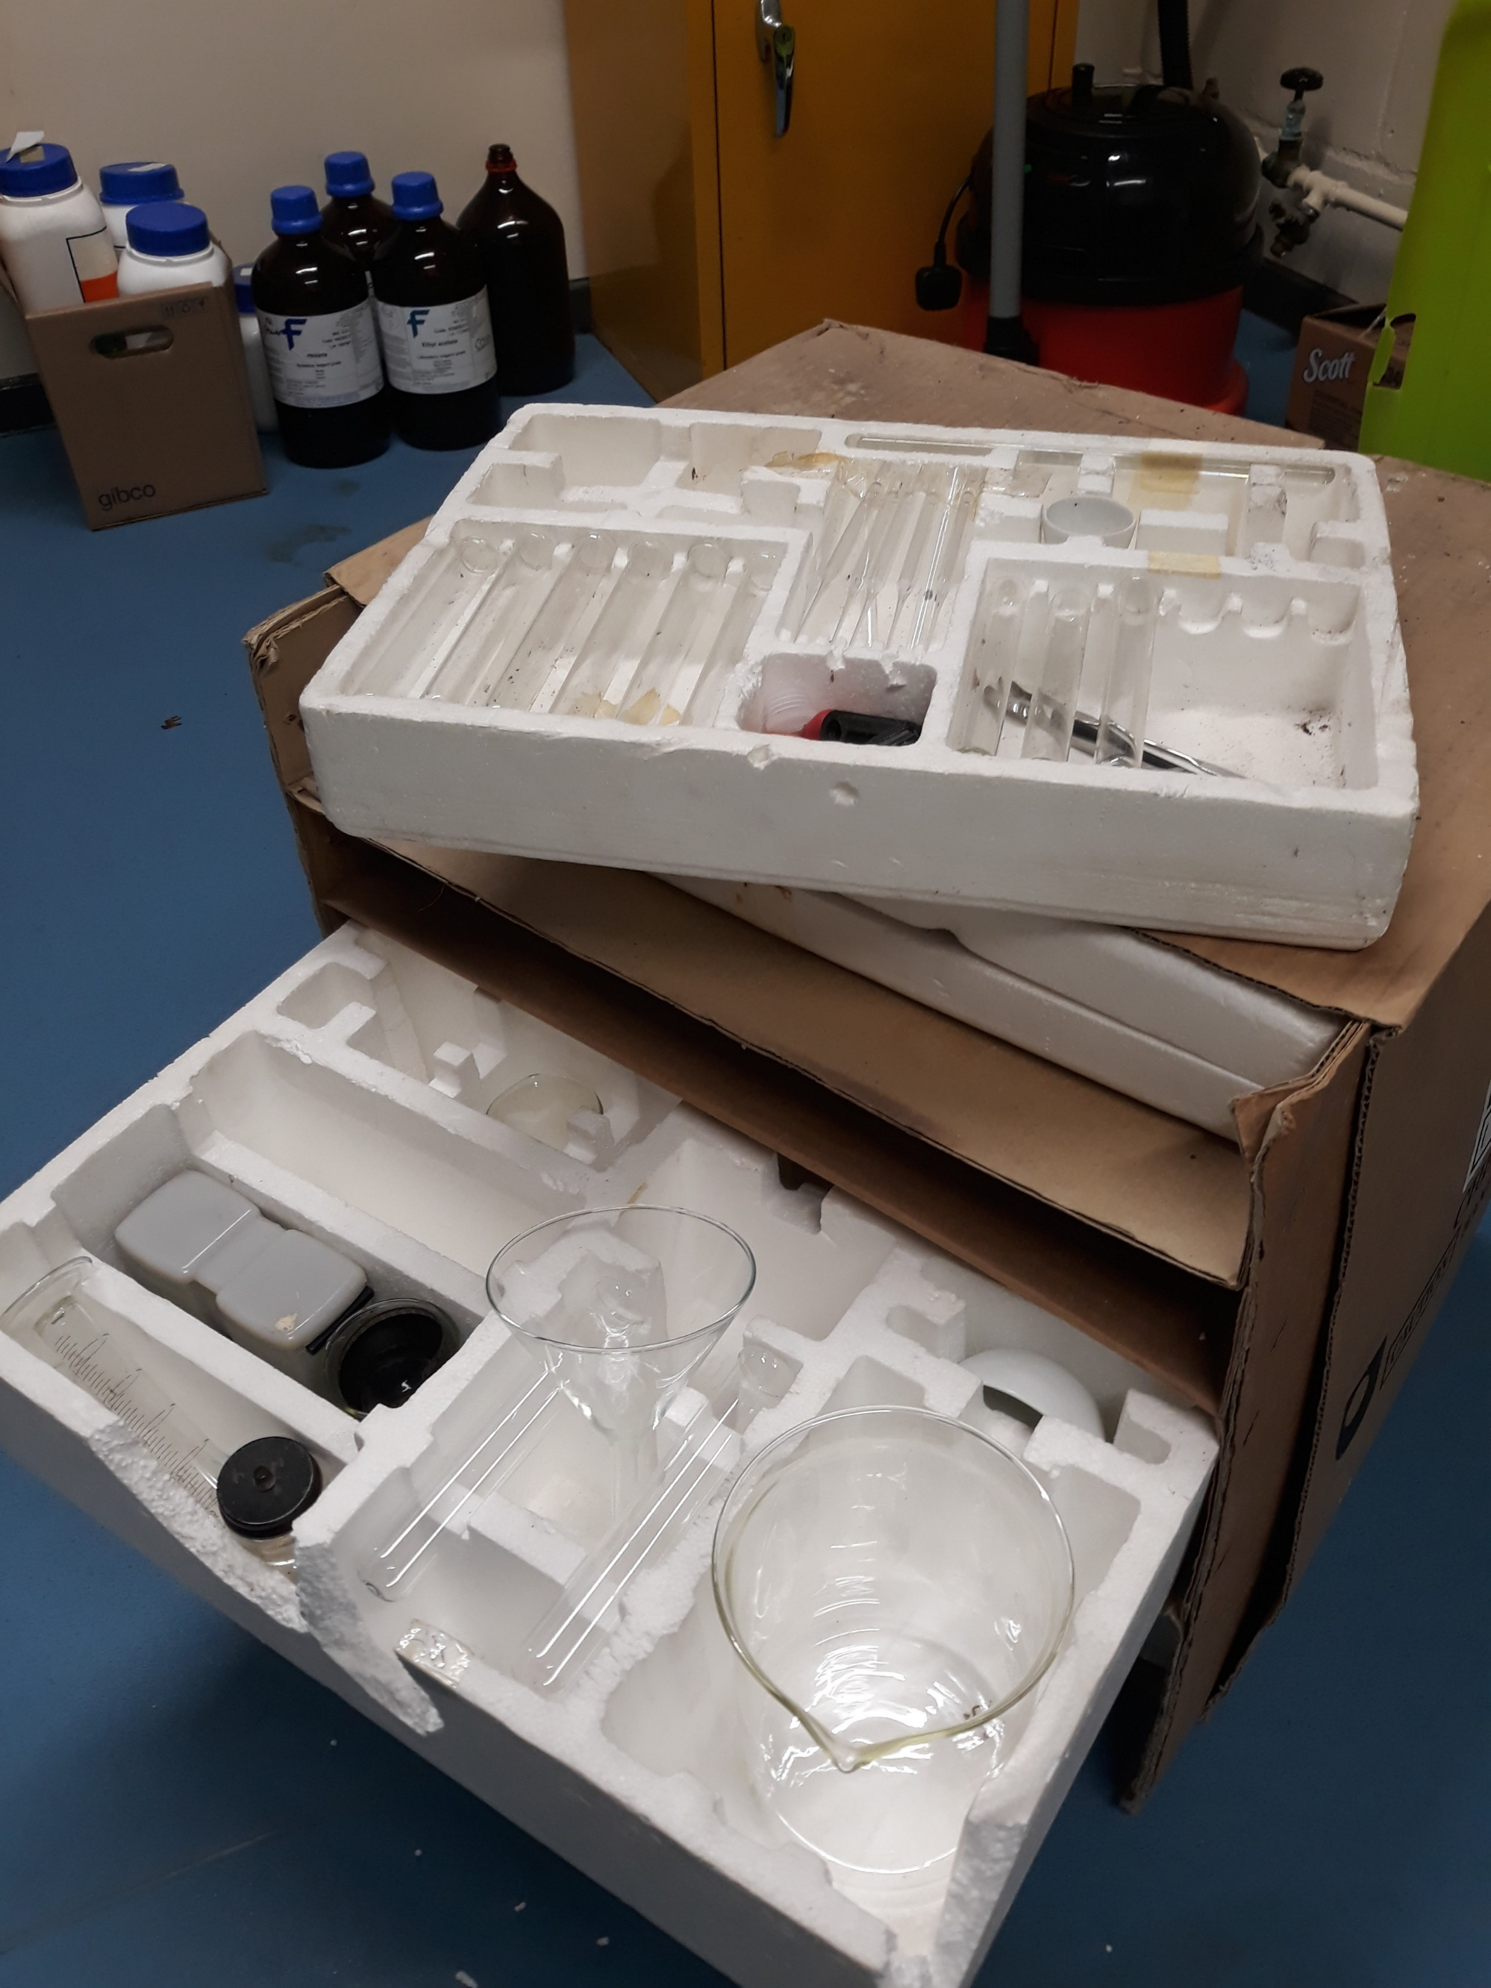

Project Background
Practical work in the form of home experiments has always formed an integral part of the science curriculum.
A move from printed materials to online delivery has been accompanied by a change in the way students are supported in home experiments with students no longer being sent home experiment kits as part of their module fees.

Slide 4
Project Background
S111
18 Home Experiments
8 assessed in TMAs
The current stage one curriculum (S111 and S112), compulsory in several science qualifications, has the expectation that students will be able to purchase, and have ready access to equipment needed to perform experiments at home, contributing to core module content and assessment.
Some of this equipment is relatively costly and may not be easily accessible to some students.
S112
9 Home Experiments
5 assessed in TMAs

Slide 5
30 cm ruler
a few A4 sheets of 1 mm2 graph paper
a few glasses for testing your solutions
a small light coin (such as a Japanese yen) or any other light object
about a quarter of a red cabbage
absorbent paper (e.g. kitchen towel)
access to either a fridge, freezer or fridge with an ice box or freezer compartment
accurate kitchen scales (needed to calculate the salinity of your solutions)
aluminium foil
an egg, with the egg white separated from the yolk
any other equipment as per your experimental design
at least two polystyrene cups with lids – available from general office supplies, or perhaps ask at your local café.
black felt-tip pens with washable ink
Blu-Tack® or Plasticine®
calculator
camera device or scanner, to capture an images of your graphs
chopping board (or alternative flat surface such as a wooden plank or large hardback book)
citric acid, which is used to descale kettles and is available from most supermarkets for around £2 for 250 g.
clear, resealable plastic bags
cling film
clock with a second hand, digital timer or stopwatch
coffee filter paper
cold (chilled) water
container to hold some water with a wide top and not very tall
cooking oil
deep roasting pan (big enough to contain the large bowl)
digital multimeter (optional)
dirty copper coins (at least 15 coins presenting a similar brown layer due to oxidation)
domestic freezer
drawing pin to attach the string to the underside of a table or a door frame. Sticky tape may work for attaching the mass or the top of the string (depending on how heavy the mass is.)
dried active yeast
either a blender or a pot to boil the cabbage
either an electronic balance (i.e. kitchen scales) or set of standard measuring spoons, such as teaspoons or tablespoons
electronic kitchen scales that measure to the nearest gram, or a small measuring spoon such as a teaspoon (5 ml) or half-teaspoon (2.5 ml)
empty 500 ml transparent plastic bottle (if possible with straight sides)
empty ice-cube tray, or several small pots or egg cups
empty plastic drinks bottle with a volume between 250 ml and 500 ml and a screw-top lid
epsom salts (magnesium sulfate heptahydrate), which is used in gardening and some health products and is generally available from gardening centres for around £5 for 1 kg
eraser
four clear glasses or jars
freezer
fresh medium-sized egg
fridge to cool water
fruit sugar/dextrose powder/sugar with stevia
galvanised nails (coated with Zn) – as many as the number of wells in the ice tray
granulated sugar
grapefruit (or large orange)
grated carrot
grease or oil, it doesn't matter if it is animal, mineral or vegetable oil.
heavy duty elastic band (approximately 8 cm long and 0.5 cm wide)
hot and cold water (from a tap)
hydrogen peroxide
ice tray
kettle to heat water
kitchen scales
laboratory notebook
large bowl (big enough to contain the inflated balloon)
large funnel
large potato
large, soft sweets (such as marshmallows or jelly babies) in different colours, or modelling clay
marker pen
means for measuring the amount of household product (e.g. measuring spoon)
means of recording your observations - preferably you should use an electronic approach
measuring jug capable of measuring volumes between 50 and 200 ml of liquid.
mid-sized funnel (that will fit in the neck of the plastic bottle)
mug/container for hot water
normal tap water
one light-emitting diode
one or more samples of rock
packet of balloons
packet of small seeds
pad of paper/notebook
pair of protective gloves such as Marigolds®.
pair of safety glasses
paper towels
pen that will write on a fruit (e.g. a permanent marker).
pencil or similar stick
pencil, graph paper and perhaps a ruler
piece of string (or coloured tape)
ping pong ball
plain flour
plastic comb (or inflated balloon)
plastic spoon
pocket calculator
printed map or aerial photo of the area you are sampling
protractor
pyrex jug for the boiling water receptacle
range of compounds or solutions from around your house to test (e.g. some lemon juice, some cold tea, toilet cleaner, bathroom spray, face cleanser, etc.)
ruler or measuring tape
running tap with a narrow stream of water (or a 1 litre plastic drinks bottle with a very small hole near the bottom)
salt
scissors
see-through glass about 2/3 filled with water (or any other see-through liquid)
selection of round coins
sharp knife
sharp pencil
short piece of electric cable (about 20 cm)
sieve
silica gel (a desiccant commonly used in packaging)
six containers for preparing solutions
six small plastic or glass containers (two of which should be sealable)
small bowls/ramekins to weigh solids into
small can of food (e.g. 250 g can of baked beans or similar); short cans are preferable.
small glass
small measuring jar
small object (mass) to attach to the end of the string to weigh it down: use something compact that won’t break if it falls, e.g. a plastic ball, a metal bolt that has some weight or a clothes peg (which could be weighted with plasticine)
small pieces of copper wire (approximately 20 cm) – as many as you have galvanised nails. If stripping an old electric cable you will need wire cutters and a Stanley knife or similar
small plastic or glass container
small spoon or stirrer
small wooden cocktail sticks
soda crystals, which are used in household cleaning and are available from most supermarkets for around £2 for 1.5 kg.
sodium acetate trihydrate, which is used as a ‘salt and vinegar’ flavouring in the food industry and is available for around £5 for 1 kg from online suppliers.
sodium bicarbonate, which is used in cooking and is available from most supermarkets for around £2 for around 200 g.
something to cover your clothing such as apron and a long sleeved top to cover your arms.
stapler or paper clip
steel nails (at least 12 nails, ideally identical, with no signs of rusting)
sticky tape
stopwatch
straight object, such as a straw, pencil or knife.
straight rod
string
styrofoam cup, insulated mug or a thermos flask (supermarket, cost about £1 for pack of 10)
sugar
table salt, bicarbonate of soda or sugar (you will be assigned one by your tutor)
tall glass jar or tumbler
tape measure of at least 2 m length.
teaspoon for measuring the yeast, and a teaspoon for stirring
thermometer (needs to handle from 0 °C to 100 °C)
thermometer that operates below 0 °C
three small non-metallic bowls
three small, preferably identical, glasses (shot glasses or measuring glasses are ideal here)
three steel nails (ideally identical and with no signs of rusting)
two clear glass cups (or similar) of the exact same size and shape
two different liquid food colourings (e.g. red and blue)
two elastic bands or pieces of string
two lengths of non-stretchy string: the shorter one should be at least 30 cm and the longer one should be as long as you can use it (90 cm or more would be good)
two paper clips
two sizes of particles, preferably with as large a difference in size as possible
vegetable oil
vinegar
washing up liquid
washing-up bowl
watch (or preferably a stopwatch)
water
weighing scales
well rinsed plastic bottles with lids (2 litre ones are ideal – having four identical bottles available will speed up the experiment)
white vinegar and one other household weak acidic solution (e.g. lemon juice)
yeast (dried or ‘live yeast’ is fine)

Slide 6
30 cm ruler
a few A4 sheets of 1 mm2 graph paper
a few glasses for testing your solutions
a small light coin (such as a Japanese yen) or any other light object
about a quarter of a red cabbage
absorbent paper (e.g. kitchen towel)
access to either a fridge, freezer or fridge with an ice box or freezer compartment
accurate kitchen scales (needed to calculate the salinity of your solutions)
aluminium foil
an egg, with the egg white separated from the yolk
any other equipment as per your experimental design
at least two polystyrene cups with lids – available from general office supplies, or perhaps ask at your local café.
black felt-tip pens with washable ink
Blu-Tack® or Plasticine®
calculator
camera device or scanner, to capture an images of your graphs
chopping board (or alternative flat surface such as a wooden plank or large hardback book)
citric acid, which is used to descale kettles and is available from most supermarkets for around £2 for 250 g.
clear, resealable plastic bags
cling film
clock with a second hand, digital timer or stopwatch
coffee filter paper
cold (chilled) water
container to hold some water with a wide top and not very tall
cooking oil
deep roasting pan (big enough to contain the large bowl)
digital multimeter (optional)
dirty copper coins (at least 15 coins presenting a similar brown layer due to oxidation)
domestic freezer
drawing pin to attach the string to the underside of a table or a door frame. Sticky tape may work for attaching the mass or the top of the string (depending on how heavy the mass is.)
dried active yeast
either a blender or a pot to boil the cabbage
either an electronic balance (i.e. kitchen scales) or set of standard measuring spoons, such as teaspoons or tablespoons
electronic kitchen scales that measure to the nearest gram, or a small measuring spoon such as a teaspoon (5 ml) or half-teaspoon (2.5 ml)
empty 500 ml transparent plastic bottle (if possible with straight sides)
empty ice-cube tray, or several small pots or egg cups
empty plastic drinks bottle with a volume between 250 ml and 500 ml and a screw-top lid
epsom salts (magnesium sulfate heptahydrate), which is used in gardening and some health products and is generally available from gardening centres for around £5 for 1 kg
eraser
four clear glasses or jars
freezer
fresh medium-sized egg
fridge to cool water
fruit sugar/dextrose powder/sugar with stevia
galvanised nails (coated with Zn) – as many as the number of wells in the ice tray
granulated sugar
grapefruit (or large orange)
grated carrot
grease or oil, it doesn't matter if it is animal, mineral or vegetable oil.
heavy duty elastic band (approximately 8 cm long and 0.5 cm wide)
hot and cold water (from a tap)
hydrogen peroxide
ice tray
kettle to heat water
kitchen scales
laboratory notebook
large bowl (big enough to contain the inflated balloon)
large funnel
large potato
large, soft sweets (such as marshmallows or jelly babies) in different colours, or modelling clay
marker pen
means for measuring the amount of household product (e.g. measuring spoon)
means of recording your observations - preferably you should use an electronic approach
measuring jug capable of measuring volumes between 50 and 200 ml of liquid.
mid-sized funnel (that will fit in the neck of the plastic bottle)
mug/container for hot water
normal tap water
one light-emitting diode
one or more samples of rock
packet of balloons
packet of small seeds
pad of paper/notebook
pair of protective gloves such as Marigolds®.
pair of safety glasses
paper towels
pen that will write on a fruit (e.g. a permanent marker).
pencil or similar stick
pencil, graph paper and perhaps a ruler
piece of string (or coloured tape)
ping pong ball
plain flour
plastic comb (or inflated balloon)
plastic spoon
pocket calculator
printed map or aerial photo of the area you are sampling
protractor
pyrex jug for the boiling water receptacle
range of compounds or solutions from around your house to test (e.g. some lemon juice, some cold tea, toilet cleaner, bathroom spray, face cleanser, etc.)
ruler or measuring tape
running tap with a narrow stream of water (or a 1 litre plastic drinks bottle with a very small hole near the bottom)
salt
scissors
see-through glass about 2/3 filled with water (or any other see-through liquid)
selection of round coins
sharp knife
sharp pencil
short piece of electric cable (about 20 cm)
sieve
silica gel (a desiccant commonly used in packaging)
six containers for preparing solutions
six small plastic or glass containers (two of which should be sealable)
small bowls/ramekins to weigh solids into
small can of food (e.g. 250 g can of baked beans or similar); short cans are preferable.
small glass
small measuring jar
small object (mass) to attach to the end of the string to weigh it down: use something compact that won’t break if it falls, e.g. a plastic ball, a metal bolt that has some weight or a clothes peg (which could be weighted with plasticine)
small pieces of copper wire (approximately 20 cm) – as many as you have galvanised nails. If stripping an old electric cable you will need wire cutters and a Stanley knife or similar
small plastic or glass container
small spoon or stirrer
small wooden cocktail sticks
soda crystals, which are used in household cleaning and are available from most supermarkets for around £2 for 1.5 kg.
sodium acetate trihydrate, which is used as a ‘salt and vinegar’ flavouring in the food industry and is available for around £5 for 1 kg from online suppliers.
sodium bicarbonate, which is used in cooking and is available from most supermarkets for around £2 for around 200 g.
something to cover your clothing such as apron and a long sleeved top to cover your arms.
stapler or paper clip
steel nails (at least 12 nails, ideally identical, with no signs of rusting)
sticky tape
stopwatch
straight object, such as a straw, pencil or knife.
straight rod
string
styrofoam cup, insulated mug or a thermos flask (supermarket, cost about £1 for pack of 10)
sugar
table salt, bicarbonate of soda or sugar (you will be assigned one by your tutor)
tall glass jar or tumbler
tape measure of at least 2 m length.
teaspoon for measuring the yeast, and a teaspoon for stirring
thermometer (needs to handle from 0 °C to 100 °C)
thermometer that operates below 0 °C
three small non-metallic bowls
three small, preferably identical, glasses (shot glasses or measuring glasses are ideal here)
three steel nails (ideally identical and with no signs of rusting)
two clear glass cups (or similar) of the exact same size and shape
two different liquid food colourings (e.g. red and blue)
two elastic bands or pieces of string
two lengths of non-stretchy string: the shorter one should be at least 30 cm and the longer one should be as long as you can use it (90 cm or more would be good)
two paper clips
two sizes of particles, preferably with as large a difference in size as possible
vegetable oil
vinegar
washing up liquid
washing-up bowl
watch (or preferably a stopwatch)
water
weighing scales
well rinsed plastic bottles with lids (2 litre ones are ideal – having four identical bottles available will speed up the experiment)
white vinegar and one other household weak acidic solution (e.g. lemon juice)
yeast (dried or ‘live yeast’ is fine)
access to either a fridge, freezer or fridge with an ice box or freezer compartment
sodium acetate trihydrate
one light-emitting diode
short piece of electric cable (about 20 cm)

Slide 7
Research Questions
1
Are financially impoverished students being disadvantaged by the expectation to purchase additional equipment needed for home experiments in core stage one science modules?
2
Are financially impoverished students being disadvantaged by the expectation to use facilities assumed to be in the home (e.g., fridges and freezers)?
3
Is the expectation to use facilities assumed to be in the home (e.g., fridges and freezers) and the requirement to purchase equipment for home experiments a barrier to achieving the learning outcomes associated with practical work?
4
Is cost the only barrier to achieving learning outcomes associated with home experiment practical work?

Slide 8
Research Methodology
Phase 1: Online survey via JISC
Conducted March – April 2023
Analysis October 2023 – February 2024
Phase 2: Semi structured interviews
Conducted July – September 2023
Analysis October 2023 – February 2024
Phase 3: Development and evaluation of suitable alternative resources for S112 23J and/or practical adjustments to support achievement of learning outcomes without additional cost
Development July – September 2023
Evaluation June – July 2024

Slide 9
Phase 1: Online Survey via JISC
Overview
“Student experiences of the expectation to complete home experiments in S111 and S112”
Home experiments were defined as being those that required some form of physical set up, not virtual experiments (ISEs) or remote experiments (e.g. accessing an instrument on campus via a weblink)
Selection criteria being that students had completed both S111 and S112.
1858
No. of students invited to participate.
10.5%
195
No. of responses received.
44.6%
87
No. of students willing to be interviewed.

Slide 10
Phase 1: Online Survey via JISC
195
Preliminary Outcomes
91.8% of survey respondents said that they were aware before module start, that S111 and S112 utilised home experiments.
179
16 students were not aware
85.6% of respondents said they completed all experiments on both modules
167
Out of the 14.4% who said that they did not complete all experiments, 92.9% said that they did complete some.
26
2 students did not complete any

Slide 11
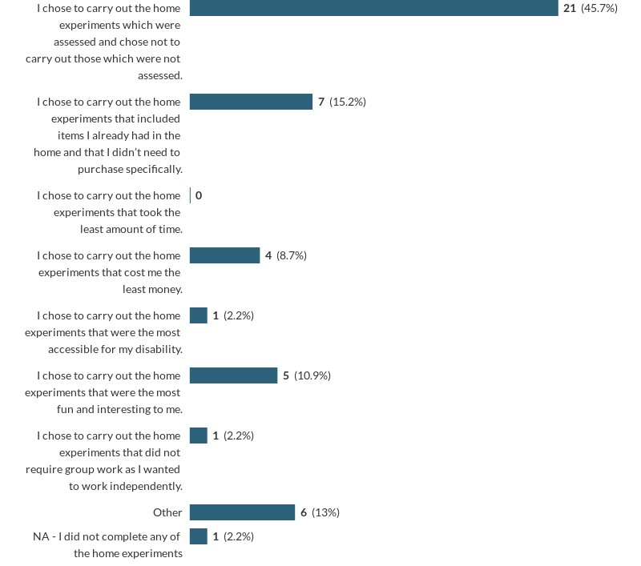
Phase 1: Online Survey via JISC
Preliminary Outcomes
45.7% of respondents who completed some of the experiments did so because they were assessed.
15.2% of respondents who completed some of the experiments did so because they already had the items required and did not need to make additional purchases.
‘Other’ reasons included (but were not exclusive to):
Insufficient time for all experiments
No access to certain items in their country
No access to certain items due to travelling
NOTE: This was a multiple answer question and some students have more than one response.

Slide 12
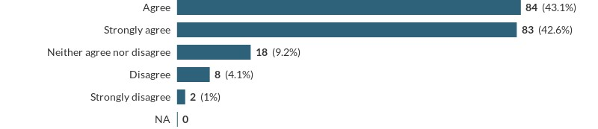
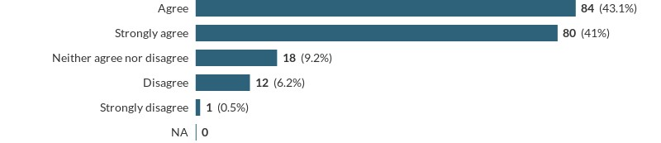
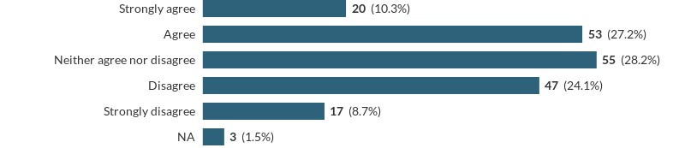
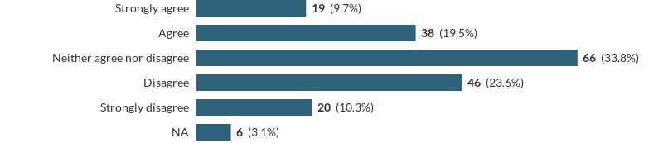
Phase 1: Online Survey via JISC
Preliminary Outcomes - Do students see the value of home experiments?
Benefitted understanding of underlying science
Benefitted wider skill development
Understand the value but would expect University to provide materials
Understand the value but would like more freedom to use alternative resources without asking tutor

Slide 13
Phase 1: Online Survey via JISC
Preliminary Outcomes – Emerging Themes
Cost of materials
Time
Availability of materials
Environmental impact
Alternative resources
”Some items are becoming expensive if you don’t have access to Poundland and the internet charged postage. I think OU should offer a experiment package (it would probably work out far cheaper).”
“For the home experiments practical kits including all (or most) of the materials should be provided at the beginning of the module. If this could not be included in the cost of the module, then it could be charged at a small fee. This would be more cost effective than for each student to have to purchase all the equipment themselves.”
“The cost of all this really added up, and as I won't be needing to use any of these items again, it is a lot of wasted money.”
“I completed all the experiments I could afford and that I could fit in to my life.“
“Some of the experimental costs creep up so if some of the more expensive ones could be changed to reduce the need to do them. There are a few that could be removed to limit the financial impact as videos could be used.”

Slide 14
Phase 1: Online Survey via JISC
Preliminary Outcomes – Emerging Themes
Cost of materials
Time
Availability of materials
Environmental impact
Alternative resources
“…the time it took to gather supplies and perform the experiment outweighed the benefits.”
“Also, the practicals were useful mostly but they were incredibly time consuming. It was challenging at times but they were beneficial to do, mostly”.
“Rough costing and general availability of resources for experiments to be set out at start of course. Had to order some online & they [materials] took time to arrive.”
“I remember there being a lot! I do think the quantity could have been reduced as some did feel irrelevant to study but still took a lot of time which could have been spent on learning the module material”.
“I dreaded practical work the most because of the time it took”
“I didn't always have a lot of time alongside study to do them”.

Slide 15
Phase 1: Online Survey via JISC
Preliminary Outcomes – Emerging Themes
Cost of materials
Time
Availability of materials
Environmental impact
Alternative resources
“I did not have some items available in my country.”
“Some of the materials were hard to get hold of (or I had to order a fairly large quantity over the internet) and a couple of times I only realised that you didn’t need all the materials (i.e. some were optional) after I had ordered them.”
“Team coordination was difficult in a yeast experiment as we couldn't get hold of same brand since we lived in different countries.”
“I had trouble sourcing some of the materials and bought some that were not right for the experiment so would have benefited from a kit that I could purchase”
“sometimes the panic on WhatsApp because people can’t find a particular items is disproportionate.”
“I live in a small town therefore some of the items were not accessible to me due to shops not selling them”

Slide 16
Phase 1: Online Survey via JISC
Preliminary Outcomes – Emerging Themes
Cost of materials
Time
Availability of materials
Environmental impact
Alternative resources
“I think it would be useful from an environmental perspective, if kits were sent out to students so that extra materials don’t need to be bought and wasted eg buying 10 table tennis balls etc. I think this would be a more effective way of doing the experiments.”
“Some materials eg . Vitamin capsules while not expensive could only be bought in large quantities, these types of thing could be supplied by OU to reduce waste.”
“Also, using kit friendly to the environment- there was a lot of plastic involved in all the investigations I had to do.”
“Apart from the cost, we really shouldn't be throwing food away like that!”

Slide 17
Phase 1: Online Survey via JISC
100% of respondents said that the alternative resources were an acceptable alternative to the home experiments
Preliminary Outcomes – Emerging Themes
Cost of materials
Time
Availability of materials
Environmental impact
Alternative resources
“I am sailing 6 months a year and have difficulty buying normal stuff, such as a chocolate bar or use a microwave. But that is what alternative resources are for!! Brilliant!”
“It would be beneficial to give more alternative options for some experiments that don't use everyday household items so that they could still be performed at home or make the alternative resources more easily available so that it doesn't make students feel like they've failed and need to admit it to the tutor.”
“When asking my tutor if I could use alternative resources, I felt a bit judged and like I had to thoroughly justify why I couldn't complete the experiment. I do understand why practical work is encouraged over the alternative resources, however it wasn't easy or nice having to explain my mental health issues and financial difficulties every single time.”

Slide 18
Research Methodology
Phase 1: Online survey via JISC
Conducted March – April 2023
Analysis October 2023 – February 2024
Phase 2: Semi structured interviews
Conducted July – September 2023
Analysis October 2023 – February 2024
Phase 3: Development and evaluation of suitable alternative resources for S112 23J and/or practical adjustments to support achievement of learning outcomes without additional cost
Development July – September 2023
Evaluation June – July 2024

Slide 19
Phase 2: Semi structured interviews
Overview
87
No. of students willing to be interviewed.
11.5%
10
No. of students interviewed (Jun-Sep ‘23).
Themes identified from the interviews mirrored those from the survey:
Cost of materials
Time
Availability of materials
Environmental impact
Alternative resources
In general, students who were interviewed were very positive about the practical work in both modules:
“…when you're actually putting everything into practice and doing the experiments, you feel like you're doing real science…”

Slide 20
Phase 2: Semi structured interviews
Preliminary Outcomes
“…my other half was hanging out my bedroom window, dropping ping pong ball down from a height…it was one of those that I found incredibly frustrating…But I wouldn't be able to do it myself. There's no way on Earth I would be able to do it myself.
“You know, balloons and latex and stuff like that. And you know, I've got child with a related allergy. So obviously having to be careful with balloons and stuff like that”
Miscellaneous
“…it would be nice if part of the degree was also enabling you to have a better chance in the job market.”
“I don't think anyone's going to want to employ me in a lab based on what I've done it the with the OU home experiments and that's just a harsh fact, isn't it?”
When I was at the OU many years ago and I did S103, you sent me out a rock kit…and you send out other bits of equipment that went with it…you had this beautiful kit with all sorts of little bits of rock. And I ended up going to university to do a geology degree. I love that kit and it was useful and at the end of it I passed it on to my children.
“From military service I have a fractured skull, gunshot shrapnel wounds, I've got encephalomalacia, which means part of my brain has been damaged. So I have to study and study and study. And I'll only take in about 5% of what I'm studying, and then I have to go back the next day and study and study and study”
“If you signed up for online learning, your home might be chaos for one reason or another. You know you might have children at home, for example. I think lots of people are parents, or you might be living in a shared house and the home experiment sort of take over the kitchen quite for quite long periods of time.”

Slide 21
Research Methodology
Phase 1: Online survey via JISC
Conducted March – April 2023
Analysis October 2023 – February 2024
Phase 2: Semi structured interviews
Conducted July – September 2023
Analysis October 2023 – February 2024
Phase 3: Development and evaluation of suitable alternative resources for S112 23J and/or practical adjustments to support achievement of learning outcomes without additional cost
Development July – September 2023
Evaluation June 2024 onwards

Slide 22
Phase 3: Development of suitable alternative resources
Overview
S112 Topic 2: Igneous Recrystallisation Experiment
Background
Comment from focus group for a previous S112 eSTEeM project
Context
Home experiment requiring preparation of several solutions and the use of a fridge/freezer
Student unable to do this experiment as no access to fridge/freezer
Student had to request alternative resources from their tutor which consisted of a table of data in a Word document
Solution
Create, provide and evaluate alternative video resource as part of current eSTEeM project to improve parity of experience

Slide 23
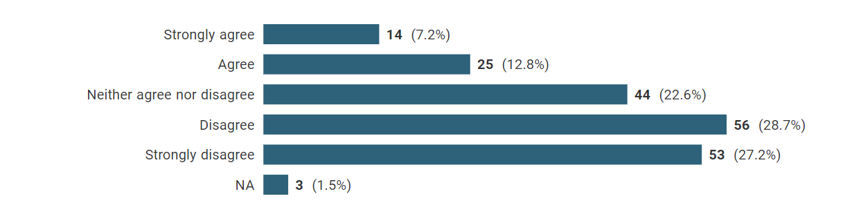
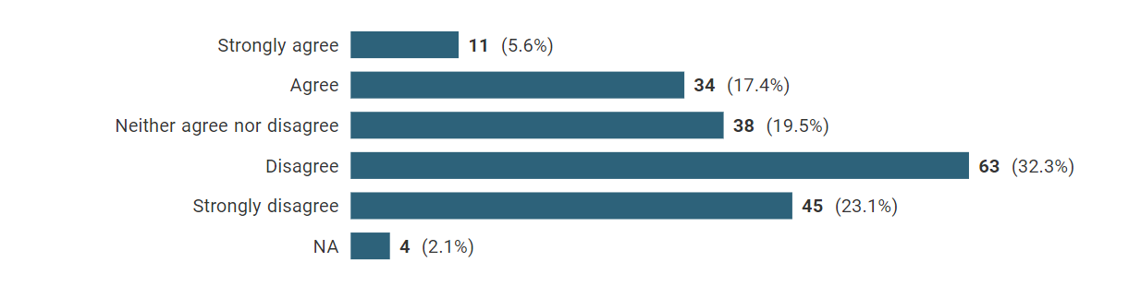
Phase 3: Development of the new alternative resources
Concerns
Students would use the alternative resources to intentionally avoid participating in any home experiments, practically, even if they had the means and time to do so.
I would use alternative resources instead of performing an experiment in my home, even if I was able to perform the experiment myself, to save time.
I would use alternative resources instead of performing an experiment in my home, even if I was able to perform the experiment myself, to save cost.
Survey responses strongly suggest that students would still participate in practical home experiments, even if the alternative resources were more readily available.

Slide 24
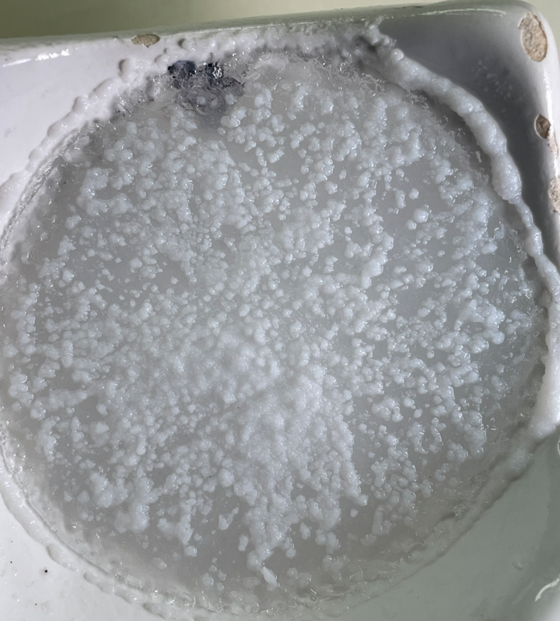
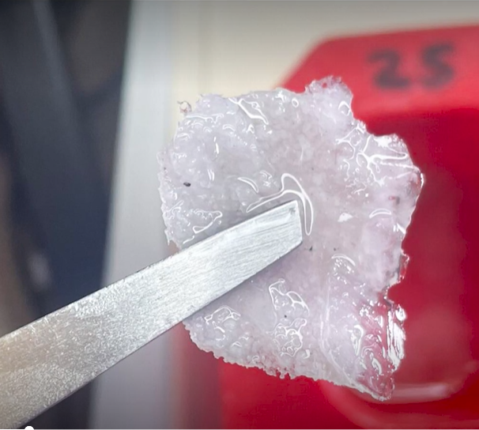
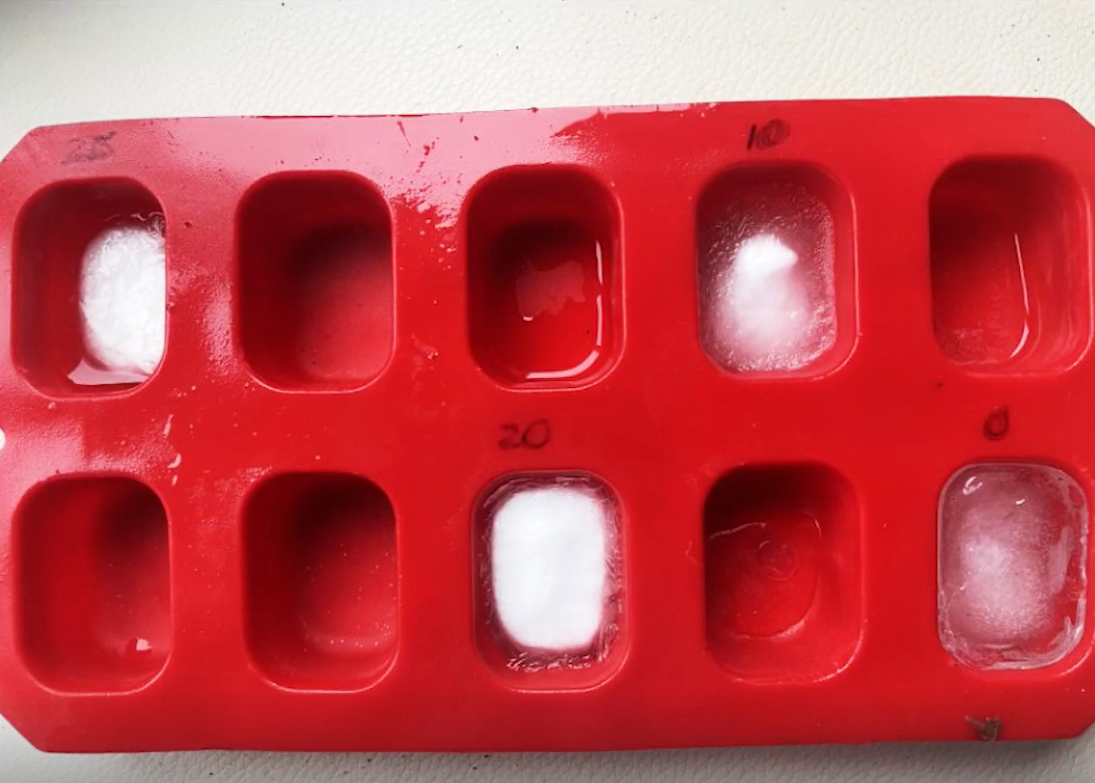
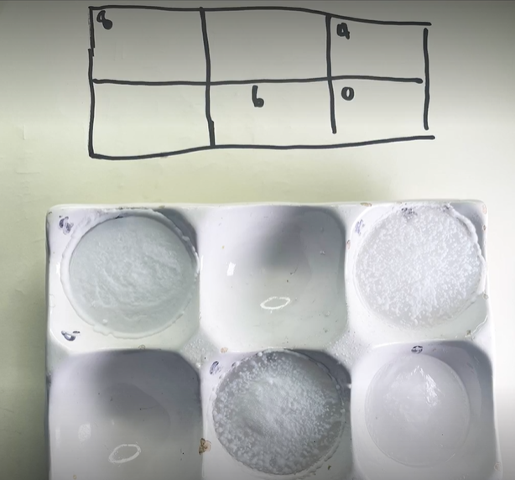
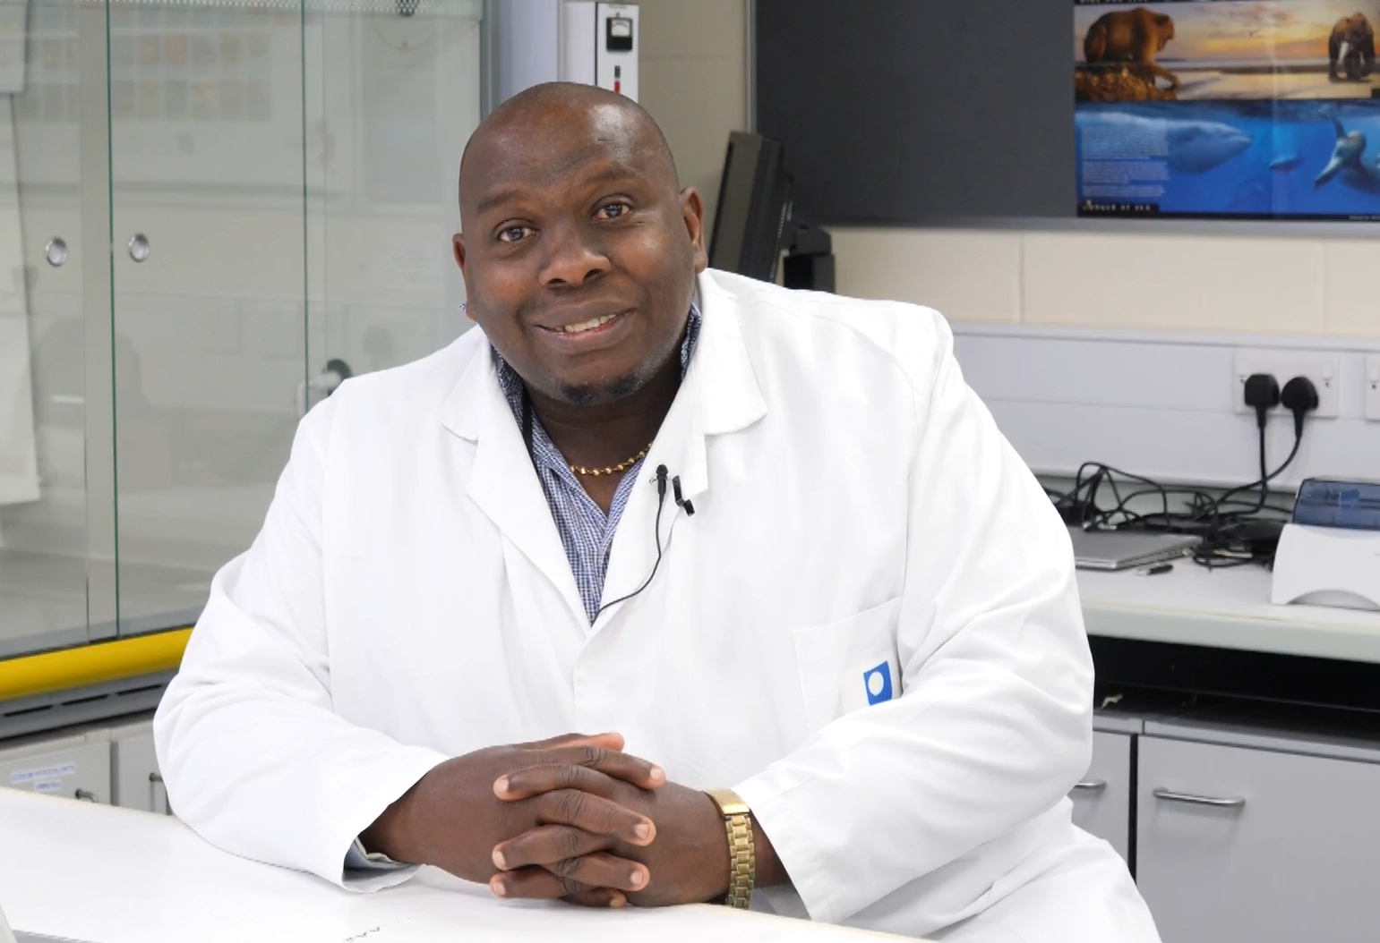
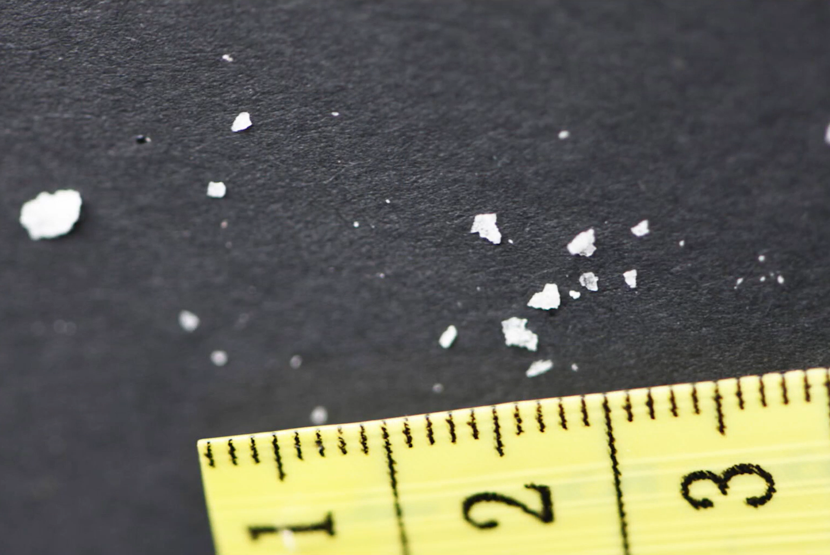
Phase 3: Development of suitable alternative resources
Preliminary Outcomes
Video illustrates the experimental set up with video demonstrations of each step to enable students to take their own observations and make their own judgements
Video recorded by Dr Sevel Miller and Dr Chris Hutton (S112 module team)
Recorded by SWIM
Made available on S112 as supplementary resource for 23J
Will be made available on S112 24J within the main VLE to all students irrespective of whether they need/want alternative resources.
Evaluation to take place in 24J

Slide 25
Initial Conclusions and Further Work
The vast majority of survey respondents did some or all of the home experiments in S111 and S112.
For those students who only did some experiments, choice was largely driven by assessment requirements.
Students who did not or could not participate in the home experiments largely did not engage with the project.
Themes identified from qualitative and quantitative data collection highlighted the same concerns.
Whilst initial focus of the project was on cost, emerging themes suggested broader issues with home experiments including the overall time required to source materials and carry out the experiments, availability of materials, environmental concerns and concerns about waste, in addition to cost.
Further work will analyse the student perspective of the new alternative resources in S112 topic 2 experiment.

Slide 26
Initial Recommendations
Whilst home experiments are popular with some students and provide a means for students to meet learning outcomes related to practical skills, not all students are able to engage in home experiments which is particularly problematic when it comes to those which form part of mandatory assessment.
Three main recommendations:
1. The OU should consider providing home experiment kits
Students showed willing to purchase (up to £50) a home experiment kit that would contain all of the items needed for home experiments in one module (similar to the OUSA S111 kit) so consideration should be given to the production of these kits with a recommendation to explore costs and logistics associated with making these available.
Home experiment kits could be means tested for students on low income.
2. Module teams should re-evaluate how they approach home experiments
Module teams should consider cost and availability of raw materials which may need to be purchased, avoiding the assumption that students will have certain items readily available (e.g., access to a fridge) and that students have the disposable income to purchase specific items.
Module teams should also consider the use of a standardised list of equipment to avoid unnecessary repeats (e.g., ‘pocket calculator’ versus ‘calculator’) to ensure students aren’t making unnecessary purchases and provide this at the beginning of the module to cover all home experiments.
3. Suitable alternative resources should be made available to all students as standard, and their purpose better explained
Every home experiment should have alternative resources readily available (avoiding the need for students to ask for access to them) and the resource should be able to offer a reasonable parity of experience.
Students should be supported to understand use of alternative resources is not a negative thing – especially if managing mitigating circumstances.

Slide 27
Thank you for listening, any questions?

