Slide 1
Improving and evaluating inclusivity in group project work for distance-learning engineering students
Jo Smedley, Hedieh Jazaeri, Alice Moncaster, Silvia Varagnolo, Fiona Gleed
Engineering and Innovation
April 10th 2024

Slide 2
Session Focus
Group-work in OU context has a particular set of issues.
Improving inclusivity in engineering practice is critical.
Group-work provides opportunity to support all students in developing skills and understanding.
Findings feed into the wider knowledge base on inclusivity in distance-learning group-work especially in STEM.

Slide 3
Project Context
Second year engineering module (T229) included distance group project during last four weeks of part three of the module.
Extended to other first year and second year core engineering modules
Group work moved from face-to-face residential school to remote due to pandemic.
Literature review: considered/predicted barriers to different student profiles.
Informed development of survey questions involving tutors and students of initial/other first and second year modules including distance-group activities.
Focus group interviews provided further insights into group-work experience from student and tutor perspectives.

Slide 4

Recommendations: communication
Greater emphasis on communication in module to benefit group working for future employability.
Communication methods outside university environment discouraged to reduce overall visibility of progress, e.g. WhatsApp.

Slide 5

Recommendations: introductory group task and prep
During group work preparation, students guided to establish effective way of group working, using appropriate technologies.
Constitution of collaboration regarding working together – possible introductory group engagement task.
Case studies from current/past students on challenges of group working at a distance provided for discussion before start of project.
Preparation arranging appropriate study environment useful feature in future module groups.​
Time management
Useful item for introductory guidance to the module ​to ensure effective engagement in team development.

Slide 6

Recommendations: group composition and roles
Collation of student availability profiles could be helpful
Inform group make-up prior to start of module.
Inclusivity did not feature as an issue
Staff indicated difficulty to form groups with a balanced gender mix and avoid gender isolation.
Further advisory guidance on group roles prior to start of project.
Advisory structure prior to project start
Guide preparatory thinking and relieve study anxiety.

Slide 7

Recommendations: assessment
Scope to increase personal reflection of assessment
Ensure students able to include individual project contributions
Comment on value of groupwork to individual career journey
Helpful guidance on presentation and report writing
Confidence and ability in academic English (rather than as first language).
Study skills resources available but students often did not locate or engage.
Alternative assessments when group arrangement changes are important.

Slide 8
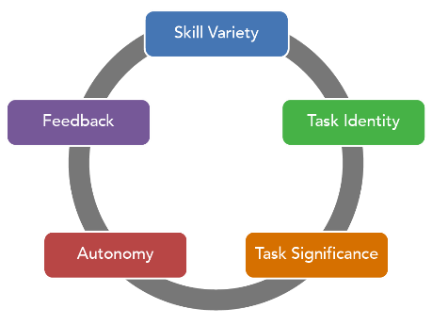
Recommendations: design
Clear definition of task: flexibility in the number of members and roles
Provide learning materials about group working
Assessment design: majority of marks independent of work of others
Authenticity of the task
Correct time allocation for task
Icebreaking and debriefing activities.

Slide 9
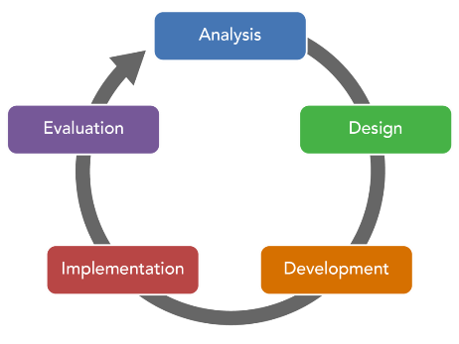
Recommendations: delivery
Timely delivery of learning materials and communications: before start of activities
Group formation: students’ time availability and attitudes
Suitable platforms for group meetings and communication: in-house options
Support for tutors

Slide 10

Continuing Work
Annual survey in same module context (T229) to enable further analysis of comparison data assessing the same group project.
Consider further interventions to reduce anxiety before group project.
Useful to expand the survey/increase the number of interviews
To identify root causes of anxiety
Impact on those affected

Slide 11
Slide Title 30
Thank you

