Slide 1

Learning from improvers
Lessons for assessment
Cathy Smith
Charlotte Lighter

Slide 2
Workshop aims
To share key findings from our eSTEeM project, Learning from improvers, and some implications for assessment (20 mins)
To reflect on two assessment frameworks and consider how they relate to OU assessments (30 mins activity working in table/breakout groups)
To provide an example of mapping assessment preparation in Mathematics Education modules (10 mins)
Notes:
Aims briefly explain format of workshop. (can remove timings but thought it would be useful to sign post we won’t just be talking given we are spending the first 20 mins speaking which people might find frustrating when it has been advertis
ed as a workshop)

Slide 3
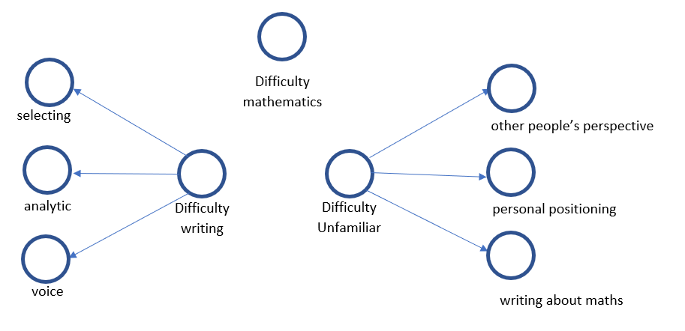

Data collection and analysis
Semi-structured interviews with 12 “improvers” (from 65 with ethics/permission)
  Criteria combined: overall improvement, trajectory, final improvement
Thematic analysis of interview transcriptions
Identified two broad categories: “difficulties” and “support”
Coded into themes and subthemes
Braun and Clarke (2006, p. 82): patterned responses or meanings within the data set that capture something important about the data in relation to the research question.
Identified two broad categories: “difficulties” and “support”
Notes:
CL start here.
- inductive and deductive codes
- Initial coding using framework – linked to research questions about specific elements of course and new resources.
- Theory driven codes also coded inductively as prevalence and/or important.
- Nvivo used to support coding process
(Background to include or not? CL Mathematics Education (ME) modules involve reflective writing, a type of writing which applies academic analysis to personal practice. Writing for ME modules therefore requires a different approach to writing for either straight mathematics or humanities and arts subjects, as it involves combining specific inter-disciplinary elements. Students entering our level 3 modules, many with mathematical rather than education backgrounds, need to develop these ways of thinking and writing to succeed in their assignments. We know from speaking to students and tutors on our modules that students find reflective writing particularly challenging and we have long been interested in learning how to help them to develop and improve this skill.
We reasoned that our support for students in this new approach to writing needed to be strengthened and felt that the most relevant experiences to understand were not necessarily those of the most successful ME students, but those who had improved their marks during a ME module. So we set out to investigate what it was that helped those students to improve.

Slide 4
Selected findings: unfamiliarity
Initial difficulties lie in the unfamiliar combination of writing about mathematics and writing about oneself while noticing other people’s perspectives.
Connects with literature that finds HE assessment advice is experienced as non-specific (Lillis & Rai, 2013), implicit (Odeniyi, 2015), opaque (Butcher, 2017).
When writing about their own activity, students have “to deal unsupported in high-stakes contexts with conflicting messages about authenticity and audience.” Jen Ross (2014, p230)
“reflective accounts need to be knowing about the craft and context of their production” (p231)
Notes:
“what threw me […] was the reflective nature of it, that I would actually have to, that some of that information would come from me personally reflecting on the feelings I got from the processes.” (Michael)
Louise “I had to keep reminding myself they are not looking for the correct – they are looking for the statistical thinking, they are looking for the methods, why you are making your choices, what are you basing your choices on…”
Make visibility unavoidable = personal does not mean anything goes, share criteria, share with peers,. Cathy needs to reread Ross but also bear in mind that this is specific to reflective writing. Red part may have wider implications

Slide 5
Selected findings: ongoing challenge and support
Students experienced continuing difficulties with selecting material to analyse, with providing analytic detail or, less frequently, with writing voice.
What helped (1): seeing the value of the process and giving it enough time
What we did (1): allocated time and specific activities in the module for assignment practice and preparation
Building “constructive alignment” between learning outcomes, assessment demands and teaching?
Notes:
“I don’t think it was my writing so much as my thinking that needed to change to improve my writing.” (Hannah)
“Give yourself at least a week to reread it and improve it because you’ll get a third of your marks in that last stage” (Laura).
For history of Biggs ‘ idea and take up of he term Loughlin, C., Lygo-Baker, S., & Lindberg-Sand, Å. (2021). Reclaiming constructive alignment. European Journal of Higher Education, 11(2), 119–136. https://doi.org/10.1080/21568235.2020.1816197

Slide 6
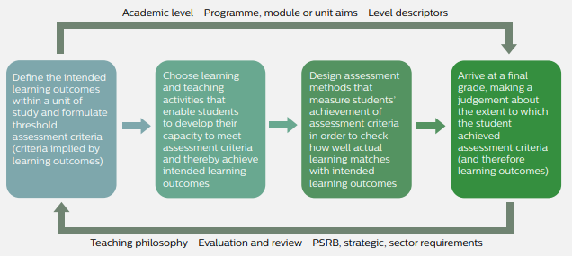
Constructive alignment
Assessment methods and criteria are aligned to learning outcomes and teaching activities
… we note assessment is also a (formative) learning and teaching activity
QAA guiding principle
The UK Quality Code for Higher Education, QAA 2018
Notes:
For history of Biggs ‘ idea and take up of the term Loughlin, C., Lygo-Baker, S., & Lindberg-Sand, Å. (2021). Reclaiming constructive alignment. European Journal of Higher Education, 11(2), 119–136. https://doi.org/10.1080/21568235.2020.1816197

Slide 7
Selected findings: ongoing challenge and support
Students experienced continuing difficulties with selecting material to analyse, with providing analytic detail or, less frequently, with writing voice.
What helped (2): alternative explanations that model the required analysis e.g. in videos, tutorials, summary chapters
What we did (2): diversified assignments (spoken reports, forum posts); diversified tutorials, provided a ‘module map’
Inspired by the Universal Design for Learning framework (CAST, 2018)

Slide 8
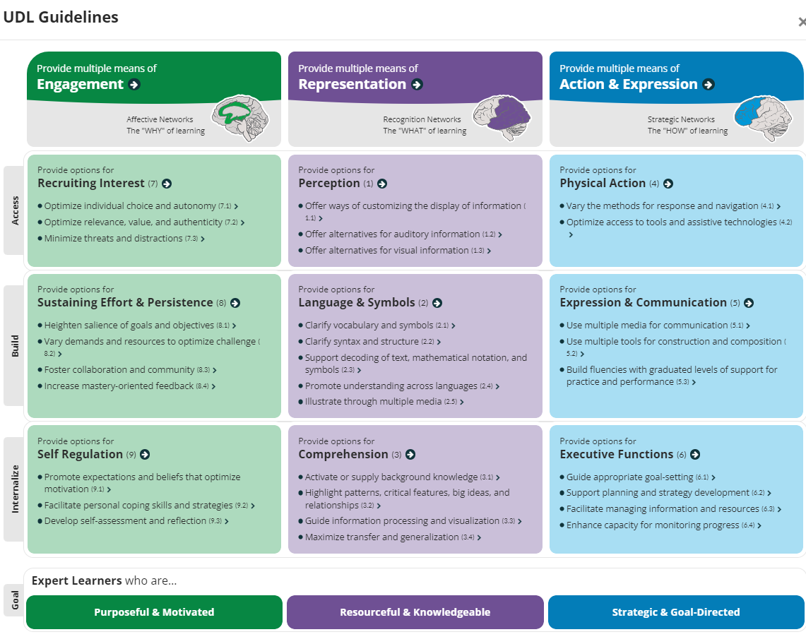
Universal Design for Learning
Notes:
diversified assignments (spoken reports, forum posts) = action and expression
diversified tutorials, videos etc = illustrate through multiple media
provided a ‘module map’ = highlight patterns and relationships
Way we used this is to note where the design of our assignments already considered some of these features, and used others to ask questions/ suggest possibilities.

Slide 9
Selected findings: support from personalised feedback
Improvers highlighted importance of personalised feedback from tutors, i.e. two-way ongoing communication of meaning
“he highlighted the areas that I’d written well and that helped me to see which parts of my thinking were useful in the context of the module and which parts maybe weren’t by highlighting the positive ones. I think the thing with that is that if you query something that I write and maybe an idea that I have or have a different angle then there are many options for a better way of looking at it whereas if you highlight a positive, this is a good way of looking at it, that actually gives me something concrete that’s informative about a good thought process!” (Hannah)
Notes:
CL While this is a cornerstone of our teaching model at the OU, it is good to see that it is highly valued by students.
Can spent time worrying about students not using it – but evidence of students using it and have improved. Also that they build between assignments.
including positive feedback

Slide 10
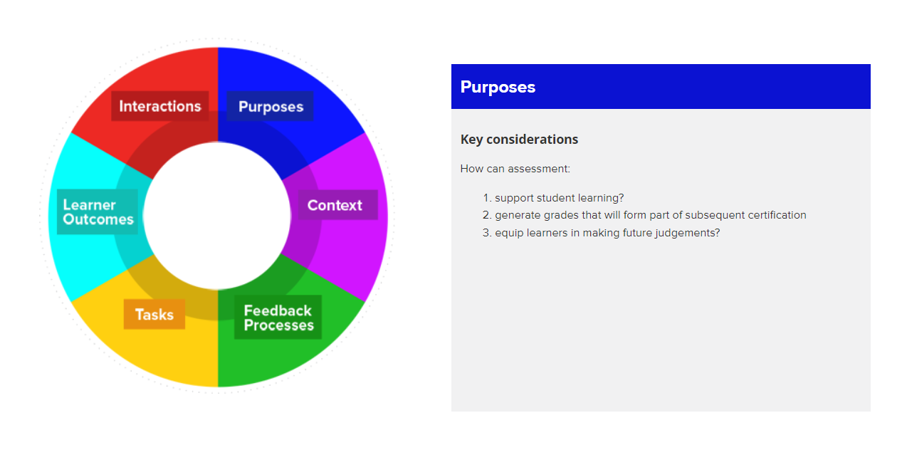
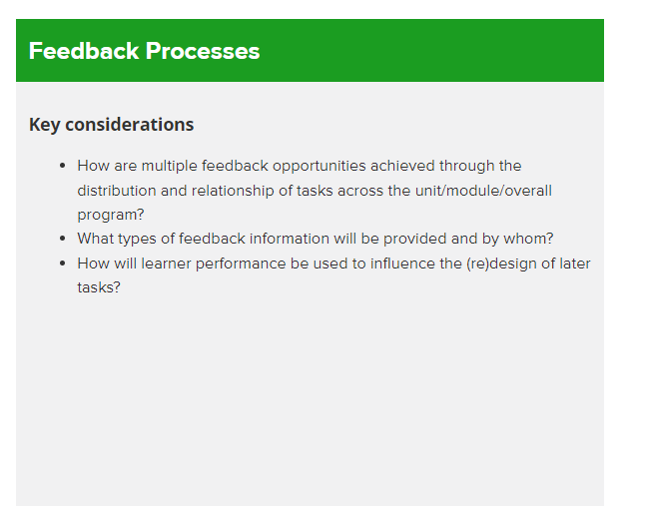
Assessment Design Decisions Framework
https://www.assessmentdecisions.org/framework/
Notes:
Either this slide or the next one….

Slide 11
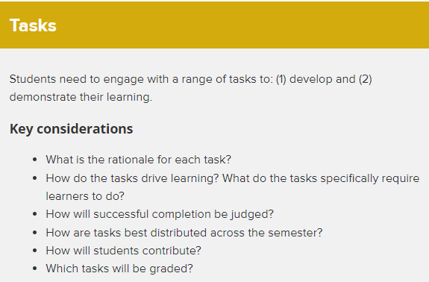
Assessment Design Decisions Framework
Notes:
Either this slide or the next one….

Slide 12
Conceptualising progression
What is your intended student journey? How are students expected to make progress across assessments? Do all markers agree?
Contrasting a topic-based structure with a developmental structure, for example:
Using different assignments and marking criteria for each assessment | Repeating the same (or similar) assignments | Increasing the challenge of assignments in a planned way
Potential for a wider breadth of topics to be assessed. | Expect students to get better through iterative feedback. | Aiming for more consistent marks across a module.
How are students expected to improve? | Potentially disheartening at the start. | Marks may not show clear indication of improvement.
Notes:
Flat performance?
Marks improving over assignments of same standard?
Marks improving slightly as assignments become more demanding in a planned way?

Slide 13
Activity
Online? Use link in chat for documents
20 mins in groups
A) Choose a framework (Assessment Design or Universal Design for Learning ).
Discuss: What are the key principles?
B)
C) Questions to consider and discuss:
Option 1) Explain your own module assessment (briefly) to others on the table
Option 2) Look at the Example assignments from OU modules (if cannot access your own TMAs).
What is the same between first and last assignments? What is different and might indicate demand increasing (regardless of focus content)
Are there elements/principles from your chosen design framework? If not, why not? Does it matter?
What is the model of progression?
Notes:
Flat performance?
Marks improving over assignments of same standard?
Marks improving slightly as assignments become more demanding in a planned way?

Slide 14
Feedback
5 minutes
Question to feedback on:
What was the progression model for the module assessments? Did they increase in challenge? Did they focus on different topics?
Did the module assessments seem to use any of the principles from your chosen framework?
Overall reflections about models of progression in assessment on your module or chosen module.

Slide 15
Changes to our assessment
New Mathematics Education assessment strategy
Move from repeated assignments and expectation to improve, to assignments which become more challenging across the module (keeping multiple feedback opportunities, AD).
Linked assignments, which build on one another so actionable and iterative feedback possible (constructive alignment, AD).
Greater variety of assessment formats, e.g. narrated PowerPoint, watching video of learners and replying to students’ forum posts (multiple media for communication, UDL).
Mapping assessment preparation across weeks so assessment is integrated (teaching and learning associated with assessment, AD).
Time allocated to different stages of assignment e.g. planning and reflecting on previous TMA feedback. (develop self-assessment and reflection, UDL)
Tasks focused on reflective writing - making craft visible (Ross, 2014)
Change in TMA performance over the module (see next slides).

Slide 16
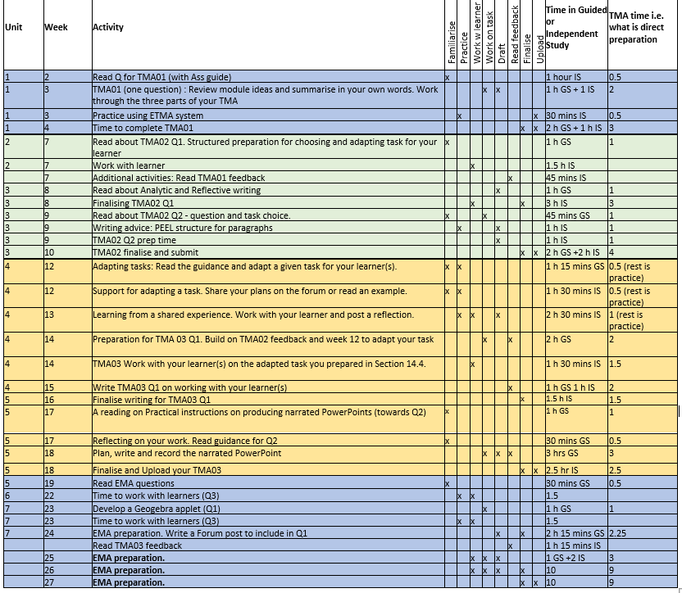
ME assessment activity mapping
This maps all activities that prepare for assignments.

Slide 17
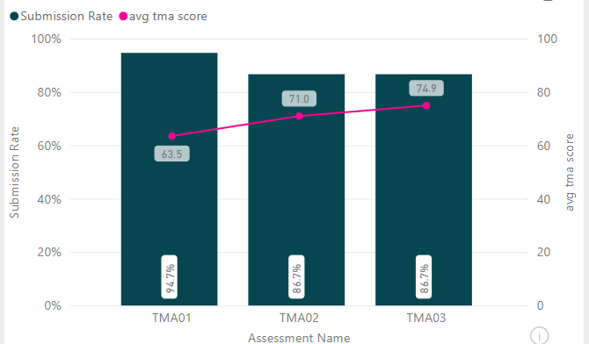
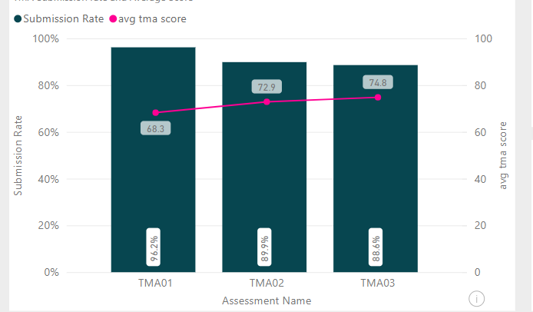
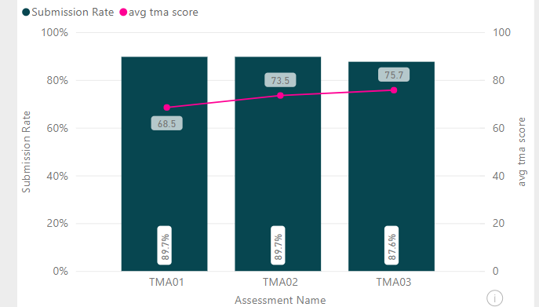
Previous module
Focus on red line showing average TMA score (bars show submission rate)
ME627 (Developing Thinking in Geometry)
18J 19J 20J

Slide 18
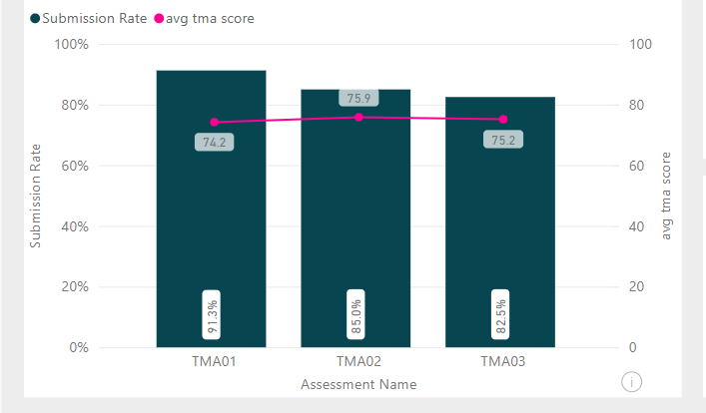
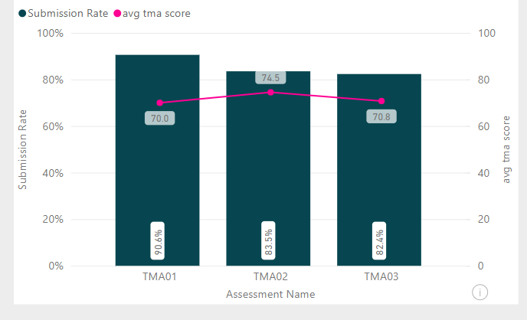
New module
Focus on red line showing average TMA score (bars show submission rate)
ME321 (Learning and Doing Geometry)
21J 22J

Slide 19
Thank you for taking part!
Further reading
Esteem report: OU Microsoft Word Report Template (open.ac.uk)
Student facing blog: Mathematics Education | Our take on teaching and researching maths (open.ac.uk)

Slide 20
References
Assessment Design Framework. (2014, September 30). Assessment Design Decisions. https://www.assessmentdecisions.org/framework/
Bearman, M., Dawson, P., Boud, D., Bennett, S., Hall, M., & Molloy, E. (2016). Support for assessment practice: Developing the Assessment Design Decisions Framework. Teaching in Higher Education, 21(5), 545–556. https://doi.org/10.1080/13562517.2016.1160217
Braun, V., & Clarke, V. (2006). Using thematic analysis in psychology. Qualitative Research in Psychology, 3(2), 77–101. https://doi.org/10.1191/1478088706qp063oa
Butcher, J., McPherson, E., Shelton, I., Clarke, A., Hills, L., & Hughes, J. (2017). Unfit for purpose? Rethinking the language of assessment for Widening Participation students. Widening Participation and Lifelong Learning, 19(2), 27–46. https://doi.org/10.5456/WPLL.19.2.27
CAST. (2018). Universal Design for Learning Guidelines version 2.2. https://udlguidelines.cast.org/
Loughlin, C., Lygo-Baker, S., & Lindberg-Sand, Å. (2021). Reclaiming constructive alignment. European Journal of Higher Education, 11(2), 119–136. https://doi.org/10.1080/21568235.2020.1816197
Odeniyi, V. (2015). An exploration of students from the African diaspora negotiating academic literacies [Phd, Canterbury Christ Church University].
QAA. (2014). The Frameworks for Higher Education Qualifications of UK Degree-Awarding Bodies.
Rai, L., & Lillis, T. (2013). ‘Getting it Write’ in social work: Exploring the value of writing in academia to writing for professional practice. Teaching in Higher Education, 18(4), 352–364. https://doi.org/10.1080/13562517.2012.719157
Ross, J. (2014). Performing the reflective self: Audience awareness in high-stakes reflection. Studies in Higher Education, 39(2), 219–232. https://doi.org/10.1080/03075079.2011.651450

