Slide 1
What do you think enrichment means?
Notes:
HEATHER
While we’re waiting for everyone to join, ask audience:
What do you think enrichment means?
If you were running an enrichment event what would you include?
[ONS uses enrichment term. Anything extra to curriculum ]

Slide 2

Intro Slide Title 2
Online Enrichment Workshops – how these can help you engage and enrich your students’ experiences
eSTEeM Conference 10-11th April 2024
Janet Haresnape*^~, Heather Fraser^~, Hanne Bown~, David Ruiz~ and Hannah Gandy⁺
School of Life, Health and Chemical Sciences
* Employability Lead
^ Staff tutor
~ Associate Lecturer
⁺ Current OU Student
Notes:
JANET
11:30-12:30
CMR 11

Slide 3
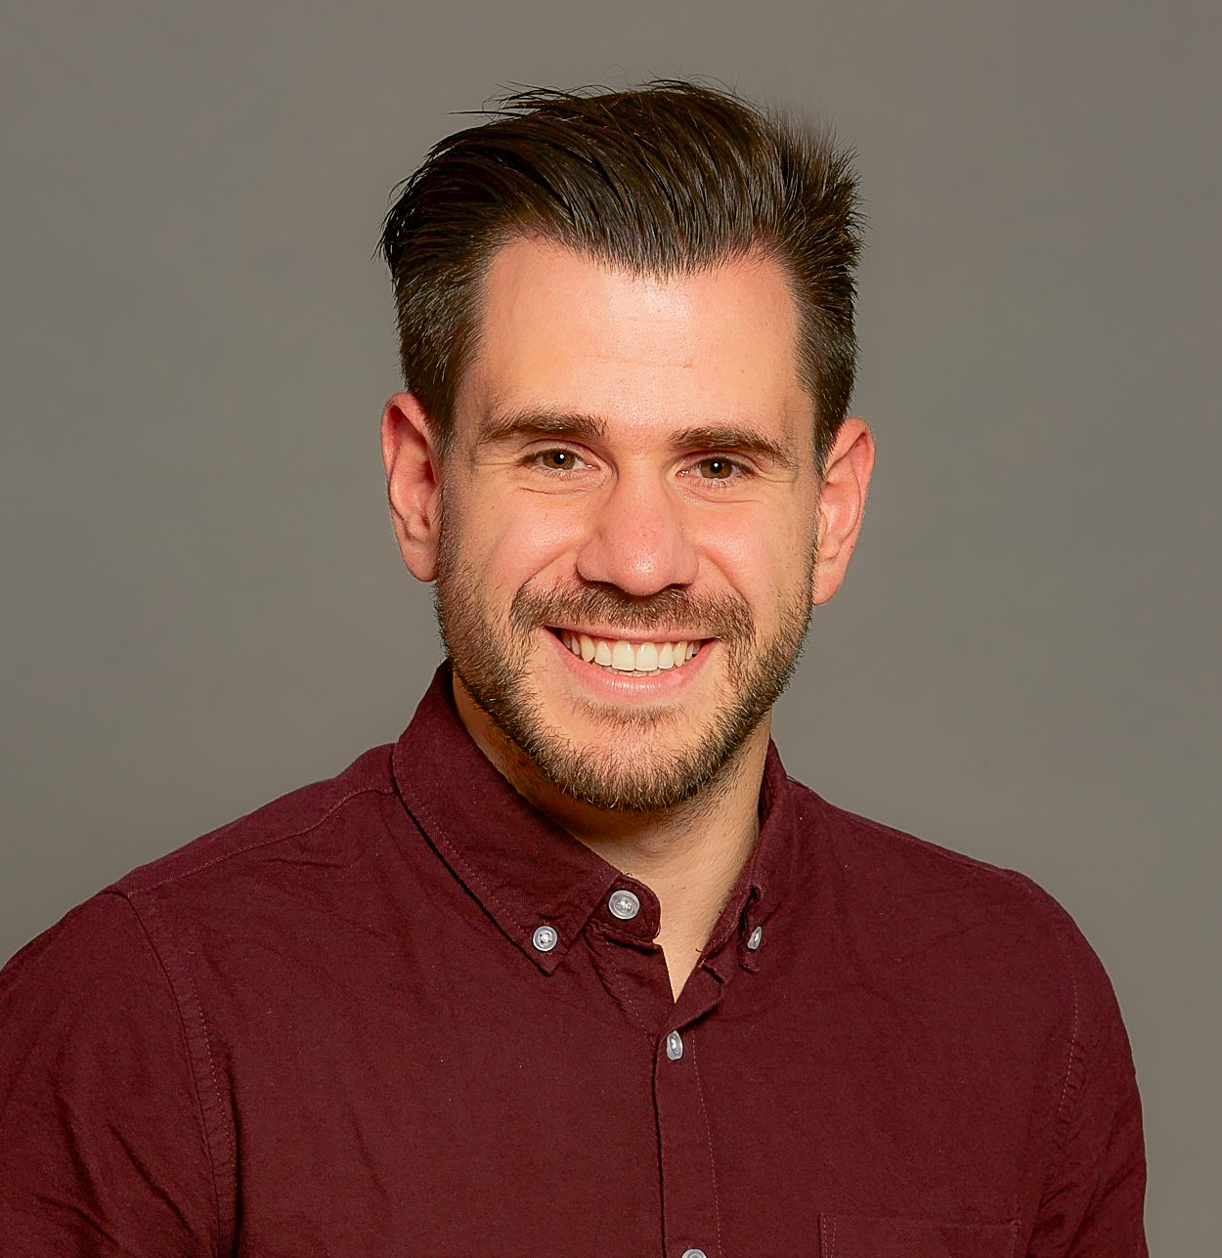
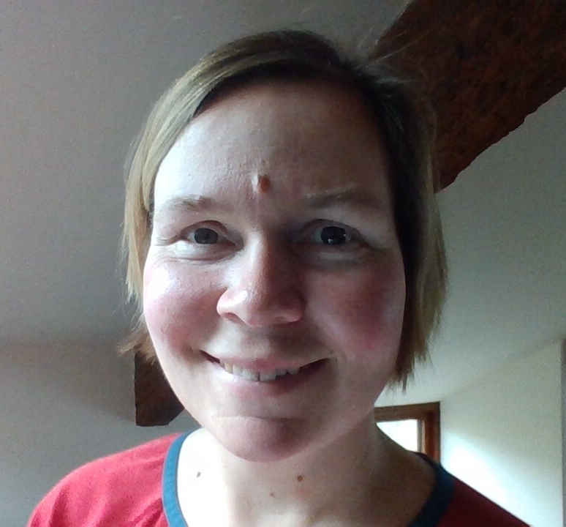
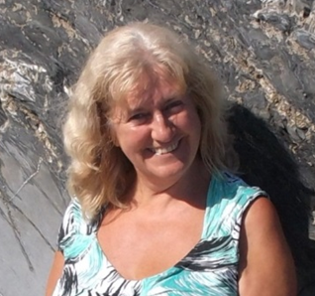
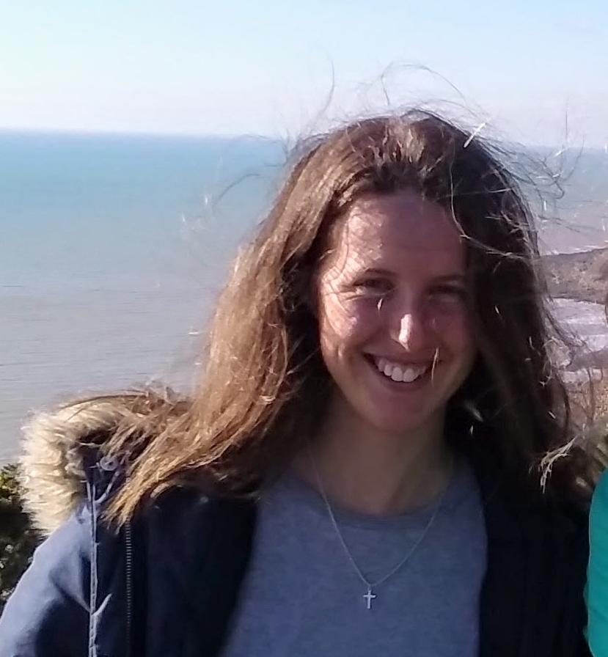
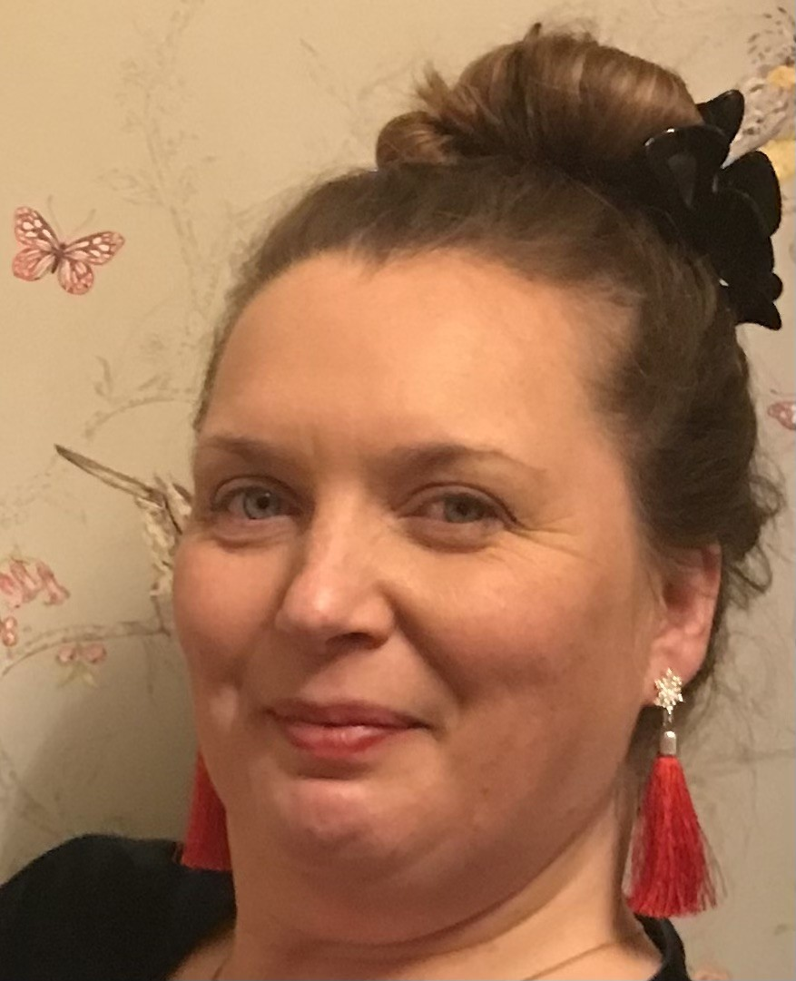
Welcome to the Team!
S111_22J, SDK100_23B,
SK299_23J, S248_23J
Notes:
Hannah has completed S111 and SDK100
Currently studying SK299 and S248

Slide 4
Slide Title 8
Online Enrichment Workshops – originally piloted in 2022, expanded in 2023
Why did we decide to run these?
A previous eSTEeM project on practical skills progression and employability (Haresnape, 2022) revealed that many students don’t realise:
- The employability benefits of engaging with practical investigations
- They are gaining crucial skills by engaging in practical work
To fill the gap between J presentations – keep keen students engaged over summer months
To help students feel a sense of community
Additional tutorials (outside the core tuition strategy) had been run by several modules in 21J (e.g. S295, SK320) and it was clear that these would be of wider interest beyond just one module.
We had ALs with spare pre-paid FTE which needed to be used by October 2022
Notes:
JANET

Slide 5
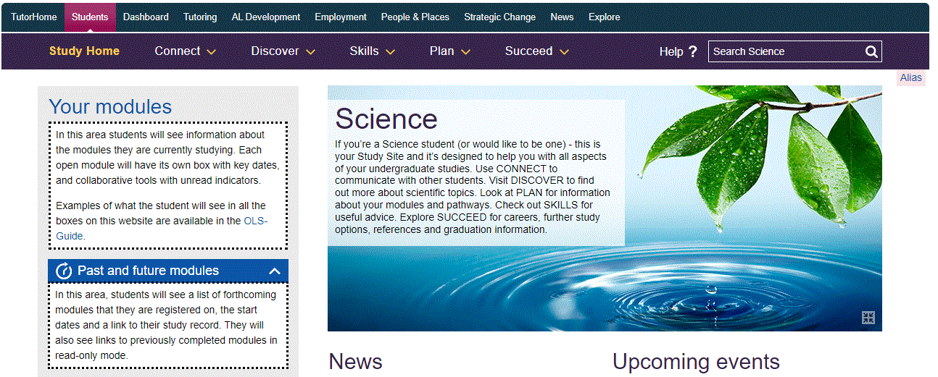
Slide Title 8
2022 Pilot programme
Therefore we ran a series of workshops for students in June and July 2022, funded by the Board of Studies.
Eleven workshops, in an AC room on Science Study site
Most run by LHCS ALs – plus one by an LHCS lecturer
One AL (Ruth Gilbert) coordinated the programme
- Contacted facilitators to arrange times
- Put together the programme
- Advertised the programme on module forums
- Introduced the facilitator at each session, and welcomed the students
- Posted a link to a feedback questionnaire at the end of each session
- Collated the feedback at the end of the summer
Notes:
JANET

Slide 6

Slide Title 8
2022 Pilot programme
Students were invited by CAMEL email, plus posts on module forums
Initially just invited Level 3 biology students (1446 students)
Later extended to all Level 2 + 3 biology & health students (2750 students).
Average attendance was 10-15 students per workshop
146 different students either attended or accessed recording of at least one workshop
The workshops focussed on a variety of biology-related jobs, giving first hand knowledge of what the job was like and the particular skills required (e.g. field-based jobs, lab-based jobs, working in bioinformatics)
Most popular sessions were those on HIV, Foodborne diseases, Communication skills, Surviving life as a field biologist, and Bioinformatics
Notes:
JANET

Slide 7
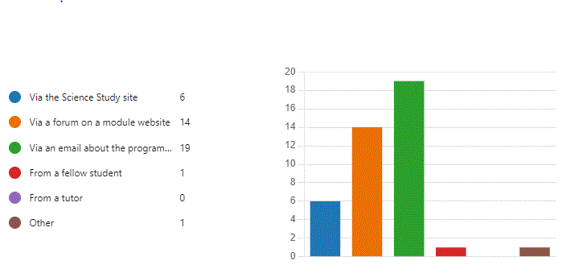
Slide Title 8
2022 Pilot programme – feedback
How did you hear about the programme?
Notes:
JANET

Slide 8

Ask the audience …..
Do you have a similar programme in your school?
Notes:
HEATHER 11:40ish
Hanne/David can keep an eye on the online feedback.

Slide 9
Slide Title 8
2023 Expanded programme
3 AL facilitators: Hanne Bown, David Ruiz, Heather Fraser
More workshops – May to September 2023
More students invited – chemistry as well as health sciences and biology
Monthly CAMEL email invite
Session reminders on module forums and science study site
Include a wider range of enrichment opportunities
            Online Journal Clubs
            Future You
            What is Global citizenship
            PhD student panel discussion
Showcase from LHCS research clusters
Library skills session
Using Excel
Positive study skills mindset
Notes:
HEATHER
22 workshops plus 4 OJC
Approximately 6000 students invited
CAMEL to 2 year, 3 year LHCS and SDK100 completers.
Nice interaction of students in sessions.
One session on communication had lots of enthusiastic participation throughout – Students clearly relaxed and engaged: one of the students cheekily suggested at the end that some tutors would benefit from watching the session.

Slide 10
2023 Attendance - outcome
Attendance ranged from 5 -29 (average 13).
Watching recordings ranged from 15 – 63.
200 different students attended at least one live event
  64 in 2022
443 different students either attended or viewed the recording of at least one event
  149 in 2022
Online Journal Club still going first Wednesday of each month.
Anecdotal: new student writing club blossoming and increased collaboration on forums
Notes:
HEATHER

Slide 11
Hannah’s feedback
Presenters were introduced giving a short clip of their journey to date.
Each topic included relatable content to life and health science module material.
Provided deeper insight to a specialist area or areas of the module material
Really inspiring to see scientific success from relatable journey
Very interactive with polls, tasks, questions (what do you think) making us feel part of a scientific research community.
Presenters were very approachable and enthusiastic for further discussion/questions.
Notes:
HANNAH 11:45ish
[Science pioneering community, feel like you belong with science, so not a community of students but part of a larger science community and what type of career would be possible.
Add something about online journal club attendance and benefit. ]

Slide 12
Slide Title 8
Other student feedback
Valuable insight into the skills required for fieldwork, and the challenges too.
Real experience brought it to life for me.
Relates degree work to outside world
Opened my eyes to opportunities out there to do field work
I had never heard of bioinformatics - really great to hear about this as possible career path
Learnt how biological techniques are used to research real-world problems.
Keeps the student/study momentum going over the break. I am impressed overall with the Biology department approach.
Notes:
HANNAH

Slide 13
Discussion
Points to discuss
Would a summer programme of interactive online enrichment events be popular at your School, and what the potential benefits and challenges might be?
Any possible opportunities for PhD students to participate in outreach/teaching missions in your School via a summer programme, e.g. giving research talks, sharing data-handling/ analysing/ interpreting skills, to practise online presentation/oral skills for future dissemination.
Would panel discussions be effective in your context – (it can be less intimidating to submit questions to an online panel than face to face).
Suggestions for improvements or additions to such a programme.
Notes:
HEATHER 11:50-11:55 Explanation.
Now we’re going to have a 15 minute brainstorm.
Could break into schools if wish LHCS, C&C, E&I, M&S, SPS, EEES. KMI into area of interest.
Please discuss these 4 points.
Please note down on paper provided and we’ll use this to improve, expand.
We’ll discuss for 15 minutes, we’ll have a 3 minute reminder, and come back to discuss, so don’t forget to nominate a speaker.
15 minute discussion (11:55-12:10)
15 minute feedback to group (12:10-12:25) Maybe 2 minutes each for 8 groups.
Heather set a TIMER to give a 3 minute warning (e.g. 12 minutes)

Slide 14
Slide Title 8
Thanks very much to all our contributors ☺
Ruth Gilbert | Isobel Richards | Corinne Kay
Penny James | Manda Laine - LTL | Kate Nixon
Jane Beal | Hannah Woods – LTL | Charlene Butler
Roseanne Miller | Claire Corkram - CES | Zoë Chapman
Lynda Weir | Nick Chatterton | Zhraa Alhaboby
Ruth Brown | Simon Collinson | Rachel McMullan
Wendi Bacon | Sheenagh Aiken | Richard Walden
Kevin Warwick | Kelly Britton | Dean Waters
Scott Tytheridge | Matt Kempster | Kalina Davies
Jon Golding | Jennifer Hollands | Kayleigh Smith
Vivien Cleary | Adrian Donoghue | Simon Chapman
Kate Tobin | Joanne Smythe | David Matalon
Notes:
JANET 12:26
CES = Careers and Employability Services
LTL = Learning and Teaching Librarians

Slide 15
Slide Title 30
Thank you – any questions?
Please email heather.fraser@open.ac.uk

