Slide 1

Strength-based scholarship and ‘good’ education:
Developing ourselves and the university
Open University
eSTEeM Conference
April 2024
Prof Dilly Fung
@DevonDilly

Slide 2
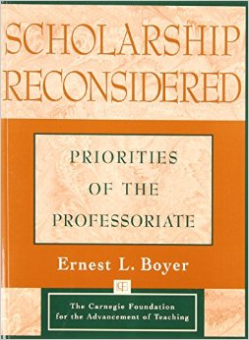
Scholarships of discovery, integration, application and teaching
‘We believe that the time has come to move beyond the tired old 'teaching versus research' debate and give the familiar and honorable term 'scholarship' a broader, more capacious meaning, one that brings legitimacy to the full scope of academic work’ (Boyer 1990, p16)

Slide 3
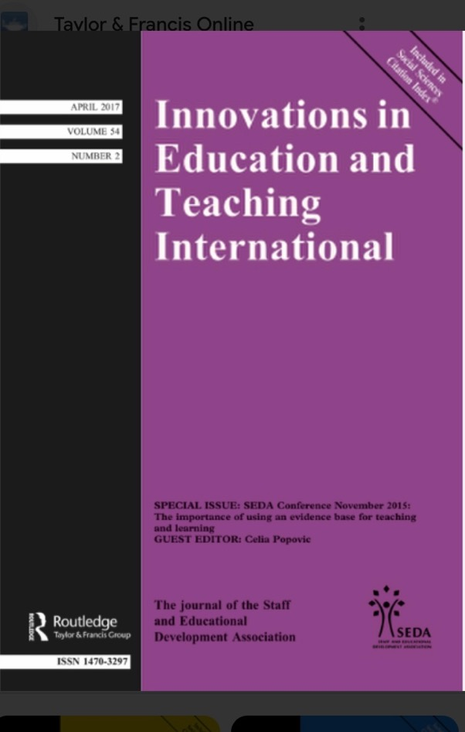
Strength-based scholarship and good education:
The scholarship circle
Higher education needs to:
celebrate the diversity of scholarly practices
help individuals develop scholarly careers that draw on their personal values, strengths and goals
help departments and institutions reward education-focused scholars and leaders more equitably.
(Fung 2017, p101)

Slide 4

Theoretical framing
Education and scholarship can both draw from the notion of Bildung, from the field of philosophical hermeneutics (Gadamer 2004):
‘self-formation’ through authentic dialogue with others
the widening of intellectual and cultural horizons.
The human mind needs to remain ‘unsatisfied with what it imagines it knows’ (Fairfield 2010: 3).

Slide 5
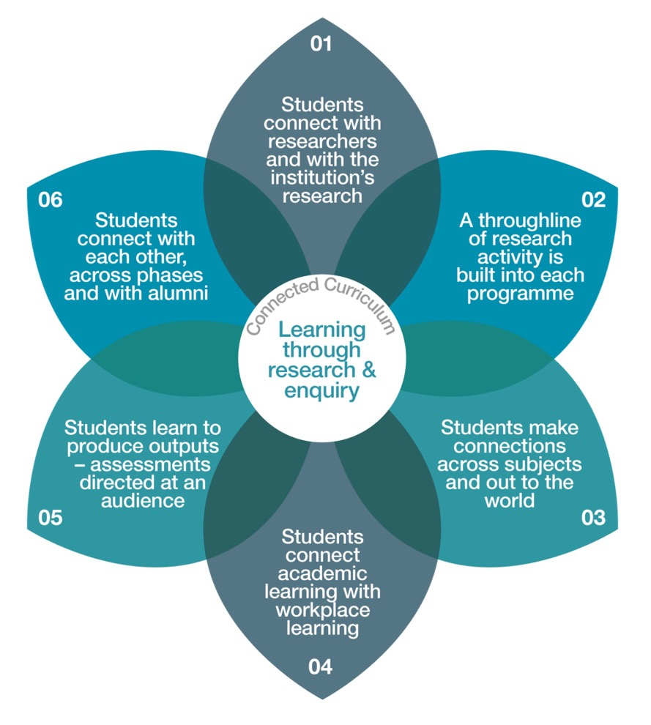
Connected
Curriculum
Fung, D. (2017)
A Connected Curriculum for Higher Education
UCL Press: London
Free download
http://discovery.ucl.ac.uk/1558776/1/A-Connected-Curriculum-for-Higher-Education.pdf

Slide 6
‘Scholarship’ signifies the principled space that connects integrity, research, teaching, learning, personal development and contribution to the world.
Scholarship enables scholars to speak, no matter who they are.
(Fung 2017, p105)

Slide 7

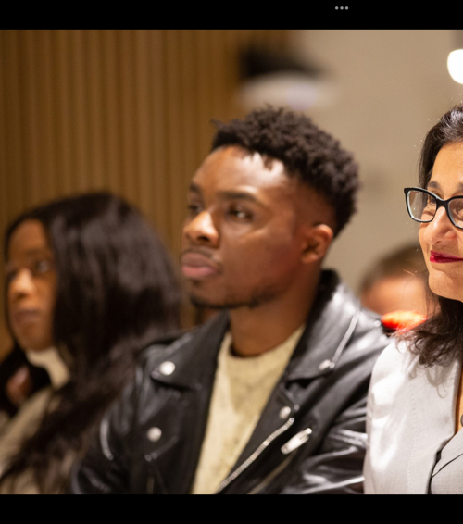
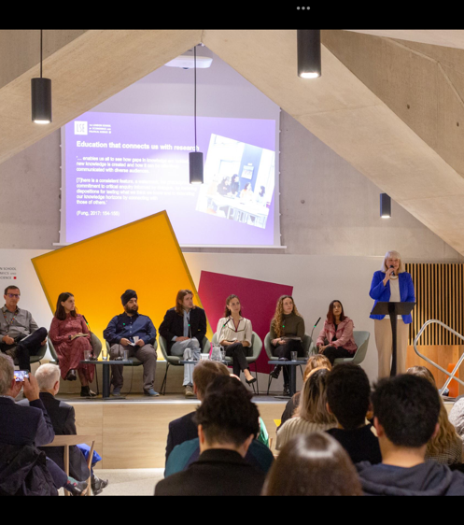
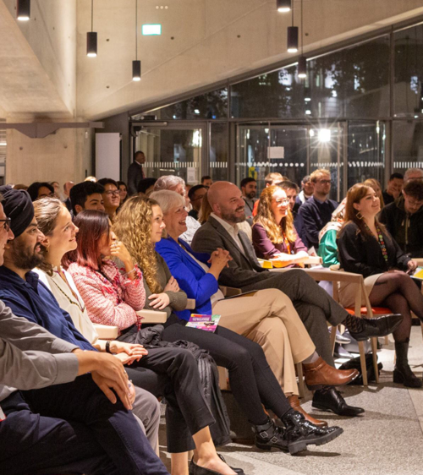
Scholarship as personal development

Slide 8
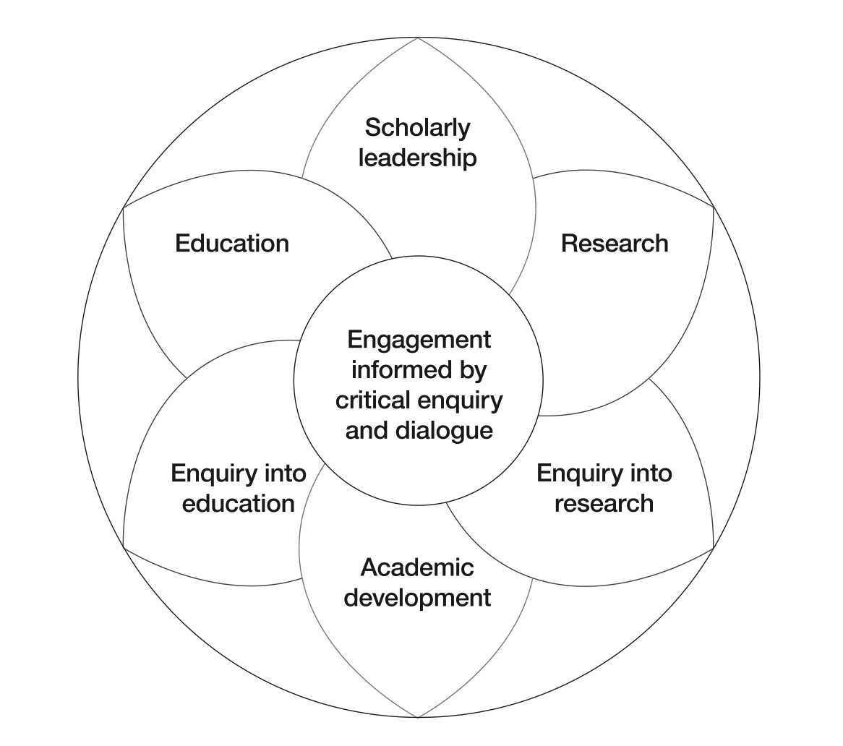
The Scholarship Circle
Fung 2017 p106

Slide 9

Strength-based scholarship in practice
Draw on your existing expertise and modes of enquiry to investigate aspects areas of interest meaningful to you
Use authentic and effective modes of enquiry and expression
Broaden your horizons through dialogue with those who bring other perspectives, including colleagues, students and alumni

Slide 10

Liberating ourselves and others
Who has put, or is putting, boundaries around you and your work?
Is your work, and your scholarship, building on your real values and passions?
Are you encouraging others to build on their values and passions?

Slide 11
Scholarship as institutional development

Slide 12
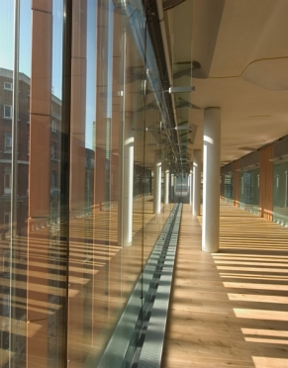
Advising your institutional leaders
Work together with fellow scholars to produce coherent evidence-based stories and propositions relevant to micro-level and macro-level strategic goals.
Use your evidence base to encourage your senior leaders to ask the right questions and find the right answers.

Slide 13
Ask questions of your institution
Has the institution fully articulated, within its own community, the values that underpin all areas of its scholarly activity?
Has the institution expressed its scholarly values effectively to the full range of external stakeholders?
Is the institution fully exploring and exploiting the synergies between different areas of scholarship, including the symbiotic relationship between research and education?
Are opportunities and resources being made available for scholars whose main strengths are in building new bridges between apparently disparate areas?
Has the institution reviewed organisational structures, job roles and promotion criteria to ensure that the full range of scholarship, including education-focused scholarship, is fostered and rewarded?

Slide 14
Ask more questions of your institution
6. Does the institution recognise fully the value of scholarship expressed through non-traditional modes of communication?
7. Is scholarly leadership, including education-focused leadership, fully recognised, developed and rewarded?
8. Is sufficient resource, including time, made available for all scholars to engage in academic/professional development, throughout their careers?
9. Does the institution explicitly draw on scholarly values and evidence-based enquiry when making decisions about its own practices and plans?
10. Do students at all levels of the curriculum engage fully as partners in the institution’s scholarship, both contributing to and benefiting from its impact on local communities, professional practices and wider society?
(Fung 2017; Fung and Gordon 2016)

Slide 15
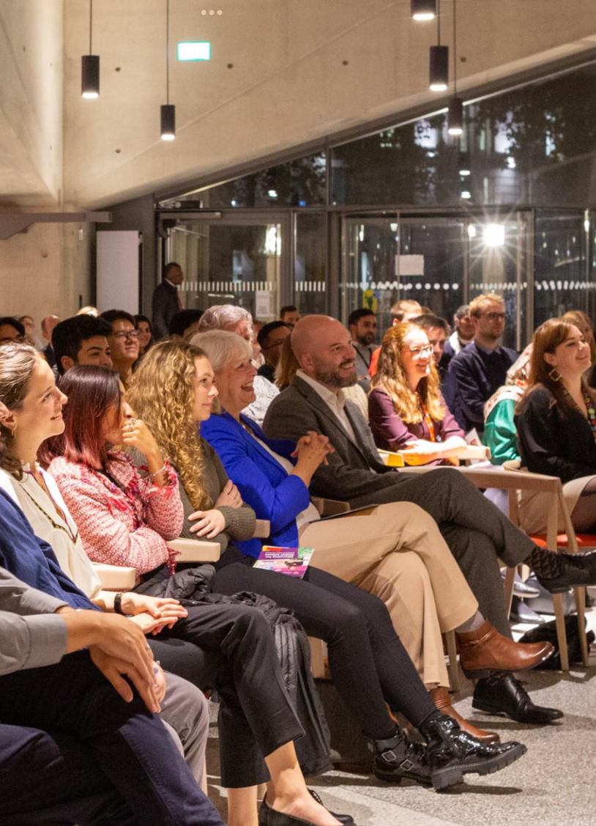
Scholarship reviewed
‘Scholarship’ signifies the principled space that connects integrity, research, teaching, learning, personal development and contribution to the world.
Scholarship enables scholars to speak, no matter who they are.
(Fung 2017, p105)

Slide 16
DISCUSSION
Strength-based scholarship and ‘good’ education:
Developing ourselves and the university
Open University
eSTEeM Conference
April 2024
Prof Dilly Fung
@DevonDilly

Slide 17
References
Boyer, E. L. (1990) Scholarship reconsidered: Priorities of the professoriate. Princeton, N.J: Carnegie Foundation for the Advancement of Teaching https://depts.washington.edu/gs630/Spring/Boyer.pdf
Fairfield, P. ed. (2011) Education, Dialogue and Hermeneutics. London: Continuum.
Fung, Dilly (2017) A Connected Curriculum for Higher Education London: UCL Press http://discovery.ucl.ac.uk/1558776/1/A-Connected-Curriculum-for-Higher-Education.pdf
Dilly Fung (2017) Strength-based scholarship and good education: The scholarship circle, Innovations in Education and Teaching International, 54:2, 101-110, DOI: 10.1080/14703297.2016.1257951
https://doi.org/10.1080/14703297.2016.1257951
Gadamer, H.-G. (2004) Truth and Method (Second, Revised ed.). (J. W. Marshall, Trans.) London and New York: Continuum.

