Slide 1
Scholarship methods and survey design
Scholarship Methods Part 1
Mark Jones / Sue Pawley
eSTEeM Directors
13 July 2023
Notes:
Mark to start

Slide 2

Aims of session
1. Thinking about quantitative and qualitative data
2. Responsible scholarship
3. Surveys
Notes:
MHJ
Download Question Lock Answer Royalty-Free Vector Graphic - Pixabay

Slide 3
Principles of research design
Research methods are split broadly into quantitative and qualitative methods
Which you choose will mostly depend on your research questions
Plus:
  your preferences and skills
  your underlying philosophy of research
Notes:
Sue take over here

Slide 4

Quantitative & Qualitative research
Quantitative research aims to test hypotheses, look at cause and effect, and make predictions - answers questions such as
How many? What? When?
Qualitative research aims to understand and interpret social phenomena and interactions - answers questions such as
Why? How?
Notes:
Download Magnifying Glass Unknown Search Royalty-Free Vector Graphic - Pixabay

Slide 5

Quantitative approaches
Attempt to explain phenomena by developing hypotheses and collecting numerical data
Can be descriptive but usually analysed through statistical methods
Tells you if there is a “difference” e.g. between conditions or groups
More ‘objective’: where variables are controlled as much as possible to eliminate interference and measure the effect of any change
Deductive reasoning: everything is known before conclusions can be drawn
Notes:
Download Evaluation Assess Investigation Royalty-Free Stock Illustration Image - Pixabay

Slide 6
Sources of quantitative data
Data sources include:
  Surveys where there are a large number of respondents and where you have asked closed questions (e.g. use of a Likert scale, multiple choice, select answers from lists)
  Observations (counts of numbers and/or coding data into numbers)
  Analytics (number of views; task time etc.)
  Secondary data (institutional data; internal reports etc.)

Slide 7
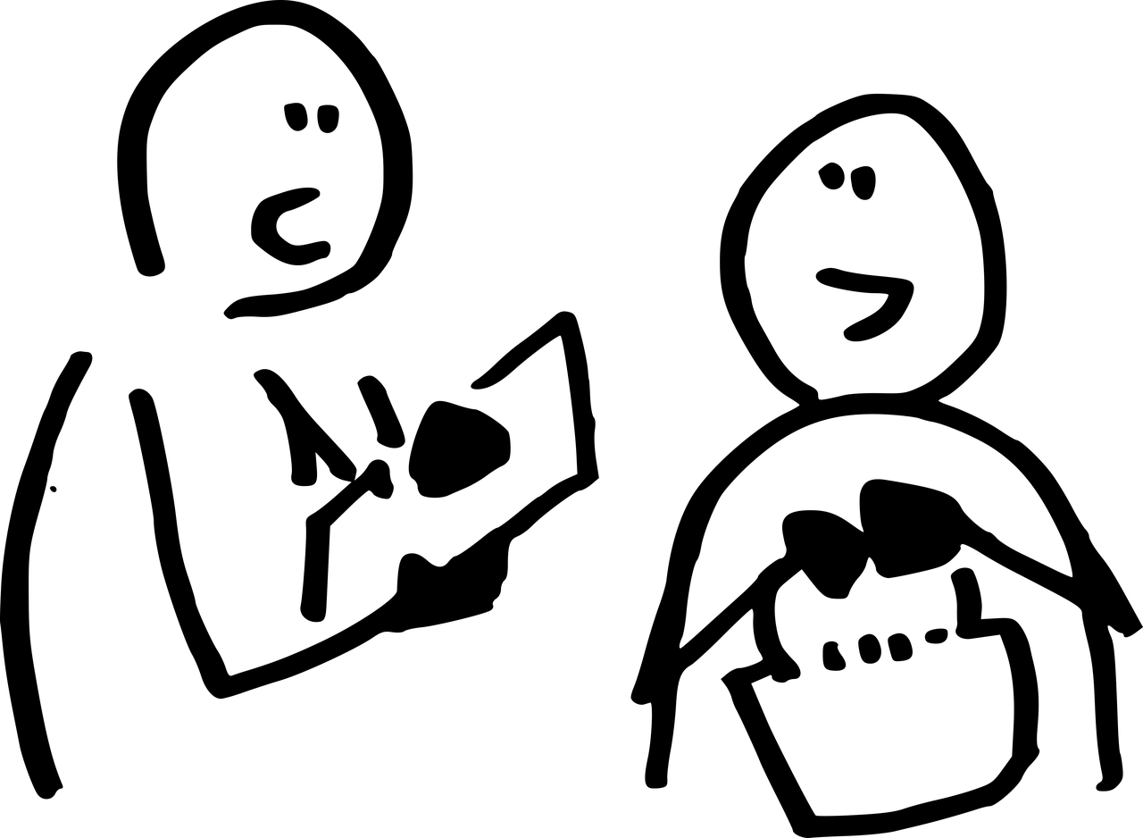
Qualitative approaches
Inform exploratory investigations
Focus on individual experience and perceptions
Reflect complexity of social phenomena
Less constrained than quantitative approaches
Can be harder to draw definitive conclusions
Often analysed using thematic methods
Notes:
Download Investigation Interview Street Royalty-Free Stock Illustration Image - Pixabay

Slide 8
Sources of qualitative data
Data sources include:
Free text responses in surveys
Interviews and focus groups (structured, semi-structured or unstructured)
Diary studies
Direct observations (face to face or online) – may also be recorded (video/audio)
Secondary data – archive data and institutional reports

Slide 9
Comparing quantitative and qualitative methods
Quantitative | Qualitative
numerical, measurable data | generally non-numerical data (words/images)
clearly stated questions, extraneous variable controls | exploratory questions, extraneous variables not controlled,
large samples | small sample size
generalisability | difficult to replicate or generalise
experiments, RCTs, large surveys, measurements/instruments, questionnaires | interviews, observations, focus groups, field notes, workshops
role of researcher: detached, non-biased | role of researcher: involved, personal beliefs influence the research
statistical analysis | interpretive and descriptive analysis
final report: comparisons of means and statistical significance of findings | final report: narrative report with contextual description &direct quotes from participants

Slide 10
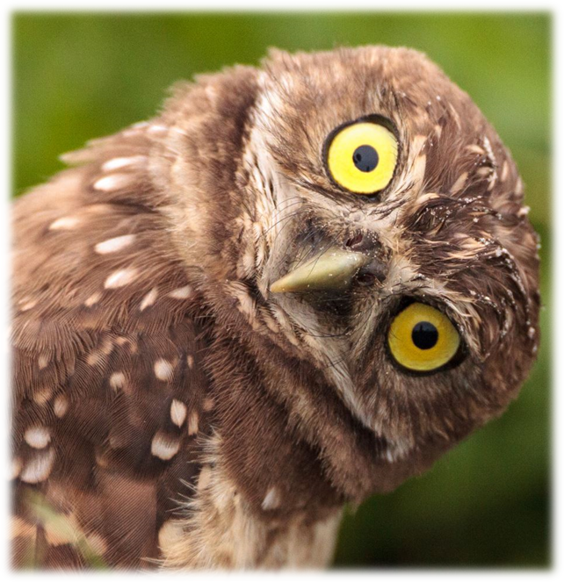
Mixed methods
In reality most SoTL projects rely on a mixed methods approach which uses both quantitative and qualitative data collection and analysis in an effort to combine the advantages of both types of data.
This allows a triangulation of evidence and methods that provide a stronger logical case in drawing conclusions

Slide 11

Responsible scholarship
By “responsible scholarship”, we mean research that:
is ethical,
protects student data, and
considers its effect on the student experience
Why is this approach important?
Notes:
MHJ to slide 11
Download Arrows Direction Way Royalty-Free Stock Illustration Image - Pixabay

Slide 12
Surveys – getting started
The surveys team can give a user account on the Jisc Online Surveys system (see Survey Guidance page)
Some other tools can be used (see Bespoke Surveys page) but you must not use anything that is not approved by Information Security.
In some cases, it may be appropriate to use Real-Time Student Feedback (VLE based tool), but it is intended to gain feedback for immediate use (see RTSF pages).

Slide 13

Surveys – SRPP and sample
Remember that all surveys of students need SRPP approval.
The Surveys team will give you advice on the student sample you have asked for but you may find that there are fewer students available in your target groups to be surveyed than you hoped – you may need a contingency for this.
Notes:
Download Man Silhouette Surveying Royalty-Free Vector Graphic - Pixabay

Slide 14
Surveys – drafting and refining questions
Your survey questions should be:
Designed to address (aspects of) your research questions
Framed in a way students will understand
Sense checked (ideally by students)
Reviewed - reflect on whether they still match what you want to know
Demographic data can be folded in:
Think about what demographic data you might want
Don’t ask for data we already hold (but ensure that SRPP are informed)
Anticipate how the data will be analysed and presented
Notes:
5 Min break here if time (by 1100)

Slide 15

The big question
The great dessert survey
Notes:
Sue – to run activity
https://pixabay.com/photos/cake-piece-plate-dessert-pastry-1971552/

Slide 16
Activity – the great dessert survey
Research question: What is the most popular dessert?
Your task – design a survey (a set of questions) to address this
Also consider:
Who are you going to survey?
When will you run the survey?
Is it helpful to collect demographic information?
How do you intend to analyse the data that your questions acquire?
Who are you going to tell about this?
Discuss in breakout rooms – report back on decisions and how you reached them
Notes:
Sue
30 mins for activity (20 mins breakout + 10 mins)

Slide 17
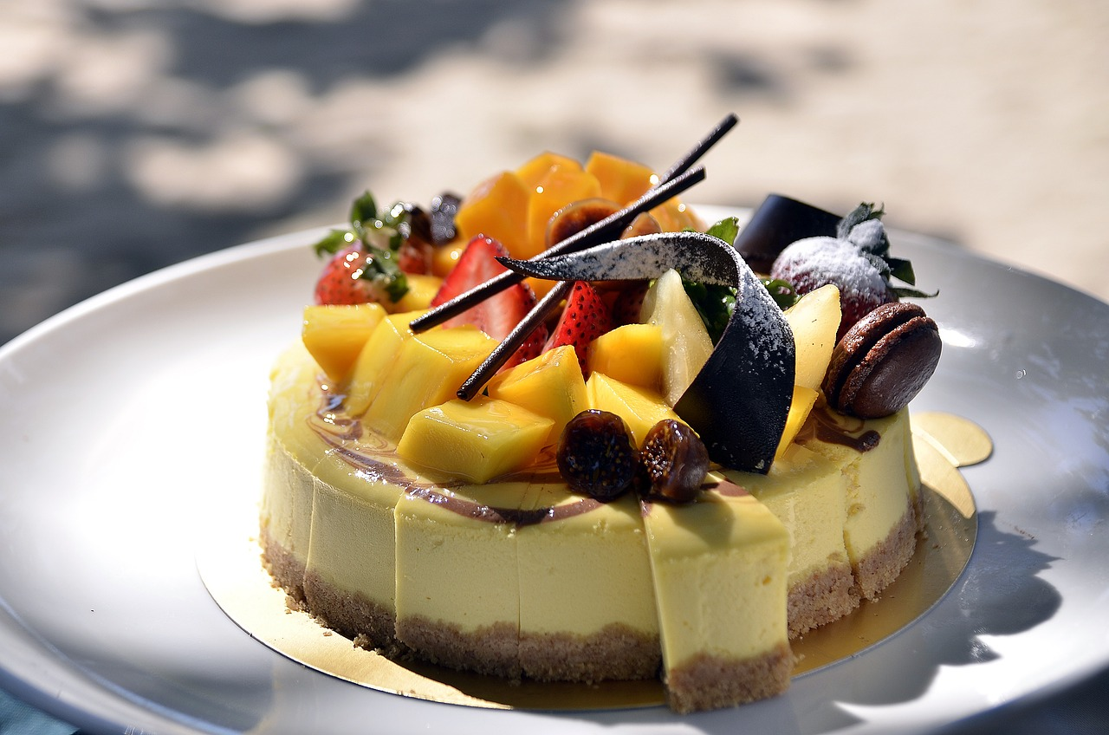

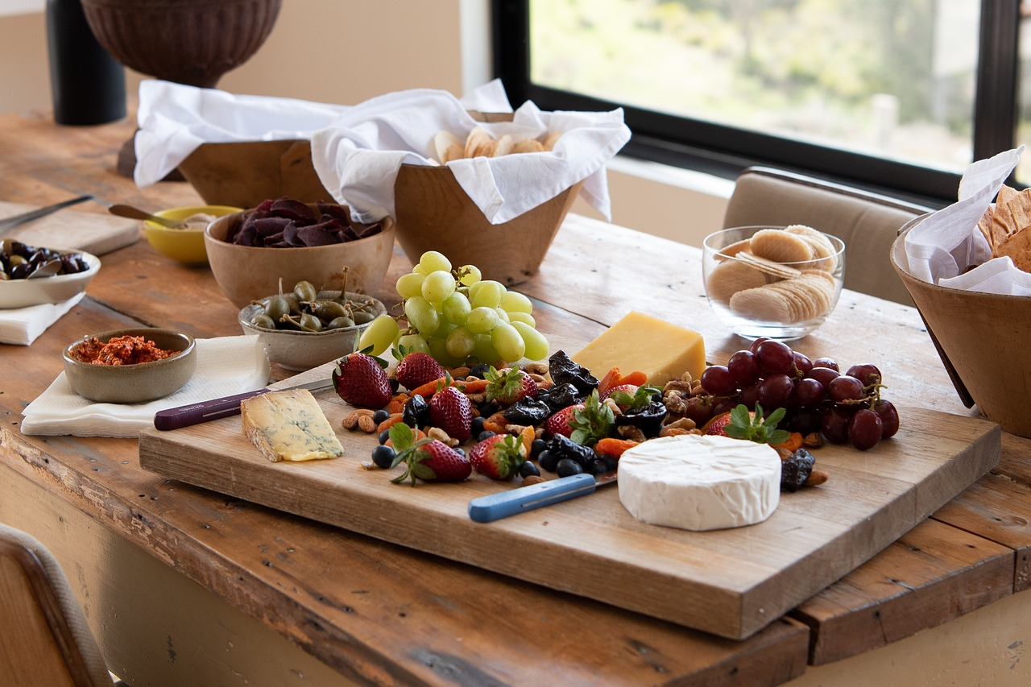


Activity – the great dessert survey
Research question: What is the most popular dessert?
Reporting back
Notes:
30 mins for activity (20 mins breakout + 10 mins)
Cake Torte Dessert - Free photo on Pixabay – Pixabay
Creme Brulee Dessert Flan - Free photo on Pixabay – Pixabay
Bowl Ice Cream - Free photo on Pixabay – Pixabay
Strawberries Strawberry Tart - Free photo on Pixabay – Pixabay
Fruit Salad Raw Food - Free photo on Pixabay – Pixabay
Cheese Fruit Platter - Free photo on Pixabay - Pixabay

Slide 18
JISC Survey tool – demo
A quick look at JISC Online Surveys
https://admin.onlinesurveys.ac.uk/accounts/login/
Demo of some question types
Free text
Multiple choice
Scoring
Branching
Using the first page for information and consent
Questionnaire Consent for Student Surveys (open.ac.uk)
Notes:
MHJ – 15 mins

Slide 19
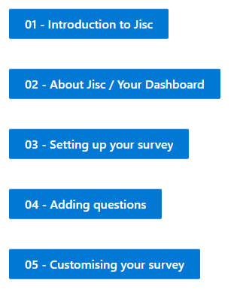
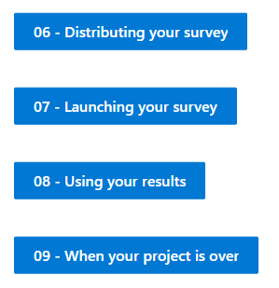
JISC Survey tool – resources
Training resources
A set of videos on Survey Guidance page

Slide 20

Surveys – hints and tips
Think about
Invitations and reminders
How long your survey will be open for
Timing your survey around module activities
Student demographics – sample selection and integrating demographic data
Length of survey – number of questions
Conditionality of routing through your questions
Balance of question types – closed and open
Types of closed question - variety while still retaining clarity!
If you want to follow up respondents for interviews/focus groups ask for consent and email addresses in your survey
Getting your survey checked before it is released
Also remember the SoTL in STEM badged open course!
Notes:
30 mins for activity (20 mins breakout + 10 mins)
Download Checklist Lists Business Royalty-Free Vector Graphic - Pixabay

Slide 21






Student barriers to engagement (SRPP workshop)
 | Student Barrier to engagement | Problem(s) to solve | What could we try? | Why do we think it might work?
 | “I’ve got too many emails, I’m not going to read that invitation to a survey!” | We know that our students receive a lot of communications: how can we cut through the noise? | Expert review of our communications, creation of ‘known good’ templates for impactful subject lines and email content through thorough testing. | Students have told us they filter their communications carefully and on occasion only open emails from the OU that appear to be directly related to their study. There is evidence that bold subject lines work better.
 | “There’s no point spending my time on this!” | The value of engaging isn’t clear. | Improve awareness of actions taken in response to feedback. | Students are more likely to spend their time engaging with feedback if they can see it will make a difference. (Student Voice focus groups, 2022)
 | “This is going to take forever to do!” | Surveys are too long, or aren’t relevant. | Work to reduce the length of surveys – use critical, relevant questions only. Cut out ‘nice to know’ and make every item worthwhile. | c.10 mins is long enough, but with other measures to support, can be longer. Younger students in particular likely to favour shorter
 | “What’s in it for me?” | Time spent engaging with research doesn’t feel rewarding enough to prioritise over study time. | Offering incentives to students to encourage them to take part. | March 23 Brand Tracker wave is trialling an incentive for completion: record response numbers throughout fieldwork.
 | “I didn’t even know there was a survey!” | Emails can get missed, or arrive at the wrong time. | Explore new options for technology enhancements that present key surveys as part of the module. | Surveys advertised on the VLE do well: (NSS VLE Flag pilot: 55% vs 34% RR, Microcredential surveys 18-20% RR, RTSF surveys average 20-70% RR)

Slide 22
Slide Title 30
Questions

