Slide 1

Intro Slide Title 1
Responsible scholarship and gaining approvals for your project
Mark Jones and Sue Pawley
Wednesday 31st May 2023, 14.00-15.30
esteem@open.ac.uk www.open.ac.uk/esteem
Please note: This session will be recorded

Slide 2
Session Plan
Today’s session will cover…
Welcome and introductions
OU’s commitment to standards
Project workflow
Data management
Approval processes
Questions and next steps

Slide 3
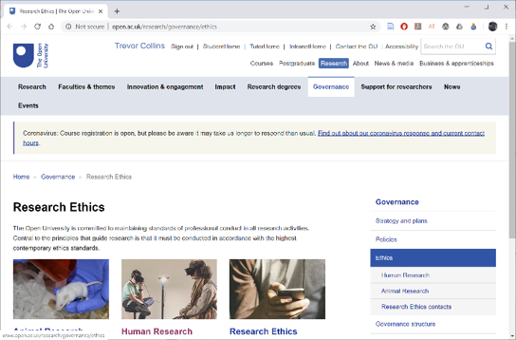
Slide Title 26
OU commitment
“The Open University is committed to maintaining standards of professional conduct in all research activities. Central to the principles that guide research is that it must be conducted in accordance with the highest contemporary ethics standards.”
ACTIVITY
Why is an ethical approach important?
What sort of research for scholarship could be unethical?
http://www.open.ac.uk/research/governance/ethics

Slide 4
Slide Title 26
OU commitment
“The Open University is committed to maintaining standards of professional conduct in all research activities. Central to the principles that guide research is that it must be conducted in accordance with the highest contemporary ethics standards.”
…and is a requirement from funders, publishers, and insurers
http://www.open.ac.uk/research/governance/ethics

Slide 5

Slide Title 26
Contemporary ethics standards
British Psychological Society (BPS)
BPS Code of Human Research Ethics | BPS - British Psychological Society
British Psychological Society gives four ethical principles:
  Respect for the autonomy, privacy and dignity of individuals, groups and communities
  Scientific integrity
  Social responsibility
  Maximising benefit and minimising harm
https://www.bps.org.uk/news-and-policy/
ethics-guidelines-internet-mediated-research

Slide 6

Slide Title 26
Further considerations (BPS)
Valid consent: “Researchers should ensure that every person from whom data are gathered for the purposes of research consents freely and voluntarily to participation, having been given sufficient information to enable then to make an informed choice. …” (BPS 2021, page 12)
Risk: “Risk can be defined as the potential physical or psychological harm, discomfort or stress to human participants that a research project may generate. …” (BPS 2021, page 10)
Confidentiality: “Subject to the requirements of legislation, including the Data Protection Act (2018), information obtained from and about a participant during an investigation is confidential unless otherwise agreed in advance.” (BPS 2021, page 21)
Research with individuals in a dependent or unequal relationship: “Researchers should be particularly diligent in establishing the valid consent of any person who is in a dependent or unequal relationship to them (e.g. student or client) because of the increased risk of consent being given under perceived coercion or obligation.” (BPS 2021, page 24)

Slide 7
Slide Title 26
Project workflow
Research design
Data management planning
Approvals
  Data Protection (GDPR)
  Human Research Ethics Committee (HREC)
  Student Research Project Panel (SRPP)
  Staff Survey Project Panel (SSPP)
Data collection
Data storage
Data deletion/anonymisation/archiving

Slide 8

Slide Title 26
Research design
Work out what you are going to do before seeking approval to do it
  What has been done before in your area that you can build on?
  What new data do you need to collect for your study?
  How will you go about collecting, analysing and presenting the data?
  How will you manage participants’ anonymity/identity?

Slide 9
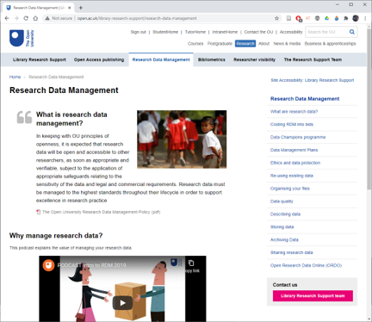
Slide Title 26
Data management planning
Think through what data you need to collect and how you will look after it
  What data do you need to collect?
  Do you have to store any personal data?
  How will you store the data securely?
  Would the data be of use to anyone else?
  When will the data no longer be needed?
More info
  OU Research Data Management Policy
  Library Research Data Management pages
  Data storage for OU research projects comparison table PDF | Word
Notes:
Library pages – recommend RDM Handbook

Slide 10
Slide Title 26
Approval processes
Approvals for…
  Data protection: General Data Protection Regulations (GDPR)
  Ethical research: Human Research Ethics Committee (HREC)
  Access to OU students: Student Research Project Panel (SRPP)
  Access to OU staff: Staff Survey Project Panel (SSPP)
Keep a record of your approvals and include in eSTEeM final report
  Data protection registration number
  HREC reference number
  SRPP application number
Recommendation
  Use the HREC templates (consent form, information sheet and invitation email)

Slide 11

Navigating the processes and approvals related to carrying out educational research with students at the Open University can be a challenge!
This 'Landing Page' will provide you with a clear road map for the journey, signposting the elements that may be relevant to you and your research and offering the links you will need to access them.​​​​​​​
The Researchers Journey Landing Page

Slide 12
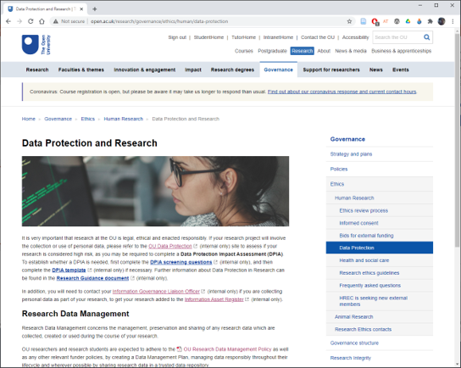
Slide Title 26
Data protection
Legal frameworks
  Freedom of Information Act 2000
  Data Protection Act 2018
  General Data Protection Regulations (GDPR)
http://www.open.ac.uk/research/governance/ethics/human/data-protection

Slide 13
Slide Title 26
Data protection
Data Protection by Design (sharepoint.com)
Complete a Data Protection Questionnaire​
  Do this as early as possible when considering your changes - you can answer "don't know yet" to questions, which will prompt that you need to clarify the answers before you start your new processing
  Send all questionnaires to data-protection@open.ac.uk, either when they are completed, or as soon as you have had an initial attempt at completing them. Please also request a discussion if you'd find that helpful.
  If your questionnaire indicates that it requires an impact and risk assessment by the information rights team, then don't start your processing until this has been completed
  The Questionnaire is an iterative process, and can be refined as you find out answers, and updated if your project or scope changes
  When you have made decisions about how your data is going to be processed, complete or update an Information Asset Register entry

Slide 14
Slide Title 26
Data protection
Will you collect any new personal data or significantly change the way you process personal data?
  If Yes, then the University needs to adjust its records to include the new data and process
  Complete the Data Protection Impact Assessment (DPIA) screening questions to check if you need to complete the DPIA template
  If yes to any of the screening questions then complete the DPIA template
IMPORTANT: Email data-protection@open.ac.uk your completed screening questions and/or DPIA template for review and the issuing of a data protection registration number (needed for the SRPP form)
More info: Research Guidance

Slide 15
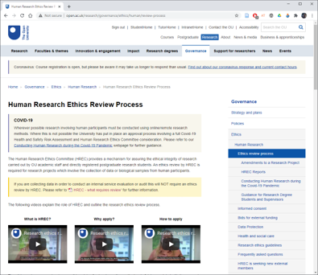
Slide Title 26
Human Research Ethics Committee (HREC)
Research involving data collection from human participants requires ethics review by HREC unless exempt.
  Check flowchart for exemption.
  Complete the HREC Project Registration and Risk Checklist plus documentation related to your project (e.g. consent form, participant information sheet, or questionnaire; response 7 days)
  If required, complete HREC application form plus docs (response up to 3 weeks)
http://www.open.ac.uk/research/governance
/ethics/human/review-process
Email: Research-REC-Review@open.ac.uk
Notes:
http://www.open.ac.uk/research/governance/ethics/human/review-process

Slide 16
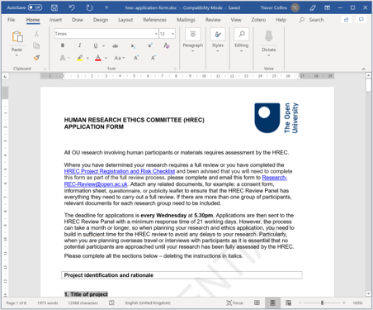
Slide Title 26
Activity – Check the ethics for your project
Checklist activity
  For your project (or future project)
  Review and answer the Higher Risk, Lower Risk and Health Research Authority questions
Walkthrough the HREC form
  Abstract (max 200 words)
  Methodology
  Recruitment procedures
  Risk of harm
  Benefits and knowledge transfer
Questions / comments
http://www.open.ac.uk/research/governance
/ethics/human/review-process
Email: Research-REC-Review@open.ac.uk
Notes:
http://www.open.ac.uk/research/governance/ethics/human/review-process

Slide 17
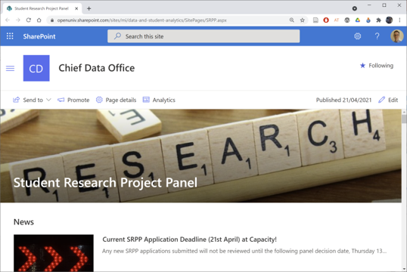
Slide Title 26
SRPP: Student Research Project Panel
https://openuniv.sharepoint.com/sites/mi/chief-data-office/SitePages/SRPP.aspx
Any research which involves making contact with current students, alumni or enquirers needs to be approved by SRPP
  Check out the examples when drafting your application
SRPP reviews applications fortnightly (allow three weeks for a response)
  Submission by 4pm Wednesday, decision following Thursday (workload dependant)
Notes:
https://openuniv.sharepoint.com/sites/mi/data-and-student-analytics/SitePages/SRPP.aspx

Slide 18
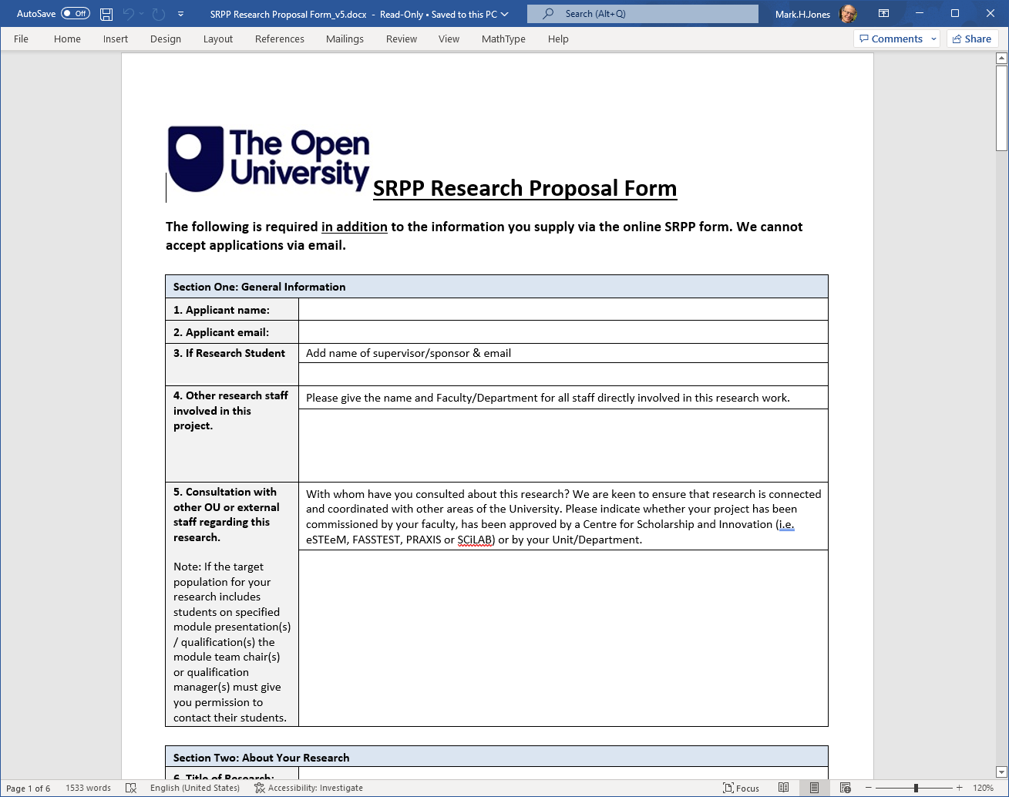
Slide Title 26
Activity – SRPP Research Proposal form
Take 10 mins to look at the form and think how to fill it out for your project. Think about re-using parts of your eSTEeM proposal for this!
10 mins further discussion and questions.
Notes:
In pairs or threes: discuss and critique this (random) example ~ 15 minutes
Plenary feedback: discuss critiques ~ 15 minutes

Slide 19
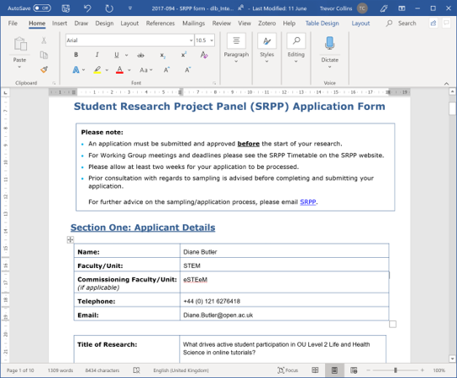
Slide Title 26
Activity – Reviewing an example
CRITERIA | EVALUATION
Working group member
Rationale and approach
Questionnaire / interview schedule
Invitation
Sample / demographics
Approve / Reject
http://bit.ly/srpp-db-2017
Notes:
In pairs or threes: discuss and critique this (random) example ~ 15 minutes
Plenary feedback: discuss critiques ~ 15 minutes

Slide 20
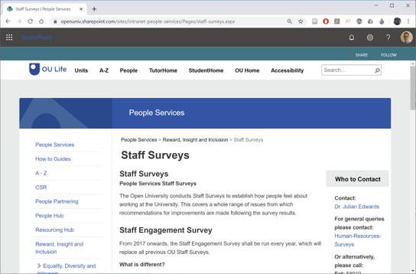
Slide Title 26
SSPP: Staff Survey Project Panel
https://openuniv.sharepoint.com/sites/intranet-people-services/Pages/staff-surveys.aspx
Email: Julian.Edwards@open.ac.uk
Who needs to apply?
  “Small-scale surveys that require less than 30 responses from staff do not need approval from the SSPP” (SSPP guidelines)
  For example: Surveying 30 or more associate lecturers
Notes:
https://openuniv.sharepoint.com/sites/intranet-people-services/Pages/staff-surveys.aspx

Slide 21
Slide Title 30
Any questions?

Slide 22
Slide Title 30
Thank you for attending

Slide 23
Slide Title 31

