Slide 1
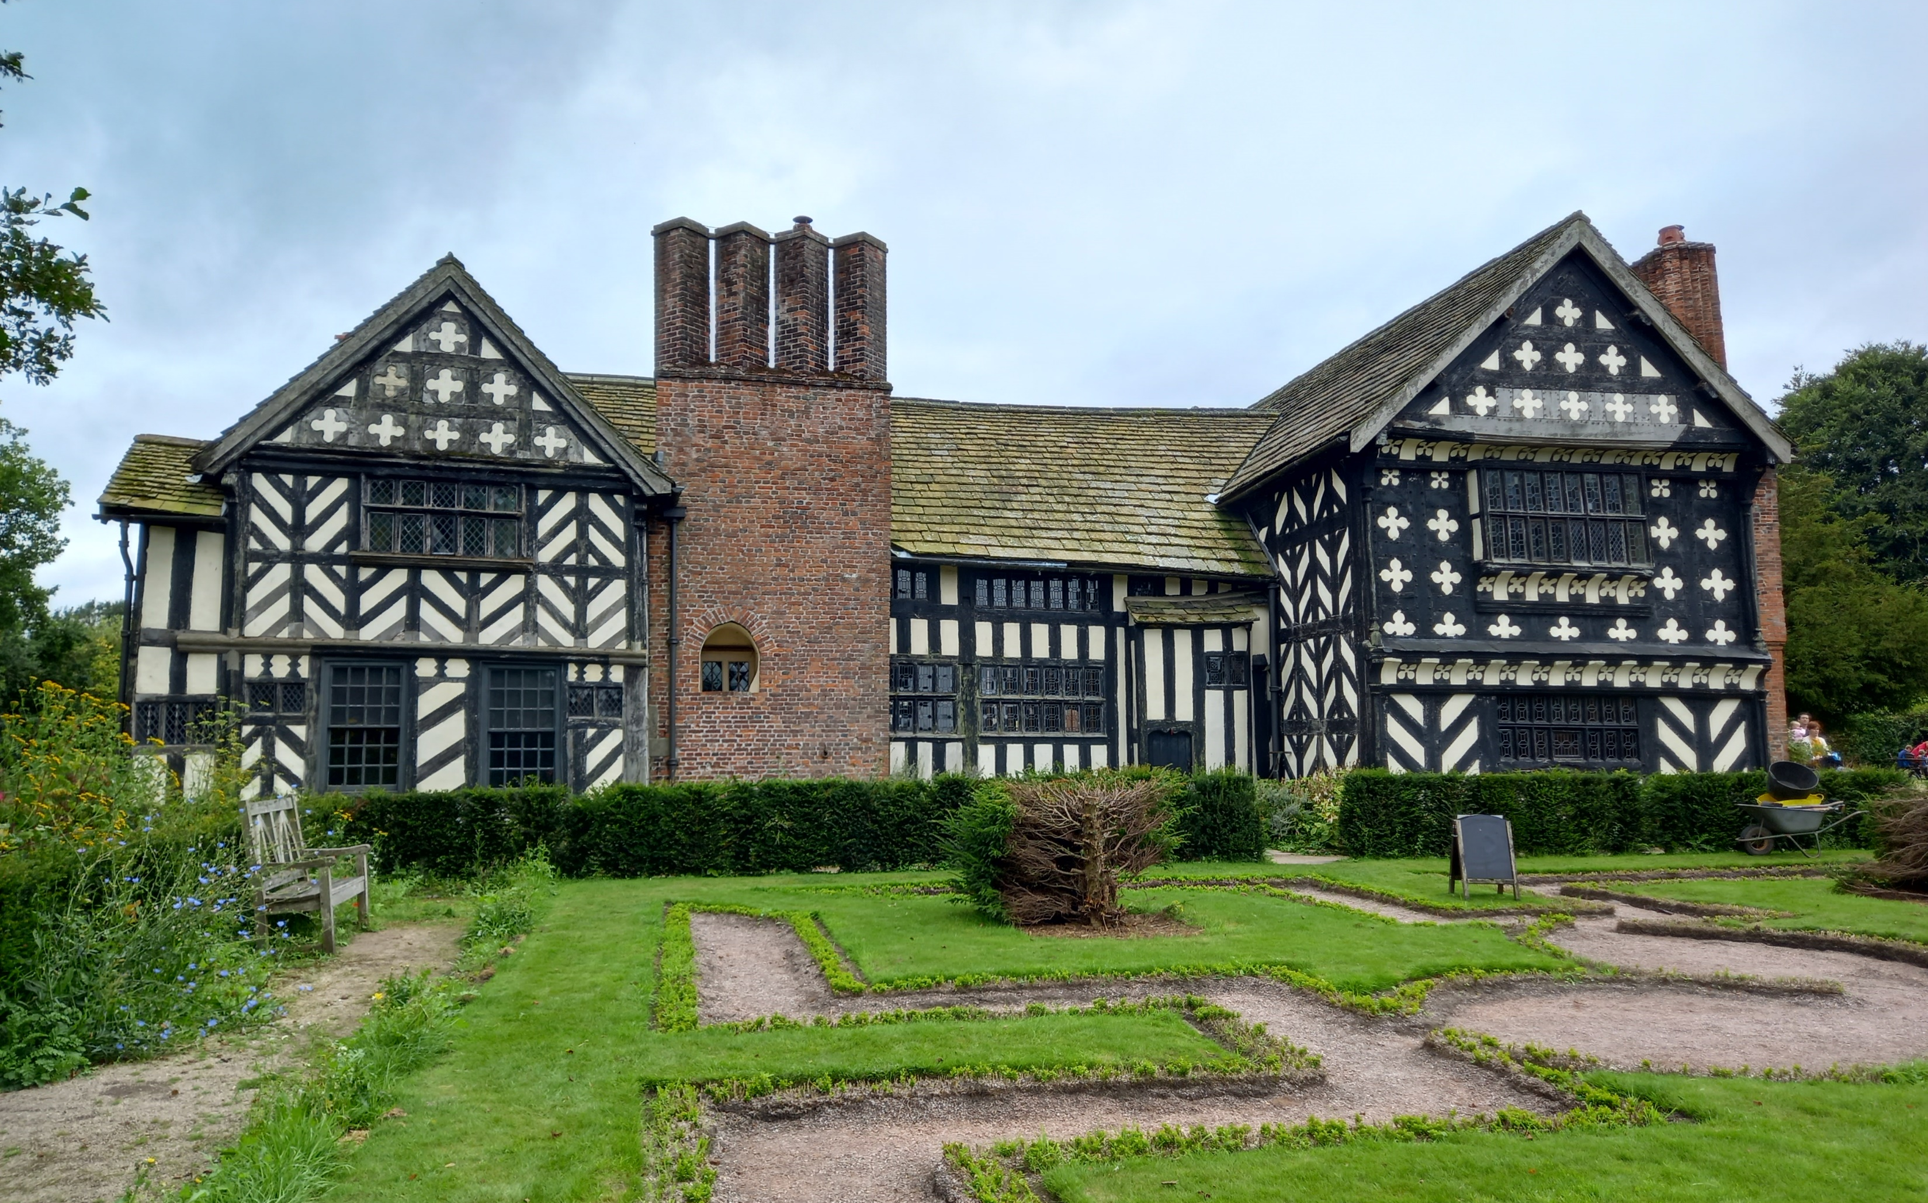
Intro Slide Title 1
Rehearsing with the Mechanicals
convenience and conventions in distance learning group work
Silvia Varagnolo, Fiona Gleed, Jo Smedley
Alice Moncaster and Hedieh Jazaeri
Engineering and Innovation
20/04/2023

Slide 2
Slide Title 7
Contents
eSTEeM project
Team task
Reflection and discussion
01
02
03

Slide 3
Slide Title 2
eSTEeM project
Context
Research method
A
B
Improving and evaluating inclusivity in group project work for distance-learning engineering students

Slide 4

Slide Title 17
A - Context
Inclusivity in:
Group project work
Distance-learning setting
Engineering
T176: 1st year Engineering module moved to distance group project because of Covid
T276: 2nd year Engineering module moved to distance group project because of Covid
T229: 2nd year Engineering module designed as distance group project from the beginning
Goal
To write guidance on producing and delivering inclusive group projects

Slide 5




Slide Title 17
B – Research method
Literature review
Survey to students
Survey to Associate Lecturers
Interviews of students through MS Teams
Interviews of Associate Lecturer through MS Teams
Data analysis

Slide 6

Slide Title 17
B – Research method
B – Research method

Slide 7
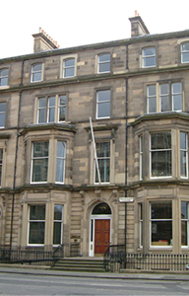
Slide Title 3
Team task
Improving the energy efficiency of an Edinburgh tenement
02

Slide 8
Slide Title 8
Technical task
Complete an energy check and recommend improvements
Scenario
Property details
Tenant is keen to stay warm and minimise bills
Drumsheugh Gardens EH3 7QJ
Tenement
Mid floor
2 sides exposed
2 bedrooms
3 habitable rooms
Built before 1919
Stone wall
Modern gas system

Slide 9
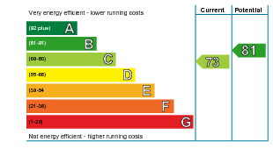
Slide Title 8
Context
Advising a prospective tenant
2019 assessment
Cost breakdown
Energy efficiency band C
Above average for Scotland
Energy use and efficiency measures
Heating, hot water, lighting, ventilation
Estimated cost for 3 years £1,632
Potential savings £ 519
Recommended measures
Wall insulation £4,000-£14,000
  Saving £384 over 3 years
Condensing boiler £2,200-£3,000
  Saving £135 over 3 years

Slide 10
Getting started …
Process
Tenements
Home Energy Scotland HUB (est.org.uk)
Background information
use postcode EH3 7QJ (OU Scotland)
select an address
provide contact details
PLEASE DON’T REQUEST INFO BY POST!
Skip entering actual bills
A type of apartment common in Scotland
Defined in Tenements (Scotland) Act 2004
Usually 2 to 5 storeys
Separate flats, divided horizontally
  e.g. 2/1 is floor 2 flat 1
May have shop units on ground floor
Communal entrance and circulation spaces
Load-bearing masonry or structural frame

Slide 11
Reporting and recommending
Energy estimates
Outputs
Team deliverables
and discussion points
Making your recommendation
Note the figures for gas + electric
  transcribe or screenshot
  How do costs compare to 2019 assessment?
Review energy saving plans
  Are the suggestions realistic?
Investigate options
  What are the benefits and disadvantages?
  How do the return periods compare?
Client
  New tenant, also starting a new job
Contents
  Suggest two actions
  Justify the suggestions
  State the budget
  Quantify the saving
Format
  1 page A4

Slide 12
Logistics
Tasks and timings
Team roles
Agenda
Allocate within your group:
15 minutes to:
Time keeper
Chair
Note taker
Reporter
Investigator
Introductions
Allocate roles
Review brief
Input data at Home Energy Scotland HUB
Investigate options
Agree recommendations
Capture to present

Slide 13
Making teamwork work
Preparation
Tips for the task
Tips for the team
Plan your work
Understand and respect each other
Annotate information provided
Communicate progress
No single answer
Remember you have a shared goal
Don’t waste time deliberating over the roles
But do build relationships

Slide 14





Feedback
What were your experiences today?
Online form
https://forms.office.com/e/PN7wjDaT1G
Exploring individual reflections
Thinking about the task today
Moving forward

Slide 15
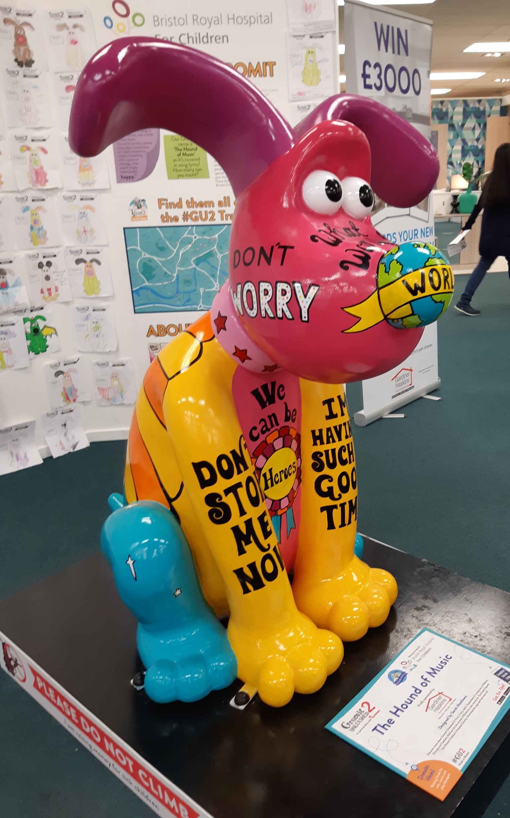
Slide Title 4
Reflection and discussion
Sharing of feedback and guidelines
03

Slide 16
Making teamwork work
Preparation
Team Organisation
Task
Plan meetings early on and well in advance.
Show enthusiasm and engage fully with your team members.
Dedicate some time to relationship building.
Make sure you fully understand how your equipment works and its limitations.
Make sure you understand the activity instructions.
Set clear tasks and deadlines
Reporting
Find a suitable system to manage all your project files and collaborative work.
Download activity instructions well in advance and annotate them.
Communication
Agree a communication method that suits everyone early on.

Slide 17
Making teamwork work
During the activity
Team Organisation
Task
Everyone is working towards the same goal and most people are reasonable and rational.
Don’t waste time deliberating over the roles.
Everyone can help each other to understand the project so support each other.
Reporting
Make sure you know who is doing what in the activity and communicate progress with your team
Communication
Be inclusive.
Don’t stress

Slide 18
Making teamwork work
Full Guidelines cover
Activity design
Contingency plans
Definition of the task
Assessment
Communication tools
Tuition strategy

Slide 19
Slide Title 8
Rehearsing with the Mechanicals:
convenience and conventions in distance learning group work
Key findings and future directions
Projects and teamwork are
important for employability
  particularly in Engineering and Design
challenging to design for distance-learning students, particularly with
  diverse environments and characteristics
  differing experience and availability
enablers of diversity
  addressing awarding gap
  experience of inclusion

Slide 20
Slide Title 30
Thank you

Slide 21
Slide Title 31

