Slide 1
Online tutorials: addressing the challenges of active student participation
A pan-university scholarship project
Team members
STEM: Karen Kear, Helen Donelan, Jon Rosewell
FASS: Paige Cuffe, Tracey Elder
FBL: Allan Mooney, Kevin Amor, Carol Edwards
WELS: Kieron Sheehy, Ale Okada
eSTEeM conference 2023

Slide 2
SYNCHRONOUS ONLINE LEARNING
Online synchronous tutorials, using Adobe Connect, are an important part of our teaching.
However, there is often a lack of active participation by students.
Our project addressed the following research questions:
What are the factors affecting active student participation in online tutorials?
To what extent do the challenges of active student participation vary across faculties?
How can these challenges be addressed?

Slide 3
RESEARCH METHODS
Two large-scale surveys - of students and of tutors
  Included 18 modules covering all four faculties
  Similar questions in both surveys
  620 students responded (8% response rate)
  197 tutors responded (22% response rate)
  Quantitative and qualitative data
Focus groups - with students and with tutors
  14 online focus groups
  Covered (separately) all four faculties
Questions (in focus groups and surveys) about topics such as …
  What sort of activities are included in online tutorials?
  Do students actively participate?
  If they don’t, why is this?

Slide 4
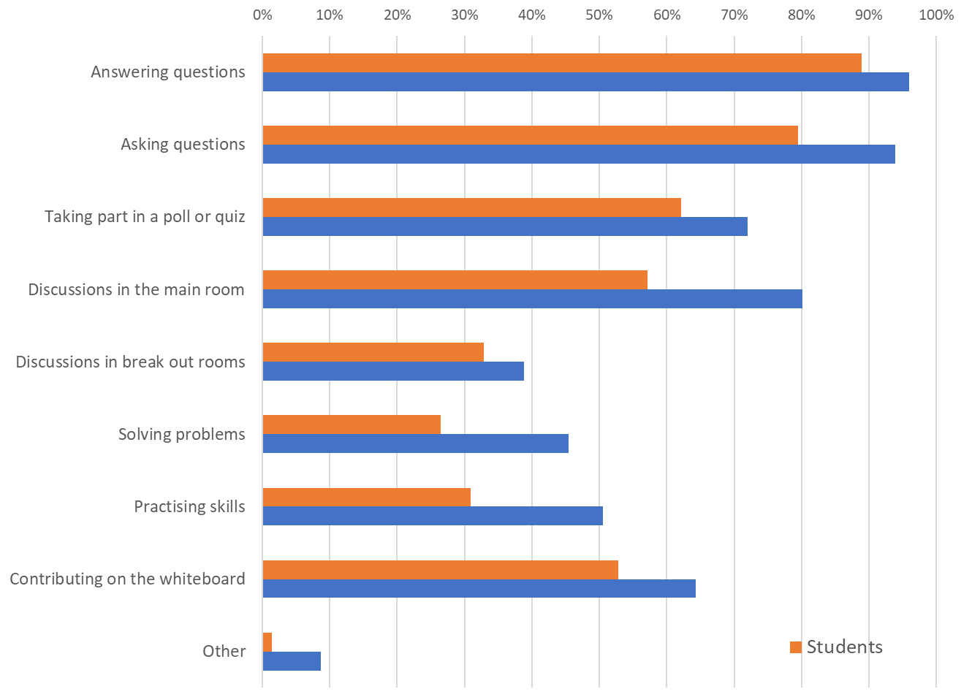

FINDINGS : Activities in online tutorials

Slide 5
FINDINGS : Text chat versus speaking
[from a student] “I’m a nervous speaker however there’s no pressure and often when I use the chat box my comment is addressed which is good confidence boost.”

Slide 6
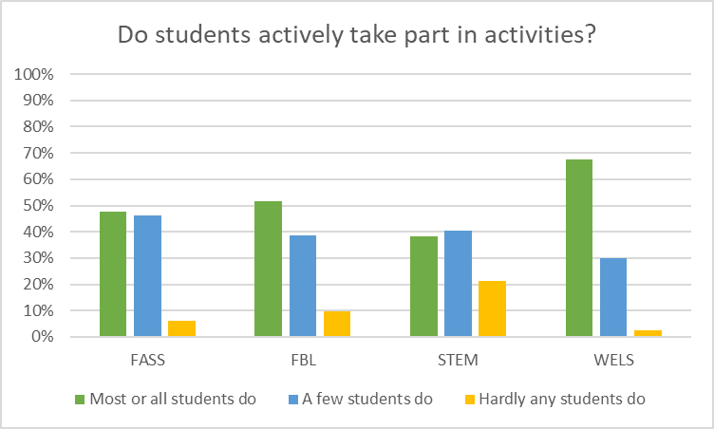
FINDINGS : Engagement across faculties
Tutor responses across faculties to …

Slide 7
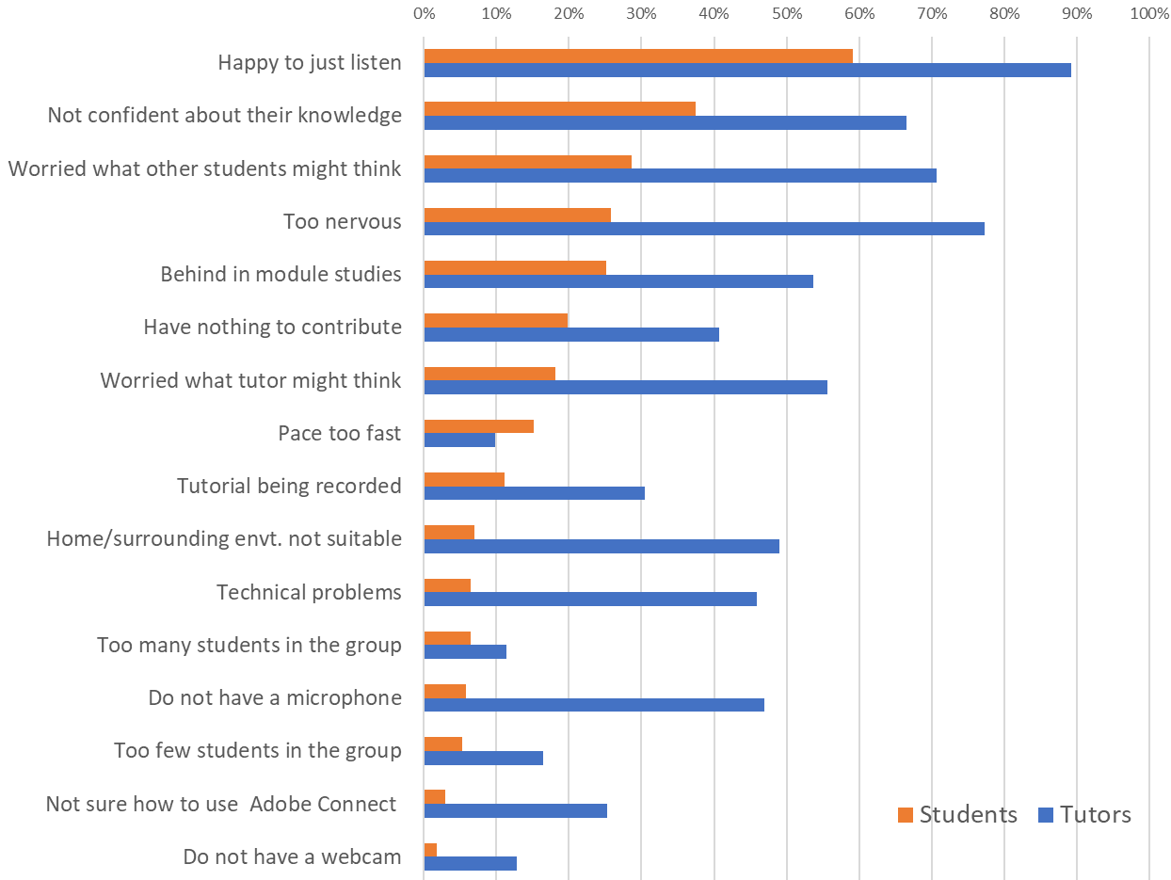
FINDINGS : Reasons for not participating actively
Notes:
Six of the top seven reasons all concern a lack of confidence
Includes ‘Too nervous’, ‘Worried what other students might think’ , ‘Worried what the tutor might think’, ‘Not confident about knowledge of module materials’ and ’Behind in module studies’.
Agreement between students and tutors on the significance of these in comparison to the other options.

Slide 8
FINDINGS : Lack of confidence about active participation
[from a student] ‘For me personally, it's confidence. I always feel as though I'm going to make myself look stupid with what I might want to say.’

Slide 9
FINDINGS : Passive attendance versus active participation
[From a student] “I'm more of a listener than a talker and I prefer to take in what everyone else contributes than to miss something thinking about what I might contribute”
Should we expect all students to actively participate?
Are there benefits to attending even without participating?
[From a tutor] “I say it's fine to listen without actively participating and that I don't put people on the spot.”

Slide 10
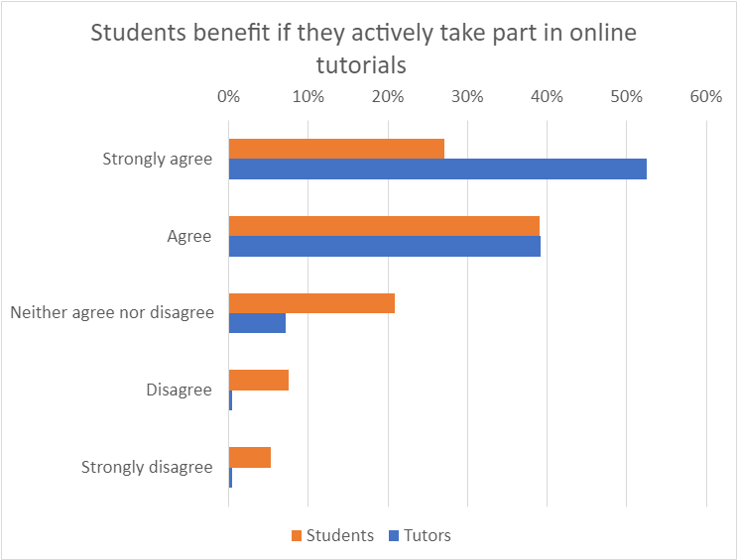
FINDINGS : Benefits of active participation
[From a student] “More encouragement for anxious students to voice opinions”

Slide 11
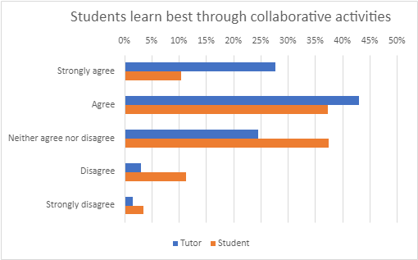
FINDINGS : Beliefs about learning
[From a student] “it is important to participate actively, especially in terms of asking questions … sometimes the other students ask questions that I haven't even thought about”

Slide 12
INTERPRETING THE DATA
Student participation in activities
  Many students enjoy participating, and think it is beneficial.
  But some students find it stressful.
Reasons for not actively participating
  Students may not be confident in their knowledge or may be behind in the module.
  They may be worried about what other students, or the tutor, might think of them.
  Many are happy just to watch and listen.
Tutors’ perspectives
  Tutors think interaction is helpful for students and for tutors.
  Tutors understand the limitations of online interaction, and the benefits to students of anonymous participation.

Slide 13
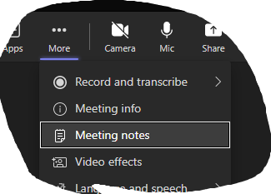
Breakout Session 1 (15 minutes)
Discuss in your group (table/breakout room) how you feel interacting online in different situations (meetings, webinars, workshops, tutorials…).
  What empowers/prevents you from contributing actively?
  What tools do you prefer to use? For example, do you use your webcam?
  How confident do you feel in online events?
  Do you think students face similar enablers/barriers to participation?
  Suggestion:
  One person to lead on one question for 3 minutes
  Then swap to another person and another question
  Please make notes on dialogue sheets (table) or meeting notes (breakouts).

Slide 14
Breakout Session 2 (15 minutes)
Drawing on your experiences in online events, share in your group:
What good practices have led to an interactive and useful session?
How can these techniques be used in OU online tutorials?
What can be done to reduce anxiety, boost confidence, and encourage participation?
What support would tutors and students need?
Suggestion:
One person to lead on one question for 3 minutes
Then swap to another person and another question
Please make notes on dialogue sheets (table) or meeting notes (breakouts).

Slide 15
Plenary
What can we do to support students? tutors? module teams?
What practices need to change? How can this be achieved?
What policies need to change? Who are the stakeholders?
How can change be achieved?

Slide 16
THANK YOU karen.kear@open.ac.uk helen.donelan@open.ac.uk jon.rosewell@open.ac.uk

