Slide 1

Intro Slide Title 2
Evaluation of a programme of employability-focussed workshops run in summer 2022 for biology students
eSTEeM conference
19-20th April 2023
Janet Haresnape
School of Life, Health and Chemical Sciences, LHCS Employability Lead
Ruth Gilbert
LHCS AL

Slide 2
Slide Title 8
Employability-focussed workshops for biology students – a pilot in summer 2022
Why did we decide to run these?
A previous eSTEeM project on practical skills progression and employability (Haresnape, 2022) revealed that many students don’t realise:
- The employability benefits of engaging with practical investigations
- They are gaining crucial skills by engaging in practical work
To fill the gap between 21J and 22J presentations – keep keen students engaged
To help students feel a sense of community
Additional tutorials (outside the core tuition strategy) had been run by several modules in 21J (e.g. S295, SK320) and it was clear that these would be of wider interest beyond just one module.
We had ALs with spare pre-paid FTE which needed to be used by October 2022

Slide 3
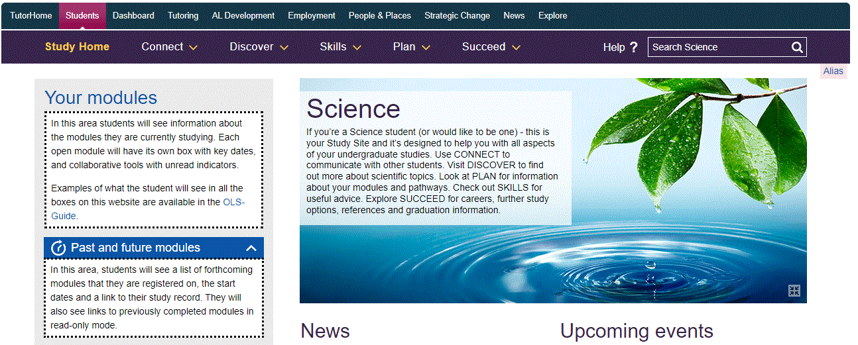
Slide Title 8
Employability-focussed workshops for biology students
Therefore we ran a series of workshops for students in June and July 2022, funded by the Board of Studies.
Eleven workshops, in an AC room on Science Study site
Most run by LHCS ALs – plus one by an LHCS lecturer
One AL (Ruth Gilbert) coordinated the programme
- Contacted facilitators to arrange times
- Put together the programme
- Advertised the programme on module forums
- Introduced the facilitator at each session, and welcomed the students
- Posted a link to a feedback questionnaire at the end of each session
- Collated the feedback at the end of the summer

Slide 4

Slide Title 8
Employability-focussed workshops for biology students
Students were invited by CAMEL email, plus posts on module forums
Initially just invited Level 3 biology students (1446 students)
Later extended to all Level 2 + 3 biology & health students (2750 students)
Average attendance was 10-15 students per workshop
149 different students either attended or accessed recording of at least one workshop
The workshops focussed on a variety of biology-related jobs, giving first hand knowledge of what the job was like and the particular skills required (e.g. field-based jobs, lab-based jobs, working in bioinformatics)
Most popular sessions were those on HIV, Foodborne diseases, Communication skills, Surviving life as a field biologist, and Bioinformatics

Slide 5
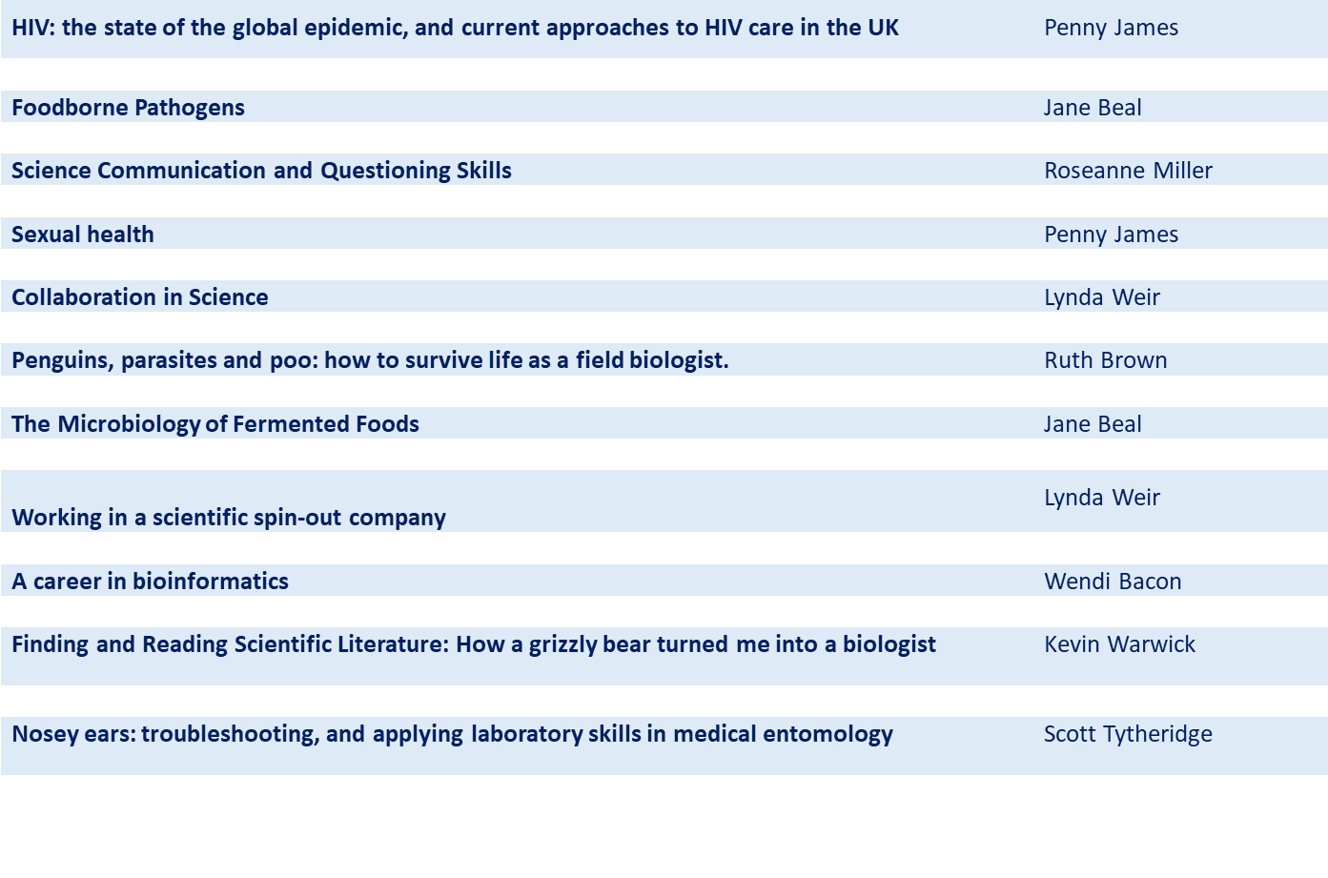
Slide Title 8
Employability focussed workshops – titles and presenters
Notes:
Title was key – popular sessions were those on ‘Penguins, parasites and poo’, and ‘How a grizzly bear turned me into a biologist’, and ‘A career in bioinformatics’.
In contrast, not many students knew what a ‘scientific spin-out company’ was – this was less well attended.
Finding and reading scientific literature – it was suggested that all Level 3 students should watch the recording of this session!
Some sessions (foodborne pathogens, microbiology of fermented food, sexual health) were on topics of interest without so much particular emphasis on skills.

Slide 6
Slide Title 8
Employability-focussed workshops – feedback
Valuable insight into the skills required for fieldwork, and the challenges too.
Real experience brought it to life for me.
Relates degree work to outside world
Opened my eyes to opportunities out there to do field work
I had never heard of bioinformatics - really great to hear about this as possible career path
Learnt how biological techniques are used to research real-world problems.
Keeps the student/study momentum going over the break. I am impressed overall with the Biology department approach.
Notes:
Roseanne’s session on communication was excellent. Lots of enthusiastic participation throughout - one of the students cheekily suggested at the end that some tutors would benefit from watching the session.
Bioinformatics was particular interest to several OU students who discovered it was possible to pursue a career in biology whilst working flexibly from home – fitting work around families and other commitments in the same way they’ve done whilst studying with OU.
Were just a few of the comments – there were many others along similar lines.

Slide 7
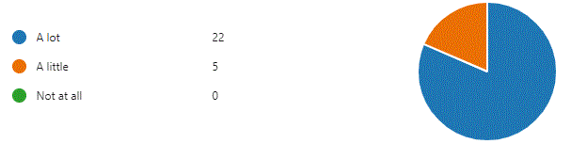
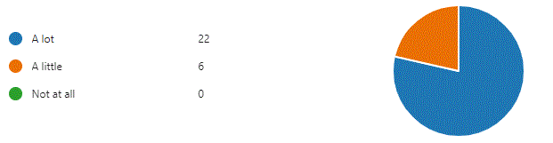

Slide Title 8
Employability-focussed workshops - feedback
Did this session help you to understand the skills required for a particular field of work?
Is this programme helping you to feel part of an OU community of biology students?
Notes:
Hence successful in its aim to help students understand/appreciate the skills they are learning, and also in building a feeling of community among our biology students.

Slide 8
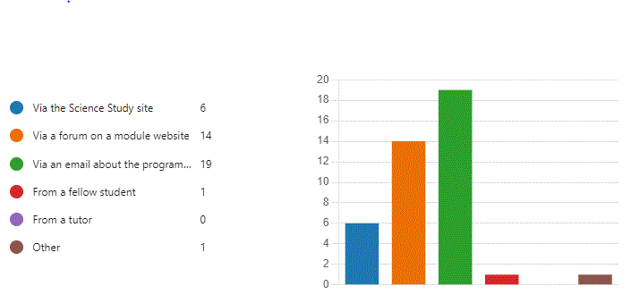
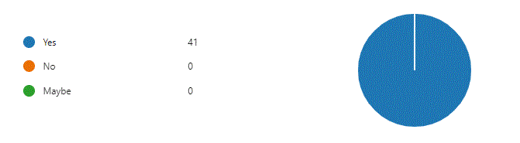
Slide Title 8
Employability focussed workshops – feedback
How did you hear about the programme?
Would you recommend participating in this programme to other students?
Notes:
Most participants had heard about the programme from the CAMEL email they received. Some also from a module forum or module website.

Slide 9
Slide Title 8
Plans for 2023
This was a successful pilot – we are expanding it for 2023.
New name for the programme – ‘Enrichment sessions: bringing your studies to life’
More workshops – from April to September 2023
Include students of chemistry and health sciences as well as biology
Invite students on all LHCS modules, both UG and PG
Include a wider range of enrichment topics in addition to skills sessions, e.g. career focussed, general interest topics, journal clubs, alumni/PhD student involvement
Advertise more widely and earlier in the year, by CAMEL email and on forums
Ask tutors to mention the programme to their students before J modules end
Coordinated approach – we are integrating all these ideas for 2023
Have recruited three ALs to help organise and run the programme

Slide 10
Slide Title 30
Thank you – any questions?
We would like to thank all the ALs and others who contributed sessions to this programme, and eSTEeM colleagues for their support.

