Slide 1
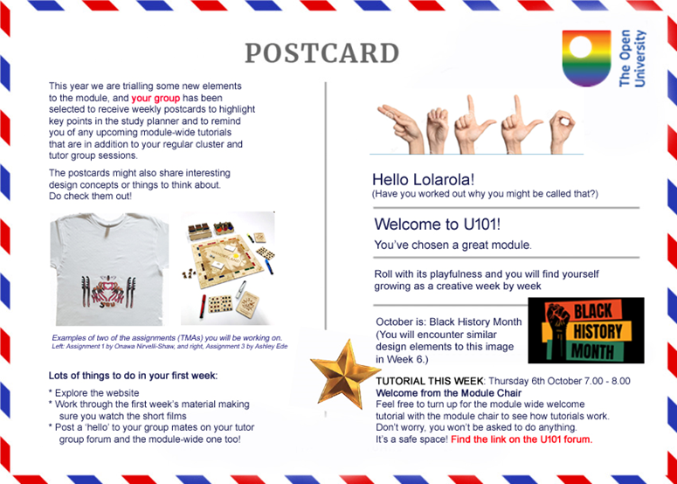
The Postcard Project
Improving retention on a level one module
Elouise Huxor and Theodora Philcox
Engineering and Innovation (Design)
20 April 2023

Slide 2
Introduction and Rationale
Student retention has been lower on module U101 (Design thinking for the 21st Century) than on other comparable Level 1 modules in E&I.
It has different challenges in that it recruits from a potentially wider range of qualification pathways, and although part of Q61 in E&I, it doesn’t yet contribute to a dedicated disciplinary degree in design.
It therefore has to work harder to meet the needs of a diverse student cohort who have chosen the module for a variety of reasons that are often extrinsic to their chosen career or study path.
‘First time completion rate’
U101 21J = 51.0%
U101 20J = 58.4%
Faculty level average = 72.4%
Other comparable modules:
U116 21J = 76.8%
T192 21J = 70.0%
A111 21J = 70.2%

Slide 3
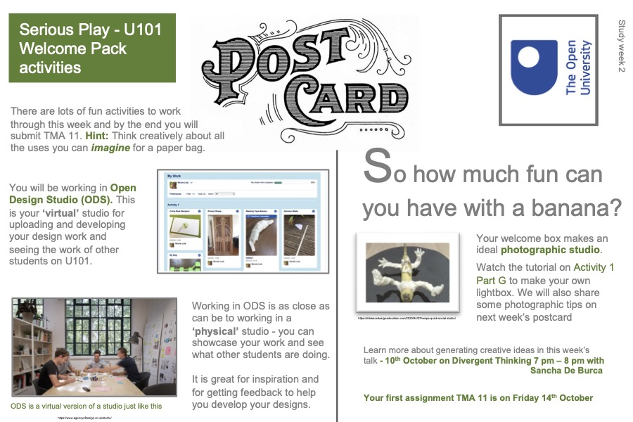
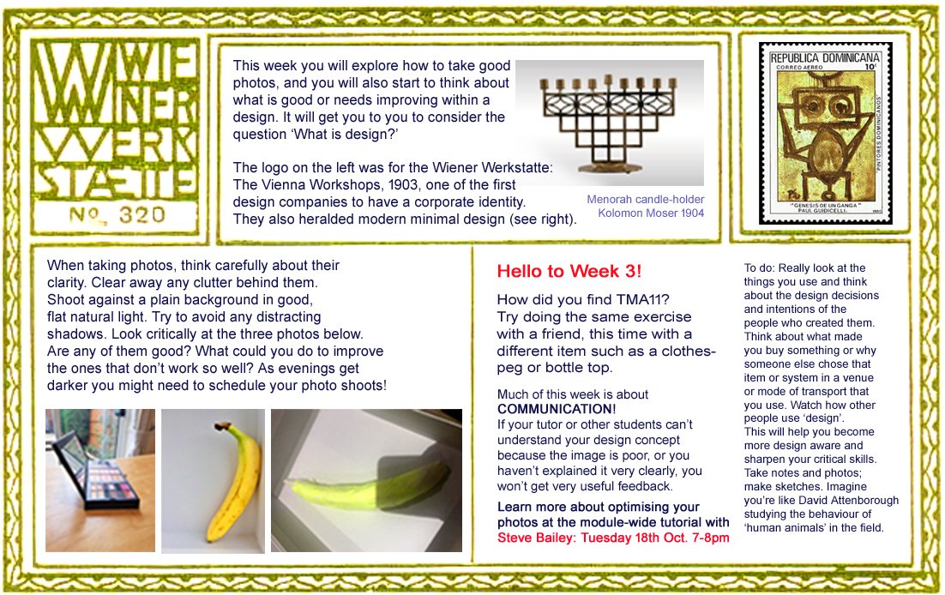
At the start of 22J the staff tutors for the module launched a pilot project with the aim of improving engagement, retention and achievement through a small intervention that ensured students in the pilot group had contact with their tutor at least once per week.
The chosen mode of contact was a digital postcard containing bite-sized visual information that highlighted key learning points from the block materials on the planner for that week along with a reminder of any module wide tutorials.

Slide 4
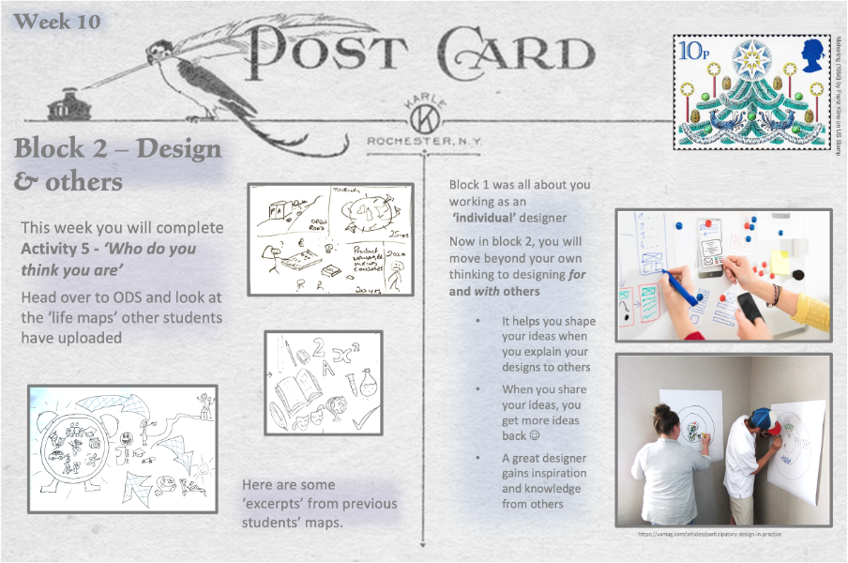
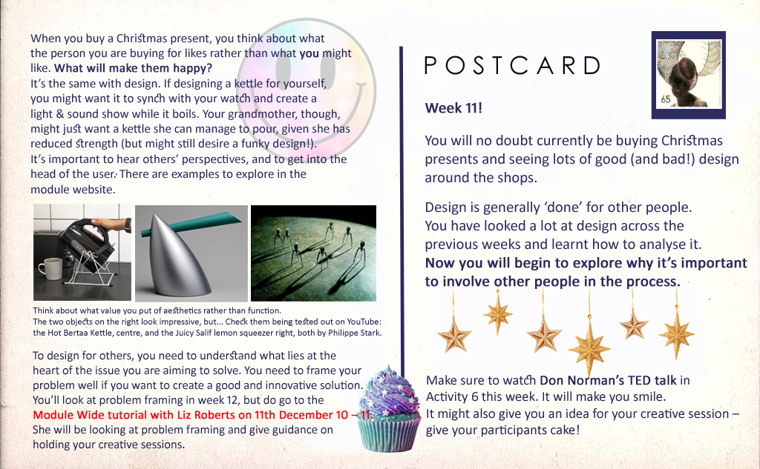
The project is being run as a pilot to allow for an analysis of the impact of this regular contact, targeting 13 groups; one from each region.
The postcards have all been created by the staff tutors to ensure all of the students are receiving the same content, but, importantly, are sent out by the students’ group tutor to encourage further interaction and develop a stronger relationship and sense of belonging within the group.
No new module information is provided on the postcards to ensure the pilot groups do not have an academic advantage over their peers in the control groups.

Slide 5
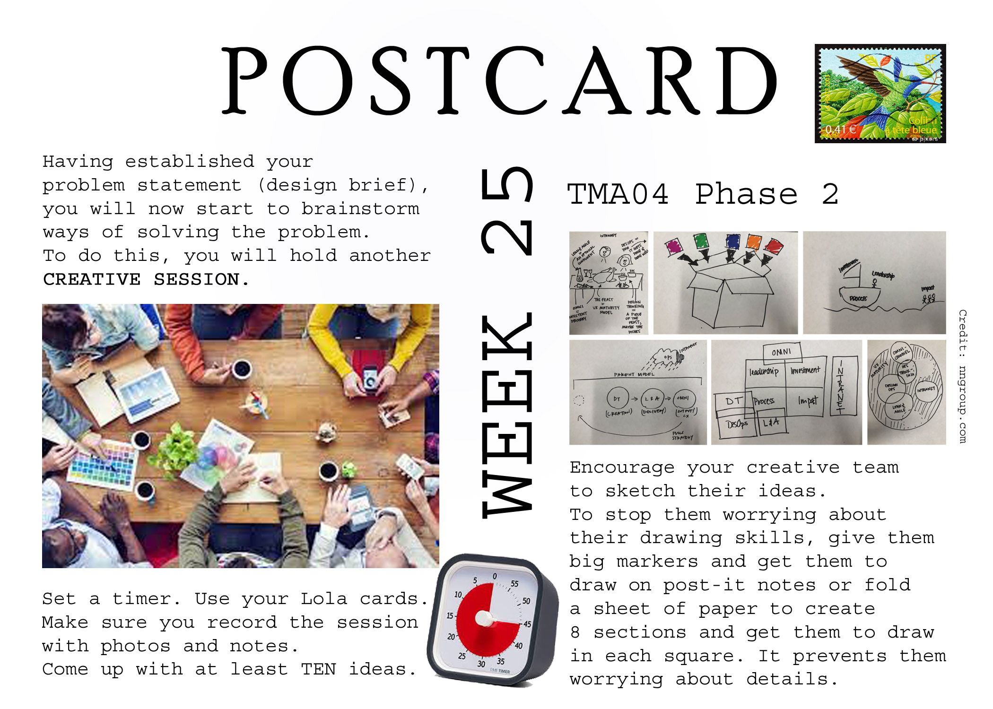
The Postcards

Slide 6
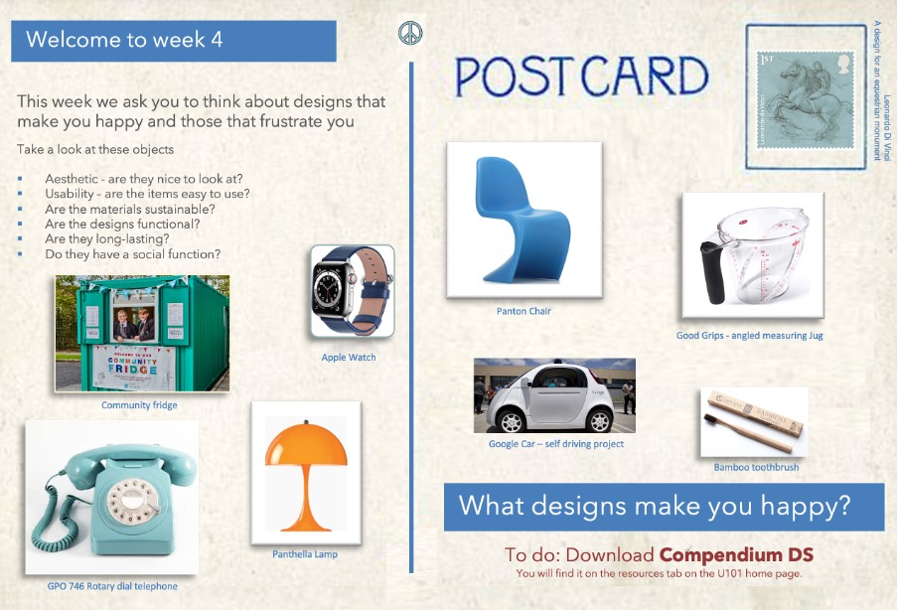
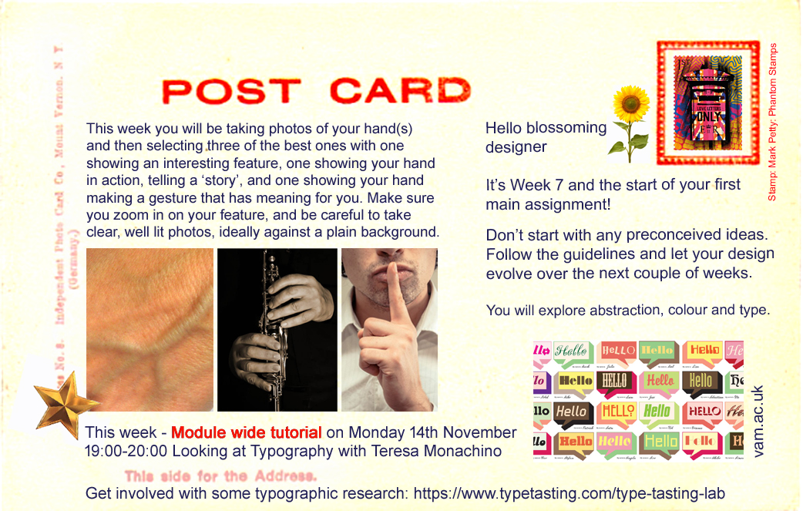
Each postcard contains:
Key learning points from the materials in planner that week
Images to inspire students relevant to the block materials
Reminders of deadlines and module wide learning events
Weekly examples

Slide 7
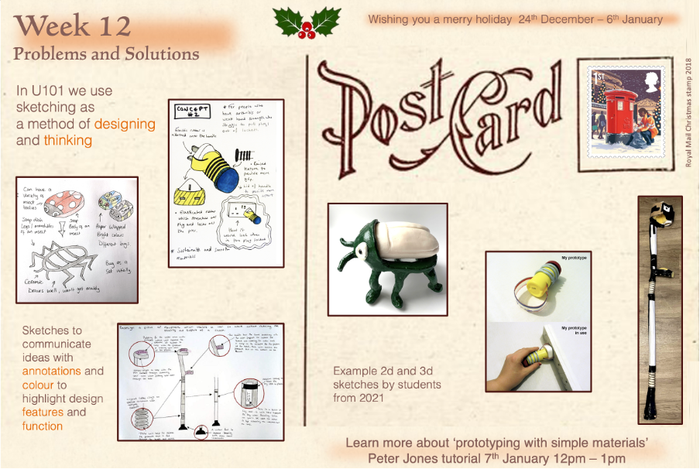
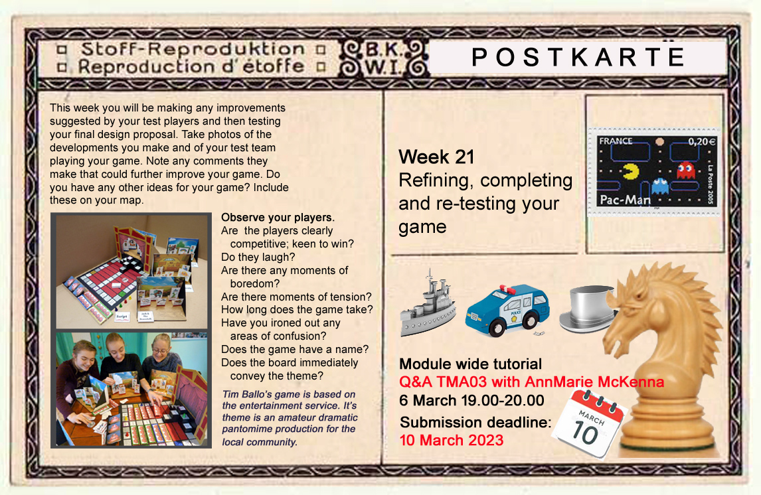
The postcards are sent out by the students’
tutor, WITHIN THE BODY of the email,
to avoid the need for an additional ‘click’.
All postcards are sent out BCC’d to comply
with GDPR
Tutors add a friendly message to their email
to encourage interaction.

Slide 8
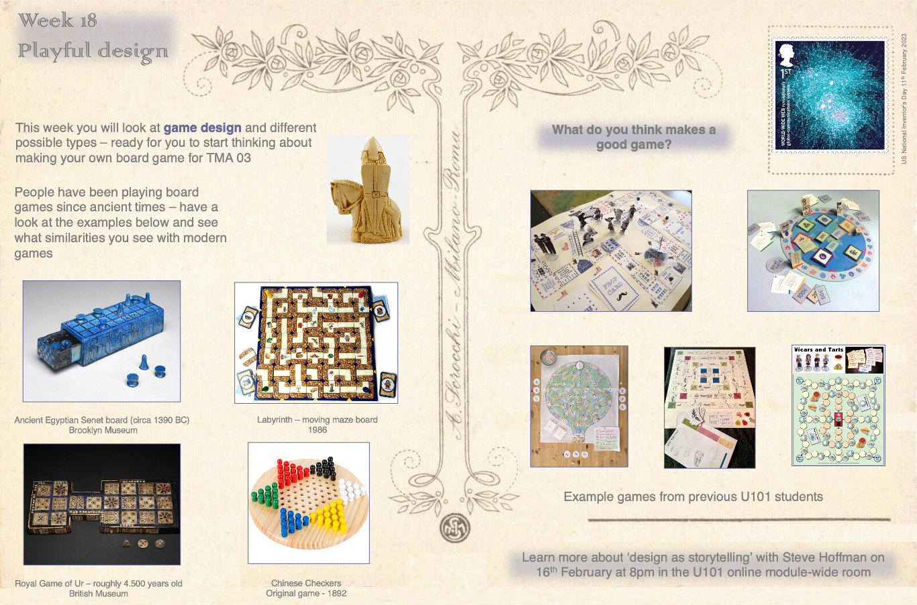
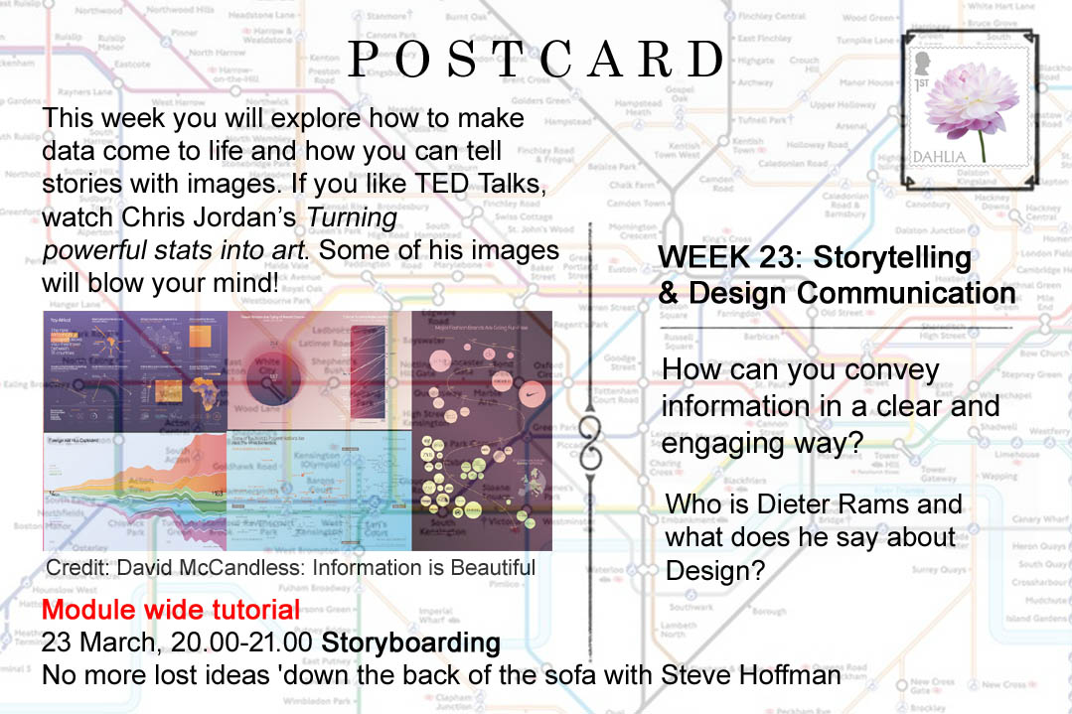
The postcards are deliberately different in
style each week to ensure students notice them.
Where relevant, stamps and imagery are
chosen to relate to current events or the time of the year and aim to be inclusive.
The contact with the tutor is as, if not more,
important than the content of the cards.

Slide 9
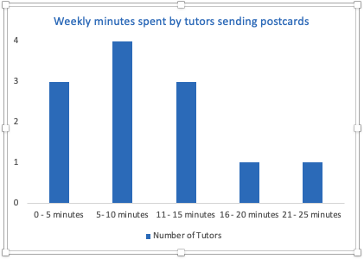
Tutor survey and responses
We asked the participating tutors five brief questions:
How many minutes per week is the project taking you?
Have you received any feedback about the postcards from your students?
Have you noticed any difference in student engagement compared to previous U101 presentations?
Do you feel the project has enhanced your relationship with your students? And if so, how?
Do you have any additional comments on the project so far?
12 tutors out of 13 responded to the survey

Slide 10
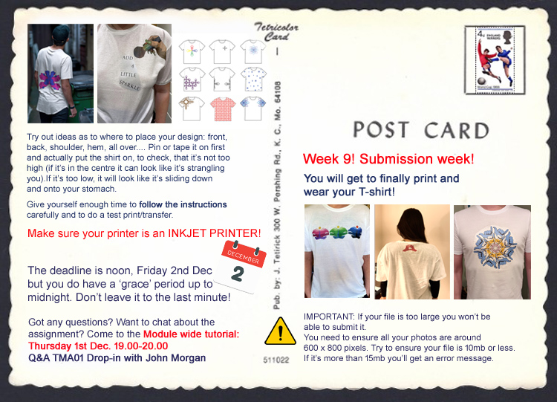
Tutor survey and responses
I've noticed that students email me with questions about the TMA following my postcard email as it probably acts as prompt to ask further questions’
‘Yes. It seems to be working as a nudge, in that students often reply to the email with questions about the work’
‘I like that it has made me send a weekly email out with the postcard where I am more chatty and describe my plans for the weekend - this has had my 'regulars' respond positively’
‘It makes my contact with them current and reminds me too as to what they're focusing on that week, so good for me and them’
‘They are more inclined to make contact AFTER receipt of the postcard.’

Slide 11
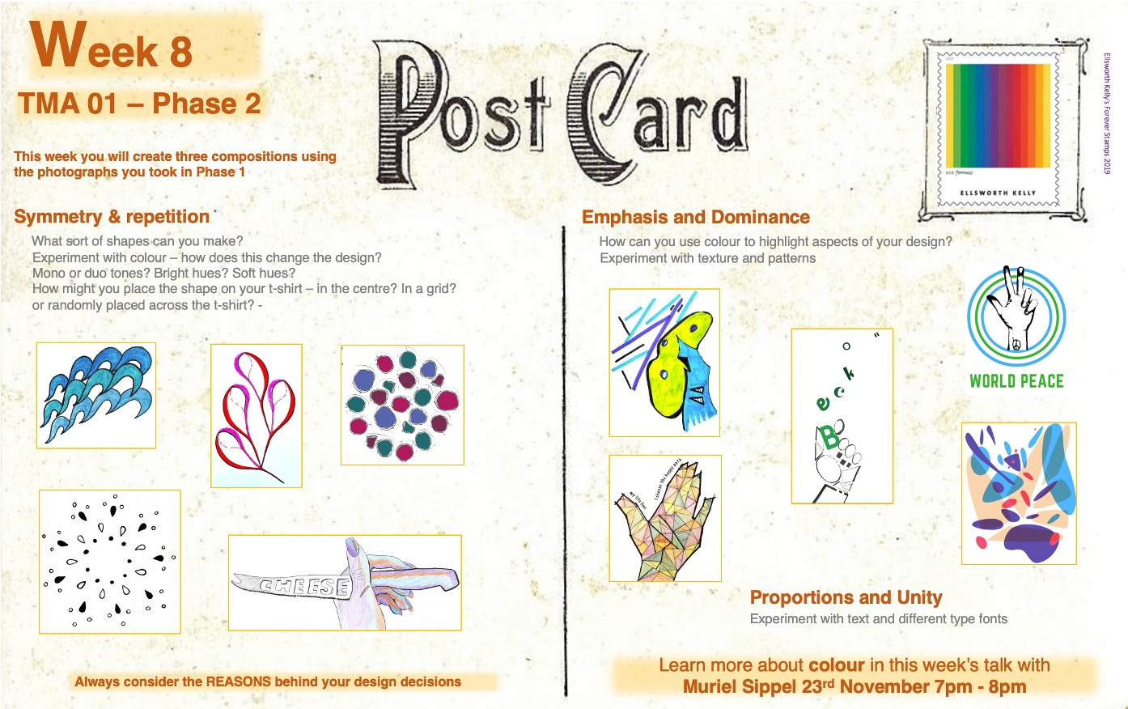
Tutor survey and responses
Do you have any additional comments on the project so far?
‘It’s a lovely and considerate initiative – I look forward to the postcards myself!’
It's very easy to pass on the completed postcards and is offering noticeable rewards, for very little impact on my time,...so keep them coming!!! :)’
‘I personally think, although the feedback is low, the weekly postcard is a great idea - for me I can see the benefits of a more visual prompt aid that all students can quickly see and understand.’
‘I think it is a good initiative and it sustains a regular channel of communication with students (especially those who don't even read TGF threads/posts)’
‘I really like the graphics and think the prompts have been well thought out.’

Slide 12
Mid-pilot Student survey feedback
33 responses were received out of 171 students (19%)
All results were anonymous
Tutors sent the questionnaire
91% of students report that they read the postcards each week
76% of students report that the postcards encouraged them to contact their tutor

Slide 13

Data Collection
Proportion of attendance compared to
random cohort samples
Early analysis from tutorial attendance indicates a higher proportion of students from the pilot group are attending the module-wide tutorials
As the project continues we will look at TMA submission and retention data
1.0
First two tutorial advertised to ALL students via the module planner
weekly module-wide tutorials

Slide 14
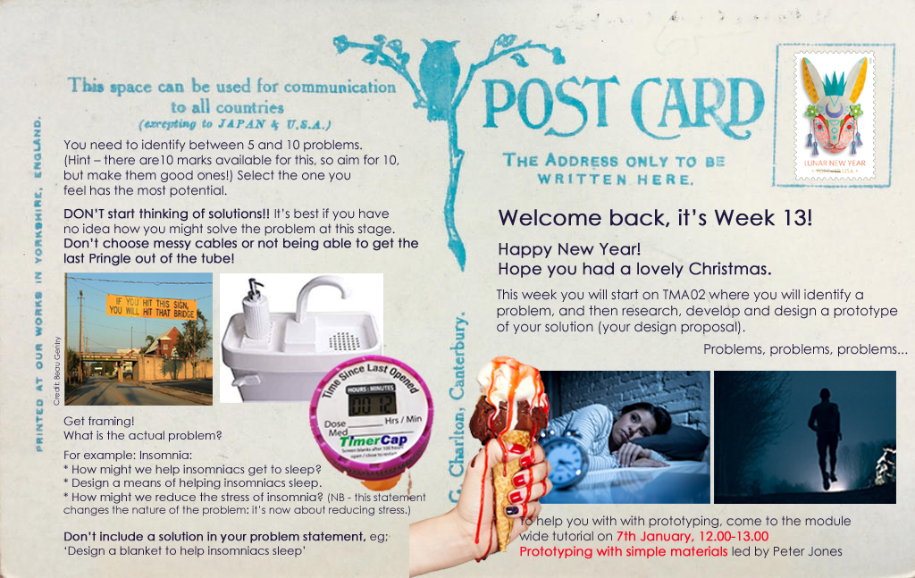
Mid-pilot Student survey feedback
Do the postcards have any impact on your studies?
‘They were an initial unexpected delight. They do show and emphasis that the tutor is available and supportive in every way’
‘They have a positive impact. I feel guided in my studies and motivated’
‘They offer new ideas and guidance’
‘It does help me a lot, it gives me more information and understanding about what to do next and what is expected from me to do’
‘It makes the module a bit more fun, and makes me feel connected to my tutor a bit more. In previous modules I didn't really hear from my tutors at all, so it's nice to get a weekly email'
‘No. They make me feel anxious if I’m slightly behind schedule’
‘They do give some context, they are attractive and engaging (more pleasing than normal OU text)’

Slide 15
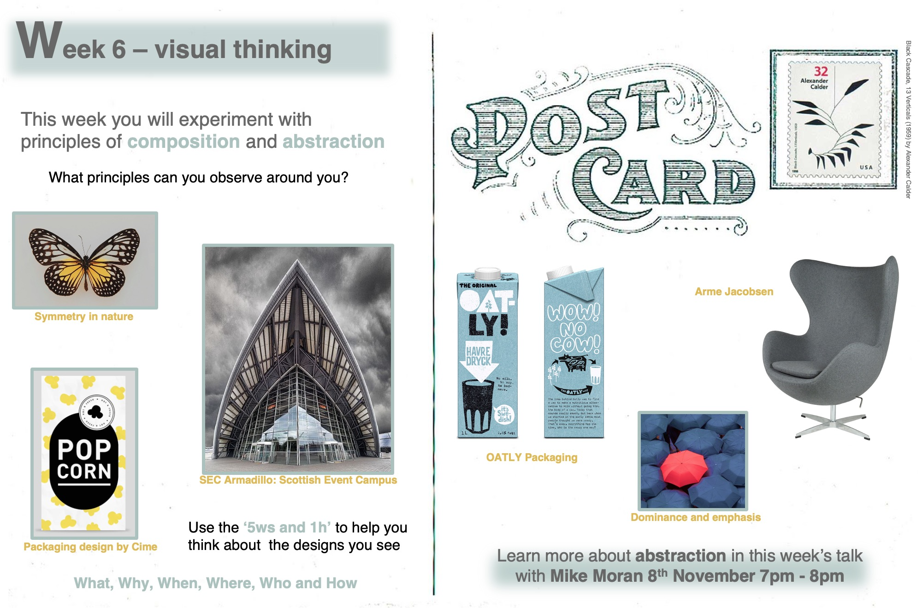
Mid-pilot Student survey feedback
Can you tell us how we might improve the postcards?
‘I would have liked to be able to opt out and they didn’t work for me. Nice idea though.’
‘I like them the way they are currently ‘
‘Add a reading suggestion for the week – either a book or an article’
‘A motivational quote – I think it would help boost me’
‘More colour’
‘Adding more images and examples’
‘A vertical postcard would work out better if reading it on a phone’

Slide 16
Next Steps
Continue to send out the remaining postcards
Consider a means of inviting students to collaborate in a final missive
Undertake a weekly analysis of retention figures and attendance at module wide tutorials
ALs to survey students at the end of the module
Survey ALs at the end of the pilot and meet with participants for further feedback
Analyse final data to evaluate the impact of the project

Slide 17
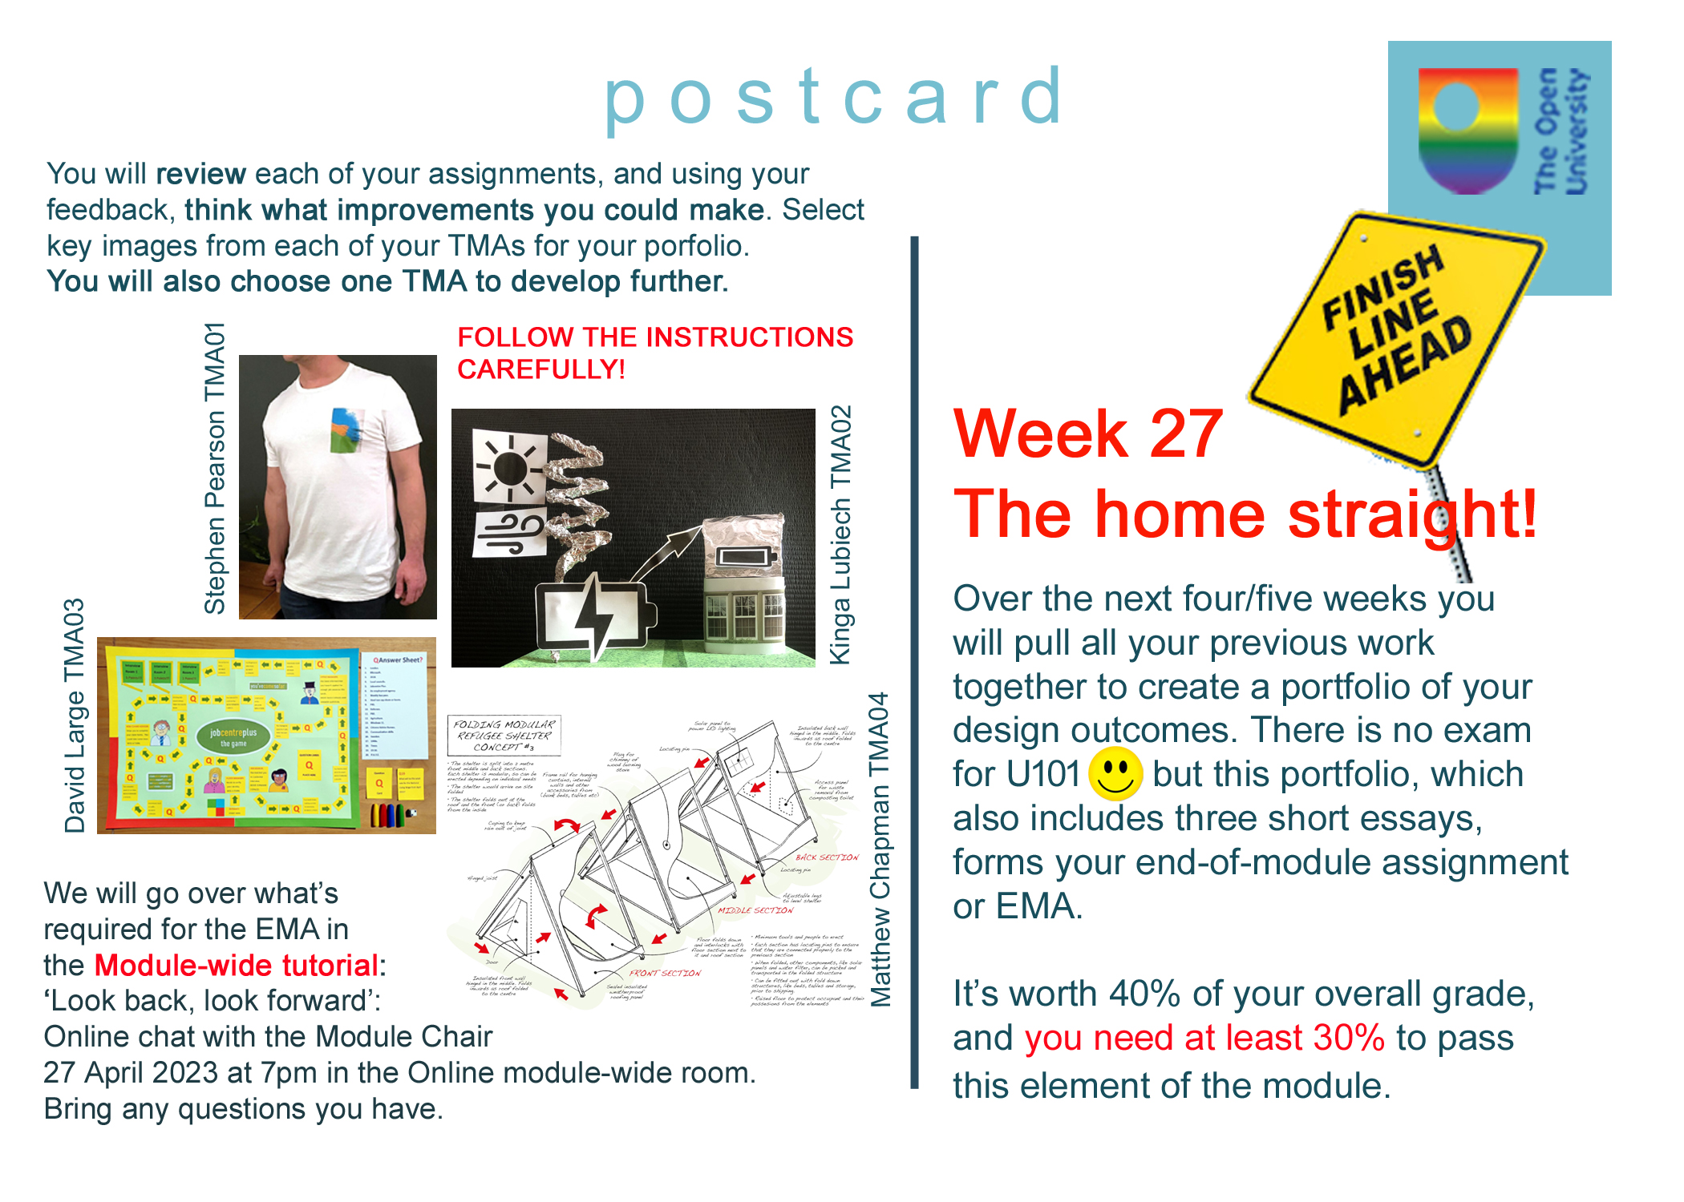

…in a weird way, the consistent communication takes away part of the loneliness that comes with distance learning.
Anon

