Slide 1
Intro Slide Title 1
Building a sense of belonging to aid retention at a level 2 Physics module
Preliminary analysis of eSTEeM project
Dr. Anne-Katrin Klehe
Physical Sciences
12th eSTEeM conference, 20/04/2023

Slide 2
Slide Title 13
Outline
Problem
  Retention in S217, lack of sense of belonging
Suggestion
  Offer “weekly” group meetings to my student
How
  How does it work?
Result so far ?
  student participation
  What do my students say about the meetings?
  Can I see a difference so far?

Slide 3
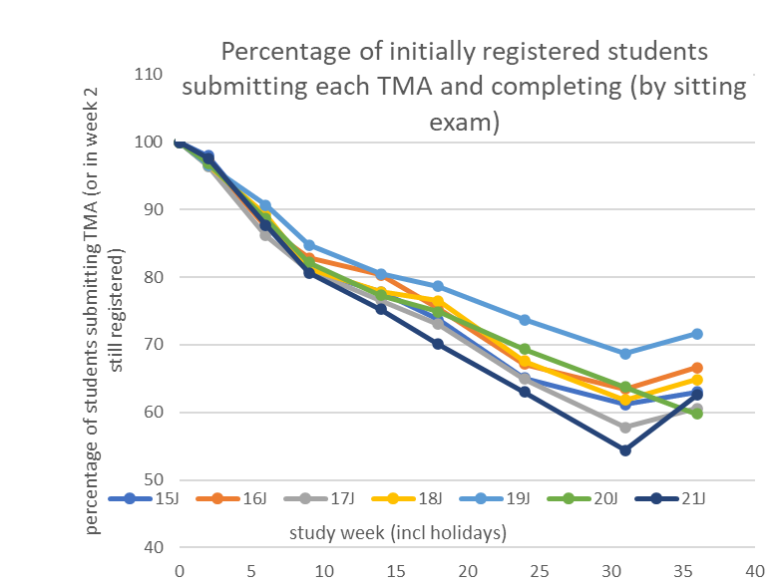
What do we know from previous years?
30-40% of students withdraw from the module (a/p)
only (47±10)% of OU Physics students feel “part of a community of staff and students” (NSS survey 2022)

Slide 4
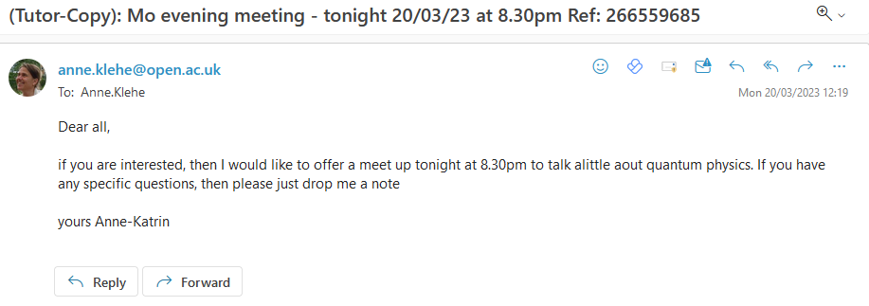
Idea: Foster a sense of belonging
How?
Offer nearly “weekly” meetings to all my students (60)
Email my students at Monday lunchtime:

Slide 5
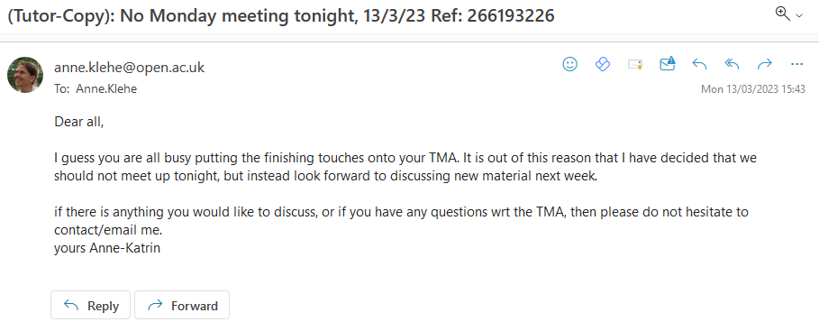
But also cancel meetings:
Students will get an email each Monday, unless it is a holiday

Slide 6
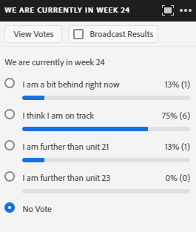
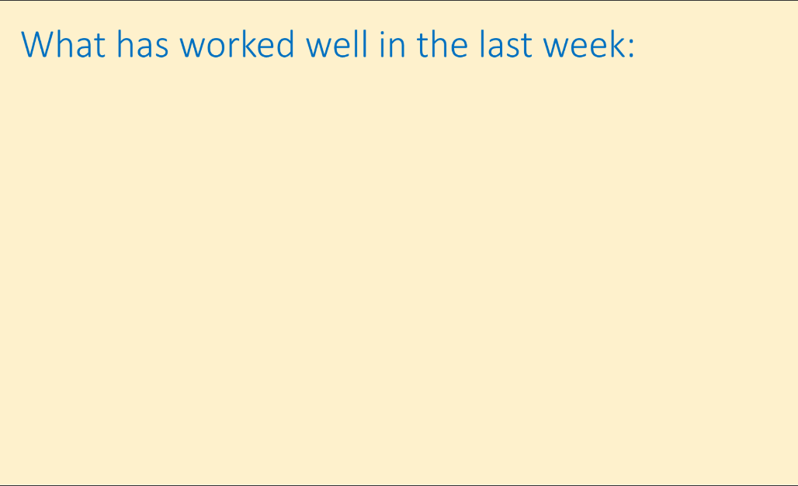
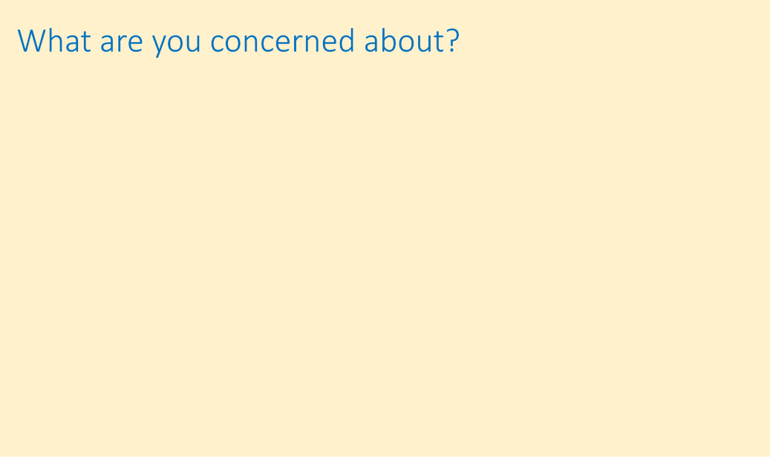
The meetings:
We start at 8.30pm, meetings last ~ 45 min, sometimes 1h
There is no recording of meetings as I want students to talk freely with each other - students know this from the beginning
We start with
  a poll: students indicated where they are in their studies
  Worked well
  Concerns
  Discussion of material

Slide 7
Things students mentioned that they enjoyed
Module material or parts of the material
A tutorial by a colleague – (I will then pass that on)

Slide 8
Concerns raised
Repeatedly: the amount of material they feel they have to know for the exam
Topic/unit specific questions they would like to discuss – which then leads us into the discussion/material part

Slide 9
Attendance (% of students still registered)
breakdown
33 out of 60 students attended at least one meeting
17 attended at least 3 meetings
4 attended at least 15 meetings

Slide 10
Retention numbers (09/04/23)
 | My test group | Comparison group | Total in S217-22J
in | 54 | 335 | 389
out | 6 | 80 | 86
 | 60 | 415 | 475
Retention | 90% | 81%
$χ^{2}$test: p=0.081
to a 90% confidence level my test group is different than the comparison group – this intervention has an effect

Slide 11
Comparison of TMA submission rate

Slide 12
What do my students say:
From those that attend:
Hi Anne-Katrin,
I want to thank you for the Monday Night tutorials you have been giving and to let you know that I find them very useful.
Last Monday's session was a real case in point. I think I was struggling to think through the process of Entropy, particularly in relation to adiabatic processes and after the session and some further reading and thinking about it, I think I feel a lot more comfortable now in my understanding.
… All the module material has been excellent, and the scheduled tutorials are helpful, but you add another dimension by looking at the topics slightly differently and getting us to think deeper and around the subject. This offers so much more than just reading and learning the presented material. Your approach in these sessions mirrors other undergraduate teaching I've received in the past, by giving us an easy opportunity to ask questions about any area of the relevant topic (or, I’m sure, any other topic), taking the time to answer them to our satisfaction and presenting us with questions if we don’t have any.

Slide 13
More positives:
I attend to consolidate my understanding of the topics and to participate actively with other students in an informal discussion not available in the forums or elsewhere. I find other points of view instructive and I find these meetings cohesive for us as a group of students and I find the routine comforting. I find that a tutor-led group is invaluable
I find the meetings useful because they are more informal than the "official" tutorials, you can ask questions
I have found it especially helpful watching you draw graphs, for example, via your webcam - somehow watching someone actually do something is always more helpful than just seeing the end product.
And I like the videos/extra material you show or link to - sometimes it's easy to forget why I started studying physics (because it's fascinating and I want to know more!) when working through all the material in S217! Generally, the Monday meetings feel more relaxed and less rushed than the tutorials.

Slide 14
But not everyone comes:
I found the meetings I attended were very worthwhile, unfortunately evenings are very difficult for me.
I did stop attending the Monday meetings for a while because I was struggling a bit to keep up with the course and something had to give. Also I work until 9 pm each evening
I am a student that does not attend on-line tutorials in general, so here is my take on the reasons.
…. the quality of material presented is unavoidably lower than the excellent material provided in the Units due to the time constraints and the need to summarise.
….From a perspective of getting clear answers to queries and issues, again the forums and/or a direct question & answer email exchange with a tutor is inevitably superior due to the extra consideration that goes into written questions and answers against hurriedly texted verbal exchanges on-line.
….Some might argue that the social aspect is the draw. But the quality of personal interaction is such a pale shadow of the real thing (physical co-location) that I just can't see it.

Slide 15
Conclusion so far
I do not know, whether my students have a better “sense of belonging”, students don’t talk in those terms
Students feel free to ask questions either in the sessions or via email in advance
Students share their worries and joys in the sessions
Attendance is better than in official tutorials
First analysis indicates a positive outcome (help retention)

Slide 16
Cost –Benefit reflection
It costs AL time to run these sessions.
Humanitarian benefit: each student who does not drop out will feel a sense of achievement
Financial benefit: Each student withdrawing before Christmas costs the OU 75% of their tuition fee
1 student not dropping out at Christmas
= 75% of £3462,-
= £2600,-
= a lot of tuition hours

Slide 17
Slide Title 30
Thank you
Special thanks to
James Jessop at SST
Sally Jordan, who shared her overview data with me last summer
And a huge “Thank you!” to my students il or chat

Slide 18
Slide Title 31

