Slide 1

Intro Slide Title 3
Physics and maths online exams in HE – A literature review
The 12th eSTEeM Annual Conference: 19-20 April 2023
Martin Braun
School of Physical Sciences
29 March 2023

Slide 2


Slide Title 11
Disclaimer
This is not about ChatGPT …
ICBE vs UOBE

Slide 3
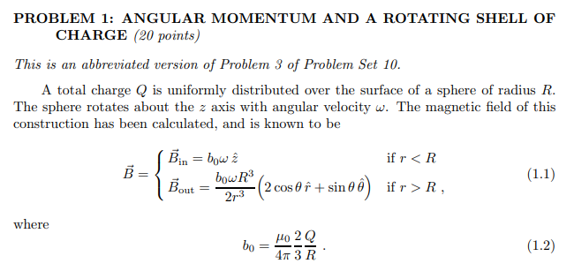

Slide Title 10
Motivation
Translation to online exam
Needed to
write EM exam
Horror stories
  MRP
  Students

Slide 4

Content
Method
Theme No 1: Advise for exam setting
Theme No 2: Cheating
Theme No 3: Advice for students
Theme No 4: Case studies

Slide 5
Slide Title 2
Method

Slide 6
Literature research method
Tried review protocol ➔ Needed to expand search terms
Academic and grey literature
Google scholar:
  allintitle: (exam OR exams OR examination) (Engineering OR Science OR STEM) online: About 47 results (some papers may have been listed twice)
  )
Google:
  allintitle: Covid (exam OR exams OR examination) site:ac.uk: 142 results
  allintitle: Covid (exam OR exams OR examination) blog: 110 results

Slide 7
Downloaded documents
Category | Academic | Grey
Advice for examiners on online exams and alternatives | 2 | 7
Cheating | 6 | 5
Advice on student wellbeing and exam preparation | 7 | 5
Case studies | 13

Slide 8
Slide Title 3
Themes

Slide 9
Theme No 1
Advice for examiners
ICBE
Advantages: Less cheating, fair, accepted
Drawbacks: Lower order thinking skills, all learning outcomes, snapshot
Question design: Learning outcome, include higher order thinking skills, student specific/randomise
Appropriate time limits
Misconduct: Watermark, handwriting, virtual vivas, hire virtual invigilation service
Student: Exam preparation needed, memorize material, encourage practicing
Stress test exam system
Virtual invigilator in supportive role

Slide 10
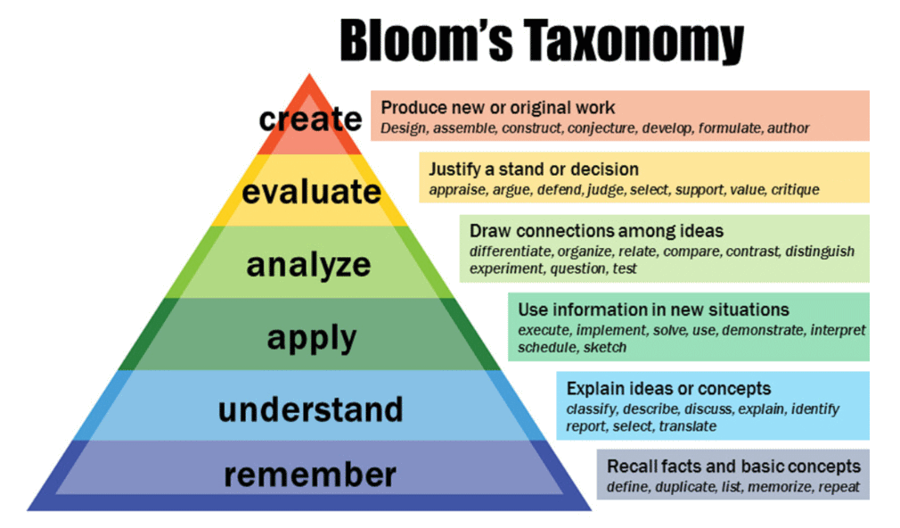
Theme No 2
Cheating
Cheating will occur
Needs: Motivation and opportunity
Criminal offences in England: Provide or arrange for money
Spread assessment tasks
Time limits: Shorter exams, more often
Exam questions: Don’t recycle, higher order thinking skills
Identity checks
Educate students

Slide 11
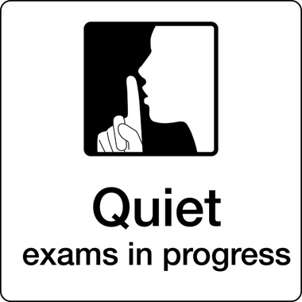
Theme No 3
Advice on students
Student wellbeing
Exam preparation methods
Exam preparation
  Know exam arrangement
  Organise revision
  Practice active revision
Exam taking
  Create exam conditions
  Eat before you begin
  Analyse exam
  Submit on time

Slide 12
Theme No 4
Case studies
Harom & Lambrinos (2008) and Chible (2021): Relationship between predictors (e.g. engagement, continuous assessment, performance in previous modules) and exam results
Böhmer et al (2018) and Smith (2021) (MCQ): Writing exam questions takes longer
UOBE struggled to be accepted (before Covid)
Jungic (2021): UOBE – two main concerns: Student wellbeing & protecting assessment integrity

Slide 13
Slide Title 5
Summing up

Slide 14
Conclusions
UOBE questions: May take longer, learning outcome, individualise, watermark
Appropriate time limits: Consider a set of smaller exams
Cheating will occur: Predictive models may help ➔ Vivas
Resources need to follow work: If less is invested in invigilation, more should be invested in exam design and cheating detection
Provide student advice for preparing and sitting exams a UOBE

Slide 15
References
BÖHMER, C., FELDMANN, N. & IBSEN, M. E-exams in engineering education—online testing of engineering competencies: Experiences and lessons learned. 2018 IEEE global engineering education conference (EDUCON), 2018. IEEE, 571-576
BRAUN (2022) What is known about how to write online exams and how to prepare students for them? Available online: https://www.open.ac.uk/scholarship-and-innovation/esteem/projects/themes/supporting-students/what-known-about-how-write-online-exams-and-how-prepare-students
CHIBLE, H. (2021) Proposed Method To Be Adopted For Online Exam Without Proctored Environment During Covid 19. Int. J. Sci. Res. in Multidisciplinary Studies Vol, 7.
HARMON, O. R. & LAMBRINOS, J. (2008) Are online exams an invitation to cheat? The Journal of Economic Education, 39, 116-125.
JUNGIC, V. (2021) Making calculus relevant: final exam in the time of COVID-19. International Journal of Mathematical Education in Science and Technology, 52, 609-621.
SMITH, C. A. (2021) Development and integration of freely available technology into online stem courses to create a proctored environment during exams. Journal of Higher Education Theory and Practice, 21, 126-130.

Slide 16
Slide Title 30
Thank you

Slide 17
Slide Title 31

