Slide 1




High Resolution Virtual Geological Outcrops for Teaching and Learning
Dr Anne Jay¹, Dr Marcus Badger¹, Dr Robert Barnes^{2,1} Brian Richardson³ and Geoff Austin³
¹ The School of Environment, Earth and Ecosystem Sciences, The Open University, Milton Keynes, UK
² Department of Earth Science and Engineering, Imperial College, London, UK.
³ SWIM Team, Open STEM Lab, The Open University, Milton Keynes, UK
Notes:
traditional fieldwork is an important part of geological education and understanding for geology students, professionals, and researchers, and is required for accreditation by professional bodies and forming part of the QAA³. However, fieldwork in the outdoors can:
be impossible or difficult for many with disabilities (physical, mental and emotional)
be inaccessible or impractical for those with caring responsibilities
be challenging for individuals from some cultural backgrounds
demand substantial travel
be too expensive to allow broad participation
Limited provision by the OU
Our students miss out on key geological experience due to a lack of field work. In S209 (Earth Science), the only pure geology 2nd level module in the geology degree, there are about 6 day field trips offered by tutors (spread around the UK, so students normally attend only 1, if at all) and one 4 day residential field school, but that is all that is offered for our students and the majority don’t attend. We are unsure as to the reason for the lack of attendance, it could be distance, time, cost or fear of unknown. The 4 day residential school can take up to 64 students, but this year about 30 attended, out of a module of about 200 students.
The QAA says that geology students should have ‘significant field based learning’ and many brick universities have over 10 weeks of compulsory fieldwork in their geology degrees. Although that has never been possible at the OU. We did offer significantly more fieldwork in the past.
The aim of this project is to develop a method of delivering high quality, high resolution virtual fieldwork to OU students that will provide significant virtual field opportunities. Not only will these cover many of the skills and learning outcomes that can be acquired by fieldwork. We hope that they will also give confidence in those skills and that will encourage students to attend field trips to further their knowledge, increase resilience and provide a network of students that can support and encourage each other.
This project was funded by a UKRI NERC EDI Digital sprint project. And the further development to establish a method of delivery to students is being funded by a OpenSTEM Lab pathfinder project.

Slide 2
3D virtual outcrops
Teach field skill
Teach geological knowledge
Easily accessible from home
Can be revisited multiple times
NOT replacing physical field trips
Confidence for physical field trips
Notes:
Virtual field trips come in many different shapes and sizes. Many are static with, single photographs or 360 photos with hotspots that students can click on to get close up images, text, links to another 360 image, or other embedded info.
Our method is to create 3D models using a method called ‘structure from motion’ to create individual very high resolution virtual outcrops rather than a whole field trip.
They aim to teach the skills and knowledge that can be gained during the time spent at an outcrop, with the advantage that it can be accessed from the students’ homes and all the associated accessibility benefits that it provides.
We are not tyring to totally replace physical field trips, but provide additional learning opportunities that are not currently available.
We also hope that by making students familiar with field techniques this may give those who have anxiety about field trips, the confidence to try physical field trips.

Slide 3
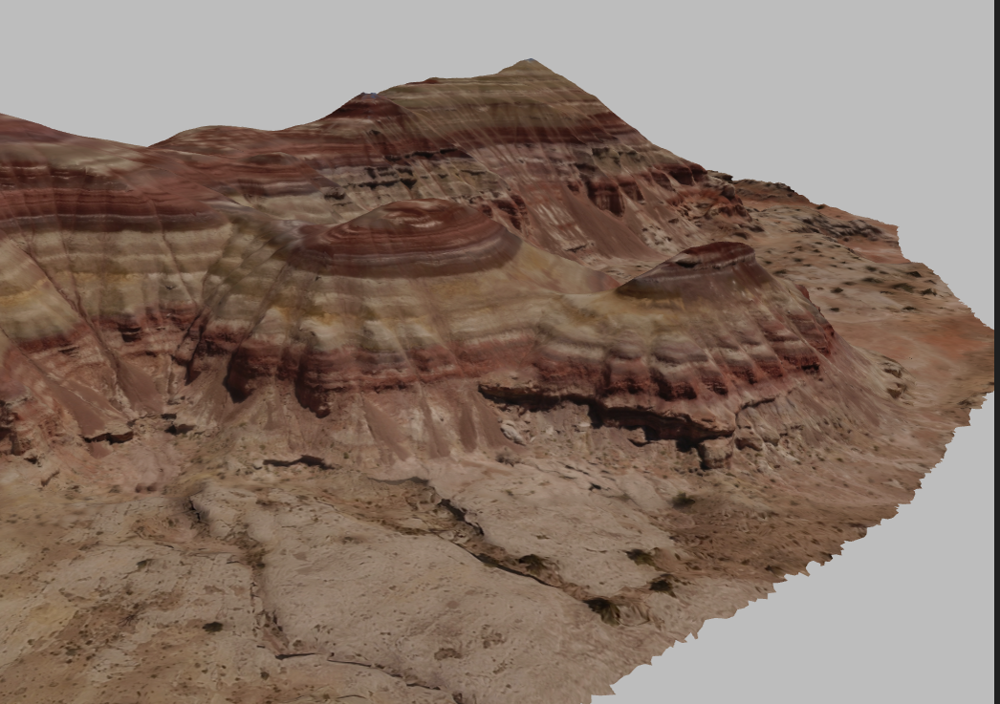
Why are ours different?
Excellent resource
www.v3geo.com
Best resolution
is 5 cm / pixel
150 m
V3Geo.com
Notes:
There are plenty of 3D geological outcrops out there and if anyone wants to see some there is a great repository called V3Geo. But a quick flick through their archive shows that best resolution image is about 5 cm per pixel with most about 20 cm. This is understandable as they are of large areas and mostly acquired by drone.
This is a screen shot of a cliff section in Utah, USA from V3Geo.
As geologist I can look at this and have a pretty good idea of the rock types that make up this cliff. But I imagin that those of you who aren’t geologist wouldn’t have a clue, very much like students new to geology.
These models, created by drones are amazing for gross structure, but even if you zoom in

Slide 4
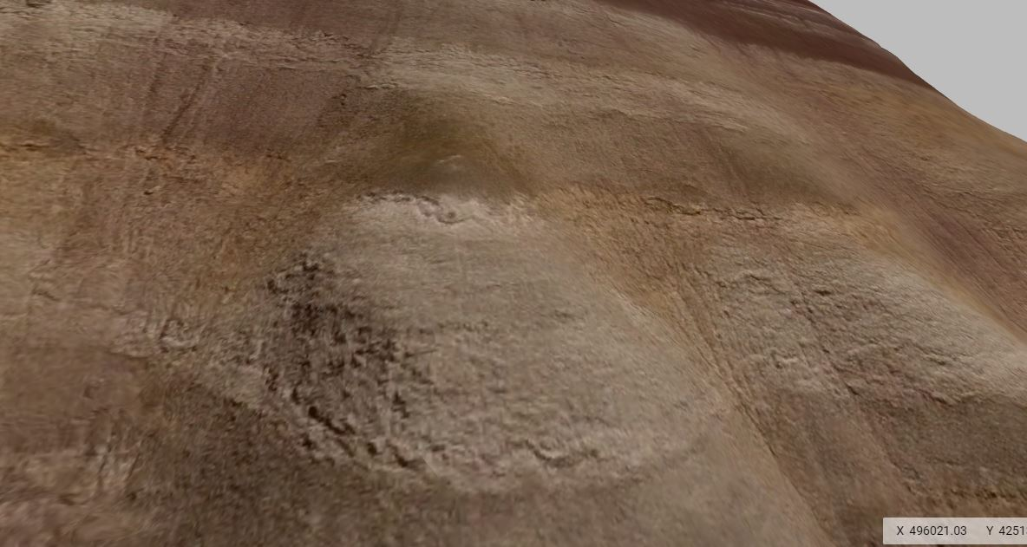
Why are ours different?
Create smaller models
Much higher resolution
to enable rock types to
be determined.
6 m
Google Earth
Notes:
I think you will agree that you are non-the-wiser as to what the rock type is.
I want to make it clear, I am not criticising these models, they are amazing, as are most of the other virtual field trips out there. We just wanted to make something that filled a different ‘learning gap’.
Our models are of much smaller areas not more than 500 m², so maybe 7 m high by 70 m long. This allows us to take the images, required to make the model, much closer to the rock face which gives a much higher resolution. We want to students to be able to see the grains that make up the rock. This is essential for students to be able to link observations with the process and environments that formed the rocks. These are key essential skills for a geologist.

Slide 5
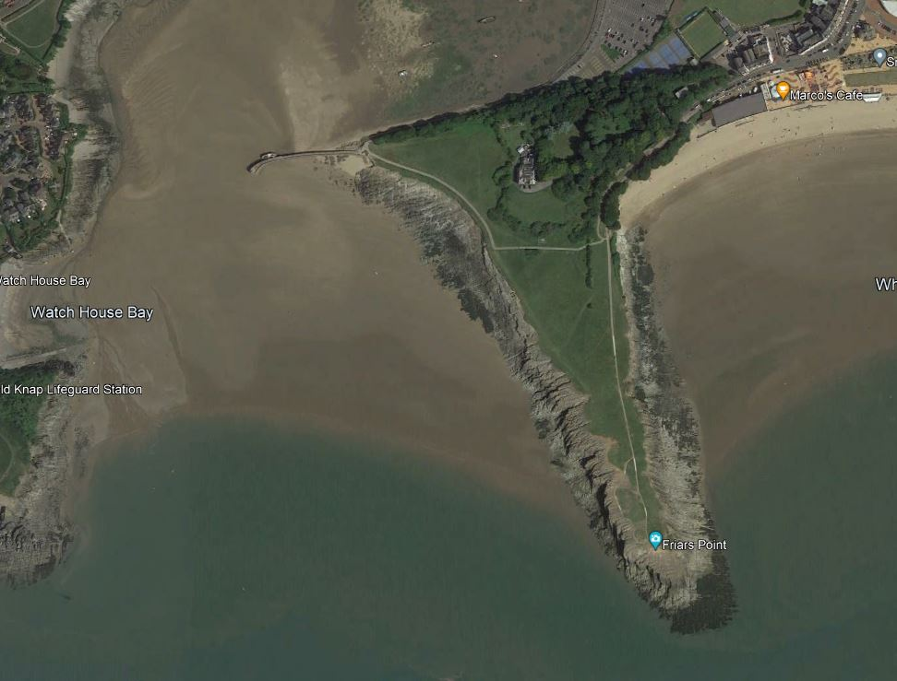
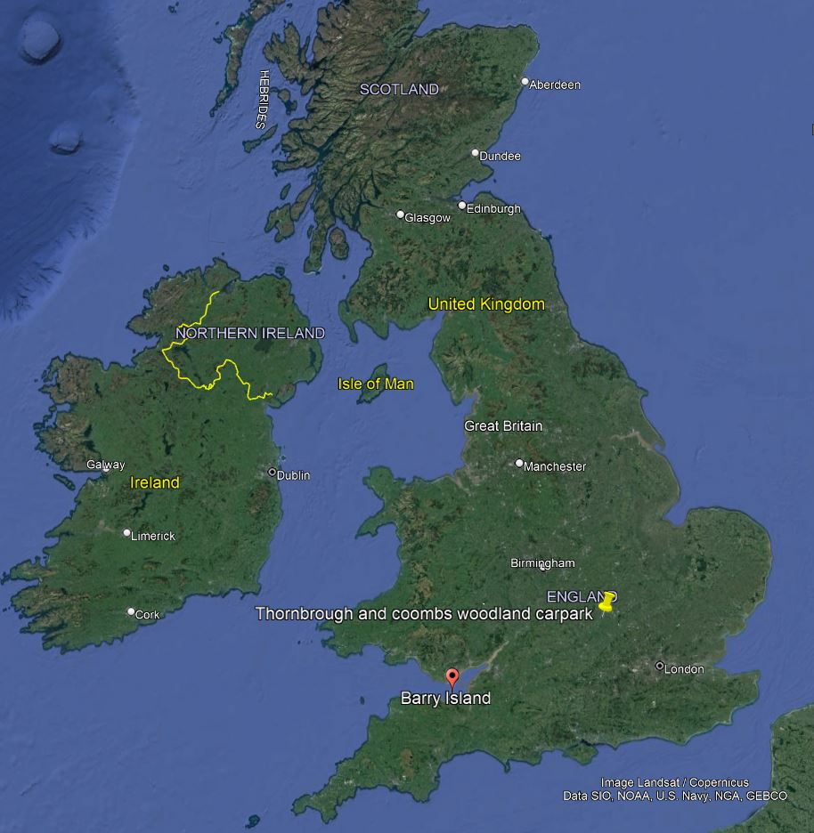
Why are ours different?
Friars Point, Barry, South Wales
50 m
Google Earth
Notes:
The 3d outcrops were created using structure from motion, which involved taking many overlapping photographs , tweaking the colour and white balance, throwing them at a piece of software called Agisoft, and it spits out a 3D model. Its almost magic.
We chose to go to Barry in south Wales as it has excellent geology, it is well exposed and it has complicated geometry. We wanted to ensure that we tested it on rocks that were not going to be too easy. There was no point doing a pilot study and then discovering that we can’t apply it to other places.
We visited Barry twice, spending approximately 4 days in the field. We chose to go in spring. Partly because our project was only 6 months long and started in January, and also because we wanted maximum day length for minimum sun. The models work much better without shadows and with the flat light and overcast day provides.

Slide 6
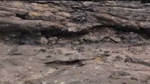
Our model
Notes:
The models we have created are many giga bites in size and so it is not possible to show the actual model here, and hence our need for the path finder project to find a method to get the models to our students.
To overcome this we put the models in to the Softwear ArcGIS which allowed me to create a video of me flying over the model, and then we put the video into You tube.
Unfortunately there is no obvious scale, but the small white markers are about 4 cm across,

Slide 7
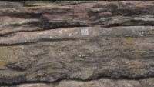
Our model

Slide 8
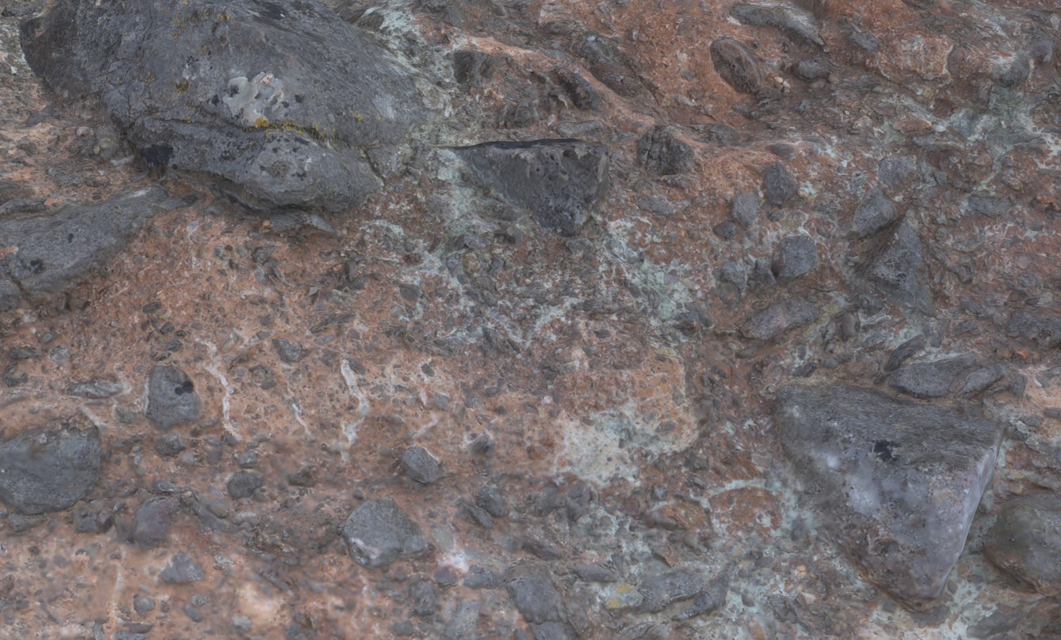
Our model
5 cm
Notes:
This is about as good as our model gets. These images have been downgraded from the original model to get the file small enough for the requirements of the conference. But is possible to make out 1mm grains on this picture and sub-1 mm grains on the original high-res model.
This is what we were aiming for when we started the project. We can make high-res 3D models that allow students the opportunity to see what a rock is made up of.
The next stage is to work out how to present it to students in a way that doesn’t need a high end gaming computer!
And add wrap around teaching material.
We envisage using multiple numbers of these in our module S229, which is the re-write of S209. At the beginning the students will be heavily guided through the models, with skills being explained and features described, but as the module progresses their learning will become more independent and self directed.
This is different to the methods used in many brick universities where they still treat their virtual field trips like physical field trips so there is less self directed independent learning.

Slide 9
Conclusions
High resolution models can be made.
The images can be collected in a couple of days, or less depending on size and resolution required.
Future work: how to present them to students?
5 cm
Notes:
Our pathfinder project is looking at a method of delivering these models to students, we are looking at working with a group at the University of Aberdeen and ORCE Norwegian Research Centre, Bergen,, who had developed software to view and interrogate these models, and are currently developing a method to stream these models over the internet so students don’t need an expensive computer.
Having just returned from fieldwork in the lake district with OU students I know how much they enjoy field work and how much it benefits their learning. We are hoping that these virtual outcrops will go some way to filling the gap encountered by OU students.

