Slide 1

Intro Slide Title 3
Typical Support Seeking Behaviour of STEM students, their outcomes and successes
Paul Collier(STEM Deanery), Fiona J. Aiken (EEES staff tutor)
12th eSTEeM annual conference 2023
20th April 2023

Slide 2

Slide Title 9
Overview
Introduction
  Background
  Objectives
  Literature
Methods
Target Group Selection
Next Steps
Acknowledgements
References

Slide 3
Slide Title 9
Introduction
Background
The importance of personal, non-academic support of students in a distance learning environment is well documented in literature. (Jacklin et al 2007)
The way that support is provided is important and negative experiences result from delays in students receiving a response.
Students indicated that it can be difficult to commence their studies and managing students' expectations vs the realities of life in Higher Education can be a challenge at the start of a module.
It is important students know who to contact, where to go and what support is available.

Slide 4
Slide Title 9
Objectives
This project is investigating student triggered interactions with the STEMA SST in terms of volume and nature to increase our understanding of the impact that these interactions have on the students success.
Focus has been on the 6 weeks from the Final Enrolment Date through to the submission of the 1st TMA.

Slide 5
Slide Title 9
Literature
In an HEA report on Improving the experiences of disabled students in Higher Education (Jacklin A., et al). It was stated it is not always the support itself that was of prime importance, but the way in which that support was provided/organised. Negative responses related to the absence or delay in receiving support.
In Ormond Simpson’s book Supporting Students in Online, Open and Distance Learning (Simpson,O., 2018 e-book) In Chapter 12 it is recommended that pre-course start support should be 1-2-1 and focus on building the students self-confidence to the point where they are able to help themselves undertaking preparatory and learning skills development work.
Notes:
Once support was in place this tended to have a substantial positive impact on the student’s experiences.
The importance of personal, non-academic support of students especially in a distance learning environment is well documented in the literature. Main findings in an HEA report (Jacklin et al, 2007) were that the way that support is provided and organised is important and negative experiences result from delays in students receiving a response. Students indicated that it can be difficult to commence their studies and managing students' expectations versus the realities of life in Higher education can be a challenge at the start of a module. In the report recommendations it stated the importance of knowing who to contact, where to go and what support is available. This is backed up further by Simpson, (Simpson, O., 2018) in chapter 3 he states that’ A good adviser will also use his or her experience and skill to help the student clarify and conceptualize the issue or problem, as well as challenging the student's perceptions when appropriate.’

Slide 6
Slide Title 9
Methods
Analysis of all incoming SRs to the STEM SST was carried out using Tableau
Based on 18J, 19J and 20J presentation period​
Automated OU System Student Loan Message omitted​
Very low volume groups are omitted​
Notes:
Direct student contact occurs within Academic Services through a variety of mediums, covering a multitude of topics and at different points in time. This project is investigating those interactions in terms of volume, nature and composition in order to understand the overall position of our dialogue with students. To assist the focus of the work the investigation will be focused around the crucial 6 weeks to Final Enrolment Date through to the submission of the 1st TMA in a module. With a baseline established the work can move into cutting the understanding by APS characteristics to see if they impact on the baselinesFurther, it is important to understand how these interactions impact upon the success the students have. Success for each of the categories of interaction will mean something totally different based on the content and timing of the interaction. This will need to be understood to ensure that we can measure the differences in outcome for students.

Slide 7
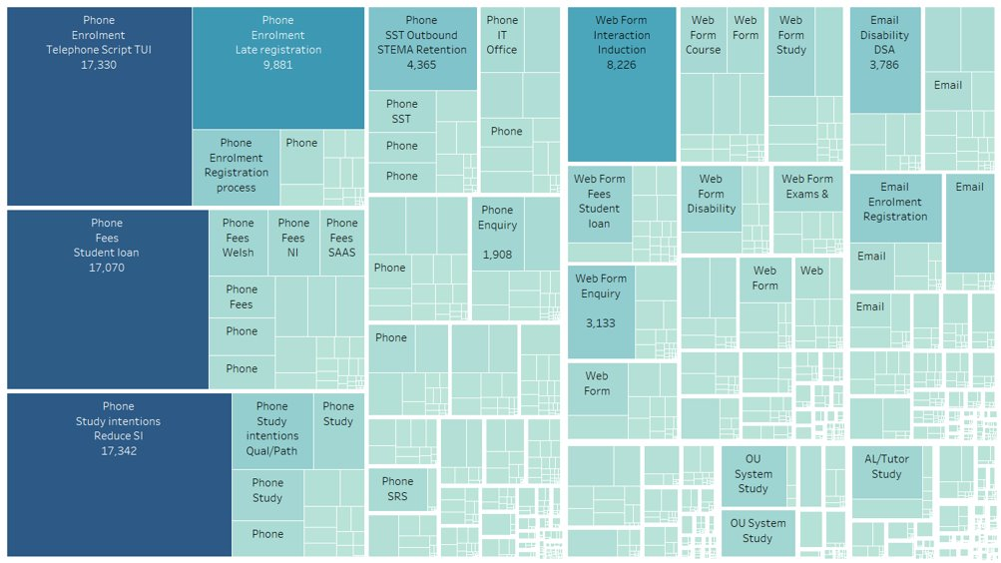
Slide Title 9
Initial Data Analysis
What are the most popular types of query?
As represented in the graphic there are over 1800 combinations of Source, Type and specific Area for queries received.​
​
Phone is the majority contact point for our students.​
​
Queries are based around multiple topics. It is not surprising that Enrolment is the most popular type but this broader topic can be split into multiple Areas.​
Notes:
As represented in the graphic there are over 1800 combinations of Source, Type and specific Area for queries received.​
​
Phone is the majority contact point for our students.​
​
Queries are based around multiple topics. It is not surprising that Enrolment is the most popular Type but this broader topic can be split into multiple Areas.​

Slide 8
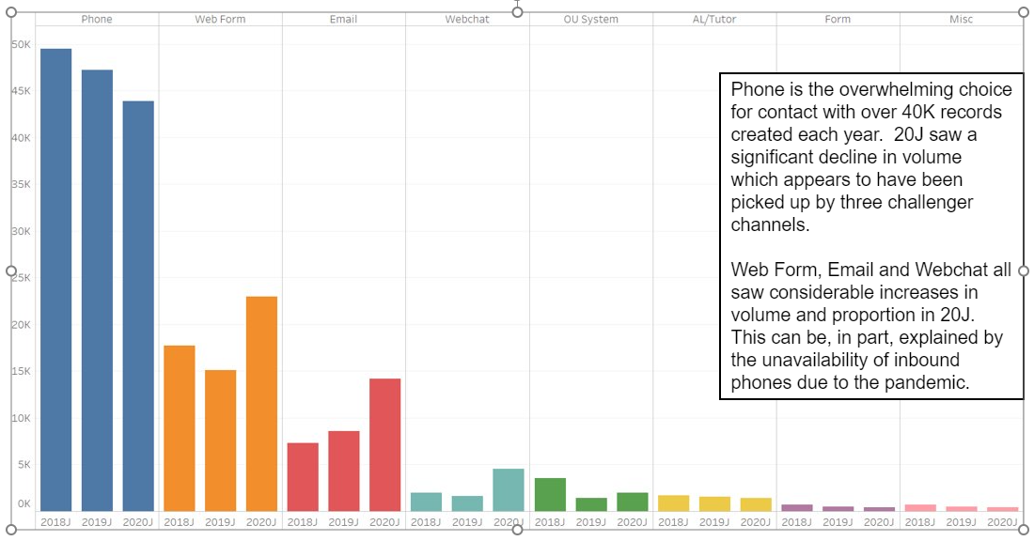
Slide Title 9
Which Source is most used for inbound contacts?

Slide 9
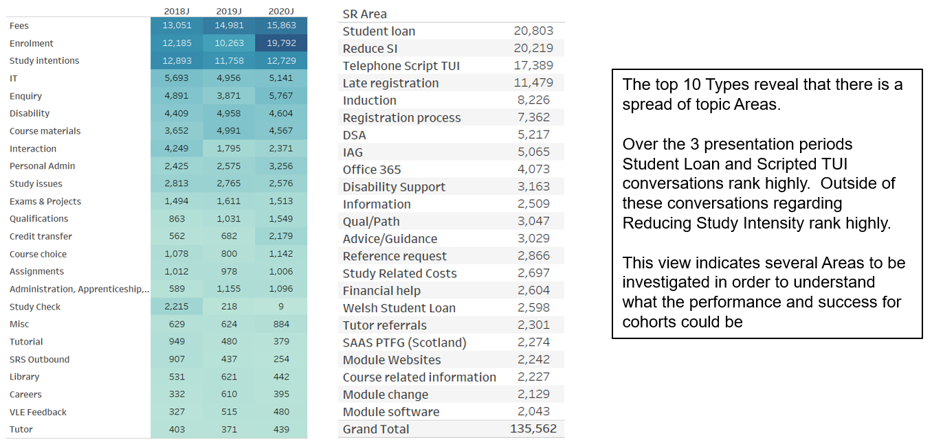
Slide Title 9
Which types receive the most queries?

Slide 10
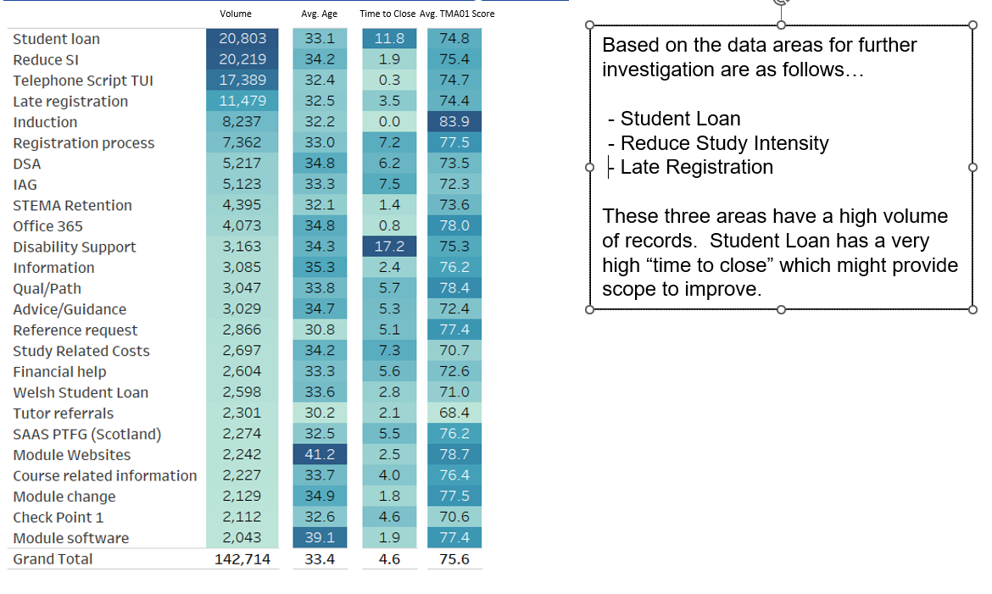
Slide Title 9
Areas identified for further investigation

Slide 11
Slide Title 9
Methods used in the investigation
Identifying target demographic areas were based on a couple of approaches. Each of the three Service Request topic areas were first cut by the following demographics…
- Age
- Ethnicity
- Gender
- Carer
- Disability
- Low PEQ
- Low SES
- Prisoner
The performance of each demographic was split by 2 variables…
- Days to complete the Service Request
- Average TMA01 score
Notes:
These metrics were considered in respect to their performance to each category within the group of that Service Request.
They w ere also be considered against their equivalent category vs all other Service request types.
By doing so we can understand the relative performance in the group and against the equivalent demographic category.

Slide 12
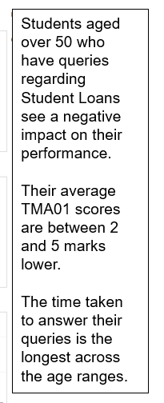
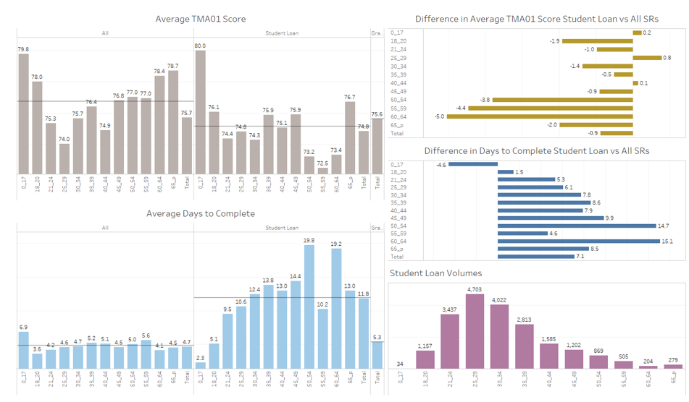
Slide Title 9
Student Loan Queries – Age Band

Slide 13
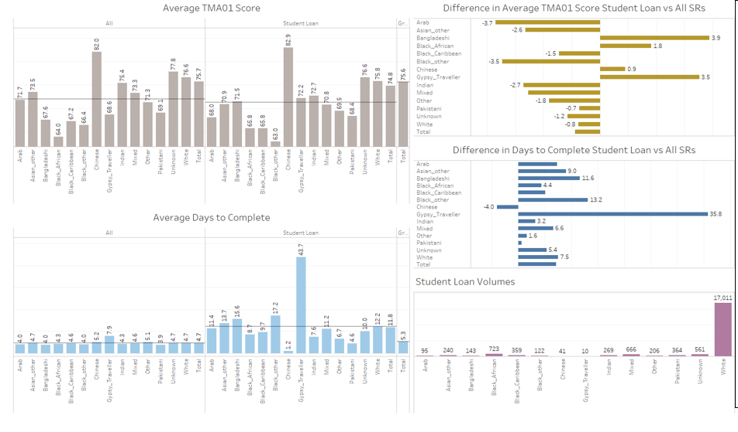
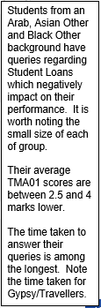
Slide Title 9
Student Loan queries- Ethnicity

Slide 14
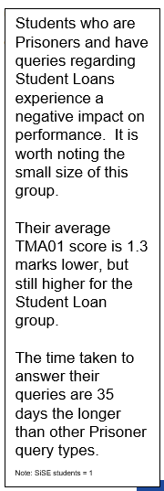
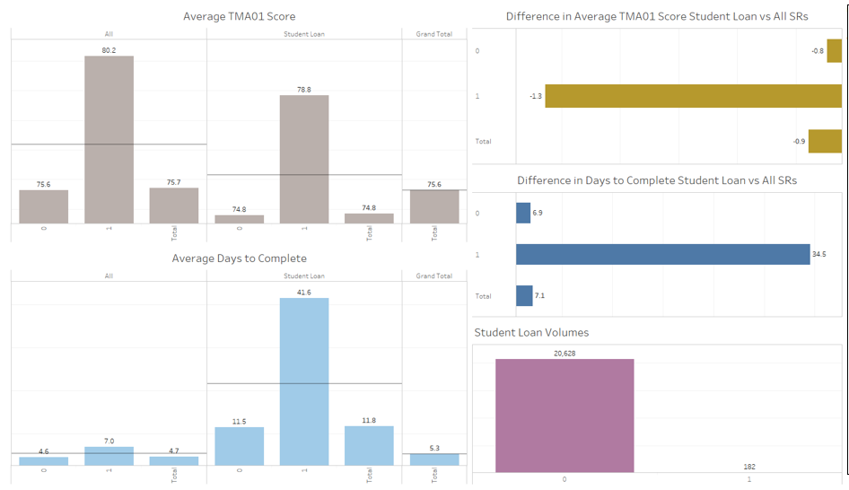
Slide Title 9
Student Loan Queries- Students in Secure environments

Slide 15
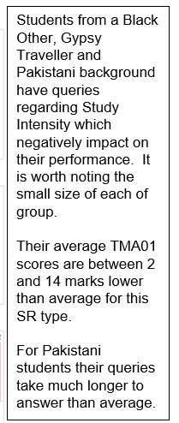
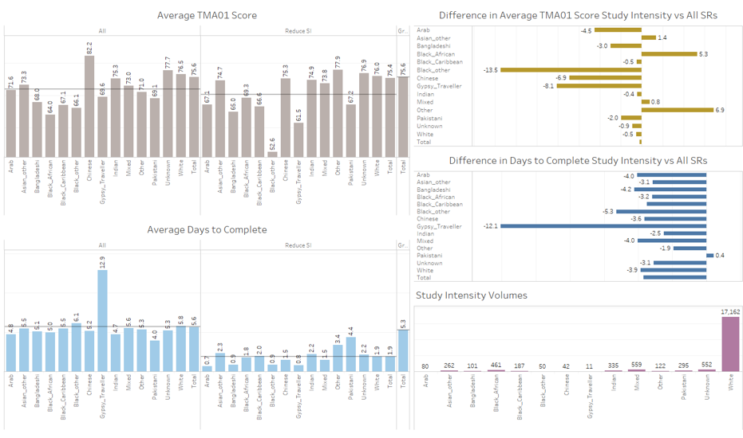
Slide Title 9
Study Intensity Queries - ethnicity

Slide 16
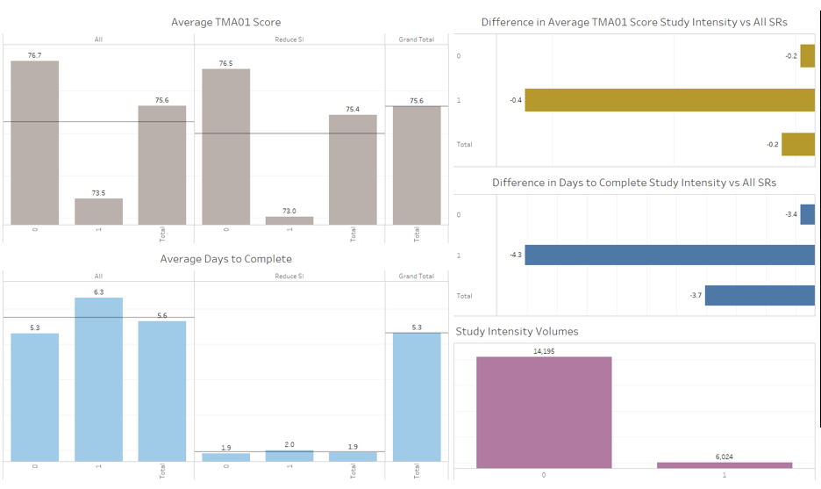
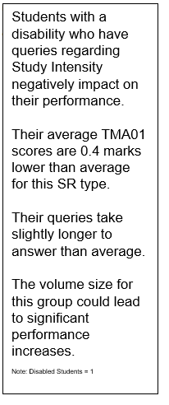
Slide Title 9
Study intensity Queries - Disability

Slide 17
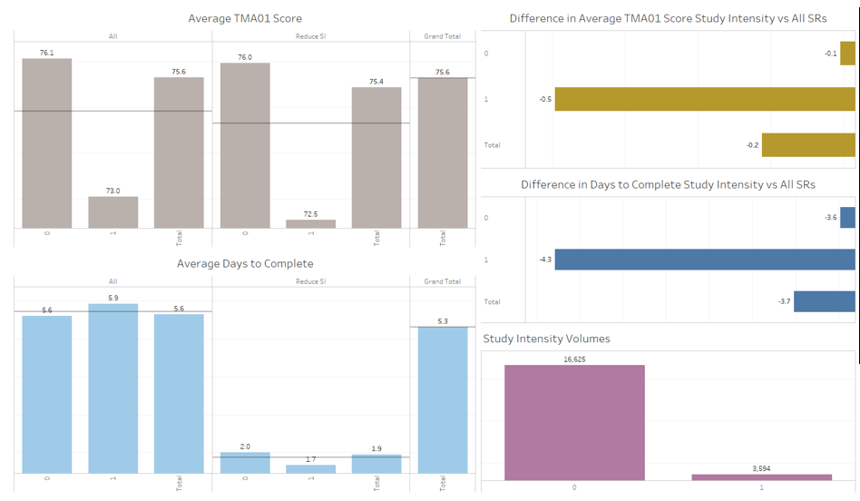
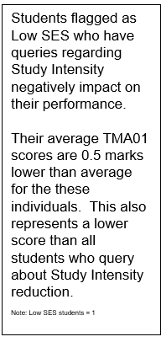
Slide Title 9
Study Intensity Queries –Low SES

Slide 18
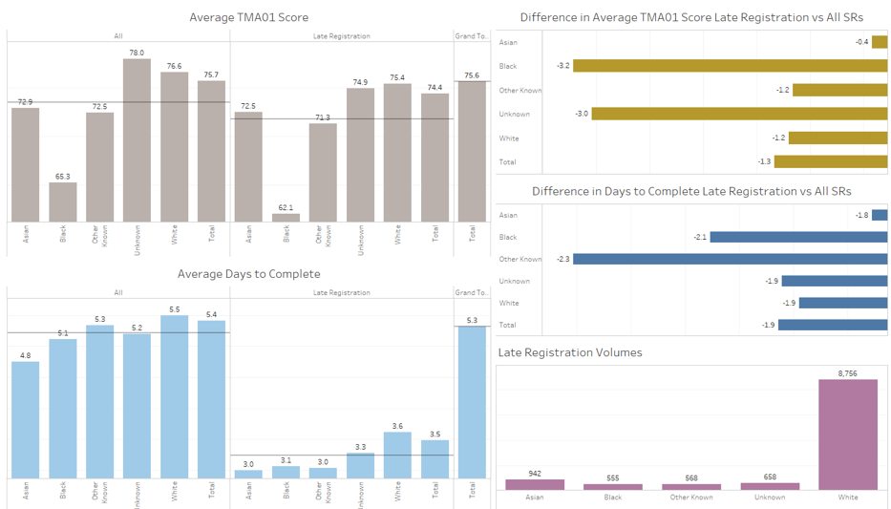
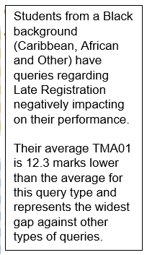
Slide Title 9
Late registration Queries - Ethnicity

Slide 19
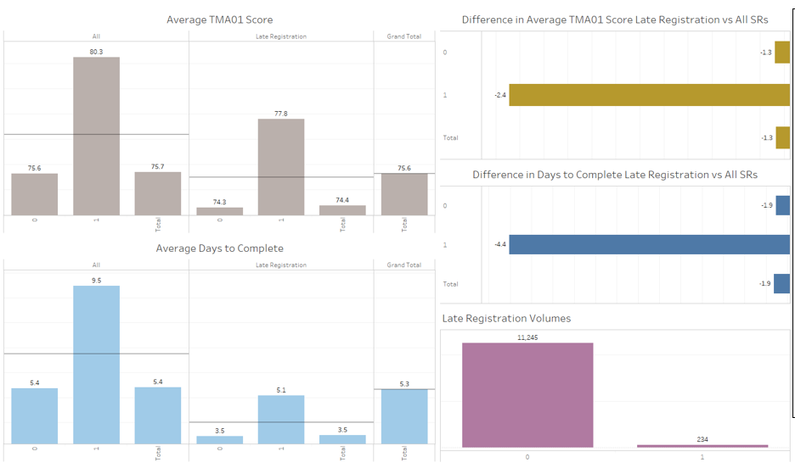
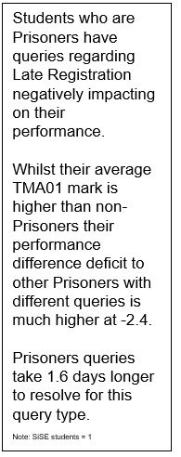
Slide Title 9
Late Registration Queries – Students in Secure Environments.

Slide 20
Slide Title 9
Target group selection
For the second phase of the project we decided to focus on the late registration of black students as there scores were 13.5 marks below that of the average on TMA01 and the time taken to answer their queries was 2 days longer than average. Given the relatively small numbers of students this was manageable for this project.
At this point we shared our initial findings with Ops managers in the STEMA SST and we had 2 meetings with the PLA team. The team are currently supporting black students and they informed us that they would be carrying out earlier interventions on 22J which would coincide with our 6 week study period.

Slide 21
Slide Title 9
Next Steps
Following the PLA support we plan to re-evaluate the data for 22J and based on the comparison of this data to the earlier analysis we will make recommendations to the SST and faculty.

Slide 22
Slide Title 9
References & Acknowledgements
Jacklin A., Robinson C., O’Meara L., and Harris A. (2007), Improving the experiences of disabled students in higher education, HEA report [online] available at https://www.researchgate.net/publication/253525979_Improving_the_Experiences_of_Disabled_Students_in_Higher_Education (accessed 06/03/2023)
Simpson, O. (2018 e-book). Supporting Students in Online, Open and Distance Learning (2nd ed.). RoutledgeFalmer.[online] available at https://doi-org.libezproxy.open.ac.uk/10.4324/9780203417003 (accessed 06/03/2023)
We would like to thank the STEMA SST ops managers and the PLA senior managers who met with us to discuss our initial results.
eSTEeM for funding this research.

Slide 23

Slide Title 30
Any Questions ?

Slide 24
Slide Title 30
Thank you for listening
Paul.Collier@open.ac.uk
Fiona.Aiken@open.ac.uk

