Slide 1
Supporting students in online tuition through the student journey
Prof Carlton Wood, Dr Lynda Cook and Dr Anactoria Clarke

Slide 2
Access module - Y033 Science, Technology and Maths
Interdisciplinary 30 points at level 3 (foundation/or pre-University level) at the Open University, UK
Introduces students to disciplines of biology, chemistry, physics, engineering, technology, design and maths
Progression pathway to named routes in STEM faculty

Slide 3
The Big Picture: Y033 student numbers and backgrounds
Student registrations: Access modules presented twice a year (now three times)
October 2018 654
February 2019 395
44% students are from 2 lowest quintiles on IMD
60+% students qualify for a fee waiver
22+% students declare a disability
55% students have prior qualifications below A level
9% students have no prior qualification

Slide 4
Pedagogic and Support Model
Supported Open Learning
1-1 telephone tuition (Tutor typically has 17 students)
Gradual shift along continuum from predominantly print-based engagement to more online (including forums, and design software in Y033)
Explicitly inter-disciplinary
Academic skills signposted to prepare learners for successful Higher Education study

Slide 5
Assessment Model
Four Tutor Marked Assignments (TMAs) – formative feedback, indicative grade
TMAs are differentially weighted, weighting increases towards the end of the module, summative – pass and distinction available (and fail)
4th TMA is weighted at 40%
Five Computer Marked Assessments (iCMAs) – formative feedback

Slide 6
Aims of this work
Does introducing students to synchronous on-line tuition in Access (or their introductory module) lead to increased participation in online tutorials throughout their degree
Are students able to use synchronous online tuition and if not, how are students best supported?

Slide 7
Methodology employed
Quantitative analysis of student’s participation in subsequent selected Level 4 modules
  Questions in science - S111,
  Engineering: origins, methods and context - T192
  Introduction to computing and information technology - TM111
Qualitative interviews of students who had progressed from the Access module onto Level 4 modules

Slide 8
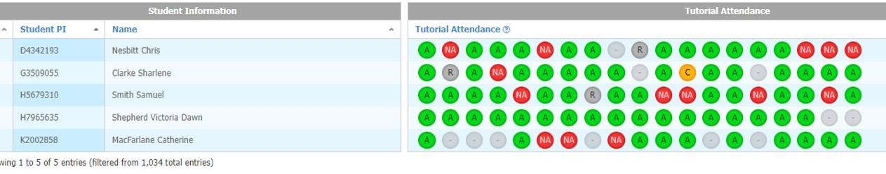
OU Analyse - Data Analytics
Use of OU’s bespoke data analytics tool (OUAnalyse)
Student did not
sign up
Student attended
Student signed up but did not attend

Slide 9
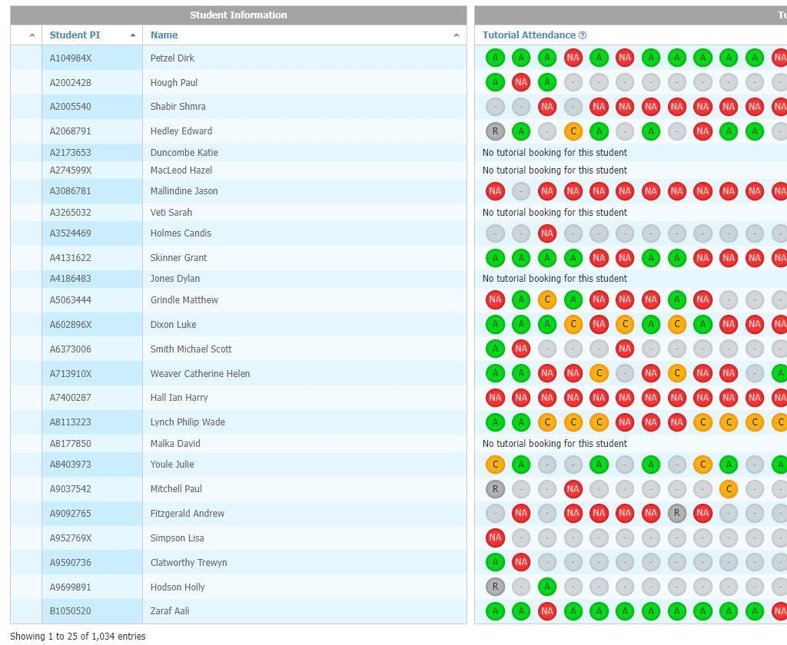
OU Analyse – Data Analytics
What was the picture if students had not undertaken Access prior to studying level 4?

Slide 10
Benefits arising from attending on-line sessions prior to level 4 study
Y033 attended
on-line session
Y033 did not attend
on-line session
No previous Y033
study

Slide 11
Qualitative responses
Can you recall attending an online tutorial run by your tutor on the subject of how to do well on the final TMA?
If I'm honest, I don't remember that because it was quite a while ago now
Yes although it was a long time ago I can remember it really well, it sticks in my mind as it was my first experience of doing anything like that…. it was good fun, there was nothing counting on it and so I could just go along and find out about the last assignment

Slide 12
Qualitative responses
How many tutorials have you attended
pretty much gone to everything …. I've got a feeling I might have missed two in the in my whole time of doing it …... and I mean, I've always been in the opinion that if you're gonna do it then, you know, do it all
I do attend as many of them as possible….. they can be helpful on maybe things that I haven't quite understood, so it is good for the tutor to explain and cover things that a lot of students tend to find more difficult, and the tutors are obviously aware of the areas the students find difficult. So they focus the tutorial on that area and they can explain things
In terms of the level 1 modules I must have attended at least 20 online tutorials, I tend to go for those that are related to assessment particularly the TMAs to get some tips on how to answer them

Slide 13
Qualitative responses
Were you influenced to any extent by your experiences on Y033
I was …..because I knew that I would need that information when I completed [the Access module]…..I would know how [the on line] tutorials would work and I would know what I had to do going forward
Completely influenced by it. I was much more likely to attend because of having had the experience of going to that [Access] tutorial
Oh, far more likely…………… It helped me get used to studying again and although I was spoon fed a little bit I knew that tutorials would be helpful. That is nice to know how, otherwise I would have had no idea about what to expect from online tutorials
Do you think that the Y033 session made it more (or less likely) that you attended future Level 1 sessions
“until I had seen that online meeting in Access I didn’t know what to expect but once I had seen how easy it was to use then that made me much more confident going forward in using it…I saw that the technology worked”
I was much more likely to attend because of having had the experience of going to that Access tutorial ……. Because it came across in a very friendly informal way.………and I think there was a few of the features in the software were explained as well, which obviously helped for future tutorials and encouraged me to go knowing that I knew a little bit how things worked

Slide 14
Any questions ?
carlton.wood@open.ac.uk

