Slide 1


Front Cover Title 1
Can we reduce anxiety of students sitting online exams? Sharing best practice between SPS and LHCS.
Fiona Moorman, Gemma Warriner and Becca Whitehead
This Photo by Unknown Author is licensed under CC BY-SA-NC
Notes:
All – motivation

Slide 2
Structure of the project
We ran two “Getting ready for your remote exam” sessions, one in March and one in May. This was done in both schools
Sent out a survey just after the exam period. We asked students about their preparation for the exam, and their perspectives about their exam experience. We did not ask about the content of their exam papers.
We are following interviews and focus groups to explore some of the issues raised in the survey in more detail

Slide 3

“Getting ready for your remote exam”
Adobe Connect sessions
This Photo by Unknown Author is licensed under CC BY-SA-NC
Notes:
Gemma 7 mins

Slide 4
Exam preparation - March
March session – this was themed “Plan ahead” and in SPS was run by Gemma Warriner and Becca Whitehead. In LHCS by Fi Moorman and Karen New
What did we cover?
Exam format, iCME system, creating & uploading pdf/word files, revision, exam day planning, advanced troubleshooting, plagiarism (LHCS)
SPS
48 attendees and 349 views
LHCS
56 attendees and 276 views
What did the students ask?
A lot of questions. Clearly anxious students attending this first session

Slide 5



March session questions
The students asked a lot of questions focussed around:
The timing of the exam and extra time, including what would happen to the timer
Uploading the file and file size
The 'open book' nature of the exam

Slide 6
Exam preparation - May
Focussed on what to do on the day. We were pleased to be joined by colleagues from ACQ, SST and the Computing Helpdesk to answer student queries.
What did we cover?
iCME system, timings, looked in some depth at the helpdesk and what to do if things went wrong on the day
SPS
122 attendees and 162 views
LHCS
65 attendees and 208 views
What did the students ask?
uploading the document, discretionary postponement, special circumstances, access to websites (open book), plagiarism

Slide 7

Survey : Your remote exam experience

Slide 8
Survey results
When
June 14th until July 10th (JISC survey)
How many took part
Sent to >2500 students. 349 responded – 138 from SPS and 211 from LHCS. >100 students indicated would take part in future research
Style of questions
Mix of qualitative and quantitative
What did we ask about
Their preparation, were the sessions helpful, how did they cope, could they complete the exam, any other issues

Slide 9
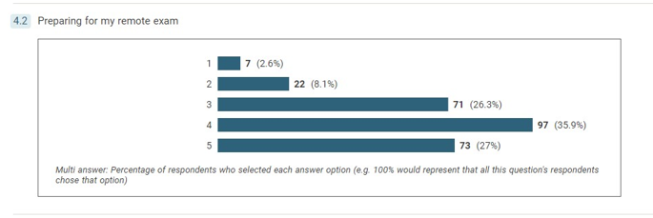
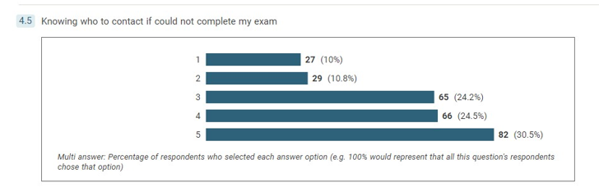
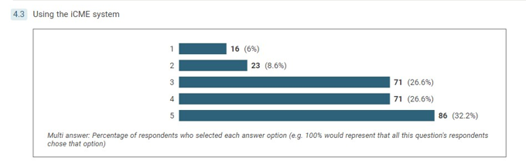
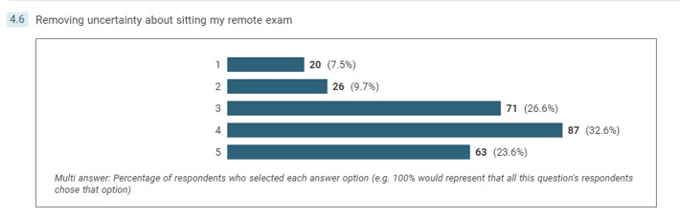
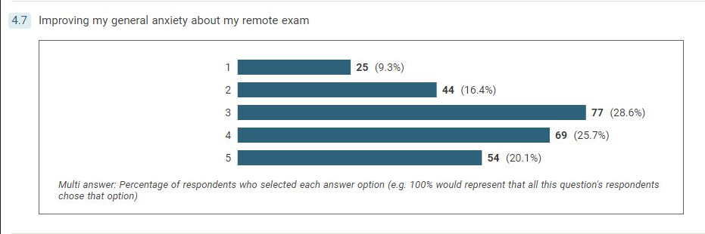
Session feedback – perceived usefulness
1 not useful to 5 very useful

Slide 10
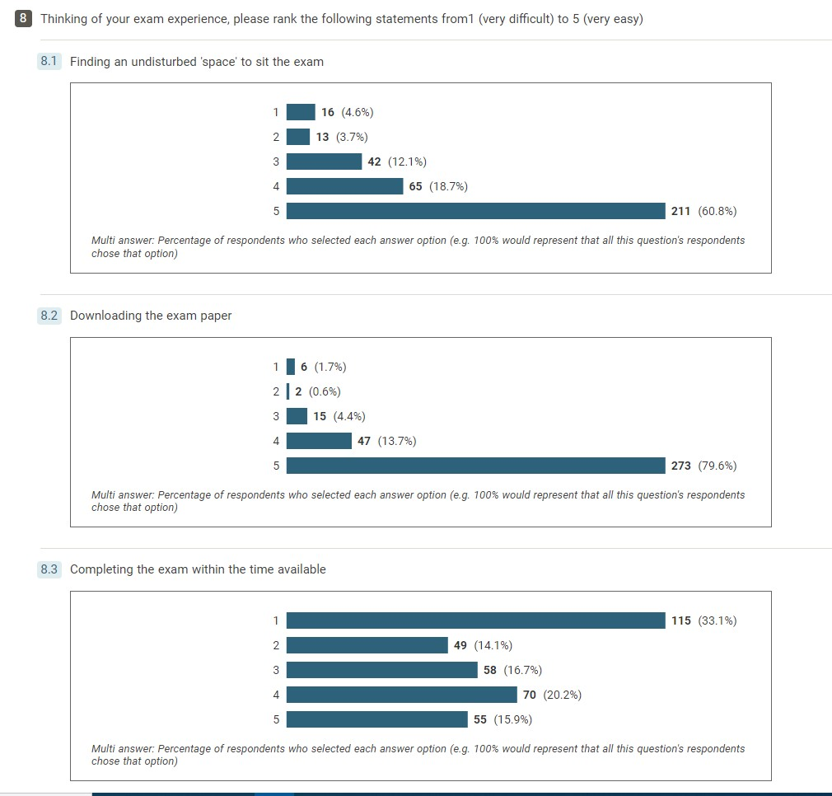
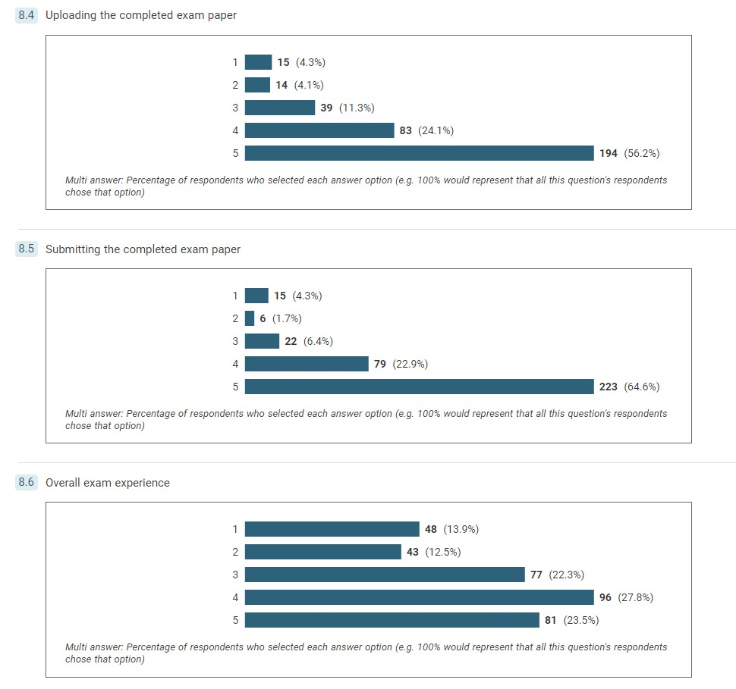
Student experience of their remote exam
1 very difficult to 5 very easy
Notes:
8.3 - 33% found completing in the time very difficult
8.6 – mixed picture. Just over 50% found the experience positive. Around 25% found it very challenging

Slide 11
Student response – What did you wish you had known?
I answered as much as I could but typing an exam was very difficult especially with equations etc and then having to add in scanned drawings etc was time consuming so wasn't able to complete the exam fully.
That I would have been better off with using 2 screens as the constant shift from tab to tab to writing the exam to looking at the research paper was horrendous
Exam set as open book, but insufficient time to consult books
That the exam would be harder than normal because it would be open book.
I wish I had test-submitted the SEP...that's my fault, but I think the issues I had would have been resolved if I had done that
I didn't feel completely sure about the timing. We were told 3 hours for the exam and 1.5 hours for scanning/uploading but I was worried.....that I would be penalised for submitting after the 3 hours.
I think when these exams are being planned someone should be timed doing it on a computer
Even though I’d revised for the exam I still struggled to finish within the time allowed without getting penalised.
We had a lot of free text responses! Strong feelings.
Notes:
We have done some initial analysis of the free text comments.
In response to "Was there anything else that you had wished you had known before going into your exam?" We had the following types of response:
That the exam would take longer than they thought
That there had been more revision/subject related support
That they had known how to access IT/SST support
That they had understood the nature of "open book"

Slide 12

Student voice
Notes:
We shared these findings with MTCs and colleagues in exams. Also shared at a scholarship session in SPS.

Slide 13

Interviews and focus group
Notes:
Becca 4 mins

Slide 14

Online Interviews (JISC)
Student response rate:
19 students (from 45 contacted) responded
We asked about:
How exams have gone in the past
Differences in experience of remote exams vs exam hall.
How helpful/unhelpful the support available was
If IT equipment was sufficient

Slide 15
Interviews
How exams have gone in the past
83% of students were positive or neutral about remote exams with only 17% negative
Differences in experience of remote exams vs exam hall.
Disadvantages to exam hall : Travel and associated cost, Stress of travelling, discomfort and small desks, not being able to have breaks/cups of tea, prefer to type than handwrite, One person said that they liked to vocalise thoughts.
Advantages to exam hall: more focussed with more adrenaline, prefer to
handwrite, saves having to upload script

Slide 16
Interviews
How helpful/unhelpful the support available was
Helpful support: good tuition , testing iCME system with SEP, understanding timings, past papers, TMAs, quizzes etc, exam prep sessions
Unhelpful support: Too much information given ahead , some of it contradictory
If their IT equipment was sufficient
Interestingly everyone happy with their set up, more or less. Exceptions were the scanning and fear of internet fail.

Slide 17
Focus group
Student response rate:
7 students (from 46 contacted) responded
Themes:
What does it mean for your exam experience, that you have access to the module materials and internet?
How did you use your time on the day?
What preparation did you do?
The focus group is scheduled 26th April

Slide 18

Outputs and future work
Notes:
Fi 4 mins

Slide 19
Outputs from our research
Updated exam prep sessions in 22J
We are running remote exam prep sessions again with updated guidance based upon issues identified in our survey
Importance of Specimen iCME
Encourage students in every way possible to do the specimen paper as a mock. Emails ALs about resources
Exam FAQs
Contribution to exam FAQs created for students and tutors
Module Team support
Disaggregated survey findings provided to individual module chairs to support 22J exam preparation

Slide 20
Project impacts
ACQ guidance
Project leads supported ACQ colleagues with preparation of student-facing remote exams guidance
Learning from each other
Cross-school collaboration
Exam workshop
Inclusion in school exam assessment workshop
Career development
Scholarship used to support successful SFHEA application

