Slide 1

Intro Slide Title 1
M250 engagement
Demographic analysis
Anton Dil
Computing and Communications
19th April 2023
Notes:
Part of the Esteem Project “An evaluation of the impact of changes to assessment practice in a second-year object-oriented Java programming module.”
Module Team and project members: Anton Dil, Sharon Dawes, Richard Walker, Lindsey Court, Matthew Nelson
With help from Michelle Aitken, Tracy Bartlett, Tyrone Court, Jonathan Evans, Ralph Greenwell, Shawndra Hayes-Budgen, Tim Hunt, John Jeffries and Chris Nelson.

Slide 2
Slide Title 2
Background
New M250
from 2021J
Object-oriented Java programming

Slide 3
M250 Changes
How 2021J materials differed
Brand new module, with unchanged learning outcomes
Dropped old in-house materials
Bought-in textbook
(‘Objects First with Java’, Barnes and Kolling)
More practical, perhaps harder
Added some extension content for better students
OU ‘Chapter companions’ : 70 embedded practical activities with automated feedback
Unlimited automated feedback on TMA solutions before submission
Lots of forum discussion relating to automated feedback
Exam now online
Well-received by tutors.
SEAM feedback generally improved
Navigating the material is harder than with old in-house materials.
Reg25 N = 1395
Exam N = 1060

Slide 4
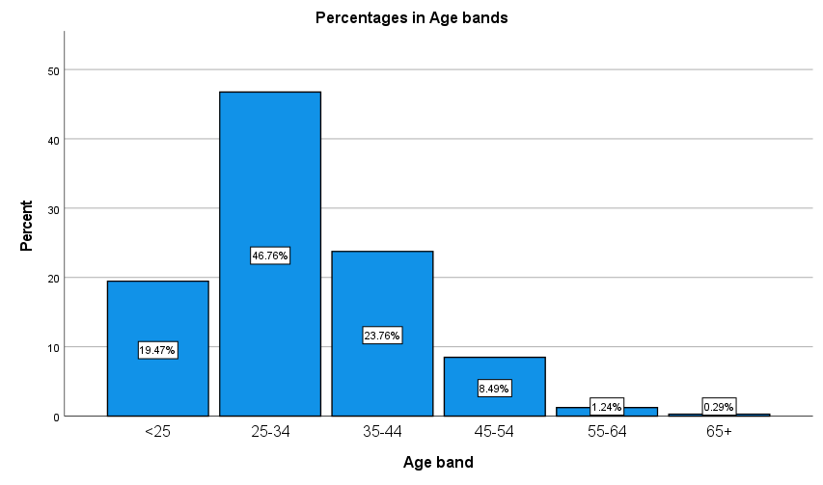
Age breakdown
Mostly 25-34
Percentages in age bands
19.5% < 25
46.7% 25-34
23.8% 35-44
8.5% 45-54
1.1% 55-64
0.3% 65+ (3 students)
Different data set to module profile tool, included demographics.
Notes:
These stats do no match module profile tool as they came from a different source.

Slide 5
M250 2021J Demographics and dropout
Students drop out rather than fail
Demographic groups
86% White, 14% other groups
85% mid to higher SES
80% not disabled
77% male, 23% female
66% aged under 35
63% Q62 Computing and IT
15% Q67 Computing and IT with a second subject
22% other qualifications
Completion rates (module profile tool)
Overall completion 69%
Asian -3% Black -11% Mixed -1% Other +13%
Low SES (-1% vs mid to higher SES)
Disabled (-15% vs non-disabled)
Female (-6% vs male)
Age 35+ (-0.7% vs < 35)
Q67 (-2% vs Q62)
For completing students, credit received rates are similar, notably except for Black students and Low SES.
Notes:
Stats on this slide are from module profile tool, which doesn’t provide statistical significance and are based on completion.

Slide 6
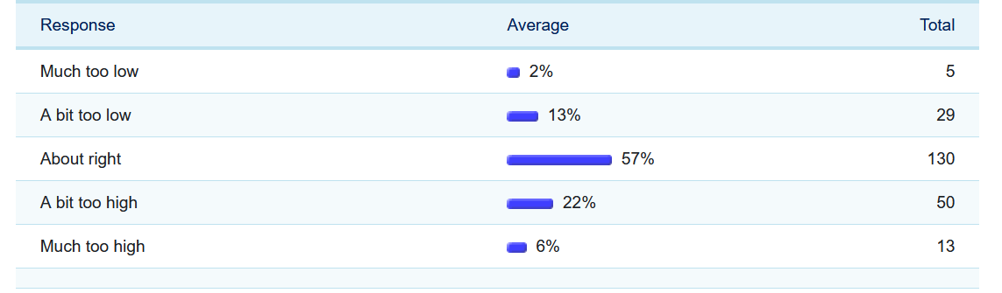
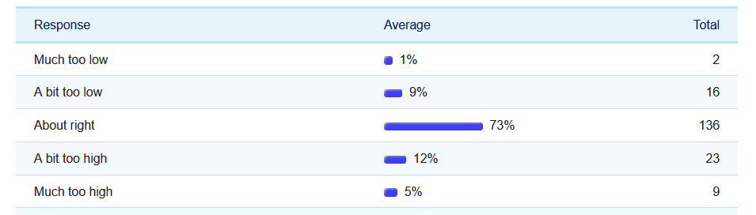
M250 level expectations
Comfort improved
How did you find the level of M250 content, compared to your expectations for a Level 2 Java module?
2020J
N=227
2021J
N=186
+ 16% in ‘about right’
Notes:
Note students answering this are more likely to have reached the end of the module, because that’s when the question appears.

Slide 7
Comfort with level of M250
Measuring students who made it to the end, probably
Mostly, students responding to our comfort survey were not affected by demographic group
No significant differences for comfort
Female vs male
Ethnicity
Disabled vs non-disabled
Age 35+ vs <35
Significant differences for comfort
Combining comfort levels 1 - 3 (‘about right’ or finding it easy) versus 4 + 5 (‘too high’ or ‘much too high’)
Higher Index of Multiple Deprivation less comfortable
IMD quintiles 1 & 2 versus 3-5,
Chi-Square = 4.405; p = .036
Q67 vs other qualifications (next slide)
Notes:
N = 186

Slide 8
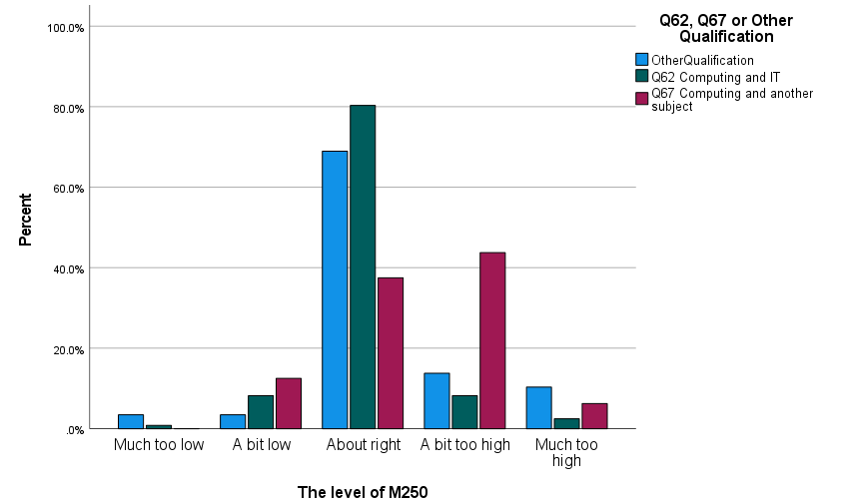
Q62 versus Q67 or Other qualification
Specialists versus non-specialists comfort levels
Q62 Computing and IT (67%) Q67 ‘with another subject’ (17%) Other (16%)
Q62 centred on ‘about right’
Q67 centred on ‘a bit too high’
Remember Q67 dropout +2%
‘Other’ Quals not sig. different comfort distribution to Q62
Q67 is taken by
26% of females vs 11% of males
30% of Black vs 14% of White
Asian lowest on Q67 (5%)
Comparing expectation in ‘Too high’ + ‘Much too high’
Q67 > non Q67
p < .001

Slide 9
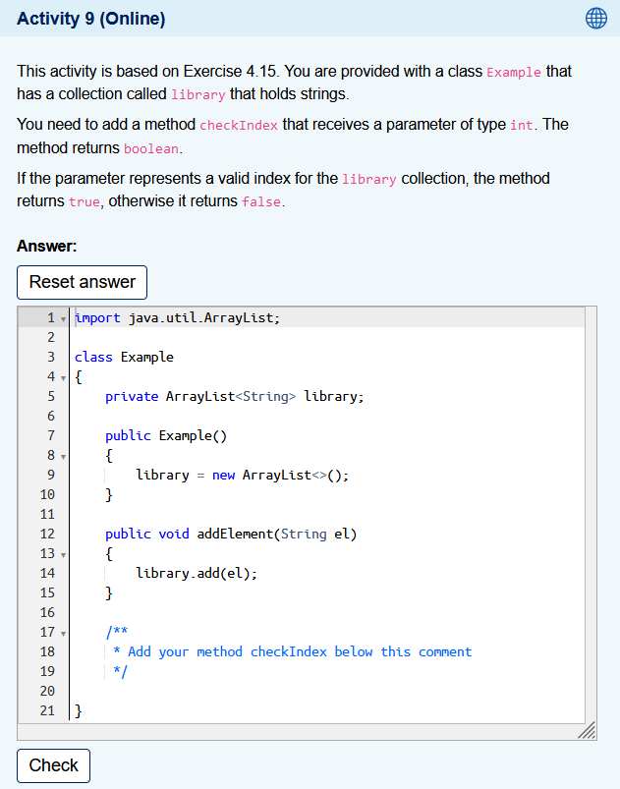
Slide Title 3
Engagement
Use of 70 formative activities
02

Slide 10
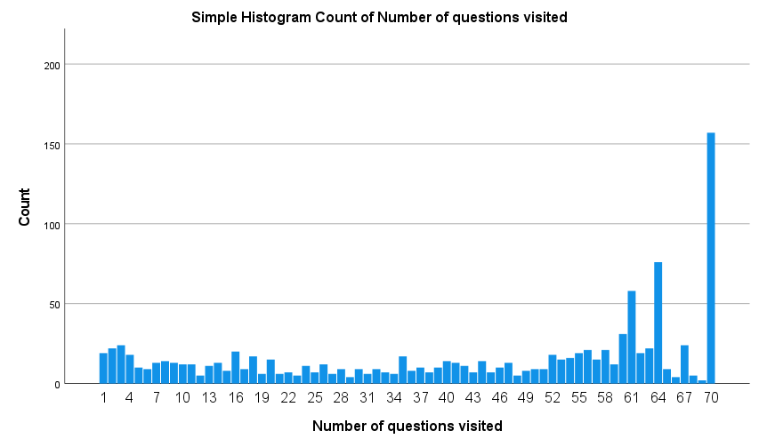
M250 2021J Formative Engagement
70 embedded activities online, with automated feedback
Formative activities were made more visible. Who does them?
Most students at least visit most activities.
Some have dropped out by these end of module stats.
Mostly around when they are scheduled, with extra peaks before related assignments
Engagement is correlated with scores on TMAs and Exam (Spearman’s rho range from 0.283 – 0.348 from TMA01 to TMA03)
Not as highly correlated as TMAs and Exam with each other (0.614 – 0.760)

Slide 11
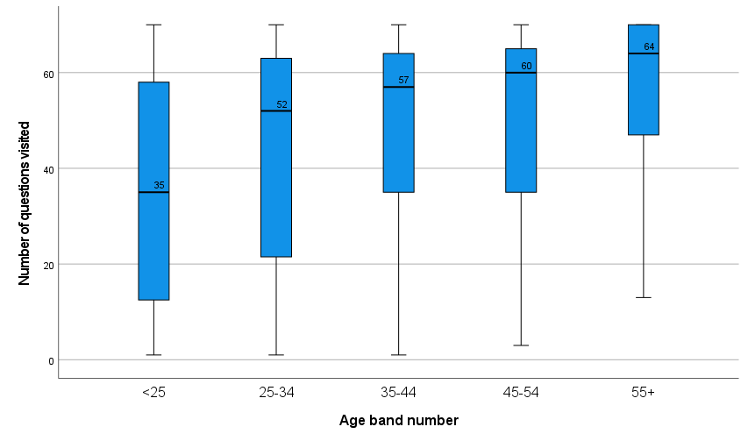
M250 2021J Formative Engagement
70 embedded activities online, with automated feedback
Age
Mean and median engagement increases with age
Here 65+ (N=3 group) is merged with 55-64.
Gender
Females more engaged (median +7) p = .024
Female lower IQR (interquartile range)

Slide 12
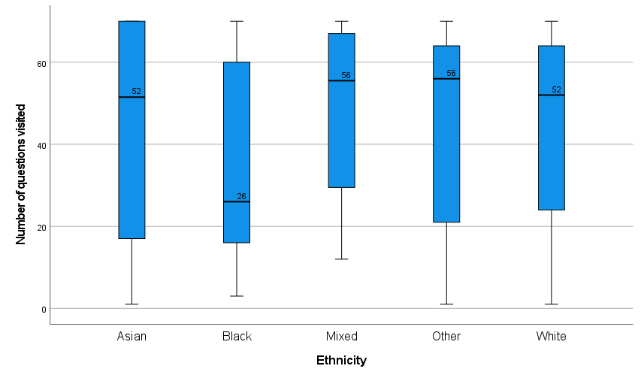
M250 2021J Formative Engagement
70 embedded activities online, with automated feedback
Ethnicity
Black students lower median (N=24 group), but not statistically sig.
Black students less likely to have done > half of the activities (p = .028)
Mixed, Other more engaged
Includes students who dropped out.
Qualification
Q62 more engaged (not sig.)
Q62 median 52
Q67 median 47
Other median 47

Slide 13
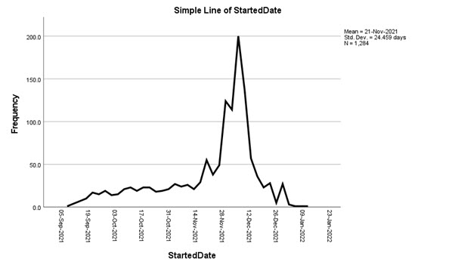
Slide Title 4
TMA engagement
Interactive feedback on summative TMA questions
03

Slide 14
M250 2021J Summative TMA Interactions
TMA testbeds also provided this formative feedback, unlimited attempts
Students visit testbeds mostly around the time a TMA is due

Slide 15
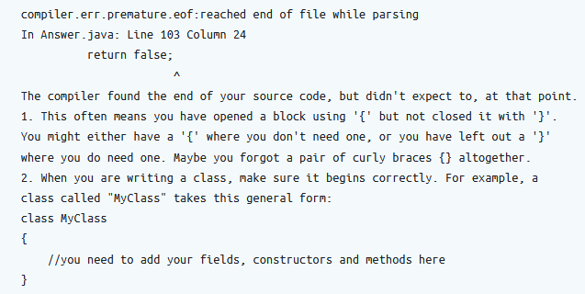
Three kinds of feedback
1. Compilation errors - hand-tuned, a bit of guesswork.
Notes:
Compilation error feedback is based on that provided in BlueJ. The compilation error code suggests what has gone wrong. Sometimes this is pretty clear, other times there could be many possible explanations.

Slide 16
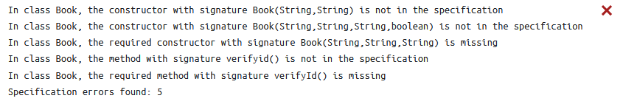
Three kinds of feedback
2. Specification – comprehensive structural feedback, leading to unit testing.
Compilation and specification feedback were produced in a previous eSTEeM project
Notes:
This work was done in a previous M250 Esteem project.
Even if code doesn’t compile, structural feedback can often be provided. This involves parsing the students code and comparing against a known specification.
In general, you can’t unit test unless your code compiles and passes structural tests, although there are a few exceptions.
The first two kinds of feedback are to help students get to the point where they can test their code.

Slide 17
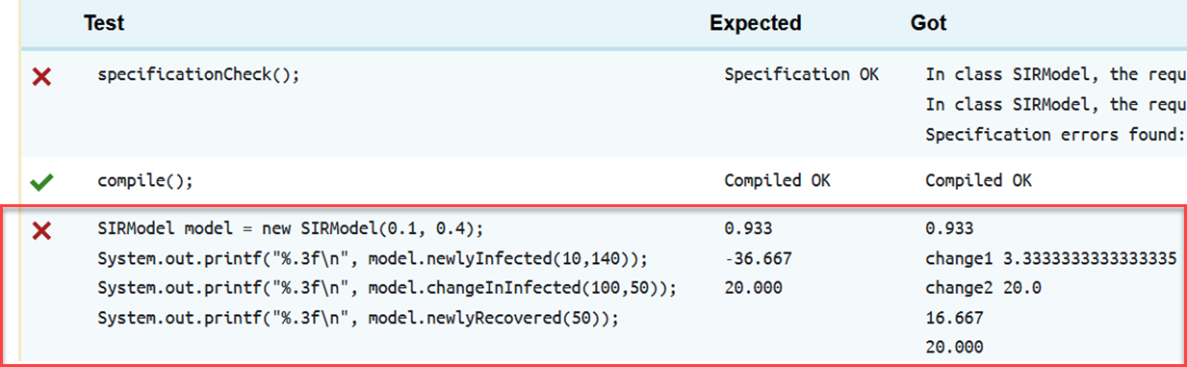
Three kinds of feedback
3. Functional, testing the student’s code
Notes:
Here all three kinds of feedback can be seen. The student should really have fixed their specification (structural errors) first.
The third test here is functional.
Students don’t always understand the difference between these three layers of testing.

Slide 18
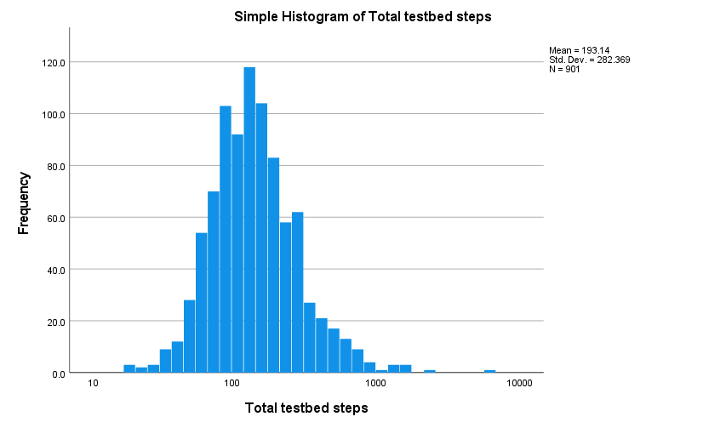
M250 2021J Summative TMA Interactions
Older, female students higher median steps on testbeds
Log-scale interactions over all TMAs per student
Many uses, with a long tail. High skew.
Mean total steps 193, median 136
but > 1000 interactions for some students.
T-tests for different mean total number of steps
Age 35+ > younger p = .005
Level ‘high’ > level OK p = .030
female > male p = .081
Unclear from this whether fewer interactions means more confident or more stuck.
Some bring nearly complete work to testbed, others work in testbed.

Slide 19
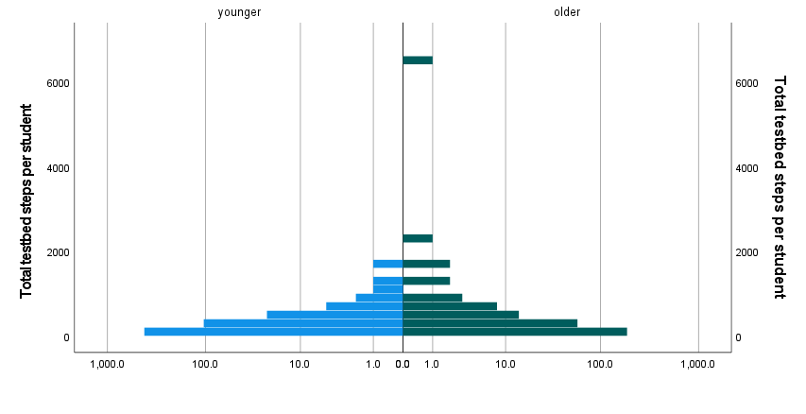
M250 2021J TMA Interactions
Age differences in testbed use
Log-scale interactions over all TMAs per student by age
Age
35+ median > younger
p = .024
Older median 145
Younger median 128
Older max 6477
Younger max 1633

Slide 20
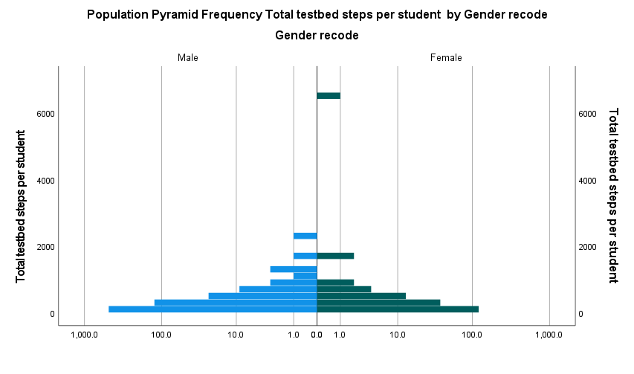
M250 2021J TMA Interactions
Gender difference in testbed use
Log-scale interactions over all TMAs per student by gender
Gender
Female median > male
p = .052
Male and female distributions look similar, but standard deviation for females is much larger – 514 vs 184 for males.
Female median 151
Male median 130
Female max 6477
Male max 2396

Slide 21
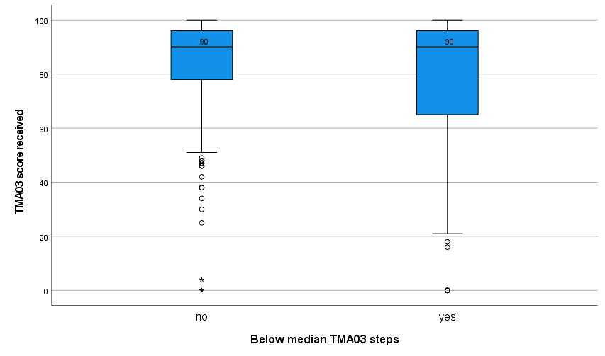
M250 2021J TMA Interactions
Below median interactions versus scores on TMAs
For all TMAs, below median interactions group has sig lower mean (but not median) TMA scores
Example for TMA03 mean score
Higher steps mean 84.5% >
Lower steps mean 78.9%
(p < .001)
Greater IQR and lower Q0 for students with below median steps on TMA03.
Number of steps correlated positively with TMA score (here .313)

Slide 22

Slide Title 5
Compilation errors
Whose TMA code failed to compile more often?
04

Slide 23
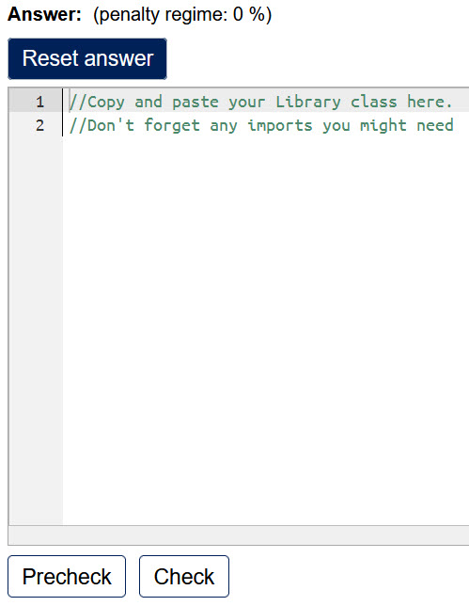
M250 2021J TMA01 Interactions
How many clicks on TMA01?
TMA01 has the highest engagement (withdrawals affect TMA02, 03)
For TMA01:
1298 Personal Identifiers
69570 steps (some not compilation, recorded as null input)
65261 compilations
40099 compilations OK
25162 errors or warnings
65 error codes
38.6% of the time a compilation error.
Dropping to 26.2% for TMA02 and 20.0% for TMA03.
Greater variety of errors for later TMAs. (TMA02 PIs 1060, TMA03 943)
Typical errors, but some related to copying and pasting from an IDE.

Slide 24
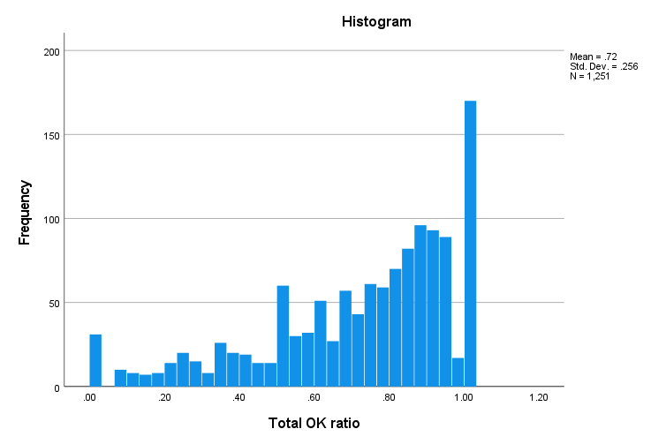
M250 2021J TMA01 Interactions
Ratio of OK compilations, means by demographics
Ratio of OK compilations / number of steps
TMA01 comparison
T-test for different means of OK compilation ratio
Mean = .72, std dev. = .256 (N = 1251)
Female < Male t = -4.881 p < .001
.65 vs .74
Low SES < Higher t = 2.399 p = .017
.68, vs .73
Disabled < Not t = 2.313 p = .021
.69, vs .73

Slide 25
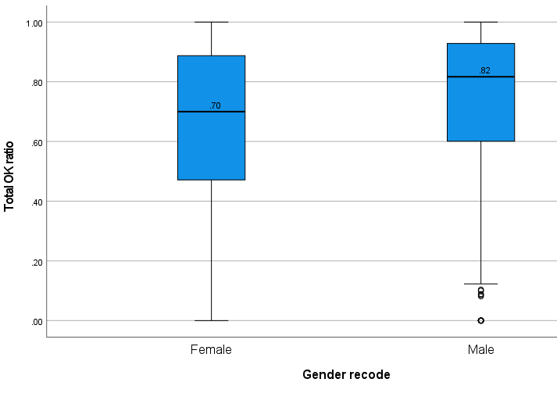
M250 2021J TMA01 Interactions
Median differences in OK Ratio, and proportions below median
Comparing ratio of OK compilations by gender
TMA01 comparison
Tests for different median OK compilation ratio.
Overall median is .793
No sig. for Qual, ethnicity, older, Low SES
Female < Male p < .001
.70 vs .82
Disabled < Not p = .042
.76 vs .80
Below median OK ratio => lower scores on the TMAs (11% difference in medians, 13% in means) and Exams (median 68% vs 85%)
p < .001

Slide 26
Summary
New M250 well-received, better comfort levels
  Q67 (non-specialists), lower SES less comfortable
Formative activity use
  Female, older, specialists (Q62) more engaged
  Black students’ less likely to have done most of the activities
TMA testbed use high, positively skewed, with a long tail
  Female, older students higher median numbers of steps (female bordering on 95% confidence)
  Higher steps => higher mean scores (suggests improving their code)
  Promotes forum discussion
OK Compilation ratio
  OK compilation ratio improves from TMA01 to TMA03, but weaker students have dropped out
  Female, disabled, lower ratio of OK compilations
  Below median OK ratio strongly associated with dropout, lower TMA scores, not taking exam (-12%), or lower exam scores
Completing students mostly pass in similar proportions, except for Black and Low SES students.

Slide 27
Slide Title 30
Project members
Sharon Dawes, Richard Walker,
Matthew Nelson, Lindsey Court
Thank you
Anton Dil
anton.dil@open.ac.uk

Slide 28
Slide Title 31

