Slide 1


Creating a community of students through social activities
Cath Brown and Sue Pawley
School of Mathematics and Statistics
April 2023

Slide 2
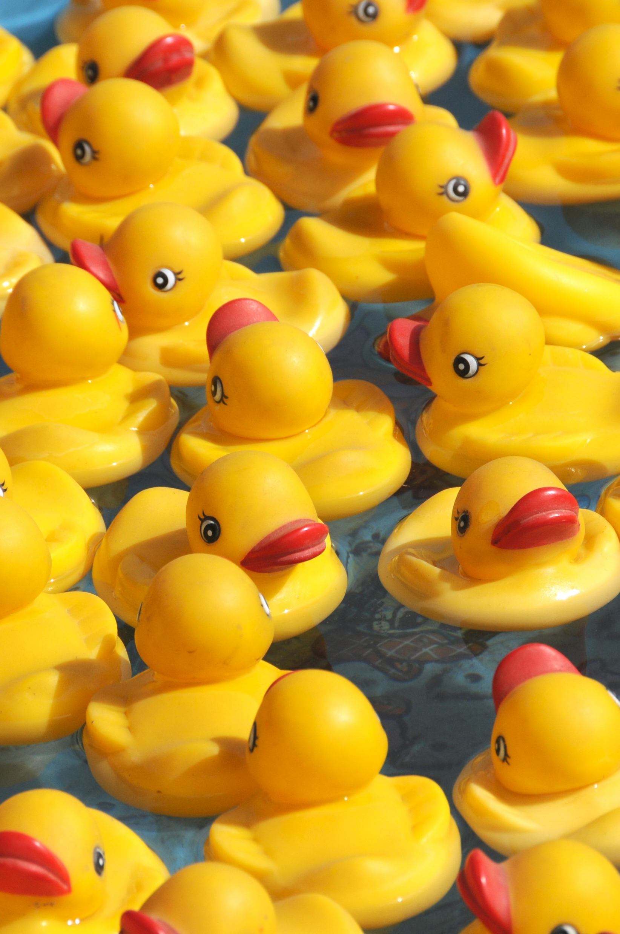
Why try to create a community?
STEM students find their modules academically demanding
  success requires the development of resilience and a growth mindset ¹
    a strong sense of community amongst learners contributes to promoting this ²
Belonging to a supportive community has also been shown to enhance attainment³ and increase retention⁴
For mathematics students in particular, studies have shown increased retention for students who were part of learning communities ⁵
  This was particularly marked for women and first generation students
Important to create environments to support students’ sense of belonging and develop structures for student interaction ⁶
  Particularly important the environment has a “family” or “caring” feel when supporting underrepresented groups in the community⁷

Slide 3
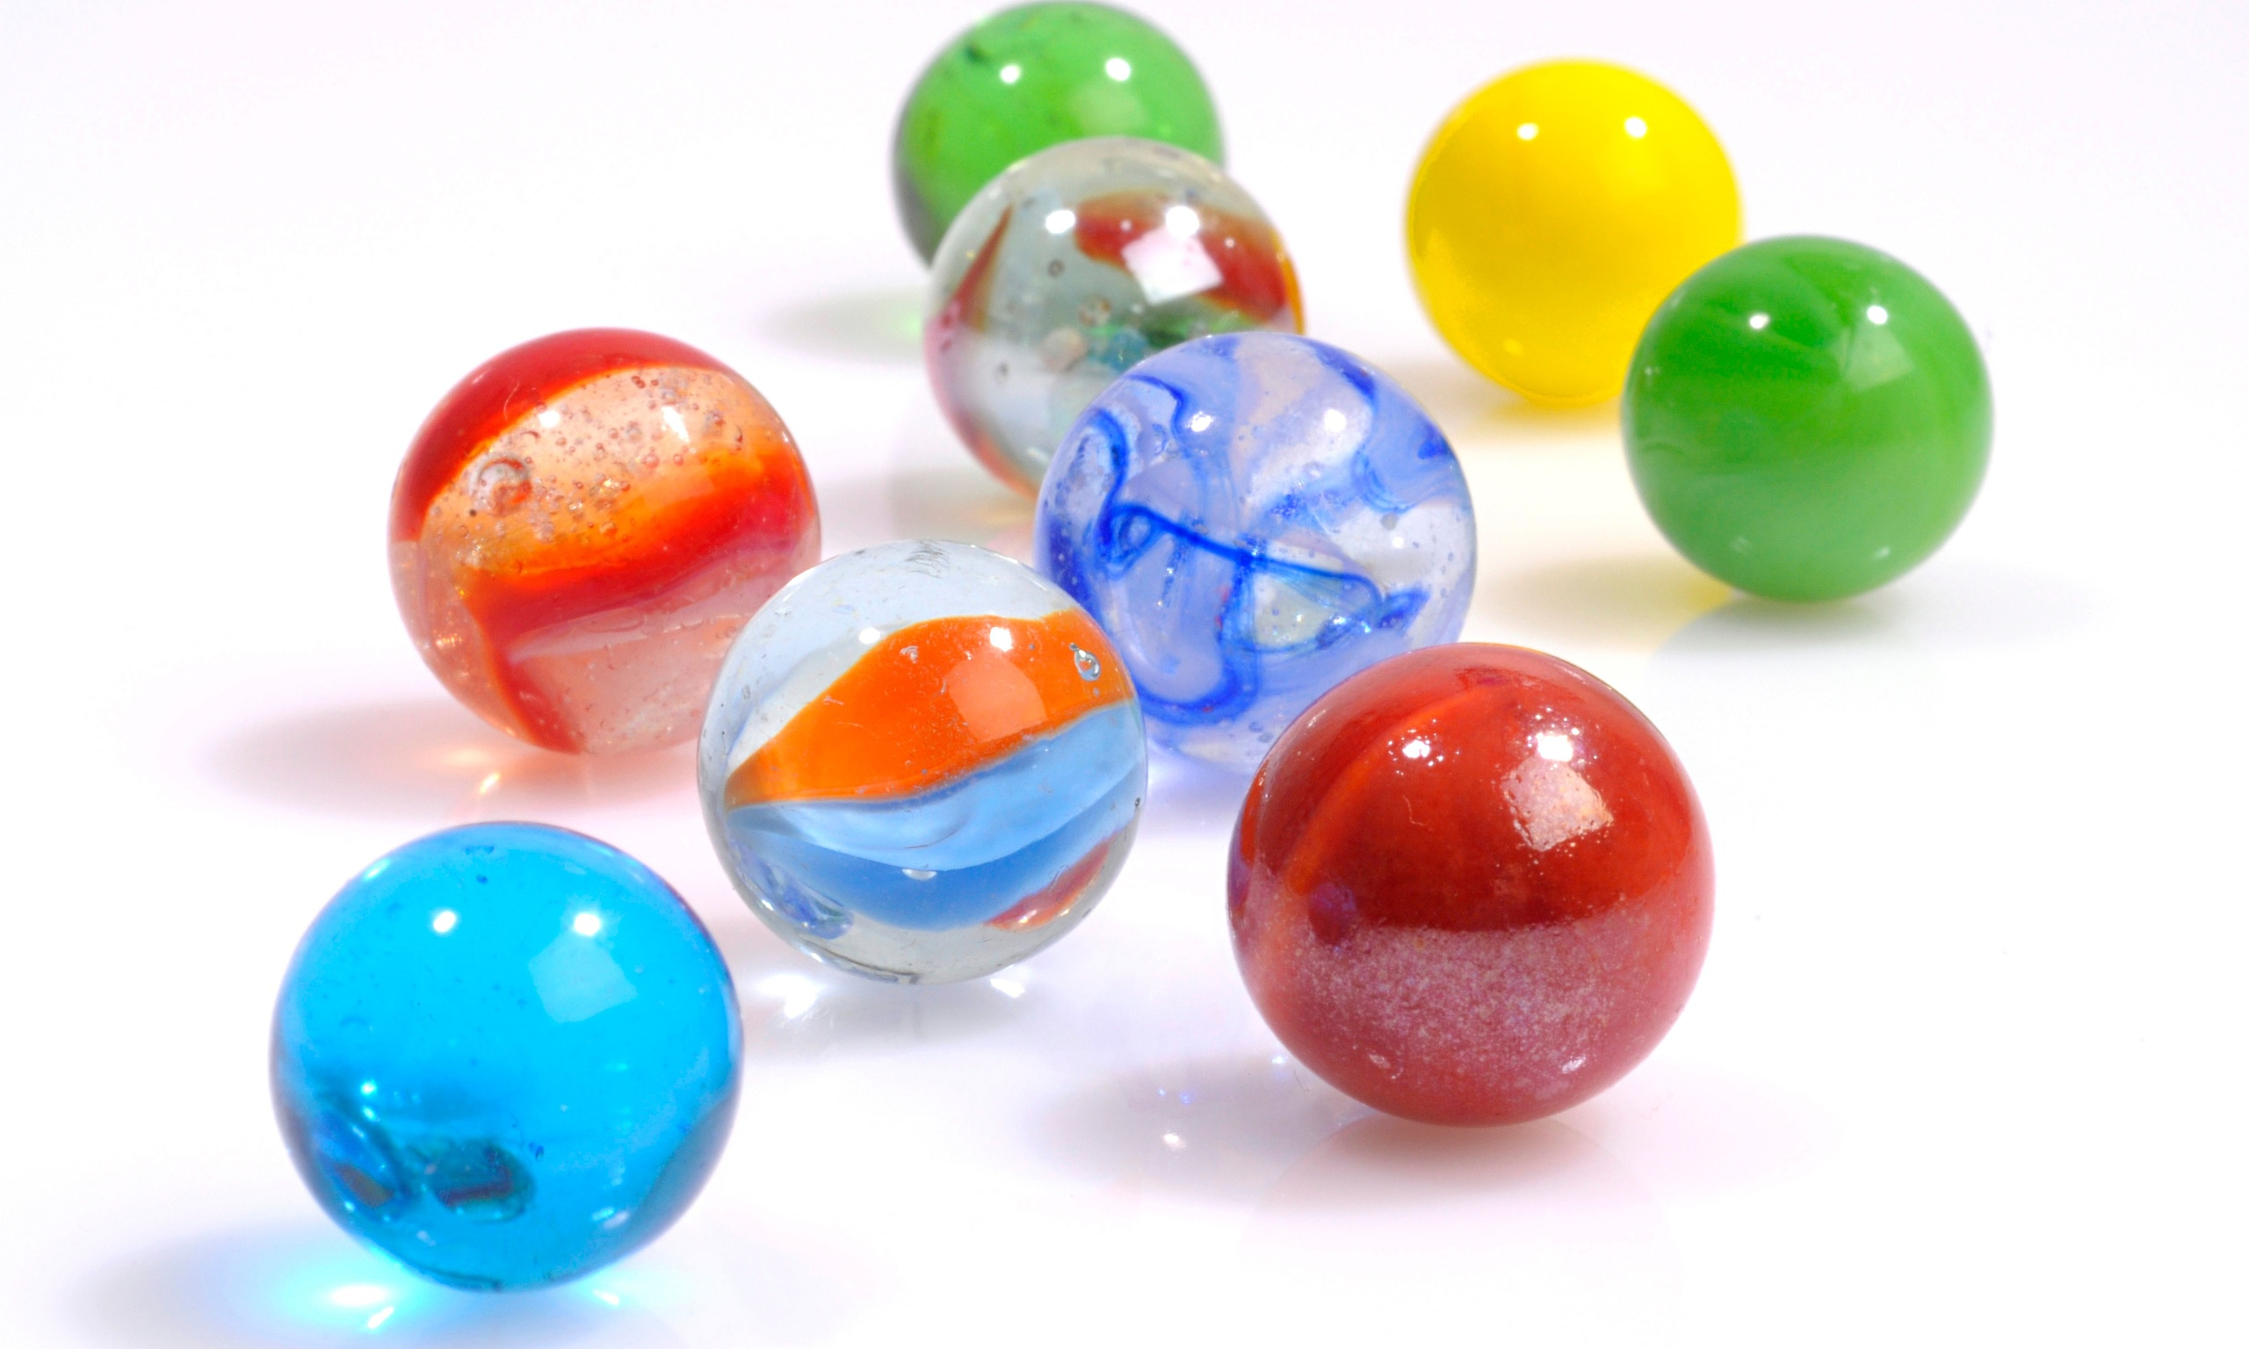
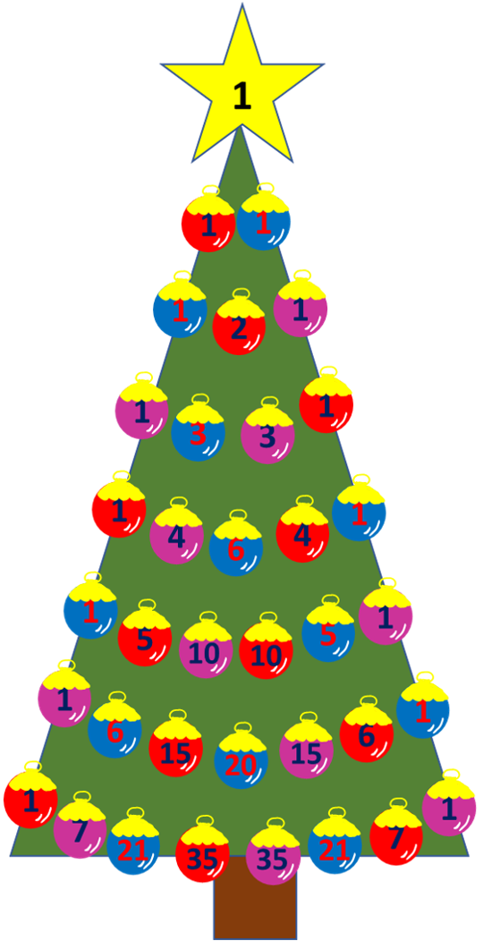
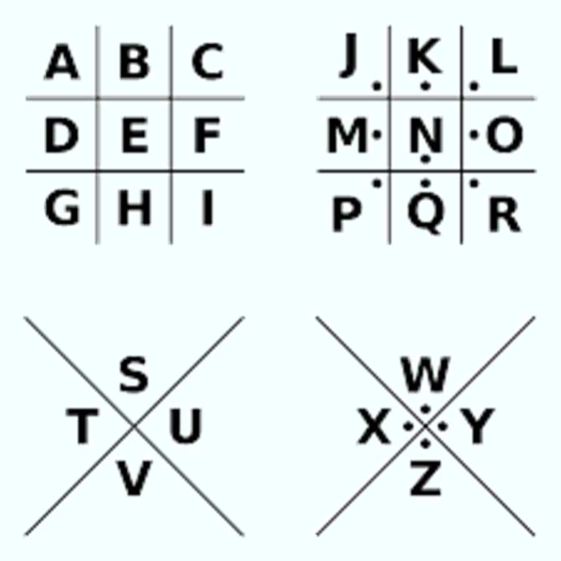
What did we do to try to create community?
Quizzes, games evening, code-breaking, puzzles...
Events about every 6 weeks-2 months ...
Including module start, Christmas, post exam wind-down
20-50 students attended
Different days of the week and times of day
Different formats – Adobe Connect vs Zoom
Pigpen Cypher
Notes:
Mention first tried it with just 124 students – then moved on to students from board of studies 22/23 – all students studying an M&S module in 22/23

Slide 4

Evaluation of community
Surveyed MST124 students during 21/22
Analysed profiles of students that enquired about social events
Surveyed students on Maths and stats modules in 22/23
Interviewed individual students to explore their thoughts on community
Surveyed MST124 students during 21/22 – Findings presented during conference last year

Slide 5
Who are the students interested in events?
Disability status – students interested in social events
Mental Health
Physical disability
11
3
3
1
2
2
7
55
Learning difficulty/ASD
Notes:
Cath to take over 5-9

Slide 6
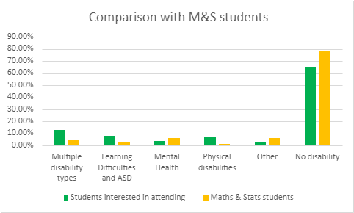
Who are the students interested in events?
Disability status – compared to Maths and Stats students

Slide 7
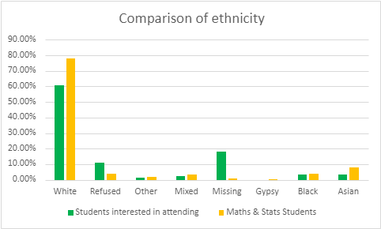
Who are the students interested in events?
Ethnicity– compared to Maths and Stats students

Slide 8
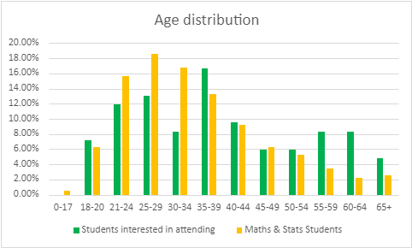
Who are the students interested in events?
Age– compared to Maths and Stats students

Slide 9
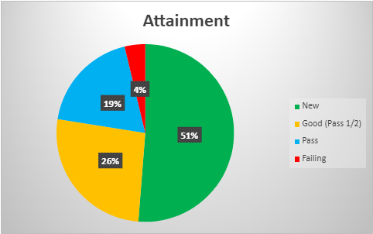
Who are the students interested in events?
Previous attainment

Slide 10
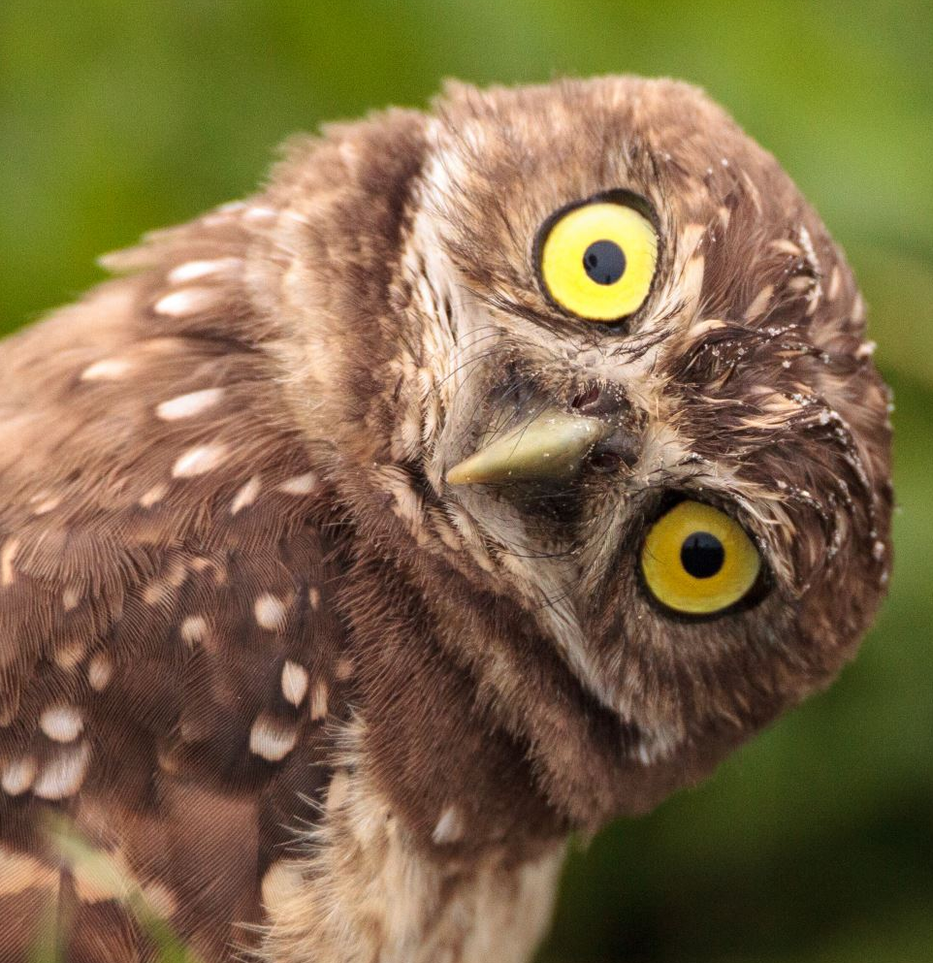
Survey distributed to all available students studying within the maths and stats board of studies during 22/23
How important is it to be part of a community?
How much do you feel part of a community?
Have your feelings about being part of a community changed over your time at the OU?
How interested are you in participating in organised social activities?
Were you aware of the organised online social activities for students studying maths and stats modules?
Did you attend any of the social activities?
Please give feedback on the activity/activities you attended
Please share any suggestions you have for further organised social activities
Give details of anything that has helped you feel part of a community at the OU, including which community
Is there anything that could be done to help you feel more part of an OU community?

Slide 11
Survey distributed to all available students studying within the maths and stats board of studies during 22/23
On a scale of 1-5 (where 1 is strongly disagree and 5 is strongly agree) How important do you feel it is to be part of the following communities?
On a scale of 1-5 (where 1 is strongly disagree and 5 is strongly agree), How much do you feel part of the following communities?
  Students studying the same module
  Students studying the same degree at the OU
  Students in your faculty
  Students with similar characteristics/interests .
  Students at the OU
  Students in general
Notes:
Tested on LKRT, but results presented as agree/neither/disagree – for clarity of resus

Slide 12
Belonging to a community
How much do you feel part of the following communities?
How important do you feel it is to be part of the following communities?
Notes:
Students really feel they want to be part of a community within their module and also part of a community within their degree pathways.
A lot would also like to be part of the community they identify with.
But less so part of the faculty, and wider students, both at the OU and even less students in general.
More students disagree with the statement they want to feel part of a community with students in general than agree with it.
However in reality, less than ½ the students feel part of a community within their module and there is only a small amount of community outside of this.
In every other category, more students disagree with the statement that they feel part of the community more than agree with it – and in all but the close communities of module and degree, over 50% of all student do not feel part of the community,
Therefore even though students want to be part of a community – and feel this is important – In reality they don’t

Slide 13
Belonging to a community
Community on a module is most important for level 3 students
50% of level 3 students feel they are part of a community on a module.
However other communities become less import.
Level 1 students are the most likely to feel wider communities are important.
Notes:
Looking at just the amounts they agree, as can be seen a lot more students feel it is important to be part of their community, than actually feel part of their communities.
Community on a module is most important for level 3 students where more students want community, but equally this is where they feel the most community. Level 3 students are the most likely to feel part of the community on a module with 50% of students agreeing they feel part of the community.
However other communities become less import and very few level 3 students have strong feelings that there should be other communities, but equally almost no students strongly agree they have any community outside of their module.
Level 1 students are more likely to feel there should be wider communities, and also equally feel more part of the wide community that their experienced colleagues - but the numbers are still low

Slide 14
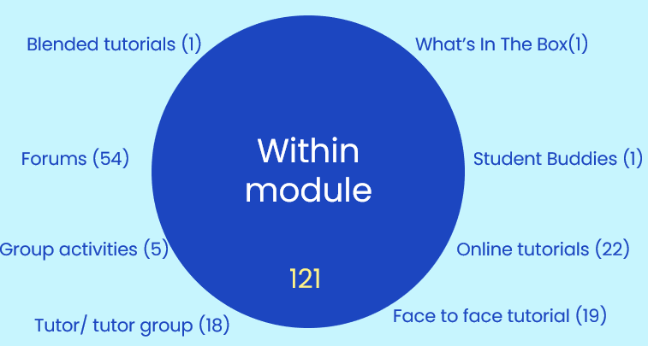


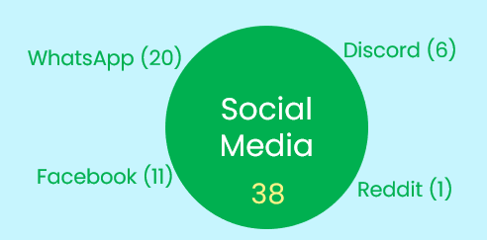
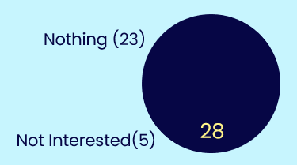
“What has helped you feel part of a community”
Notes:
Cath to do 14-15

Slide 15
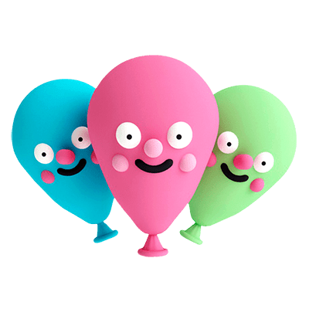
Project takeaways
Project not sustainable as is
Labour-intensive
Not enough impact
Relatively small uptake
BUT
How can forums be more friendly?
Can we harness the appeal of social media?
Most (not all) students want community on a module
Better communication of what’s on offer?
Tutorials labelled as discussion/ working together?
Student buddies?
Study groups?
In-module “fun” events?
Notes:
Cath to do 14-15

Slide 16
References
Johnston-Wilder, S. and Lee, C. (2010), Mathematical Resilience, MathematicsTeaching 218.​
Barber, W., van Oostveen, R. and Childs, E. (2019) ‘Situating Resilience, Grit and Growth Mindset as Constructs of Social Presence in the Fully Online Learning Community Model (FOLC)’, in European Conference on e-Learning. Kidmore End: Academic Conferences International Limited, pp. 65–XI.
Cançado, L., Reisel, J. and Walker, C (2018), Impact of first-year mathematics study groups on the retention and graduation of engineering students, International journal of mathematical education in science and technology 49. ​
Foster, E., Lawther, S., Keenan, C., Bates, N., Colley, B. & Lefever R. (2012) The HERE Project Toolkit: Higher Education: Retention & Engagement. London: Paul Hamlyn Foundation ​
Ellis, C K S and Berry, B (2012), Learning communities: their effects on college mathematics students, International Journal of learning, 18 (11), p 298
Lahdenperä, J and Nieminen, J H (2020), How does a mathematician fit in? A mixed-methods analysis of university students’ sense of belonging in mathematics, International Journal of Research in Undergraduate Mathematics Education, 6 (3) p 475
Marzocchi, A S, (2016), The development of underrepresented students’ sense of belonging in the mathematics community through participation in college outreach, Journal of Women and Minorities in Science and Engineering, 22(2), p219

Slide 17
Slide Title 31
Thank you

